Slide 1

Herefordshire economy and cost-of-living compendium
August 2024
Herefordshire Council Intelligence Unit

Slide 2
About this compendium
The purpose of this compendium is firstly to provide local intelligence relating to Herefordshire’s economy and labour market and secondly the local impact of the cost-of-living crisis and the groups likely to be most affected.
Most of the open-source data presented are published retrospectively, so for the most part, it is not possible to observe the state of the economy and labour market, or the impact of the cost-of-living crisis in real time, but the data do provide important context, identify trends, strengths and vulnerabilities, and identifying groups and areas likely to be disproportionately affected. The compendium comprises four sections and appendices:
  Section 1: Herefordshire’s economy
  Section 2: The labour market
  Section 3: Household finances
  Section 4: Income deprivation, poverty and homelessness
  Appendix: Useful resources
If you need help to understand this document, or would like it in another format or language, please contact us on 01432 261944 or e-mail researchteam@herefordshire.gov.uk

Slide 3
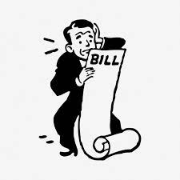
The big picture
The cost of living increased across the UK during 2021 then escalated rapidly following Russia’s invasion of Ukraine in February 2022, affecting the affordability of goods and services bought by households. The annual rate of inflation peaked at 11.1% in October 2022, a 41-year high, before subsequently easing over the subsequent 18 months and in May 2024 fell to 2.0%, the Bank of England’s target, for the first time since July 2021. (House of Commons Library, July 2024).
The cost-of-living crisis has caused real hardship to millions of people across the country and has widening existing inequalities, with the biggest impacts often being felt by the poorest, disabled people and the young.
Herefordshire, whilst overall being a relatively affluent area, has some long-standing underlying vulnerabilities, which are mostly linked to its rurality and feed into the cost-of-living pressures many people are continuing to feel. These include:
One of the lowest levels of productivity amongst comparable areas of the UK contributing to a low-wage economy and a social mobility ‘cold spot’.
One of the worst levels of housing affordability in the West Midlands region.
Higher than average levels of fuel poverty, linked to an over-representation of older, poorly insulated houses, coupled with low wages and a lower than average proportion of homes with mains gas.
Limited public transport infrastructure across much of the county and a reliance on private motor transport to get around.
Significant levels of digital exclusion (which are more related to age and deprivation than lack of infrastructure).
Credit: rawpixel.com

Slide 4
Key points (sections 1 & 2)
In 2022, Herefordshire’s Gross Domestic Product (GDP) at current prices was £4,556 million. Adjusting for inflation (chained volume measure), this represented an increase of 1.3% from the previous year, a smaller growth compared to the year before. Over the past two decades per capita GDP has consistently lagged behind England and the West Midlands region. The value of goods and services produced (GVA) shrank to pre-2014 levels during the pandemic but has since partially recovered and after adjusting for the effects of inflation has grown back to the level seen in 2018. However, Herefordshire has one of the lowest levels of labour productivity amongst ITL3 areas of the UK.
The rate of inflation rose slightly in July 2024: the Consumer Prices Index (CPI) increased by 2.2% in the 12 months to July 2024, up from 2.0% in June, but below the recent peak of 11.1% in October 2022.
The number of unique job postings fell again in July 2024 and was lower than in the same month last year, and remained well below the most recent peak seen in June 2023.
Herefordshire has higher proportion of the working-age population qualified to RQF4 level or above than regionally and nationally but a higher proportion of young people not in education, employment or training (NEET) than nationally, with young people from areas of highest deprivation significantly more likely to be NEET.
The latest estimate of unemployment (for the period April 2023 to March 2024) is 2.7% of adults aged 16+ (c.2,800 people); lower than nationally and significantly lower than regionally. The number of people claiming out-of-work related benefits rose sharply again in July 2024 to 3,135 (+8% from June) and numbers are significantly higher than pre-pandemic.
Latest data suggest c.4,300 people in Herefordshire aged 16-64 are economically inactive due to long-term sickness.
In 2022 the estimated proportion of workless households increased slightly but was lower than in England and the West Midlands region, although not significantly so.

Slide 5
Key points (sections 3 & 4)
Average gross weekly earnings grew faster than nationally or regionally in 2023 but remain significantly lower than the average for both the West Midlands and England as a whole. The gap is largest amongst full-time male workers.
In 2021 Gross Disposable Household Income increased more than nationally but remained lower than the average for England.
There are currently around 14,600 people claiming Universal Credit in Herefordshire; significantly more than in the pandemic peak and increasing.
Average house prices in Herefordshire increased by 3.5% in the year to July 2024, more than in England (2.4%) and the West Midlands (3.1%).
Average monthly rents (all property types) are lower than regionally or nationally and rising more slowly than the national and regional trend. In Q2 2024, landlord possessions in Herefordshire were similar to the previous quarter, but there were significantly fewer mortgage possessions. The levels of both remain historically low.
Among people supported by Citizens Advice, the top debt issue faced by people in Herefordshire is currently Council Tax arrears, replacing energy debt. The proportion of people being helped with crisis support in Herefordshire has fallen and is relatively low compared to some areas of the country but remains much higher than pre-pandemic..
Before the current crisis, in 2021/22 18.6% of children were living in relative poverty: a significantly lower proportion than nationally and regionally, however analysis by JRF using 2020/21 data suggests that after housing costs the proportion is much higher (27%) and above the average for England (22%).
Fuel poverty increased in 2022 and Herefordshire already had a higher proportion of homes deemed to have an excess cold hazard than nationally.
Between 2020-21 and 2022-23 the number of households that were either homeless (with a relief duty owed) or threatened with homeless (preventing duty owed) increased.

Slide 6
Section 1: Herefordshire’s economy

Slide 7
Economic prosperity
Key points
GDP is calculated by adding up the total value of goods and services produced, income, or spending and is a key indicator of economic well-being.
Whereas GVA helps in inter-sectoral economic comparison by comparing the economic standing of sectors like agriculture, manufacturing, and services, GDP facilitates international economic comparison, which compares income levels, living conditions, and the overall financial status of different countries or areas.
Using GDP as a measure, the United Kingdom is currently the world’s 6th largest economy, however growth has, by historical and comparative standards, been anaemic since the Financial Crisis of 2008, with population growth (driven primarily by inward net migration) being its biggest contributor. According to Goldman Sachs (briefing 23/02/24), since 2007, the increase in average annual productivity has been just 0.2%, compared to an average of 3.6% in the three decades following World War II. Meanwhile growth in GDP per capita, which is what really matters for living standards, has been particularly poor and here the UK is not amongst the 20 richest countries.
In 2022, Herefordshire’s Gross Domestic Product (GDP) at current prices was £4,556 million. Adjusting for inflation (chained volume measure), this represented an increase of 1.3% from the previous year, a smaller growth compared to the year before.
In real terms, in 2020 Herefordshire’s economy shrank to its smallest level since 2013 as a result of the pandemic. While it yet to recover fully, in 2022 it was larger than it was in 2017.
In 2022, per capita GDP at current prices in Herefordshire was £27,278 compared to £37,852 in England and £30,117 in the West Midlands: 28% lower than England and 9% lower than the West Midlands.
Looking at the change over time in real terms, i.e. adjusting for inflation (chained volume measures in 2019 value), per capita GDP in Herefordshire has consistently lagged behind that of both England and the West Midlands region and the gap is currently wider than it was in 1998 (see chart).
Need to know: GDP per capita measures economic output per person and is calculated by dividing the GDP of an area by its population. It is a global measure for gauging the prosperity of nations and is used by economists, along with GDP, to analyse the prosperity of a country based on its economic growth. It allows economists to monitor the productivity of an area with other comparable geographies. This article explains the difference between GDP and GVA.
Data source: ONS
Frequency: Annually
Last updated: 24 April 2024
Next update: March 2025

Slide 8
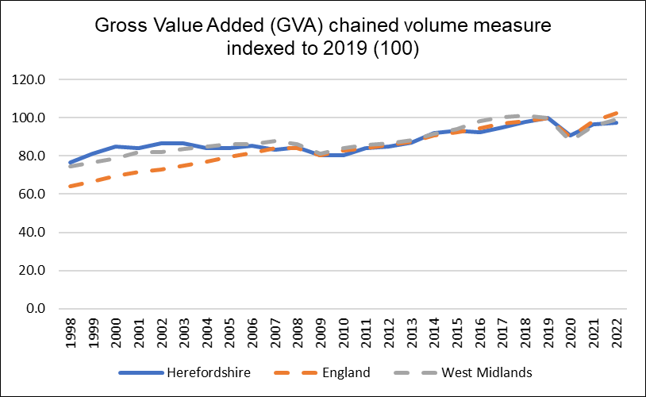
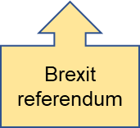
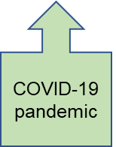
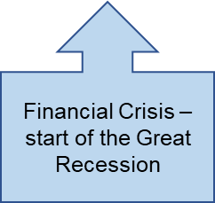
Relative value of the economy over time
A local economy grows when it increases the amount of goods and services it produces. Gross Value Added (GVA) is a way of measuring this output. There is a widely accepted association between economic growth and living standards.
Key points
In the mid 2000s, Herefordshire’s Gross Value Added (GVA) across all industrial sectors together declined relative to England and the West Midlands region. Thereafter it increased fairly consistently in line with the national trend until 2016 when it dipped again. Although it increased again subsequently, increases were lower than nationally and regionally.
Adjusting to remove the effects of inflation (i.e. using the chained volume measure), following the serious contraction in 2020 due to the pandemic, now the economy has grown back to the level seen in 2018. In 2022 (the latest year available), Herefordshire’s total GVA was £3,944 million in 2019 money value.
In 2022 (the latest year available) Herefordshire’s total GVA at current prices was £4,456 million, reflecting the national trend, Herefordshire’s GVA increased by 7% in real terms since the previous year.
Need to know: Gross value added (GVA) is the value of goods and services produced in an area, industry, or sector of an economy and is used to measure the value of the economy due to the production of goods and services over time. The data above provide estimates of GVA derived by balancing the income and production approaches to measuring GVA. The dataset includes both current price (nominal or value) and 'real' (chained volume) measures. Using an index value allows us to compare relative growth between different areas. Factors that affect GVA include the size of the population, the proportion of that population who are in employment, demand for labour, and worker productivity (see what works centre for local economic growth - Understanding GVA)
Data source: ONS
Frequency: Annually
Last updated: 24 April 2024
Next update: March 2025

Slide 9
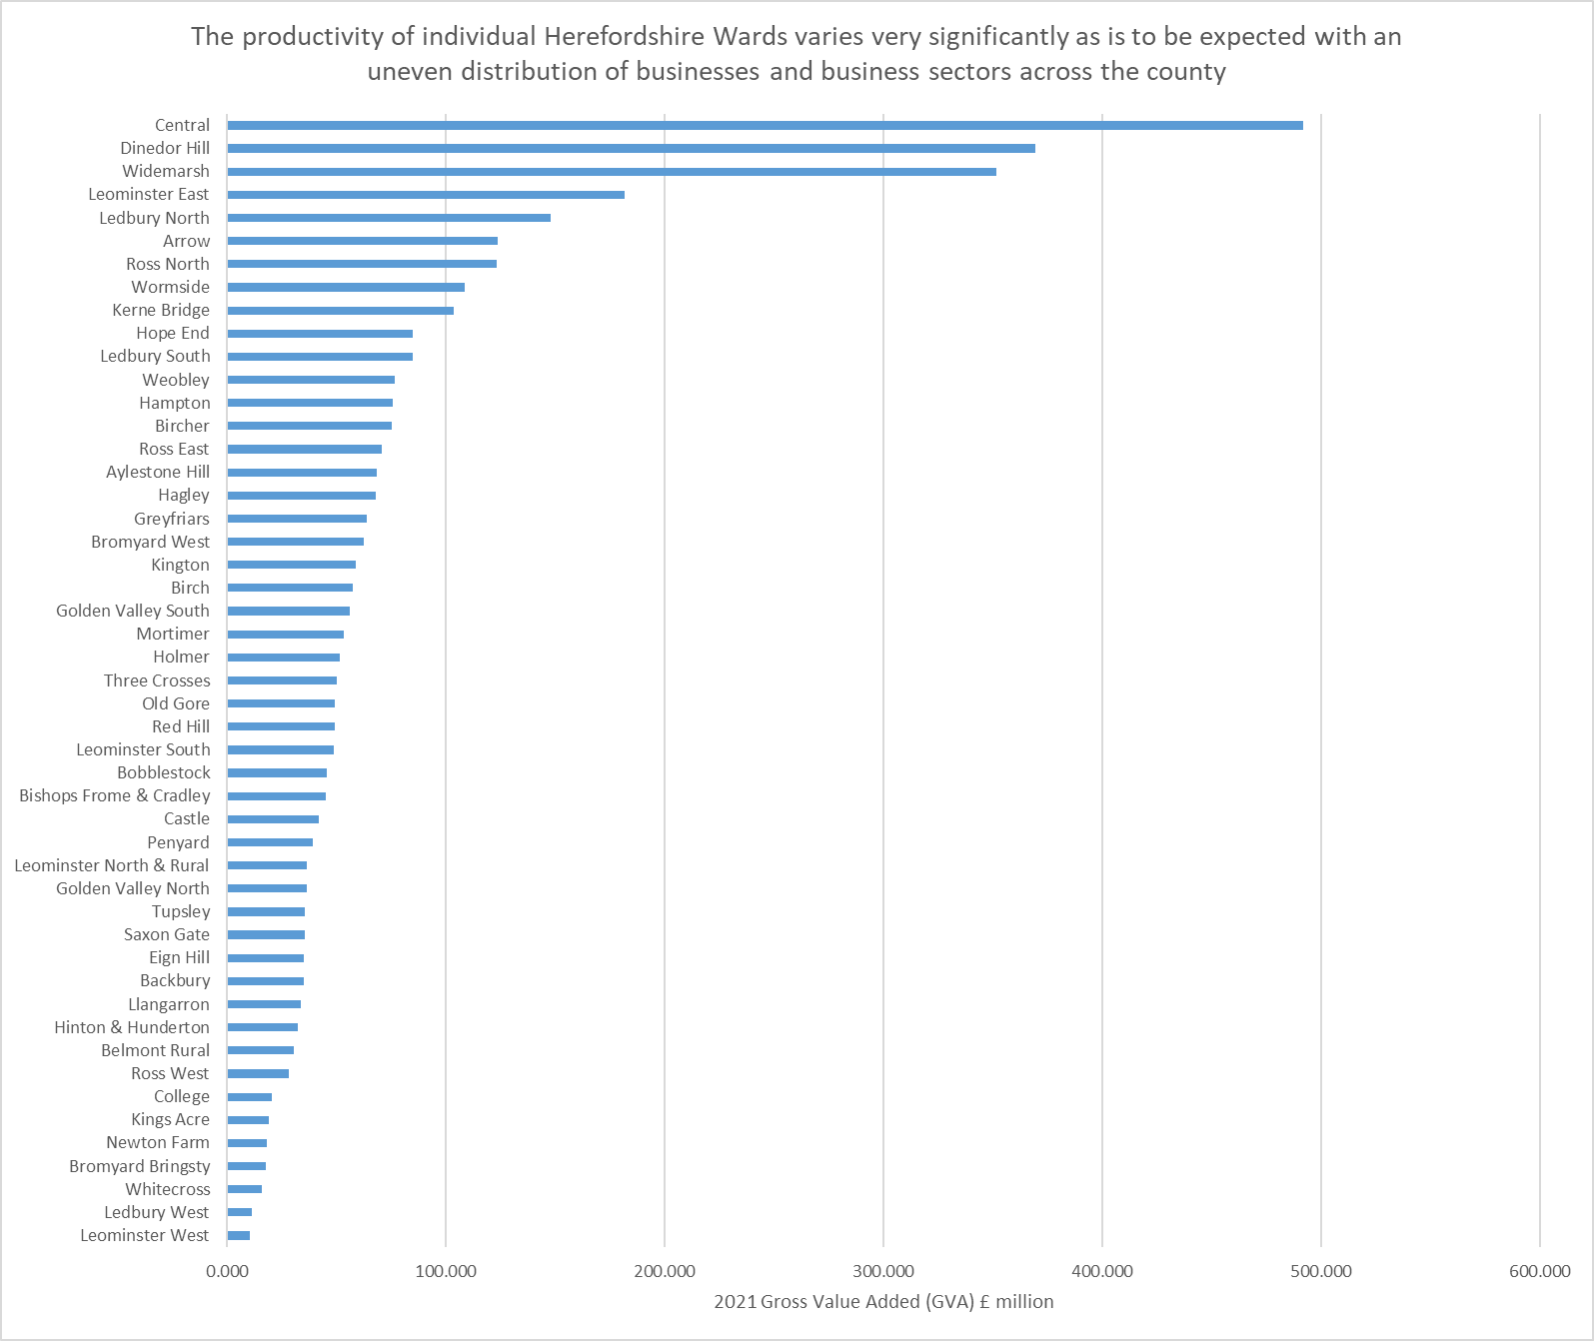
Productivity by Herefordshire ward
ONS has recently started to publish granular Gross Value Added (GVA) data down to Lower Super Output Area level, allowing sub-county analysis.
Key points
The GVA of a ward is obviously dependent upon the concentration of businesses in that area, their size and numbers of people they employ, and the type of businesses they are, so wide variation in GVA between wards is to be expected.
However, it is still useful to see what areas of the county are driving Herefordshire’s economy and where the most and least productive wards are within Herefordshire.
As the chart shows, in 2021 Hereford Central, Dinedor Hill, Widemarsh, Leominster East and Ledbury North were the wards with the largest GVA.
Data source: ONS
Frequency: Annually
Last updated: 31 January 2024
Next update: T.b.c.

Slide 10
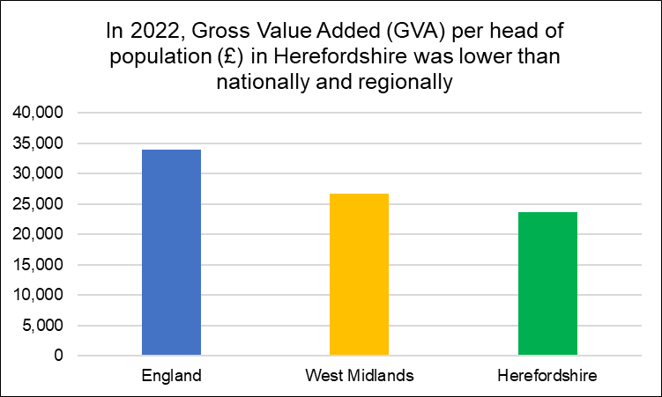
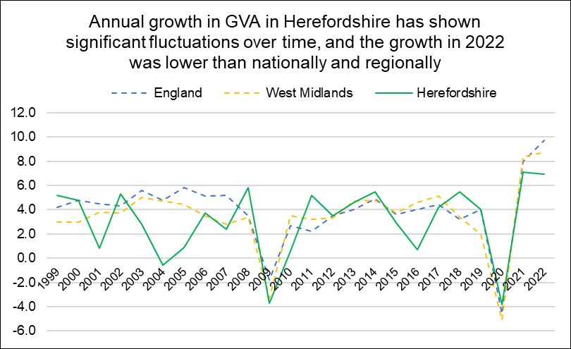
Productivity - per capita Gross Value Added (GVA)
Need to know:
Productivity measures are often used to indicate how well a country or area can use its human and physical resources to generate economic growth. Strong economic growth will generally mean an improvement in living standards. However, productivity alone does not tell us everything about the economic wellbeing of different areas. The potential of any given place depends on the mix of industries, the infrastructure and the size of settlements there. Based on these circumstances, even an area with low productivity might be performing as well as it can.
Gross Value Added (GVA) measures the contribution to the economy of each individual producer, industry or sector and is often used as a measure of productivity. Simplistically it is the value of the amount of goods and services that have been produced, less the cost of all inputs and raw materials that are directly attributable to that production.. (Department for Environment, Food & Rural Affairs - Rural productivity and gross value added (GVA))
*ONS advises that 2021 data are not currently available as growth in GDP per head between 2020 and 2021 is unreliable due to a discontinuity in population data for some areas, caused by differences in the timing of census updates.
ONS recommends using GVA per hour worked (see next slide) to measure labour productivity. GVA per hour worked gives a more nuanced measure of labour productivity as it is not so affected by demographic differences between areas.
Data source: ONS
Frequency: Annually
Last updated: 24 April 2024
Next update: March 2025

Slide 11
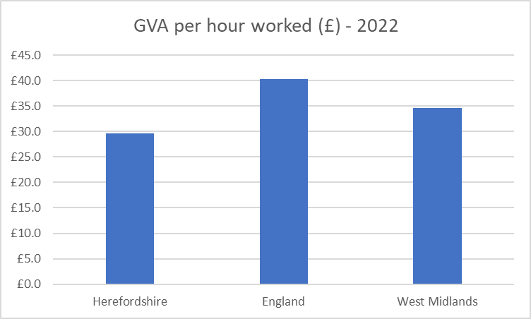
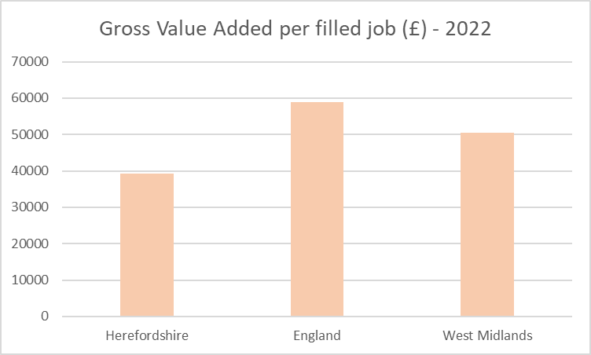
Labour productivity
The level of labour productivity is determined by how efficiently and effectively labour is utilized in an economy. Comparing the labour productivity of different areas provides an indication of relative competitiveness. Labour productivity is one of the key determinants of wages and poor labour productivity is a barrier to social mobility. There is evidence that cost-of-living related pressures are having a negative impact on workers’ productivity.
Key points
In March 2023, PWC reported that UK productivity levels have increased by only 7% in the last 10 years and in 2021 growth was the second slowest in the G7 group of advanced economies.
Research by the University of Birmingham (January 2023) found that the West Midlands has one of the largest inter-regional gaps in productivity in the UK, with its most productive sub-region (Solihull) producing £21.50 (47%) per hour more than its least productive sub-region (Herefordshire).
In 2022, Herefordshire GVA per hour worked (smoothed*) was £29.6: significantly lower than England (£40.3) and the West Midlands (£34.6).
Similarly, Herefordshire’s GVA per filled job (smoothed*) in 2022 was £42,952.10, compared to £62,751.40 for England and £53,389.60 for the West Midlands.
Using the GVA per hour worked measure, in 2022 Herefordshire had one of the lowest levels labour productivity of any International Territorial Level (ITL) 3 area of the UK, ranking 170th out of 179. The reasons for this are complex but are likely related to Herefordshire’s rurality and the associated composition of its economy. The Midlands Engine Intelligence Hub contains a useful GVA for Small Areas map which can be used to compare local authority areas.
Data source: ONS Subregional Productivity
Frequency: Annually
Last updated: 17 June 2024
Next update: T.b.c.
Need to know: Gross value added (GVA) measures the contribution made to an economy by one individual producer, industry, sector or region. The figure is used in the calculation of gross domestic product (GDP) – University of Birmingham *Data are smoothed using a weighted 5-year moving average.
ONS provide two measures of labour productivity. The first is a ratio of output (measured as gross value added (GVA)) divided by the hours worked to create it. The second measure divides GVA by the number of filled jobs used to create it. In both cases, GVA is an estimate of the total amount of goods and services produced less the value of intermediate inputs. GVA per hour worked is the preferred measure of labour productivity. More information.

Slide 12
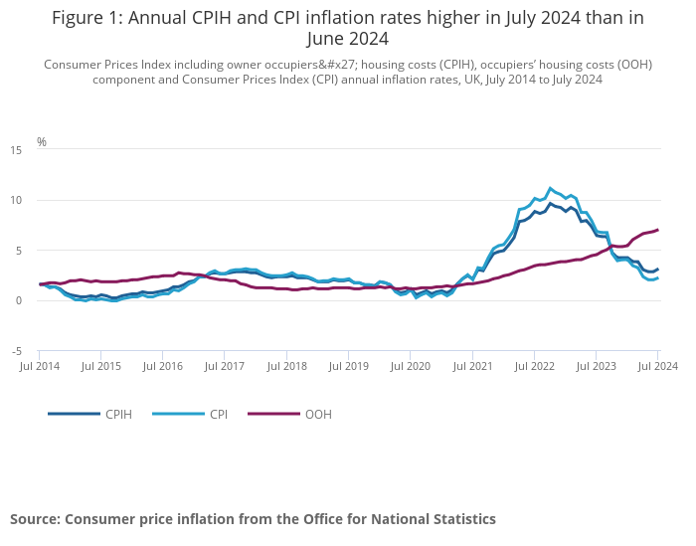
Inflation
Key points
ONS reports that the Consumer Prices Index including owner occupiers' housing costs (CPIH) rose by 3.1% in the 12 months to July 2024, up from 2.8% in June 2024. On a monthly basis, the level of CPIH was little changed in July 2024, compared with a fall of 0.3% in July 2023.
The Consumer Prices Index (CPI) rose by 2.2% in the 12 months to July 2024, up from 2.0% in June 2024. On a monthly basis, CPI fell by 0.2% in July 2024, compared with a fall of 0.4% in July 2023.
The largest upward contribution to the monthly change in both CPIH and CPI annual rates came from housing and household services where prices of gas and electricity fell by less than they did last year; the largest downward contribution came from restaurants and hotels, where prices of hotels fell this year having risen last year.
Core CPIH (excluding energy, food, alcohol and tobacco) rose by 4.1% in the 12 months to July 2024, down from 4.2% in June; the CPIH goods annual rate rose from negative 1.4% to negative 0.5%, while the CPIH services annual rate fell from 6.0% to 5.7%.
Core CPI (excluding energy, food, alcohol and tobacco) rose by 3.3% in the 12 months to July 2024, down from 3.5% in June; the CPI goods annual rate rose from negative 1.4% to negative 0.6%, while the CPI services annual rate fell from 5.7% to 5.2%.
Need to know: The Consumer Prices Index including owner occupiers' housing costs (CPIH) is the lead and most comprehensive measure of consumer price inflation CPIH includes a measure of the costs associated with owning, maintaining and living in one's own home, known as owner occupiers' housing costs (OOH), along with Council Tax. Both are significant expenses for many households and are not included in the CPI. However, the Consumer Prices Index (CPI) is based on a harmonised methodology developed by Eurostat and allows for international comparisons to be drawn.
Source: ONS
Last updated: 14 August 2024
Frequency of update: Monthly
Next update: 18 September 2024

Slide 13
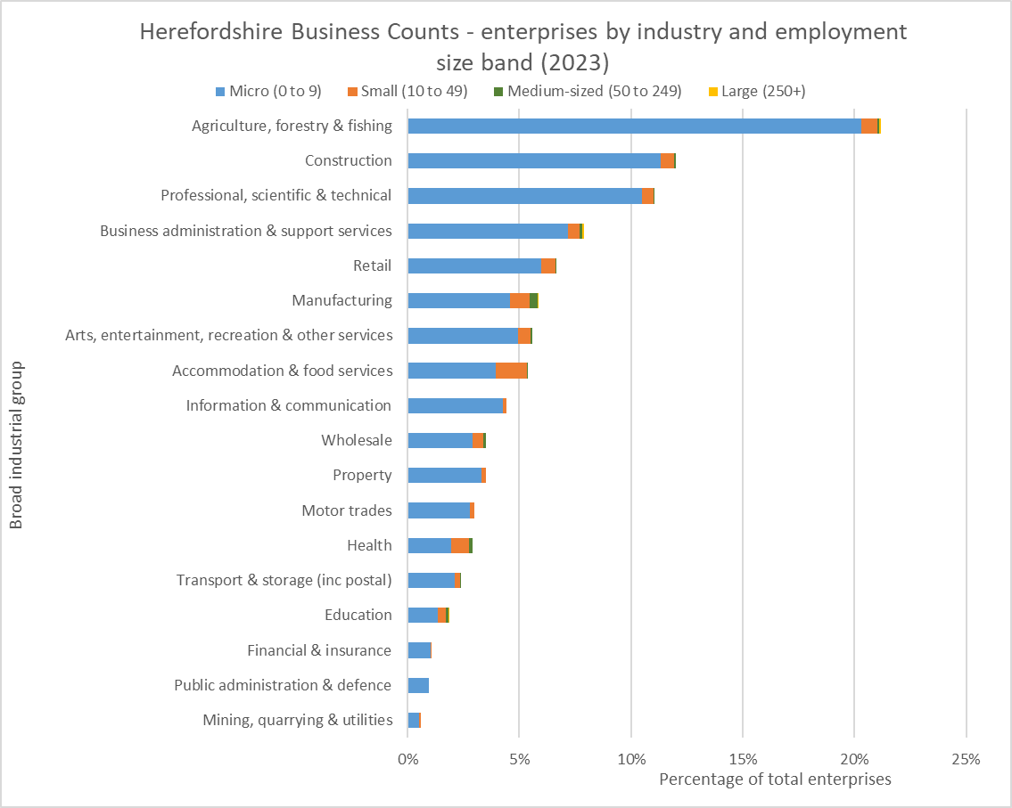
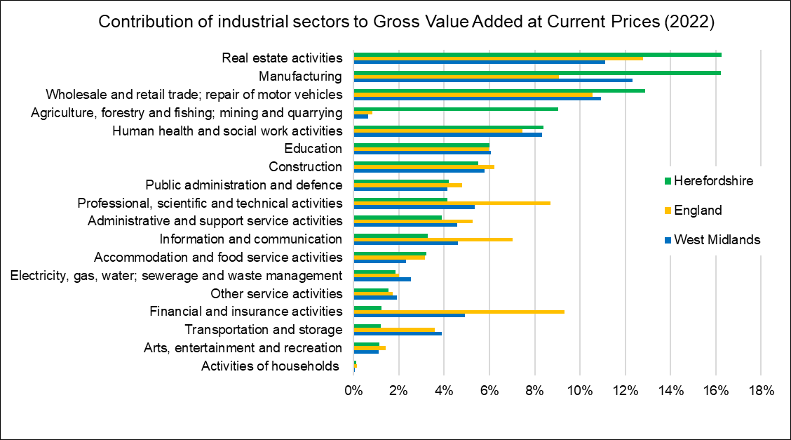
Numbers of businesses (enterprises) by industry and size, and contribution to the value of economic output by industry
Data source: ONS – NOMIS
Frequency: Annually
Last updated: 28 September 2023
Next update: September 2024.
Key point:
The structure of Herefordshire’s economy is significantly different to nationally and regionally, largely due to the rurality of the county, with agriculture, real-estate activities and manufacturing accounting for a greater proportion of economic output and financial and insurance activities and information and communication much less.
Data source: ONS
Frequency: Annually
Last updated: 24 April 2024
Next update: May 2025

Slide 14
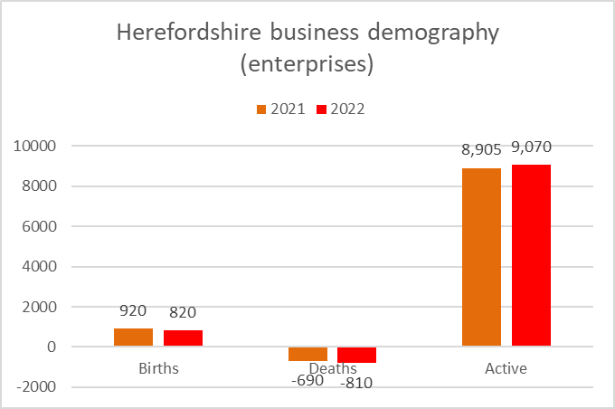
Business demography
Need to know:
Birth - identified as a business that was present in year t, but did not exist in year t-1 or t-2. Births are identified by making comparison of annual active population files and identifying those present in the latest file, but not the two previous ones.
Death - defined as a business that was on the active file in year t, but was no longer present in the active file in t+1 and t+2. In order to provide an early estimate of deaths, an adjustment has been made to the latest two years deaths to allow for reactivations. These figures are provisional and subject to revision.
Active - These are defined as businesses that had either turnover or employment at any time during the reference period.
Data source: ONS
Data last updated: 22 November 2023
Frequency: Annually
Next update: t.b.c.

Slide 15
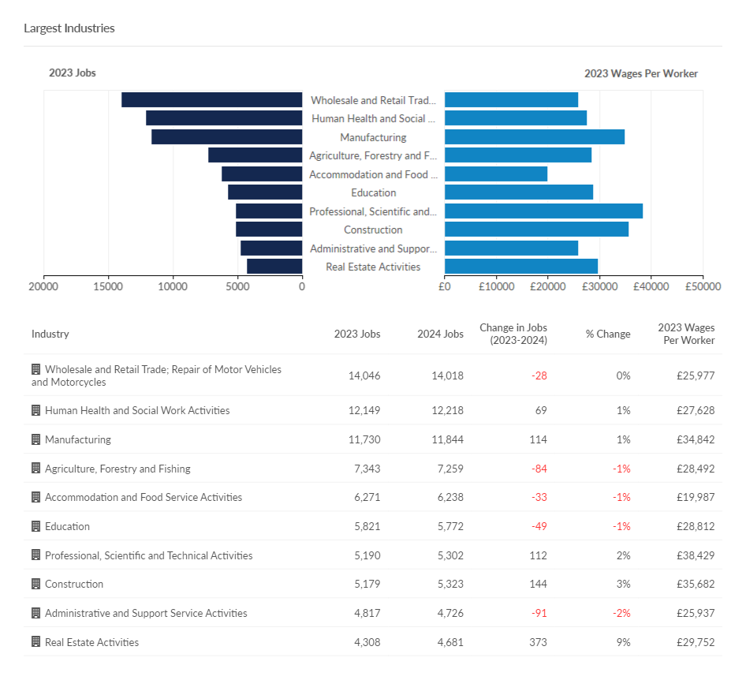
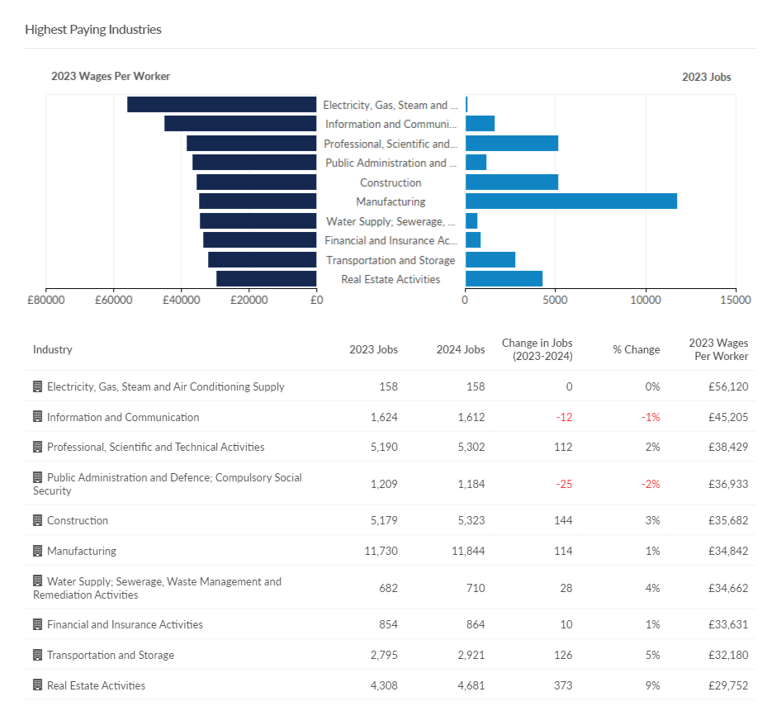
Largest and highest paying industries
Need to know: The charts show occupations at Standard Industry Classification (SIC) 1 level but data are available down to SIC 4 level if more granularity is required.
Source: Lightcast (EMSI): economicmodelling.co.uk
Date last updated: June 2024
Frequency of update: Annually
Next update: June 2025

Slide 16
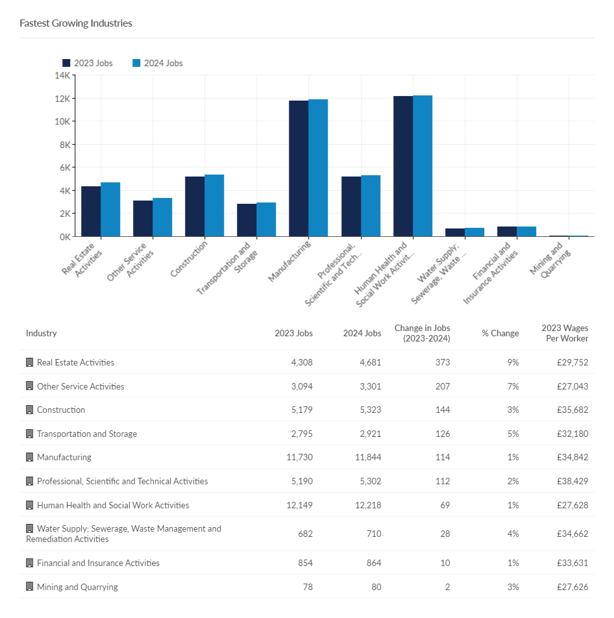
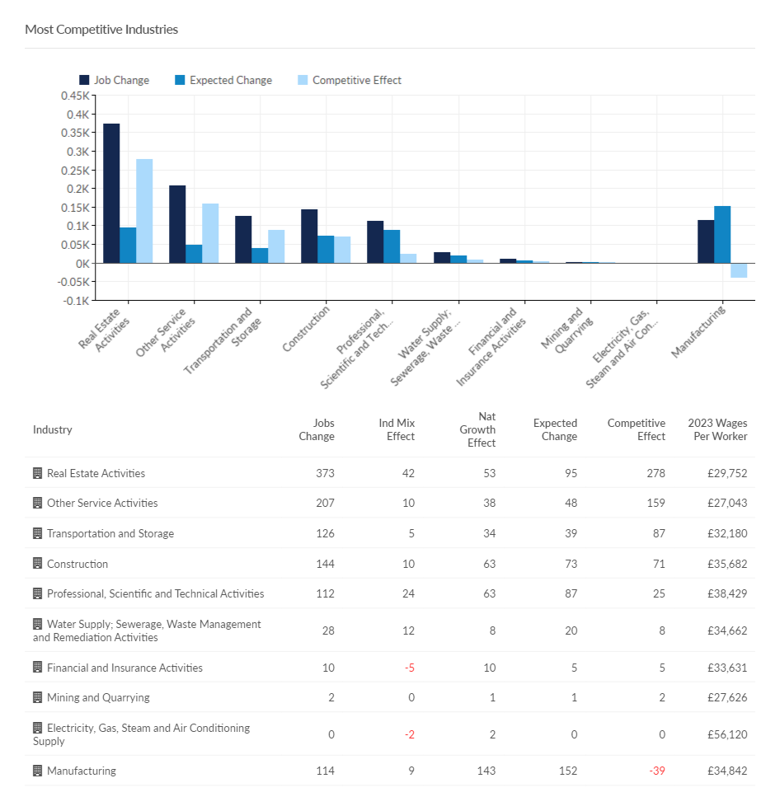
Fastest growing and most competitive industries
Need to know:
Competitive effect indicates how much of the job change within a given region is the result of some unique competitive advantage of the region. This is because the competitive effect, by definition, measures the job change that occurs within a regional industry that cannot be explained by broader trends.
The charts show occupations at Standard Industry Classification (SIC) 1 level but data are available down to SIC 4 level if more granularity is required.
Source: Lightcast (EMSI): economicmodelling.co.uk
Date last updated: June 2024 Frequency of update: Annually
Next update: June 2025

Slide 17
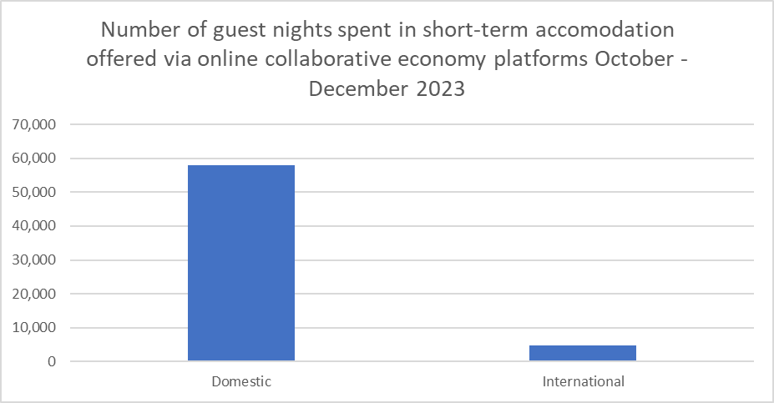
Visitor economy
Key points
ONS reports that from October to December 2023, there were nearly 1.9 million stays in short-term lets booked through the three online collaborative economy platforms in the UK (Airbnb, Booking.com and Expedia Group); this totalled nearly 18.1 million guest nights. The number of guest nights decreased in the UK by 37.3% from Quarter 3 (July to Sept) to Quarter 4 2023, decreasing in each UK country, which is to be expected with the seasonal trend of moving from the busier summer months into autumn.
In the UK, domestic visitors made up 63.6% of guest nights (18.4 million) compared with 36.4% by international visitors (10.5 million); Wales was the UK country with the highest proportion of domestic guest nights (85.3%).
According to the latest GTS STEAM report, tourism was worth £637.45 million to Herefordshire’s economy in 2022, 5.56 million visitors spending 7.73 million visitor days in the county supporting 7,489 jobs.
Data from Lightcast suggest that the visitor economy is a strength for Herefordshire, directly employing c.2,600 people in 2022; 56% above the national average. However, average wages per job in the sector are significantly lower than the national average (£20,241 vs £24,093).
In Herefordshire in the period October to December 2023, there were 62,660 guest nights spent in short-term lets offered via online collaborative economy platforms, 57,830 domestic and 4,830 international from 7,240 bookings (6,810 domestic, 430 international). These numbers are of course highly seasonal.
Need to know: Short-term lets refers to rentals, such as apartments or rooms, booked through these three platforms, excluding other forms of accommodation, such as hotels or campsites.
Number of guest nights = The number of nights spent during a stay, with a night counted per individual member of the visiting group. This can be influenced by guest group size and length of stay. For example, a family of four staying for 2 nights would be 8 guest nights, but 2 nights and 1 stay.
Data source: ONS
Date last updated: 30 May 2024
Frequency of update: Annually
Next update: November 2024

Slide 18
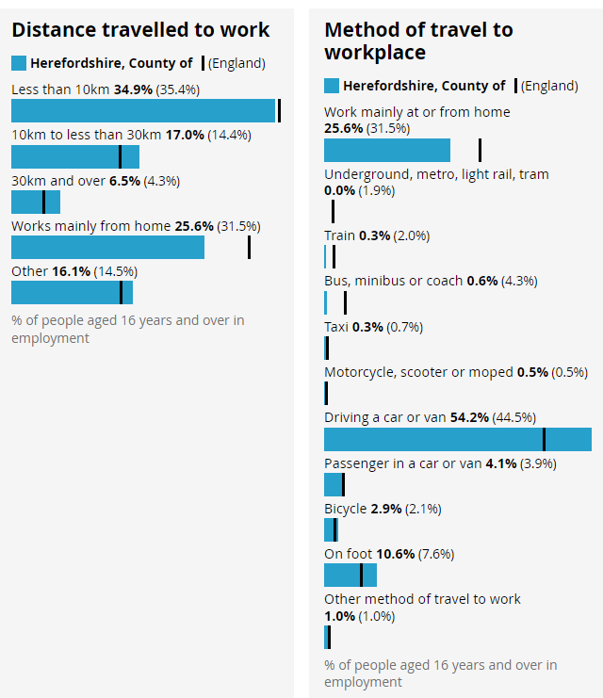
Distance travelled to work and method of travel
Key points
The frequency of, and ways in which, people travel to and from work has implications not only for the environment and health and wellbeing but for household budgets, for some in terms of transport costs, and for others, in terms of home heating costs.
Herefordshire in one of England’s most rural counties and is relatively lacking in public transport infrastructure with only four railway stations (Colwall, Hereford – Barr’s Court, Ledbury and Leominster). Almost two thirds of all Herefordshire LSOAs (72 out of 116) are among the 25% most deprived in England in respect to geographical barriers to services with 53 being in the most deprived 10% across England. Of these three quarters are in rural areas.
The 2021 Census provides information about distance travelled to work and mode of transport. Because of the Covid-19 pandemic, and because the ONS widened the age range (from 16-74 in 2011 to 16 and over in 2021), is not appropriate to compare the 2021 results with 2011.
The ONS Subnational Indicator Explorer shows Herefordshire to be below the UK median for three indicators:
  1. Public transport or walk to employment centre with 500 to 4999 jobs 2. Drive to employment centre with 500 to 4999 jobs 3. Cycle to employment centre with 500 to 4999 jobs.
In 2021, of all people aged 16+ in employment, although a similar proportion travelled less than 10 kilometres to work as nationally (34.9 vs 35.4%), a greater proportion travelled 10–30 kilometres to work (17.0% vs 14.4%). The proportion who travelled 30 or more kilometres is also higher (6.5% vs 4.3%).
Not only did a greater proportion of people travel longer distances to work than nationally, a higher proportion did so in a car or van (58.3% vs 48.4), which is to be expected given the longer distances involved, and relative lack of public transport.
A lower proportion of people worked from home than nationally (25.6% vs 31.5%), which is to be expected given the occupation profile of the county.
Source: ONS
Last updated: 8 December 2022
Frequency: Decennially
Next update: 2031
Need to know: Lower Super Output Areas (LSOAs) are fixed statistical geographies of about 1,500 people designed by the Office for National Statistics (ONS).
On the Census 2021 form, people who were in employment or temporarily away from work in the week before Census Day were asked "How do you usually travel to work?". People were asked to select one mode of transport that they used for the longest part, by distance, of their usual journey to work. With regard to the above proportions, it should be noted that the Census was undertaken when COVID measures were still in place, so these are likely to have changed significantly since.

Slide 19
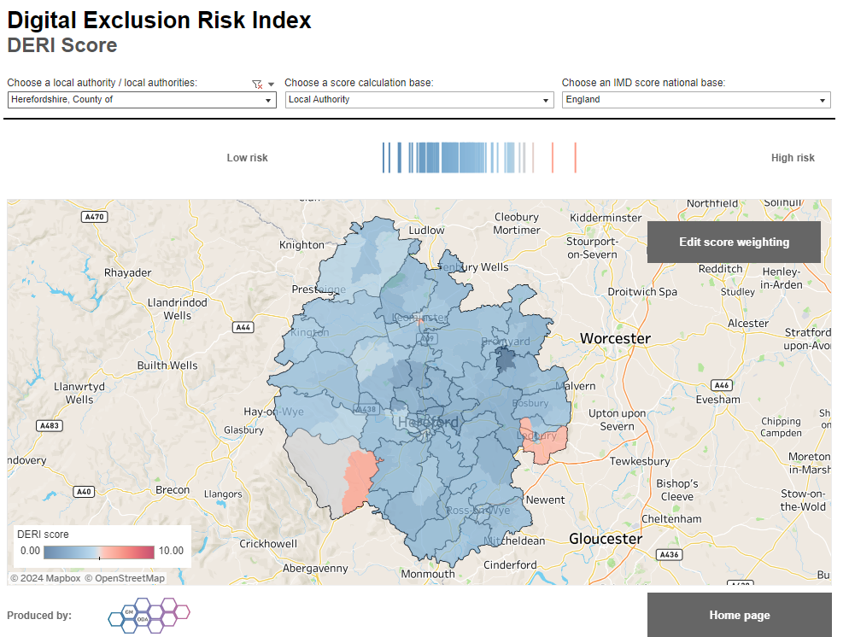
Digital exclusion
Digital exclusion is a barrier to employment and educational opportunities, social networking and access to everyday services and thus has a range of negative impacts on affected individuals. People may be digitally excluded for multiple reasons, including not having access to the required infrastructure and/or devices, lack of skills, or lack of motivation to use technology.
Research has found that without internet access, consumers can pay as much as 25% more for essential goods and services, while pressures on household budgets have forced many to cancel broadband contracts.
Nationally, ONS reports that in 2020 92% of adults in the UK were recent internet users: up from 91% in 2019. 99% of adults aged 16 to 44 years were recent internet users (99%), whereas for people aged 75 years and over it was only 54%, although this proportion had increased from 29% in 2013. 81% of disabled adults were recent internet users. 6.3% of adults had never used the internet: down from 7.5% in 2019.
Key points
The proportion of adults in Herefordshire who are either lapsed or non-internet users has declined in recent years in line with the trend nationally. There was an increase in 2020 although this was not statistically significant. In 2020, ONS estimated that there were around 17,000 adults (age 16+) in Herefordshire who don’t use the internet.
The 2023 Community Wellbeing Survey found that 88% of Herefordshire adults regularly access the internet for non-work purposes: similar to 2021 (89%). 12% do not use it regularly, similar to 2021 (10%), and this proportion rises for people living in the most deprived locations (19%), aged 65+ (25%), and with no formal educational qualifications (41%). Asked why, 44% say it’s because they don’t need it, however 31% say they don’t have the skills, rising to 48% amongst Housing Association tenants.
While 35% of people say their use of the internet increased since that start of the COVID-19 pandemic, for 5% it has reduced, rising to 12% among those in the most deprived locations, 11% amongst Housing Association tenants and 12% of people with an ethnic minority background.
41% of people are positive about more things being provided online - a 17% point decrease since 2021 (58%). 35% are now concerned about more things being provided online: an increase of 13% points from 2021 and the proportion is higher amongst those aged 55+ (46%), the economically inactive (44% - likely driven by age), people with no formal educational qualifications (43%), those with a disability (43%) or those who receive care (43%), and those who do not use the internet regularly (54%).
The 2022 Telecare Users’ Survey found that 49% of users in Herefordshire do not use the internet (down slightly from 52% in 2019), 36% of Telecare users say they are not confident using the internet.
GMCA has produced a Digital Exclusion Risk Index for Great Britain. Overall, Herefordshire is low risk but there are pockets of higher risk in Ledbury South and Golden Valley South Lower Super Output Areas (LSOAs).
Source: Greater Manchester Office of Data Analytics at Greater Manchester Combined Authority (GMCA)

Slide 20
Section 2: The labour market

Slide 21
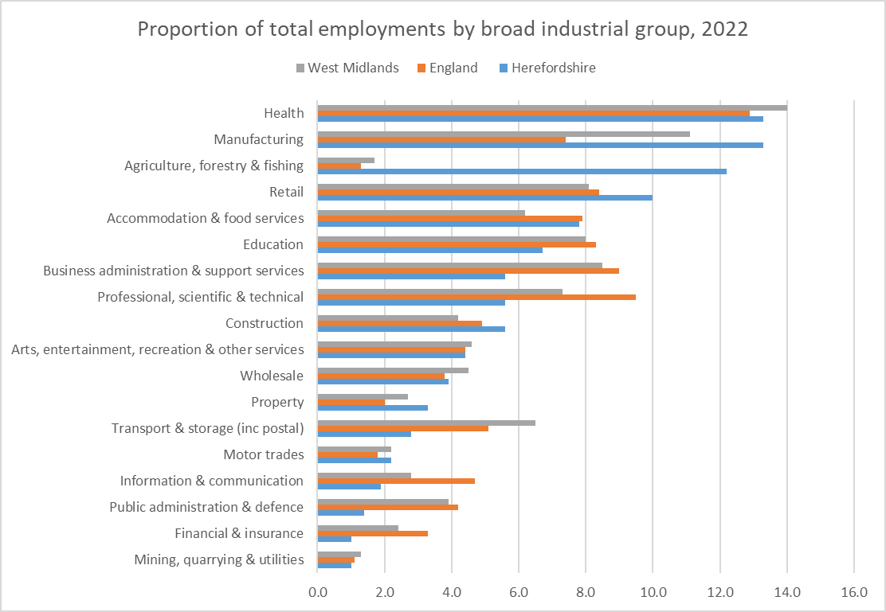
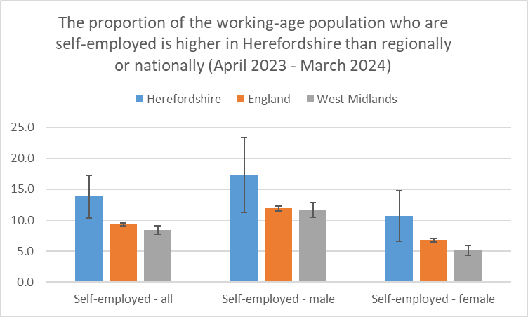
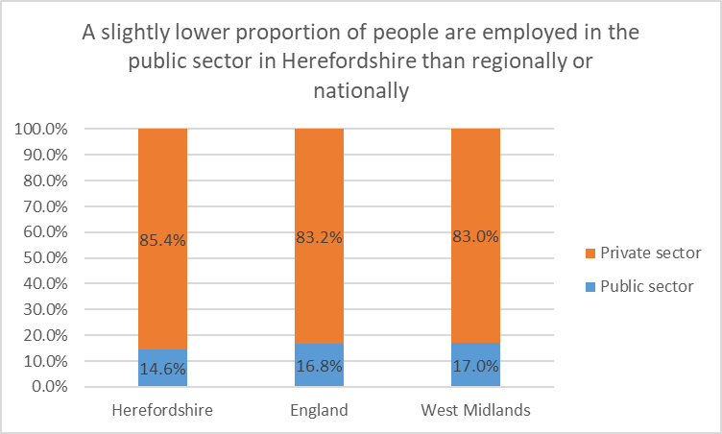
Distribution of jobs
Data source: ONS – NOMIS
Frequency: Quarterly
Last updated: 18 July 2024
Next update: 15 October 2024
Data source: ONS – NOMIS
Frequency: Annual
Last updated: 25 October 2023
Next update: 17 October 2024
Data source: ONS – NOMIS
Frequency: Annually
Last updated: 25 October 2023
Next update: 31 October 2024
Key points:
A much higher proportion of jobs are in agriculture and manufacturing than nationally. A greater proportion of people are self-employed than nationally. Most jobs are in the private sector.

Slide 22
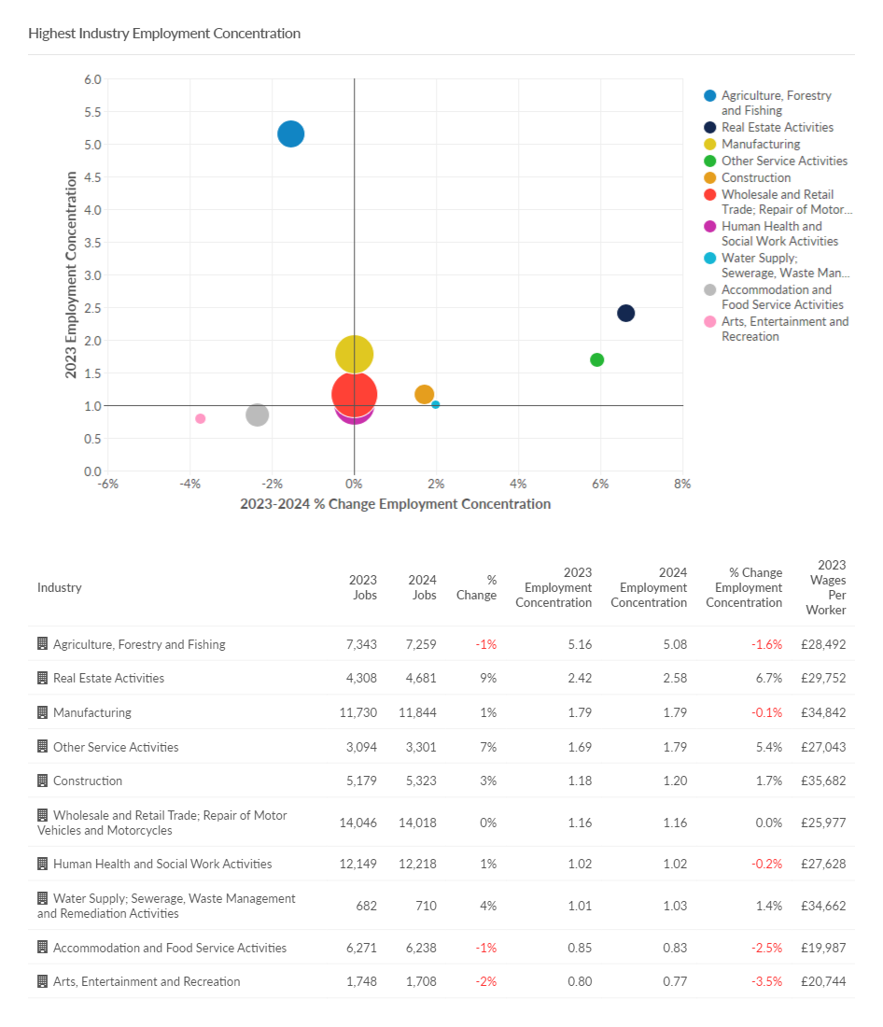
Highest industry employment concentrations
Need to know: The charts show occupations at Standard Industry Classification (SIC) 1 level but data are available down to SIC 4 level if more granularity is required.
Source: Lightcast (EMSI): economicmodelling.co.uk
Date last updated: June 2024
Frequency of update: Annually
Next update: June 2025

Slide 23
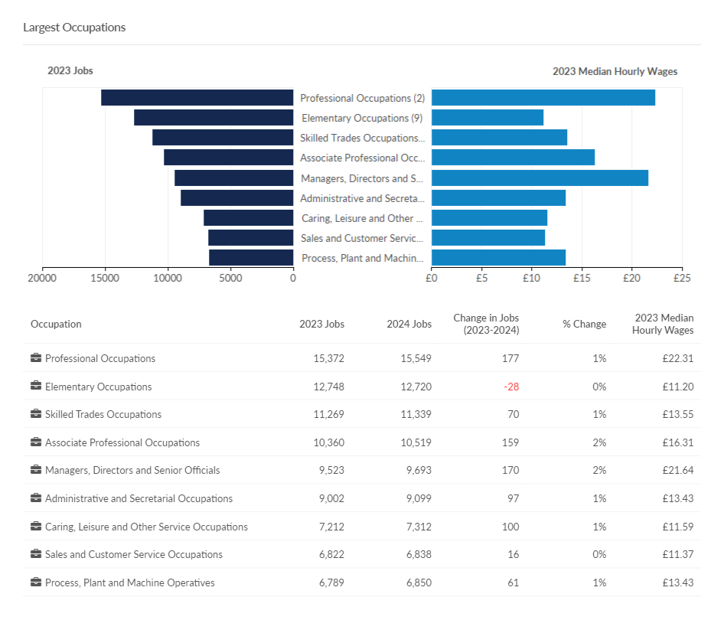
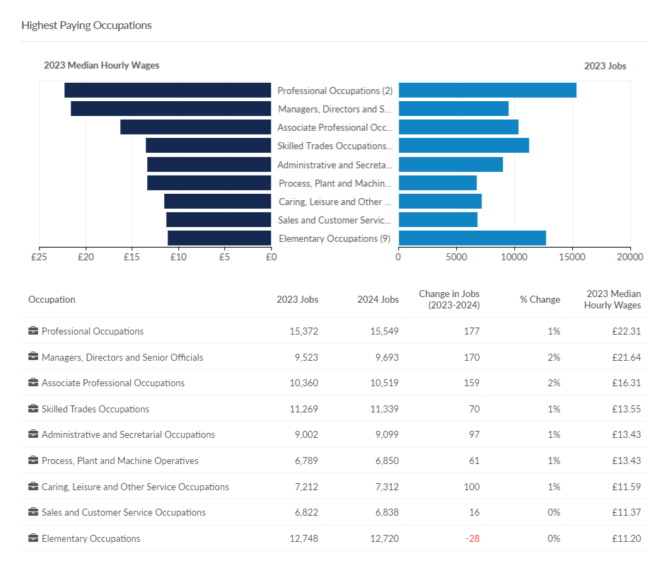
Largest and highest paying occupations
Need to know: The charts show occupations at Standard Occupation Classification (SOC) 1 level but data are available down to SOC 4 level if more granularity is required.
Source: Lightcast (EMSI): economicmodelling.co.uk
Date last updated: June 2024
Frequency of update: Annually
Next update: June 2025

Slide 24
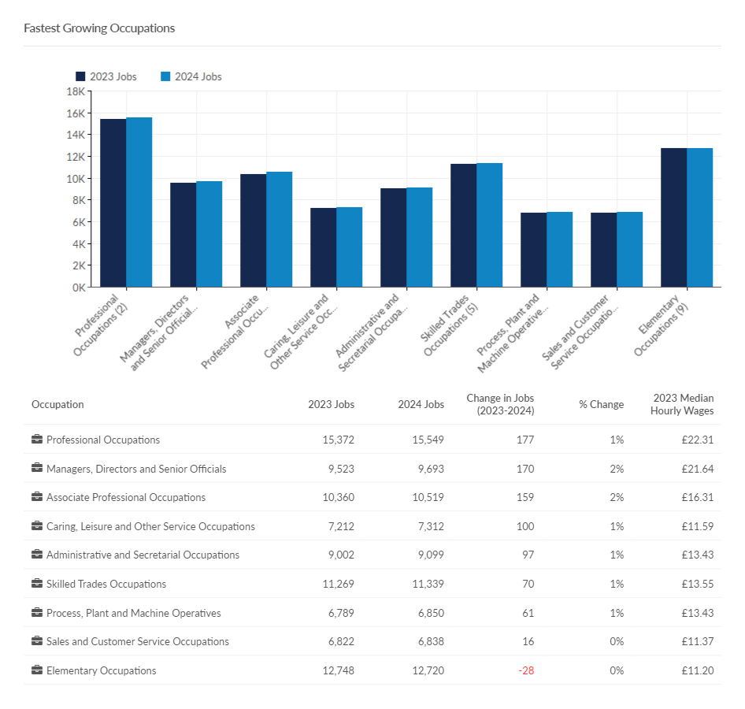
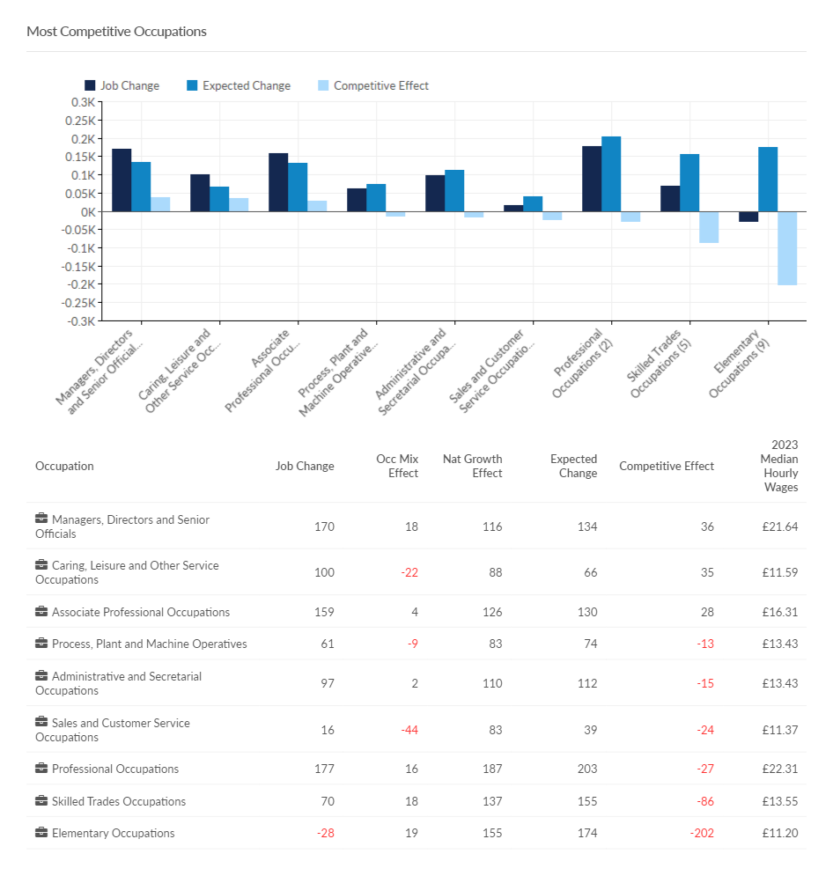
Fastest growing and most competitive occupations
Need to know:
Competitive effect indicates how much of the job change within a given region is the result of some unique competitive advantage of the region. This is because the competitive effect, by definition, measures the job change that occurs within a regional industry that cannot be explained by broader trends.
The charts show occupations at Standard Occupation Classification (SOC) 1 level but data are available down to SOC 4 level if more granularity is required.
Source: Lightcast (EMSI): economicmodelling.co.uk
Date last updated: June 2024
Frequency of update: Annually
Next update: June 2025

Slide 25
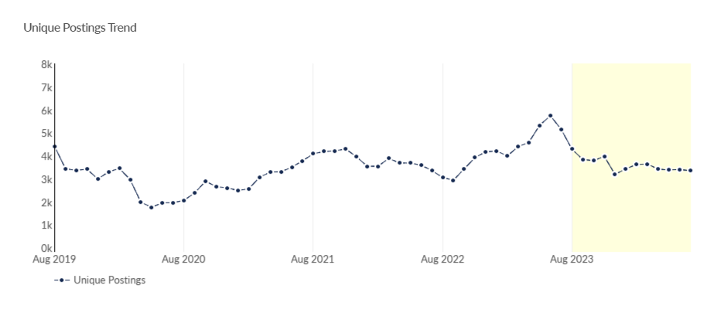
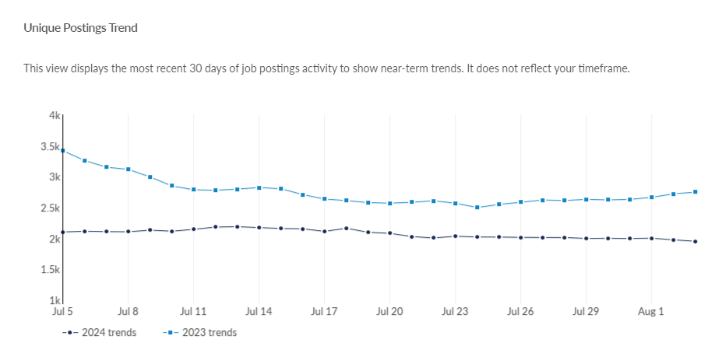
Job postings
Key points
In Herefordshire, during the period from August 2023 to July 2024 there were 48,710 job postings, of which 21,068 were unique. The number of unique posting fell again in July 2024 to 3,346, down from 3,304 in June (-1.7%) (revised) and remains well below the peak in June last year (5,742).
In July 2024 the number of unique postings was lower than a year ago (5,151 in July 2023), and is similar to the number immediately before the first pandemic lockdown (3,450 in February 2020).
The top ten posted occupations (SOC 3 level) in the period August 2023 to July 2024 were caring personal services (1,406 unique postings), other elementary service occupations (862), nursing professionals (839), and sales related occupations (812). Top posted job titles in this period were support workers (700 unique postings), cleaners (295), care assistants (229) and warehouse operatives (164).
The most in-demand specialized skills over the year to June 2024 (by frequency in job postings) were auditing, nursing and finance (see next slide).
Need to know: A unique job posting is one that has been de-duplicated as postings can appear on multiple websites, multiple times. Data include voluntary, internships, side jobs and freelance.
The Standard Occupational Classification (SOC) is a common classification of occupational information for the UK and comprises 4 tiers with 4 being the most detailed.
Source: Lightcast (EMSI): economicmodelling.co.uk
Date last updated: 5 August 2024
Frequency of update: Monthly
Next update: September 2024

Slide 26
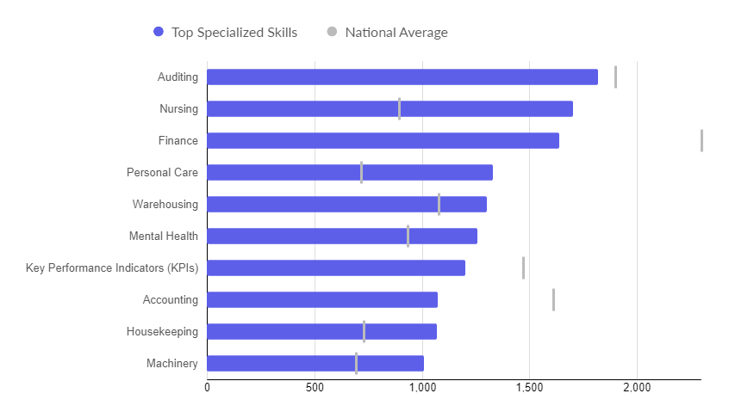
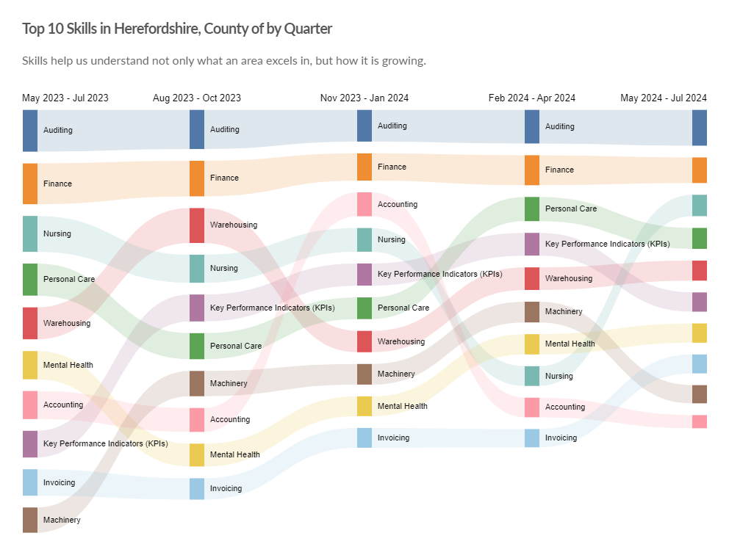
In-demand skills
Top hard skills
Top 10 hard skills by quarter
Need to know: Hard skills are abilities that have been taught to or learnt by a person.
Source: Lightcast (EMSI): economicmodelling.co.uk
Date last updated: 5 August 2024
Frequency of update: Monthly
Next update: September 2024

Slide 27
Hard to fill vacancies
Key points
CIPD reports that nationally 38% of employers surveyed have hard-to-fill vacancies and that hard-to-fill vacancies are significantly higher in the public sector (51%) than the private sector (34%)
There is no standard definition of a “hard-to-fill” vacancy and no equivalent survey to that undertaken by CIPD at local level, but the table shows those occupations (SOC 3 level) for the period August 2023 to July 2024 with a higher than average posting intensity. Those which also have a higher than average median posting duration (in this case, senior officers in protective services and caring personal services) are likely to be those most difficult to fill.
This is the most timely proxy for “hard-to-fill” vacancies and although there are some issues associated with this methodology, it has been shown to be a robust approximation.
SOC | Occupation | Avg. Posting Intensity (Aug 2023 - Jul 2024) | Median Posting Duration from Aug 2023 - Jul 2024 | Unique Postings from Aug 2023 - Jul 2024
631 | Community and Civil Enforcement Occupations | 2 : 1 | 37 | 5
116 | Senior Officers in Protective Services | 4 : 1 | 35 | 13
815 | Construction Operatives | 2 : 1 | 33 | 11
211 | Natural and Social Science Professionals | 3 : 1 | 31 | 41
341 | Artistic, Literary and Media Occupations | 2 : 1 | 31 | 142
241 | Legal Professionals | 2 : 1 | 29 | 221
342 | Design Occupations | 3 : 1 | 29 | 24
521 | Metal Forming, Welding and Related Trades | 2 : 1 | 29 | 127
523 | Vehicle Trades | 2 : 1 | 29 | 215
525 | Skilled Metal, Electrical and Electronic Trades Supervisors | 3 : 1 | 29 | 78
532 | Building Finishing Trades | 1 : 1 | 29 | 41
542 | Printing Trades | 1 : 1 | 29 | 11
613 | Caring Personal Services | 4 : 1 | 29 | 1,406
811 | Process Operatives | 2 : 1 | 29 | 81
822 | Mobile Machine Drivers and Operatives | 2 : 1 | 29 | 149
911 | Elementary Agricultural Occupations | 2 : 1 | 29 | 70
913 | Elementary Process Plant Occupations | 2 : 1 | 29 | 67
212 | Engineering Professionals | 3 : 1 | 28 | 612
221 | Medical Practitioners | 3 : 1 | 28 | 204
225 | Other Health Professionals | 3 : 1 | 28 | 194
246 | Welfare Professionals | 3 : 1 | 28 | 785
247 | Librarians and Related Professionals | 2 : 1 | 28 | 12
354 | Business Associate Professionals | 2 : 1 | 28 | 142
511 | Agricultural and Related Trades | 2 : 1 | 28 | 164
722 | Customer Service Supervisors | 2 : 1 | 28 | 74
215 | Conservation and Environment Professionals | 2 : 1 | 27 | 9
216 | Research and Development (R&D) and Other Research Professionals | 2 : 1 | 27 | 33
322 | Welfare and Housing Associate Professionals | 3 : 1 | 27 | 352
711 | Sales Assistants and Retail Cashiers | 3 : 1 | 27 | 438
812 | Metal Working Machine Operatives | 3 : 1 | 27 | 3
814 | Assemblers and Routine Operatives | 3 : 1 | 27 | 209
821 | Road Transport Drivers | 3 : 1 | 27 | 709
912 | Elementary Construction Occupations | 2 : 1 | 27 | 115
923 | Elementary Security Occupations | 3 : 1 | 27 | 102
926 | Other Elementary Services Occupations | 3 : 1 | 27 | 862
Need to know: Posting Intensity is a ratio of total job postings to unique, or de-duplicated, job postings. A higher than average posting intensity can mean that employers are putting more effort than normal into hiring that position. Posting intensity is available by occupation, by job title, by company, and by region. The median posting duration (how long a posting was live before it was taken down) can be compared to the regional average for all postings in the region, giving an indication of whether these positions are harder or easier to fill than the typical job posting.
Source: Lightcast (EMSI): economicmodelling.co.uk
Date last updated: 5 August 2024
Frequency of update: Monthly
Next update: September 2024

Slide 28
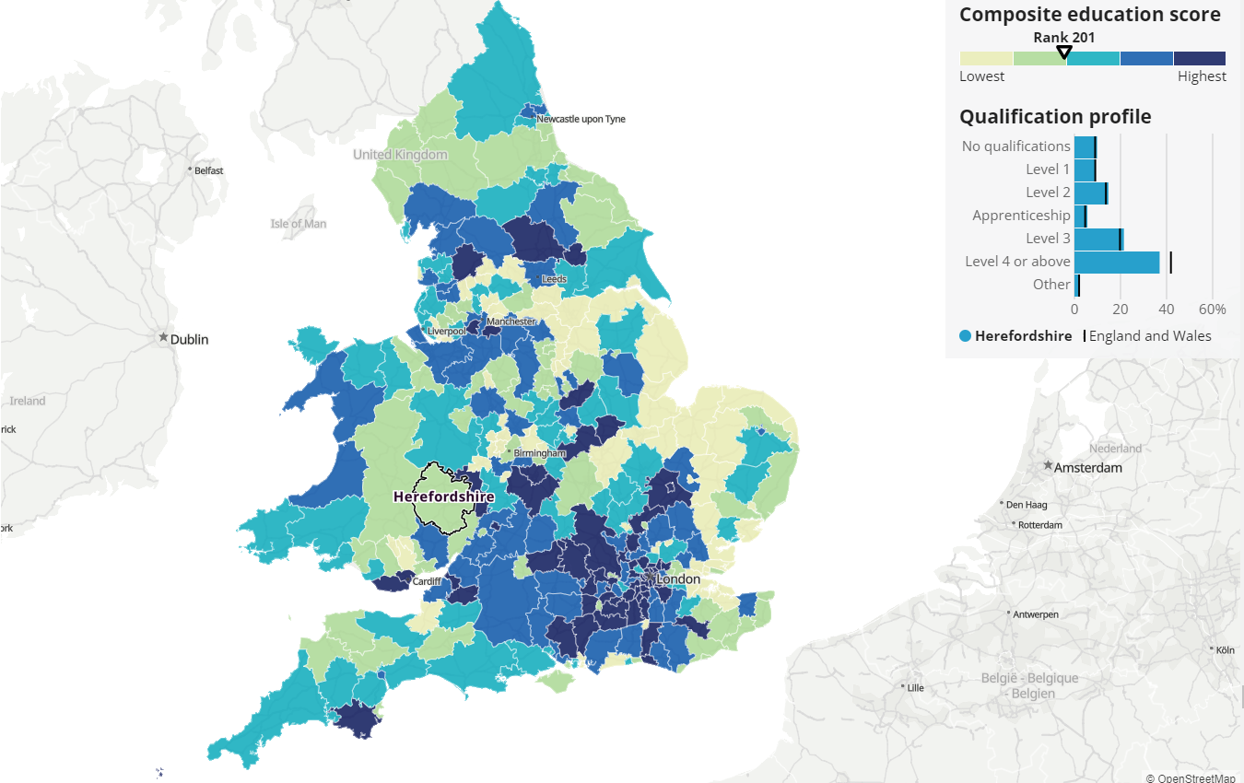
Workforce qualifications
Census 2021 data show that education levels among local labour forces vary between areas in England and Wales. This matters, because it can indicate the quality of locally available jobs, whether they require higher levels of education and whether they are higher-paid. Areas with good educational attainment, opportunities and job markets are likely to have a richer local economy.
Meanwhile, areas with a less-qualified workforce might have fewer job opportunities for highly qualified people, struggle to train or attract and keep qualified workers, and have a poorer local economy. All of this has cost-of-living implications.
Key points
Using ONS’s composite education score methodology, Herefordshire is ranked 201 out of 331 English and Welsh local authorities. This puts it in the bottom 40% of areas.
The five most similar areas to Herefordshire in terms of qualification profile are: 1. Gateshead 2. Ryedale 3. Kirklees 4. Powys 5. Calderdale. The most similar area, Gateshead, was ranked eight places higher than Herefordshire.
ONS Annual Population Survey data for the period January to December 2023 show that 43.6% (+/-4.9) of the working-age population in Herefordshire are qualified to RQF level 4 or above, compared to 46.7% (+/- 0.4) for England and 42.5% (+/-1.3) for the West Midlands. 3.7% (+/-1.9) had no qualifications, compared to 6.2% (+/-0.2) in England and 7.3% (+/-0.7) in the West Midlands. Herefordshire is not therefore statistically significantly different from either England or the West Midlands region is respect of RFQ4+, but is significantly lower in the proportion of the working-age population with no qualifications.
Source: ONS
Frequency: Decennially
Last Updated: 17 February 2023
Next update: 2033
Need to know: For information on how the composite education score was derived see ONS: How workforce qualification levels differ across England and Wales, technical annex: Census.
RQF = Registered Qualifications Framework

Slide 29
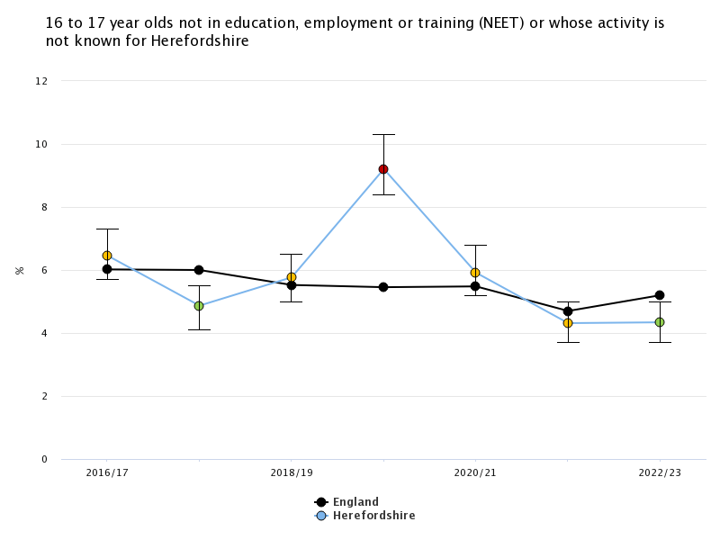
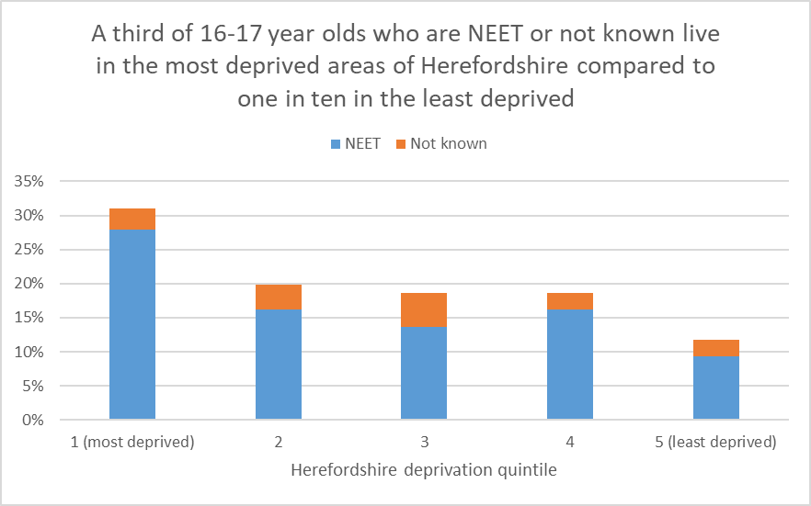
Young people not in Education, Employment or Training (NEET)
The Scottish Longitudinal NEET Study (2015) found that young people who are NEET suffer long-lasting and cumulative detrimental effects:
NEETs remained disadvantaged in their level of educational attainment 10 and 20 years later. More than one in five of NEET young people in 2001 had no qualifications in 2011, compared with only one in twenty five of non-NEETS.
There is a 'scarring effect' on economic activity. In comparison with their non-NEET peers, NEET young people in 2001 were 2.8 times as likely to be unemployed or economically inactive 10 years later. The scarring effect is also evident in the occupational positions that NEET young people take up, if they entered employment. For example, NEET young people in 2001 were 2.5 times as likely as their non-NEET peers to work in a low status occupation in 2011, if they found work.
NEET experiences are associated with a higher risk of poor physical health after 10 and 20 years. The risk for the NEET group was 1.6-2.5 times that for the non-NEET group, varying with different health outcomes. NEET experiences are also associated with a higher risk of poor mental health after 10 and 20 years. The risk of depression and anxiety prescription for the NEET group is over 50% higher than that for the non-NEET group.
Key points
In 2022-23 Herefordshire’s NEET/not known rate was 4.3%, unchanged from the previous year but now lower than the West Midlands (5.2%) and England (5.2%).
The number of NEETS and not knowns varies significantly month-on-month, the annual rate data are an average of the figures submitted by to the DfE for the months of December, January, February each year.
The proportion of young people who are NEET or not known in Herefordshire has fallen recently from a peak of 9.2% in 2019-20.
Young people living in the most deprived areas of the county are much more likely to be NEET than those in the least deprived.
*Office for Health Improvement & Disparities Fingertips
Chart 1 image copyright: Office for Health Improvement & Disparities. Public Health Profiles. [Date accessed: 20 November 2023] https://fingertips.phe.org.uk © Crown copyright [2023]. Source (chart 1): .Office for Health Improvement & Disparities Fingertips, Last updated: November 2023, Next update: T.b.c.. Data source (chart 2): Herefordshire Council Children and Young People Directorate, Frequency: Annually, Last updated: June 2023, Next update: June 2024.

Slide 30
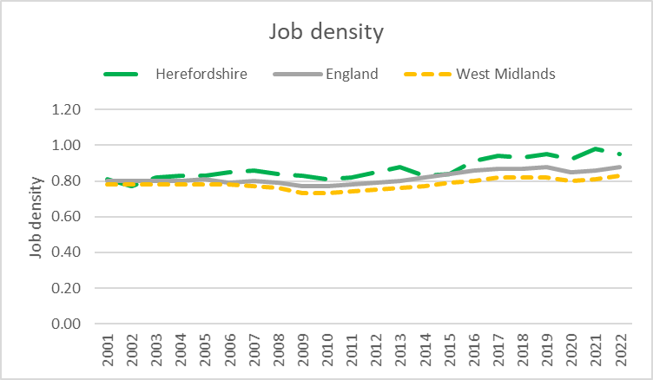
Job density
Job density is a measure of labour demand in an area. It shows the supply of jobs relative to the size of the working-age population. A higher job density can be suggestive of a high proportion of people being employed locally, or (less likely in the case of Herefordshire) large numbers commuting into an area to work.
Key points
In 2022 (the latest available year), job density in Herefordshire (0.95) was slightly lower than in 2021 (0.98), which was its highest level since data became available in 2001, but was still higher than in both the West Midlands region (0.83) and England (0.88).
Need to know: Job density is the number of jobs in an area divided by the resident population aged 16-64. For example, a job density of 1.0 would mean that there is one job for every resident aged 16-64. Job density is based on a workplace-based measure of jobs that comprises employee jobs, self-employed, government-supported trainees and HM Forces. In areas with high jobs densities the demand exceeds the supply, and the imbalance may be satisfied by workers who live outside the area (inward commuting). In areas with a low jobs density, the supply exceeds the demand and often residents will have to work in other areas (outward commuting) or become
unemployed or economically inactive..
Data Source ONS -: NOMIS
Frequency: Annually
Last updated: 15 February 2024
Next update: 31 January 2025

Slide 31
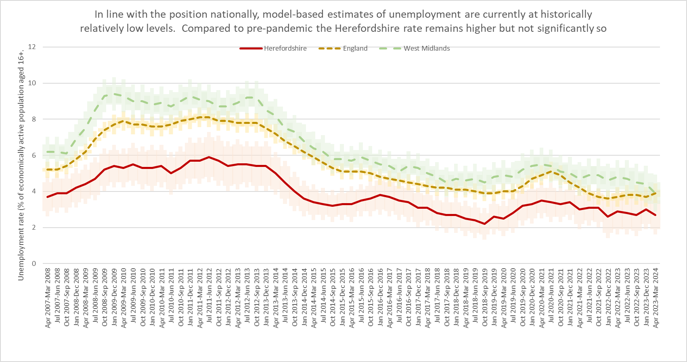
Model-based estimates of unemployment
Key points
ONS reports that the UK unemployment rate (for people aged 16 years and over) was estimated at 4.4% in March to May 2024, above estimates of a year ago, and increased in the latest quarter.
The model-based estimate of unemployment is ONS’s recommended measure of unemployment at local authority level. In the period April 2023 to March 2024 the unemployment rate in Herefordshire was 2.7% (CI+-0.8), equating to c. 2,800 people (+-800), compared to 3.9% (CI+-0.2) in England as a whole and 3.9% (CI+-0.6) across the West Midlands region.
In the latest period, Herefordshire’s unemployment rate remained lower than in England and significantly lower than in the West Midlands region. It remained elevated compared to pre-pandemic levels, although not significantly so.
Compared to the previous period (January to December 2023), the Herefordshire rate was slightly lower (2.7% vs 3.0%) but due to the wide confidence intervals on these data, there has been no statistically significant change in the Herefordshire rate observed since April 2016 – March 2017.
Data source: ONS -NOMIS
Date last updated: 18 July 2024
Frequency: Quarterly
Next update: 15 October 2024
Need to know
This dataset gives the official unemployment figures for local authorities. Percentages are of the economically active population aged 16 and over. Model-based estimates are produced for local authority areas. Estimates of unemployment for nations and regions are not model-based and have been taken directly from the Annual Population Survey dataset. No further breakdown is available below the all-age county rate. More information can be found in the User Guide. Estimates are modelled to improve their precision compared to those based only on responses provided via the Annual Population Survey. These estimates are calculated from a model based on the Annual Population Survey with Jobseeker's Allowance as an auxiliary. The disadvantage is that because it is based partly on a sample survey, the confidence intervals are still quite wide making it difficult to observe any statistically significant variation.For more information on the difference between the unemployment and claimant count rates see this article.

Slide 32
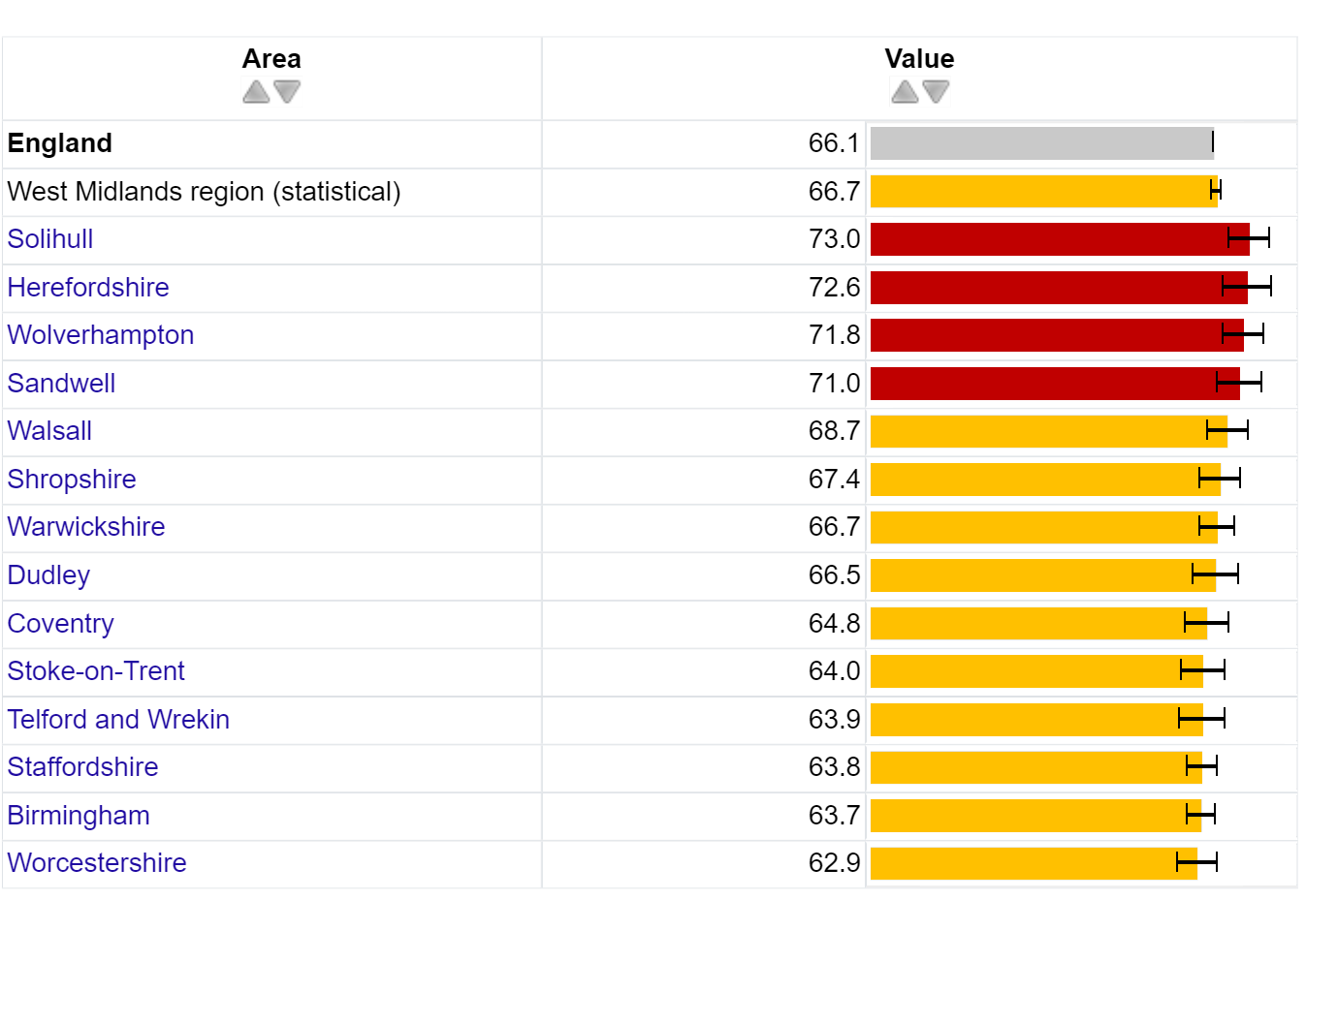
Unemployment and mental wellbeing
Key points
The relationship between mental health and unemployment complex and bi-directional. Good mental health is a key influence on employability, finding a job and remaining in that job. Unemployment causes stress, which ultimately has long-term physiological health effects and can have negative consequences for people’s mental health, including depression, anxiety and lower self-esteem. (Wilson & Finch, 2021). Those in unemployment tend to have lower levels of wellbeing than those in employment and conversely those with greater job security tend to have higher levels of wellbeing (Department of Health, 2014). Research conducted in 2022, in the wake of the covid-19 pandemic, found that mental health disabled workers were concentrated in those jobs and sectors that were most affected by the pandemic and associated response, pointing to the importance of segmentation and segregation as explanations of labour market inequality (Bryan et al, 2022).
In 2020-21, the gap in the employment rate between those in contact with secondary mental health services aged 18-69 and on the Care Plan Approach (CPA), and the overall employment rate in Herefordshire was 72.6%, significantly larger than the gap for the West Midlands region (66.7%) and England (66.1%). The gap in Herefordshire was also the second highest amongst both comparable West Midlands authorities and statistically similar (CIPFA) neighbours.
Need to know: Indicator definition – the percentage point gap between the percentage of working age adults who are receiving secondary mental health services and who are on the Care Plan/Programme Approach recorded as being in paid employment at the time of their most recent assessment, formal review, or other multi disciplinary care planning meeting (aged 18 to 69), and the percentage of all respondents in the Labour Force Survey classed as employed (aged 16 to 64).
Care Programme Approach (CPA) describes the approach used in mental healthcare to assess, plan, review and coordinate the range of treatment, care and support needed for people in contact with services and who have complex care needs. Warning: Values for this indicator must be interpreted with caution. The rigidity of the Care Programme Approach (CPA) means that some people who are on the plan are not in receipt of secondary mental health services support as the criteria to qualify are often arbitrary. More information.
Source: OHID – Public Health Outcomes Framework
Last updated: 3 May 2023
Frequency: Annual
Next update: t.b.c.
Image copyright: https://fingertips.phe.org.uk © Crown copyright [2023].

Slide 33
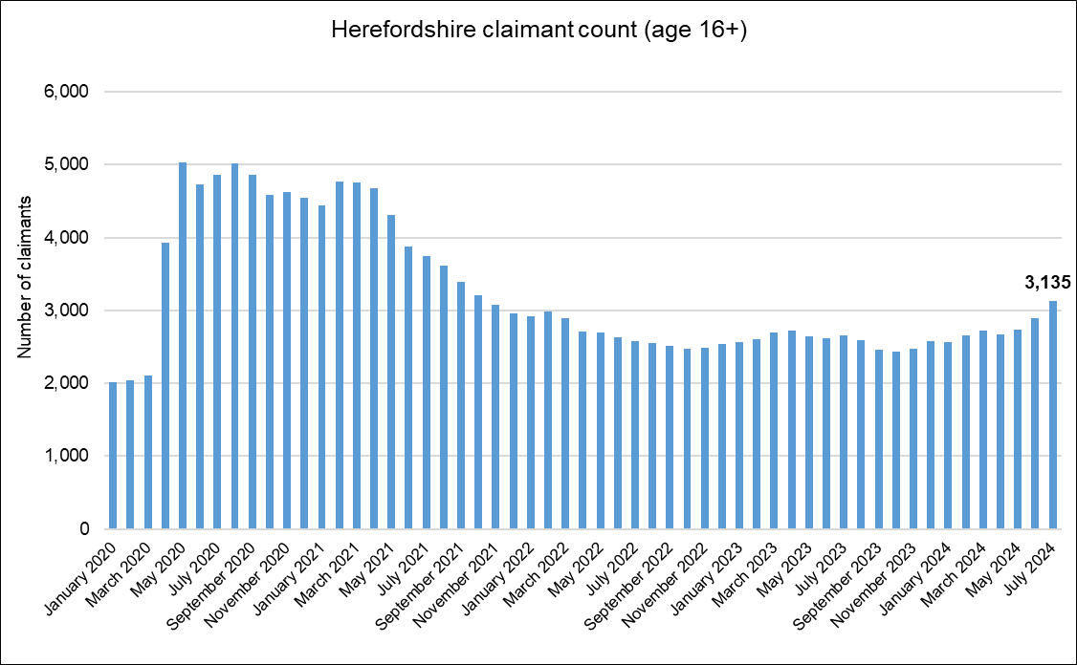
Out-of-work related claimant count: all ages
Key points
There were 3,135 people aged 16+ in Herefordshire claiming out-of-work-related benefits* in July 2024: an 8% increase and 245 more since June.
Numbers remain significantly higher than pre-pandemic levels, being 49% higher than in March 2020; similar to England as a whole (48%).
Numbers are now similar to those seen in the aftermath of the Great Recession (3,125 in February 2012).
The claimant count rate as a proportion of residents aged 16-64** was 2.9% in July 2024 compared to 4.4% for England and 5.8% for the West Midlands region.
Need to know
*The Claimant Count is an experimental statistic that measures the number of people who are claiming unemployment-related benefits. It does not meet the internationally agreed definition of unemployment specified by the International Labour Organisation (ILO). Claimant Count includes people claiming Jobseeker's Allowance plus those claiming Universal Credit who are required to seek and be available for work. However, not everyone who is unemployed claims these benefits and ONS advises that ‘the Claimant Count does not attempt to measure unemployment. However, since the people claiming benefits are generally a particular subset of the unemployed, the Claimant Count can provide a useful indication of how unemployment is likely to vary between areas and over time. The model-based estimates of unemployment, which are derived from the ONS Annual Population/Labour Force Survey are the official measure of unemployment. For more information on this topic see the Economics Help website.
** IMPORTANT: Note this rate is not comparable to the official UK unemployment rate which is expressed as a proportion of the economically active population aged 16+.
Data source: ONS - NOMIS
Date last updated: 13 August 2024
Frequency of update: Monthly
Next update: 10 September 2024

Slide 34
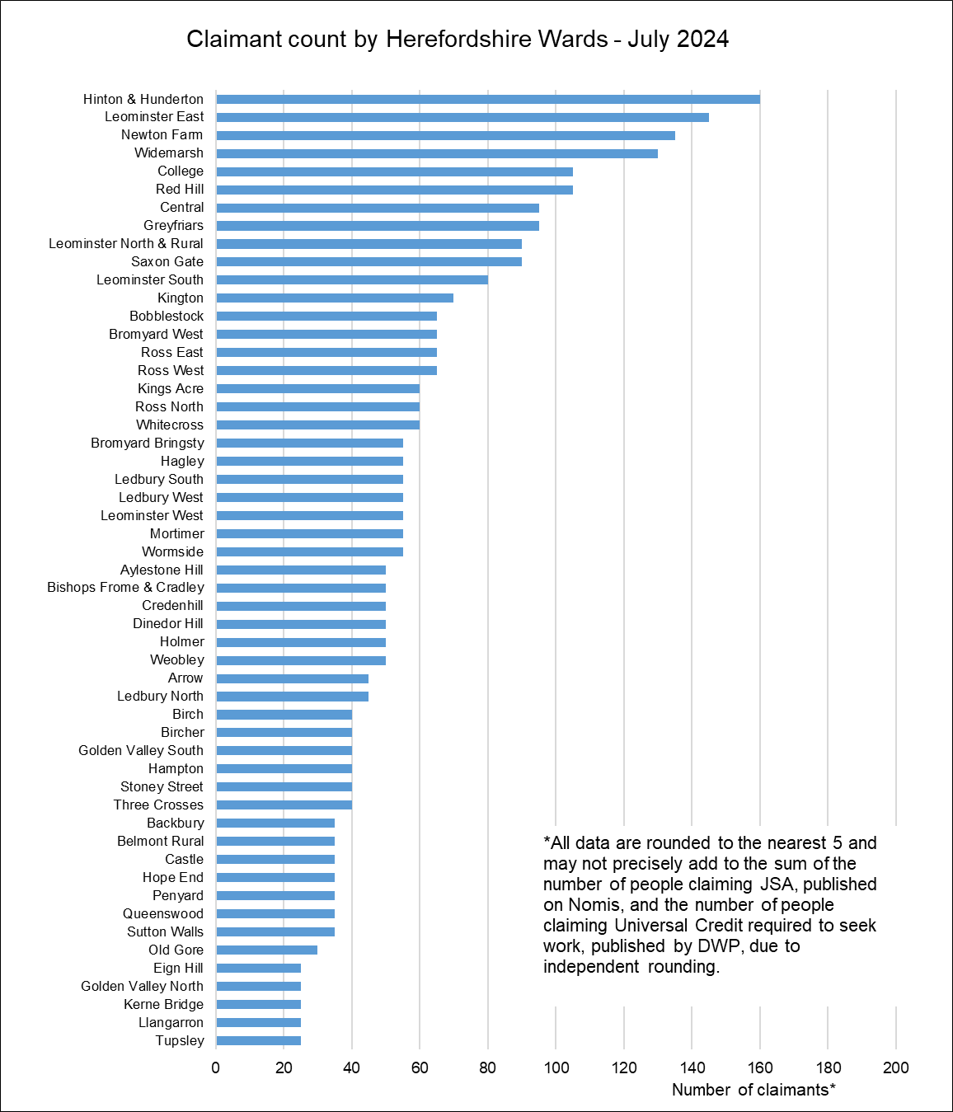
Out-of-work claimant count by ward
Key points
Generally, those wards with the highest numbers of claimants before the pandemic still have the highest numbers now.
In July 2024 the wards with the highest numbers of claimants were Hinton & Hunderton (160), Leominster East (145), Newton Farm (135) and, Widemarsh (130).
The largest proportional increases in the claimant count since March 2020 have occurred in Leominster – Rural & North (167%), Hampton (150%), and Queenswood (140%).
In terms of numerical increases, the largest have been in Bromyard – Bringsty and Hagley (both +50) and Old Gore (+45).
Data source: ONS - NOMIS
Date last updated: 13 August 2024
Frequency of update: Monthly
Next update: 10 September 2024

Slide 35
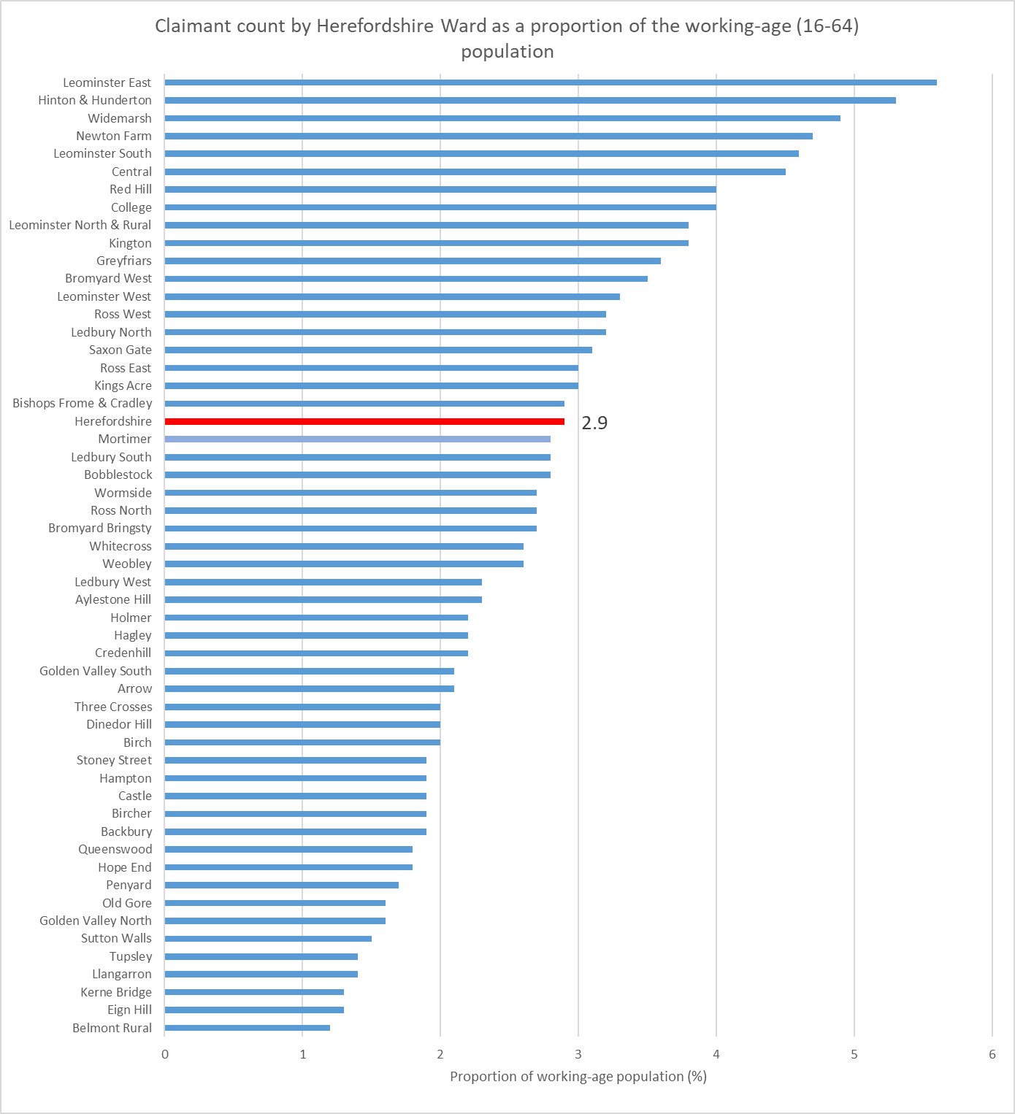
Out of work claimant count rate by ward
Key points
As the size of the working-age population (aged 16-64), who are eligible to claim out of work benefits, varies significantly between wards, it is useful to express the count as a rate, that is as a proportion of the working-age population.
However, it should be noted that due to the size of the population at ward level, relatively small changes in the numbers of claimants can have a significant impact on the rate.
As at July 2024, the wards with the highest claimant count rates were Leominster East (5.6%), Hinton & Hunderton (5.3%), Widemarsh (4.9%) and Newton Farm (4.7%).
The lowest rates were in Belmont Rural (1.2%) and Eign Hill and Kerne Bridge (both 1.3%).
The rate for Herefordshire as a whole was 2.9%.
Data source: ONS - NOMIS
Date last updated: 13 August 2024
Frequency of update: Monthly
Next update: 10 September 2024

Slide 36
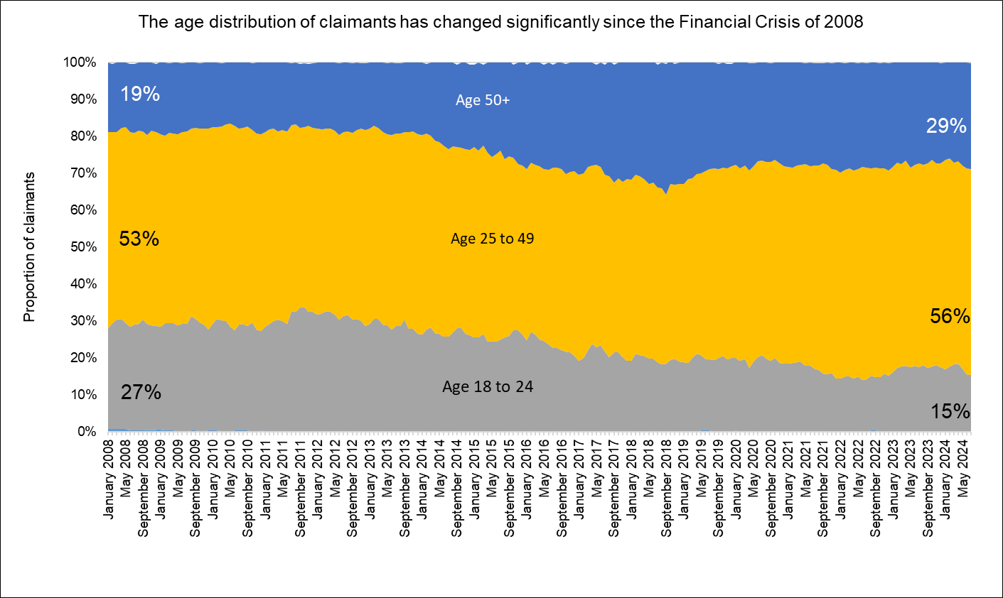
Age distribution of out-of-work claimants
Key points
Nationally, it has been reported that in the period November 2022 to January 2023, 3.5 million people aged 50 to 64 were out of work and not looking for work, compared to 3.3 million people of that age in January to March 2020: a rise of 280,000 people. The inactivity rate for those aged 50 to 64 rose by 1.7 percentage points, from 25.5% at the start of the pandemic to 27.2% in November to January 2023. This rise came after years of falling economic inactivity among this age group before the pandemic. Ill-health and/or early retirement have been identified as the primary drivers for the increase.
However, barriers to accessing employment may also be a factor and this is supported by the changing age profile of those who are out of work and claiming out-of-work benefits (the eligibility criteria for which include an expectation to be looking for work).
Recent IFS research suggests that nationally many older workers were forced out of employment (through the jobs they were in not being compatible with home working and/or health fears) during the COVID-19 pandemic and that people who become inactive at older ages often never re-enter the workforce.
Looking at the age distribution of Herefordshire’s out-of-work benefit claimants now compared to January 2008 (before the Financial Crisis and the Great Recession) this has changed significantly.
In January 2008, 18 to 24 year olds accounted for 27% of claimants and over 50s accounted for 19% of claimants in Herefordshire. In July 2024 18 to 24 year-olds accounted for 15% of claimants and over 50s 29% of claimants, completely reversing the distribution at the start of the period.
This change is partly a reflection of our ageing workforce but may also indicate that older workers who want to work are finding it harder to get another job than they did in the past.
Data source: ONS - NOMIS
Date last updated: 13 August 2024
Frequency of update: Monthly
Next update: 10 September 2024

Slide 37
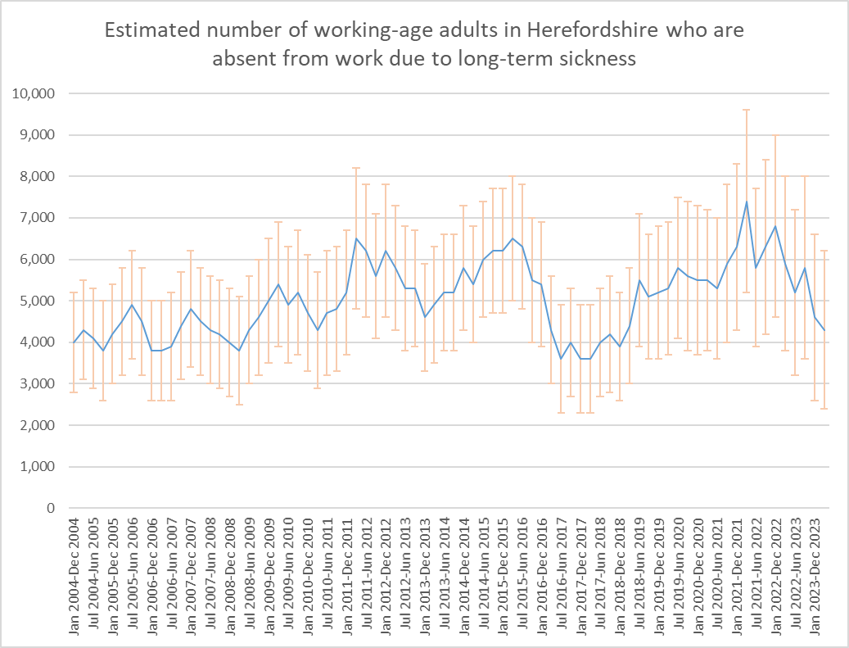
Long-term sickness
Economic inactivity as a result of long-term sickness can have a significant impact on the economy of a country and on welfare spending. For the individual, it can in itself have a detrimental impact on long-term health, as well as on financial security and social inclusion (NICE, 2019). An ageing workforce, increasing mental ill health, and obesity are all contributing to an increase in long-term sickness. (SOM)
According to ONS, in Q1 2023, nationally the number of people economically inactive because of long-term sickness had risen to over 2.5 million people, an increase of over 400,000 since the start of the coronavirus (COVID-19) pandemic. Nearly two-fifths (38%) report having five or more health conditions (up from 34% in 2019), suggesting that many have interlinked and complex health issues. The biggest increases have been among people over the age of 50 (House of Commons Library) and according to ONS in the period April 2023 to March 2024, the majority of those who were inactive because of long-term sickness were aged 50 to 64 years, although long-term sickness has been increasing across all age groups. In June 2023, research by the Resolution Foundation found that nationally economic inactivity due to ill health among 18-24 year-olds had also nearly doubled over the past decade, and is heavily concentrated among those with low levels of skills, with four-in-five young people who are too ill to work having only qualifications at GCSE-level or below. Young people in areas dominated by small towns and villages more likely to be workless due to ill health than those living in large cities. People with disabilities, in insecure employment, and in lower socio-economic groups, who are already at higher risk of financial insecurity and poverty, are also more likely to experience long-term sickness absence (IPPR, 2017).
Key points
2021 Census data show that 3.6% of usual residents of Herefordshire aged 16 years and over were economically inactive as a result of being long-term sick or disabled, up from 3.2% in 2011.
According to the ONS Annual Population Survey, in the period April 2023 – March 2024, in the region of 4,300 people aged 16-64 in Herefordshire were economically inactive due to long-term sickness; an apparent decrease of around 300 people from the previous period (January – December 2023). However, as these data are based on a national survey the confidence intervals are very wide. These data show that long-term sickness rates as a proportion of those economically inactive in Herefordshire have fluctuated very significantly in the past two decades but are currently (April 2023 - March 2024) slightly lower than for Great Britain and the West Midlands but not significantly so (23.4% in Herefordshire vs 29.1% in the West Midlands and 27.3% in Great Britain).
Data source: ONS - NOMIS
Frequency: Quarterly
Last updated: 18 July 2024
Next update: 15 October 2024
Need to know:
Long-term sickness is defined by the DWP as ‘an instance of sickness absence from work lasting 4 or more weeks.’
Economic activity is defined by ONS as ‘people not in employment who have not been seeking work within the last four weeks and/or are unable to start work within the next two weeks.’
Note the wide confidence intervals associated with the Annual Population Survey at local authority level in the chart above.

Slide 38
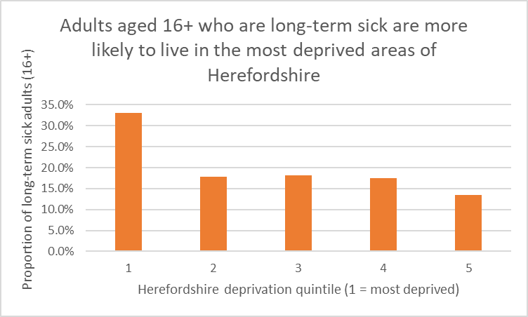
Long-term sickness by Herefordshire deprivation quintile
Key points
According to The Health Foundation more working-age people in the UK are living with long-term health conditions than ever before. For many, poor health means not being able to work. The relationship between long-term sickness and deprivation is complex, involving not only inequalities in economic and social capital, but cultural and lifestyle factors, and the differing types of work more likely to be undertaken by different socio-economic groups.
The Kings Fund has found that people in the poorest social class have a 60% cent higher prevalence of long-term health conditions than those in the richest social class.
2021 Census data indicated that there were around 5,600 adults aged 16+ in Herefordshire who were economically inactive as a result of being long-term sick.
A third of these people were from the most deprived quintile of the county, compared to 13% from the least deprived.
Herefordshire deprivation quintile (1 = most deprived) | Count of adults aged 16+ who are long-term sick | Proportion of adults aged 16+ who are long-term sick
1 | 1,855 | 33%
2 | 1,003 | 18%
3 | 1,021 | 18%
4 | 977 | 17%
5 | 756 | 13%
Total | 5,612 | 100%
Need to know: The 2021 Census took place at the time of significant disruption to the labour market as a result of the covid-19 pandemic. ONS advises ‘as Census 2021 was during a unique period of rapid change, take care when using this data for planning purposes.’ For this reason, it is inappropriate to compare these data to 2011 Census data.
Data source: ONS
Frequency: Decennially
Last updated: 8 December 2022
Next update: 2031

Slide 39
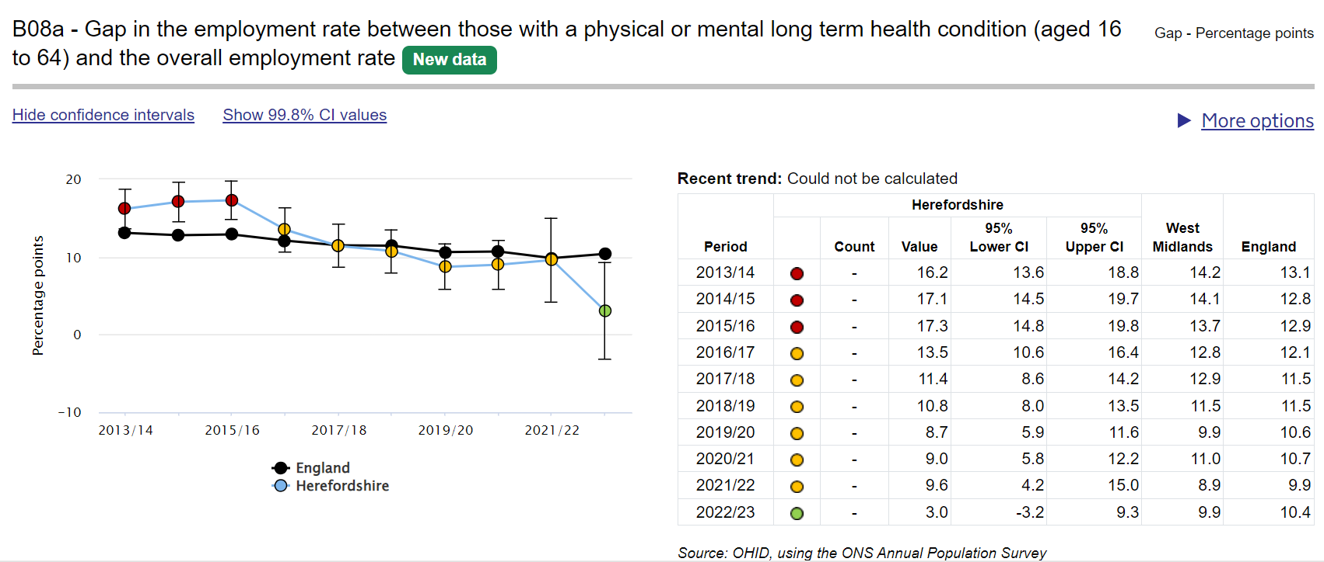
Long-term conditions and employment
Key points:
Data from ONS’s Annual Population Survey suggest that in 2022-23 72.9% (CI 65.4% - 80.3%) of working-age people (16-64) with a physical or mental long term health condition in Herefordshire were in employment, higher than in England (65.3% CI 64.6% - 66.0%) and the West Midlands ((63.7% CI 61.6% - 65.8%) but not significantly so. In 2022-23, Herefordshire had the 2nd highest employment rate out of 14 comparable West Midlands local authority areas.
In Herefordshire, in 2022-23, the gap in the employment rate between those with a physical or mental long-term health condition (aged 16 to 64) and the overall employment rate was 3.0% (CI -3.2% to 9.3%); lower than in England (10.4% CI 8.4% - 12.4%) and the West Midlands (9.9% CI 7.3% - 12.6%) but due to the large confidence intervals, not significantly so.
Contrary to upward movement in the West Midlands and England, the Herefordshire rate fell in 2022-23 from 9.6% (CI 4.2% - 15.0%) in 2021-22. The reasons for this are unclear and due to the wide confidence intervals around these data, the fall was not statistically significant.
Research by IFS has found that there are now 4.2 million working-age individuals (10.2% of the working-age population) receiving at least one health-related benefit. This is up from 3.2 million in 2019 (7.9%). The rise is driven by rapid increases in the number of people starting a new benefit claim. Prior to the pandemic, both incapacity and disability benefits saw about 20,000 new claims each month. By November 2022, there were 51,000 new claims for incapacity benefits and 43,000 new claims for disability benefits each month.
Source: OHID – Public Health Outcomes Framework
Last updated: 7 November 2023
Frequency: Annual
Next update: t.b.c.
image copyright: https://fingertips.phe.org.uk © Crown copyright [2023].
Need to know: Indicator definition- the percentage point gap between the percentage of respondents in the Labour Force Survey who have a long term condition who are classified as employed (aged 16 to 64) and the percentage of all respondents in the Labour Force Survey classed as employed (aged 16 to 64) .
A long term condition is defined as a physical or mental health condition or illness lasting or expected to last more than a year.

Slide 40
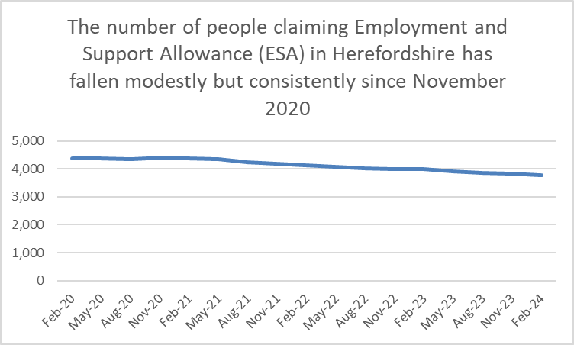
Employment and Support Allowance (ESA) claimants
According to recent IFS analysis in April 2024, there are around 4.2 million working-age individuals (10.2%) in Great Britain receiving at least one health-related benefit, compared with 3.2 million (7.9%) in 2019. This rise has been driven by large increases in the number of new claims. Before the pandemic, both incapacity benefits and disability benefits saw about 20,000 new claims per month. By November 2022, that had risen to 51,000 and 43,000 respectively.
Employment and Support Allowance (ESA) can be claimed by adults under state pension age who have a disability or health condition that affects how much they can work. ESA replaced Incapacity Benefit and Severe Disablement Allowance for new claimants from October 2008.
ESA provides:
Money to help with living costs if you’re unable to work
Support to get back into work if you’re able to
People can apply if they are employed, self-employed or unemployed. How much they get depends on what stage their application is at, as well other criteria such as age and whether they are able to get back into work. Claimants can get new style or contribution-based ESA on its own or at the same time as Universal Credit. If they get both at the same time, the ESA payment is deducted from the Universal Credit payment. Income-related ESA has also been replaced by Universal Credit.
Key points
Since May 2018 the number of ESA claimants in Herefordshire has been on a gradual but fairly consistent downward trajectory, falling from 5,258 in May 2018 to 3,785 in February 2024. In addition, a small number of claimants (84 in February 2024) whose claims were made prior to October 2008 are still in receipt of Incapacity Benefit and Severe Disablement Allowance.
Data source: Department for Work & Pensions (Stat-Xplore)
Frequency: Quarterly in arrears
Last updated: 13 August 2024
Next update: 12 November 2024

Slide 41
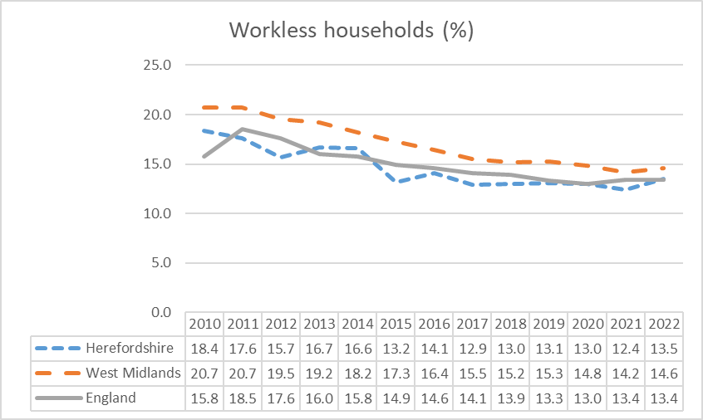
Workless households
Worklessness is associated with a range of adverse social and health outcomes with long-term negative impacts for the wellbeing and life chances of affected households.
Even before the current cost-of-living crisis, Department for Work & Pensions (DWP) analysis (2017) found that that problem debt was around twice as prevalent in workless households. Around 60% of housing benefit claimants in temporary accommodation are workless or on out-of-work benefits. In couple-parent families, relationship distress is around three times as prevalent if both parents are workless, as when both parents are working. The vast majority of parents reporting treatment for drug/alcohol use/dependency had been out of work for at least a month. Around half of children in workless families are living with parents who have at least three potential barriers to work, such as ill health, low qualifications or lone parenthood. Children in workless families are almost twice as likely to live with at least one parent with poor mental health. Children growing up in workless families are almost twice as likely as children in working families to fail to reach the expected levels at all stages of their education and are more likely to more likely to suffer mental and physical ill-health in later life if they have jobless parents during their childhood.
Key points
In 2022 (the latest data available), the estimated proportion of workless households in Herefordshire (13.5%) had increased slightly from 12.4% in 2021 and was higher than in England both as a whole (13.4%) and the West Midlands region (14.6%) but not significantly so.
2021 Census data indicated that around 9,700 usual residents aged 16 and over in Herefordshire (6%) had never worked or were long-term unemployed and therefore classified as ‘workless’. This was higher than in 2011 (4%), but was lower than nationally (9% in 2021, up from 6% in 2011).
Need to know: Workless households are households where no one aged 16 years or over is in employment. These members may be unemployed or economically inactive. Economically inactive members may be unavailable to work because of family commitments, retirement or study, or sickness or disability. Percentages are of working age households i.e. where at least one household member is aged 16-64. ONS advises that the population totals used for the latest LFS estimates use projected growth rates from Real-Time Information (RTI) data for EU and non-EU populations based on 2021 patterns. The total population used for the LFS therefore does not take into account any changes in migration, birth rates, death rates, and so on, since June 2021, so levels estimates may be under- or over-estimating the true values and should be used with caution.
Data source: ONS
Last updated: 28 September 2022
Frequency: Annually
Next update: 27 September 2024

Slide 42
Section 3: Household finances

Slide 43
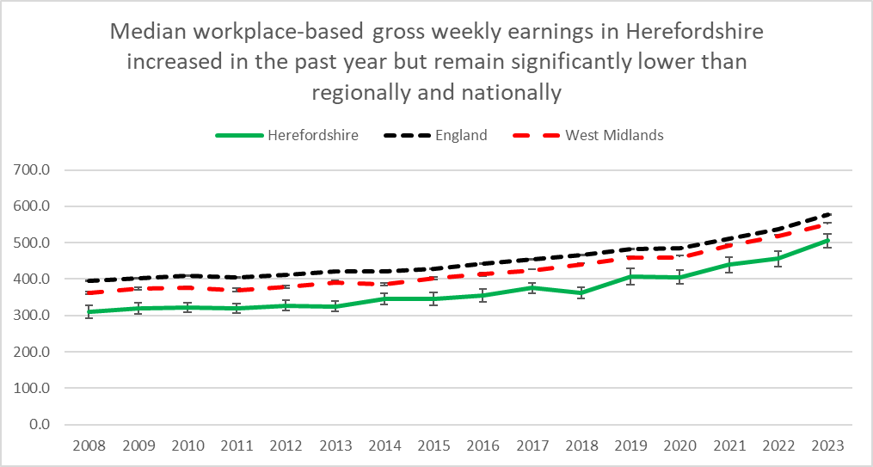
Earnings
Key points
ONS reports that annual growth in regular earnings (excluding bonuses) was 6.0% in the period January to March 2024 and annual growth in employees' average total earnings (including bonuses) was 5.7%. Annual growth in real terms (adjusted for inflation using the Consumer Prices Index including owner occupiers’ housing costs (CPIH)) for total pay rose on the year by 1.7% and for regular pay rose on the year by 2.0%. Annual average regular earnings growth for the public sector was 6.3% and for the private sector it was 5.9%. Both the manufacturing sector and the finance and business services sector saw the largest annual regular growth rate at 6.8%.
Nationally, IFS reports that the UK went from one of the fastest growers for working-age incomes among developed countries pre-2007, to one of the slower performers. While growth slowed across the board, the UK’s growth from 2007 to 2019 (6%) was well below that of the US (12%) and Germany (16%). IFS research has also pointed to widening geographical inequalities in earnings across the country.
Workplace-based median weekly earnings for all employees (full and part-time) who work in Herefordshire in 2023* were £505.50 (+-£19.21): a 10.8% increase from the amount recorded for 2022 (£456.30) and a larger percentage increase than in both England (7.4%) and the West Midlands (6.4%). However, Herefordshire earnings remain significantly lower than the average for England (£577.10 +-£1.15)) and the West Midlands (£550.4 +- £5.50).
The largest gap between Herefordshire and the England average was amongst full-time male workers (£616.80 vs £729.60)). The gap was smaller for female full-time workers (£540.60 vs £626.00). Amongst female part-time workers, in 2023 the gap was not significant (£240.90 vs £244.90). 2023 Herefordshire data for male part-time workers are not yet available.
In 2023, Herefordshire ranked 13th out of the 14 comparator West Midlands authorities, a slight improvement from 2022 when it was the lowest. But remained in the bottom quartile of English unitary and county local authority areas.
Data source: ONS – NOMIS (Annual Survey of Hours and Earnings (ASHE)
Frequency: Annually
Last updated: 30 November 2023
Next update: 30 November 2024
Need to know: workplace-based earnings includes all people who work in Herefordshire regardless of which county they live in.. This gives a better sense of earnings from local employment than the residence-based measure.
Earnings figures are for full and part-time employees – Herefordshire has a higher proportion of part-time employees than both England and the West Midlands region.
*2023 data are provisional.

Slide 44
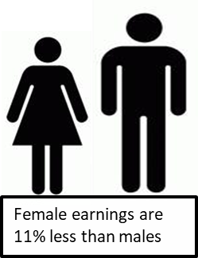
Gender pay gap
Key points
The gender pay gap is a persistent source of inequality. According to ONS, nationally the gender pay gap has been declining slowly over time. Over the last decade it has fallen by approximately a quarter among both full-time employees and all employees and in April 2023 it stood at 7.7%. There remains a large difference in the gap between employees aged 40 years and over and those aged under 40 years. Compared with lower-paid employees, the gap among higher earners is much larger, despite having decreased in recent years.
The gender pay gap decreased across all major occupational groups between 2022 and 2023. The gap in skilled trades occupations remains the largest of the major occupational groups, however, it has also decreased by the largest amount over the past years.
The gender pay gap is higher for all employees than it is for full-time employees or part-time employees. This is because women fill more part-time jobs, which in comparison with full-time jobs have lower hourly median pay.
In 2021, research by IFS found that over three-quarters of the reduction in the earnings gap over the past 25 years can be explained by the rapid increase in women’s educational attainment. It also found that the divergence in earnings occurs with parenthood, when the gendered roles that mothers and fathers take on appear to be largely unrelated to their relative earnings potential. IFS suggests that persistent social norms around parenting are reinforced by a policy environment that sustains and incentivises a traditionally gendered division of labour, even when policies are ostensibly gender-neutral.
Provisional data suggest that in Herefordshire in 2023, the median gender pay gap for all employees was 10.8% up from 4.8% in 2022, but still smaller than in both the West Midlands region (14.4%) and England (15.5%). For full-time employees only, the gap in Herefordshire was 6.3%, up from 0.1% in 2022, but again better than the West Midlands (9.8%) and England (9%).
In 2023*, the median gender pay gap (all employees) in Herefordshire was 10.8% but for full-time workers it was only 6.3%
*provisional data
Source: ONS – Annual Survey of Hours and Earnings (ASHE)
Frequency: Annually
Last updated: 30 November 2023
Next update: 30 November 2024
Need to know:
Source table = PROV - Work Geography Table 7.12 Gender pay gap 2023.xls
Herefordshire has a higher proportion of part-time employees than both England and the West Midlands region. Figures for part-time earnings only are not available for Herefordshire.
* ONS advise that over the coronavirus (COVID-19) pandemic period, earnings estimates were affected by changes in composition of the workforce and the impact of the Coronavirus Job Retention Scheme (furlough) making interpretation difficult; also data collection disruption and lower response rates mean that, for 2020 and 2021, data were subject to more uncertainty and should be treated with caution; so users are being encouraged to focus on long-term trends rather than year-on-year changes.

Slide 45
Income from self-employment
Key points
In the period April 2023 to March 2024, there were estimated to be around 19,600 people aged 16+ in Herefordshire who were self-employed (ONS - NOMIS)
The proportion of the working-age population (16-64) in Herefordshire who were self-employed (13.8%) was higher than in both Great Britain as a whole (9.2%) and the West Midlands region (8.4%) (ONS – NOMIS).
2021 Census data showed the rate of self-employment in Herefordshire to be 12% of adults aged 16+, which meant Herefordshire sat just outside the highest 10% of local authorities across England and Wales (the national rate was 10%). The rate remained relatively stable since 2011, both locally and nationally.
In the tax year 2021-22, median income from self-employment in Herefordshire was £16,900; higher than for the West Midlands region as a whole (£16,100) but not significantly so. Median income was 2nd highest of the 14 upper-tier West Midlands local authorities but due to the small sample sizes involved any apparent differences should be treated with caution (see note below).
Local authority area | Self-employment income 2021-22: Median (£)
Walsall | 19,100
Herefordshire UA | 16,900
Solihull | 16,500
Worcestershire County | 16,500
Stoke-on-Trent UA | 16,400
Dudley | 16,400
Sandwell | 15,800
Birmingham | 15,700
Shropshire UA | 15,600
Warwickshire County | 15,600
Coventry | 15,600
Wolverhampton | 15,500
Staffordshire County | 15,400
Telford and Wrekin UA | 15,000
Need to know: NOMIS estimates of the numbers and proportions of self-employed are taken from the Annual Population Survey (APS) and thus differ from the 2021 Census figures. Census data show the rate of self-employment in Herefordshire to be 12% of all 16+ year-olds – just outside the highest 10% of local authorities across England and Wales (the national rate was 10%). The number of self-employed (full and part-time including those who are also students) was 19,400 in 2021.
Median income: these data are derived from the Survey of Personal Incomes (SPI). HMRC advises that due to the small sample sizes estimates of income for sub-UK geographical areas (e.g. by country, region, county etc.) should be treated with particular caution.
.
Data source: HM Revenue & Customs - Income and tax by borough and district or unitary authority
Frequency: Annually
Last updated: 29 February 2024
Next update: T.b.c.

Slide 46

Gross disposable household income (GDHI)
Key points
In 2021, Herefordshire’s GDHI per head at current prices was £21,602; an increase from £20,249 in 2020 but lower than England (£22,213). It was however higher than that for the West Midlands (£18,566).
In 2021, GDHI in Herefordshire increased by 6.2% compared to 2020; significantly more than in the UK as a whole (3.6%), England (3.7%) and the West Midlands region (3.4%).
The relatively high level of GDHI per head in Herefordshire compared to the West Midlands as a whole is in contrast to the low level of earnings for the county and the low Gross Value Added (GVA) per head. This difference may be partly explained by a relatively large proportion of people of retirement age in Herefordshire, who may derive a considerable income from pensions and other financial assets and investments.
Data source: ONS
Date last updated: 14 September 2023
Frequency: Annually
Next update: Summer 2024
Need to know: GDHI is the amount of money that individuals have available for spending or saving and is a concept that is seen to reflect the “material welfare” of the household sector, as such it is preferred to Gross Value Added (GVA) as the measure of economic welfare.
The household sector includes residents of traditional households, as well as those living in communal establishments. GDHI also includes the business income of self-employed people.
GDHI includes income from wages, salaries, self-employment, property and pensions and is money left after expenditure associated with this income i.e. taxes and social contributions. To make the measure comparable between areas, per head indices are used.

Slide 47


Access to childcare
Accessible childcare can be crucial for parents and guardians who want to return to work, increase their hours, or even enter the labour market for the first time. A primary challenge for families is whether they can access suitable childcare locally.
Key points
ONS reports that areas with lower levels of access to childcare were generally more likely to have lower disposable household incomes, on average, and a higher proportion of children living in poverty. In Herefordshire in 2023 there were an average of 23 childcare places per 100 children aged 0-7 years, compared to 25 across England as a whole and GDHI per head was £22,000.
There was a particularly strong relationship between childcare access and women's qualifications. Among women in households with dependent children aged 0 to 4 years, the proportion with higher education qualifications tended to be higher in areas with higher levels of childcare access. Of the 10 local authorities with the highest levels of childcare access, nine were also in the highest 10% for the proportion of women in households with dependent young children, who were highly qualified. The 10 local authorities with the lowest levels of childcare access were in the lowest 30% for proportions of women with dependent children, who were highly qualified. In Herefordshire in 2023 41% of women in households with dependent children aged 0 – 4 years had higher education qualifications.
By public transport, there was the equivalent of 13 childcare places accessible per 100 children aged 0 to 7 years in the West Midlands in 2023. That was the lowest of England’s nine regions.
Source: ONS
Date last updated: 4 June 2024
Frequency: annual
Next updated: t.b.c.

Slide 48

People claiming Universal Credit (UC)
Key points
In March 2024, the Resolution Foundation reported that based on DWP Households Below Average Incomes statistics, 41% of UK households on Universal Credit are now food insecure (TOTC, 22 March 2024).
The number of people claiming the Universal Credit (UC) doubled between March 2020 and May 2020. Since then the claimant numbers remained at a high level are currently on an upward trend. Provisional data suggest there were 14,600 Universal Credit in claimants in Herefordshire in July 2024: 2,215 claimants more than the pandemic peak of 12,390 in April 2021.
In Herefordshire, UC claimants currently comprise 13% of the working age population; lower than the West Midlands Region (20%) and England (17%) but still more than double the 5% seen in March 2020.
The wards with the highest number of UC claimants were Hinton & Hunderton (825) and Newton Farm (750) followed by Leominster East (570), and Widemarsh (510).
In May 2024, there were 11,800 households in Herefordshire claiming Universal Credit, slightly up from 11,560 in April 2024 (both provisional) . Of these households over a half (6,220) contained at least one child.
Data source: Date l Department for Work & Pensions (Stat-Xplore)
Last updated: 13 August 2024
Frequency of update: Monthly
Next update: 12 November 2024
Need to know:
The monthly number of people on Universal Credit includes all individuals who have an open claim on the count date for the month.
Some people will have their claim terminated either at the request of the individual or if their entitlement to Universal Credit ends. If a termination is recorded, but the person is still receiving a payment, then the claim will still be classed as live at the end of each reporting month.
The latest month's figures are provisional and are subject to change in the next publication where they will be revised and finalised. Monthly figures are currently not subject to retrospection beyond the first revision.

Slide 49
People claiming Pension Credit
Key points
Pension Credit provides help with living costs for people who are over State Pension age and on a low income. Pension Credit can also help with housing costs such as ground rent or service charges.
Pension Credit tops up:
  weekly income to £182.60 if you’re single
  joint weekly income to £278.70 if you have a partner
The number of people claiming Pension Credit (UC) in Herefordshire has fallen fairly consistently since May 2018 from 5,025 to 3,890 in February 2024.
The wards with the highest number of pension credit claimants were Leominster East (180) and Hinton & Hunderton followed by (145), Widemarsh (130) and Kington (125).
Need to know: The age in which you qualify for pension credit has gradually increased from 60 to State Pension Age between April 2010 and November 2018 in line with the female State Pension age.
To be entitled to Pension Credit, you must be of qualifying age and living in Great Britain. In the case of a couple, either may claim if both are of qualifying age but only one partner can get Pension Credit at any one time. The second element is the savings credit whereby pensioners aged 65 and over receive a cash reward for their second pension or savings income above the level of the savings credit threshold.
Data source: Department for Work & Pensions (Stat-Xplore)
Frequency: quarterly in arrears
Last updated: 13 August 2024
Next update: 12 November 2024

Slide 50

House prices
Key points
HM Land Registry data show that in June 2024, in England on average house prices rose by 0.6% from the previous month. The annual price rise of 2.4% takes the average property value to £305,370. Across the UK as a whole, semi-detached properties showed the greatest increase; 4.0% in the 12 months to June 2024. Flats and maisonettes showed the lowest annual percentage change increasing by 0.5% in the 12 months to June 2024.
According to ONS data, the average house price in Herefordshire was £303,000 in June 2024 (provisional), up 3.5% from June 2023. This was slightly higher than the rise in the West Midlands (3.1%) over the same period. For each property type, average prices as of June 2024 in Herefordshire were: Detached properties: £433,000, Semi-detached properties: £285,000, Terraced properties: £212,000, Flats and maisonettes: £138,000
Since January 2005, the trend in house price inflation in Herefordshire has been broadly similar to nationally and regionally (see chart).
ONS data show typical payments on a 5-year fixed mortgage for an average terraced property in Herefordshire is £1,060 with a deposit of £30,000 and a 25-year mortgage. The average price for a terraced property in Herefordshire was £210k in May 2024, up 30% since May 2019.
Source: ONS
Frequency: Monthly
Last update: 14 August 2024
Next update: 18 September 2024

Slide 51

Housing affordability
Housing affordability is linked to house prices and to wages and is indicative of high demand and/or inadequate supply in the housing market of an area. According to one estimate, 340,000 new homes need to be supplied in England each year, of which 145,000 should be affordable, in order to meet predicted demand. ONS reports that over the last 25 years, housing affordability has worsened in every local authority area but especially in London and surrounding areas. In England in 2023, full-time employees in England could expect to spend around 8.3 times their annual earnings buying a home. At the national level, these ratios were similar to 2022, and represent a return to the pre-coronavirus (COVID-19) pandemic trend after a large increase between 2020 and 2021.
It’s rurality means that Herefordshire has an over-representation of desirable, larger detached houses combined with a relatively low wage economy, which creates barriers to home ownership for young and single people and for those with low to average earnings. At the same time, the county is an attractive destination for those from more affluent areas.
Key points
In 2023, the ratio of median house price to median annual workplace-based earnings in Herefordshire was 9.8: significantly higher than in England (8.1) and the West Midlands region as a whole (7.2). Herefordshire had the 6th worst housing affordability out of the West Midlands region’s 30 local authority areas (all tiers).
In line with a fall observed nationally and regionally, the Herefordshire ratio fell slightly from 10.3 in 2021.
Data source: ONS
Last updated: 25 March 2024
Frequency: Annually
Next update: March 2025
Need to know: Housing affordability can be measured based on either residence-based earnings or workplace-based earnings. The latter is, on balance, a more accurate reflection of the county’s economic status and as such is more influential in planning. The data above are for the lower quartile (rather than median ratio) as this gives a better representation of conditions at the lower end of the market where most first-time buyers are concentrated.
*The sharp price increases in 2021 corresponded with increases in the volume of sales and changes in Stamp Duty Land Tax and Land Transaction Tax. The ratios in 2022 are therefore a return to the long-term trend, following a sharp increase in 2021. In March 2024 ONS stated that they were no longer intending to publish lower quartile data hence we are now reporting the median house price. .

Slide 52

Private rental costs
Key points
Nationally, a chronic undersupply of private rental accommodation is being exacerbated by rising mortgage costs on buy-to-let properties, tax and regulatory changes that are causing many small landlords to quit the market. In addition, while the cost of rental homes has increased, Local Housing Allowance has been frozen at 2019 rent levels for the past four years, which according to NIESR, has resulted in a strong fall in the number of affordable rental properties.
According to ONS, between 12 July and 1 October 2023, those renting were more likely to report an increase in their rental payments than mortgage holders in their mortgage payments (55% and 34%, respectively). This proportion appears to have increased among renters compared with earlier this year, but not among mortgage holders (42% and 32%, respectively).
Census data show that 18.8% of Herefordshire households rented privately in 2021, up from 15.5% in 2011 but still a lower proportion than regionally (17.9%) and nationally (20.5%).
Median monthly rents (all property types) are lower in Herefordshire than regionally or nationally but are rising in line with the national and regional trend. Also, earnings are significantly lower here than regionally and nationally.
ONS data indicate that the average monthly private rent in Herefordshire was £748 in July 2024, lower than the West Midlands (£884) and England (£1,319). Average monthly rents in Herefordshire increased by 6.9% in the year to July 2024, compared to 9.0% in the West Midlands and 8.6% in England. Average monthly rents in Herefordshire by number of bedrooms in July 2024 were: 1 bedroom £537, 2 bedroom £702, 3 bedroom £873, 4+ bedroom £1,251. ONS has produced an interactive tool exploring the impact of rent and mortgage increases on local areas.
Need to know: On 20 March 2024, the new, monthly Private rent and house prices, UK bulletin replaced the UK House Price Index (UK HPI) bulletin, the Index of Private Housing Rental Prices (IPHRP) bulletin and the Private rental market summary statistics in England (PRMS) bulletin. This new release uses the Price Index of Private Rents (PIPR) to provide more insight into the UK private rental sector and includes headline UK HPI statistics.
Data source: ONS
Last updated: 14 August 2024
Frequency: Monthly
Next update: 18 September 2024

Slide 53

Mortgage and landlord possessions
Key points
Interest rates have risen substantially in the past 12 months as the Bank of England tried to control inflation. Consequently, mortgages became much more expensive at the same time as other cost were also increasing significantly. Borrowers coming off of fixed-term deals faced really significant payment increases and first-time buyers found it harder to get on the property ladder. Higher costs for landlords translated into higher rental prices.
ONS reports that in January 2024, around a third (35%) of adults in Great Britain who were paying rent, or a mortgage, said they were finding payments very or somewhat difficult to afford. This proportion has slowly fallen from a high of 46% in the period covering 28 June to 9 July 2023. ONS also found that some groups were more likely to report difficulty with rent and mortgage payments, including lone parents, Asian and Asian British adults and Black, African, Caribbean or Black British adults.
In summer 2023, IFS research suggested that 60% of mortgage holders (8.5 million; 19% of adults) were likely to spend more than a fifth of their incomes on mortgage payments - a substantial increase.
Chronic undersupply has kept prices relatively stable, preventing negative equity becoming an issue, and tighter regulation of mortgage lending introduced after the Financial Crisis seems to have prevented repossessions on the sort of scale seen in past market upheavals.
Q2 2024 data from UK Finance show that nationally there were 96,070 homeowner mortgages in arrears of 2.5% or more of the outstanding balance in the second quarter of 2024, broadly unchanged from in the previous quarter. There were 13,570 buy-to-let mortgages in arrears of 2.5% or more of the outstanding balance in the second quarter of 2024, 1% greater than in the previous quarter.
980 homeowner mortgaged properties were taken into possession in the second quarter of 2024, 8% greater than in the previous quarter. 710 buy-to-let mortgaged properties were taken into possession in the second quarter of 2024, 13% greater than in the previous quarter..
Latest Ministry of Justice data (April to June 2024) showed that mortgage and landlord possession claims rates have risen across all regions of England and Wales. Compared to the same quarter in 2023 mortgage possession claims increased from 3,991 to 5,343 (34%), orders from 2,529 to 3,395 (34%), warrants from 2,679 to 2,918 (9%) and repossessions by county court bailiffs from 660 to 854 (29%). When compared to the same quarter in 2023, landlord possession claims increased from 22,526 to 24,495 (9%), orders from 16,029 to 18,436 (15%), warrants from 9,957 to 11,172 (12%) and repossessions from 5,950 to 6,927 (16%).
Source: LG Inform
Date last updated: 14 August 2024
Frequency: Quarterly
Next update: November 2024
In Q2 2024, there were 12 mortgage possessions in Herefordshire, significantly down from 20 in Q1. The number of landlord possessions was similar to Q1 (39 compared to 40). Historically these levels remain low.
ONS has produced an interactive tool exploring the impact of rent and mortgage increases on local areas.

Slide 54

Household heating
Key points
Typical household energy bills increased by 54% in April 2022 and 27% in October 2022. Lower wholesale prices have led to falls in prices, but bills remain around 29% above their winter 2021/22 levels. (House of Commons Library, July 2024)
According to ONS survey data (17-28 January 2024), 41% of adults who pay energy bills said it was very or somewhat difficult to afford them, down from a peak of 49% in the period covering 17 to 29 May 2023, but appears to have slowly decreased since then. The survey also revealed that 44% of adults in Great Britain are using less fuel, such as gas or electricity, in their homes because of the rising cost of living. Of the 49% of adults who reported that their cost of living had increased over the last month, 81% cited rising gas or electricity bills as a reason for this.
Cold homes are a risk factor across a range of serious health conditions and ultimately contribute to excess winter deaths.
Households with expensive oil-fired or bottled gas central heating are particularly vulnerable to cost-of-living increases. Department for Business, Energy & Industrial Strategy data show that in 2022, an estimated 37% of Herefordshire properties were not connected to the gas grid, compared to 13% in the West Midlands region and 15% in England as a whole.
2021 Census data show the proportion of households in Herefordshire with oil only central heating is significantly higher than regionally and nationally: 16.2% compared to 3.0% and 3.2% respectively. The proportion with tank or bottled gas only, although relatively small, is also significantly higher than regionally and nationally (3.5% compared to 1.2% and 1.0% respectively). Conversely, the proportion of households with mains gas central heating is significantly lower: 53.7% compared to 75.2% in the West Midlands and 74.0% in England.
1.9% of households in Herefordshire (over 1,500 homes) have no central heating compared to 1.5% regionally and nationally.
Data source: ONS
Frequency: Decennially
Last updated: 5 January 2023
Next update: 2031

Slide 55

Energy efficiency of homes (1)
Key points
Less energy efficient homes are more difficult and expensive to heat. National research by ONS has found that older adults 65+ and those with multiple generations living in them are disproportionately likely to be living in such homes.
Herefordshire has a median energy efficiency rating in band D, with an overall score of 65 across all property types, similar to the West Midlands region (66) and England as a whole (67), where the most energy-efficient homes have an energy efficiency rating in band A and the least energy-efficient homes are in band G.
Several factors affect the energy efficiency of housing, including property type, tenure and when it was constructed.
Less energy efficient properties are more expensive to keep warm.
Herefordshire has a disproportionately high number of relatively energy inefficient older detached houses compared to regionally and nationally (see fuel poverty slide).
The median energy efficiency score of detached houses in Herefordshire (60) is significantly lower than regionally and nationally (both 65) although still within Band D.
Conversely, the median energy efficiency score of terraced properties in higher than regionally and nationally (67 compared to 64 and 65 respectively).
Need to know: Energy Performance Certificates (EPCs) indicate the energy efficiency of dwellings. They are based on data about a building's energy features, for example, the building materials used, the heating systems and insulation. These are collected by an accredited energy assessor and entered into government-approved software to generate an EPC score, typically ranging from 0 to 100. Domestic EPCs are banded from A to G, where A is the most energy efficient.
Around 40% of all properties across England and Wales still did not have an EPC by 2021,
Data source: ONS
Frequency: Annually
Last updated: 22 October 2022
Next update: T.b.c.

Slide 56

Energy efficiency of homes (2)
Key points
2023 data from ONS show that a smaller proportion of Herefordshire housing is in the most energy efficient bands than regionally and nationally.
As with regionally and nationally only a very small proportion of housing is in band A (most energy efficient) – 0.5% compared to 0.3% regionally and nationally.
11.5% of housing is in band B, compare to 14.3% nationally and 13.2% nationally.
Conversely, 17.8% of housing in Herefordshire is in band E compared to 12.9% nationally and 14.6% in the West Midlands.
Similarly, 5.9% of housing is in band F compared to 2.2% nationally and 2.5% regionally and 2.3% is in band G (least energy efficient), compared to 0.6% nationally and 0.7% regionally.
Need to know: Energy efficiency rating Band A is very energy efficient and Band G is very energy inefficient.
Data source: ONS
Frequency: Annually
Last updated: 9 February 2024
Next update: T.b.c.

Slide 57


Debt issues and crisis support
Key points
Citizens Advice (CA) has developed an interactive dashboard that provides indicators around financial insecurity at local authority level. This shows that in Herefordshire, as in much of the rest of the country, the top debt issue faced by people in 2021-22 and 2022-23 was energy debts, however in 2023-24 it became Council Tax arrears.
In Q4 2023-24 in Herefordshire 7.18 people per 10,000 were being helped with crisis support: up from 6.77 in Q3 2023-24 and 1.39 in Q1 2019-2020 but still low compared to some other areas of the country.
Nationally, CA report record numbers of people in a negative budget and that more than 60% of the people helped with crisis support are disabled or have a long-term health condition. In Herefordshire CA estimate that 6.22% of households in Hereford and South Herefordshire constituency are in a negative budget and 5.28% of households in North Herefordshire constituency. In total this amounts to more than 10,700 households.
Single people and single people with children, social housing tenants, people with disabilities, people whose ethnicity is mixed or black, and women are all more likely to be referred to food banks.
Source: Citizens Advice: Cost-of-living dashboard
Frequency: Quarterly
Last updated: 16 July 2024
Next update: t.b.c.

Slide 58



What people have told us
The second Herefordshire Community Wellbeing Survey ran between January and March 2023 (the first was in early 2021) and asked a representative sample of Herefordshire adults about a range of topics to do with community and wellbeing.
Asked in the last 12 months, how often, if at all, they or their household had cut back on the use of heating 21% always or often had, rising to 36% amongst those of an ethnic minority background, 29% amongst those from the most deprived areas, and 29% amongst private renters. 3% of all adults said they always or often skipped meals or ate less.
Asked about measures they might take to reduce outgoings, 75% said they had started, were already, or were thinking about not turning their heating on when they usually would have and 51% said they have either started, are already, or are thinking about socialising less. 16% said they had started, were already, or were thinking about skipping meals.
Asked to think about their household’s total monthly or weekly income, 38% of those who expressed a view said it wasn’t easy to pay usual expenses (e.g. rent/mortgage, food, bills): up from 14% in 2021. For those living in the most deprived areas it was 65%, for social renters 69%, and private renters 62%.
Source: Herefordshire Council, Community Wellbeing Survey, 2023.
Frequency: Biennially
Last update: April 2023
Net update: None scheduled

Slide 59

Impact on wellbeing
Unsurprisingly, the cost-of-living crisis is having a detrimental impact on both mental and physical wellbeing and is widening existing health inequalities. According to research by mental health charity MIND, three in every 50 people in England and Wales say they have considered ending their lives because of cost-of-living pressures, one in five report worsening depression, and one in ten say they’ve developed disordered eating as a result.
ONS has devised a Health Index for England comprising an overall score for each local authority area and a number of sub-domains. A score of 100 in the Health Index and its components represents health in England in 2015. A higher number always means better health and a lower number means worse health. The overall Health Index for England was improved in 2021 (the latest year available) compared with 2020, though it remained below 2019 levels.
Key points
In 2021, before the current cost-of-living crisis took hold, Herefordshire had an overall Health Index score of 99.9 in 2021: down 1.6 points compared with the previous year. Herefordshire ranked around average among local authority areas in England for health in 2021.
Herefordshire's Health Index value for "economic and working conditions" worsened by 0.8 points between 2020 and 2021, falling from 107.1 in 2020 to 106.3 in 2021. Consequently, Herefordshire went from being in the top 40% of local authority areas to being close to average across England for this subdomain. ONS reports that the change was largely because of an increase in unemployment (the index worsened by 1.7 points) and a worsening in job-related training (a decrease of 1.5).
The 2023 Community Wellbeing Survey of Herefordshire adults found that using the Warwick & Edinburgh Mental Wellbeing Score scale, 8% had poor wellbeing, The average (mean) score (25.9) was roughly in line with the 2021 survey (25.7) and the 2021 score for England as a whole (26.0), but was significantly lower among those living in the most deprived communities (24.3), those renting from a Housing Association/Trust (23.9) and people living with a disability (24.5).
Source: ONS
Last updated: 16 June 2023
Frequency: Annually
Next update: t.b.c.
ONS also publishes a personal wellbeing interactive map, which shows how wellbeing has changed at a local authority since 2011/12 and covers four domains: life satisfaction, feeling things are worthwhile, happiness and anxiety. In Herefordshire, scores for life satisfaction, worthwhile and happiness fell markedly during the pandemic, while anxiety increased, and are yet to recover to pre-pandemic levels.
Need to know: "Economic and working conditions" addresses child poverty, job-related training, unemployment, and workplace safety.

Slide 60
Impact on disabled people
Key points
Research suggests that disabled people have been disproportionately impacted by the cost of living crisis as a larger proportion of their total spending is on energy and fuel, which saw some of the largest price rises. Furthermore, disabled people have lower than average incomes and are more likely to rely upon benefits that have not kept pace with inflation.
Research undertaken by the Glasgow Centre for Population Health has found that the crisis has crisis has worsened poverty and financial insecurity, leaving some disabled people unable to afford a healthy life. Being unable to heat their homes over winter and going hungry or eating a nutritionally deficient diet has, the study claims, been ‘utterly corrosive to mental health and wellbeing, particularly stress levels’, and ‘directly compromises the management of… health conditions, disrupting medication routines and worsening symptoms, including pain management.’ (Harkins, Burke & Walsh, August 2023)
According to the Joseph Rowntree Foundation (JRF) in 2021-22, there were 15.7 million disabled people in the UK – nearly a quarter of the population. A third of all families contained at least one person who was disabled.
Even before the current cost-of-living crisis, disabled people faced a higher risk of poverty and have done so for at least the past 20 years. This is driven partly by the additional costs associated with disability and ill-health, and partly by the barriers to work that disabled people face. The poverty rate for disabled people is 31%, 12 percentage points higher than the rate for people who are not disabled. Nearly half of all people who were disabled and living in poverty had a long-term, limiting mental condition – around 2.3 million people. (JRF).
Many disabled people are not in work and welfare payments are their only income. According to Scope, benefit rates for disabled people have seen a significant real-terms cut due to not keeping pace with rising costs - up to £678 in real terms for someone receiving income based Employment and Support Allowance as of October 2022.
Recent ONS analysis of 2021 Census data indicates that nationally unemployment varies greatly by disability status (and ethnicity) when other factors were accounted for.
The Resolution Foundation has reported that between 2013-14 and 2022-23, real spending on working-age incapacity benefits increased by 34%, and that on disability benefits rose by 89%.
According to Citizens Advice, 1 in 10 with a disabled person in Britain are in a negative budget compared to 1 in 15 of all households.
2021 Census data suggested there were 34,828 disabled people in Herefordshire comprising 18.6% of the population; a higher proportion than in England (17.3%) and the West Midlands (18.1%). Of these people, 14,001 said their daily activities were limited a lot.
In Herefordshire, in April 2024 there were 9,250 people entitled to Personal Independence Payment (PIP)*, up from 6,221 in January 2020 (+49%), of whom 3,357 (36%) had some form of psychiatric disorder and are likely especially vulnerable to the cost-of-living-related mental health risks described by the research. In February 2024, a further 2,977 people were entitled to Disability Living Allowance and 5,805 people over state pension age were entitled to Attendance Allowance.
In 2023-24, in Herefordshire as in many other areas of the country, PIP was the most common type of benefit issue Citizens Advice helped clients with.
The 2023 Herefordshire Community Wellbeing Survey found disabled adults had lower than average mental wellbeing scores* (24.5 vs 25.9), were more likely to rate their health as fair or poor (62% vs 25%) and say their health had deteriorated over the past year (40% vs 18%), say their anxiety levels has increased in the same period (27% vs 22%), and say they often or always feel lonely (10% vs 6%).
*Warwick Edinburgh Mental Wellbeing Scale (WEMWBS)

Slide 61
Section 4: Income deprivation, poverty and homelessness

Slide 62
Households with below average income
The Department for Work and Pensions (DWP) Households Below Average Income (HBAI) report presents information on UK living standards based on household income measures for the latest financial year ending (FYE) and is taken from the Family Resources Survey (FRS). The latest 2023 data show that across the UK as a whole:
  There was a decrease in real terms median household income between FYE 2022 and FYE 2023 of 0.5% before housing costs (BHC) and 1.5% after housing costs (AHC);
  Most of the income distribution experienced a fall in real household incomes (BHC), with slightly larger reductions (averaging around 2%) seen in the bottom half of the income distribution, and those in the top 10% of the distribution recording small increases in real terms BHC incomes;
  Income inequality increased slightly in FYE 2023, both before and after housing costs. The level has remained broadly stable since FYE 2011;
  The percentage of individuals in relative low income increased before housing costs, and both before and after housing costs for absolute low income measures;
  The largest increases in low-income measures are seen for children, with absolute measures showing the most increase. Changes in BHC rates were slightly higher than AHC;
  Low-income rates for working age adults are broadly flat compared with FYE 2022, with pensioner BHC rates showing small increases, and pensioner AHC rates flat or falling;
  There was a statistically significant increase in the percentage of pensioners in material deprivation compared to FYE 2020;
  Estimates of the percentage of children in combined low income and material deprivation have also increased since FYE 2020, but they are stable for working age adults over the same time period;
  The percentage of individuals in food secure households reduced for all age groups, and reductions were greater for those in low-income households. All estimates are at their lowest levels since their introduction in FYE 2020;
  The percentage of individuals in households who had accessed a food bank in the 30 days prior to their Family Resources Survey (FRS) interview has increased since FYE 2022. Those in low-income households remain more likely to have used a food bank. The largest increases in household food bank usage were recorded for children. Estimates of the percentage of individuals in households who had used a food bank during the 12 months prior to their interview were more stable.

Slide 63

Income deprivation in Herefordshire
IFS reports that material deprivation rose substantially between 2019–20 and 2022–23, as more households reported being unable to afford all sorts of essentials.
The income domain of the Indices of Multiple Deprivation (IMD) 2019 measures the proportion of the population in a Lower Super Output Area (LSOA)* that live in income deprivation. The definition of low income used includes both people who are out-of-work and those who are in work but have low earnings (and who satisfy the respective means tests). Unfortunately, these data are now out-of-date but the areas most likely to be affected are unlikely to have changed.
Key points
In 2019, there were 10 LSOAs in Herefordshire amongst the 25% most deprived nationally in this domain, all having at least one in five people who live in income deprived households. Half of these areas were located in south Hereford, with a further three in Leominster and one each in Bromyard and Ross-on-Wye.
In nine out of ten of these areas the proportion of the population estimated as living in income deprived households had fallen since 2015, the exception being ‘John Kyrle’ where the proportion remains unchanged.
‘Golden Post – Newton Farm’ in Hereford and ‘Leominster Ridgemoor’ with respectively 29% and 28% of the population living in deprived households were within the 10% most deprived LSOAs in England.
There were 22 LSOAs across Herefordshire amongst the 25% least deprived nationally, with between 4% and 6% of their population living in income deprived households. These LSOAs were spread across the county with some in Hereford city and the market towns of Ledbury and Ross-on-Wye as well as a number in rural areas, although two thirds were within urban areas.
Need to know: LSOAs are fixed statistical geographies of about 1,500 people designed by the Office for National Statistics (ONS). The income domain is divided into two supplementary indices - one for income deprivation affecting children and one for income deprivation affecting older people. Further information, including about Herefordshire’s overall IMD score and the other domains of the IMD can be found on the Understanding Herefordshire website.
Data source: Department for Levelling Up, Housing and Communities and Ministry of Housing, Communities & Local Government
Frequency: 5-yearly. Last updated: 2019. Next update: T.b.c.

Slide 64

Income deprivation by ward
Source: Office for Health Improvement & Disparities – Local Inequalities Explorer Tool Crown Copyright [date accessed 4 October 2023]
Data source: Department for Levelling Up, Housing and Communities and Ministry of Housing, Communities & Local Government
Frequency: 5-yearly. Last updated: 2019. Next update: T.b.c.

Slide 65

Children living in low-income families
Key points
Low income is often used as a proxy for poverty but they are not quite the same thing. Whether someone is in poverty or not is also determined by their fixed costs (see Full Fact - Poverty in the UK: a guide to the facts and figures.) Department for Work and Pensions (DWP) data show that around one in six people in the UK were in relative low income (relative poverty) before housing costs in 2021/22. This rises to just over one in five people once housing costs are accounted for.
In 2022/23, 19.7% of children under 16 in Herefordshire (5,938 children) were living in relative low-income families; a similar proportion to England (19.8%) but lower than the West Midlands (28.4%).
15.0% of children (4,512 children) were living in absolute low-income families, compared to 15.6% in England and 21.7% in the West Midlands. 2020/21.
In 2022/23, the proportion of children in Herefordshire living in relative low income families was similar to nationally but lower than for the West Midlands region
Need to know
Relative low income refers to children living in households with income below 60% of the median in that year. A family must have claimed one or more of Universal Credit, Tax Credits or Housing Benefit at any point in the year to be classed as low income in these statistics.
Absolute low income is defined as a family in low income Before Housing Costs (BHC) in the reference year in comparison with incomes in 2010 to 2011. A family must have claimed one or more of Universal Credit, Tax Credits or Housing Benefit at any point in the year to be classed as low income in these statistics. Absolute low income takes the 60% of median income threshold from 2010 to 2011 and then fixes this in real terms (i.e. the line moves with inflation). This is designed to assess how low incomes are faring with reference to inflation. Source: OHID.
More information about measures of poverty in the UK can be found in Poverty in the UK: Statistics
Data source: Office for Health Improvements & Disparities Fingertips
Frequency: Annually
Last updated: 8 May 2024
Next update: May 2025
Image copyright: https://fingertips.phe.org.uk © Crown copyright [2024].

Slide 66

Children living in relative low-income families by ward
Key points
The number of children in each ward living in relative low-income families is obviously influenced by the number of children living in that ward. However, these data are not available as a rate at ward level.
Provisional Department for Work and Pensions (DWP) data for 2022/23 show that the wards with the highest numbers of children living in relative low-income households Hinton & Hunderton (394), Newton Farm (381), Red Hill (290) and Leominster North & Rural (251).
The wards with the lowest numbers were Tupsley (51), Old Gore (52), Eign Hill (60) and Llangarron (63).
The median number of children per ward living in relative low-income families for the county as a whole in 2022/23 was 124.
Need to know
Relative low-income is defined as a family whose equivalised income is below 60 per cent of contemporary median income, however only families that have claimed Child Benefit and at least one other household benefit (Universal Credit, Tax Credit or Housing Benefit) are be included in the statistics.
Data source: Department for Work & Pensions – Stat-Xplore
Frequency: Annually
Last updated: 4 March 2024
Next update: March 2025

Slide 67

Child poverty rates after housing costs
Key points
According to the charity Child Poverty Action Group there were around 4.3 million children living in poverty in the UK in 2022-23.
Joseph Rowntree Foundation’s annual UK poverty report found that around two in every ten adults are in poverty in the UK, with about three in every ten children being in poverty. The number and proportion of children and pensioners in poverty rose between 2020/21 and 2021/22, as did overall poverty. . Larger families with three or more children have consistently faced a higher rate of poverty (43% of children in large families were in poverty in 2021/22).
Poverty rates have now returned to around their pre-pandemic levels and it is now almost twenty years since poverty rates last fell. Around 3.8 million people experienced destitution (where people cannot afford to meet their most basic physical needs) in 2022, including around one million children; more than double the figure in 2017.
JRF report that those families disproportionately likely to experience child poverty. Poverty rates are highest for people in the social rented and private rented sectors, and much higher for households including a disabled person or an informal carer. In addition, larger families (3 or more children) and certain minority ethnic families (e.g. Bangladeshi, Pakistani & Black ethnicities) are more likely to experience child poverty.
When housing costs are factored in, poverty rates in the UK are actually much higher than suggested by income measures alone. Data published by the charity End Child Poverty suggest that after taking account of housing costs, in 2021-22 30.7% of children in Herefordshire were living in poverty; a higher proportion than nationally (29.2%) but less than the West Midlands region (38%). This equates to around 10,900 children in Herefordshire living in poverty.
Source: End Child Poverty – Child poverty in your area
Frequency: Annually
Last updated: June 2023
Next update: June 2024

Slide 68

Fuel poverty and excess cold
Key points
Recent research by the University of York’s Cost of Living Research Group has found that nationally ‘fuel poverty has risen alarmingly since 2021. Households with a low-income are being hit hard, and the Westminster government’s Energy Price Guarantee has done little to alleviate hardship.’
Herefordshire is exposed to a number of risk factors for fuel poverty and excess cold, which are linked to its rurality, including below average earnings; a higher proportion of detached houses (40%) compared to England (23%); a higher proportion (37%) of households not on mains gas grid compared to nationally (15%); and a higher proportion (39%) of houses built pre-1900 than nationally (8%) (such homes can be more expensive and inefficient to heat).
Applying the Government’s ‘low income, low energy efficiency' measure, in 2022, the West Midlands had the highest rate of fuel poverty of any English region. Around 19.7% (c.16,900) of households in Herefordshire were in fuel poverty in 2022: a higher proportion than in England (13.1%) and the West Midlands (19.6%) and an increase from 19.2% (c.16,300 households) in 2021.
Within Herefordshire, there is a wide variation in the proportions of households in fuel poverty, ranging from 6.1% of households in Ledbury – New Mills LSOA to 33.3% in Aymestrey Horseshoe LSOA.
In 2019, a BRE report found that 14,300 Herefordshire homes (17%) were deemed to have an excess cold hazard compared to 3% for England. Excess cold was more likely to affect owner occupied dwellings (20%) than private rented (16%) or social rented (4%) dwellings.
Data source: Department for Business, Energy & Industrial Strategy
Frequency: Annually
Last updated: 25 April 2024
Next update: April 2025.
Need to know: The ‘Low Income Low Energy Efficiency’ (LILEE) indicator counts a household as fuel-poor if they are living in a property with an energy efficiency rating in band D, E, F or G and their disposable income (income after housing costs and energy needs) is below the relative poverty line (relative poverty being defined as having an income 60 per cent below the median national household income).

Slide 69

Homelessness
Key points
Cost-of-living pressures coupled with an under-supply of affordable social housing and the failure of housing benefit to keep pace with inflation, has all increased the risk of homelessness. Homelessness is also more prevalent amongst certain groups.
In February 2024, Shelter reported that in 2023, 3,898 people were estimated to be sleeping rough in England: a 27% annual increase. In addition, 109,000 households were homeless in temporary accommodation – up 10% in a year and 142,490 children were homeless – up 16,960 (14%) in a year. According to Shelter, the increase has been fuelled by cost-of-living pressures, particularly real terms cuts to the value of housing benefit, lack of affordable and social housing, and insecure private rental conditions, including the use of Section 21 no fault evictions.
In Herefordshire, between 2021-22 and 2022-23 the number of households that were either homeless (with a relief duty owed) or threatened with homeless (preventing duty owed) increased from 1,158 to 1,328
Within the total of those threatened with homelessness, the number of households threatened with homelessness due to a valid Section 21 Notice dropped from 115 to 88.
Data source: Department for Levelling Up, Housing and Communities
Data last updated: 13 October 2023
Frequency: Annually
Next update: October 2024

Slide 70
Appendix: Useful resources

Slide 71
Appendix: Useful resources (1)
Barnardo’s – ‘At What Cost?’ The impact of the cost-of-living crisis on children and young people (report)
Cambridge Centre for Housing and Planning Research – Digital exclusion and the cost of living crisis (report)
Carers UK - State of Caring Survey 2023 - The impact of caring on: finances (report)
Centre for Cities – Cost-of-Living tracker
Centre for Cities - Donation nation: The geography of charitable giving in the UK (report)
Centre for Cities - Mission accepted: How the new Government can revive growth (research briefing)
Centre for Economic Performance - From Covid-19 to collapse? The self-employed and the cost of living crisis (report)
Centre for Social Justice - Left Out: How to tackle digital exclusion and reduce the poverty premium (report)
Centre for Thriving Places – Thriving Places Index: Herefordshire
The Chartered Institute of Personnel and Development (CIPD) – Labour Market Outlook Spring 2024 (report)
Citizens Advice – Cost-of-Living data dashboard
Citizens Advice - Living on Empty: a policy report from Citizens Advice (report)
Citizens Advice - The National Red Index: how to turn the tide on falling living standards

Slide 72
Appendix: Useful resources (2)
Consumer Data Research Centre (CDRC) - Priority Places for Food Index (interactive map)
End Child Poverty – Child Poverty in your area (interactive map and report)
End Furniture Poverty - The Extent of Furniture Poverty in the UK (report)
End Furniture Poverty – On the cliff edge: the state of crisis support 2022/23 (report)
Energy & Climate Intelligence Unit - The UK’s net zero economy (report and interactive parliamentary constituency-level map)
Financial Conduct Authority – Financial Lives Survey 2023 (report)
The Food Foundation - Children's Right2Food Dashboard (interactive dashboard)
The Food Foundation - Food insecurity and inequalities experienced by disabled people (report)
Greater Manchester Combines Authority – Digital Exclusion Risk Index (interactive tool)
Hargreaves Lansdown – Savings and resilience comparison tool (interactive tool)
Heath Foundation – Health inequalities local authority dashboard (interactive tool)
The Health Foundation – Map of child poverty (interactive map)
The Health Foundation - What we know about the UK’s working-age health challenge

Slide 73
Appendix: Useful resources (3)
House of Commons Library – Rising cost of living in the UK (research briefing)
House of Commons Library - Poverty in the UK: Statistics (research briefing)
House of Commons Library - Cost of living for people with disabilities (research briefing)
House Commons Library - Fuel poverty in the UK (research briefing)
House of Commons Library – Domestic energy prices (research briefing)
Institute for Fiscal Studies (IFS) – Constraints and trade-offs for the next government (report)
IFS - Housing quality and affordability for lower-income households (report)
IFS - Living standards, poverty and inequality in the UK, 2024 (report)
IFS - Living standards, poverty and inequality in the UK (interactive webpage)
IFS - Living standards since the last election (report)
IFS - Recent trends in and the outlook for health-related benefits (report)
IFS - Seven key facts about UK living standards (report)
IFS - How have pensioner incomes and poverty changed in recent years? (report)

Slide 74
Appendix: Useful resources (4)
Institute for Government – Cost of living crisis explainer
Institute of Health Equity – Fuel poverty, cold homes and health inequalities in the UK (report)
Joseph Rowntree Foundation (JRF) - UK Poverty 2024 (report)
JRF - Cost of living tracker, summer 2023 (research briefing)
JRF – Destitution in the UK 2023 (report)
KPMG – UK Economic Forecast July 2024
Living Wage Foundation - Precarious pay and uncertain hours: insecure work in the UK Labour Market (report)
Local Government Association - LG Inform (interactive dashboard)
Mental Health Foundation - Mental Health and the Cost-of-Living Crisis: Another pandemic in the making? (briefing paper)
Midlands Engine – Midlands Engine Observatory Intelligence Hub
Midlands Engine – Megatrends in the Midlands (report)
National Centre for Social Research (NatCen) - Society Watch 2023: The Price We Pay - the social impact of the cost of living crisis (report)
National Institute for Economic and Social Research (NIESR) – UK Economic Outlook Summer 2024 (report)

Slide 75
Appendix: Useful resources (5)
NatWest Group – The Princes Trust NatWest Youth Index 2024 (report)
NCVO – UK Civil Society Almanac 2023 (report)
Office for Health Improvement and Disparities (OHID) – Health inequalities dashboard ((interactive dashboard)
OHID – Local Inequalities Explorer Tool (interactive dashbard)
Office for National Statistics (ONS) - Build a custom area profile interactive tool (Census 2021 data)
ONS - Business insights and impact on the UK economy
ONS – Census 2021: How homes are heated in your area (interactive map)
ONS – Census 2021: How workforce qualification levels differ across England and Wales (interactive map)
ONS - Childcare accessibility by neighbourhood (interactive tool)
ONS – Digital Exclusion Risk Factors Mapped Across Herefordshire (interactive map)
ONS - Economic activity and social change in the UK, real-time indicators
ONS – Explore: Which towns attract people with advanced education? (interactive map)
ONS – Explore Local Indicators: Facts and figures about people living in Herefordshire (interactive tool)

Slide 76
Appendix: Useful resources (6)
ONS - Firm employment dynamics in local economies, UK: 2004 to 2022
ONS - Geographical mobility of young people across English towns and cities: March 2024 (interactive map)
ONS – Health Index - Health in England: 2015 to 2021 (interactive map)
ONS – Household Costs Indices for UK household groups
ONS - Housing prices in your area (interactive tool)
ONS - How are monthly mortgage repayments changing in Great Britain? (interactive tool)
ONS – Impact of increased cost of living on adults across Great Britain: July to October 2023
ONS - Income estimates for small areas, England and Wales: financial year ending 2020 (interactive map)
ONS – Inflation and price indices
ONS – NOMIS Herefordshire Labour Market Profile
ONS - Personal well-being in the UK: April 2022 to March 2023 (includes personal well-being explorer tools showing change in key indicators of wellbeing at local authority area level)
ONS - Public service productivity, quarterly, UK: January to March 2024

Slide 77
Appendix: Useful resources (7)
ONS - Regional consumer card spending, UK: 2019 to 2023
ONS - Subnational indicators explorer (interactive tool)
ONS – Understanding the UK Economy dashboard (interactive dashboard)
ONS – UK Labour market overview
ONS - UK Measures of National Well-being Dashboard (interactive dashboard)
ONS - Understanding towns: industry analysis (interactive map)
ONS - Understanding unemployment: what role does ethnicity and disability play?
ONS – Visualising people flows (interactive map)
ONS - Who is most exposed to rising housing costs in England and Wales? (interactive tool)
ONS – ‘Young people from disadvantaged backgrounds feel less in control of their futures’ (article)
The Policy Institute - Experiencing the cost-of-living crisis: the impact on mental health (report)
The Productivity Institute - The Midlands’ Productivity Challenge: Exploring the issues (insight paper)
The Productivity Institute - Regional Productivity Scorecard: ITL3 West Midlands

Slide 78
Appendix: Useful resources (8)
PWC – UK Economic Outlook July 2024 (report)
The Resolution Foundation - Job done? Assessing the labour market since 2010 and the challenges for the next government (briefing paper)
The Resolution Foundation - Shared prosperity: What would it take to see a return to rising living standards for all? (webinar)
The Resolution Foundation – The 2030 Enquiry: The final report (report)
The Resolution Foundation - Under strain: Investigating trends in working-age disability and incapacity benefits (briefing paper)
The Resolution Foundation – We’ve only just begun: Action to improve young people’s mental health, education and employment (report)
Royal London – Cost of living report (report)
Royal Society for Public Health - Our health: the price we will pay for the cost-of-living crisis (report)
Rural Services Network - Rural Cost of Living Survey 2023: Final Report (report)
Rural Services Network – Winning the Rural Vote: Rural Economies (report chapter)
Social Mobility Commission - State of the Nation 2023: People and Places (report)
UK Finance – Monthly Economic Review July 2024 (report)
University of Birmingham / City REDI – West Midlands Economic Impact Monitor (bulletin)

Slide 79
Appendix: Useful resources (9)
University of Sheffield – UK adult food insecurity interactive map (2021)
University of York – Sticking Plasters and Systemic Solutions – cost of living responses in the UK (report)
Youth Futures Foundation - Unlocking youth employment: Opportunities for employers and marginalised groups (report)
Zoopla – Rental Market Report: June 2024 (report)

