Slide 1

Seasonal workers from overseas on farms in Herefordshire 2021
(Farm Survey)
Intelligence Unit, May 2021

Slide 2
Content
Key messages
The Farm Survey 2021
Best estimates about this year
Total number of workers by locality
Characteristics of seasonal workers
Seasonality
Expected length of stay
Provision of Accommodation
Method of recruitment
British seasonal workers
Concerns about recruitment in 2021
Last year’s experience and future years
If you need help to understand this document, or would like it in another format or language, please contact us on 01432 261944 or e-mail researchteam@herefordshire.gov.uk

Slide 3
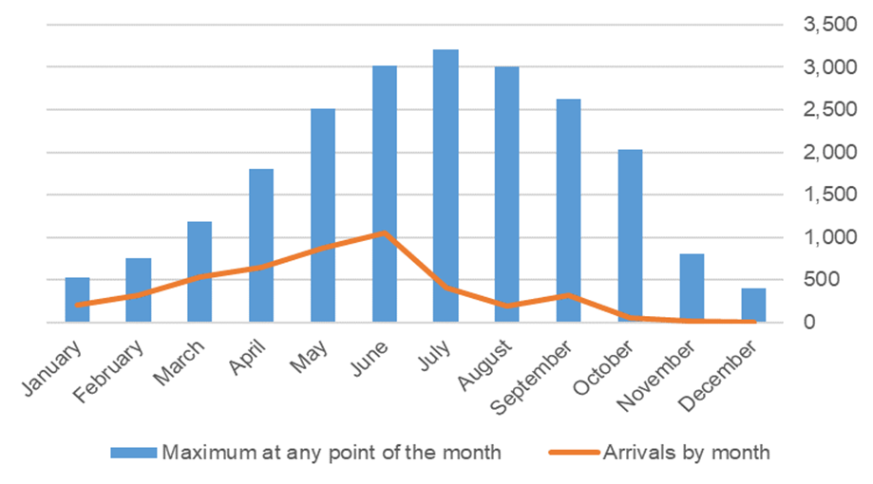
Key points
As a result of the pandemic and the need to better understand the seasonal workforce on farms in Herefordshire, this survey was carried out in March 2021 for the first time since 2014. Any farm intending to recruit temporary workers from overseas was invited to respond: as there is no definitive list 108 possible farms were contacted directly and it was also promoted openly by the NFU.
A total of 39 farms responded, including all the largest soft fruit growers in the county. 23 intended to recruit in 2021, and based on their responses:
4,500 seasonal workers from overseas are expected on Herefordshire farms over the course of 2021 with the majority (42%) arriving during May and June. Two-thirds are expected to be aged 25 to 44, and 59% male.
The peak numbers expected at any one time are around 3,000 during June, July and August, although at least 400 at any point in the year. 75% are expected to stay for between 3 and 6 months.
Reflecting the SAWS Pilot Scheme, two-thirds are still expected to come from Bulgaria and Romania. However, a higher number than previously are expected to come from outside the EU. Farms also intend to employ more British workers this year (~ 250).
The vast majority (95%) are expected to be accommodated on-site, with almost
all farms having a documented Covid-19 risk assessment.
Although 15 farms use an agency to recruit their workers, 8 of these also
directly recruit themselves, and another 7 don’t use an agency at all.
There were mixed feelings about last year, with difficulties caused by the
transition out of the EU as well as the pandemic, but also reflection on the
success of getting through such a difficult year.
15 farms have concerns about actually being able to recruit enough workers
this year, with reasons including the requirements placed on EU workers due
to Brexit e.g. having to have applied for ‘settled status’, the cost of travel,
and Covid restrictions / concerns.

Slide 4
About the farm survey
Context
  The reinstated annual farm survey which helps to fill the gaps in understanding of seasonal workforce in farms in Herefordshire. During the COVID pandemic it was felt that there was a lack of up to date information about Herefordshire’s seasonal workforce in terms of providing necessary support during an out break. Therefore, it was recommended that to reinstate the farm survey which provides most up to date information.
Questions were designed to find out
  best estimates of the numbers of seasonal workers from overseas* expected to be employed in 2021, including age, gender and nationality
  experiences in 2020, in the middle of the pandemic
  thoughts on the future, especially in relation to the impact of COVID-19 and with the recent and planned changes to the recruitment system following Britain’s exit from the EU.
Distribution and duration
  84 farms in the central database were invited to complete the online survey via email, 24 were sent a paper copy.
  promoted in National Farmers’ Union (NFU) monthly newsletter to all farms in Herefordshire
  survey was live from 2 March – 17 March 2021
  * Seasonal workers from overseas in this context mean foreign nationals who are employed on a temporary basis, probably over the growing season. These seasonal workers could arrive directly from abroad, or could already be in Herefordshire or elsewhere in the UK.

Slide 5
Best estimates for 2021

Slide 6
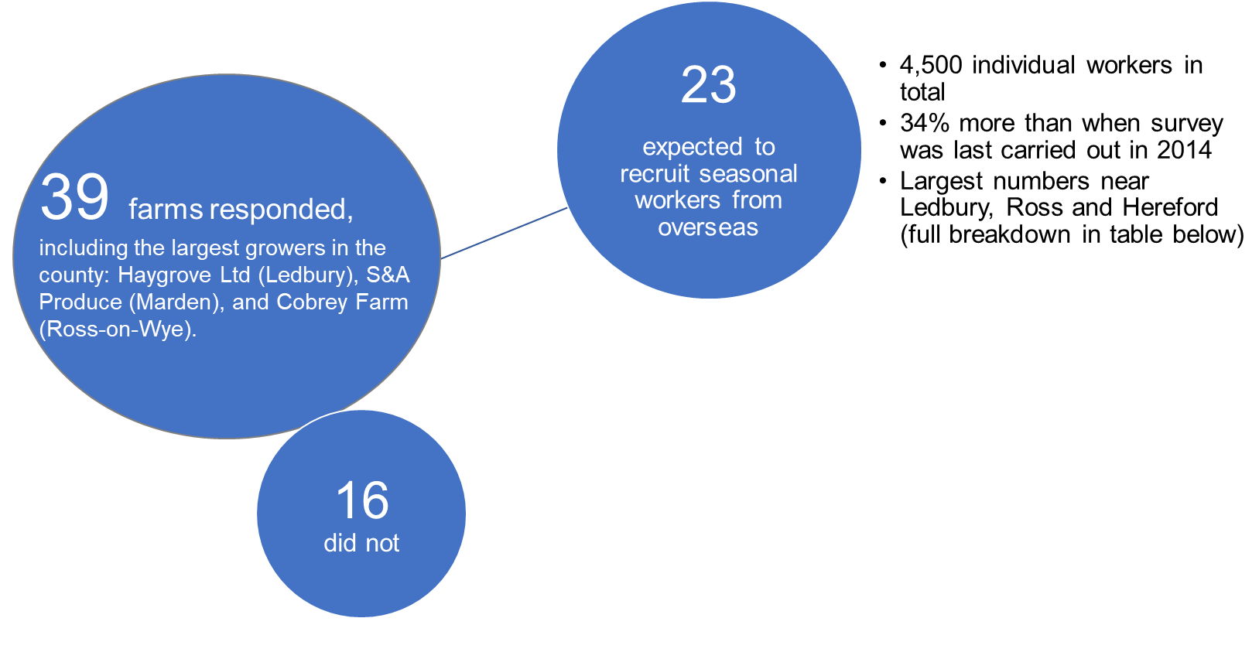
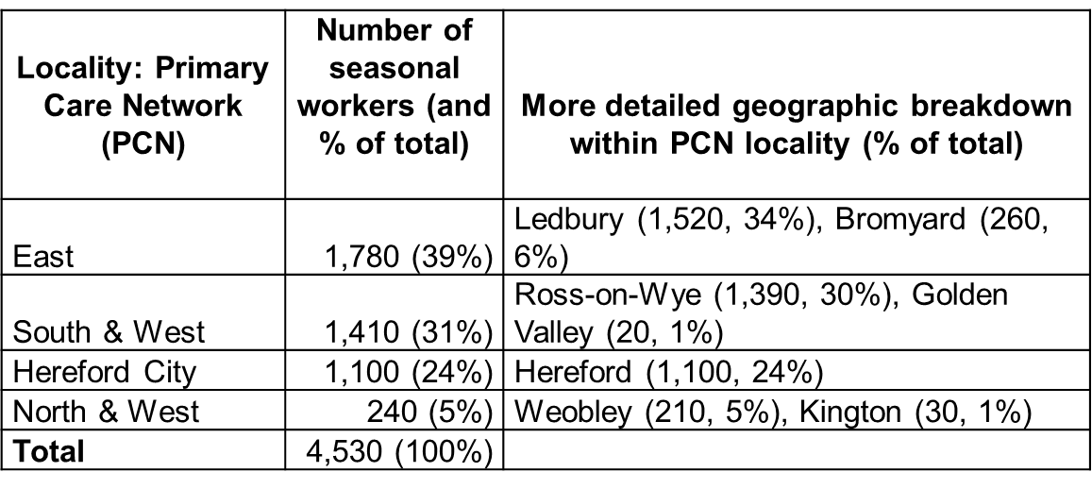
Total number of workers by locality

Slide 7
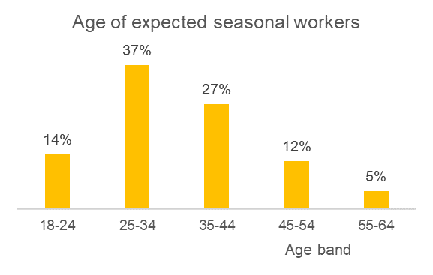
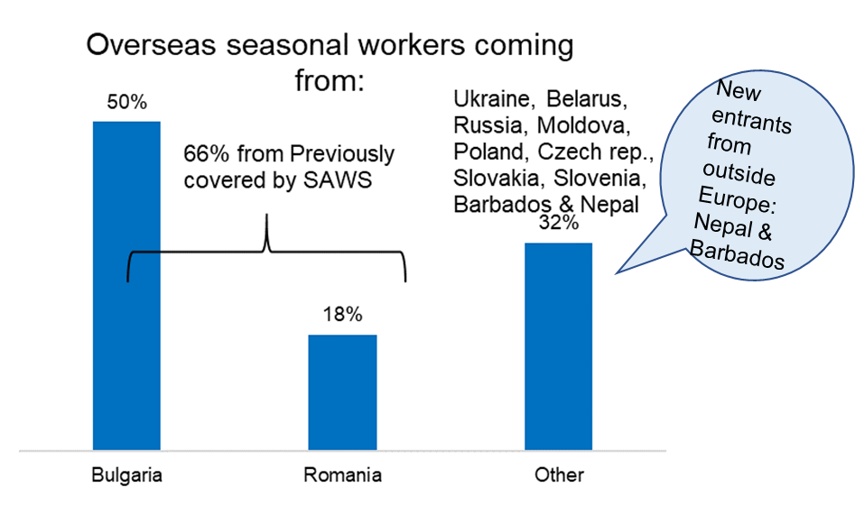
Characteristics of seasonal workers
As in previous years, the biggest proportions of workers are expected to be:
  men (59%)
  aged 25 to 44 (64%)
68% are expected from a country previously covered by Seasonal Agricultural Worker Scheme (SAWS); Bulgaria & Romania.
32% from other countries including Barbados & Nepal,
previously not recorded in Herefordshire.
Indication that higher numbers are expected from
Ukraine, Belarus, and Russia but exact numbers
not known yet.

Slide 8
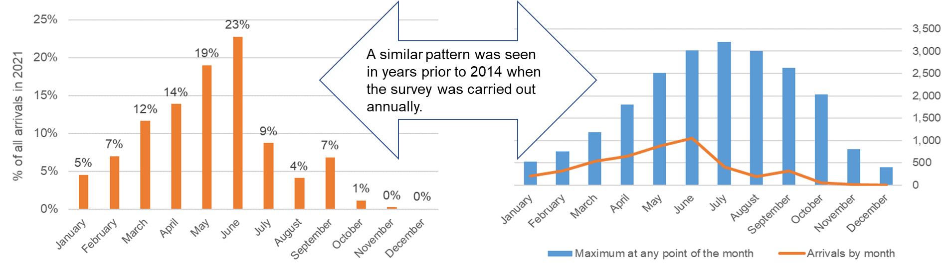
Seasonality
Arrivals
The highest number of arrivals expected to be in May (900) and June (1,100) - 19% & 23% of all arrivals expected in 2021.
80% of all arrivals expected to be in the first half of the year.
Maximum numbers
Peak numbers of arrivals are expected in June (3,000), July (3,200) & August (3,000),
although at least 400 seasonal workers are expected to be employed at any point of the month throughout the year.

Slide 9
Expected length of stay
According to 13 farms, 270 seasonal workers (6% of expected total) would already be living in UK, 35% already living in Herefordshire.
22 farms provided the length of stay of their 4,470 expected seasonal workers: 29% - less than 3 months, 46% - 3-6 months, 24% - 6-12 months and 1% - for more than 12 months.
Provision of accommodation
20 farms provide accommodation for their 4,140 seasonal workers either on-site (95%) or off-site (5%).
16 farms gave information about the type of off-site accommodation that seasonal workers will live in:
Caravans - 8 farms (1 farm also has bank houses)
Mobile homes - 4 farms
Privately rented houses - 3 farms (1 also has on-site accommodation)
Unknown – 1 farm
Number of workers sharing amenities including kitchen, bathroom and toilet in each on-site accommodation unit: the majority of farms (11) have on-site units shared by 4 workers, 4 farms each have units shared by 3 or 5 workers.

Slide 10

Method of recruitment
7 farms expected to recruit seasonal workers through an agency, another 7 farms expected to directly source their workforce while further 8 will use combination of methods - through an agency and direct recruitment. Those who expected to source seasonal workers through an agency (15 in total) will use a pilot operator too (7 farms).
That is 2,670 workers expected to recruit via Seasonal Worker Pilot Scheme which is extended for 2021.
The farms who expected to recruit through an agency will use one of the Seasonal Worker Pilot Operators: Concordia, Pro-Force or Fruitful Jobs.
Those who will not use a pilot operator will use other agencies such as: HOPS Labour Solutions, Agri HR, East Recruitment Admin Ltd, Opus, JSSINA or WWOOF.
19 farms said that they actively try and recruit workers who have worked for them before:
7 farms expected returnees to make up at least 50 per cent of their seasonal workforce.
47% (2,120) of total expected in 2021 may have worked in the country before.
British seasonal workers
21 farms expected to recruit British seasonal workers, among them approximately 250 British seasonal workers were expected over the course of 2021.
This is a marked increase compared to the numbers expected in previous years* (50 British seasonal workers in 2012, 10 in 2013 & 70 in 2014).
*Note: trend analysis can be affected by different farms responding each year and some farms not responding every year.

Slide 11

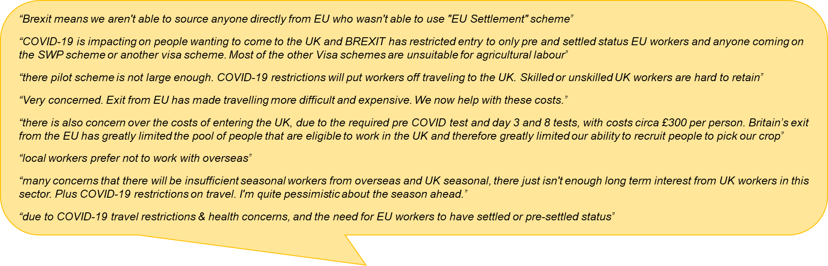
Concerns about recruitment in 2021
15 farms had concerns about being able to recruit enough seasonal workers this year, 14 of whom gave
reasons as due to:
COVID & Brexit (both) – 9 farms
Brexit – 3 farms
COVID – 1 farm
Other reasons (Strength of £/$, Benefit payments) - 1 farm

Slide 12
Last year’s experience and future years
Covid-19 & transition out of the EU

Slide 13
Numbers of workers last year and response to Covid-19
2020 – 22 farms employed seasonal workers
Last years numbers:
19 recruited as many as expected
2 recruited fewer than expected (due to “COVID-19 and Travel restrictions” or “Frosted crop”)
1 recruited more than expected
Response to COVID
Varied bubble sizes - 2, 3, 4, 6, 16 or 20
Bubble size varied according to accommodation or type of work, work requirements, season and demographics of the workers
Family groups in one bubble
2021 – 23 farms expected to employ seasonal workers
Of these, 2 farms had more seasonal workers than needed, so the situation was dealt with:
Reduced hours (1 farm)
Found them work (1 farm)
2022 & beyond
21 farms + …

Slide 14
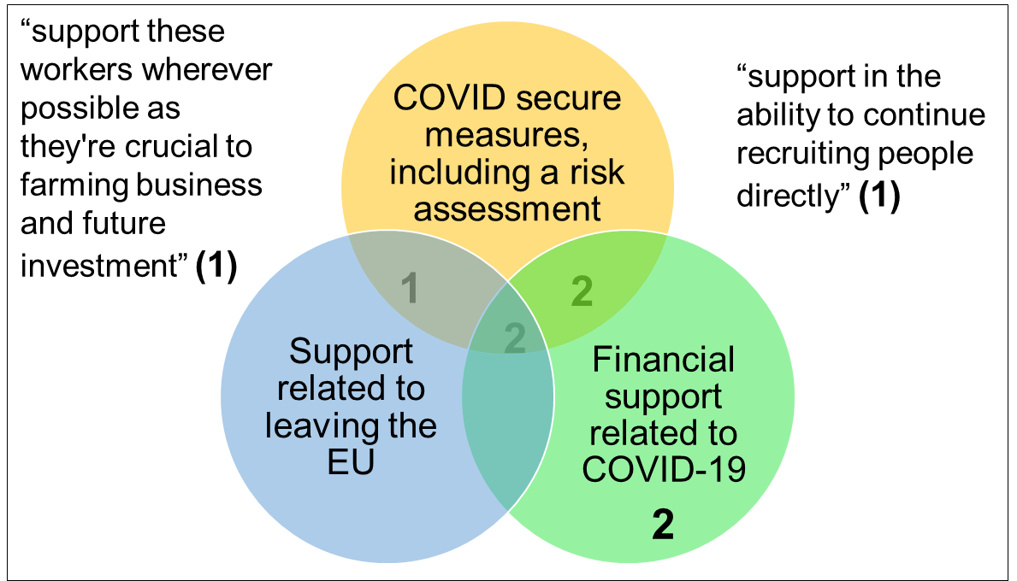
Support from Herefordshire Council
19 farms said they have a documented Covid-19 risk assessment. Two farms said they don’t, giving the reasons that they “do not provide accommodation” or “recruit less than 5 seasonal workers, of whom the majority are British”.
9 farms would like specific information and support from Herefordshire Council for:
(note - farms were able to chose more than
one answer)
NB. These questions were asked to find out
whether the council can do anything to improve
future communication and support for farms

Slide 15

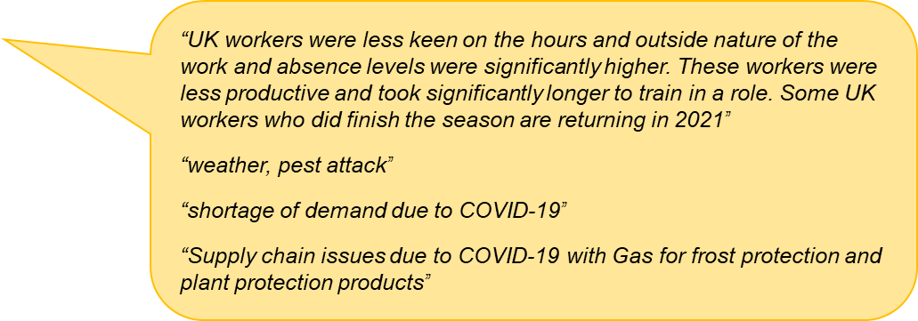
Difficulties faced in 2020
According to 15 farms, the difficulties that they faced in 2020 were:
(note - farms were able to select more than one answer)
Shortage of seasonal workers linked to COVID-19 - 11 farms
Loss of crops because of labour shortages - 7 farms
Shortage of seasonal workers linked to Brexit - 5 farms
Loss of crops for other reasons, e.g. weather - 3 farms
Outbreak of COVID-19 amongst workers living onsite - 1 farm
Other difficulties - 3 farms

Slide 16
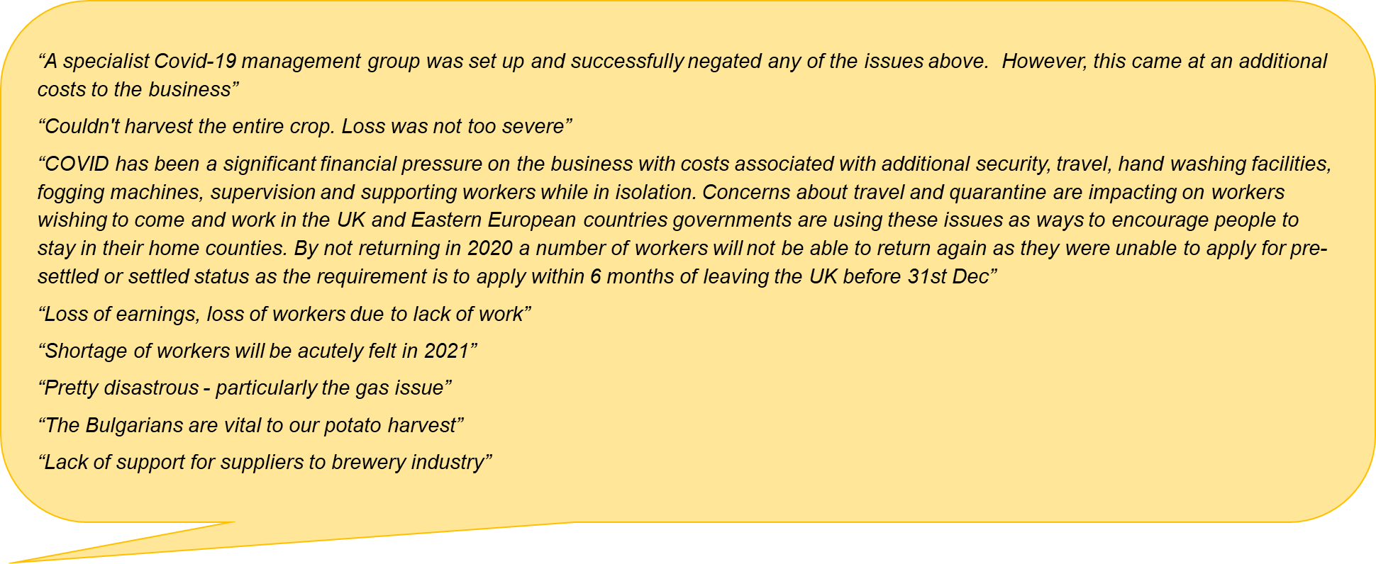
Impacts of the difficulties in 2020

Slide 17
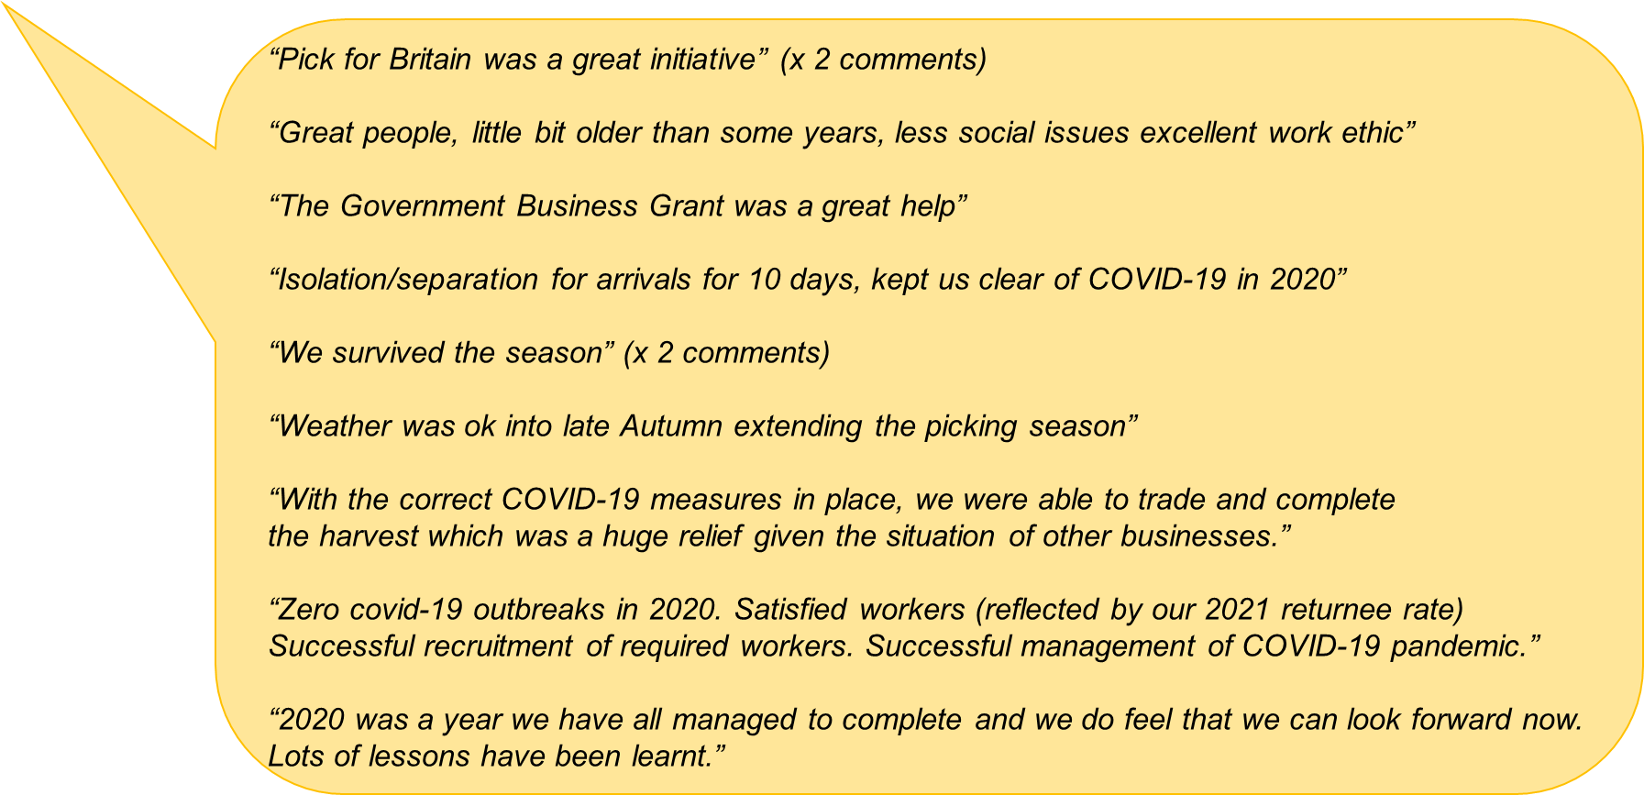

Positives in 2020

Slide 18

Considering future years
(i.e. 2022 and beyond)
Most of the farms planning to recruit in 2021 also expect to recruit in future years:
  Yes – 21 farms (all of whom expect seasonal workers in 2021)
  No – 10 farms (none of whom employed/expect seasonal workers in 2020/21)
  Don’t know – 5 farms (1 of whom expected seasonal workers in 2021)
Reasons why and what farms do instead of employing seasonal workers from overseas:
  Not required (mostly small business) - 3 farms
  Use locally sourced labour - 2 farms
  Require full time, skilled labour (unskilled seasonal labour is not suitable) - 2 farms
  SAWS scheme numbers look massively below what the industry needs - 1 farm

