Slide 1

Herefordshire's Joint Strategic Needs Assessment (JSNA):
Key Findings 2021
December 2021
v1.2

Slide 2

About / contents
This document presents the Key Findings of the 2021 JSNA for Herefordshire. It has been compiled by Herefordshire Council’s Intelligence Unit on behalf of the Health and Well-being Board, with contributions from colleagues across the One Herefordshire Partnership.
About the JSNA: purpose, form and structure of this 3-yearly summary
Overall key messages: common themes across all topics and main strengths and challenges
Inequalities and interconnectedness of vulnerabilities: including impacts of rurality and impacts of Covid-19
Section summaries: for environment, infrastructure, economy, community, protecting vulnerable people,
housing, financial security, getting a good start, lifestyles and health outcomes
Appendix: some of the detail behind the key findings
If you need help to understand this document, or would like it in another format or language, please contact us on 01432 261944 or e-mail researchteam@herefordshire.gov.uk

Slide 3
1. About the JSNA
Purpose and form of Herefordshire’s JSNA, and structure of the 2021 summary

Slide 4
The JSNA: everything about everything
Statutory purpose: inform priorities of Health and Well-being
Board, but should be accessible to all
Continuous assessment of current and future health,
care and well-being needs of the population
Wider determinants: the causes of the causes
People and places
Synonymous with Population Health Management:
data driven planning and delivery of proactive care to
achieve maximum impact
Highlight gaps and inequalities between different groups or communities - so this year includes particular attention to
impacts of Covid-19
Source: The health map,
Barton and Grant (2006)

Slide 5
Herefordshire’s JSNA
Understanding Herefordshire: people and place
Provide the basis for service planning and commissioning decisions for the system
Jigsaw of disparate evidence: JSNA is opportunity to bring it all together
Anyone making sense of any of this information is part of the JSNA
Live website publishing all JSNA outputs and evidence
Programme of place- and topic-based outputs
Summary of key findings (3 yearly)
Area profiles, eg. wards, localities, primary care networks (PCNs)
Demography
Deprivation
Economy
Environment
Inequalities
Housing
Regular intelligence bulletins
Corporate plan & delivery plan
Covid recovery plans
Health and well-being strategy
Integrated care strategy
PCN priorities
… etc…..
Social
care
Poverty
??
Education
Adults
Older
people
Lifestyles
Health
New resources / data: subscribe for updates
Children

Slide 6
JSNA and system priorities
These key findings summarise evidence of the main issues for Herefordshire, aiming to draw it together into a holistic picture of the county.
JSNAs provide a strategic overview to inform strategies, plans and priorities. They focus on the ‘causes of the causes’ of poor health and inequalities, which are the result of complex interactions and complex systems.
JSNAs are not intended to be tools to monitor progress against the many plans and strategies across systems, but should be used alongside such plans to provide the wider context.
The Public Health Outcomes Framework includes many indicators of health and well-being. Fingertips includes the latest data for these and a wide range of other profiles (including trends and comparisons).
Health and Well-being Board priorities:
the current picture
JSNAs play a particular role in informing HWBB strategies. Herefordshire’s HWBB published four priorities in late 2017.
Giving our children a good start in life by maintaining a healthy weight and looking after their teeth.
Levels of dental decay and excess weight haven’t changed.
See Getting a good start and Healthy lifestyles.
Supporting people with dementia to remain as independent as possible within their community, ensuring that people are well cared for when nearing the end of life.
Dementia diagnosis rates remain significantly below the national, and haven’t changed between 2017 and 2021. See Health services and prevention.
Supporting the development of resilient communities, where people help each other to remain independent and in control of their own lives. The 2021 Community Well-being Survey confirmed that there are high levels of community cohesion and support. See Community.
Keeping people warm so they are less likely to develop enduring health problems and become acutely ill when it is cold. Excess cold is not routinely measured, but in 2019 a higher proportion of Herefordshire homes were at risk than nationally. Fewer households were estimated to be in fuel poverty in 2018 (10,700) than 2015 (13,300); a new measure now suggests the figure was 13,900 in 2019 . See Housing.
In addition to the impact of COVID-19 pandemic, this JSNA covers a period of significant change for the health and social care system. Ways of working have been transformed due to COVID-19 and the establishment of the Herefordshire and Worcestershire Integrated Care System and the One Herefordshire Partnership.
The Health and Well-being Board published priorities in late 2017, and had started to review them as the pandemic began.
2022 will bring a statutory requirement for an Integrated Care Strategy, which will link with the Health and Well-being Strategy.

Slide 7
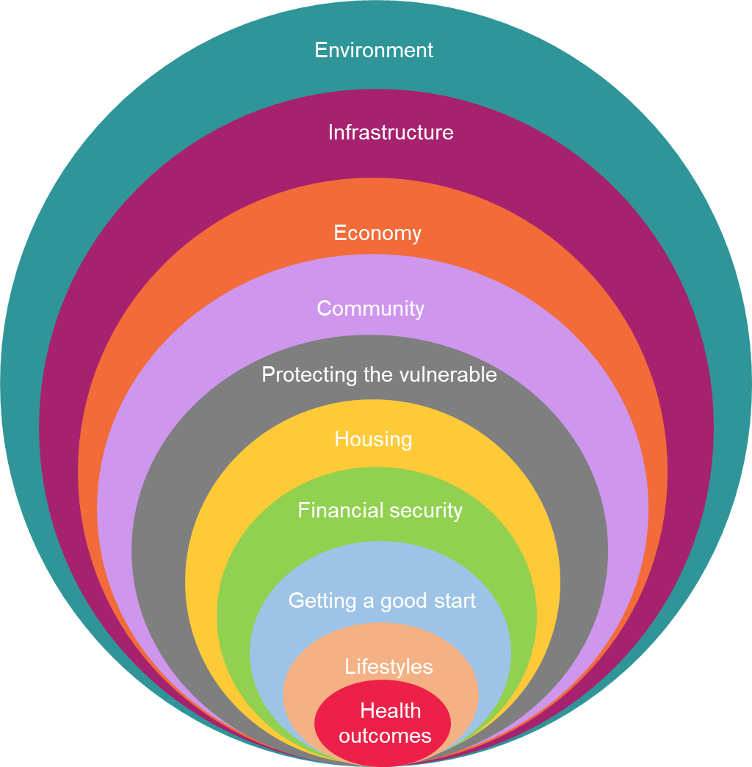
Structure of the 2021 JSNA summary
To emphasise the importance of the wider determinants on health and wellbeing, this summary:
starts at the macro level of the environment, infrastructure and the economy
moves on to community and individual circumstances like getting a good start in life, financial security and lifestyles
ends with the health outcomes that are influenced by all these factors.
Golden threads:
Inequalities
Impacts of Covid-19

Slide 8
2. Overall key messages

Slide 9




Common themes across all topics
Overall, Herefordshire is still a good place to live, with relatively low levels of poverty and deprivation, and the majority of people are happy
Covid-19 has impacted all aspects of life; increasing risks and worry for some, and widening pre-existing, deep-rooted inequalities
The headline figures mask some important minorities of people, who are at the biggest risk of poor outcomes
There are also some significant risks to consider for the future – including the baseline health of many people as well as the environment
Interconnections between risk factors and inter-generational factors

Slide 10





Key messages: place
Double edged sword of rurality: natural environment vs challenges of service delivery; ‘urban flight’ and boost to economy vs affordability
Threat of climate change and associated ecosystem breakdown
Strong, resilient and cohesive communities – but there are significant local variations, with people in the city less likely to feel this way
Areas of persistent deprivation in some urban areas and other hidden pockets
Nature of housing stock and its implications on affordability; condition in the private rented sector particularly in relation to excess cold; and fuel poverty

Slide 11


Key messages: economic & financial
Productivity per hours worked second lowest of all economic areas (NUTS / ITL level 3) in Britain. Economy dominated by small businesses, with an over-representation of employment in agriculture and manufacturing. Workplace-based earnings are consistently the lowest in the region and amongst the lowest in England and Wales (current average of £500 per week).
Signs of a strong recovery amongst businesses, but don’t yet know what the low take-up of support
has meant for the relatively high number of self-employed.
Skills gaps: nursing and social care in high demand, the latter hard-to-fill; as are a range of
skilled manufacturing jobs.
Jobs: fared relatively well during pandemic but areas that already had the highest unemployment worst hit. Older workers out-of-work or furloughed for 6 months+ can struggle to return to employment, for younger workers long-term impact on earnings & progression and quality of entry-level jobs.
Social mobility cold spot in terms of the chances that disadvantaged children will do well at school and go on to get a good job and secure housing. Driven by low wages, but there are also persistent gaps in educational attainment for these children – as well as for those with additional needs.
Financial security: Covid has widened gap between rich and poor; unclear how many ‘just about managing’ families might fall into poverty in near future; more people seeking advice on problem debt.
Homelessness: still small numbers, but increasing numbers of families; impact of end of eviction ban unclear.
NB. Note amendment from previous version to clarify wording around earnings and productivity

Slide 12





Key messages: people
Continuing implications of an ageing population, many of whom are living longer but not necessarily in good health.
Digital divide: acceleration of digitisation due to COVID-19 risks leaving behind the c.17,000 people who don’t use
the internet regularly; impacts on isolation, access to services, educational and employment opportunities.
Loneliness and isolation: increasingly affecting younger people; more likely amongst disadvantaged groups.
Mental well-being is generally good, but Covid increased anxiety for substantial minorities (adults and children). Disproportionate risk amongst social renters, women and teenage girls, financially insecure, disabled people.
Lifestyles: some positive news on smoking, but it remains a significant cause of disease - along with obesity, oral health, alcohol consumption and physical inactivity. Lockdowns had significant impacts on those most at risk of substance misuse.
Male total and healthy life expectancy is no longer better than average, and health inequalities persist. Males born
in the most deprived areas can expect to live 6.3 years less than those in the least deprived; females 4.0 years less.
Impact of people whose diagnosis/treatment was delayed during the pandemic now being in need of more
urgent care, particularly for cancer and other long-term conditions. Both on their quality of life and for services.
Interconnections between risks to both physical and mental well-being (generational, adverse childhood experiences (ACEs), substance misuse, exploitation, crime, financial insecurity): ~150 people with multiple complex vulnerabilities are most at risk.
NB. Note correction from previous version which incorrectly quoted higher figures for inequality in life expectancy

Slide 13
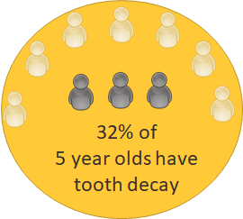
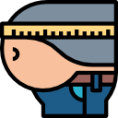
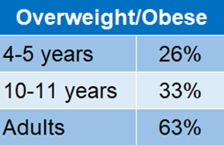
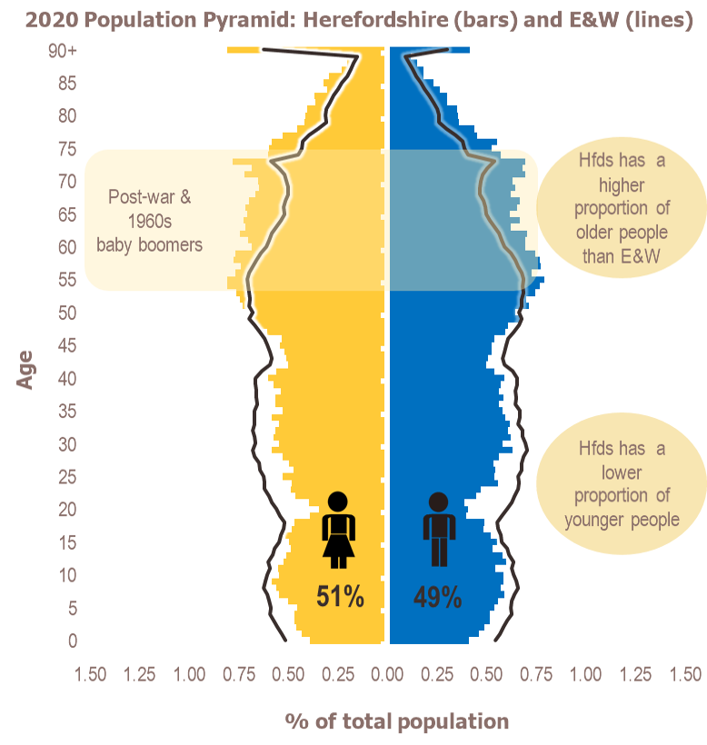
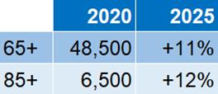
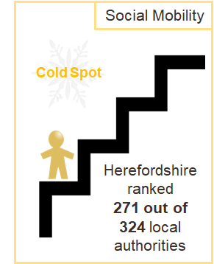



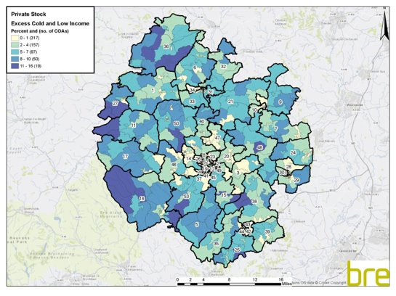


Fundamentals about Herefordshire
An ageing population
1 in 3 jobs pay less than the living wage
Small population in large rural county
193,600 residents scattered over 842 sq miles
4th lowest density in England
95% rural; 9% designated for
nature conservation
2 AONBs; 8 designated Local
Nature Reserves (256Ha)
Relatively low productivity
2nd worst housing affordability in West Mids in 2020 (after Solihull).
High proportion of detached houses (40% vs 23% across England)
Many were built pre-1900
(39% vs 8% nationally)
Private housing: significantly worse than England for excess cold (19% vs 4%)
Fuel Poverty:
17% (14,000) of households in 2019 (higher than England's 13%)​ on new 'low income, low energy efficiency' measure
Rural households more at risk of combination of excess cold and low income​

Slide 14

Gaps in the evidence base: recommendations
Based on the analysis to inform the 2021 JSNA summary, it is recommended that priorities for theme-based analysis for 2022/23 are:
  continued assessment of the longer-term impacts of the Covid-19 pandemic on the health and well-being of Herefordshire’s people and place
  system-wide understanding of need and demand for mental health services in the county
  research into the drivers of Herefordshire’s low economic productivity
  research to understand the drivers of the observed fall in overall life expectancy and healthy life expectancy amongst males in Herefordshire, so that we are no longer significantly better than the average for England as a whole.
Also to continue strengthening the evidence base by considering how to:
  bring together partners’ insights about vulnerabilities, safeguarding and community safety
  measure the impact of environmental changes on people’s well-being locally
  gain a more complete understanding of what poverty and financial insecurity look like in Herefordshire

Slide 15
3. Inequalities and interconnectedness of vulnerabilities
Golden threads running throughout all topics

Slide 16
Inequalities in Herefordshire
Take-up of COVID-19 vaccination is lower amongst the 30% most deprived areas
Based on
national patterns, it is expected that those living in the most deprived areas are more likely to be overweight, to smoke and to be admitted to hospital due to alcohol consumption
People living in the
most deprived areas are 1.25 times more likely to die prematurely of cancer, 1.3 times more likely to die of heart disease or stroke and twice as likely to die of respiratory disease
Emotional well-being and resilience appears lower for some, including disadvantaged children, those living with one parent, young carers
Pupils who live with one parent are less likely to have been to a dentist in the last year, or to clean their teeth at least twice a day
Males born in the 10% most deprived areas of Hfds can expect to live 6.3 fewer years than those in the least deprived; for females the gap is 4.0 years
Children and young people
Health
Over 65s are almost 3 times as likely as <65s to provide 50+ hours’ unpaid care to family/friends a week. Many unpaid carers don’t have enough: time to do things they enjoy, control over their lives, social contact, encouragement &
support.
4,450 under 16s
are living in absolute poverty. Highest rates (>25%) in parts of Hereford, Leominster and Ross
INEQUALITIES IN HEREFORDSHIRE 2021
Life expectancy measures for males are no longer significantly better than the English average (whilst they still are for females)
Persistent gaps in educational attainment for disadvantaged children, and for those with EHCP/SEND
People accessing mental health services or who have learning disabilities are much less likely to be in employment than others
Women and people living in the most deprived areas are less likely to feel safe in their local area after
dark
Older people
Over 75s, people who are economically inactive, people in housing association rented accommodation are significantly less likely to use the internet
regularly
Employment
Community
Older people living in the most deprived areas are three times as likely to be living in income deprivation as those in the least deprived
Out-of-work
benefit claimants increased the most during the pandemic in areas with already high numbers
Women’s average earnings are 4% lower than men’s – a smaller gap compared to the West Midlands region (10%) and England (9%)
There is no significant difference in the rate of emergency admissions due to falls amongst the over 65s between the most and
least deprived areas
People living in rented accommodation are more likely to report struggling financially during COVID
Note correction to health inequalities figures from previous version

Slide 17
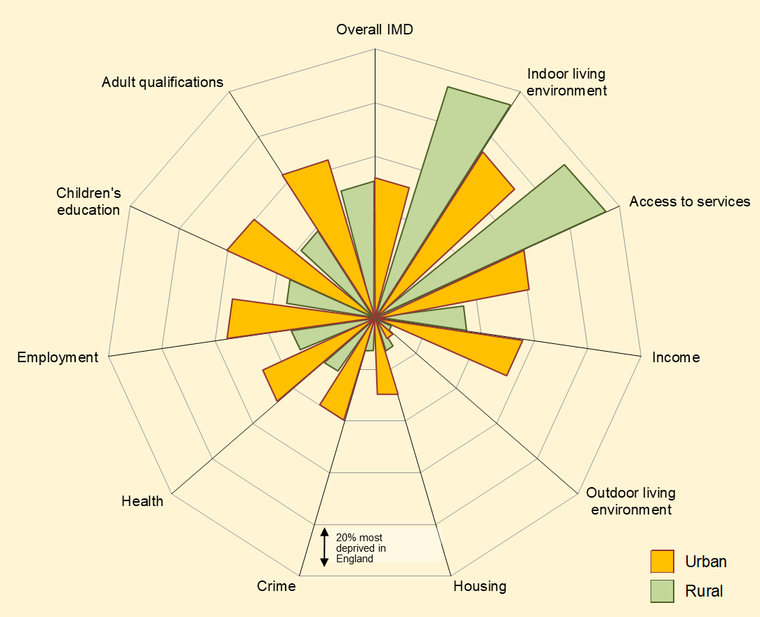

Types of deprivation affecting rural Herefordshire are very different to urban
The impact of rurality
4th most sparsely populated county in England; 95% of land area is ‘rural’ and over ½ live in rural areas
Better health and longer life expectancy on average, but hidden pockets of multiple deprivation
Some health problems and domestic violence are under-reported in rural communities
Deprived rural households can face different challenges to urban
Geographical barriers can exacerbate inequalities, eg. transport costs, digital exclusion
Living costs 10-20% higher for rural households, so thresholds for poverty might be different
Find out more: Rural Herefordshire – what does it mean for health and well-being?

Slide 18
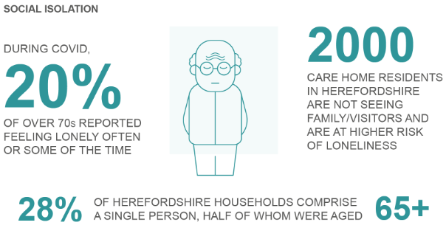
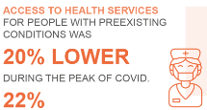
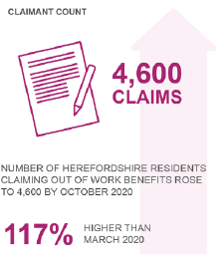
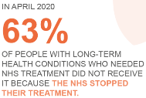
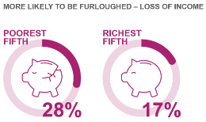
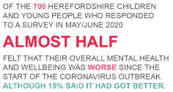
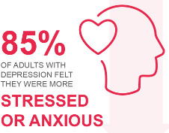
Widening inequalities due to COVID-19 pandemic
“We are all in the same storm, but not in the same boat”*
These statistics from late 2020 (some of which are now out of date) illustrate the disproportionate effect the pandemic had on already vulnerable groups
Poorest people: hardest hit by economic impacts
Loneliness & isolation
Pre-existing conditions
Mental well-being
Find out more in the Director of Public Health Report 2020: Impacts of Covid-19, and in our monthly Economic Impacts of Coronavirus updates
*Quote: Mental Health Foundation

Slide 19
Interconnected & compounding vulnerabilities
Many of the risk factors to wellbeing are linked to each other, and experiencing some can lead to others – compounding their effects.
Not only can early preventative action to address these multiple complex vulnerabilities improve people’s lives, it also has clear cost benefits in terms of changing their trajectory before they require intensive interventions across many services.
Estimates suggest annual cost across statutory services in the region of:
£14,000 for someone who is homeless or rough sleeping with no additional needs
£39,000 for someone who is homeless with complex entrenched needs (mental health, health and offending).
Multiple complex vulnerabilities
= high risk of premature death
Insecure, low-paid work
Mental ill-health
Substance & alcohol misuse
Offending
Poverty – food, fuel, struggling to make needs meet
Obesity & poor diet
Poor dental health
Unemployed
Problem debt
Homeless
Exploitation
Problem gambling
No qualifications
Low physical activity
Domestic abuse
Care leaver
Rough sleepers & sofa surfers
People with learning difficulties
Children experiencing neglect
Self-neglect and hoarding
Regular emergency services contact
Supported by Families First programme
Common risk factors
Project BRAVE* individuals of concern
* Project BRAVE: a multi-agency response to meet the ‘Everyone In’ lockdown requirement, which has since expanded its strategic ambition to ‘’make rough sleeping rare, infrequent and non-reoccurring’’.

Slide 20
5. Section summaries

Slide 21
Sections
Environment
Infrastructure
Economy
Community
Protecting the vulnerable
Housing
Financial security
Getting a good start
Lifestyles
Health outcomes

Slide 22


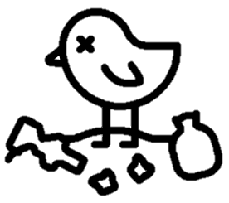
Environment
Rich, varied and supports a wealth of healthy outdoor activities and interests.
An important protective factor for health and wellbeing.
In 2021, 92% of people satisfied with their local area as a place to live, and significant increase since 2012 in those who are very satisfied
(from 35% to 61%).
In 2018, pre-covid, 78% of people said they’d visited a natural heritage place (park or garden) in the past year and 63% visited ‘every few months.’ 60% spent time outdoors daily (excluding shopping trips/chores or time spent in their garden) with middle-aged people spending more time outdoors than younger people.
Herefordshire fares relatively well in terms of access to green space but access to woodland is lower than nationally, and there are some variations in terms of access to the recommended equivalent of two football pitches within 10 minutes’ walk.
In 2021, 8% of people said parks and open spaces are the aspect of their local areas that most needed improving (the fourth highest proportion but nowhere near the 46% that cited roads and pavements) and only 2% (the joint lowest) say access to nature.
Generally relatively low levels of air pollution but still two air quality management areas where levels of nitrogen oxide are higher than government standards (a section of the A49(T) corridor in Hereford and the A44/B4361 around Bargates, Leominster).
But these positives are being undermined by multiple risk factors:
  Climate change will mean more extreme weather events with consequent threat to lives and livelihoods.
  Here as elsewhere, intensive agriculture and development has over many decades degraded or destroyed habitats and led to a loss of biodiversity.
  Phosphate pollution currently poses a severe threat to the county’s river ecosystems and is delaying much-needed development. However, innovative wetland solutions are being developed to try to alleviate this problem.
  Fly-tipping increased during the pandemic and has yet to fall to pre-COVID levels. Ever-increasing plastic pollution threatens water quality and wildlife.

Slide 23



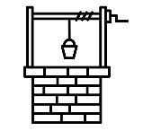




Infrastructure
  Herefordshire is one of England’s most sparsely populated counties, road infrastructure mainly comprises minor roads with only the south-east directly connected to the motorway network.
  Limited public transport options – large areas no longer served by the rail network and bus travel does not offer a viable alternative to private cars in isolated rural areas. Bus usage took a big hit during COVID and has yet to recover. Majority of residents who travel to get to work do so by driving themselves in a car or a van (70%).
  Unsurprisingly, transport is the biggest source of carbon emissions in the county accounting for 36% of total emissions.
  The state of the roads is consistently the thing residents are least satisfied with (46% of people rated it most in need of improvement in the Community Well-being Survey 2021, and frequently cited in Budget consultations).
  A lower proportion of houses in Herefordshire are connected to main gas than nationally (69% compared to 87%), with implications for heating costs, cold homes and fuel poverty (see Housing).
  Over 2.000 households with private water supplies and not connected to mains sewers.
  Historically access to high-speed broadband has been an issue but this is improving with coverage now over 90%. There is no dataset on mobile data coverage.
    These challenges have implications in terms of living costs, access to services, education and employment. Low-income households living in isolated rural areas are disproportionately affected: almost two thirds of all Herefordshire LSOAs are among the 25% most deprived in England in respect to geographical barriers to services. They act as a constraint to both social mobility and business investment (with consequent implications for productivity and growth). Reducing carbon emissions from transport has additional challenges in rural areas.

Slide 24





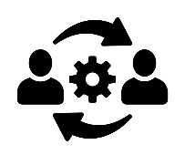

Economy
    Higher proportion self-employed than nationally (17% vs 10%*). 98% of enterprises comprise micro (0-9 employees) and small businesses (10-49 employees)
    Slightly lower proportion of workforce qualified to NVQ4 and above than nationally (41% vs 43%* - although the size of the gap between these annual survey-based estimates fluctuates). Consistently high demand for nursing skills and some evidence of hard-to-fill vacancies in personal care services and some skilled manual occupations where it may reflect a skills gap.
    Lower unemployment rate than nationally (3.5% vs 4.9%*). The claimant count for out-of-work benefits more than doubled during the first COVID-19 wave but has since fallen though remains 55% above pre-pandemic levels (October 2021). Broadly, areas that had the highest numbers pre-pandemic saw the largest increases.
    Much higher proportion of employments in agriculture, forestry & fishing (12% vs 1%^) and manufacturing (13% vs 8%^) and lower proportion in professional, scientific & technical (5% vs 9%^) than nationally
    Lowest median workplace-based earnings of all 14 West Midlands authorities since 2012, and consistently ranked as amongst the lowest in England and Wales (14th out of 111 top-tier authorities in 2021 provisional figures). For the last three years (2019-21), estimated average earnings of people working in Herefordshire have been around £500 per week.
    Second lowest productivity (GVA per hours worked measure) of any NUTS 3** sub-region of Great Britain
    National evidence suggests older workers furloughed or unemployed for 6 months or more finding it hardest to re-enter the labour market.
    * Great Britain ^ England **The NUTS classification (Nomenclature of territorial units for statistics) is a hierarchical system for dividing up the economic territory of the EU and the UK
Find out more: Economic bulletins produced monthly during 2020 and 2021

Slide 25


Community
Living in a strong, diverse and cohesive community can provide a sense of identity, purpose and belonging. Strong local support networks can help prolong independent living. Conversely, areas with little sense of community, a lack of integration between different groups, or high levels of crime and anti-social behaviour, present significant risks to health and wellbeing.
Satisfaction with local area
9 in 10 people are satisfied with their local area as a place to live.
Satisfaction is significantly lower among -
people living in the most deprived areas
younger people
those who have lived in the county for less than 10 years
Sense of belonging
9 in 10 people say they belong to their local area strongly and there has been a marked positive improvement in attitudes since 2012.
Sense of belonging is lower in Hereford City among deprived households and among those who have lived in Herefordshire for less than 10 years.
Community support
4 in 5 people felt that their community had supported each other during the last year (in the period covering the February 2020 floods and the first twelve months of the COVID pandemic).
4 in 5 people also agree that if they needed help during the pandemic, there would be people in their community who would be there for them.
Community safety - Herefordshire is a relatively safe place to live and people generally feel safe living here.
4 in 5 people say they feel safe outside in their local area after dark, a significant improvement since 2012.
Feelings of safety are markedly lower among -
people who live in the most deprived areas
people who live in areas defined as ‘City and Town’
younger people
females
those who rent their property
those who do not feel a strong sense of belonging to their area
Diversity
9 in 10 people believe that their local area is a place where people of different backgrounds get on well together (much higher than the 69% who did in 2012).
Find out more: Talk Community Wellbeing Survey 2021

Slide 26
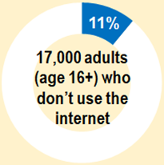
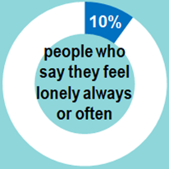
Connecting with others
Social isolation and loneliness
Involuntary social isolation and loneliness have a range of negative impacts on well-being. Older people in particular are often linked to living alone. Mental ill-health is a risk factor for loneliness and is more likely to affect people who are lonely.
Highest levels of loneliness:
People living in most deprived areas (22%)
housing association renters (20%)
non-White British (19%)
in poor current health (21%)
16,600 (14%) of households were occupied by a single person aged 65 or over in 2017 (compared with 12% & 13% in England and the W. Mids respectively). Numbers are expected to increase to 24,300 by 2035.
28% of people talk to family and friends less than before the COVID-19 pandemic. Reduced contact much more likely for people living in the most deprived areas (45%) or in social rented accommodation (41%); with a disability (33%); with low mental wellbeing levels (54%); who have felt lonely often/sometimes in the last year (40%).
27% of people talk to neighbours less than before the COVID-19 pandemic.
Digital divide
Having access to, and being confident using, the internet is increasingly important for accessing services, education and employment. Being digitally excluded is a risk factor for mental wellbeing.
Main reasons for adults not using the internet: don’t feel they need to use it or lack the necessary skills. Latter is highest among people:
aged 65+ (33%)
living in most deprived areas (71%)
with a disability or long-term health condition (40%)
In 2019, 52% of Telecare service users didn’t use the internet and 37% of them do not want to use it.
COVID has accelerated the pre-existing trend toward greater reliance upon digital communication and services and locally the majority (69%) of people had made greater use of the internet during the past 12 months.
A significant minority of 22% feel concerned about the fact that more things are being provided online. Concern is higher among respondents who do not regularly access the internet (38%), among those 65+ (28%), among the economically inactive (26%), and among the retired (28%).
Around 300 children in Herefordshire live in households where no home broadband above 2mbps is available at the premises and around 1,800 where there is no internet above 10mbps.
Find out more: most of the statistics on this slide are from the Talk Community Wellbeing Survey 2021

Slide 27



Caring for vulnerable adults
Herefordshire Council supports around 750 people to meet their assessed eligible social care needs in a care home. This is around a third of the total Herefordshire care home capacity; the remaining placements are used by self-funders, the NHS, other local authorities, or are vacant.
The need for care home beds for those aged 65 and over is projected to increase by around 70% over the next 20-years (in the absence of changes to eligibility criteria or other policies that would affect future trends).
Herefordshire Council currently commissions just under 10,000 hours of home care per week from providers to support around 700 customers at any one time. This is around 60% of the total market in Herefordshire.
The need for home care provision for those aged 65 and over is projected to increase by around 70% over the next 20-years (in the absence of changes to eligibility criteria or other policies that would affect future trends).
Find out more: Herefordshire Market Position Statement 2020-2025
2,200 adults
are supported by Adult Social Care (ASC) services*
* Average number of adults aged 18 & over accessing long-term support from ASC at any one time during 2020-21.
Social care workforce
Herefordshire experiences workforce issues in relation to recruitment & retention, particularly in the home care service.
Unpaid carers
In the more recent 2021 Community Wellbeing Survey, 23% of people indicated they provide unpaid care.
Armed forces community
Herefordshire’s Armed Forces community make an outstanding contribution to society with the majority of service personnel settled with their families, or as veterans having adapted well to civilian life.
A minority of veterans have issues with mental health, housing, employment and training, and interactions with the criminal justice system.
A great deal of work has been done by the Armed Forces Covenant and local authorities to ensure those who serve or who have served in the Armed Forces, and their families, are treated fairly.
Find out more: Armed forces community needs assessment 2019
6,300 jobs
in adult social care
21,000 people (11%)
providing at least an hour of unpaid care a week (Census 2011)

Slide 28

Safeguarding the most vulnerable
Throughout the JSNA, we highlight the interconnections between many of the risks to both physical and mental well-being: generational, adverse childhood experiences (ACEs), substance misuse, exploitation, crime, financial insecurity. These multiple complex vulnerabilities (MCVs) increase the risk of leading chaotic lifestyles and dying prematurely.
Although few in number, people with MCVs consume a disproportionately high amount of resources across multiple services. At the start of the pandemic around 150 individuals with MCVs were identified by strategic partners, many of whom will have had at least one adverse childhood experience.
Rough sleepers are one of the groups most likely to have MCVs, and have a shorter life expectancy. They were an early focus for Project BRAVE, which was initially set up to meet the government requirement of ‘Everyone In’ at the start of the first lockdown, when 200 people were provided with emergency accommodation at fifteen sites across Herefordshire. Its strategic ambition has since expanded to ‘’to make rough sleeping rare, infrequent and non-reoccurring’’.
Referrals to Herefordshire Adult Safeguarding are currently 25% higher than they were a year ago, believed to be partly due to increasing need due to COVID-19 and partly to increased awareness.
A Complex Adult Referrals Matrix approach can contribute to positive outcomes for adults and greatly aids meaningful communication between services; over the last six months there has been a clear uptake in the use of CARMS by services.
There is scope for further intelligence sharing across agencies to provide a more holistic understanding of the key vulnerabilities that lead to these complex cases.
Domestic abuse
An estimated 4,900 women and 2,400 men aged 16-74 were victims of domestic abuse (DA) in Herefordshire during the year to March 2020.
Domestic abuse offences have been increasing steadily over the last 3 years, and in 2020/21 there were almost 2,200 offences recorded in Herefordshire by the police.
Victims of DA are more likely to be younger and that prevalence rates largely decreases through the age groups.
The majority of DA is between partners, with 4% of adults having experienced this type of abuse, and 1.9% of adults experiencing abuse from family members. Women are also most likely to be victims of all types of DA, although the difference in prevalence between men and women suffering family abuse is much smaller than the difference in prevalence between men and women suffering partner abuse.
There were reports in national media that COVID-19 restrictions led to a large increase in domestic abuse, but local data does not suggest this has been the case in Herefordshire.
7.3% of women and 3.6% of men aged 16-74 estimated victims

Slide 29

Housing in Herefordshire
During 2020, around 1,100 households were eligible for prevention from homelessness or homeless relief
Affordability
Average house price rose by 15% in year to Sept 2021, to £279,500.
Consistently one of the worst areas of the West Midlands for housing affordability (2nd worst in 2020)
Stock
High proportion of detached houses (40%) compared to England (23%)
Many (39% vs 8% nationally) were built pre-1900
Mains gas: 69% of properties compared to 87% nationally
Housing delivery had not reached Core Strategy targets over the three years prior to 2020, with the delivery of just 80% of the target. However, last year saw an improved delivery rate of 106%
Fuel poverty
17% (14,000) of households in 2019 (higher than England's 13%) on 2021's new 'low income, low energy efficiency' measure.
Under the old 'low income, high cost' measure the last estimate was 13% (10,700) in 2018, compared to England's 10%. Lower than the 17% in 2015, although estimates fluctuated since 2011.
Condition (2019 Housing Stock Modelling, BRE)
Twice as many Herefordshire dwellings as nationally rated as having a serious hazard (category 1): 25% compared to 12% for England. Difference largely due to excess cold (17% compared to 3% for England), which was more likely to affect owner occupied dwellings (20%) than private rented (16%) or social rented (4%). 20,600 county dwellings had at least one serious hazard; 14,300 of which had an excess cold hazard.
Fall hazards affected a slightly higher proportion of dwellings than nationally (9% compared to 7%), with owner occupied (10%) and private rented (11%) dwellings more likely to be affected than social rented (6%)
A substantial proportion (24%) of private sector dwellings (i.e. not social rented) had a low energy efficiency rating (Energy Performance Certificate below band E). Recent legislation (2020) means that the 21% of private rented dwellings this applies to should no longer be let to tenants, unless landlords have a valid exemption.

Slide 30
Financial security
Nationally the gap between the most and least well-off households has widened and there is widespread concern about combined impact of the end of the Universal Credit uplift, rising inflation (especially in energy, food and fuel prices), and the end of the ban on bailiff-enforced evictions on struggling families, especially those where no one is in work.
The local picture
Herefordshire has historically had a low-wage economy with an above average proportion of elementary occupations.
Pre-COVID (2019), around 18,500 people living in income deprivation across Herefordshire (10% of the population). More than half (57%) of these in urban areas of the country.
Historically, Herefordshire has had relatively low levels of both absolute and relative poverty [see next slide] compared to nationally but there is an increasing trend (in line with the national picture) for numbers living in relative poverty.
In the first quarter of 2021 14% of households in Herefordshire said they were finding it difficult to pay for their basic living needs (CWS, 2021).
At the same time, 5% of people said they always or often cut back on the use of their heating and 4% always or often skipped meals or ate less (CWS, 2021).
Anecdotal evidence from local foodbanks is that more people were supported during 2020; Hereford Food Bank saw a marked spike in food distribution in April and May of 2020, falling away during the summer before rising again the autumn.
Find out more: Economic impact of coronavirus bulletins produced monthly during 2020 and 2021

Slide 31
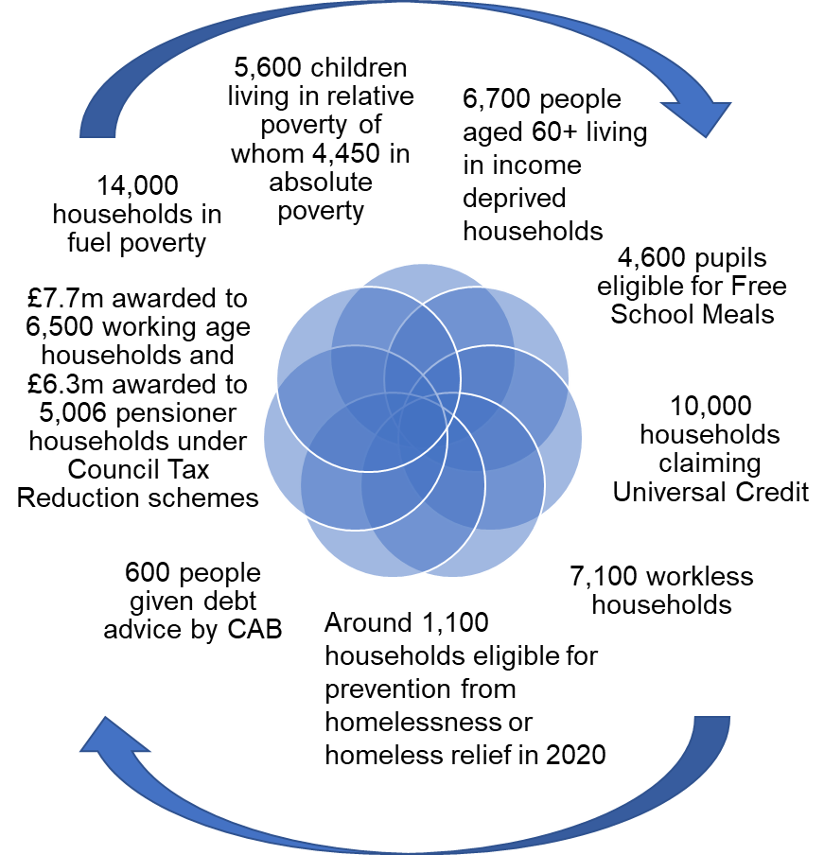
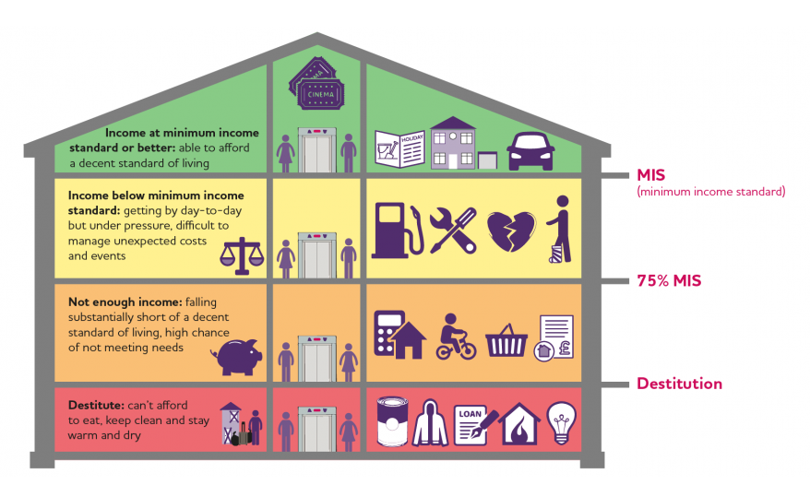
What does poverty look like in Herefordshire?
Being in relative poverty is officially defined as having an income of less than 60% of the average (median) household income. Absolute poverty is where someone lives in a household with an income that is below a level that was the relative low-income threshold in 2010/11 adjusted for inflation. However, the Joseph Rowntree Foundation and others are campaigning for a Minimum Income Standard that would raise many low-income households out of poverty and mean they could afford to buy more necessities.
There are many individual indicators of financial insecurity in Herefordshire, but it’s not currently possible to determine how they relate to each other – which means we don’t have a clear picture of those people who are ‘just about managing’
Image credit: the three levels of poverty, Joseph Rowntree Foundation

Slide 32
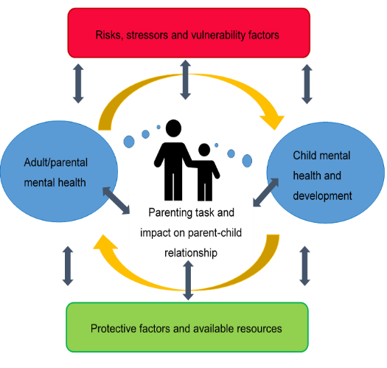
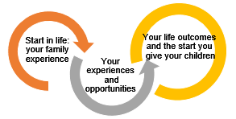
Getting a good start: children and young people (CYP) where our understanding comes from
Core themes from 2018 Children’s integrated needs assessment (ChINA):
importance of mental well-being for both children and their families, from its power in coping with adversity to the risks of poor parental mental health
need for a family-centred preventative approach to tackle issues affecting life chances
The views of England’s children and young people in 2021: the Big Ask survey
Quotes from The Children’s Commissioner
The 2021 Herefordshire Children and Young People’s Quality of Life survey:
Filled gaps identified by the ChINA (eg community and emotional well-being)
Gave some insight into impacts of Covid-19
Provides a post-covid baseline
Emerging from the pandemic:
“If adults are to learn one thing from this report, it should be as follows. This is not a ‘snowflake generation.’ It is a heroic generation.”
Focusing on inequality:
“Across age, gender, ethnicity, family income levels, location, vulnerable groups, what children want is remarkably consistent: a good home life, a good education, a job, enough money, friends, to feel well, to be treated fairly and to look after the environment. In short – to do well and create a better world.”
These are the interconnections highlighted throughout this JSNA, so this section links to many others (eg economy, financial security, lifestyles, mental health and wellbeing)
Key findings about Herefordshire’s children and young people in 2021 are summarised on the
next slide
Adapted from Social Care Institute of Excellence

Slide 33

Getting a good start: children and young people in 2021
Health and well-being
Few underweight babies, increasing rates of breastfeeding at 6-8 weeks,
and falling teenage pregnancies. But smoking at delivery is high, falling vaccinations of
2 year-olds and rising A&E attendances for <5s.
Obesity doubles between ages 4-5 (10%) and 10-11 (20%), and one in three 5 year-olds have dental decay (see Healthy lifestyles).
Healthy eating: only a fifth had 5+ portions of fruit and veg ‘yesterday’; falls with age
although older pupils less likely to eat crisps, sweets and chocolate ‘most days’.
By the last year of primary, boys are more likely to be physically active than girls.
Smoking and drinking amongst secondary pupils has fallen since 2007.
Correlation between risky behaviours: drinking, smoking, drugs and sexual
relationships. Those with no trusted adult more likely to drink or smoke.
Although most are happy with life, only a quarter of teenagers say that their
lives aren’t affected much by worry and anxiety. Most common worries
are the future, the way they look, and their mental health. (see Mental Health)
Education and moving into adulthood
Children do well at school overall: achievement in top quartile across
most stages.
But persistent inequalities: disadvantaged children (incl. eligible for free school meals) do less well than peers, with indications that the gap was already widening pre-covid.
Full impact of pandemic not yet known, but national studies indicate these children have fallen further behind. At schools who shared GCSE results in 2020, attainment rates for disadvantaged pupils and those with EHCPs were amongst lowest in England.
Proportions of young people not in education, employment or training (NEET) remain high – although we have fewer ‘unknowns’ than nationally. We don’t know the status of many care leavers.
All contribute (with local low wages) to county being a social mobility ‘cold spot’: one of the 20% worst areas in terms of the chances that disadvantaged children will do well at school and get a good job and secure housing.
Only 1/4 teenagers feel they have enough guidance about options after leaving school – although this almost doubles amongst non white British and disadvantaged pupils.
Following a review of local approaches, the rate of first time entrants to the Youth Justice System had fallen to average levels by 2019.
Relatively low
child poverty, and no change in absolute poverty in last 5 years (14%) whilst national rate has risen (to 16%)
But still means that 4,450 <16s were living in absolute poverty in 2019/20
Highest levels of deprivation in parts of Hereford, Leominster and Ross (> 25%)
Safe environments (physical, online, safeguarding)
Majority of pupils (2/3) feel safe in their local area during the day,
but 1/3 of primary and ¼ of secondary never feel safe going out after dark.
1/3 are sometimes afraid of going to school because of bullying, and 1/5
have been bullied in the last year. Fewer than 1/10 feel unsafe online, and
cyber-bullying doesn’t feature very highly on the list of what they worry about.
5,500 children live in households with any of the so called ‘toxic trio’ of domestic abuse, parental mental ill-health or substance misuse; 300 of them with all three. Rates are amongst the lowest in England. These children are most at risk of harm or neglect.
‘Children in Need’ of support from social services have increased in last 18 months; the rate is now above comparators. Within this, the proportion of children in care (LAC) remains significantly higher than would be expected. Although the number of children with protection plans (CPPs) has increased since early 2020, the rate remains lower than average.
Majority of CPPs are due to emotional abuse (1/2) or neglect (1/3), and ¼ of children with a plan in 2021 had one previously.
Be part of the community
Overall majority feel strong sense of belonging (to school,
neighbourhood, county and Britain), although dips amongst secondary pupils
Mixed picture on ‘having your say’, with the majority having chances to give
their views but around half say it makes no difference (Feeling of belonging)
Majority make use of parks / open spaces, and around half of all school-age boys and girls take part in sports clubs or classes (the most common leisure activity for all).
Over half said that nothing stops them doing the activities that they want to do; for those who do face barriers, the main reasons are being too busy doing other things or having nothing that they wanted to do.

Slide 34





Healthy lifestyles
Lifestyles and associated health issues are generally better than nationally,
but there is significant variation, often linked to areas of multiple deprivation
Oral health: not good
Remains significantly worse than across England: a third of 5 year-olds
showing visible signs of decay in 2018/19. Little change over last 10 years and compares unfavourably even with other unflouridated areas.
Access to dentists has historically been an issue in Herefordshire and national reports suggest that the pandemic has exacerbated this problem. In summer 2021 around half of children and young people said they had seen a dentist in the 2020/21 academic year.
Poor oral health and oral diseases disproportionally affect people who are disadvantaged, vulnerable or socially excluded. In Herefordshire primary school children living with one parent are less likely to brush their teeth twice a day, or to have seen a dentist than those living with both parents.
Find out more: Oral Health Needs Assessment, 2019
Smoking: positive news
Remains less common than nationally, and has fallen by a third in recent
years (to 2019/20). Numbers accessing Stop Smoking support increased
during the pandemic - with early indications that quit rates have improved.
Smoking-related mortality has also fallen and is lower than nationally, although hospital admissions have remained stable.
Encouragingly high rates of children and young people have ‘never smoked’.
However…there are still almost 20,000 smokers across the county. In 2019/20 significantly more mothers are known to be smokers at time of delivery: 14% compared to 10% for England. Across England, those in the most deprived areas are twice as likely to smoke and to die from smoking related conditions than those in the least deprived.
Alcohol & substance misuse: difficult to tell
Little known about current levels of alcohol consumption amongst adults
in Herefordshire, although previously similar to the national picture. Indications are that nationally overall levels of consumption increased during lockdowns.
Following the national trend, alcohol-specific hospital admissions continue to rise, with 600 seen in 2019/20.
Across England, people from the most deprived areas remain twice as likely be admitted to hospital and 50% more likely to die prematurely due to alcohol than those in the least deprived.
Nationally, problematic use of drugs such as heroin and crack cocaine more common in otherwise disadvantaged communities. Furthermore, those drug users living in more deprived areas less likely to get care and treatment. Opiate and crack cocaine use appears less prevalent here than nationally, although the age profile of users is older than in neighbouring authorities.
Find out more: Alcohol Needs Assessment, 2019
Food, activity and weight: mixed picture
As nationally, rates of excess weight continue to rise, and increase
with age: in 2019/20 26% of Reception children, 34% of Year 6, and 61% of adults were overweight. Some link with deprivation, but importantly, there are no areas of the county where fewer than 12% of 11 year-olds are obese.
1 in 2 children and young people and 2 in 3 adults routinely eat the recommended ‘5 a day’ fruit and vegetables: little change in recent years, higher than across England. Secondary pupils who are eligible for free school meals are less likely to eat vegetables most days (36% vs. 52%).
Physical activity rates are higher than nationally, although close to 20% are considered to be physically inactive. A substantial minority of adults (42%, early 2021) said their levels of activity had fallen during the pandemic - social renters and disabled people the most likely to say this.

Slide 35
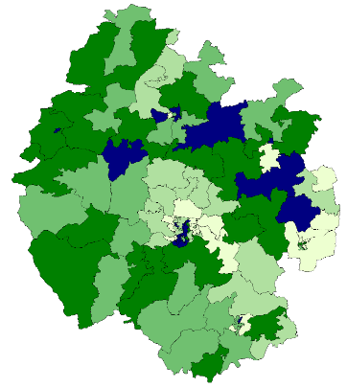
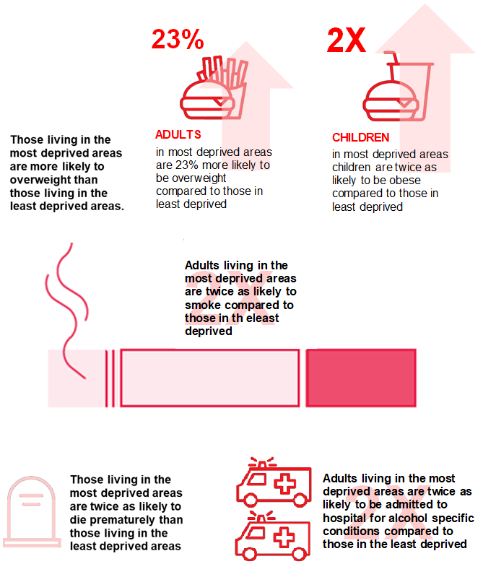
Inequalities in healthy lifestyles
Lifestyle choices such as smoking, drinking alcohol, poor diet and lack of exercise impact on health and life expectancy. There is a clear association between these lifestyle factors and living in an area of deprivation. Data on inequalities in healthy lifestyles aren’t currently available for Herefordshire, but inequalities in premature mortality (slide 40) suggest that national patterns are likely to be relevant.
Across England:
IMD 2019 in local context (Herefordshire quintiles)
Darker = more deprived
Source: Fingertips https://fingertips.phe.org.uk/

Slide 36

Mental health
Recap of mental health risk factors in Herefordshire
10% of adults say they feel lonely always or often.
5% of adults always or often cut back on the use of their heating and 4% always or often skipped meals or ate less during the COVID-19 pandemic.
Over 7,000 workless households.
7% of women and 4% of men aged 16-74 were victims of domestic abuse in the year to March ‘20.
Alcohol-specific hospital admissions continue to rise, with 600 seen in 2019/20 but opiate and crack cocaine use appears less prevalent here than nationally.
During 2020, around 1,100 households were eligible for prevention from homelessness or homeless relief.
Nationally, Covid-19 increased many of the pre-existing risk factors for mental health, as well as generating anxiety around contracting the virus, raising demand for services.
At the same time, the supply of specialist mental health services has fallen with a sharp drop in adults in contact with MH services in April 2020 and which is still no where near pre-pandemic levels.
(Institute for Fiscal Studies, Nov 2021)
Mental wellbeing outcomes
10% of adults have a poor wellbeing score (on the Warwickshire Edinburgh Mental Wellbeing scale) ​
28% of Herefordshire adults rate their anxiety levels as 6-10 (where 10 is completely anxious). Covid-19 increased anxiety for 45% of adults and 40% of school-children locally. More likely amongst women, housing association renters and disabled people. ​
25% of primary and 48% of secondary/FE age pupils had low/medium-low mental well-being scores in summer 2021. Emotional well-being and resilience is lowest amongst teenage girls. ​
Around 4,900 young people are living with a parent with severe mental health issues. ​
65% of those affected by flooding in 2019/20 said it had affected their mental health, and 85% were worried about being flooded again in the future. ​
The number of Herefordshire patients diagnosed with depression increased by 13% (to 19,850) between March 2020 and November 2021.
The volume of Harm Assessment Unit referrals from the police to Adult Safeguarding has substantially increased over the last 24 months; currently over 100 each month. On average 50% of the referrals received from police each month are mental health related.​
?​
What does this mean for access to Mental Health Services​
Uncertainty about current and future demand and how this will impact in terms of access to services

Slide 37
Health services and prevention – the bigger picture
Health inequalities are unfair and avoidable differences in health across the population. These are related to age, the conditions in which we are born, grow, live and work, all factors which influence opportunities for good health, and how we think, feel and act which in turn shapes our mental health, physical health and wellbeing. These factors have all been influenced by Covid-19, resulting in many cases, in the widening of inequalities compared to before the pandemic.
Inequalities in health care and treatment
An assessment across four care pathways (COPD, heart failure, hip arthritis and cataracts) for each ICS in the Midlands in 2021 found:
The likelihood of emergency hospital admission increases with level of deprivation, particularly aged 55+
Whilst, as seen across the region, patients living in the most deprived areas are more likely to be identified by GPs and placed on a heart failure register there does not appear to be significant inequality across the rest of the pathway.
Inequalities exist across deprivation levels in hospital admissions for respiratory diseases, mental and behavioural disorders and disorders of blood and immune system.
Although local BAME populations are small there are indications that considerable inequalities exist across a range of conditions for people from non-white ethnicities.
In particular, it appears that people from the most deprived areas, or who are not ‘white’ are several times more likely to be discharged without a firm diagnosis. Further investigation as to why was recommended.
For reasons both of fairness and of overall outcomes improvement, the NHS Long Term Plan is taking a more concerted and systematic approach to reducing health inequalities and addressing unwarranted variation in care.
Trends in prevention and protection: pre-Covid (up to 2019/20)
Overall cancer screening rates were higher than in England, although for some county GP practices they were lower. While generally similar to, or better than nationally, rates of breast and cervical cancer screening amongst older women were falling, while those for bowel cancer and cervical amongst younger women had been rising.
Screening uptake is lower in the most deprived areas while mortality rates from cancers were higher compared to least deprived areas.
Prevalence of diagnosed diabetes was increasing steadily in line with the national pattern, although it is estimated that over a third of cases remain undiagnosed.
Mixed picture for school age vaccinations: proportion of 5 year olds receiving two doses of the MMR vaccine remains steady and higher than England, but the uptake of the HPV vaccine in 12-13 year old girls had fallen to below the national figure.
As observed across the country the proportion of those aged 65+ who have had a flu vaccine increased during the pandemic and is now higher than nationally (83% in 2021, compared to 81% for England)
Health care towards the end of life
Despite the ageing population, the proportion of people aged 65+ diagnosed with dementia has not changed since 2017: 3.4% in 2020 (1,600). At just over 50% of estimated cases, the diagnosis rate is one of the worst in England (nationally 62%).
A system-wide approach to falls prevention has been a priority in 2020/21. An estimated 8,000 patients are at high risk of a fall, 2,000 of them severe. A 2020 Healthwatch consultation found that, although a number of services are available to help prevent falls, many aren’t known to the public until they experience one.
Emergency admissions related to falls in those aged 65+ are lower than for England, although the numbers are rising. Numbers of hip fractures amongst older people is similar to nationally.
Place of death: it’s widely recognised that most people would prefer not to die in hospital. Since March 2020, 36% of Herefordshire deaths occurred in hospital – lower than the 41% average for 2015 to 2019, although it’s difficult to unpick the impact of the pandemic.

Slide 38
Health services and prevention – impact of Covid-19
The Covid-19 pandemic has disrupted all aspects of healthcare, and the focus now is on recovery and restoration.
NHS waiting times have increased with concern about missed/delayed diagnoses. Particularly cancer, but also other long term conditions.
Delayed treatment can reduce chance of survival, but also has implications for quality of life of both patients and their carers whilst they are waiting: for example reduced mobility can increase isolation. Also widening existing inequalities.
Primary care
Nationally GP appointments fell during the first lockdown but have since recovered to 2019 levels, although referral rate is below 2019 level.
In 2021, 87% of H&W patients reported overall experience of their GP practice as ‘good’, similar to 2020 and slightly higher than England (83%). During the pandemic, 41% of patients who felt they had needed an appointment had avoided making one – main concerns were the burden on the NHS (21%) and the risk of catching covid-19 (17%).
Impact of long COVID unclear: an estimated 700 people are likely to suffer severe post-acute COVID-19 and require support from services between Jan ‘20 and Dec ’21. By Oct ’21, 150 GP patients had been recorded as having ‘post-covid syndrome’, 25% of whom have been referred for further assessment.
Impacts on hospital patient access
Emergency visits to A&E at Hereford hospital halved from average of 5,400 a month at the onset of the pandemic, but returned to pre-Covid levels during summer 2020 and have remained there (except during the winter lockdown).
In March 2020, elective (planned) admissions at Wye Valley Trust fell by 90% from the 2019/20 average of 1,700 a month. Recovery of services across elective, cancer and diagnostics is challenging. Overall waiting lists and times have increased, as expected in the early phase of recovery.
Challenges of recovery
Scale of recovery: British Medical Association (BMA) estimates that if elective activity increased to 110% of 2019 levels, the waiting list would take up to five years to come back down to pre-pandemic levels, and up to a decade to return to more manageable levels
Implications of recovery for an already tired and vulnerable workforce: in 2021, 59% of doctors and health care workers reported higher than normal levels of exhaustion or fatigue in the BMA’s COVID-19 Tracker Survey.
Impacts of covid-19 on some preventative services locally included:
  NHS Healthchecks suspended by GPs from March 2020; numbers have been increasing slowly since spring 2021 but remain at ~10% pre-pandemic levels
  Suspension of routine cancer screenings during the first wave in 2020
  Alcohol and drug support moved to a telephone only service; numbers in receipt of services haven’t changed
  Sexual health services stayed open throughout

Slide 39
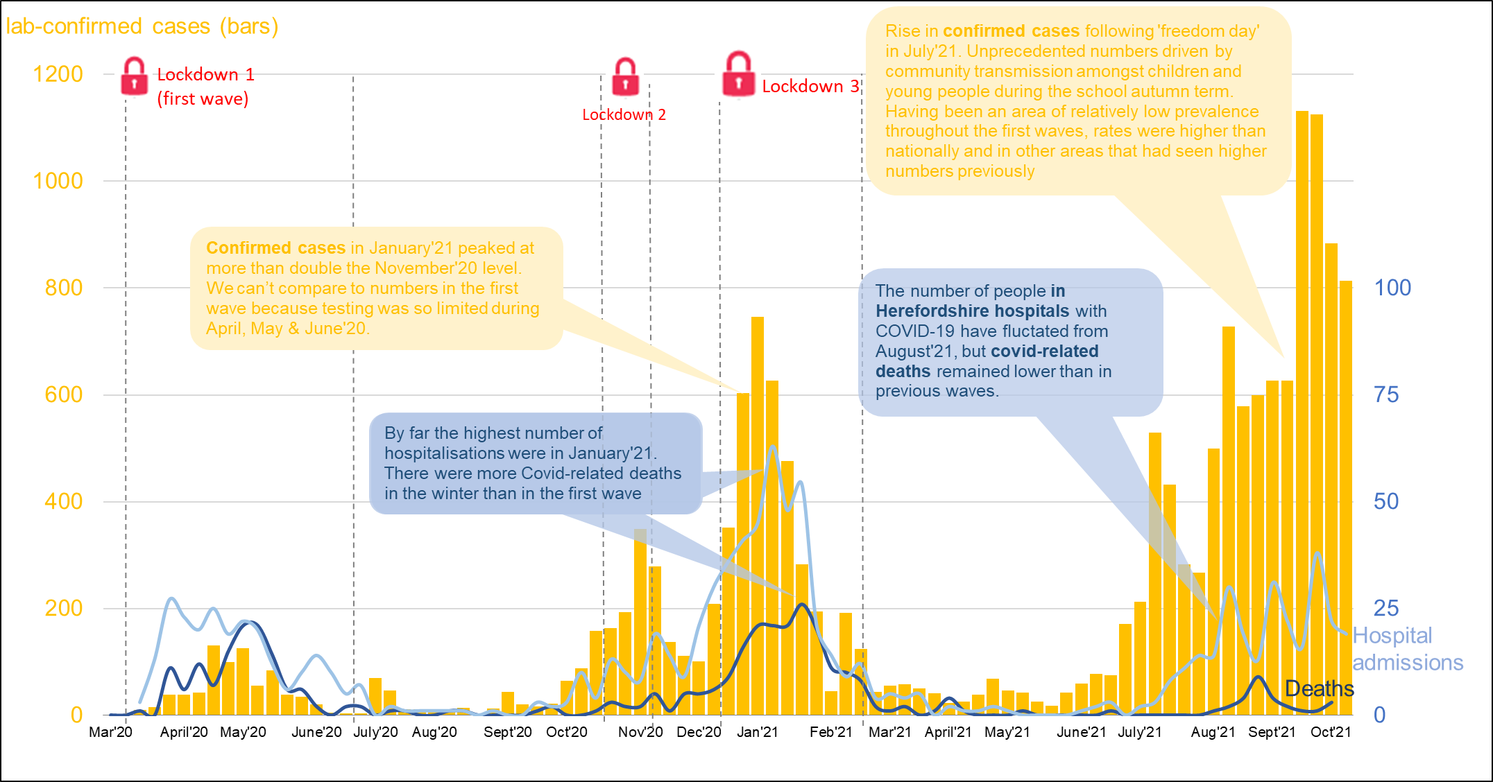
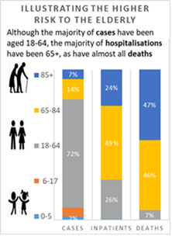
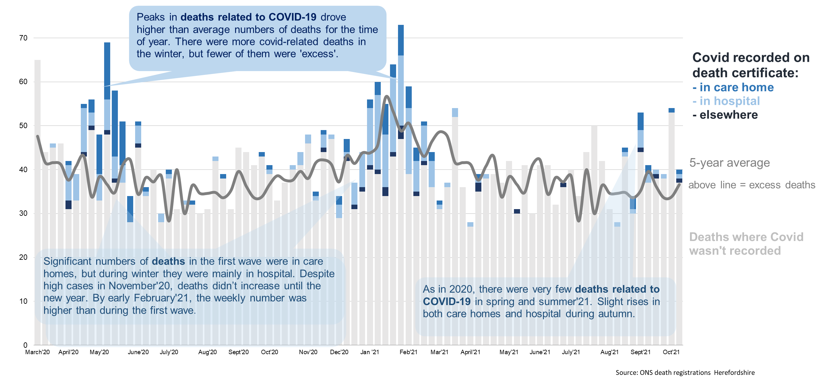
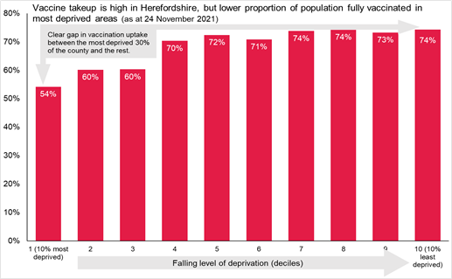
Covid-19: story of the pandemic in Herefordshire
Case rates were generally below national levels until late summer 2021, when – as in other areas of low prevalence – infections spread amongst children and young people particularly.
As of November 2021, in Herefordshire:
Throughout the pandemic there have been 328 excess deaths (compared to the average for the five years preceding the pandemic).
Since April‘20 COVID-19 has been mentioned in a higher proportion of deaths than any other single condition* (9%), although not necessarily the underlying cause of death
Vaccine uptake is high overall: 80% of those aged 12+ fully vaccinated, but is notably lower amongst most deprived 30% of county.
3,700 people are estimated to have some post-COVID symptoms between Jan'20 and Dec'21. One fifth of these are likely to suffer severe post-acute Covid-19.

Slide 40




Premature mortality
Many factors combine together to affect the health of individuals and communities. Whether people are healthy or not, is determined by their age, circumstances and environment. Factors such as where we live, the state of our environment, genetics, our income and education level can all have considerable impacts on health.
Premature mortality (i.e. before age 75) in Herefordshire is lower than nationally. However, there are local pockets where mortality is higher compared to the overall picture with these inequalities being clearly linked to deprivation – residents in the most deprived areas of the county are 1.6 times* more likely to die prematurely than those in the least deprived areas.
As nationally, the most common causes of premature death in Herefordshire are cancer, heart disease, stroke and lung disease, between them accounting for on average 3,800 years of life lost annually. Recent trends and comparisons to the national picture are in the table below.
In the five years prior to the pandemic 28% of mortality was premature - a similar proportion has been seen during the pandemic (in 2008-12 the proportion was one third)
Cause of premature mortality | Prevalence of key risks | Disease prevalence and trend (nb. not age adjusted) | Premature mortality | Inequalities: difference between most and least deprived areas*
Cancer | Smoking: falling and lower than nationally (12.5% compared to 13.9% in 2019) | Consistently higher, rising in line with England for last decade 2019/20 was 4.1% compared to 3.1% for England | Fell between 2017 and 2019 to below national level, but a small rise in 2020 brought it back in line with national rate: 113 per 100,000 in 2019/20 In line with England but no clear pattern | 1.25 x more likely to die of cancer
COPD / respiratory | Asthma: stable since 2005/06, similar to England 6.9% in 2019/20 compared to 6.5% nationally | COPD higher: 2.5% in 2019/20 compared to 1.9% for England Increasing steadily since 2005/06, whilst national has been stable | Respiratory mortality increased between 2009 and 2017 but subsequently fallen. Consistently below England: 26 per 100,000 in 2017-19 Better than England | 2 x more likely to die of respiratory disease
Heart disease (CHD) / heart failure | Smoking: falling and lower than nationally (12.5% compared to 13.9% in 2019) | CHD and heart failure are consistently higher: 3.6% in Hfds had CHD in 2019/20 compared to 3.1% for England Stable for last decade while national rate falling | Consistently in line with national; almost halved since 2003-05 34.9 per 100,000 in 2017-19 Stable, in line with England | 1.3 x more likely to die of heart disease
Stroke | High blood pressure (the single biggest risk factor for stroke) has been rising steadily in Herefordshire and in 2019//20 local prevalence was 16.7% compared to14.1% nationally | Stroke prevalence consistently higher than England: 2.5% in 2019/20 compared to 1.8% nationally. Rising slowly locally since 2014/15, in line with national | Fallen in recent years, to below national rate 9.2 per 100,000 in 2017-19 Falling, and better than England | 1.3 x more likely to die of cerebrovascular disease, including stroke
* Correction note: figures for inequalities in premature mortality are slightly lower than quoted in previous version

Slide 41
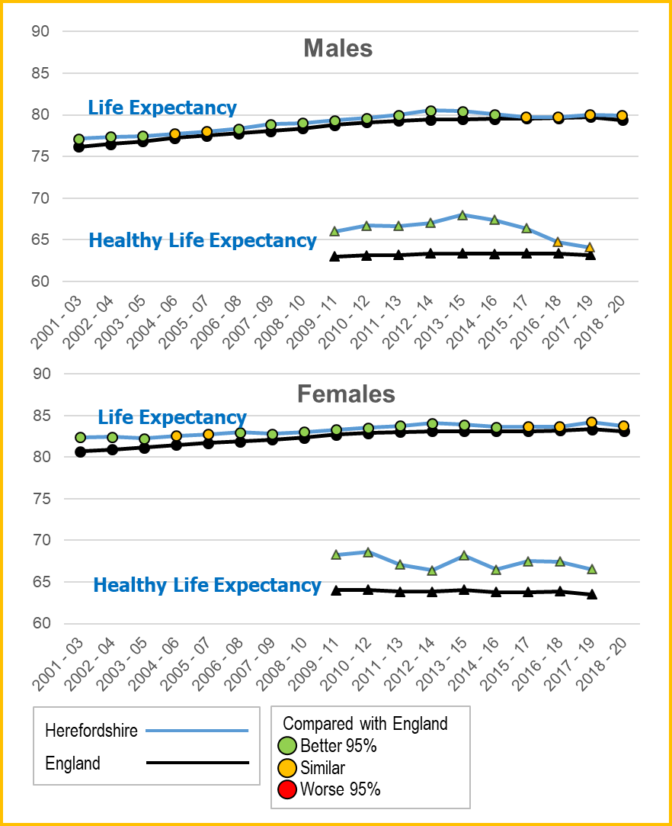
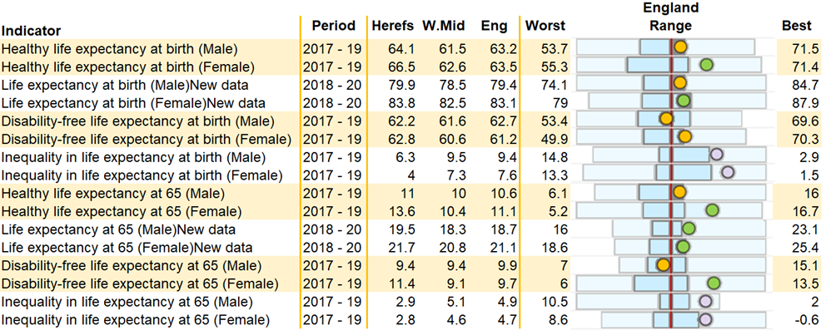
Life expectancy
Life expectancy is the ultimate health outcome. Measures are broken down into total, healthy and disability-free years at birth and at age 65.
COVID-19 resulted in a small fall in total life expectancy nationally (2018-20), but no significant changes locally. Levelled off in last decade, but remain higher than in 2007-09.
On most measures, females in Herefordshire fare better than nationally. But the gap has closed for males: most measures are no longer significantly different to England.
Proportion of life lived without a disability appears to be falling locally (stable nationally):
4 years lower for men in 2017-19 than 2015-17.
Inequalities in life expectancy between people born in the most and least deprived areas of Herefordshire remain lower than nationally, with no change over the last decade. Gap is currently (2017-19) 6.3 years for men; 4.0 for women*.
The most common causes of death in Herefordshire are dementia and Alzheimer's combined (accounting for 12% of deaths a year).
* Note correction from previous version which incorrectly quoted higher figures for inequality in life expectancy

Slide 42
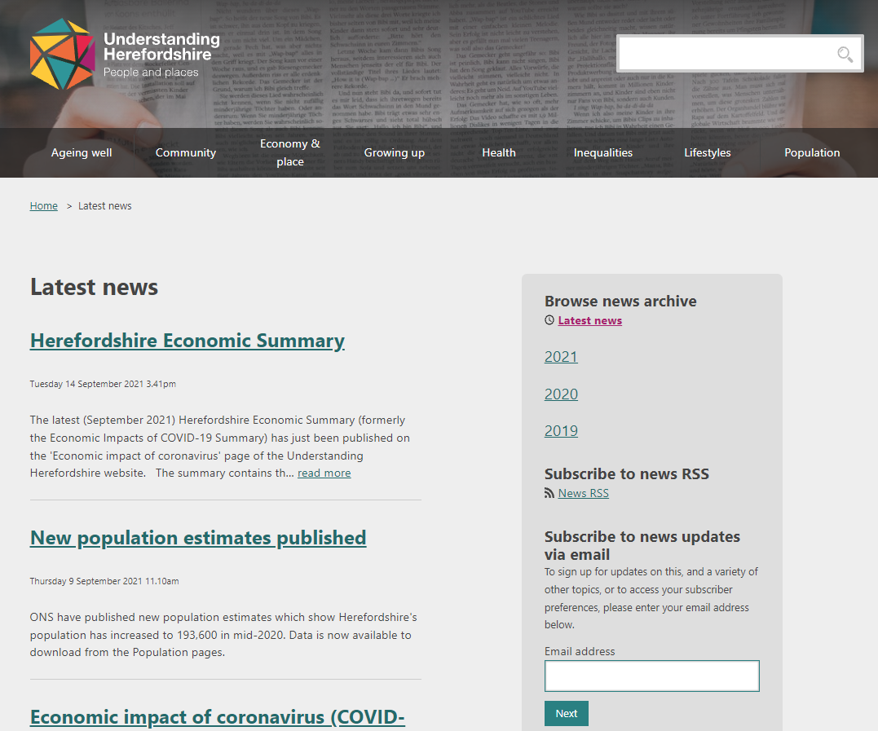
Find out more: Understanding Herefordshire website
https://understanding.herefordshire.gov.uk/
Contact us: researchteam@herefordshire.gov.uk
Tel: 01432 261944
Keep up-to-date with the latest insights by signing up for news updates via email: https://understanding.herefordshire.gov.uk/latest-news/

Slide 43
7. Appendix
Some of the detail behind the key findings

Slide 44
Work that informed the 2021 JSNA
Round-up of what we’ve learnt since the 2018 summary, with a particular emphasis on inequalities and understanding the impacts of Covid-19
Existing work pre-2021 | New research / analysis in 2021
Economic impacts of coronavirus (monthly) | Talk Community well-being survey ** Published July **
Armed forces community assessment | CYP Quality of Life Survey ** Published November **
Rural inequalities | Domestic abuse needs assessment (draft)
Housing stock condition | Profile of mental well-being (draft)
Children’s integrated needs assessment | Health and social care needs of older opiate users (in progress)
Needs assessments on oral health, alcohol, vulnerable persons’ housing needs, and the evidence base for physical activity strategy | Understanding wider impacts of Covid-19 to inform recovery
 | Health and well-being needs of SEND (in progress)
 | Cardiovascular disease (CVD) needs analysis

Slide 45
2021 engagement
Meeting | Date
All Member Public Health briefing | 29/4/21
Supplementary portfolio holders briefing (Public Health) | 13/5/21
UH Forum (officers) | 26/5/21
WVT Board | 1/7/21
CPF Forum | 27/7/21
Management Board: plans & process | 17/8/21
Informal portfolio holders’ session | 27/9/21
1-2-1 engagement with key subject matter experts throughout September and October*
Community Leaders’ meeting | 7/10/21
Business Board | 4/10/21
CCG QPR Committee | 6/10/21
HWBB workshop | 1/11/21
Community Partnership workshop | 10/11/21
Management Board: pre sign-off | Nov
HWBB sign off | 6/12/21
Followed by further opportunities for awareness-raising
Acknowledgements for input from colleagues across the council and partners, including:
All age commissioning
CCG information & finance
Environmental & environmental health services
Education performance & school admissions
Housing
Public health
Strategic planning

Slide 46
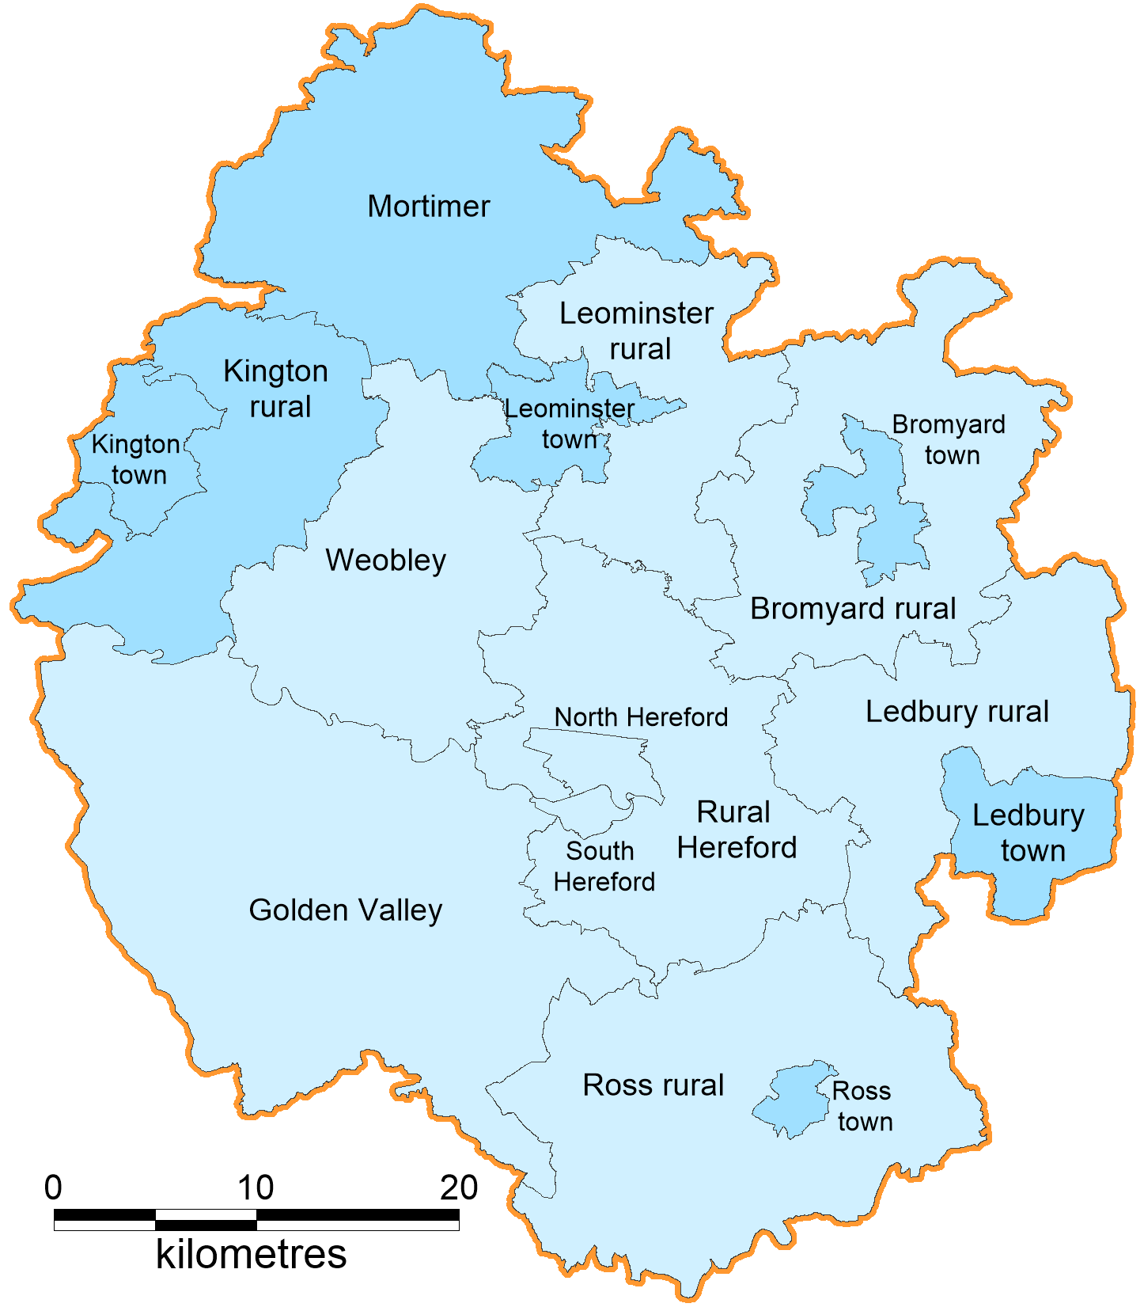
Proportion of the population aged 65+ by sub-locality - 2001
19% | Herefordshire
16% | England
ONS OA Boundaries are reproduced
with the permission of HMSO
Crown copyright. All rights reserved. Herefordshire Council 100024168. (2019)

Slide 47
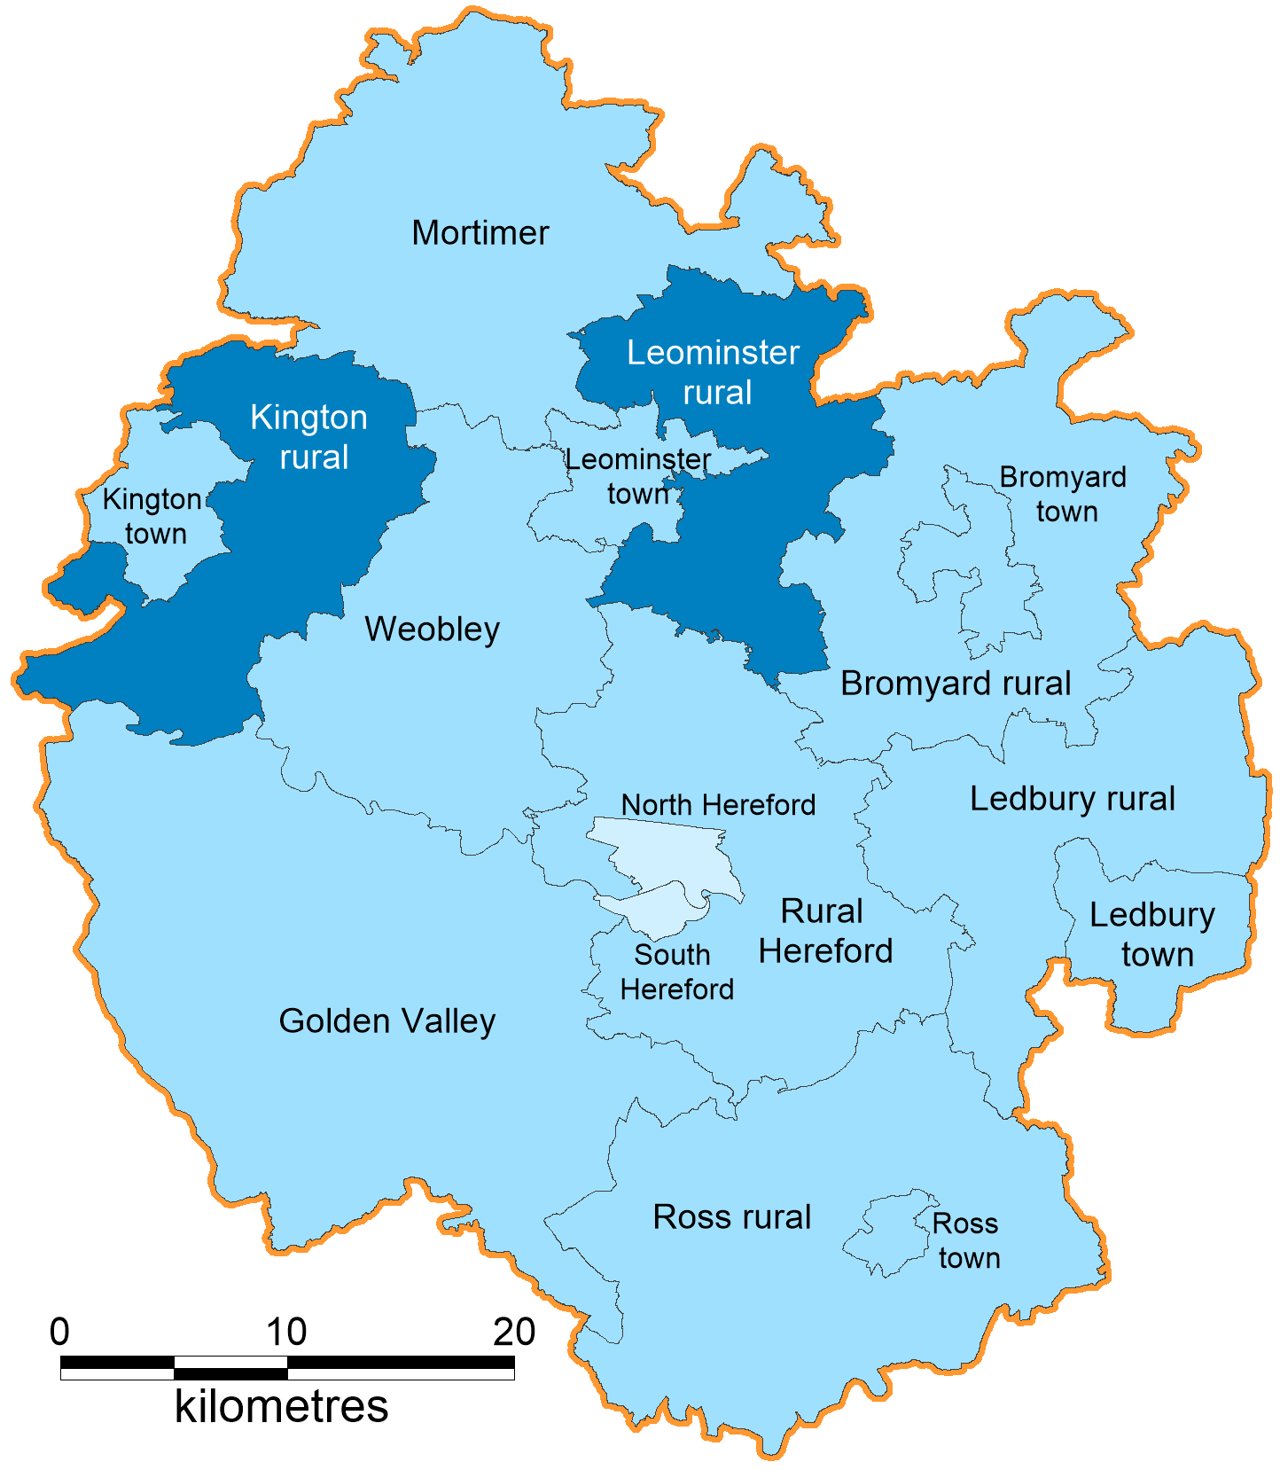
Proportion of the population aged 65+ by sub-locality - 2011
21% | Herefordshire
16% | England
ONS OA Boundaries are reproduced
with the permission of HMSO
Crown copyright. All rights reserved. Herefordshire Council 100024168. (2019)

Slide 48
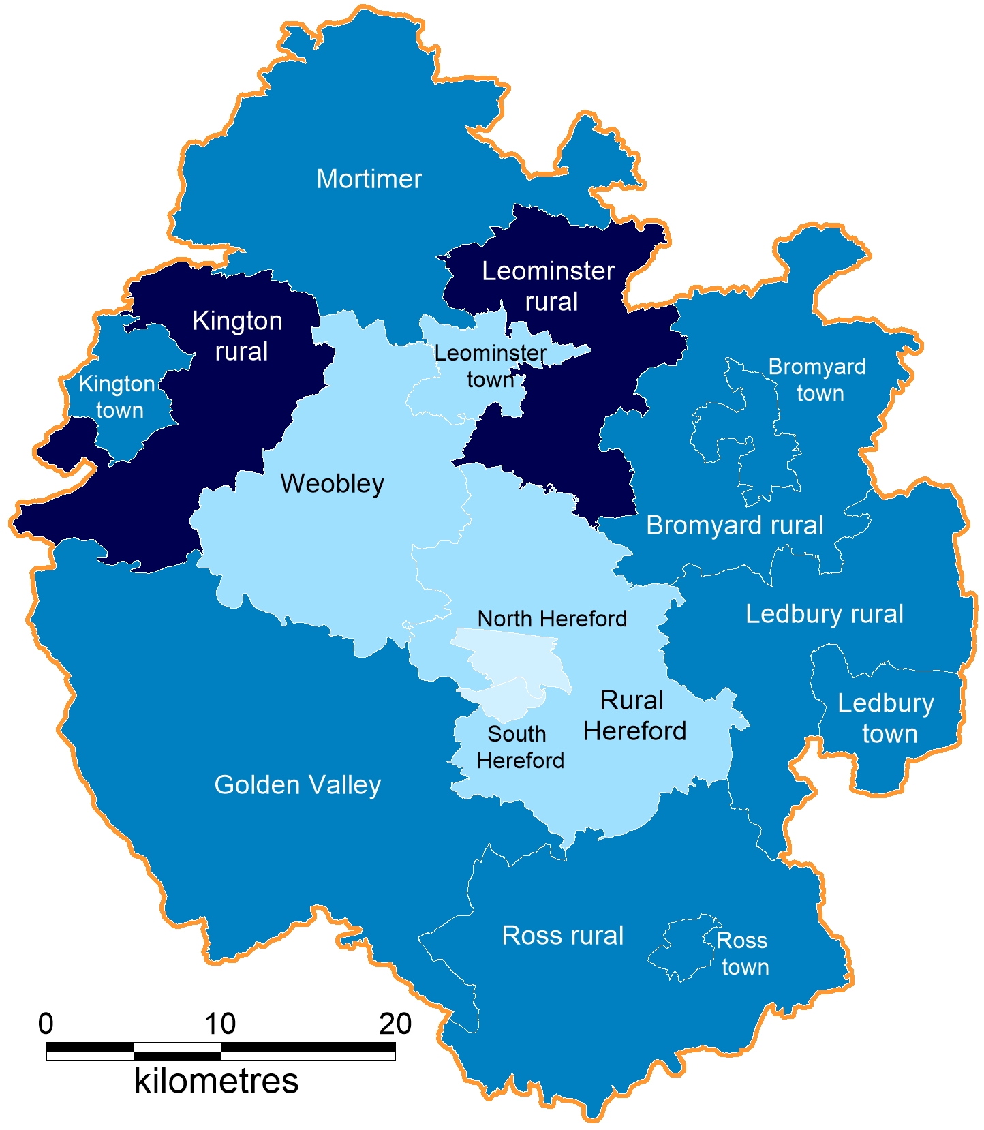
Proportion of the population aged 65+ by sub-locality - 2018
24% | Herefordshire
18% | England
ONS OA Boundaries are reproduced
with the permission of HMSO
Crown copyright. All rights reserved. Herefordshire Council 100024168. (2019)

Slide 49
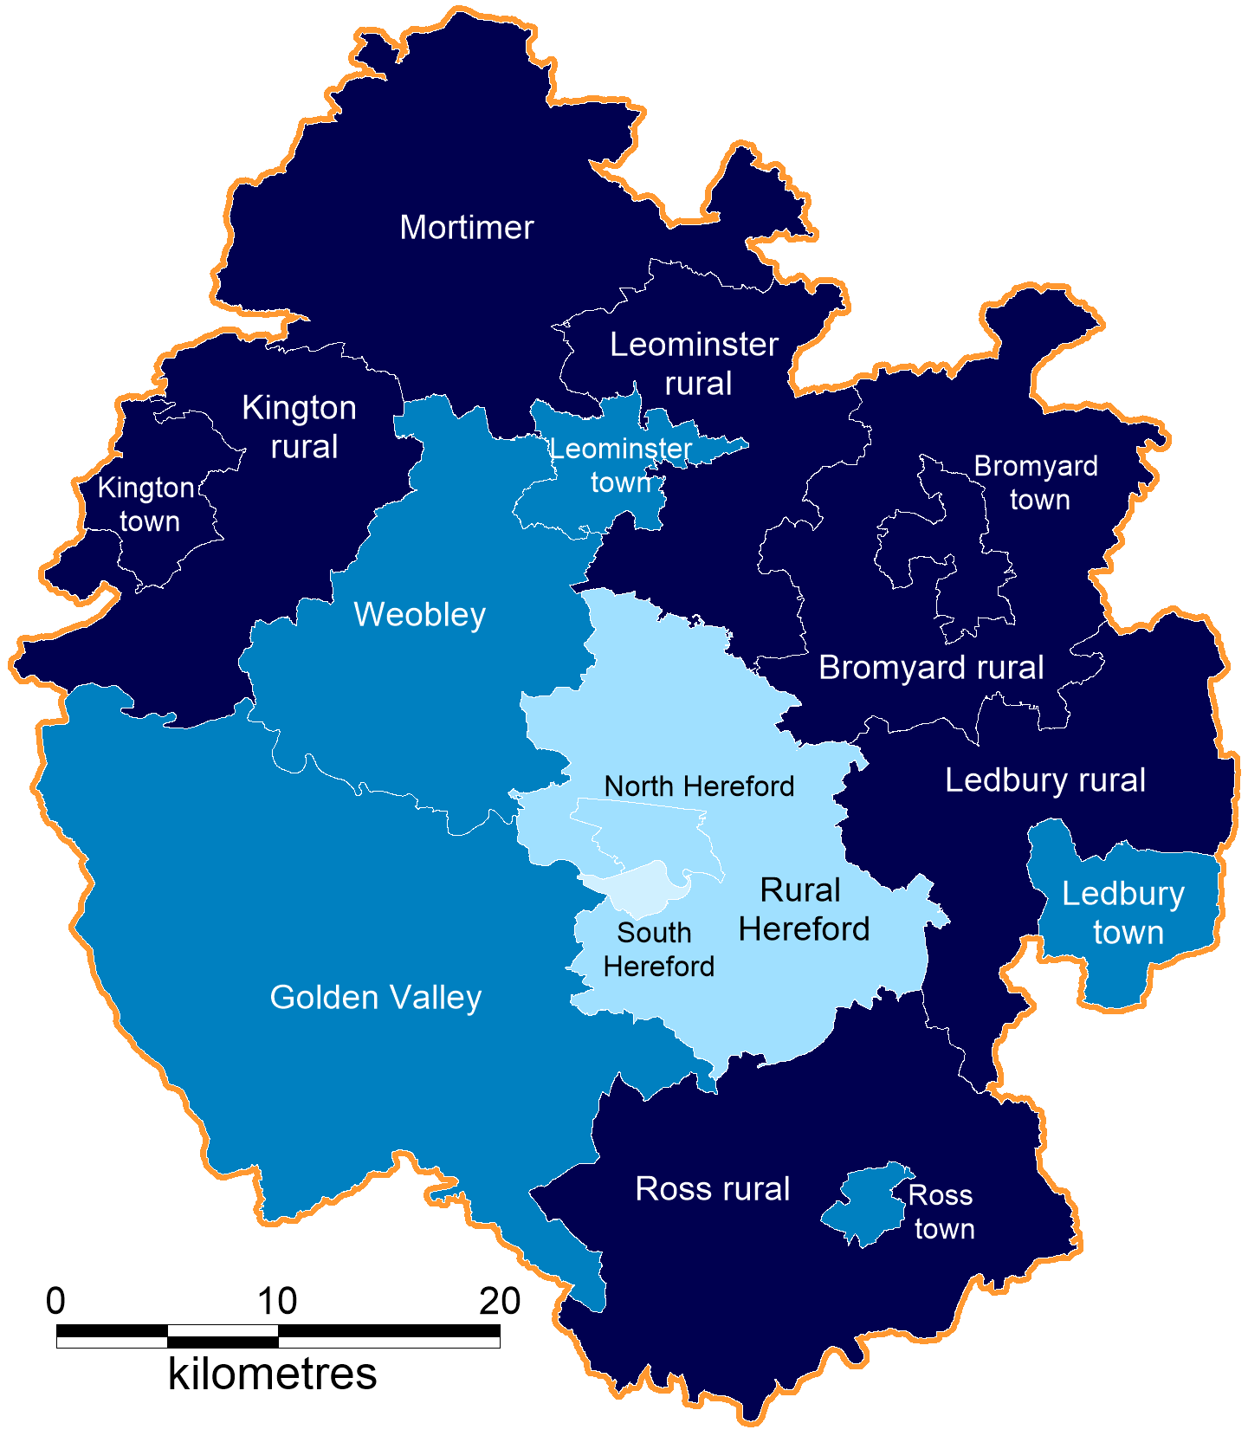
Proportion of the population aged 65+ by sub-locality - 2028
28% | Herefordshire
21% | England
ONS OA Boundaries are reproduced
with the permission of HMSO
Crown copyright. All rights reserved. Herefordshire Council 100024168. (2019)

Slide 50
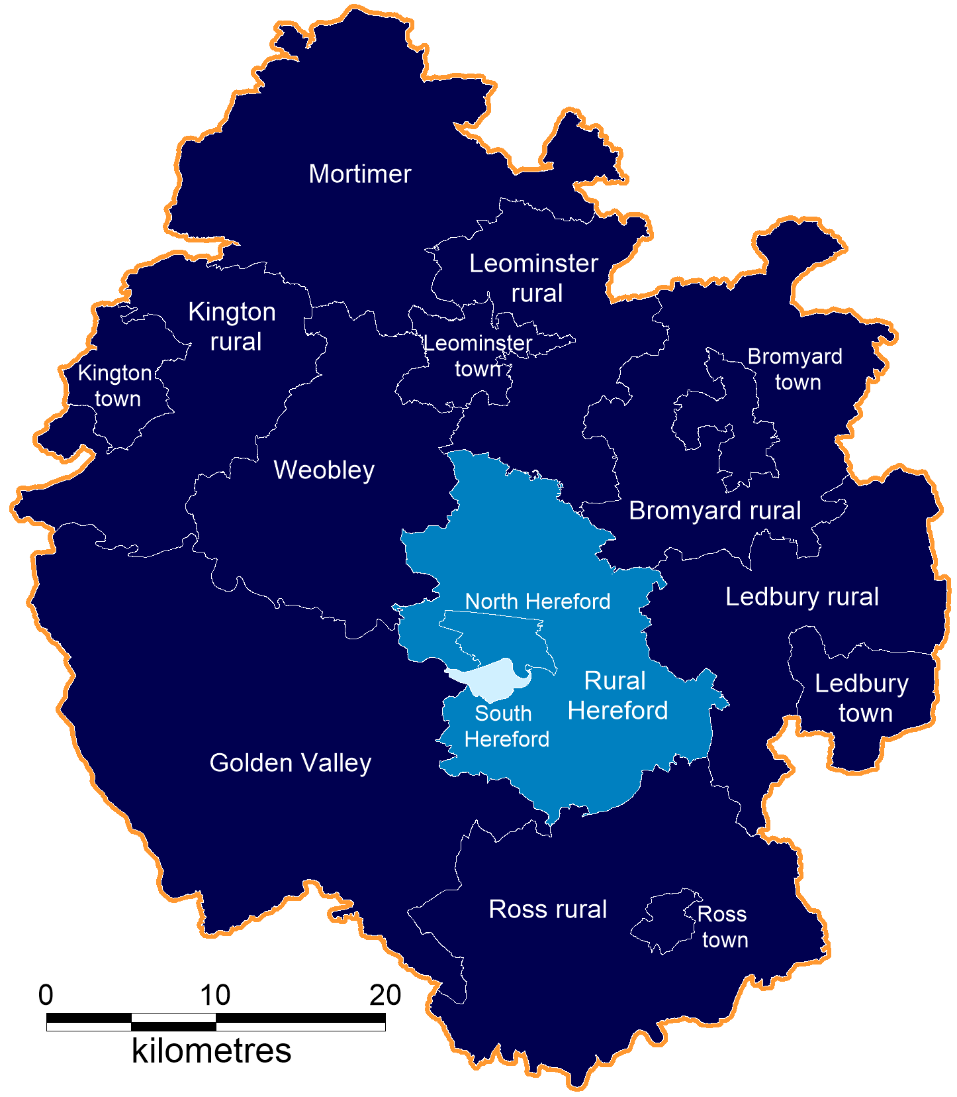
Proportion of the population aged 65+ by sub-locality - 2038
32% | Herefordshire
24% | England
ONS OA Boundaries are reproduced
with the permission of HMSO
Crown copyright. All rights reserved. Herefordshire Council 100024168. (2019)

Slide 51
Economic impact of COVID
The Covid-19 pandemic delivered the greatest shock to the British economy for over 300 years:
30% of Herefordshire employments furloughed by June 2020 (down to 4% by July 2021).
32,400 claims made by 10,300 individuals under the Self-employment Income Support Scheme with a total value of £87,900,000 (and many were not eligible!).
Almost £209 million government-backed loans offered to Herefordshire businesses.
Around £111 million in local authority administered grants paid to Herefordshire businesses.
£1.7 million claimed under the “Eat Out To Help Out” scheme.
Herefordshire Council investing in a £6 million economic and wellbeing recovery plan, funded by Government Covid-19 outbreak management funds, to support the county to recover from the impact of Covid-19.

Slide 52
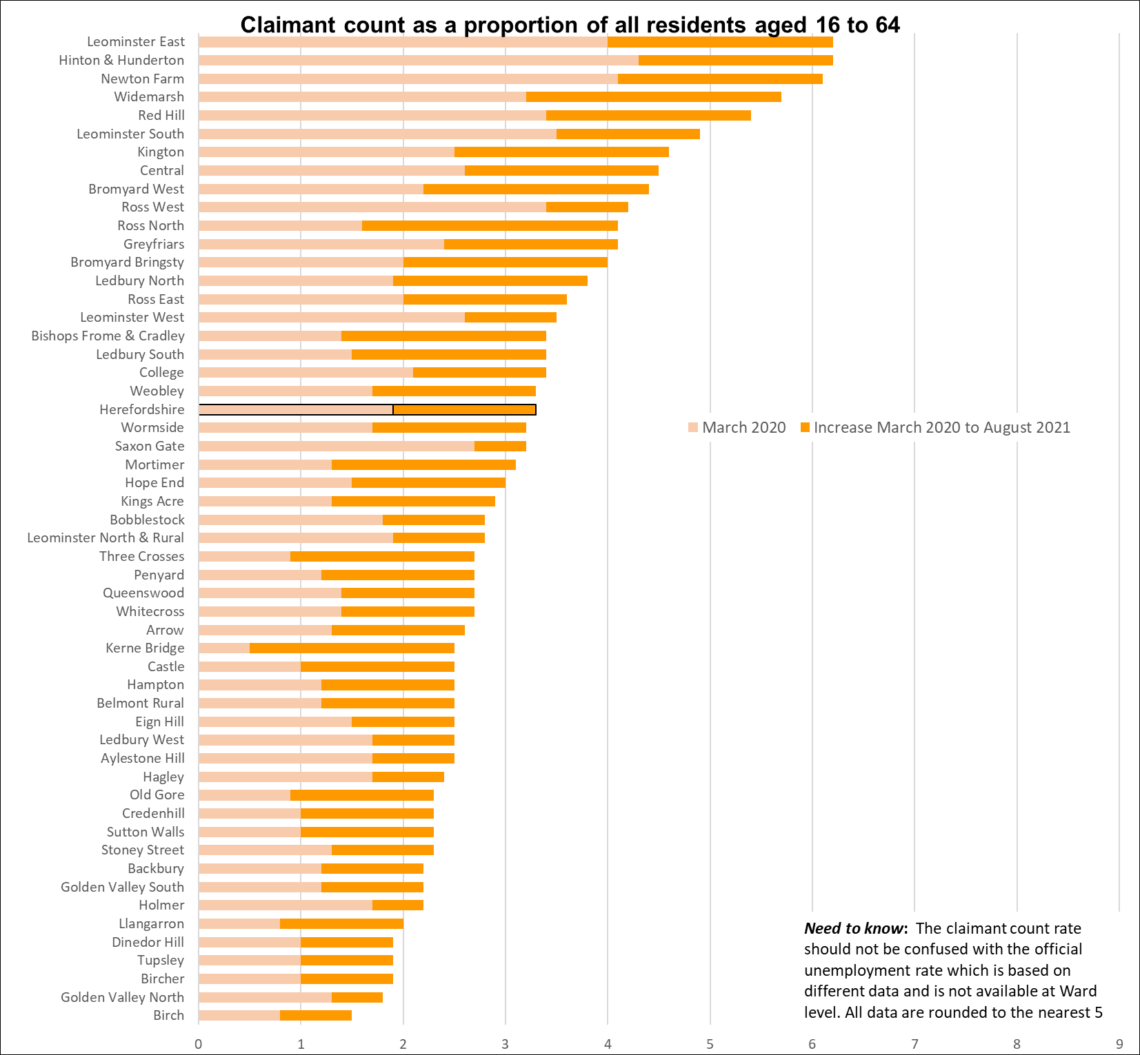
Wards with highest unemployment
Key points:
Generally, those wards with the highest claimant count rates before the pandemic still have the highest rates in August 2021
These include Leominster East , Hinton & Hunderton, and Newton Farm, which also have the highest numbers of claimants (160, 185 & 175 respectively). Followed by Widemarsh (145) and Red Hill (140).
Ross North, and Widemarsh Wards have seen the largest increases in claimant count rate from March 2020.
The claimant count rate for the county as a whole in August was 3.3%.
Note that due to the small population sizes a relatively small change in the number of claimants can have a significant impact on the rate.
Data source: ONS/NOMIS
Date last updated: 14 Sept. 2021
Frequency of update: monthly
HC data lead: Intelligence Unit

Slide 53
Talk Community Well-being Survey 2021
Telephone based survey of 1,100 household residents across Herefordshire Primary Care Network localities

Slide 54
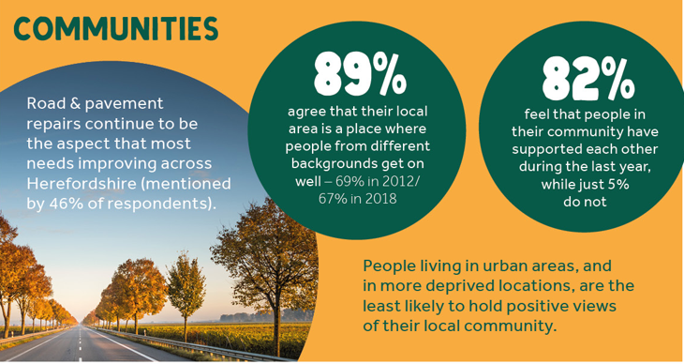
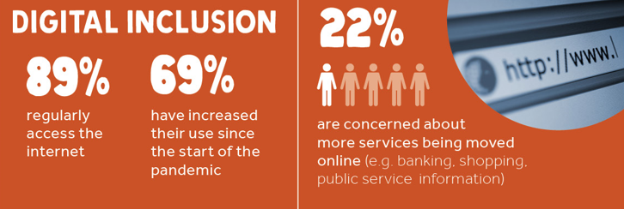
Community wellbeing survey: themes
Plenty of positives; in general:
High levels of satisfaction with / belonging to local area
People get on well together & have supported each other through pandemic
Most have daily contact with others
Most trust their neighbours & feel safe out after dark
Two-thirds didn’t see their income fall
Comparatively good mental health
But some important minorities:
3% struggling to cope financially
4% / 5% have had to cut back on heating / food
10% feel lonely always or often
10% don’t use the internet
And significant differences:
Less of a sense of community in Hereford
Some groups highlighted throughout the survey: most deprived, social renters, lower socio-economic, younger people, disabled people, newer residents

Slide 55
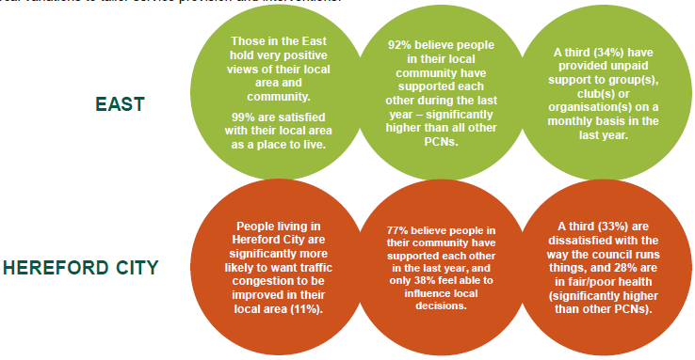
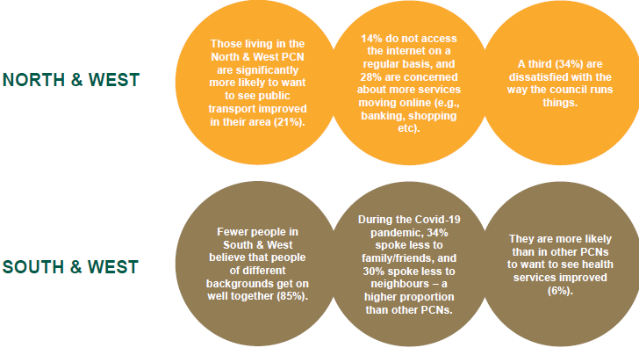
Differences between areas (and groups)
EAST | NORTH & WEST
HEREFORD CITY | SOUTH & WEST
Find out more: Talk Community Wellbeing Survey 2021

Slide 56
CYP Quality of Life Survey 2021
School-based survey of 4,700 pupils in 25 primary, 11 secondary, 2 FEs and 1 special school.
Note: the following slides are based on interim results so may change slightly; they are also only a selection of key findings based on work to date

Slide 57
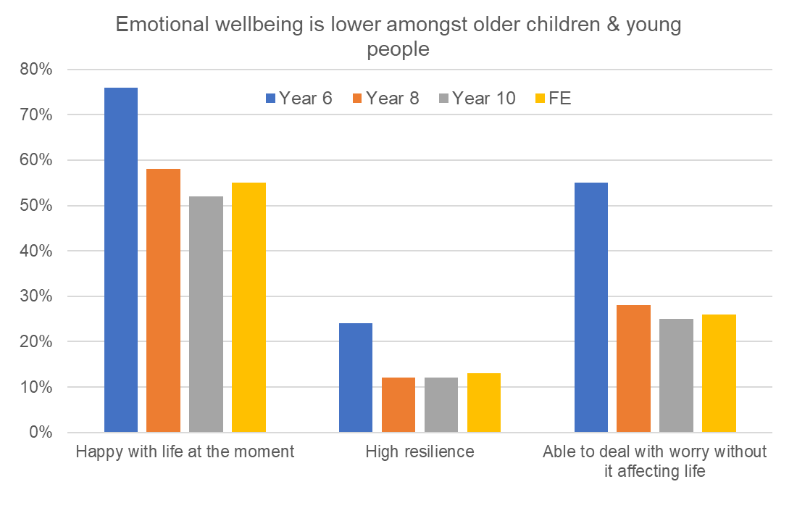
Headlines: emotional health & wellbeing (1)
Majority are ‘happy with life at the moment’
  Highest amongst primary age:
    42% boys / 34% girls very happy
  Notably lower amongst older girls:
    28% Y7+ girls not happy
    10-13% of boys of all ages
Emotional wellbeing and resilience
was lower amongst older pupils
Large minority said feelings of worry
or anxiety have got worse since Covid-19
    37% of primary, 36% FE
    40% of secondary

Slide 58
Common worries
Worry ‘quite a lot’ or ‘a lot’ | Primary | Secondary | FE
Covid-19 | 38% | 17% | 17%
Environment & climate change | 30% | 19% | 23%
Being safe on the road | 29% | 16% | 23%
Health of family member | 29% | 28% | 31%
Future, eg home, job | 28% (b) | 39% (boys) | 61% (all)
The way they look | 34% (g) | 59% (girls) | 49% (all)
Own mental health | 20% | 34% | 44%
Sexual harassment |  | 27% (g) | 36% (g)
Biggest worries vary by age/sex
  Primary pupils: Covid-19 (38%)
  Secondary girls: the way they look (59%)
  Secondary boys: their future, e.g. home, job (39%)
  FE: their future (61%), looks (49%), mental health (44%)
Other key points
  ‘Environment & climate change’ and ‘Being safe on the road’: less likely to worry secondary pupils
  ‘Physical or mental health of a family member: almost one third of all ages
  Even at primary age, 28% of boys worry about the future and 34% of girls worry about the way they look
  Note awareness of own mental health at all ages

Slide 59


Headlines: emotional health & wellbeing (2)
One in three primary & secondary pupils afraid to go to school at least ‘sometimes’ because of bullying
  20% had been bullied at or near school in last year
  Lower for FE students: 12% afraid; 5% had been bullied
  Most common reasons: the way they look or size / weight
  Fear / experience of bullying higher amongst:
    Y4-6 who live with one parent (42% afraid to go to school vs 32% of those who live with two)
    Secondary pupils with SEND (48% afraid to go to school vs 29% of those without SEND)
    Secondary pupils eligible for free school meals (27% have been bullied in last year vs 18%)
The most common way of dealing with a problem was to talk to someone about it
  Majority of Year 6 (63%) and FE (57%) pupils
  Secondary pupils less likely to (45%)

Slide 60



Connecting with local area
Majority make use of parks or open spaces in their free time
  Almost three out of four primary (72%) / secondary pupils (73%), and
  Two out of three FE students (67%) had been to park/open space in the last 4 weeks
Mixed picture on ‘having your say’:
  Majority (two-thirds) have chances to give their views about their community and environment, although not all use them and engagement falls with age
      40% of Y6, 28% of secondary, 17% of FE have chances and use them
  Two-thirds of all age groups say they’ve had chances to give their views about
  leisure opportunities, but around half say it makes no difference to what happens
    51% of Y6, 53% of secondary, 45% of FE
High levels of feeling safe at home (>90%), and at school / college (~80%),
but a large minority ‘never’ feel safe going out after dark
  34% of primary, 25% of older

Slide 61
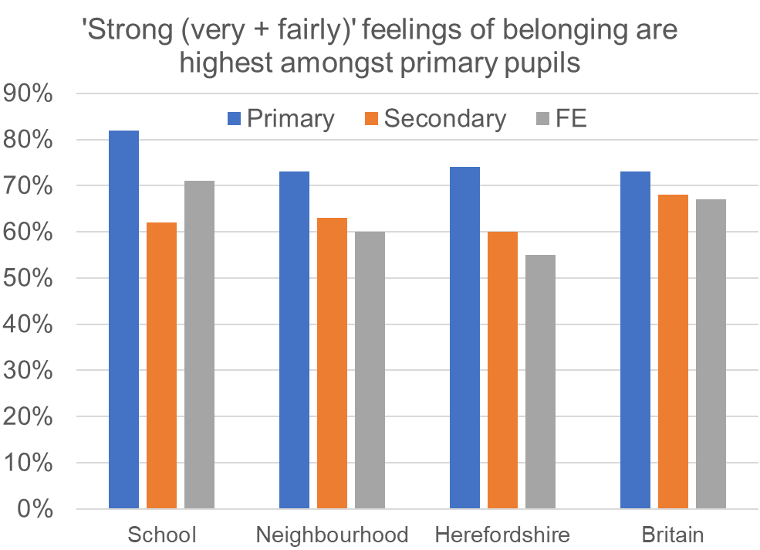
Feelings of belonging to community
Primary pupils are most likely to ‘strongly’ feel they belong to their school
Relatively low levels of ‘strongly’ belonging to a local community* amongst older CYP (60 -70%)
  Primary: 75-85%
  Community well-being survey of adults:
  88% ‘strongly’ belong to local area
* school, neighbourhood or community, rather than Britain

