Slide 1

Herefordshire JSNA: inequalities focus
HC Intelligence Unit, May 2024

Slide 2
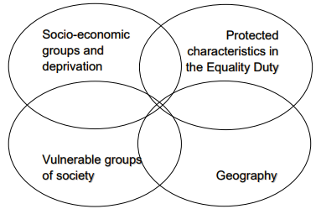
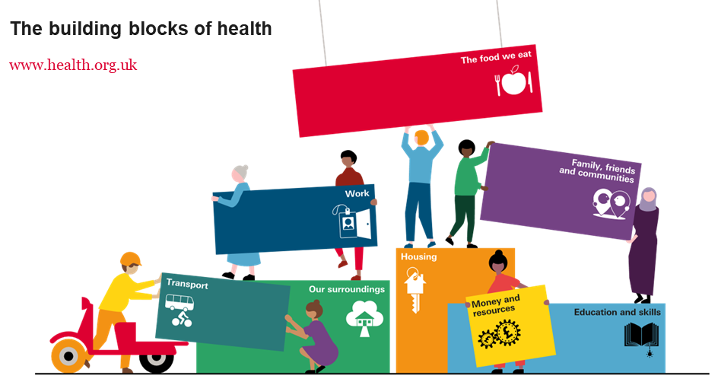
What do we mean by inequalities?
“”
“Health inequalities are unfair and avoidable differences in health across the population, and between different groups within society. Health inequalities arise because of the conditions in which we are born, grow, live, work and age. These conditions influence our opportunities for good health, and how we think, feel and act, and this shapes our mental health, physical health and wellbeing.”
At least 4 overlapping factors: NHS England: Place-based approach to health inequalities
See also Kings Fund explainer:
What are health inequalities? | The King's Fund (kingsfund.org.uk)
and A vision for population health | The King's Fund (kingsfund.org.uk)

Slide 3
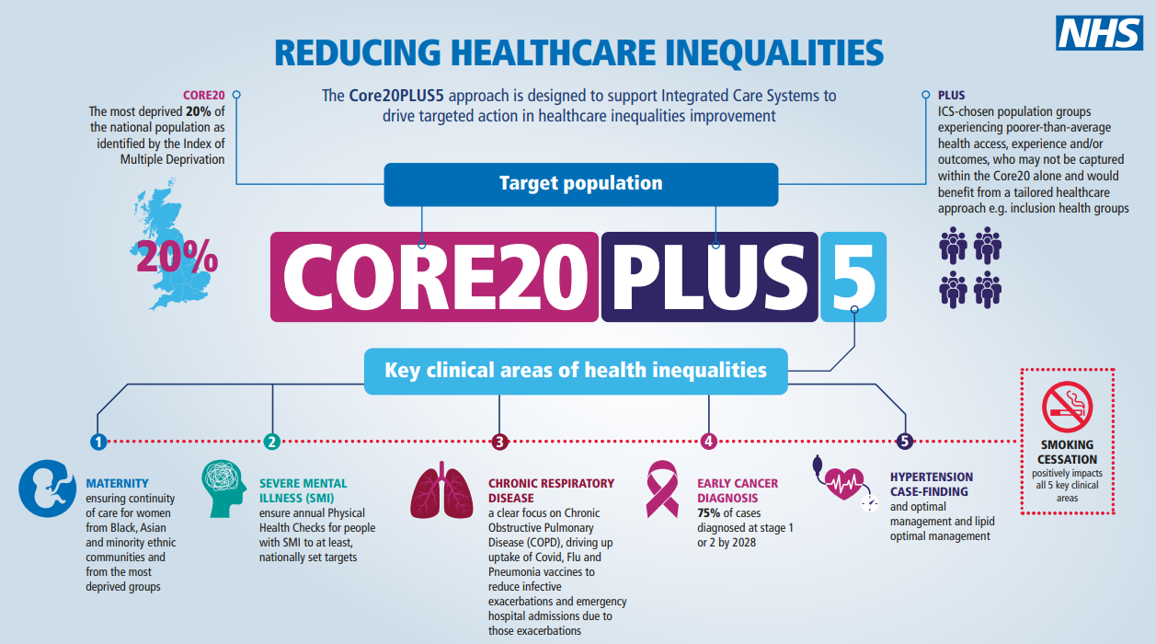

Core20 Plus 5: the NHS approach
9 areas of Herefordshire are amongst the 20% most deprived in England
H&W:
Rurally dispersed
Travelling Community
Unregistered individuals
Find out more: Herefordshire & Worcestershire Inequalities Strategy 2023-2026

Slide 4
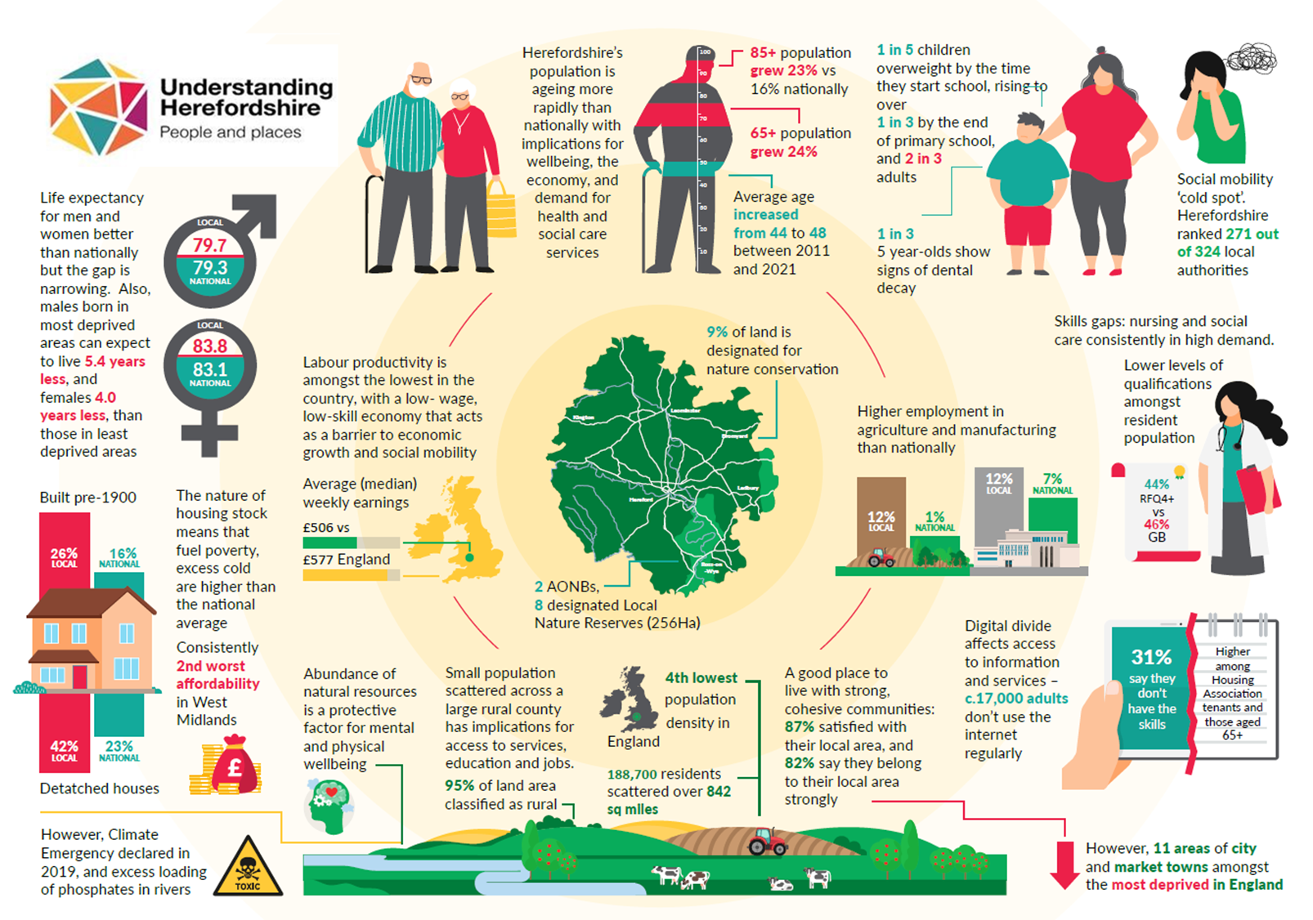
Herefordshire: the context
Herefordshire: the context (May 2024)
Notes:
Most things about life in Herefordshire come back to two fundamentals: our rurality and our demography:
1. we are a VERY rural county, with a relatively small population (about 186k) scattered across a relatively large rural area reliant on a network of B & C roads. This is what poses an almost unique challenge for providing services here: we’re one of the most sparsely populated areas of the country.
2. We have a relatively old population – an average age of 48 compared to 44 nationally, and will continue to see disproportionate increases in the number of people in the oldest age groups. We actually saw a 5% fall in the number of children living in the county between the last censuses, compared to a 4% rise across E&W as a whole.
Our rurality obviously means that the natural environment provides lots of opportunities for positive impacts on mental and physical health, but access isn’t always great – and the environment itself is under threat.
On average, we have relatively low levels of deprivation and poverty compared to the rest of England, and strong and cohesive communities
- But…we've got one of the lowest productivity levels in Britain: we don't really know the full reasons behind this, [CLICK4]
but it's often linked to the low wage economy with relatively high proportions working in agriculture and manufacturing, and there may be some connection with high levels of self-employment
these low wages are one of the key drivers of the reason that we're flagged as a 'cold spot' for social mobility - meaning its one of the worst 20% of local authorities in England in terms of the chances that disadvantaged children will do well at school and go on to get a good job and secure housing
the nature of our housing stock (dominated by large, older properties) combined with these low average wages means that housing affordability is a big issue, as is the risk of excess cold – which is exacerbated by relatively high levels of fuel poverty, especially in rural areas – even before the current cost of living crisis
Health and wellbeing outcomes – in general life expectancy is better than nationally, but the gap is narrowing and there is a persistent inequality. In terms of risks facing the future health of our CYP, the big issues are weight and teeth – fairly average levels of overweight/obesity, but large numbers – and a worrying picture of increasing numbers within a cohort as they move through school, and a third of 5 year-olds have tooth decay: a statistic that hasn't really changed for many years.
Then finally: technology provides opportunities to make it easier for our scattered population to access services, and there has been significant investment in infrastructure to improve connectivity – but there is still a digital divide whereby some people are less likely than others to have the skills needed to use the internet.

Slide 5
Deprivation in Herefordshire
These slides summarise key aspects of the Indices of Deprivation for Herefordshire. For more detailed analysis of all domains see the Understanding Herefordshire website

Slide 6
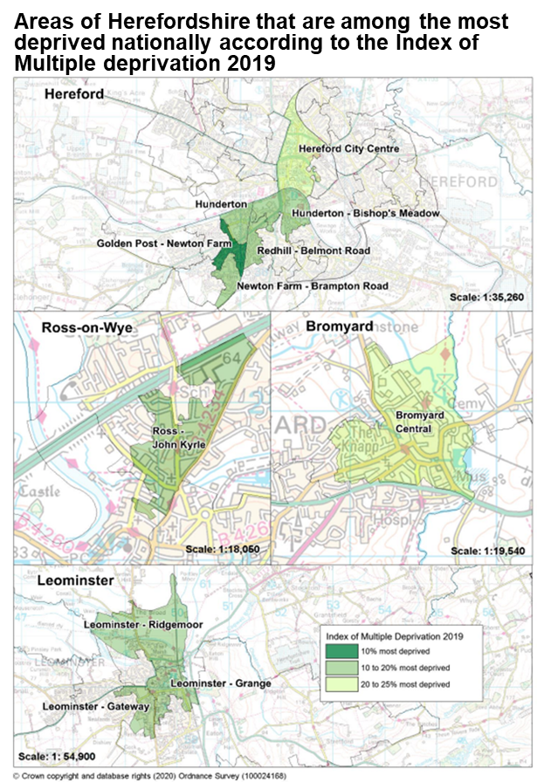
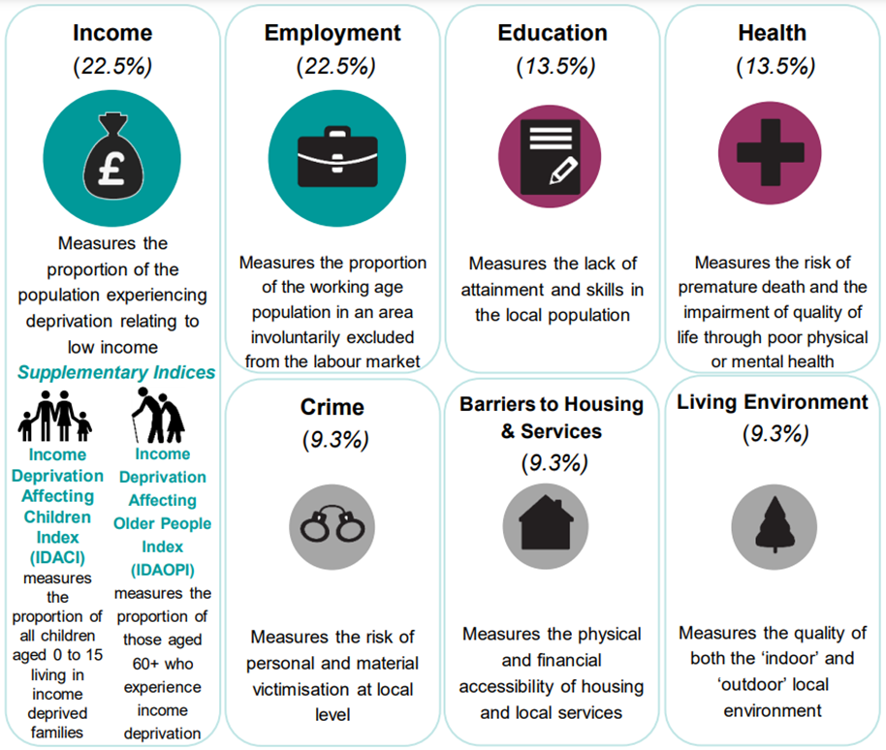
Areas of multiple deprivation: IMD 2019
The English Indices of Deprivation 2019 (ID) rank all areas (LSOAs) in the country based on scores across seven domains of deprivation. The Index of Multiple Deprivation (IMD) combines the domains into one overall score.
The 11 areas shown on the maps are ranked amongst the 25% most deprived in England: in Hereford, Leominster, Ross and Bromyard
‘Golden Post-Newton Farm’ remains the most deprived and the only area amongst the 10% most deprived nationally

Slide 7
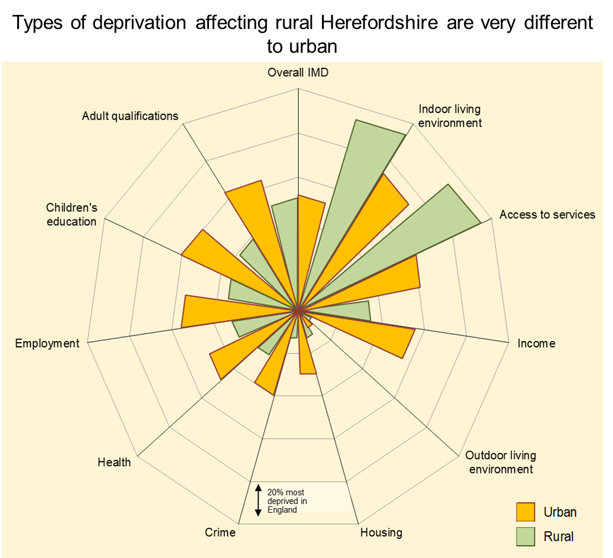

The impact of rurality
4th most sparsely populated county in England; 95% of land area is ‘rural’ and over ½ live in rural areas.
Better health and longer life expectancy on average, but hidden pockets of multiple deprivation.
Some health problems and domestic violence are under-reported in rural communities.
Deprived rural households can face different challenges to urban.
Geographical barriers can exacerbate inequalities by making it harder, and more expensive to access services and facilities. Lack of adequate public transport means many people are reliant on private vehicles to get about.
Access to high-speed broadband is an issue in some remote rural areas.
Social mobility challenges are exacerbated for young people in rural areas by the geographical barriers around transport that make it difficult for them to commute to good jobs.
Living costs were estimated to be 10-20% higher for rural households even before the current cost of living crisis, so thresholds for poverty might be different.
Find out more: Rural Herefordshire – what does it mean for health and well-being?
Notes:
The chart shows the seven different domains of deprivation, and it shows how different the types of deprivation affecting rural Herefordshire are compared to the urban parts of the county. The long bars in the top right corner show that the biggest ‘types’ of deprivation facing Herefordshire as a whole are the more environmental-related ones: ‘indoor living environment’ and ‘access to services’ – and the fact that the green bars are longer than the yellow shows they’re much more common in rural Herefordshire.

Slide 8
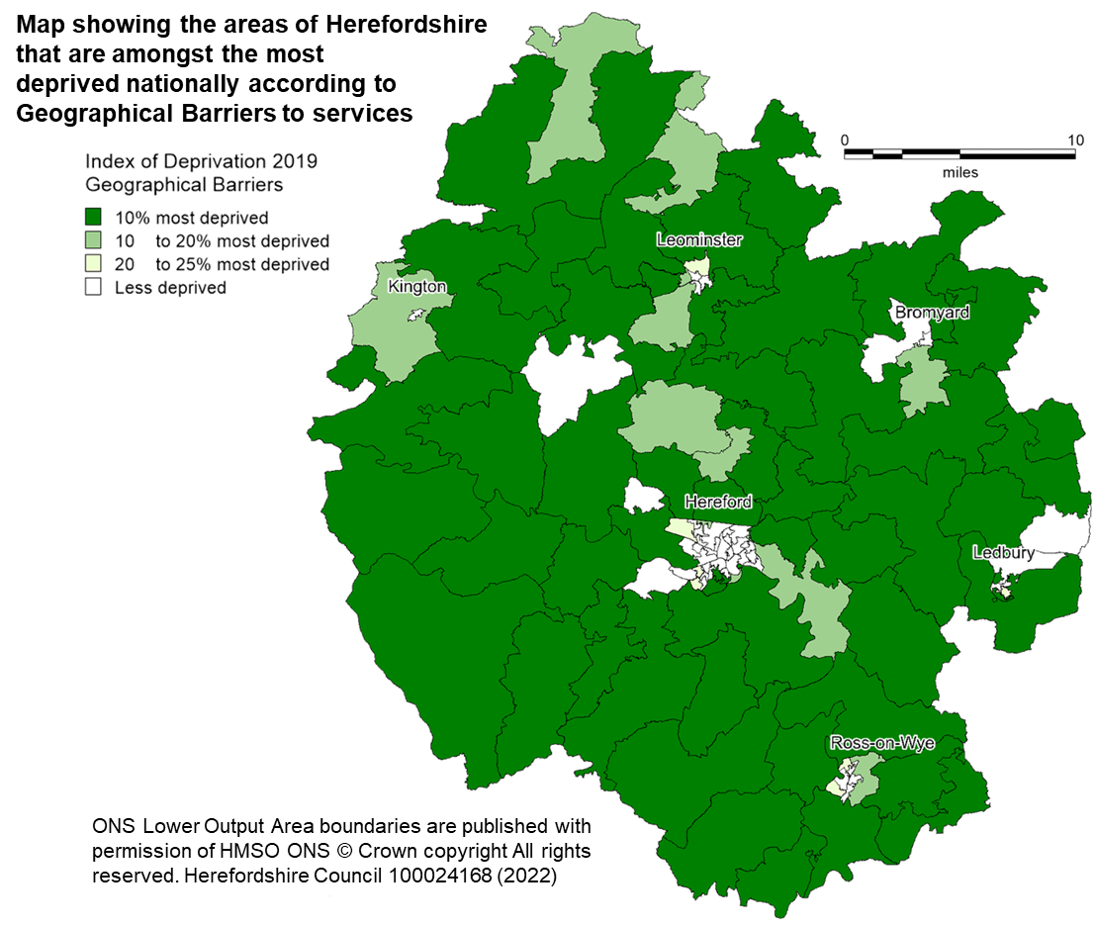
Access to services
Geographical barriers to services deprivation
Physical distance from services and facilities presents a problem in rural areas such as Herefordshire. Almost two thirds of all Herefordshire LSOAs¹ (72 of the 116) are among the 25% most deprived in England in respect to geographical barriers to services; half are in the most deprived 10% across England. Of these deprived 72 LSOAs, three quarters are in rural areas, which as can be seen in the map, results in the majority of rural Herefordshire.
Distribution of services
An asset mapping engagement exercise undertaken by Hitachi Solutions (Prevention and Early Help in Communities business case, 2022) identified two related areas for development:
There is an unequal distribution of services across Herefordshire. With provision currently concentrated in the city
Poor transport links can be a barrier to access services
¹Lower Super Output Areas (LSOAs) are fixed statistical geographies of about 1,500 people, designed by the Office for National Statistics (ONS).
Source of deprivation data: English indices of deprivation 2019

Slide 9
Impacts of inequalities

Slide 10
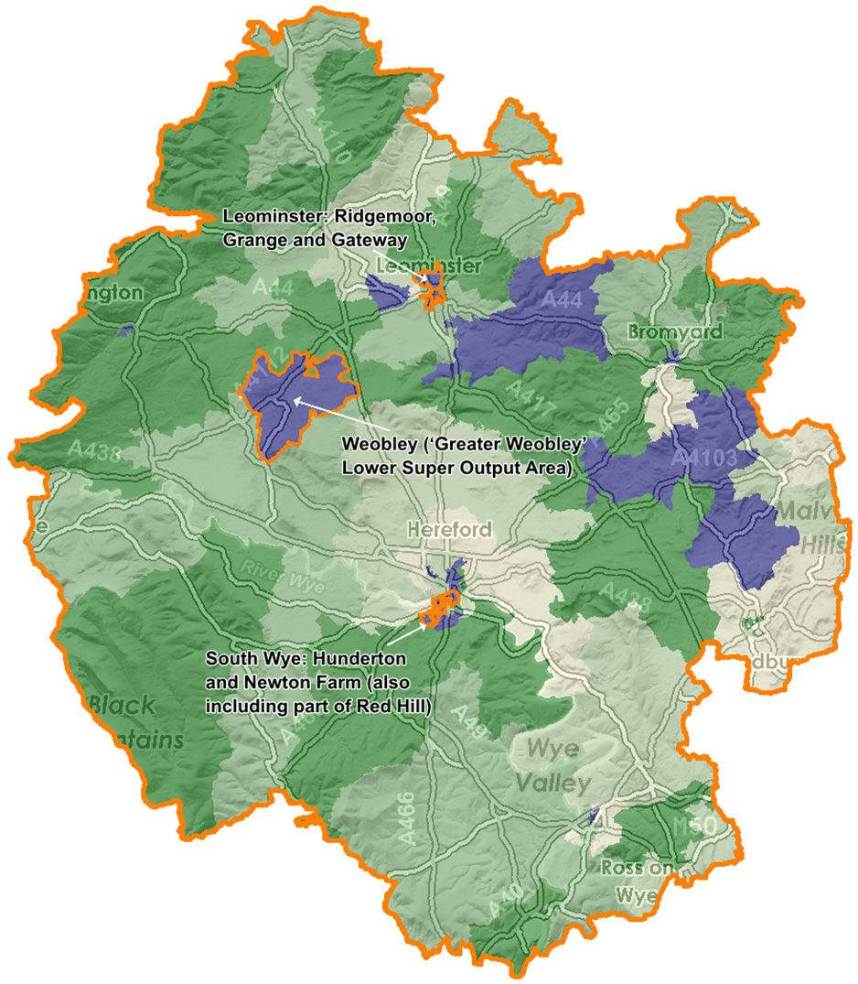
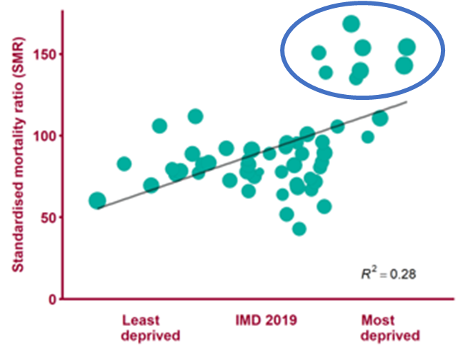


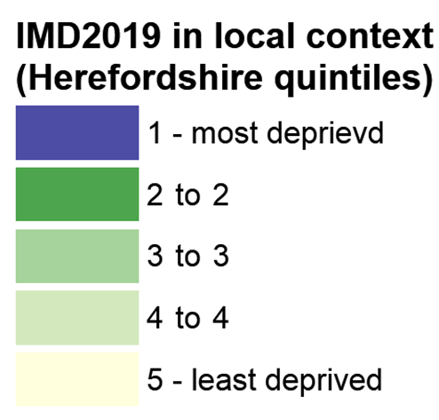
Areas of deprivation and health inequalities
In general, people living in the 20% most deprived areas of Herefordshire (blue on map) are more likely to:
Smoke, be overweight / obese and be admitted to hospital because of alcohol (based on national patterns)
Die prematurely of cancer, respiratory conditions, and circulatory diseases
For people born in the 10% most deprived, life expectancy is currently (2018-20):
5.4 years lower for males
4.0 years lower for females
than in the 10% least deprived
Preventable deaths by level of deprivation, wards in Herefordshire (2013-17)
Source: PHE Health Inequalities slides 2020
IMD 2019 in local context (Herefordshire quintiles)
Darker = more deprived

Slide 11

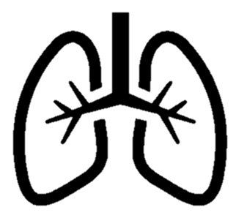


Premature mortality (nb. not updated since 2021)
Many factors combine together to affect the health of individuals and communities. Whether people are healthy or not, is determined by their age, circumstances and environment. Factors such as where we live, the state of our environment, genetics, our income and education level can all have considerable impacts on health.
Premature mortality (i.e. before age 75) in Herefordshire is lower than nationally. However, there are local pockets where mortality is higher compared to the overall picture with these inequalities being clearly linked to deprivation – residents in the most deprived areas of the county are 1.6 times* more likely to die prematurely than those in the least deprived areas.
As nationally, the most common causes of premature death in Herefordshire are cancer, heart disease, stroke and lung disease, between them accounting for on average 3,800 years of life lost annually. Recent trends and comparisons to the national picture are in the table below.
In the five years prior to the pandemic 28% of mortality was premature - a similar proportion was seen during the pandemic (in 2008-12 the proportion was one third)
Cause of premature mortality | Prevalence of key risks | Disease prevalence and trend (nb. not age adjusted) | Premature mortality | Inequalities: difference between most and least deprived areas*
Cancer | Smoking: falling and lower than nationally (12.5% compared to 13.9% in 2019) | Consistently higher, rising in line with England for last decade 2019/20 was 4.1% compared to 3.1% for England | Fell between 2017 and 2019 to below national level, but a small rise in 2020 brought it back in line with national rate: 113 per 100,000 in 2019/20 In line with England but no clear pattern | 1.25 x more likely to die of cancer
COPD / respiratory | Asthma: stable since 2005/06, similar to England 6.9% in 2019/20 compared to 6.5% nationally | COPD higher: 2.5% in 2019/20 compared to 1.9% for England Increasing steadily since 2005/06, whilst national has been stable | Respiratory mortality increased between 2009 and 2017 but subsequently fallen. Consistently below England: 26 per 100,000 in 2017-19 Better than England | 2 x more likely to die of respiratory disease
Heart disease (CHD) / heart failure | Smoking: falling and lower than nationally (12.5% compared to 13.9% in 2019) | CHD and heart failure are consistently higher: 3.6% in Hfds had CHD in 2019/20 compared to 3.1% for England Stable for last decade while national rate falling | Consistently in line with national; almost halved since 2003-05 34.9 per 100,000 in 2017-19 Stable, in line with England | 1.3 x more likely to die of heart disease
Stroke | High blood pressure (the single biggest risk factor for stroke) has been rising steadily in Herefordshire and in 2019//20 local prevalence was 16.7% compared to 14.1% nationally | Stroke prevalence consistently higher than England: 2.5% in 2019/20 compared to 1.8% nationally. Rising slowly locally since 2014/15, in line with national | Fallen in recent years, to below national rate 9.2 per 100,000 in 2017-19 Falling, and better than England | 1.3 x more likely to die of cerebrovascular disease, including stroke
* Correction note: figures for inequalities in premature mortality are slightly lower than quoted in previous version

Slide 12
Inequalities in Herefordshire
Take-up of COVID-19 vaccination was lower amongst the 30% most deprived areas
Based on
national patterns, it is expected that those living in the most deprived areas are more likely to be overweight, to smoke and to be admitted to hospital due to alcohol consumption
People living in the
most deprived areas are 1.25 times more likely to die prematurely of cancer, 1.3 times more likely to die of heart disease or stroke and twice as likely to die of respiratory disease
Emotional well-being and resilience appears lower for some, including disadvantaged children, those living with one parent, young carers
Pupils who live with one parent are less likely to have been to a dentist in the last year, or to clean their teeth at least twice a day
Males born in the 10% most deprived areas of Hfds can expect to live 5.4 fewer years than those in the least deprived; for females the gap is 4.0 years
Children and young people
Health
Over 65s are almost 3 times as likely as <65s to provide 50+ hours’ unpaid care to family/friends a week. Many unpaid carers don’t have enough: time to do things they enjoy, control over their lives, social contact, encouragement &
support.
4,450 under 16s living in absolute poverty. Highest rates (>25%) in parts of Hereford, Leominster and Ross
INEQUALITIES IN HEREFORDSHIRE 2021
Life expectancy measures for males are no longer significantly better than the English average (whilst they still are for females)
Persistent gaps in educational attainment for disadvantaged children, and for those with EHCP/SEND
People accessing mental health services or who have learning disabilities are much less likely to be in employment than others
Women and people living in the most deprived areas are less likely to feel safe in their local area after
dark
Older people
Over 75s, people who are economically inactive, people in housing association rented accommodation are significantly less likely to use the internet
regularly
Employment
Community
Older people living in the most deprived areas are three times as likely to be living in income deprivation as those in the least deprived
Out-of-work
benefit claimants increased the most during the pandemic in areas with already high numbers
Women’s average earnings are 4% lower than men’s – a smaller gap compared to the West Midlands region (10%) and England (9%)
There is no significant difference in the rate of emergency admissions due to falls amongst the over 65s between the most and
least deprived areas
People living in rented accommodation were more likely to report struggling financially during COVID
Note correction to health inequalities figures from previous version
Notes:
This shows the wide range of different types of inequality: many are related to areas of deprivation, but there are also examples of inequalities based on other factors. For example:
protected characteristics: the difference between male and female earnings; the fact that over 65s are more likely to provide significant amounts of unpaid care and therefore experience the associated risks to wellbeing
Particular vulnerabilities: persistent gaps in educational attainment for children with EHCPs, and the employment rate for people with learning disabilities.

Slide 13
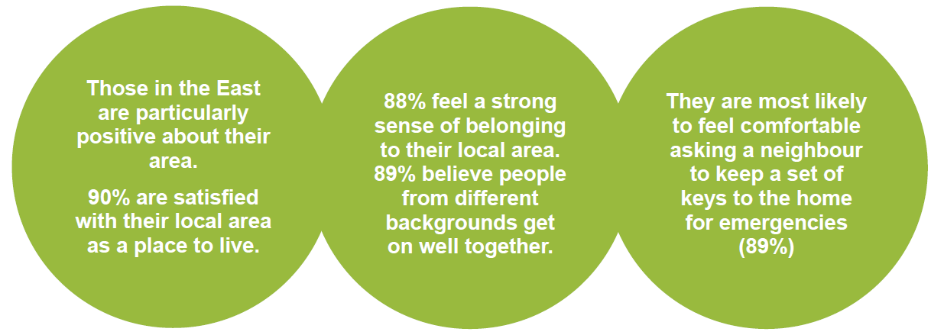
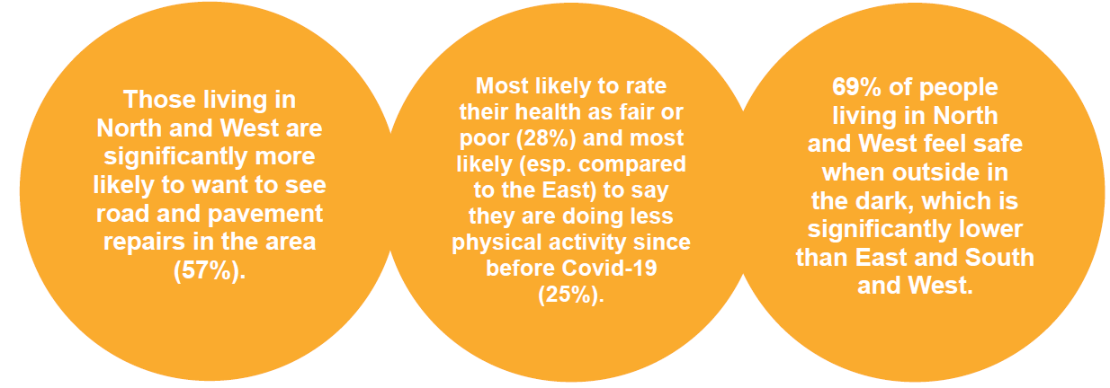
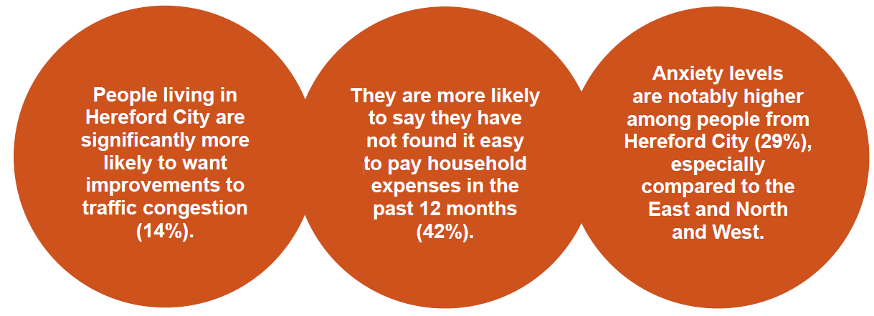
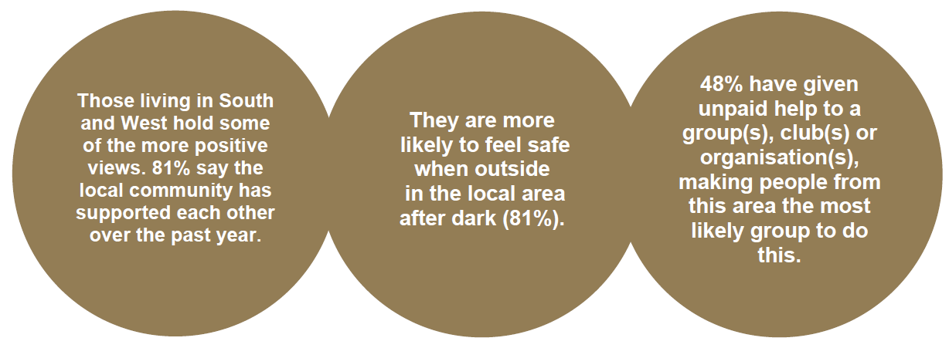
Community wellbeing survey: differences between areas (2023)
EAST | NORTH & WEST
HEREFORD CITY | SOUTH & WEST
Find out more: Talk Community Wellbeing Survey

Slide 14
Interconnected & compounding vulnerabilities (2021)
Many of the risk factors to wellbeing are linked to each other, and experiencing some can lead to others – compounding their effects.
Not only can early preventative action to address these multiple complex vulnerabilities improve people’s lives, it also has clear cost benefits in terms of changing their trajectory before they require intensive interventions across many services.
Estimates suggest annual cost across statutory services in the region of:
£14,000 for someone who is homeless or rough sleeping with no additional needs
£39,000 for someone who is homeless with complex entrenched needs (mental health, health and offending).
Multiple complex vulnerabilities
= high risk of premature death
Insecure, low-paid work
Mental ill-health
Substance & alcohol misuse
Offending
Poverty – food, fuel, struggling to make needs meet
Obesity & poor diet
Poor dental health
Unemployed
Problem debt
Homeless
Exploitation
Problem gambling
No qualifications
Low physical activity
Domestic abuse
Care leaver
Rough sleepers & sofa surfers
People with learning difficulties
Children experiencing neglect
Self-neglect and hoarding
Regular emergency services contact
Supported by Families First programme
Common risk factors
Project BRAVE* individuals of concern
* Project BRAVE: a multi-agency response to meet the ‘Everyone In’ lockdown requirement, which has since expanded its strategic ambition to ‘’make rough sleeping rare, infrequent and non-reoccurring’’.
Notes:
Interactions of different vulnerabilities and inequalities.
The most extreme manifestation of this can be seen in individuals with multiple, complex vulnerabilities, who are significantly more likely to spend a higher than average proportion of their lives in ill-health and to die prematurely - Whether we look at air quality, access to green space, oral health, physical activity, substance or alcohol misuse, homelessness, fuel or food poverty, or problem debt, we see the same disadvantaged places or groups, and thus often the same individuals, featuring time and again.
There is also an inter-generational aspect to this; for example, it is still the case in Britain that those with wealthy parents tend to be wealthier themselves and in the UK around half of the persistence in wealth across generations can be accounted for by the intergenerational persistence of education and earnings (IFS, September 2021). Conversely, children brought up in poverty are much more likely to themselves be poor and to have a shorter life expectancy than those who had a more financially secure childhood.
We don’t know for sure how many people there are in Herefordshire who fall under this umbrella of multiple, complex vulnerabilities – the numbers are likely relatively small – maybe around 150 people at any one time.

Slide 15
Tools

Slide 16
Tools for exploring inequalities / variation
Herefordshire ward profiles
  Explore a wide range of census and deprivation statistics about the resident population of the county’s 53 wards and the LSOAs within them (lower super output areas: statistical geographies of about 1,500 people)
2021 Census
  Explore maps of key variables about people living in different areas: Census Maps - Census 2021 data interactive, ONS
  Build your own areas to extract data: profiler tool
Fingertips.phe.org.uk
OHID’s public health statistics tool covering a huge range of national indicators of health and well-being:
    County level benchmarks against neighbours and statistical comparators
    Trends compared to other areas
    Within county variation showing significant differences for residents of MSOAs (middle super output areas) and wards compared to the rest of the county and nationally
    Profiles of registered patients by GP practice and Primary Care Network (benchmarks and trends)

Slide 17
Focus on specific areas of deprivation
Summaries of the key characteristics of the most deprived areas of Herefordshire. Note that these were last updated in 2021.

Slide 18
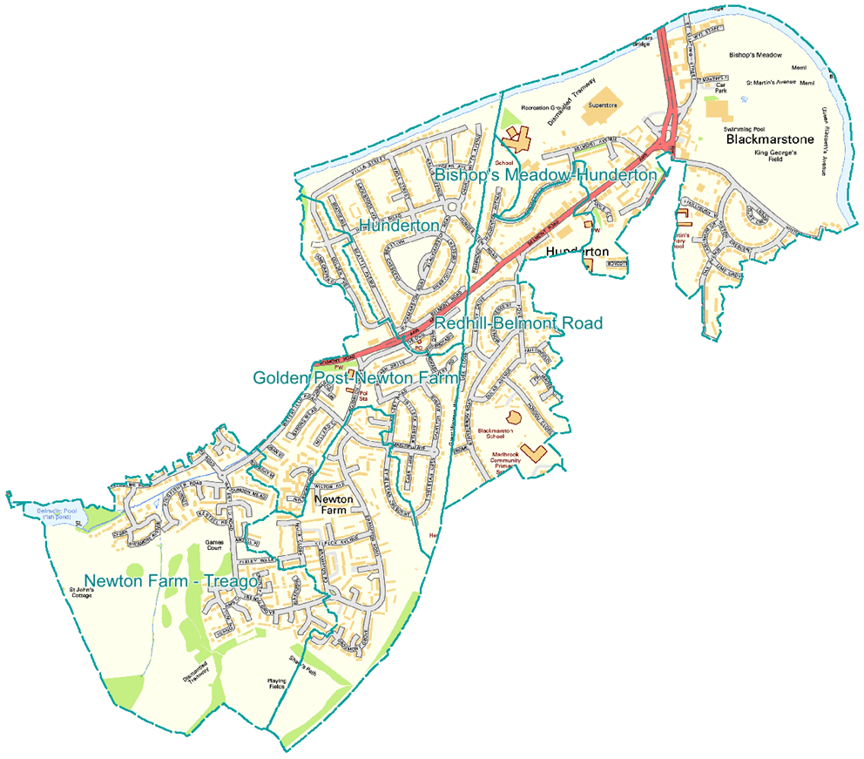
South Wye: Hunderton and Newton Farm (also including part of Red Hill) (May 2024)
Area of predominantly post-war housing estates, intersected by one of the main north-south routes through the county (A465, Belmont Road) as it joins the city’s only river crossings. Almost half of households are social renters.
Local amenities include fast food outlets and betting shops, plus the city’s only swimming pool and Belmont community country park.
9,400 residents; young age profile: high proportions of children and under 40s, with higher than average number of ‘white other’ ethnic group
Residents most likely to be registered at HMG (50%), Belmont (35%) or Wargrave House (9%) surgeries
Households twice as likely to be lone parents as county overall
Persistently high levels of deprivation: these are 6 of the 12 areas which make up Herefordshire’s most deprived 10%
  5 fall within the 25% most deprived in England (of only 11 in the county)
  ‘Golden Post-Newton Farm’ is the only county area amongst the 10% most deprived in England
  All feature in the most deprived locally across all types of deprivation, except geographical access to services and living environment (indoor and outdoor)
Higher unemployment and lower skills
  Three of the six county wards with the highest rates and absolute numbers of people claiming out-of-work benefits, both pre and post Covid: 4-5% of 16-64s in Mar’24 (Hfds: 2.5%)
  Higher proportions with no or low qualifications
  Twice as likely to work in routine occupations as county overall (>25%; Hfds 12%)
Health indicators:
  High levels of poor health and disability in ‘Golden Post-Newton Farm’ (41% disabled; Hfds 19%)
  Higher mortality rates, premature mortality and deaths considered preventable
  Higher levels of childhood obesity at ages 10/11 – although no longer significant at age 4/5
According to the 2023 Community Wellbeing Survey, people in the Hereford locality generally were more likely to:
  have not found it easy to pay household expenses in past year (42% vs 38%)
  have high anxiety levels (29% vs. 24% for county)
  want to see traffic congestion improved (14% vs. 8%)
and less likely to feel that:
  communities supported each other during the last year (70% vs. 75% county)
  they are safe after dark than residents of East and South & West (70% vs. ~80%)
Map: most deprived areas of the wards of Newton Farm, Hinton and Hunderton, and Red Hill
Find out more: ward profiles; Fingertips Local Health; Talk Community Wellbeing Survey

Slide 19
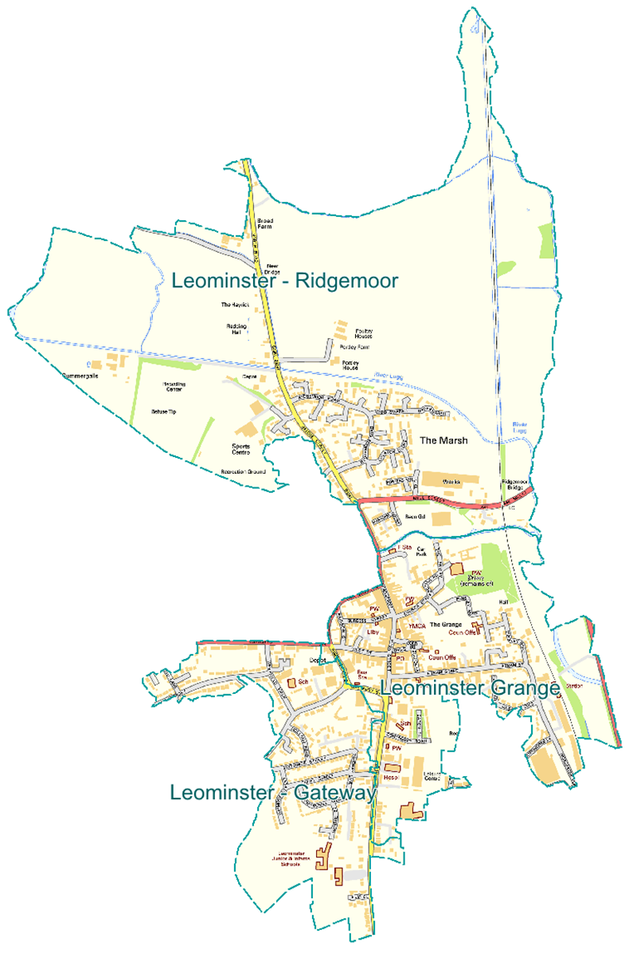
Leominster: Ridgemoor, Grange and Gateway (May 2024)
Encompassing Leominster town centre and nearby housing; including one of the county’s two areas of Air Quality Management in the county
4,600 residents mid-2022. Ridgemoor and Gateway have relatively young populations, with notably high numbers of children. Also high proportions of lone parents. Grange has high proportion of working age.
Almost all (95%) are registered with Ryelands GP surgery
Persistently high levels of deprivation: these are 3 of the 12 areas which make up Herefordshire’s most deprived 10%
  All feature in the most deprived locally across all types of deprivation, except geographical access to services and living environment (indoor and outdoor)
  25% of population living in income deprivation, even higher amongst children and older people
More than 1 in 4 have no qualifications (18% across county); high proportions work in routine occupations (19% vs 12% Hfds)
Relatively high unemployment: all 3 Leominster wards consistently above county rate; Leominster East highest rate in county (4.8% Mar’24)
High levels of renting than county overall, especially social housing. Private renting more common in Grange, where there are also a large number of houses of multiple occupation.
Health indicators (Leominster wards):
  Higher than average rates of childhood obesity
  Life expectancy in Leominster South and East wards below county figure
  Higher mortality rates, particularly from cancer and circulatory disease in Leo. S.
Map: most deprived areas of the wards of Leominster East, South, and North and rural
According to 2023
Community Wellbeing
Survey, people in the North
and West locality generally were more likely to:
  Feel that road and pavement repairs are most important to improve (57%). (Note highest priority in all areas)
  Rate their health as fair or poor (28% vs. 25% for county), and most likely (especially compared to the East)
  to be doing less physical activity since before the pandemic (25%)
  Feel unsafe when outside after dark (17%), particularly compared to those in the East (9%)
Find out more: Leominster ward profiles; Fingertips Local Health; Talk Community Wellbeing Survey

Slide 20
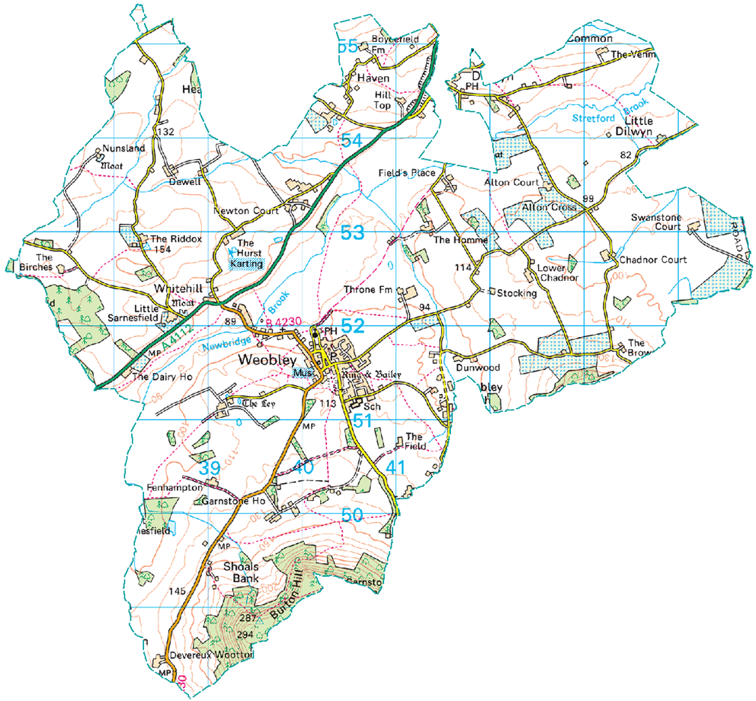
Weobley* (‘Greater Weobley’ Lower Super Output Area)
Large village in Weobley ward in north-west locality, between Leominster and Kington
Rural, but not that rural for Herefordshire – access to services less of an issue than elsewhere
Well served in terms of local amenities, e.g. GP surgery, primary and secondary schools, pharmacy, shops, pubs and restaurants
Almost all (94%) are registered with Weobley and Staunton-on-Wye GP
1,500 residents; older age profile compared to rest of county
  high proportion of older people, lower working age
  similar number of children overall, but higher proportion of teenagers
Higher levels of social renting than county overall (18 % vs 14%)
Overall, the most deprived rural area of Herefordshire; driven by income and employment measures – particularly child poverty
  Biggest gap with county figure is for child poverty (23% of under 16s compared to 13%)
  Unemployment benefit rates are similar to county overall; remain higher than pre-pandemic
Relatively high rate of overweight children in Reception (23%; Hfds 17% 20/21 to 22/23)
High level of Early Help intervention activity identified in 2018, felt to be due to high levels of community and partnership engagement with the service.
  Children’s Integrated Needs Assessment recommended that Weobley could be used as a successful case example for improving engagement in other areas
Map: Greater Weobley lower super output area
According to the 2023 Community Wellbeing Survey, people in the North and West locality generally were more likely to:
  Feel that road and pavement repairs are most important to improve (57%). (Note highest priority in all areas)
  Rate their health as fair or poor (28% vs. 25% for county), and most likely (especially compared to the East) to be doing less physical activity since before the pandemic (25%)
  Feel unsafe when outside after dark (17%), particularly compared to those in the East (9%)
Find out more: Weobley ward profile; Fingertips Local Health; Talk Community Wellbeing Survey

