Slide 1
Herefordshire economy & cost-of-living monthly monitoring report March 2024 Herefordshire Council Intelligence Unit

Slide 2
About the monthly monitoring report
The monthly monitoring report is a supplementary report to the quarterly Economy and Cost-of-Living Bulletin and provides the latest data from the limited number of datasets that are updated on a monthly basis.
If you need help to understand this document, or would like it in another format or language, please contact us on 01432 261944 or e-mail researchteam@herefordshire.gov.uk

Slide 3
Key points
The rate of inflation fell in February 2024; the Consumer Prices Index (CPI) rose by 3.4% in the 12 months to February 2024, down from 4.0% in January..
There are currently 13,370 people claiming Universal Credit in Herefordshire; significantly more than in the pandemic peak.
The number of people claiming out-of-work related benefits increased again in February 2024 to 2,690 and numbers remain significantly higher than pre-pandemic. Generally, those wards with the highest numbers of claimants before the pandemic still have the highest numbers now.
The number of unique job postings rose slightly in February 2024 but was lower than in the same month last year and remained well below the 12-month peak seen in June 2023.

Slide 4
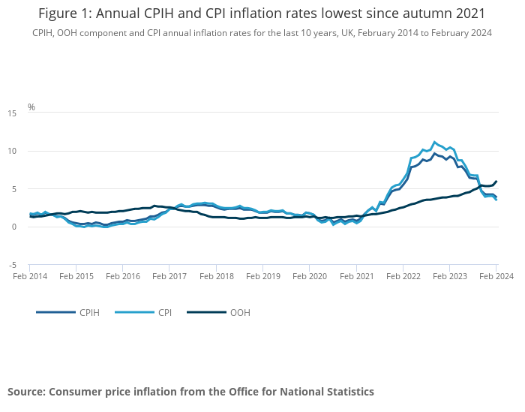
Inflation
Key points
ONS reports that the Consumer Prices Index including owner occupiers' housing costs (CPIH) rose by 3.8% in the 12 months to February 2024, down from 4.2% in January. On a monthly basis, CPIH rose by 0.6% in February 2024, compared with a rise of 1.0% in February 2023..
The Consumer Prices Index (CPI) rose by 3.4% in the 12 months to February 2024, down from 4.0% in January. On a monthly basis, CPI rose by 0.6% in February 2024, compared with a rise of 1.1% in February 2023.
The largest downward contributions to the monthly change in both CPIH and CPI annual rates came from food, and restaurants and cafes, while the largest upward contributions came from housing and household services, and motor fuels.
Core CPIH (excluding energy, food, alcohol and tobacco) rose by 4.8% in the 12 months to February 2024, down from 5.1% in January; the CPIH goods annual rate slowed from 1.8% to 1.1%, while the CPIH services annual rate eased slightly from 6.1% to 6.0%.
Core CPI (excluding energy, food, alcohol and tobacco) rose by 4.5% in the 12 months to February 2024, down from 5.1% in January; the CPI goods annual rate slowed from 1.8% to 1.1%, while the CPI services annual rate eased from 6.5% to 6.1%.
Need to know: The Consumer Prices Index including owner occupiers' housing costs (CPIH) is the lead and most comprehensive measure of consumer price inflation CPIH includes a measure of the costs associated with owning, maintaining and living in one's own home, known as owner occupiers' housing costs (OOH), along with Council Tax. Both are significant expenses for many households and are not included in the CPI. However, the Consumer Prices Index (CPI) is based on a harmonised methodology developed by Eurostat and allows for international comparisons to be drawn.
Source: ONS
Last updated: 20 March 2024
Frequency of update: Monthly
Next update: 17 April 2024

Slide 5
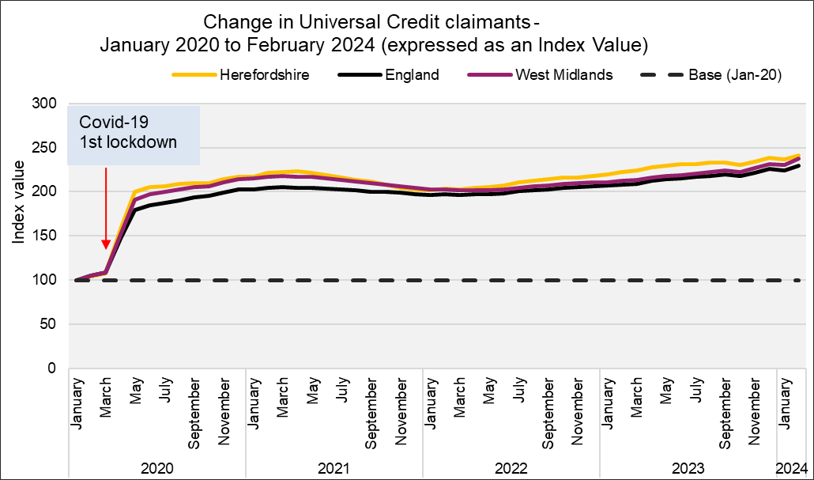
People claiming Universal Credit (UC)
Key points
The number of people claiming the Universal Credit (UC) doubled between March 2020 and May 2020. Since then the claimant numbers remained at a high level are currently on an upward trend. Provisional data suggest there were 13,370 Universal Credit claimants in Herefordshire in February 2024: 985 claimants more than the pandemic peak of 12,390 in April 2021.
In Herefordshire, UC claimants currently comprise 12% of the working age population; lower than the West Midlands Region (18%) and England (16%) but still more than double the 5% seen in March 2020.
The wards with the highest number of UC claimants were Hinton & Hunderton (775) and Newton Farm (680) followed by Leominster East (535), and Widemarsh (500).
In November 2023, there were 10,870 households in Herefordshire claiming Universal Credit, slightly up from 10,810 in October 2023 (both provisional) . Of these households over a half (5,600) contained at least one child.
Need to know:
The monthly number of people on Universal Credit includes all individuals who have an open claim on the count date for the month.
Some people will have their claim terminated either at the request of the individual or if their entitlement to Universal Credit ends. If a termination is recorded, but the person is still receiving a payment, then the claim will still be classed as live at the end of each reporting month.
The latest month's figures are provisional and are subject to change in the next publication where they will be revised and finalised. Monthly figures are currently not subject to retrospection beyond the first revision.
Data source: Date l Department for Work & Pensions (Stat-Xplore)
Last updated: 12 March 2024
Frequency of update: Monthly
Next update: 16 April 2024

Slide 6
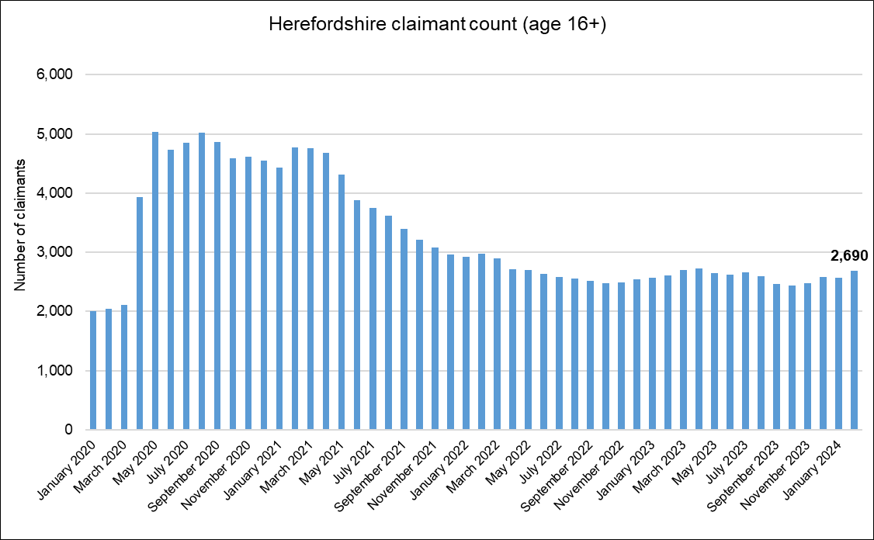
Out-of-work related claimant count: all ages
Key points
2,690 people aged 16+ in Herefordshire were claiming out-of-work-related benefits* in February 2024: up from the previous month by 120 claimants.
Numbers remain significantly higher than pre-pandemic levels, being 27% higher than in March 2020; a smaller increase than in England as a whole (32%).
There are currently around 435 fewer claimants than the peak in the aftermath of the Great Recession (February 2012).
The claimant count rate as a proportion of residents aged 16-64** was 2.5% in February 2024 compared to 3.9% for England and 5.0% for the West Midlands region.
Need to know
*The Claimant Count is an experimental statistic that measures the number of people who are claiming unemployment-related benefits. It does not meet the internationally agreed definition of unemployment specified by the International Labour Organisation (ILO). Claimant Count includes people claiming Jobseeker's Allowance plus those claiming Universal Credit who are required to seek and be available for work. However, not everyone who is unemployed claims these benefits and ONS advises that ‘the Claimant Count does not attempt to measure unemployment. However, since the people claiming benefits are generally a particular subset of the unemployed, the Claimant Count can provide a useful indication of how unemployment is likely to vary between areas and over time. The model-based estimates of unemployment, which are derived from the ONS Annual Population/Labour Force Survey are the official measure of unemployment. For more information on this topic see the Economics Help website.
** IMPORTANT: Note this rate is not comparable to the official UK unemployment rate which is expressed as a proportion of the economically active population aged 16+.
Data source: ONS - NOMIS Date last updated: 12 March 2024
Frequency of update: Monthly
Next update: 16 April 2024

Slide 7
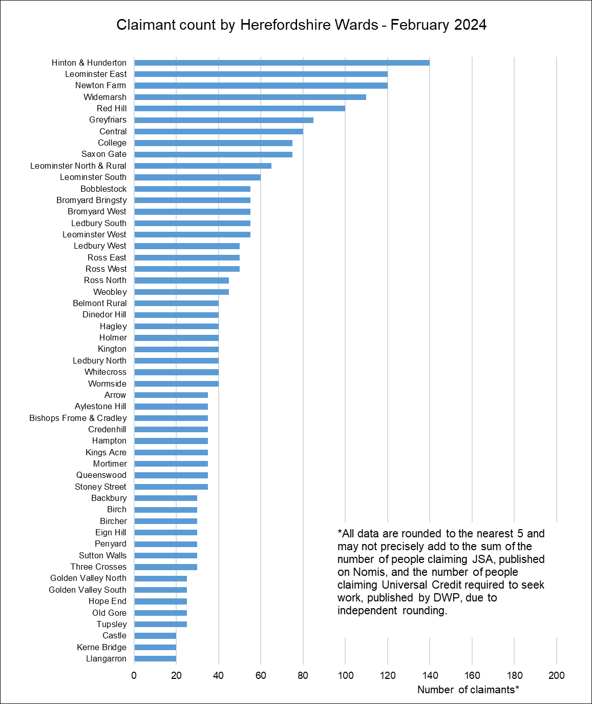
Out-of-work claimant count by ward
Key points
Generally, those wards with the highest numbers of claimants before the pandemic still have the highest numbers now.
In February 2024 the wards with the highest numbers of claimants were Hinton & Hunderton (140), Leominster East (120), Newton Farm (120). Widemarsh (110) and Red Hill (100).
The largest proportional increases in the claimant count since March 2020 have occurred in Ledbury South (117%), Kerne Bridge (100%), Sutton Walls (100%), and Ledbury North (80%).
In terms of numerical increases, the largest have been in Ledbury South (35 claimants), Widemarsh (35) and Central (30).
Data source: ONS - NOMIS Date last updated: 12 March 2024
Frequency of update: Monthly
Next update: 16 April 2024

Slide 8
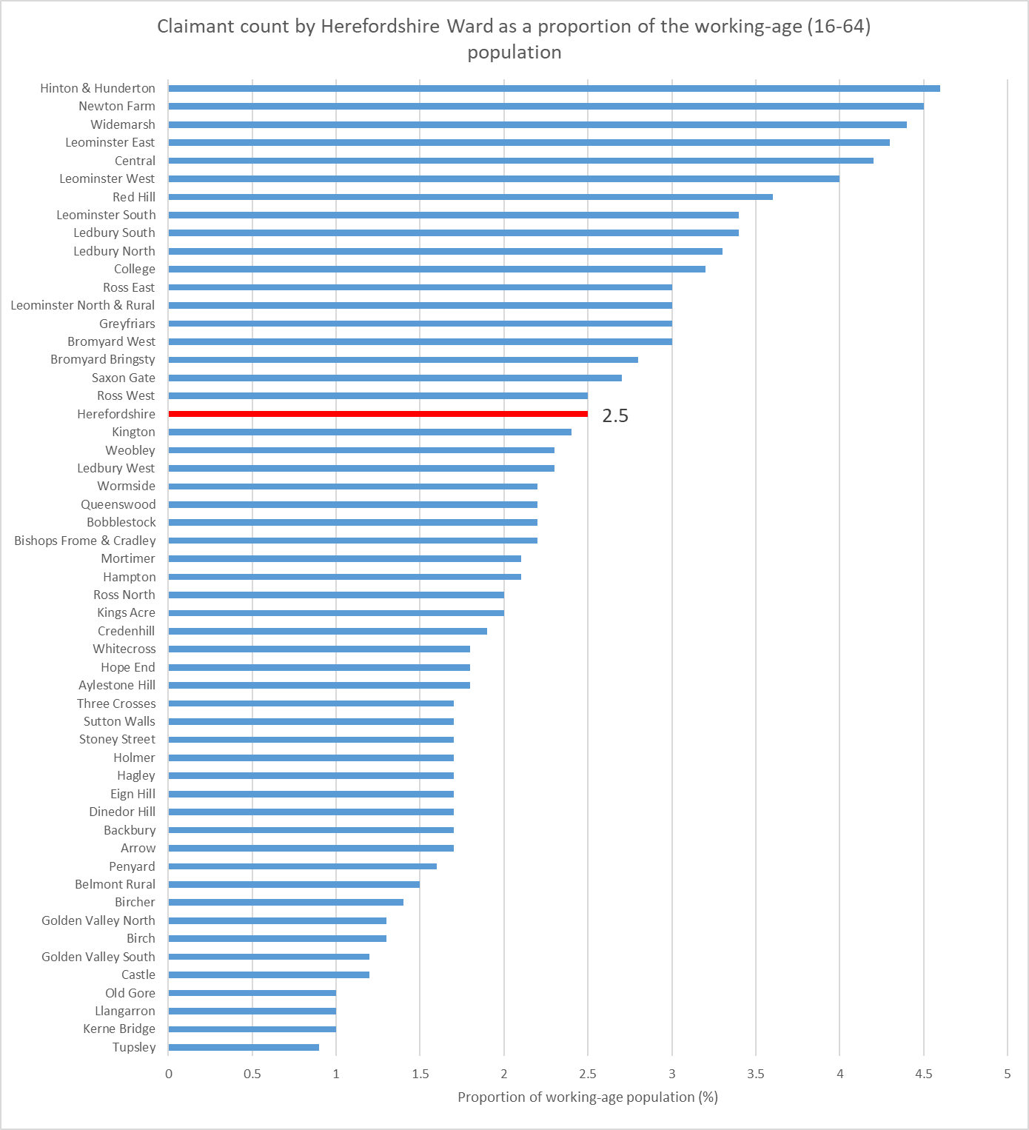
Out of work claimant count rate by ward
Key points
As the size of the working-age population (aged 16-64), who are eligible to claim out of work benefits, varies significantly between wards, it is useful to express the count as a rate, that is as a proportion of the working-age population.
However, it should be noted that due to the size of the population at ward level, relatively small changes in the numbers of claimants can have a significant impact on the rate.
As at February 2024, the wards with the highest claimant count rates were Hinton & Hunderton (4.6%), Newton Farm (4.5%), Widemarsh (4.4%), Leominster East (4.3%) and Central (4.2%).
The lowest rates were in Tupsley (0.9%), Kerne Bridge, Llangarron and Old Gore (all 1.0%).
The rate for Herefordshire as a whole was 2.5%.
Data source: ONS - NOMIS Date last updated: 12 March 2024
Frequency of update: Monthly
Next update: 16 April 2024

Slide 9
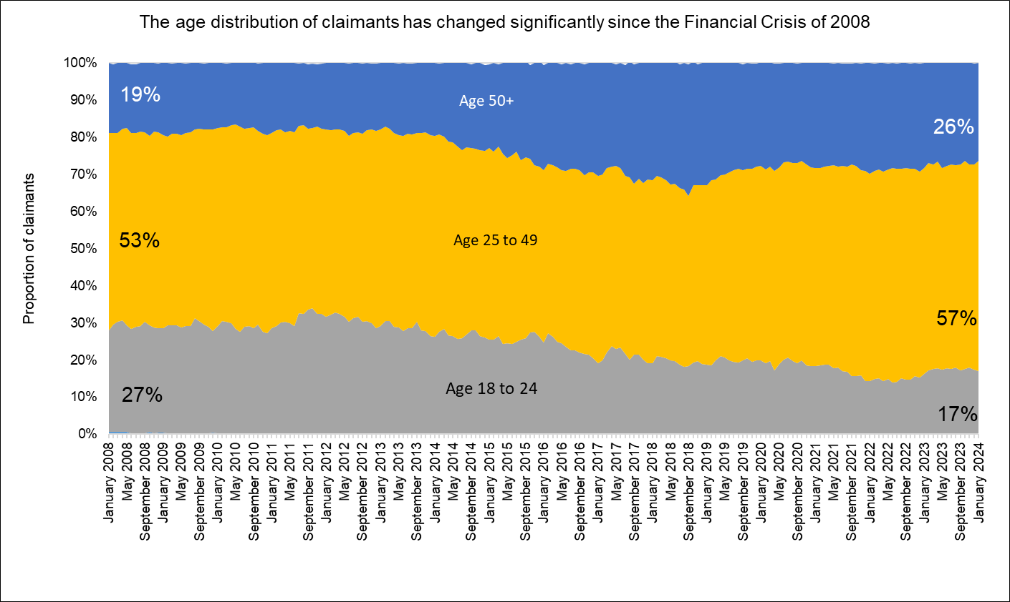
Age distribution of out-of-work claimants
Key points
Nationally, it has been reported that in the period November 2022 to January 2023, 3.5 million people aged 50 to 64 were out of work and not looking for work, compared to 3.3 million people of that age in January to March 2020: a rise of 280,000 people. The inactivity rate for those aged 50 to 64 rose by 1.7 percentage points, from 25.5% at the start of the pandemic to 27.2% in November to January 2023. This rise came after years of falling economic inactivity among this age group before the pandemic. Ill-health and/or early retirement have been identified as the primary drivers for the increase.
However, barriers to accessing employment may also be a factor and this is supported by the changing age profile of those who are out of work and claiming out-of-work benefits (the eligibility criteria for which include an expectation to be looking for work).
Recent IFS research suggests that nationally many older workers were forced out of employment (through the jobs they were in not being compatible with home working and/or health fears) during the COVID-19 pandemic and that people who become inactive at older ages often never re-enter the workforce.
Looking at the age distribution of Herefordshire’s out-of-work benefit claimants now compared to January 2008 (before the Financial Crisis and the Great Recession) this has changed significantly.
In January 2008, 18 to 24 year olds accounted for 27% of claimants and over 50s accounted for 19% of claimants in Herefordshire. In January 2024 18 to 24 year-olds accounted for 17% of claimants and over 50s 26% of claimants, completely reversing the distribution at the start of the period.
This change is partly a reflection of our ageing workforce but may also indicate that older workers who want to work are finding it harder to get another job than they did in the past.
Data source: ONS - NOMIS Date last updated: 12 March 2024
Frequency of update: Monthly
Next update: 16 April 2024

Slide 10
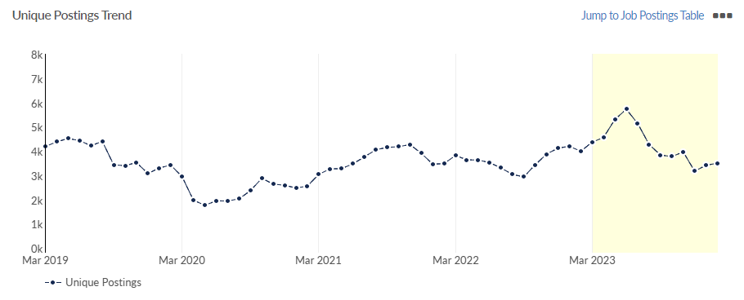
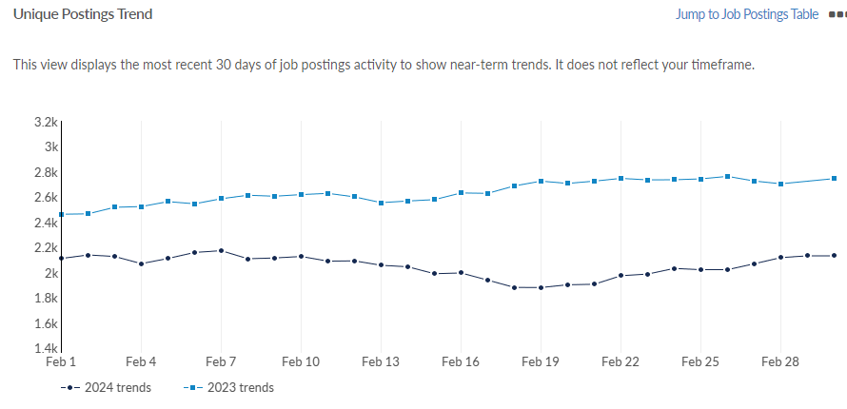
Job postings
Key points
In Herefordshire, during the period from March 2023 to February 2024 there were 56,775 job postings, of which 22,647 were unique. The number of unique posting rose in February 2024 to 3,505, up from 3,423 in January (+2%) (revised) but remains well below the 12-month peak in June last year (5,732).
In February 2024 the number of unique postings was lower than a year ago (4,001 in February 2023), and is similar to the number immediately before the first pandemic lockdown (3,430 in February 2020).
The top ten posted occupations (SOC 3 level) in the period March 2023 to February 2024 were caring personal services (1,583 unique postings), nursing professionals (927), sales related occupations (917), and other elementary service occupations (837). Top posted job titles in this period were support workers (749 unique postings), cleaners (272), care assistants (231) and healthcare assistants (214).
The most in-demand specialized skills in this period (by frequency in job postings) were auditing, finance and nursing.
Need to know: A unique job posting is one that has been de-duplicated as postings can appear on multiple websites, multiple times. Data include voluntary, internships, side jobs and freelance.
The Standard Occupational Classification (SOC) is a common classification of occupational information for the UK and comprises 4 tiers with 4 being the most detailed.
Source: Lightcast (EMSI): economicmodelling.co.uk
Date last updated: 4 March 2024
Frequency of update: Monthly
Next update: April 2024

Slide 11
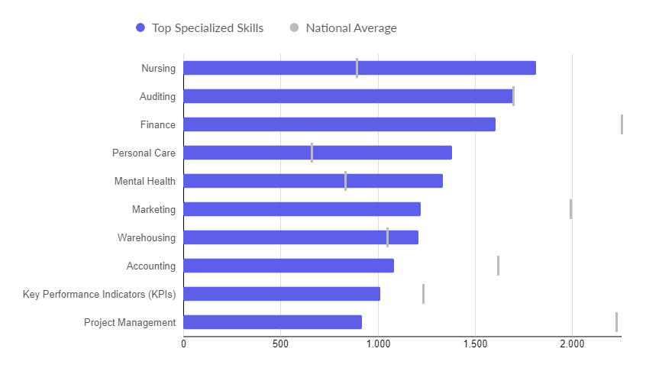
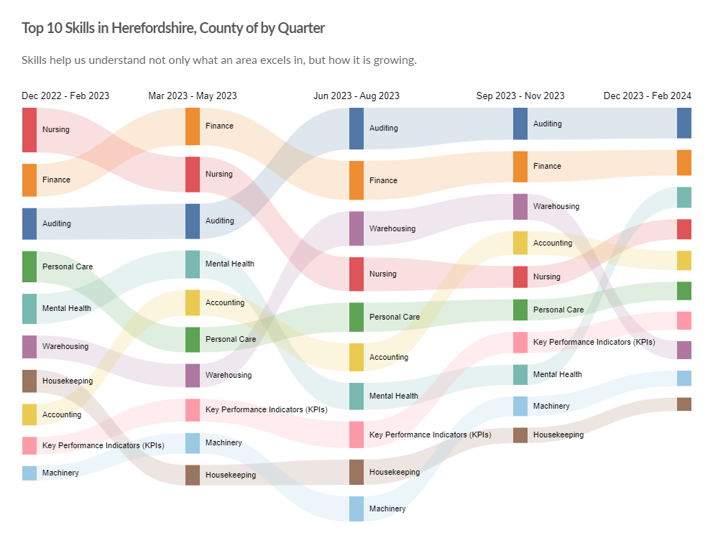
In-demand skills
Top hard skills
Top 10 hard skills by quarter
Need to know: Hard skills are abilities that have been taught to or learnt by a person.
Source: Lightcast (EMSI): economicmodelling.co.uk
Date last updated: 4 March 2024
Frequency of update: Monthly
Next update: April 2024

Slide 12
Hard to fill vacancies
SOC | Occupation | Median Posting Duration from Mar 2023 - Feb 2024 | Unique Postings from Mar 2023 - Feb 2024 | Avg. Posting Intensity (Mar 2023 - Feb 2024)
812 | Metal Working Machine Operatives | 52 | 1 | 4 : 1
116 | Senior Officers in Protective Services | 47 | 10 | 5 : 1
215 | Conservation and Environment Professionals | 44 | 22 | 2 : 1
247 | Librarians and Related Professionals | 44 | 10 | 2 : 1
342 | Design Occupations | 41 | 30 | 3 : 1
631 | Community and Civil Enforcement Occupations | 38 | 7 | 3 : 1
356 | Public Services Associate Professionals | 36 | 12 | 2 : 1
221 | Medical Practitioners | 35 | 210 | 3 : 1
524 | Electrical and Electronic Trades | 35 | 96 | 2 : 1
225 | Other Health Professionals | 34 | 208 | 3 : 1
624 | Cleaning and Housekeeping Managers and Supervisors | 34 | 28 | 3 : 1
211 | Natural and Social Science Professionals | 33 | 46 | 3 : 1
343 | Sports and Fitness Occupations | 33 | 115 | 2 : 1
358 | Regulatory Associate Professionals | 33 | 115 | 3 : 1
523 | Vehicle Trades | 33 | 239 | 2 : 1
521 | Metal Forming, Welding and Related Trades | 32 | 153 | 2 : 1
613 | Caring Personal Services | 32 | 1,583 | 5 : 1
722 | Customer Service Supervisors | 32 | 96 | 2 : 1
815 | Construction Operatives | 32 | 8 | 2 : 1
921 | Elementary Administration Occupations | 32 | 20 | 2 : 1
115 | Managers and Directors in Retail and Wholesale | 31 | 380 | 3 : 1
117 | Health and Social Services Managers and Directors | 31 | 319 | 5 : 1
232 | Other Educational Professionals | 31 | 155 | 3 : 1
241 | Legal Professionals | 31 | 191 | 2 : 1
244 | Business and Financial Project Management Professionals | 31 | 33 | 2 : 1
246 | Welfare Professionals | 31 | 832 | 3 : 1
321 | Health Associate Professionals | 31 | 386 | 3 : 1
341 | Artistic, Literary and Media Occupations | 31 | 181 | 2 : 1
355 | Sales, Marketing and Related Associate Professionals | 31 | 487 | 2 : 1
413 | Administrative Occupations: Records | 31 | 253 | 3 : 1
712 | Sales Related Occupations | 31 | 917 | 3 : 1
713 | Shopkeepers and Sales Supervisors | 31 | 150 | 4 : 1
811 | Process Operatives | 31 | 80 | 2 : 1
816 | Production, Factory and Assembly Supervisors | 31 | 55 | 2 : 1
923 | Elementary Security Occupations | 31 | 112 | 3 : 1
926 | Other Elementary Services Occupations | 31 | 837 | 3 : 1
 | Total Across All Occupations | 30 | 22,533 | 3 : 1
Key points
CIPD reports that nationally 38% of employers surveyed have hard-to-fill vacancies and that hard-to-fill vacancies are significantly higher in the public sector (51%) than the private sector (34%)
There is no standard definition of a “hard-to-fill” vacancy and no equivalent survey to that undertaken by CIPD at local level, but the table shows those occupations (SOC 3 level) for the period March 2023 to February 2024 with a higher than average posting intensity. Those which also have a higher than average median posting duration (highlighted in red) are likely to be those most difficult to fill.
This is the most timely proxy for “hard-to-fill” vacancies and although there are some issues associated with this methodology, it has been shown to be a robust approximation.
Source: Lightcast (EMSI): economicmodelling.co.uk
Date last updated: 4 March 2024
Frequency of update: Monthly
Next update: April 2024
Need to know: Posting Intensity is a ratio of total job postings to unique, or de-duplicated, job postings. A higher than average posting intensity can mean that employers are putting more effort than normal into hiring that position. Posting intensity is available by occupation, by job title, by company, and by region. The median posting duration (how long a posting was live before it was taken down) can be compared to the regional average for all postings in the region, giving an indication of whether these positions are harder or easier to fill than the typical job posting.

