Slide 1

Herefordshire economy and cost-of-living bulletin
January 2024
Herefordshire Council Intelligence Unit

Slide 2
About this bulletin
The purpose of this bulletin is to provide local intelligence relating to the cost-of-living crisis and the groups likely to be most affected. It contains data and intelligence covering a range of relevant socio-economic indicators, acting as an evidence base to inform policy interventions. Most of the open source data presented are published retrospectively, so it is not possible to observe the impact of the cost-of-living crisis in real time, but the data can still provide important context, identifying pre-existing strengths and vulnerabilities, and identifying groups and areas likely to be disproportionately affected. There are a limited number of datasets that are updated on a more regular and timely basis – these can be found in Section 1.
The bulletin comprises four sections and appendices:
  Section 1: Monthly monitor – benefit claimants and job postings
  Section 2: The local economy
  Section 3: Household finances
  Section 4: Income deprivation, poverty and homelessness
  Appendix 1: Useful resources
  Appendix 2 - Composition of Herefordshire’s economy
If you need help to understand this document, or would like it in another format or language, please contact us on 01432 261944 or e-mail researchteam@herefordshire.gov.uk

Slide 3
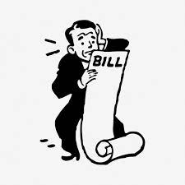
The big picture
Coming hot on the heels of the Covid-19 pandemic, which delivered the biggest shock to the UK economy in 300 years, the ongoing cost-of-living crisis is causing real hardship to millions of people across the country and is widening existing inequalities, with the biggest impacts being felt by the poorest and the young. While the rate of inflation is now falling faster than expected, prices still continue to rise. Cost-of-living wise, 2024 is likely to be complicated, with winners and losers, and with housing costs coming to the fore as an issue. Meanwhile, in the wider economy anaemic growth and lack of investment are areas of ongoing concern.
Economist Torsten Bell (Chief Executive of The Resolution Foundation) believes that in 2024 ‘those that own their home outright, alongside those who benefit most from tax cuts and wage rises, may think a corner has been turned. Those seeing their mortgages and rents surge, or benefit support cut back, most certainly won’t’ and ‘incomes for poorer households will likely fall as cost of living support comes to an end’. Overall, he suggests that ‘British households are on course to be poorer (by 4 per cent, or £1,200 on average) going into the coming election than they were coming out of the last one - something never seen before in modern British history’. (TOTC 29 December 2023).
Herefordshire, whilst overall being a relatively affluent area, has some long-standing underlying vulnerabilities, which are mostly linked to its rurality and feed into the cost-of-living pressures many people are continuing to feel. These include:
Larger than average agriculture and manufacturing sectors and levels of self-employment, with one of the lowest levels of productivity amongst comparable areas of the UK contributing to a low-wage, low-skill economy, and a social mobility ‘cold spot’.
One of the worst levels of housing affordability in the West Midlands region.
Higher than average levels of fuel poverty, linked to an over-representation of older, poorly insulated houses, coupled with low wages and a lower than average proportion of homes with mains gas.
Limited public transport infrastructure across much of the county and a reliance on private cars and vans to get around.
Significant levels of digital exclusion (which are more related to age and deprivation than lack of infrastructure).
Credit: rawpixel.com

Slide 4
Key points (sections 1 & 2)
Unexpectedly, the rate of Inflation rose on December 2023 - the Consumer Prices Index (CPI) rose by 4.0% in the 12 months to December 2023, up from 3.9% in November; the first time the rate has increased since February 2023.
The number of people claiming Universal Credit is gradually increasing and at 13,210 is currently significantly higher than the pandemic peak. The number of people claiming out-of-work related benefits increased in December 2023 to 2,605 and numbers remain significantly higher than pre-pandemic.
The number of unique job postings rose slightly in November 2023 and was similar to the same month last year but higher than immediately prior to the Covid-19 pandemic.
In 2020 Herefordshire’s Gross Domestic Product (GDP) fell sharply to it’s lowest level in real terms since 2013 but recovered somewhat in 2021. Over the past two decades per capita GDP has consistently lagged behind England and the West Midlands region. The value of goods and services produced (GVA) shrank to pre-2014 levels during the pandemic. Herefordshire also has one of the lowest levels of labour productivity amongst ITL3 areas of the UK.
The latest estimate of unemployment (for the period October 2022 to September 2023) is 2.7% of adults aged 16+ (c.2,600 people); significantly lower than nationally and regionally.
Latest data suggest c.5,800 people in Herefordshire aged 16-64 are economically inactive due to long-term sickness.
In 2022 the estimated proportion of workless households increased slightly but was lower than in England and the West Midlands region, although not significantly so..
Herefordshire has a smaller proportion of the working-age population qualified to NVQ4 and above than regionally and nationally and higher proportion of young people not in education, employment or training (NEET) than nationally, with young people from areas of highest deprivation significantly more likely to be NEET.

Slide 5
Key points (sections 3 & 4)
Average gross weekly earnings grew faster than nationally or regionally in 2023 but remain significantly lower than the average for both the West Midlands and England as a whole. The gap is largest amongst full-time male workers. Higher than average proportion of self-employed, whose median earnings are below the West Midlands average. In 2021 Gross Disposable Household Income increased more than nationally but remained lower than the average for England.
Median house prices significantly higher than the West Midlands region average and housing affordability significantly worse than regionally and nationally. Median monthly rents (all property types) lower than regionally or nationally but rising in line with the national and regional trend. In Q3 2023/24, mortgage possessions in Herefordshire were lower than in the previous quarter but landlord possessions more than doubled, although the levels of both are still historically low.
Among people supported by Citizens Advice, the top debt issue faced by people in Herefordshire is currently Council Tax arrears, replacing energy debt. The proportion of people being helped with crisis support in Herefordshire has fallen and is relatively low compared to some areas of the country but remains much higher than pre-pandemic..
Before the current crisis, in 2021/22 18.6% of children were living in relative poverty: a significantly lower proportion than nationally and regionally, however analysis by JRF using 2020/21 data suggests that after housing costs the proportion is much higher (27%) and above the average for England (22%).
Fuel poverty increased in 2021 and Herefordshire already had a higher proportion of homes deemed to have an excess cold hazard than nationally.
Between 2020-21 and 2022-23 the number of households that were either homeless (with a relief duty owed) or threatened with homeless (preventing duty owed) increased.

Slide 6
Section 1: Monthly monitor – Universal Credit and out-of-work benefit claimants, and job postings
The data in this section are those that are updated monthly (in arrears)

Slide 7
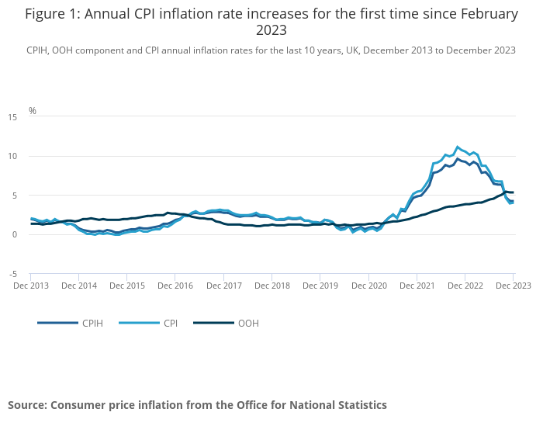
Inflation
Key points
ONS reports that Consumer Prices Index including owner occupiers’ housing costs (CPIH) rose by 4.2% in the 12 months to December 2023, the same rate as in November. On a monthly basis, CPIH rose by 0.4% in December 2023, the same rate as in December 2022.
The Consumer Prices Index (CPI) rose by 4.0% in the 12 months to December 2023, up from 3.9% in November, and the first time the rate has increased since February 2023. On a monthly basis, CPI rose by 0.4% in December 2023, the same rate as in December 2022.
The largest upward contribution to the monthly change in both CPIH and CPI annual rates came from alcohol and tobacco while the largest downward contribution came from food and non-alcoholic beverages.
Core CPIH (excluding energy, food, alcohol and tobacco) rose by 5.2% in the 12 months to December 2023, the same rate as in November; the CPIH goods annual rate slowed from 2.0% to 1.9%, while the CPIH services annual rate remained at 6.0%.
Core CPI (excluding energy, food, alcohol and tobacco) rose by 5.1% in the 12 months to December 2023, the same rate as in November; the CPI goods annual rate slowed from 2.0% to 1.9%, while the CPI services annual rate increased from 6.3% to 6.4%.
Need to know: The Consumer Prices Index including owner occupiers' housing costs (CPIH) is the lead and most comprehensive measure of consumer price inflation CPIH includes a measure of the costs associated with owning, maintaining and living in one's own home, known as owner occupiers' housing costs (OOH), along with Council Tax. Both are significant expenses for many households and are not included in the CPI. However, the Consumer Prices Index (CPI) is based on a harmonised methodology developed by Eurostat and allows for international comparisons to be drawn.
Source: ONS
Last updated: 17 January 2024
Frequency of update: Monthly
Next update: 14 February 2024

Slide 8
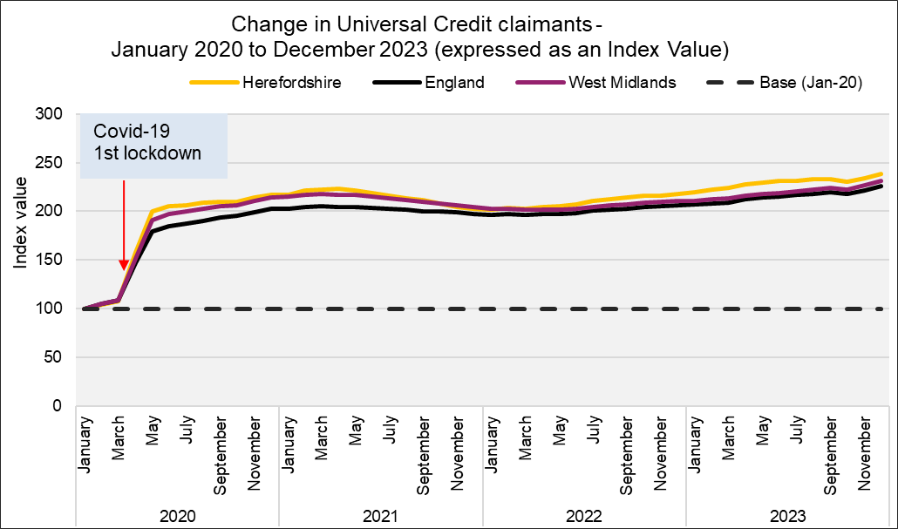
People claiming Universal Credit (UC)
Key points
The number of people claiming the Universal Credit (UC) doubled between March 2020 and May 2020. Since then the claimant numbers remained at a high level are currently on an upward trend. Provisional data suggest there were 13,210 Universal Credit in claimants in Herefordshire in December 2023: 828 claimants more than the pandemic peak of 12,390 in April 2021.
In Herefordshire, UC claimants currently comprise 12% of the working age population; lower than the West Midlands Region (18%) and England (16%) but still more than double the 5% seen in March 2020.
The wards with the highest number of UC claimants were Hinton & Hunderton (770) and Newton Farm (670) followed by Leominster East (530), and Widemarsh (510).
In August 2023, there were 10,745 households in Herefordshire claiming Universal Credit, slightly up from 10,695 in July 2023 (both provisional) . Of these households over a half (5,495) contained at least one child.
Need to know:
The monthly number of people on Universal Credit includes all individuals who have an open claim on the count date for the month.
Some people will have their claim terminated either at the request of the individual or if their entitlement to Universal Credit ends. If a termination is recorded, but the person is still receiving a payment, then the claim will still be classed as live at the end of each reporting month.
The latest month's figures are provisional and are subject to change in the next publication where they will be revised and finalised. Monthly figures are currently not subject to retrospection beyond the first revision.
Data source: Date l Department for Work & Pensions (Stat-Xplore)
Last updated: 17 January 2024
Frequency of update: Monthly
Next update: 13 February 2024

Slide 9
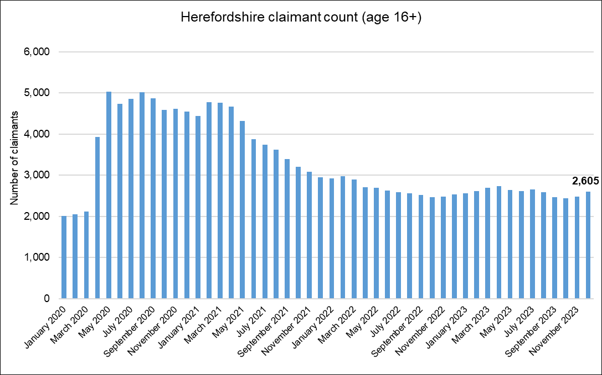
Out-of-work related claimant count: all ages
Key points
2,605 people aged 16+ in Herefordshire were claiming unemployment related benefits* in December 2023: up from the previous month by 130 claimants.
Numbers remain significantly higher than pre-pandemic levels, being 23% higher than in March 2020; a smaller increase than in England as a whole (27%).
There are currently around 520 fewer claimants than the peak in the aftermath of the Great Recession (February 2012).
The claimant count rate a proportion of residents aged 16-64 was 2.4% in December 2023 compared to 3.8% for England and 4.9% for the West Midlands region.
What this doesn’t tell us:
Claimant count is NOT a full measure of unemployment, but it is the most timely indicator.
From these data, we do not know which industry sector(s) any increases or decreases are being driven by.
Need to know
*Includes people claiming Jobseeker's Allowance plus those claiming Universal Credit who are required to seek and be available for work.
Month-by-month comparisons are difficult as previous data is often revised
Data source: ONS - NOMIS
Date last updated: 16 January 2024
Frequency of update: Monthly
Next update: 13 February 2024

Slide 10
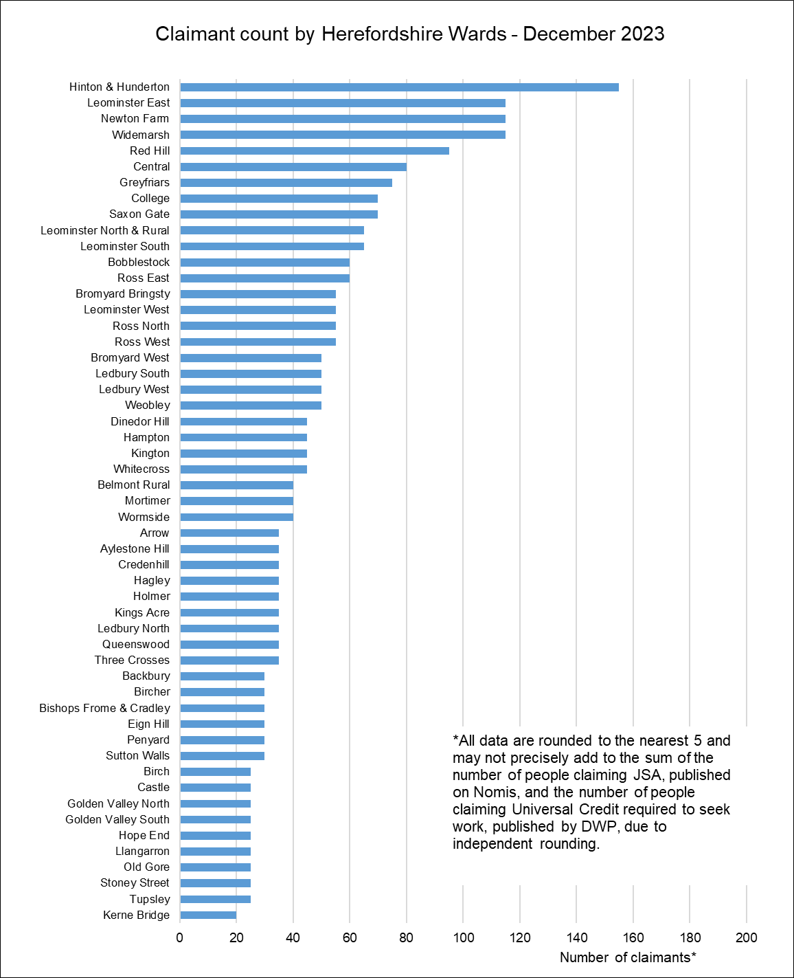
Out-of-work claimant count by ward
Key points
Generally, those wards with the highest numbers of claimants before the pandemic still have the highest numbers now.
In December 2023, the wards with the highest numbers of claimants were Hinton & Hunderton (155) and Leominster East, Newton Farm and Widemarsh (all 115).
The largest proportional increases in the claimant count since March 2020 have occurred in Kerne Bridge (100%), Dinedor Hill and Hampton (both 80%) and Three Crosses (75%).
In terms of numerical increases, the largest have been in Widemarsh (35 claimants) and Hinton & Hunderton and Central (both 25).
Data source: ONS - NOMIS
Date last updated: 16 January 2024
Frequency of update: Monthly
Next update: 13 February 2024

Slide 11
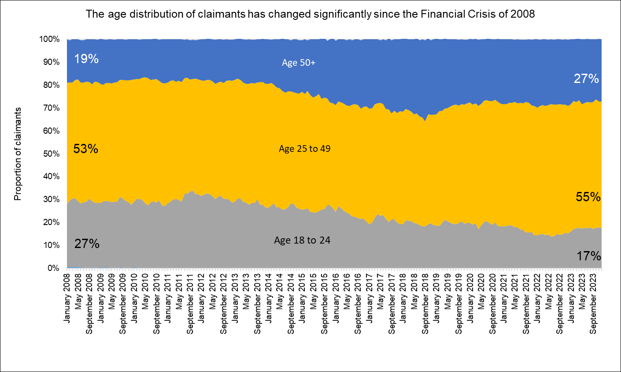
Age distribution of out-of-work claimants
Key points
Looking at the age distribution of out-of-work benefit claimants in January 2008, before the Financial Crisis and the Great Recession, this has changed significantly.
In January 2008, 18 to 24 year olds accounted for 27% of claimants and over 50s accounted for 19% of claimants. In December 2023, 18 to 24 year-olds accounted for 17% of claimants and over 50s 27% of claimants, completely reversing the distribution at the start of the period.
This trend is partly a reflection of our ageing workforce but may also be an indicator of discrimination in the labour market whereby older workers who want to work find it harder to find another job than they did in the past. Recent IFS research suggests that nationally many older workers were forced out of employment (through the jobs they were in not being compatible with home working and/or health fears) during the COVID-19 pandemic and that people who become inactive at older ages often never re-enter the workforce.
Data source: ONS - NOMIS
Date last updated: 16 January 2024
Frequency of update: Monthly
Next update: 13 February 2024

Slide 12
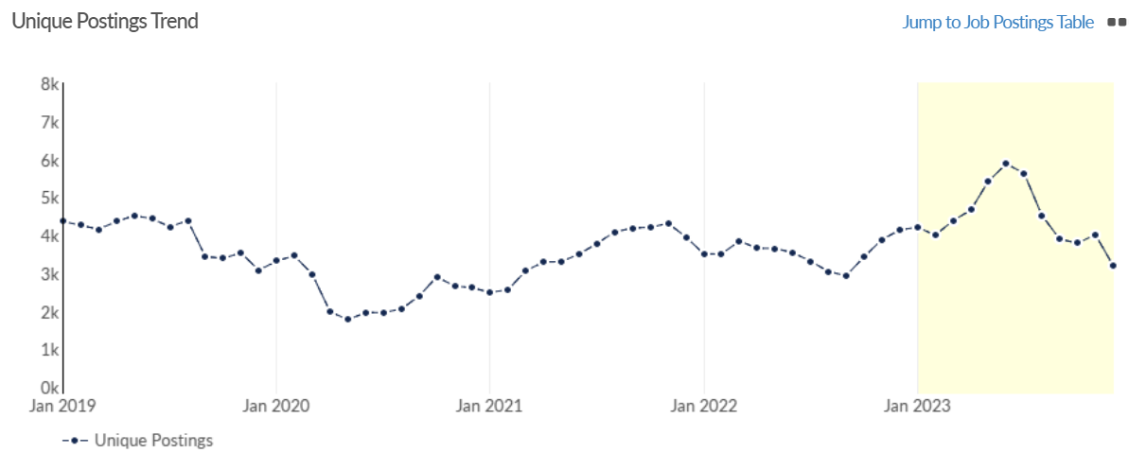
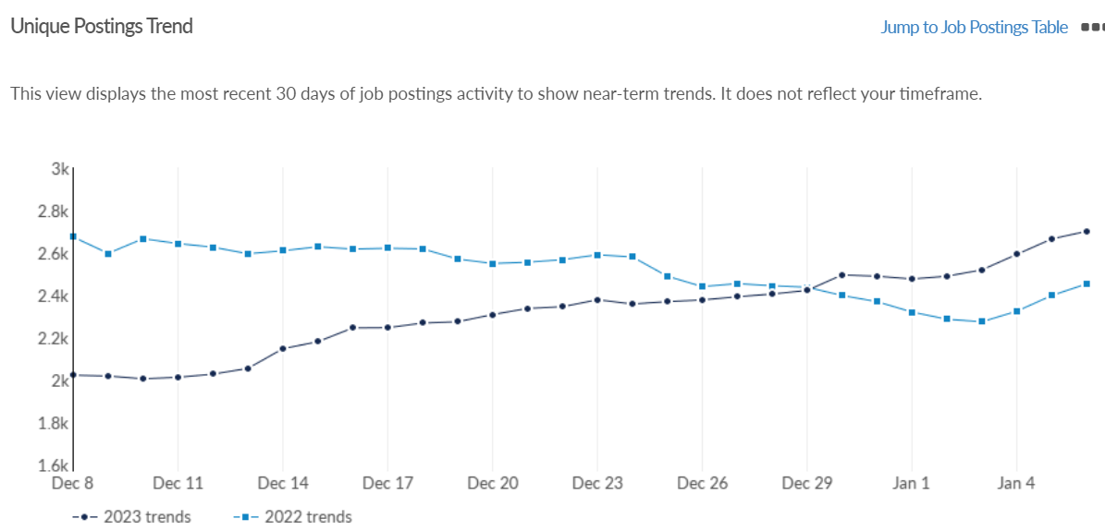
Job postings
Key points
In Herefordshire, during the period from January to December 2023 there were 59,224 job postings, of which 22,687 were unique. The number of unique posting fell n December 2023 to 3,195: down from 4,008 in November (-20%) (revised) and is now well below their 12-month peak in June last year (5,877).
In December 2023 the number of unique postings was lower than a year ago (4,130 in December 2022), but still higher than immediately before the first pandemic lockdown (3,451 in February 2020).
The top ten posted occupations (SOC 3 level) in the period January to December 2023 were caring personal services (1,819 unique postings), nursing professionals (995), sales related occupations (888), and welfare professionals (837). Top posted job titles in this period were support workers (805 unique postings), healthcare assistants (285), cleaners (258) and care assistants (236).
The most in-demand specialized skills in this period (by frequency in job postings) were auditing, finance and nursing.
Need to know: A unique job posting is one that has been de-duplicated as postings can appear on multiple websites, multiple times. Data include voluntary, internships, side jobs and freelance.
The Standard Occupational Classification (SOC) is a common classification of occupational information for the UK and comprises 4 tiers with 4 being the most detailed.
Source: Lightcast (EMSI): economicmodelling.co.uk
Date last updated: 8 January 2024
Frequency of update: Monthly
Next update: February 2024

Slide 13
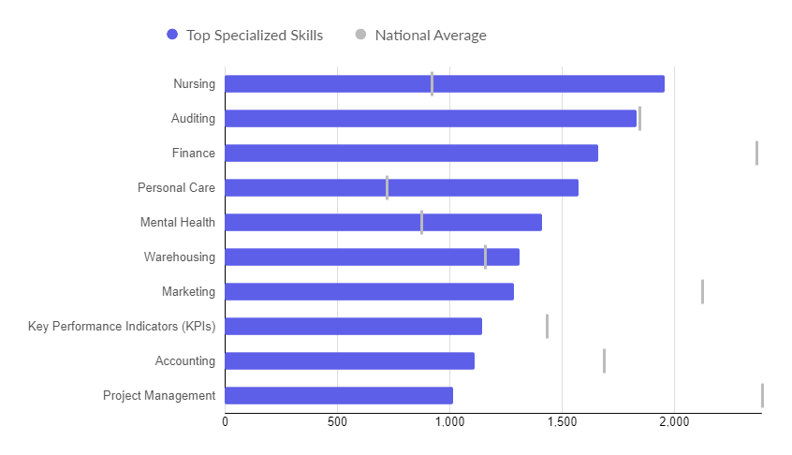
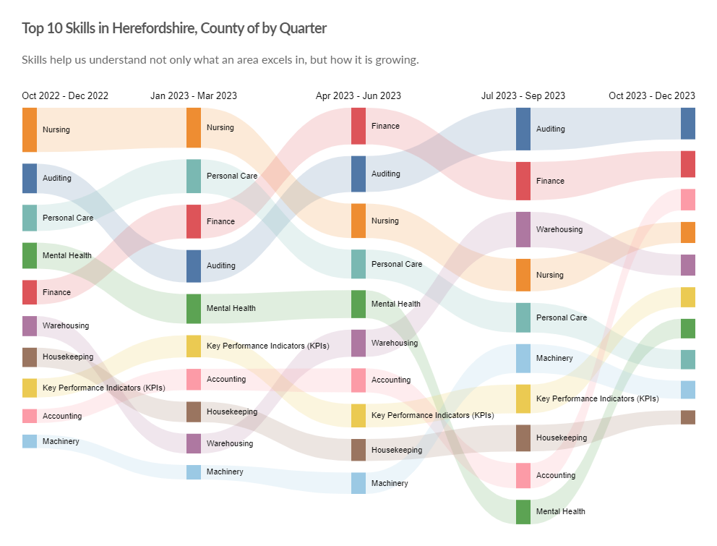
In-demand skills
Top hard skills
Top 10 hard skills by quarter
Need to know: Hard skills are abilities that have been taught to or learnt by a person.
Source: Lightcast (EMSI): economicmodelling.co.uk
Date last updated: 8 January 2024
Frequency of update: Monthly
Next update: February 2024

Slide 14
Hard to fill vacancies
Key points
CIPD reports that nationally 41% of employers surveyed in the three months to December 2023 have hard-to-fill vacancies. Hard-to-fill vacancies remain a problem for the public sector, with 51% reporting having them. The level of employers in the private sector reporting hard-to-fill vacancies is lower at 38%
There is no standard definition of a “hard-to-fill” vacancy and no equivalent survey to that undertaken by CIPD at local level, but the table shows those occupations (SOC 3 level) for the period January to December 2023 with a higher than average posting intensity. Those which also have a higher than average median posting duration (highlighted in red) are likely to be those most difficult to fill.
This is the most timely proxy for “hard-to-fill” vacancies and although there are some issues associated with this methodology, it has been shown to be a robust approximation.
SOC | Occupation | Median Posting Duration from Jan 2023 - Dec 2023 | Unique Postings from Jan 2023 - Dec 2023 | Avg. Posting Intensity (Jan 2023 - Dec 2023)
115 | Managers and Directors in Retail and Wholesale | 34 | 341 | 4 : 1
116 | Senior Officers in Protective Services | 23 | 15 | 4 : 1
216 | Research and Development (R&D) and Other Research Professionals3 | 29 | 49 | 4 : 1
222 | Therapy Professionals | 28 | 277 | 4 : 1
225 | Other Health Professionals | 34 | 242 | 4 : 1
246 | Welfare Professionals | 30 | 837 | 4 : 1
322 | Welfare and Housing Associate Professionals | 27 | 341 | 4 : 1
525 | Skilled Metal, Electrical and Electronic Trades Supervisors | 31 | 85 | 4 : 1
713 | Shopkeepers and Sales Supervisors | 29 | 181 | 4 : 1
821 | Road Transport Drivers | 29 | 659 | 4 : 1
117 | Health and Social Services Managers and Directors | 34 | 304 | 5 : 1
613 | Caring Personal Services | 31 | 1,819 | 5 : 1
223 | Nursing Professionals | 29 | 995 | 6 : 1
 | Total Across All Occupations | 30 | 22,569 | 3 : 1
Need to know: Posting Intensity is a ratio of total job postings to unique, or de-duplicated, job postings. A higher than average posting intensity can mean that employers are putting more effort than normal into hiring that position. Posting intensity is available by occupation, by job title, by company, and by region. The median posting duration (how long a posting was live before it was taken down) can be compared to the regional average for all postings in the region, giving an indication of whether these positions are harder or easier to fill than the typical job posting.
Source: Lightcast (EMSI): economicmodelling.co.uk
Date last updated: 8 January 2024
Frequency of update: Monthly
Next update: February 2024

Slide 15
Section 2: The local economy

Slide 16
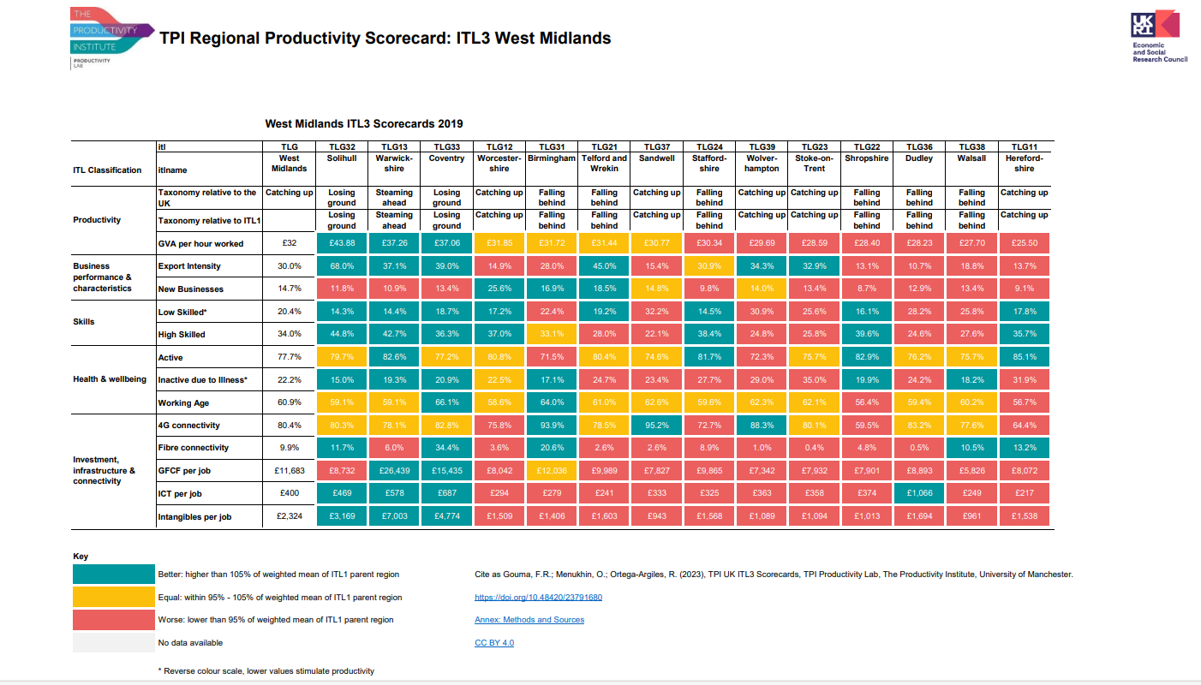
The Productivity Institute’s Regional Productivity Scorecard
Need to know: The scorecard is based on 2019 data. More up-to-date data are available elsewhere is this Bulletin. For details of the methodology and metrics used see https://www.productivity.ac.uk/the-productivity-lab/the-tpi-uk-itl3-productivity-scorecard-series/ .
Following the UKs withdrawal from the EU, to distinguish the replacement UK classification from its EU predecessor (NUTS - Nomenclature of territorial units for statistics), the UK-managed classification is referred to as International Territorial Levels (ITLs) and adopts a convention used by the Organisation for Economic Co-operation and Development (OECD) member countries. These ITLs therefore align with international standards, enabling comparability internationally.
Source: The Productivity Institute
Gouma, F.R.; Menukhin, O.; Ortega-Argiles, R. (2023), TPI UK ITL3 Scorecards, TPI Productivity Lab, The Productivity Institute, University of Manchester

Slide 17
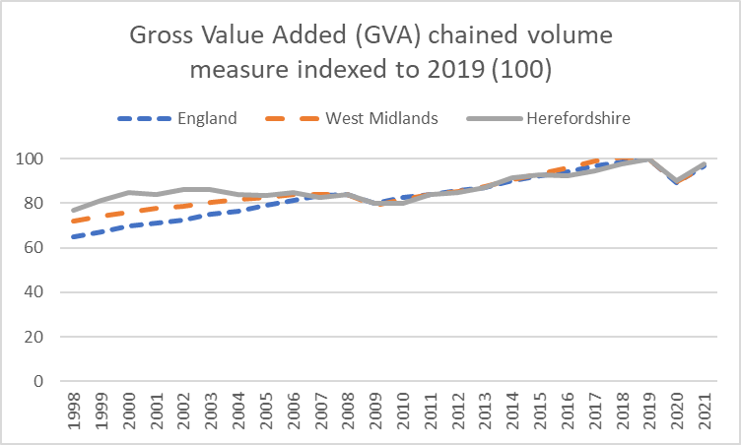
Relative value of the economy over time
A local economy grows when it increases the amount of goods and services it produces. Gross Value Added (GVA) is a way of measuring this output. There is a widely accepted association between economic growth and living standards.
Key points
In the mid 2000s, Herefordshire’s Gross Value Added (GVA) across all industrial sectors together declined relative to England and the West Midlands region. Thereafter it increased fairly consistently in line with the national trend until 2016 when it dipped again. Although it increased again subsequently, increases were lower than nationally and regionally. In 2020 the economy was seriously impacted by the pandemic and GVA contracted to less than the level seen in 2014.
In 2021 (the latest year available) Herefordshire’s total GVA at current prices was £4,141 million.
Adjusting to remove the effects of inflation (i.e. using the chained volume measure), as a result of the pandemic GVA shrank by 11% in 2020 compared to the previous year. This followed an 8% increase in real terms between 2015 and 2019 and mirrored the national trend (8% increase in real terms 2015-2019 then a 10% fall 2019-2020). In 2021, again reflecting the national trend, Herefordshire’s GVA increased by 8.5% in real terms.
Brexit referendum
COVID-19 pandemic
Financial Crisis – start of the Great Recession
Need to know: Gross value added (GVA) is the value of goods and services produced in an area, industry, or sector of an economy and is used to measure the value of the economy due to the production of goods and services over time. The data above provide estimates of GVA derived by balancing the income and production approaches to measuring GVA. The dataset includes both current price (nominal or value) and 'real' (chained volume) measures. Using an index value allows us to compare relative growth between different areas. Factors that affect GVA include the size of the population, the proportion of that population who are in employment, demand for labour, and worker productivity (see what works centre for local economic growth - Understanding GVA)
Data source: ONS
Frequency: Annually
Last updated: 25 April 2023
Next update: March 2024

Slide 18
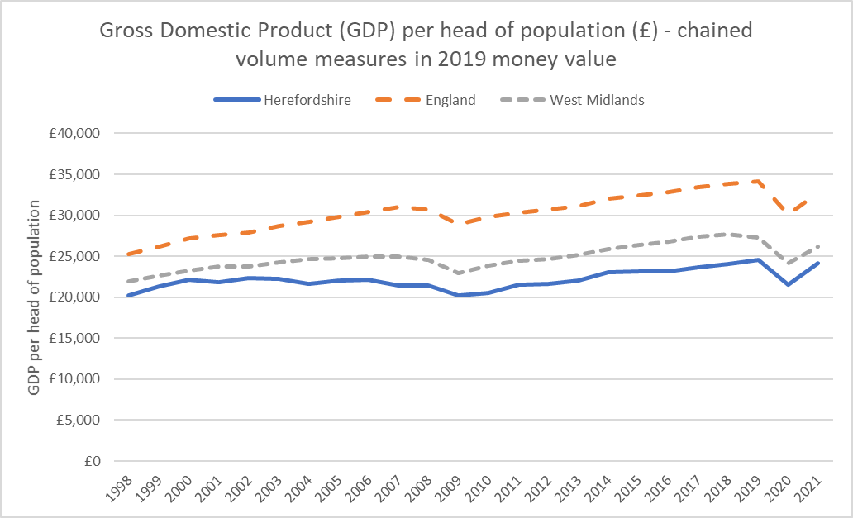
Economic prosperity
Key points
Gross Domestic Product (GDP) is used to identify if, and how, much the economy is growing and to compare the economic performance of countries over time and relative to each other. GDP is calculated by adding up the total value of goods and services produced, income, or spending and is a key indicator of economic well-being.
Using GDP as a measure, the United Kingdom is currently the world’s 6th largest economy, however growth has, by historical and comparative standards, been pretty anaemic since the Financial Crisis of 2008, with population growth (driven primarily by inward net migration) being its biggest contributor. Meanwhile growth in GDP per capita, which is what really matters for living standards, has been particularly poor and here the UK is not amongst the 20 richest countries.
In 2021, Herefordshire’s Gross Domestic Product (GDP) at current prices was £4,729 million. Adjusting for inflation (chained volume measure), this represented an increase of 8.69% from the previous year as the economy recovered from the COVID-19 pandemic.
In real terms, in 2020 Herefordshire’s economy shrank to it’s smallest level since 2013 as a result of the pandemic. While it yet to recover fully, in 2021 it was larger than it was in 2017.
In 2021, per capita GDP at current prices in Herefordshire was £25,214 compared to £32,763 in England and £26,134 in the West Midlands: 23% lower than England and 4% lower than the West Midlands.
Looking at the change over time in real terms, i.e. adjusting for inflation (chained volume measures in 2019 value), per capita GDP in Herefordshire has consistently lagged behind that of both England and the West Midlands region and the gap is currently wider than it was in 1998 (see chart).
Need to know: GDP per capita measures economic output per person and is calculated by dividing the GDP of an area by its population. It is a global measure for gauging the prosperity of nations and is used by economists, along with GDP, to analyze the prosperity of a country based on its economic growth. It allows economists to monitor the productivity of an area with other comparable geographies. This article explains the difference between GDP and GVA.
Data source: ONS
Frequency: Annually
Last updated: 25 April 2023
Next update: March 2024

Slide 19
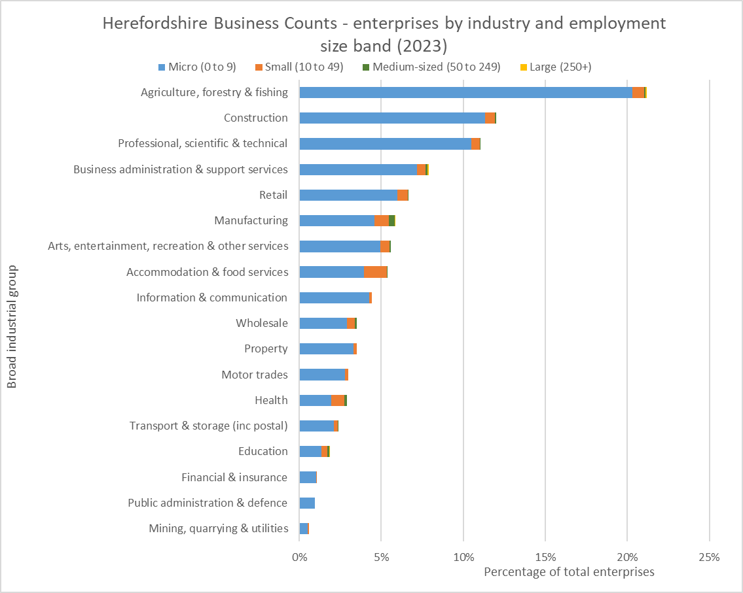
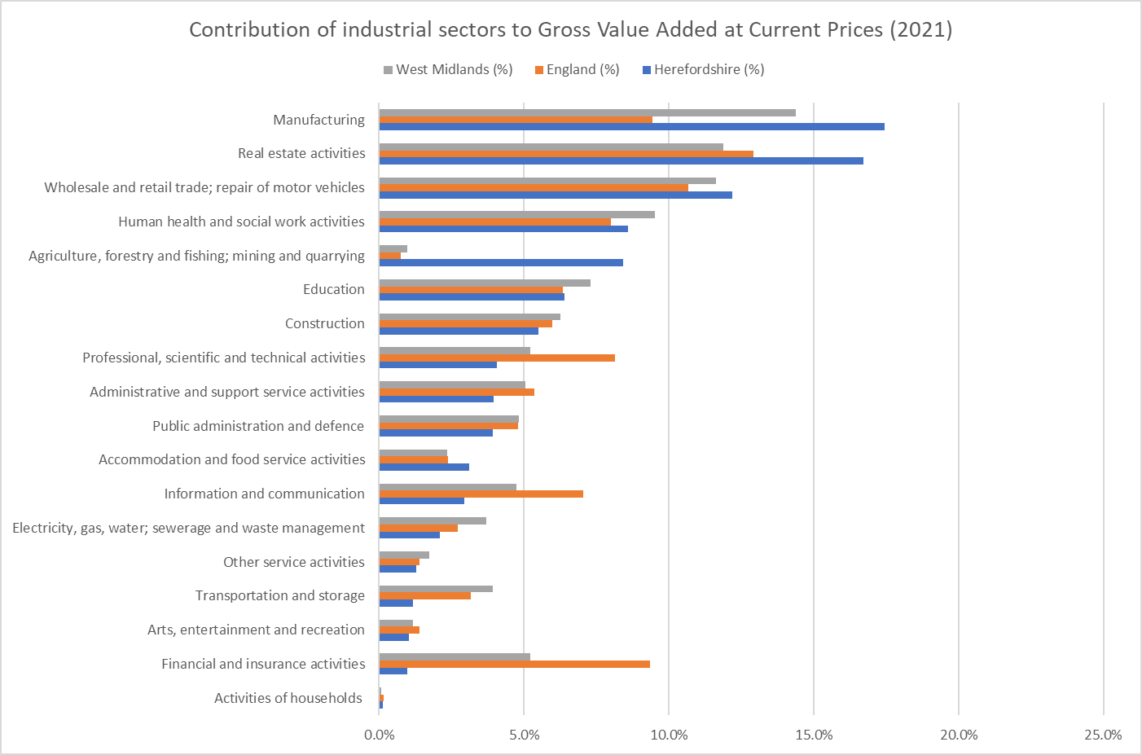
Numbers of businesses (enterprises) by industry and size, and contribution to the value of economic output by industry
Data source: ONS – NOMIS
Frequency: Annually
Last updated: 28 September 2023
Next update: September 2024.
Key point:
The structure of Herefordshire’s economy is significantly different to nationally and regionally, largely due to the rurality of the county, with agriculture, real-estate activities and manufacturing accounting for a greater proportion of economic output and financial and insurance activities and information and communication much less.
Data source: ONS
Frequency: Annually
Last updated: 25 April 2023
Next update: March 2024.

Slide 20
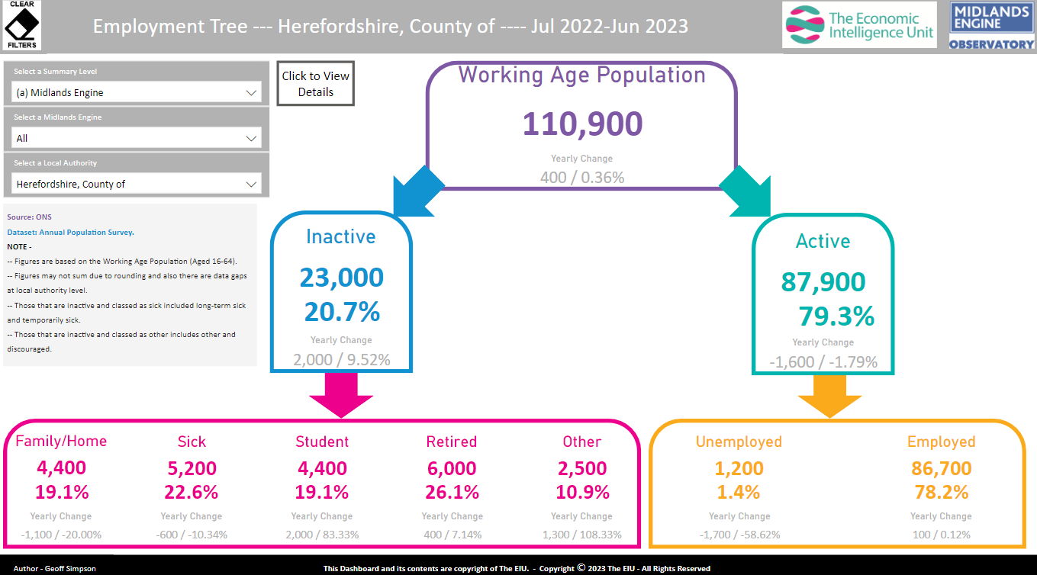
Labour force breakdown
Source: : Midlands Engine Observatory Intelligence Hub
From ONS Annual Population Survey
Frequency: Quarterly
Last updated: 15 October 2023
Next update: January 2024
Image Source: Midlands Engine Observatory Intelligence Hub
Need to know:
The unemployed figure shown here has been taken directly from the ONS Annual Population Survey, which is based on a small sample. It should therefore be regarded as unreliable. For a more accurate estimate see the model-based estimates of unemployment slide.

Slide 21
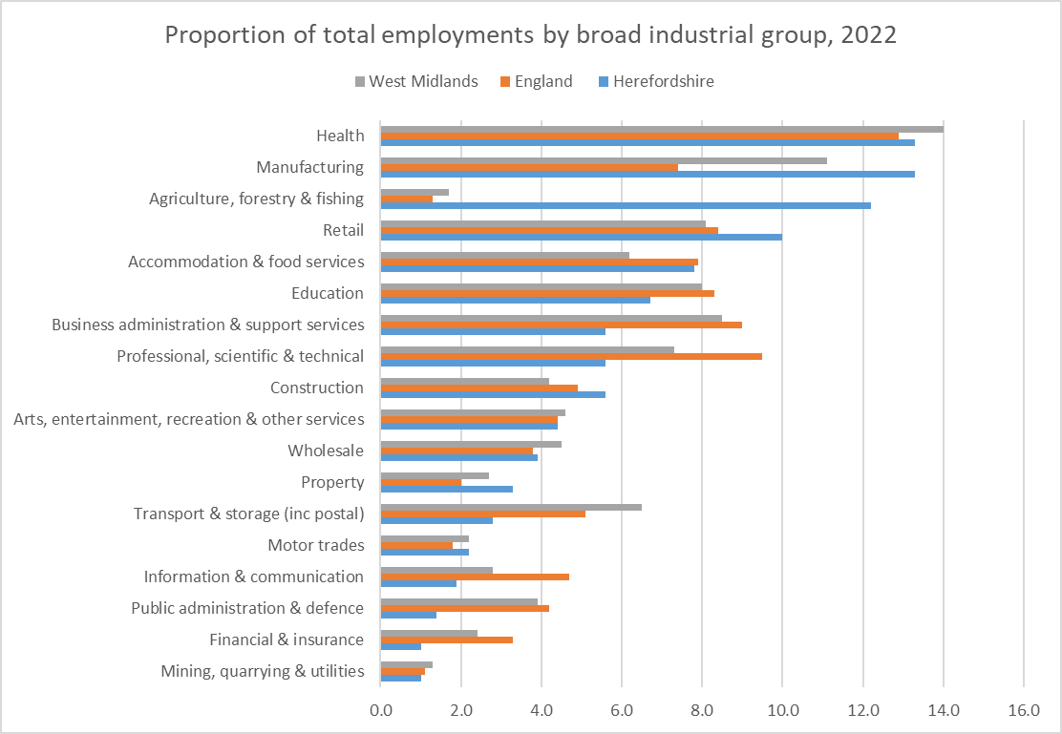
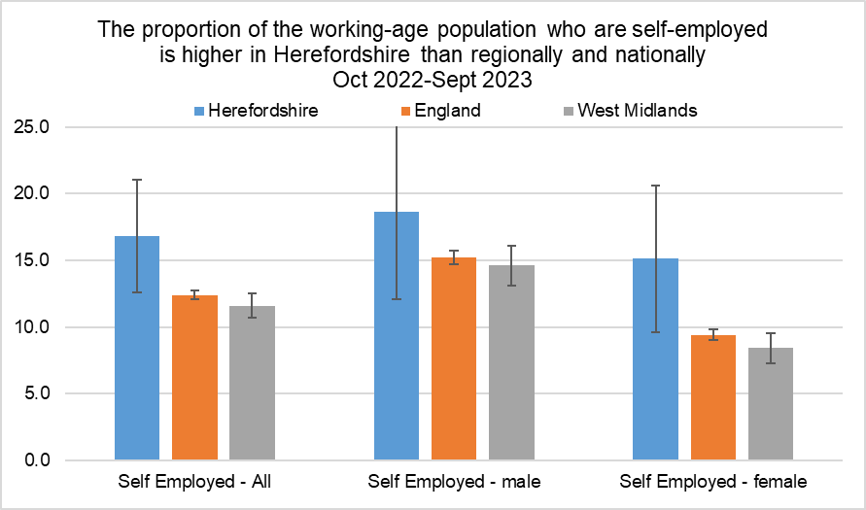
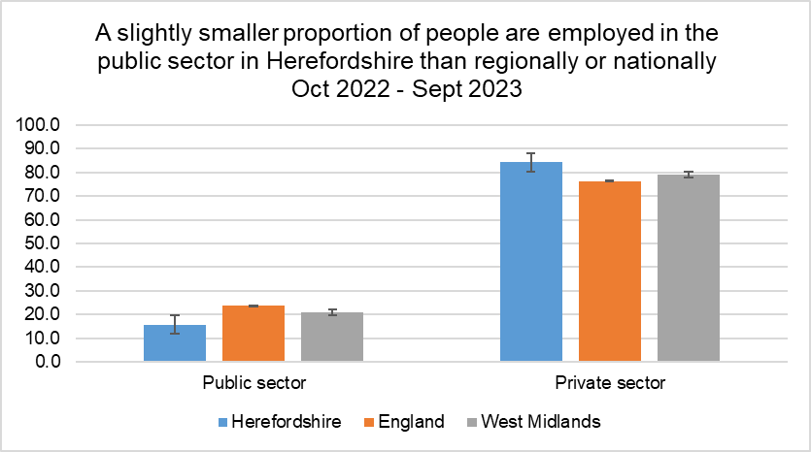
Distribution of jobs
Data source: ONS – NOMIS
Frequency: Quarterly
Last updated: 17 January 2024
Next update: 16 April 2024
Data source: ONS – NOMIS
Frequency: Quarterly
Last updated: 16 January 2024 Next update: 16 April 2024
Data source: ONS – NOMIS
Frequency: Annually
Last updated: 25 October 2023
Next update: 31 October 2024
Key points:
A much higher proportion of jobs are in agriculture and manufacturing than nationally. A greater proportion of people are self-employed than nationally. Most jobs are in the private sector.

Slide 22
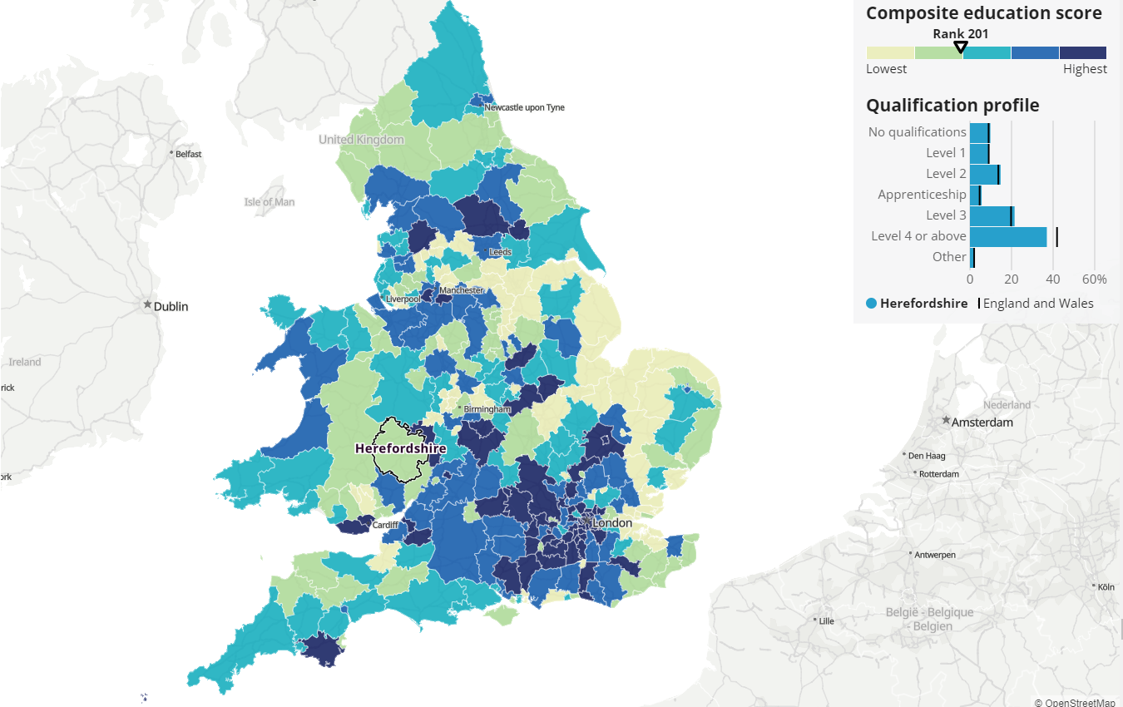
Workforce qualifications
Census 2021 data show that education levels among local labour forces vary between areas in England and Wales. This matters, because it can indicate the quality of locally available jobs, whether they require higher levels of education and whether they are higher-paid. Areas with good educational attainment, opportunities and job markets are likely to have a richer local economy.
Meanwhile, areas with a less-qualified workforce might have fewer job opportunities for highly qualified people, struggle to train or attract and keep qualified workers, and have a poorer local economy. All of this has cost-of-living implications.
Key points
Using ONSs composite education score methodology, Herefordshire is ranked 201 out of 331 English and Welsh local authorities. This puts it in the bottom 40% of areas.
The five most similar areas to Herefordshire in terms of qualification profile are: 1. Gateshead 2. Ryedale 3. Kirklees 4. Powys 5. Calderdale. The most similar area, Gateshead, was ranked eight places higher than Herefordshire.
ONS Annual Population Survey data from 2021* showed that 39.4% of the working-age population in Herefordshire were qualified to NVQ Level 4 or above, compared to 43.2% for England and 38.9% for the West Midlands.
Source: ONS
Frequency: Decennially
Last Updated: 17 February 2023
Next update: 2033
Need to know: For information on how the composite education score was derived see ONS: How workforce qualification levels differ across England and Wales, technical annex: Census.
*In April 2023, ONS advised that qualification estimates for the Jan 2022-Dec 2022 APS were being temporarily suspended due to a change in coding to reflect an updated qualification framework.

Slide 23
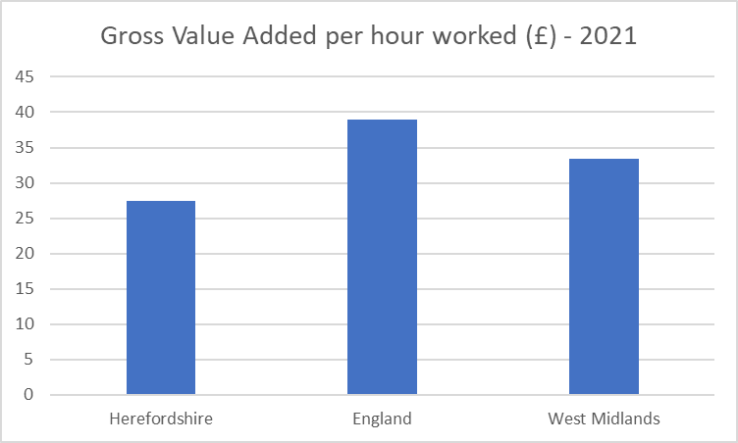
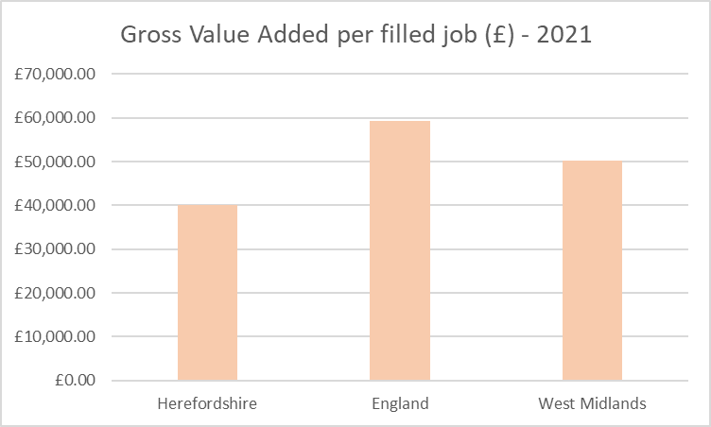
Labour productivity
The level of labour productivity is determined by how efficiently and effectively labour is utilized in an economy. Comparing the labour productivity of different areas provides an indication of relative competitiveness. Labour productivity is one of the key determinants of wages and poor labour productivity is a barrier to social mobility. There is evidence that cost-of-living related pressures are having a negative impact on workers’ productivity.
Key points
PWC reports that UK productivity levels have increased by only 7% in the last 10 years and in 2021 growth was the second slowest in the G7 group of advanced economies.
Recent research by the University of Birmingham found that the West Midlands has one of the largest inter-regional gaps in productivity in the UK, with its most productive sub-region (Solihull) producing £21.50 (47%) per hour more than its least productive sub-region (Herefordshire).
In 2021, Herefordshire GVA per hour worked (smoothed) was £27.5: significantly lower than England (£38.9) and the West Midlands (£33.4).
Similarly, Herefordshire’s GVA per filled job (smoothed) in 2021 was £40,061.12, compared to £59,286.30 for England and £50,315.80 for the West Midlands.
Using the GVA per hour worked measure, in 2021 Herefordshire had one of the lowest levels labour productivity of any International Territorial Level (ITL) 3 area of the UK (ONS), ranking 176th out of 181. The reasons for this are complex but are likely related to Herefordshire’s rurality, the composition of its economy, and an associated over-representation of low-skill occupations. The Midlands Engine Intelligence Hub contains a useful GVA for Small Areas map which can be used to compare local authority areas.
Data source: ONS Subregional Productivity
Frequency: Annually
Last updated: 20 June 2023
Next update: T.b.c.
Need to know: Gross value added (GVA) measures the contribution made to an economy by one individual producer, industry, sector or region. The figure is used in the calculation of gross domestic product (GDP) – University of Birmingham
ONS provide two measures of labour productivity. The first is a ratio of output (measured as gross value added (GVA)) divided by the hours worked to create it. The second measure divides GVA by the number of filled jobs used to create it. In both cases, GVA is an estimate of the total amount of goods and services produced less the value of intermediate inputs. GVA per hour worked is the preferred measure of labour productivity. More information.

Slide 24
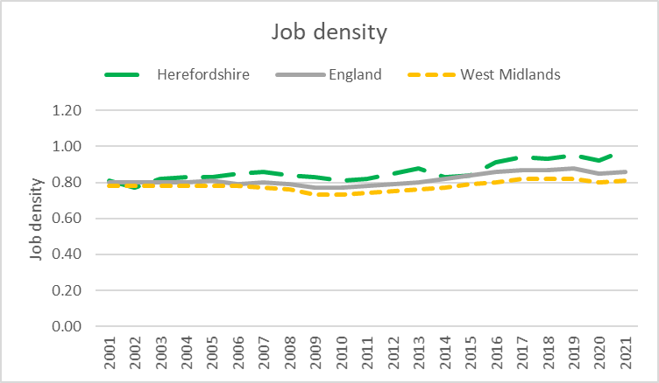
Job density
Job density is a measure of labour demand in an area. It shows the supply of jobs relative to the size of the working-age population. A higher job density can be suggestive of a high proportion of people being employed locally, or (less likely in the case of Herefordshire) large numbers commuting into an area to work.
Key points
In 2021 (the latest available year), job density in Herefordshire (0.98) was at its highest level since data became available in 2001 and was higher than in both the West Midlands region (0.81) and England (0.86). Job density in Herefordshire has shown as increasing trend since 2014.
Need to know: Job density is the number of jobs in an area divided by the resident population aged 16-64. For example, a job density of 1.0 would mean that there is one job for every resident aged 16-64. Job density is based on a workplace-based measure of jobs that comprises employee jobs, self-employed, government-supported trainees and HM Forces. In areas with high jobs densities the demand exceeds the supply, and the imbalance may be satisfied by workers who live outside the area (inward commuting). In areas with a low jobs density, the supply exceeds the demand and often residents will have to work in other areas (outward commuting) or become
unemployed or economically inactive..
Data Source ONS -: NOMIS
Frequency: Annually
Last updated: 31 January 2022
Next update: 31 January 2024 (provisional)

Slide 25
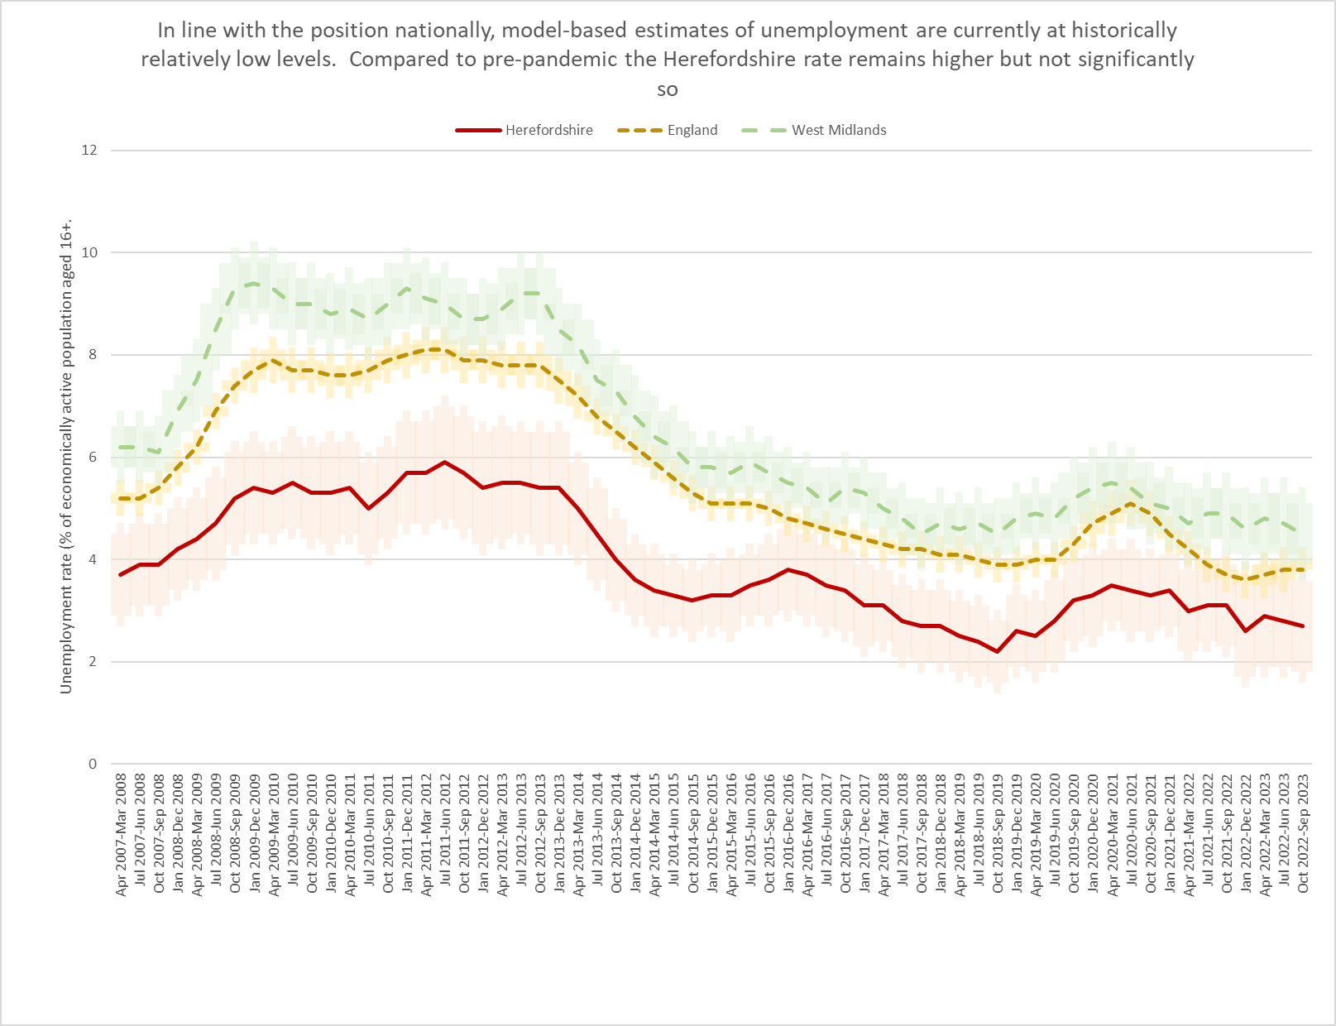
Model-based estimates of unemployment
Key points
The model-based estimate of unemployment is ONS’s recommended measure of unemployment at local authority level. Recent ONS analysis of 2021 Census data indicates that nationally unemployment varied greatly by disability status and ethnicity when other factors were accounted for.
In the period October 2022 to September 2023 the unemployment rate in Herefordshire was 2.7% (CI+-0.9), equating to c. 2,600 people (+-800), compared to 3.8% (CI+-0.2) in England as a whole and 4.5% (CI+-0.6) across the West Midlands region.
In the latest period, Herefordshire’s unemployment rate remained significantly lower than in England and the West Midlands region. It remained elevated compared to pre-pandemic levels, although not significantly so.
Compared to the previous period (July 2022 to June 2023), the Herefordshire rate was much the same (2.7% vs 2.8%) and due to the wide confidence intervals on these data, there has been no statistically significant change in the Herefordshire rate observed since April 2016 – March 2017.
Need to know
Percentages are of the population aged 16 and over. No further breakdown is available below the all-age county rate.
Model-based estimates are produced for local authority areas. Estimates of unemployment for nations and regions are not model-based and have been taken directly from the Annual Population Survey dataset. More information can be found in the User Guide.
For more information on the difference between the unemployment and claimant count rates see this article.
Data source: ONS -NOMIS
Date last updated: 16 January 2024
Frequency: Quarterly
Next update: 16 April 2024

Slide 26
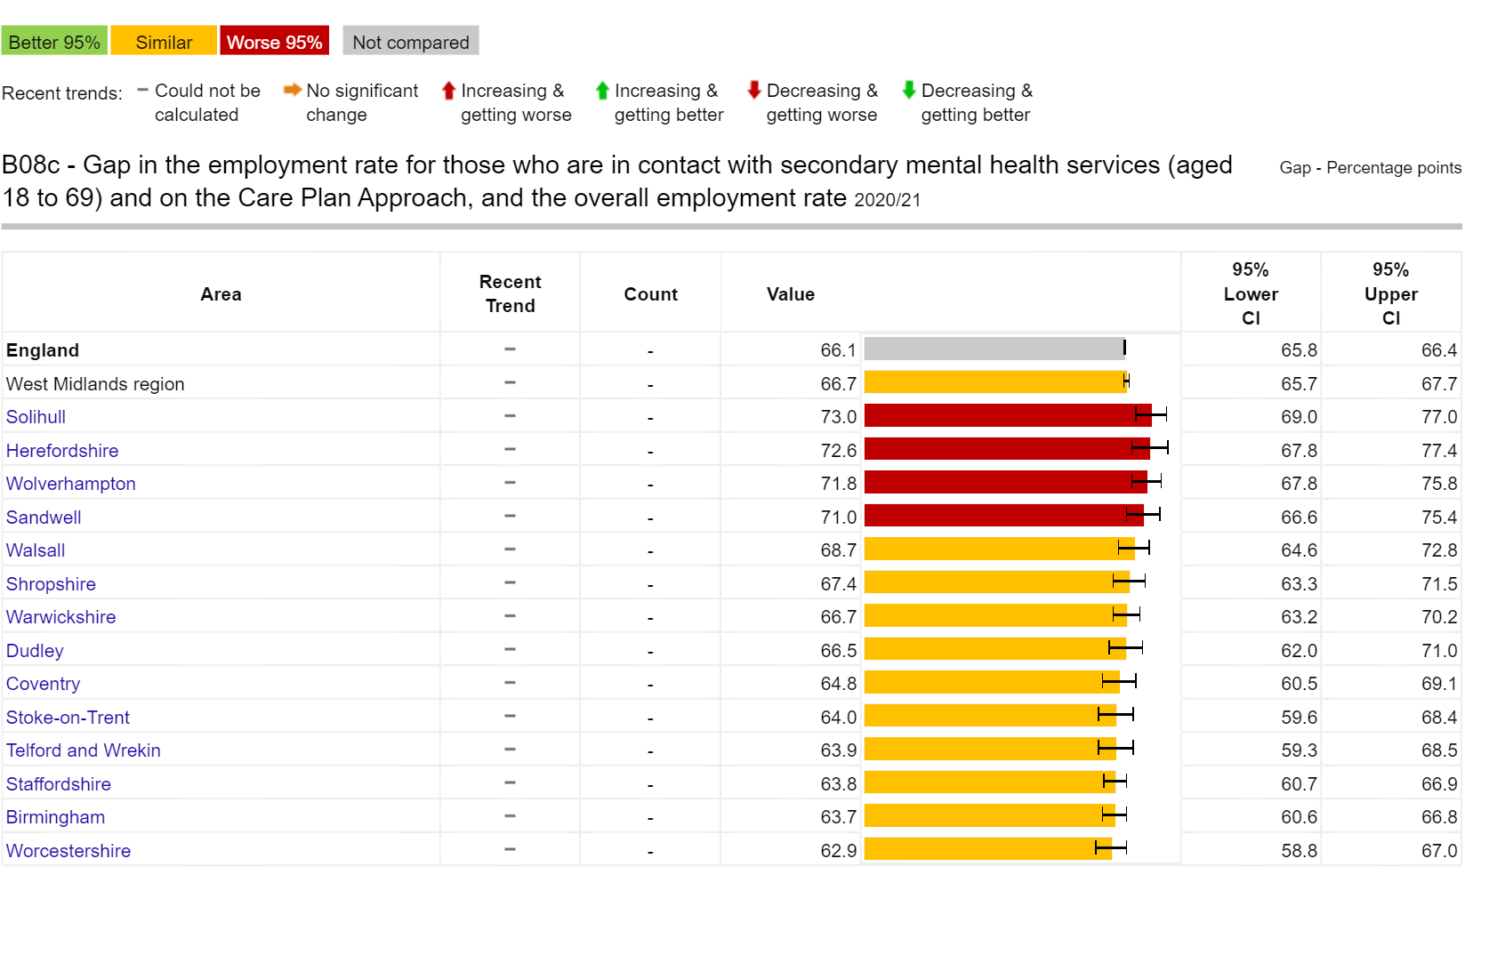
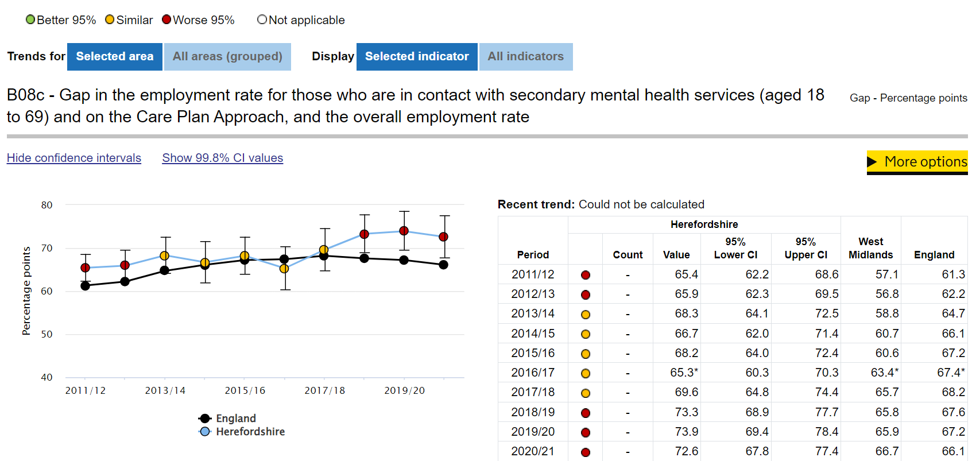
Unemployment and mental wellbeing
Key points
The relationship between mental health and unemployment complex and bi-directional. Good mental health is a key influence on employability, finding a job and remaining in that job. Unemployment causes stress, which ultimately has long-term physiological health effects and can have negative consequences for people’s mental health, including depression, anxiety and lower self-esteem. (Wilson & Finch, 2021). Those in unemployment tend to have lower levels of wellbeing than those in employment and conversely those with greater job security tend to have higher levels of wellbeing (Department of Health, 2014). Research conducted in the wake of the covid-19 pandemic in 2022 found that mental health disabled workers were concentrated in those jobs and sectors that were most affected by the pandemic and associated response, pointing to the importance of segmentation and segregation as explanations of labour market inequality (Bryan et al, 2022).
In 2020-21, the gap in the employment rate between those in contact with secondary mental health services aged 18-69 and on the Care Plan Approach (CPA), and the overall employment rate was 72.6% (CI 67.8% - 77.4%); significantly larger than the gap for the West Midlands region (66.7% (CI 65.7% - 67.7%)) and England (66.1% (CI 65.8% – 66.4%)). Until 2020-21 the gap in Herefordshire had, with the exception of a fall in 2016- 17 (when there was a data quality issue), been on an upward trajectory since 2014-15.
Source: OHID – Public Health Outcomes Framework
Last updated: 2 August 2022
Frequency: Annual
Next update: t.b.c.
image copyright: https://fingertips.phe.org.uk © Crown copyright [2023].
Need to know: Indicator definition – the percentage point gap between the percentage of working age adults who are receiving secondary mental health services and who are on the Care Plan/Programme Approach recorded as being in paid employment at the time of their most recent assessment, formal review, or other multi disciplinary care planning meeting (aged 18 to 69), and the percentage of all respondents in the Labour Force Survey classed as employed (aged 16 to 64).
Care Programme Approach (CPA) describes the approach used in mental healthcare to assess, plan, review and coordinate the range of treatment, care and support needed for people in contact with services and who have complex care needs. Warning: Values for this indicator must be interpreted with caution. The rigidity of the Care Programme Approach (CPA) means that some people who are on the plan are not in receipt of secondary mental health services support as the criteria to qualify are often arbitrary. More information.

Slide 27
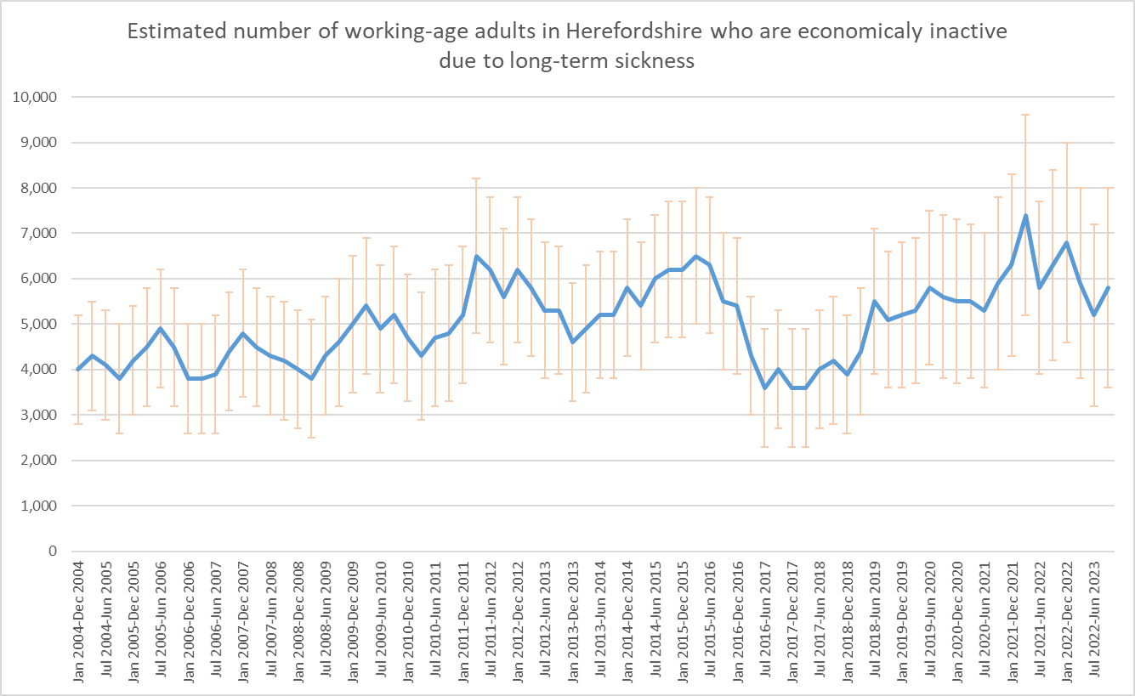
Absence from work due to long-term sickness
Sickness absence is a key indicator of labour productivity. In addition, long-term absence from the workplace can have a serious detrimental impact on individuals’ long-term health, financial security and social inclusion (NICE, 2019).
People with disabilities, in insecure employment, and in lower socio-economic groups, who are already at higher risk of financial insecurity and poverty, are more likely to experience long-term sickness absence (IPPR, 2017; De Souza et al, 2006).
Mental ill-health is one of the major causes of long-term sickness absence and is being adversely impacted by the cost-of-living crisis (ONS, 2022).
ONS report that across the UK the number of working-age adults who are out of the labour market (known as "economically inactive") because of long-term sickness has been rising since 2019, from around 2.0 million people in spring 2019, to about 2.5 million in summer 2022. In Q1 2023, for those whose long-term sickness has led them to stop working or looking for work, 38% report having five or more health conditions: up from 34% in 2019
Key points
2021 Census data show that 3.6% of usual residents of Herefordshire aged 16 years and over were economically inactive as a result of being long-term sick or disabled, up from 3.2% in 2011.
According to the ONS Annual Population Survey, in the period October 2022 – September 2023, around 5,800 people aged 16-64 in Herefordshire were economically inactive due to long-term sickness; an increase of c.600 people from the previous period (July 22 – June 23).
These data show that long-term sickness rates as a proportion of those economically inactive in Herefordshire have fluctuated very significantly in the past two decades but are currently (October 2022 – September 2023) slightly lower than for Great Britain and the West Midlands but not significantly so: 24.5% in Herefordshire, compared to 27.6% in the West Midlands and 26.9% in Great Britain.
Recent research by the Resolution Foundation has found that nationally economic inactivity due to ill health among 18-24 year-olds has nearly doubled over the past decade, and is heavily concentrated among those with low levels of skills, with four-in-five young people who are too ill to work having only qualifications at GCSE-level or below. Young people in areas dominated by small towns and villages more likely to be workless due to ill health than those living in large cities.
Data source: ONS - NOMIS
Frequency: Quarterly
Last updated: 16 January 2024
Next update: 16 April 2024
Need to know: Note the wide confidence intervals associated with the Annual Population Survey at local authority level.

Slide 28
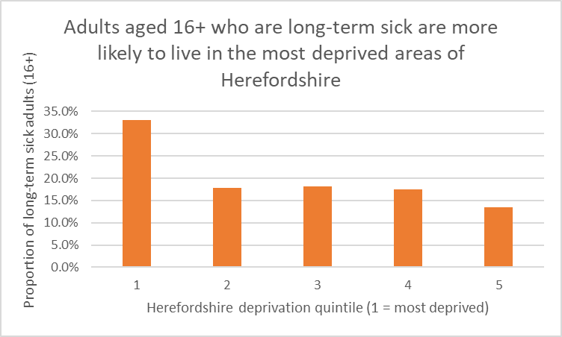
Absence from work due to long-term sickness by Herefordshire deprivation quintile
Key points
According to The Health Foundation more working-age people in the UK are living with long-term health conditions than ever before. For many, poor health means not being able to work. There are currently more than 2.6 million working-age people who are out of the labour market due to long-term sickness, with sharp increases since the beginning of the COVID-19 pandemic. As well as putting more people at risk of poverty, this has implications for productivity and growth and for welfare spending.
The relationship between long-term sickness and deprivation is complex, involving not only inequalities in economic and social capital, but cultural and lifestyle factors, and the differing types of work more likely to be undertaken by different socio-economic groups.
According to The Kings Fund, people in the poorest social class have a 60% cent higher prevalence of long-term health conditions than those in the richest social class.
2021 Census data indicated that there were around 5,600 adults aged 16+ in Herefordshire who were economically inactive as a result of being long-term sick.
A third of these people were from the most deprived quintile of the county, compared to 13% from the least deprived.
Herefordshire deprivation quintile (1 = most deprived) | Count of adults aged 16+ who are long-term sick | Proportion of adults aged 16+ who are long-term sick
1 | 1,855 | 33%
2 | 1,003 | 18%
3 | 1,021 | 18%
4 | 977 | 17%
5 | 756 | 13%
Total | 5,612 | 100%
Need to know: The 2021 Census took place at the time of significant disruption to the labour market as a result of the covid-19 pandemic. ONS advises ‘as Census 2021 was during a unique period of rapid change, take care when using this data for planning purposes.’ For this reason, it is inappropriate to compare these data to 2011 Census data.
Data source: ONS
Frequency: Decennially
Last updated: 8 December 2022
Next update: 2031

Slide 29
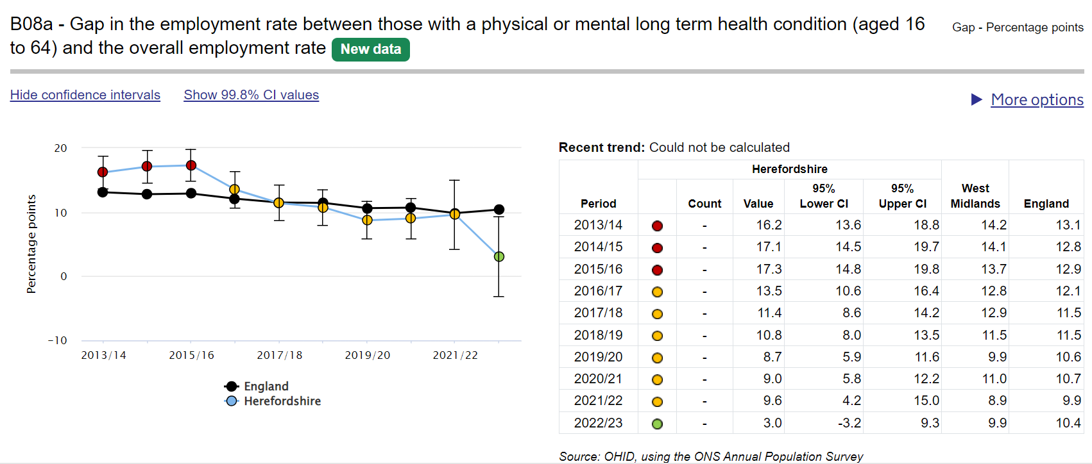
Long-term conditions and employment
Key points:
According to ONS data, the number of working-age adults who are out of the labour market (known as "economically inactive") because of long-term sickness has been rising since 2019, from around 2.0 million people in spring 2019, to about 2.5 million in summer 2022.
This rise in long-term sickness started before the coronavirus (COVID-19) pandemic, but since the pandemic hit the UK in early 2020, the number of people out of work because of long-term sickness has risen by 363,000.
In Herefordshire, in 2022-23, the gap in the employment rate between those with a physical or mental long-term health condition (aged 16 to 64) and the overall employment rate was 3.0% (CI -3.2% to 9.3%); lower than in England (10.4% CI 8.4% - 12.4%) and the West Midlands (9.9% CI 7.3% - 12.6%) but due to the large confidence intervals, not significantly so.
Contrary to upward movement in the West Midlands and England, the Herefordshire rate fell dramatically in 2022-23 from 9.6% (CI 4.2% - 15.0%) in 2021-22. The reasons for this are unclear and due to the wide confidence intervals around these data, the fall was not statistically significant.
Source: OHID – Public Health Outcomes Framework
Last updated: 7 November 2023
Frequency: Annual
Next update: t.b.c.
image copyright: https://fingertips.phe.org.uk © Crown copyright [2023].
Need to know: Indicator definition- the percentage point gap between the percentage of respondents in the Labour Force Survey who have a long term condition who are classified as employed (aged 16 to 64) and the percentage of all respondents in the Labour Force Survey classed as employed (aged 16 to 64) .
A long term condition is defined as a physical or mental health condition or illness lasting or expected to last more than a year.

Slide 30
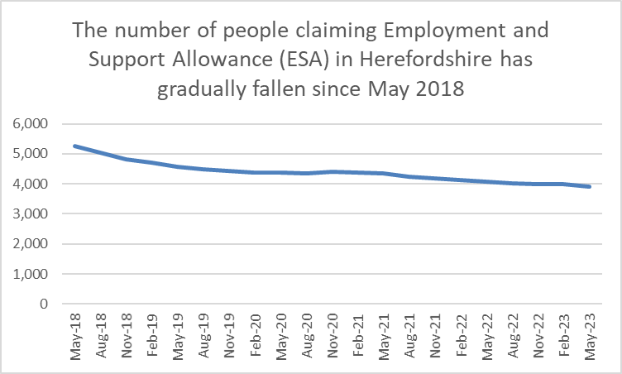
Employment and Support Allowance (ESA) claimants
According to the Centre for Social Justice, in November 2022 there were 3.7 million claimants in the UK with No Work Requirements, meaning they are exempt from work due to physical and mental health conditions, disabilities or caring responsibilities. Of this group, it suggests that at at least 700,000 in this group say they want to work and think they could with the right support.
Employment and Support Allowance (ESA) can be claimed by adults under state pension age who have a disability or health condition that affects how much they can work. ESA replaced Incapacity Benefit and Severe Disablement Allowance for new claimants from October 2008.
ESA provides:
Money to help with living costs if you’re unable to work
Support to get back into work if you’re able to
People can apply if they are employed, self-employed or unemployed. How much they get depends on what stage their application is at, as well other criteria such as age and whether they are able to get back into work. Claimants can get new style or contribution-based ESA on its own or at the same time as Universal Credit. If they get both at the same time, the ESA payment is deducted from the Universal Credit payment. Income-related ESA has also been replaced by Universal Credit.
Key points
Since May 2018 the number of ESA claimants in Herefordshire has been on a gradual but fairly consistent downward trajectory, falling from 5,258 in May 2018 to 3,906 in May 2023. In addition, a small number of claimants (86 in May 2023) whose claims were made prior to October 2008 are still in receipt of Incapacity Benefit and Severe Disablement Allowance.
Data source: Department for Work & Pensions (Stat-Xplore)
Frequency: Quarterly
Last updated: 15 November 2023
Next update: February 2024

Slide 31
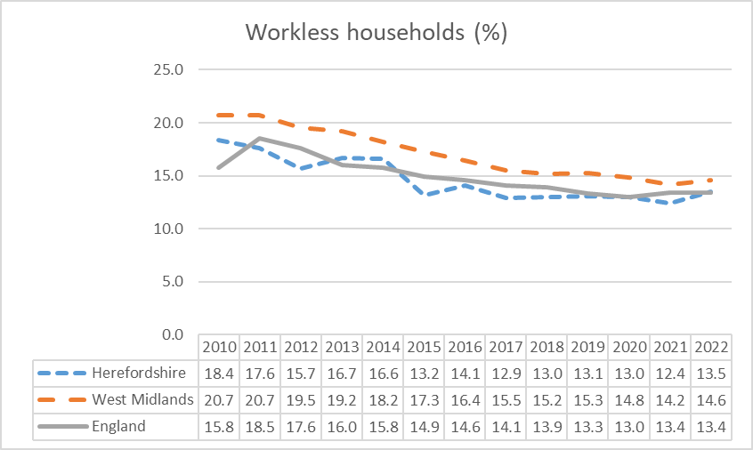
Workless households
Worklessness is associated with a range of adverse social and health outcomes with long-term negative impacts for the wellbeing and life chances of affected households.
Department for Work & Pensions (DWP) analysis shows that problem debt is around twice as prevalent in workless households. In addition, around 60% of housing benefit claimants in temporary accommodation are workless or on out-of-work benefits. In couple-parent families, relationship distress is around three times as prevalent if both parents are workless, as when both parents are working. The vast majority of parents reporting treatment for drug/alcohol use/dependency had been out of work for at least a month. Around half of children in workless families are living with parents who have at least three potential barriers to work, such as ill health, low qualifications or lone parenthood. Children in workless families are almost twice as likely to live with at least one parent with poor mental health. Children growing up in workless families are almost twice as likely as children in working families to fail to reach the expected levels at all stages of their education and are more likely to more likely to suffer mental and physical ill-health in later life if they have jobless parents during their childhood.
Key points
In 2022 (the latest data available), the estimated proportion of workless households in Herefordshire (13.5%) had increased slightly from 12.4% in 2021 and was higher than in England both as a whole (13.4%) and the West Midlands region (14.6%) but not significantly so.
2021 Census data indicated that around 9,700 usual residents aged 16 and over in Herefordshire (6%) had never worked or were long-term unemployed and therefore classified as ‘workless’. This was higher than in 2011 (4%), but was lower than nationally (9% in 2021, up from 6% in 2011).
Need to know: Workless households are households where no one aged 16 years or over is in employment. These members may be unemployed or economically inactive. Economically inactive members may be unavailable to work because of family commitments, retirement or study, or sickness or disability. Percentages are of working age households i.e. where at least one household member is aged 16-64. ONS advises that the population totals used for the latest LFS estimates use projected growth rates from Real-Time Information (RTI) data for EU and non-EU populations based on 2021 patterns. The total population used for the LFS therefore does not take into account any changes in migration, birth rates, death rates, and so on, since June 2021, so levels estimates may be under- or over-estimating the true values and should be used with caution.
Data source: ONS
Last updated: 28 September 2022
Frequency: Annually
Next update: 27 September 2024

Slide 32
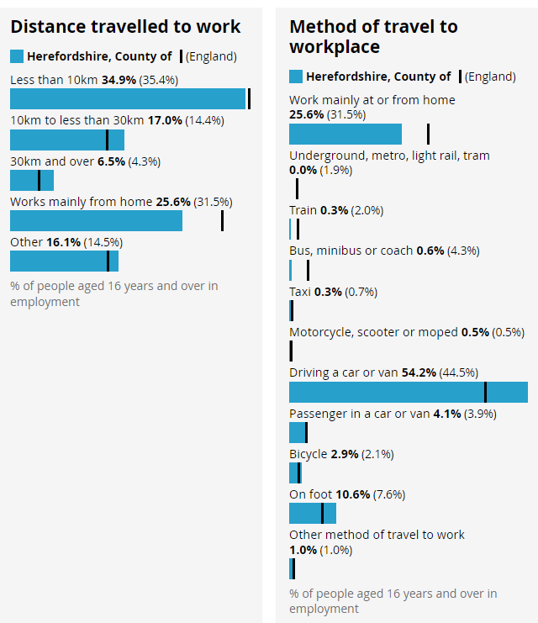
Distance travelled to work and method of travel
Key points
The frequency of, and ways in which, people travel to and from work has implications not only for the environment and health and wellbeing but for household budgets, for some in terms of transport costs, and for others, in terms of home heating costs. ONS analysis of travel to work areas (inc. Hereford).
Herefordshire in one of England’s most rural counties and is relatively lacking in public transport infrastructure with only four railway stations (Colwall, Hereford, Ledbury and Leominster). Almost two thirds of all Herefordshire LSOAs (72 out of 116) are among the 25% most deprived in England in respect to geographical barriers to services with 53 being in the most deprived 10% across England. Of these three quarters are in rural areas.
The 2021 Census provides information about distance travelled to work and mode of transport. Because of the Covid-19 pandemic, and because the ONS widened the age range (from 16-74 in 2011 to 16 and over in 2021), is not appropriate to compare the 2021 results with 2011.
In 2021, of all people aged 16+ in employment, although a similar proportion travelled less than 10 kilometres to work as nationally (34.9 vs 35.4%), a greater proportion travelled 10–30 kilometres to work (17.0% vs 14.4%). The proportion who travelled 30 or more kilometres is also higher (6.5% vs 4.3%).
Not only did a greater proportion of people travel longer distances to work than nationally, a higher proportion did so in a car or van (58.3% vs 48.4), which is to be expected given the longer distances involved, and relative lack of public transport.
A lower proportion of people worked from home than nationally (25.6% vs 31.5%), which is to be expected given the occupation profile of the county.
Source: ONS
Last updated: 8 December 2022
Frequency: Decennially
Next update: 2031
Need to know: Lower Super Output Areas (LSOAs) are fixed statistical geographies of about 1,500 people designed by the Office for National Statistics (ONS).
On the Census 2021 form, people who were in employment or temporarily away from work in the week before Census Day were asked "How do you usually travel to work?". People were asked to select one mode of transport that they used for the longest part, by distance, of their usual journey to work. With regard to the above proportions, it should be noted that the Census was undertaken when COVID measures were still in place, so these are likely to have changed significantly since.

Slide 33
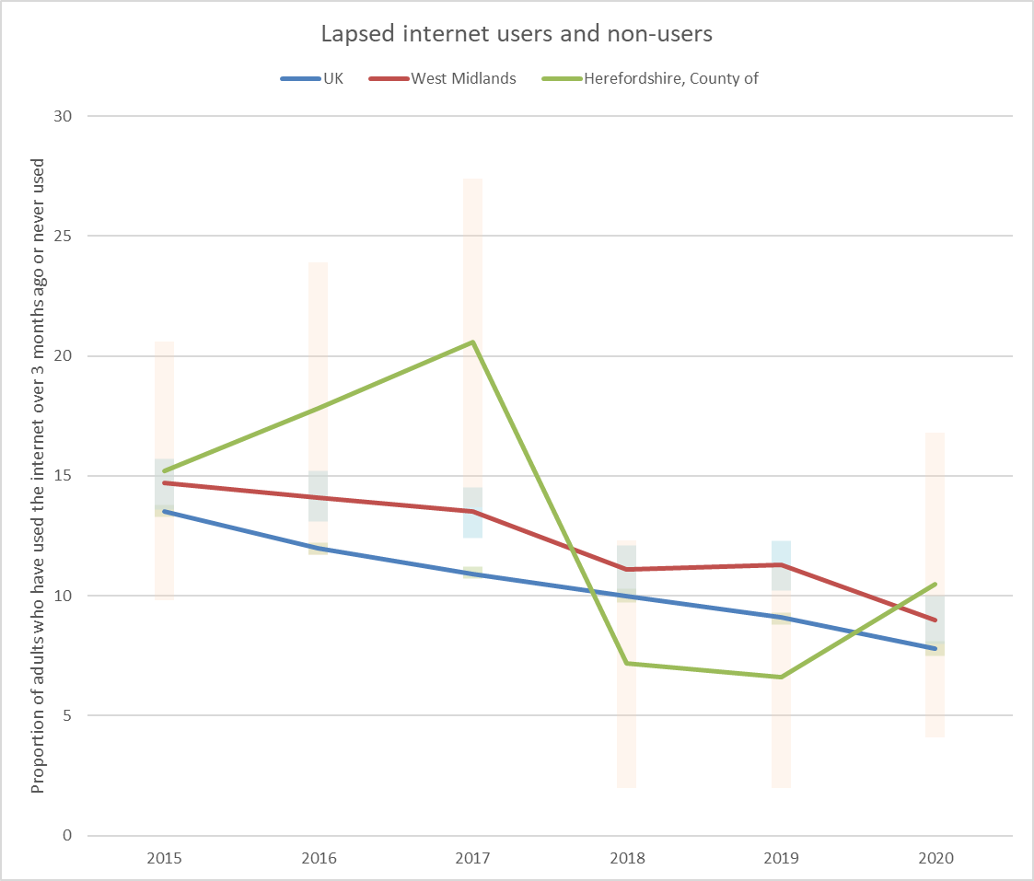
Digital exclusion
Digital exclusion is a barrier to employment and educational opportunities, social networking and access to everyday services and thus has a range of negative impacts on affected individuals. People may be digitally excluded for multiple reasons, including not having access to the required infrastructure and/or devices, lack of skills, or lack of motivation to use technology. The main factors that influence the risk of digital exclusion in the UK are age, geographical location, socioeconomic status and whether a person has a disability. Usefully, ONS has recently produced a digital exclusion risk factors map for Herefordshire. Research suggests that in the cost-of-living crisis digital access has become more important but at the same time financial pressures are forcing many to cancel their broadband contracts. Nationally, ONS reports that in 2020 92% of adults in the UK were recent internet users: up from 91% in 2019. Almost all adults aged 16 to 44 years were recent internet users (99%), compared with 54% of adults aged 75 years and over, although this proportion had increased from 29% in 2013. 81% of disabled adults were recent internet users. 6.3% of adults had never used the internet: down from 7.5% in 2019.
Key points
The proportion of adults in Herefordshire who are either lapsed or non-internet users has declined in recent years in line with the trend nationally. There was an increase in 2020 although this was not statistically significant. In 2020, ONS estimated that there were around 17,000 adults (age 16+) in Herefordshire who don’t use the internet. ONS has recently produced a digital exclusion risk factors map for Herefordshire.
The 2023 Community Wellbeing Survey found that 88% of Herefordshire adults regularly access the internet for non-work purposes: similar to 2021 (89%). 12% do not use it regularly, similar to 2021 (10%), and this proportion rises for people living in the most deprived locations (19%), aged 65+ (25%), and with no formal educational qualifications (41%). Asked why, 44% say it’s because they don’t need it, however 31% say they don’t have the skills, rising to 48% amongst Housing Association tenants.
While 35% of people say their use of the internet increased since that start of the COVID-19 pandemic, for 5% it has reduced, rising to 12% among those in the most deprived locations, 11% amongst Housing Association tenants and 12% of people with an ethnic minority background.
41% of people are positive about more things being provided online - a 17% point decrease since 2021 (58%). 35% are now concerned about more things being provided online: an increase of 13% points from 2021 and the proportion is higher amongst those aged 55+ (46%), the economically inactive (44% - likely driven by age), people with no formal educational qualifications (43%), those with a disability (43%) or those who receive care (43%), and those who do not use the internet regularly (54%).
The 2022 Telecare Users’ Survey found that 49% of users in Herefordshire do not use the internet (down slightly from 52% in 2019), 36% of users say they are not confident using it.
Data source: ONS
Date last updated: 6 April 2021
Frequency of update: Annually
Next update: T.b.c.

Slide 34
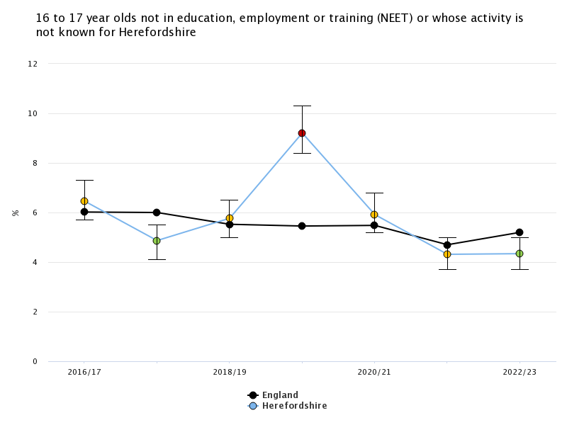
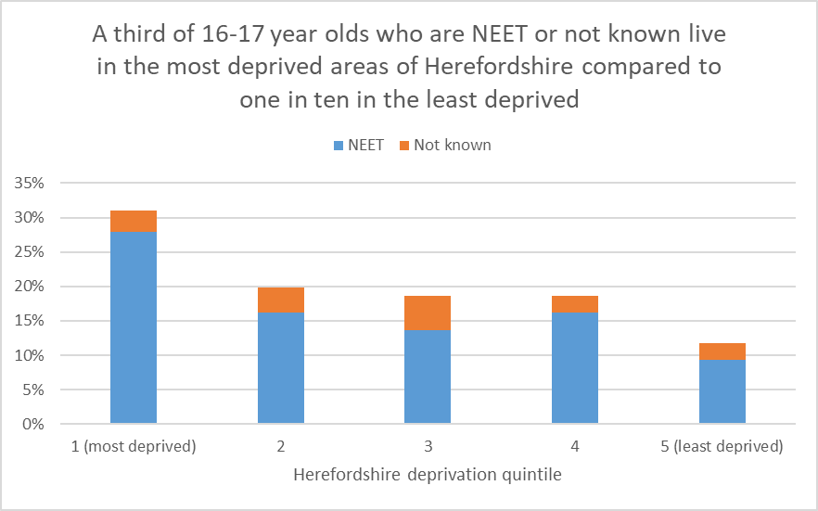
Young people not in Education, Employment or Training (NEET)
The Scottish Longitudinal NEET Study (2015) found that young people who are NEET suffer long-lasting and cumulative detrimental effects:
NEETs remained disadvantaged in their level of educational attainment 10 and 20 years later. More than one in five of NEET young people in 2001 had no qualifications in 2011, compared with only one in twenty five of non-NEETS.
There is a 'scarring effect' on economic activity. In comparison with their non-NEET peers, NEET young people in 2001 were 2.8 times as likely to be unemployed or economically inactive 10 years later. The scarring effect is also evident in the occupational positions that NEET young people take up, if they entered employment. For example, NEET young people in 2001 were 2.5 times as likely as their non-NEET peers to work in a low status occupation in 2011, if they found work.
NEET experiences are associated with a higher risk of poor physical health after 10 and 20 years. The risk for the NEET group was 1.6-2.5 times that for the non-NEET group, varying with different health outcomes. NEET experiences are also associated with a higher risk of poor mental health after 10 and 20 years. The risk of depression and anxiety prescription for the NEET group is over 50% higher than that for the non-NEET group.
Key points
In 2022-23 Herefordshire’s NEET/not known rate was 4.3%, unchanged from the previous year but now lower than the West Midlands (5.2%) and England (5.2%).
The number of NEETS and not knowns varies significantly month-on-month, the annual rate data are an average of the figures submitted by to the DfE for the months of December, January, February each year.
The proportion of young people who are NEET or not known in Herefordshire has fallen recently from a peak of 9.2% in 2019-20.
Young people living in the most deprived areas of the county are much more likely to be NEET than those in the least deprived.
*Office for Health Improvement & Disparities Fingertips
Frequency: Annually; Last updated: November 2023. Chart 1 image copyright: Office for Health Improvement & Disparities. Public Health Profiles. [Date accessed: 20 November 2023] https://fingertips.phe.org.uk © Crown copyright [2023]. Data source (chart 1): .Office for Health Improvement & Disparities Fingertips, Last updated: November 2023, Next update: T.b.c.. Data source (chart 2): Herefordshire Council Children and Young People Directorate, Frequency: Annually, Last updated: June 2023, Next update: June 2024.

Slide 35
Section 3: Household finances

Slide 36
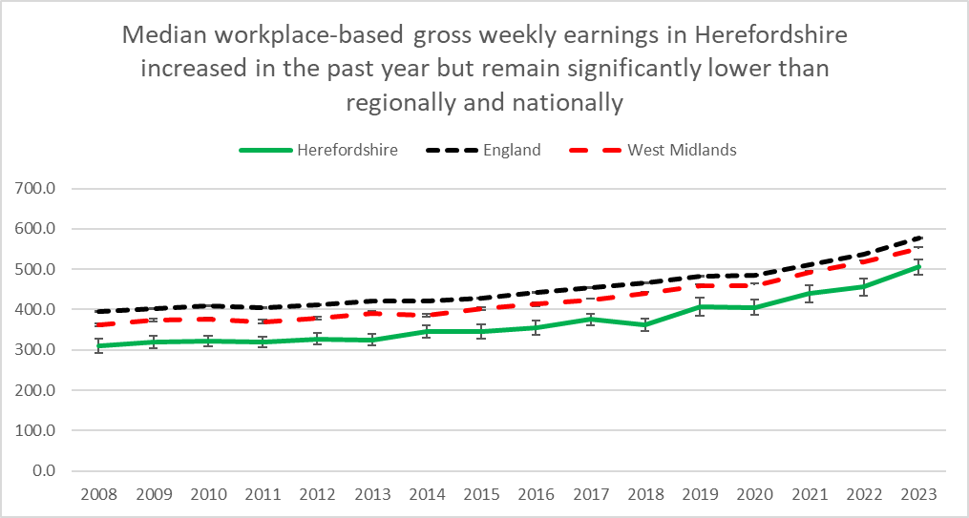
Earnings
Key points
ONS reports that nationally, annual growth in regular earnings (excluding bonuses) was 6.6% in September to November 2023, and annual growth in employees' average total earnings (including bonuses) was 6.5% in September to November 2023. Annual growth in real terms (adjusted for inflation using the Consumer Prices Index including owner occupiers' housing costs (CPIH)) for total pay rose on the year by 1.3% in September to November 2023, and for regular pay rose on the year by 1.4%.
Annual average regular earnings growth for the public sector was 6.6% in September to November 2023, remaining strong but not as high as in recent periods; for the private sector this was 6.5%, with growth last lower than this in June to August 2022 (6.2%). The wholesaling, retailing hotels and restaurants sector saw the largest annual regular growth rate at 7.2%, followed by the finance and business services and sector and manufacturing sector both at 7.0%.
IFS esearch has pointed to widening geographical inequalities in earnings across the country.
Workplace-based median weekly earnings for all employees (full and part-time) who work in Herefordshire in 2023* were £505.50 (+-£19.21): a 10.8% increase from the amount recorded for 2022 (£456.30) and a larger percentage increase than in both England (7.4%) and the West Midlands (6.4%). However, Herefordshire earnings remain significantly lower than the average for England (£577.10 +-£1.15)) and the West Midlands (£550.4 +- £5.50).
The largest gap between Herefordshire and the England average was amongst full-time male workers (£616.80 vs £729.60)). The gap was smaller for female full-time workers (£540.60 vs £626.00). Amongst female part-time workers, in 2023 the gap was not significant (£240.90 vs £244.90). 2023 Herefordshire data for male part-time workers are not yet available.
In 2023, Herefordshire ranked 13th out of the 14 comparator West Midlands authorities, a slight improvement from 2022 when it was the lowest. But remained in the bottom quartile of English unitary and county local authority areas.
Data source: ONS – NOMIS (Annual Survey of Hours and Earnings (ASHE)
Frequency: Annually
Last updated: 30 November 2023
Next update: 30 November 2024
Need to know: workplace-based earnings includes all people who work in Herefordshire regardless of which county they live in.. This gives a better sense of earnings from local employment than the residence-based measure.
Earnings figures are for full and part-time employees – Herefordshire has a higher proportion of part-time employees than both England and the West Midlands region.
*2023 data are provisional.

Slide 37
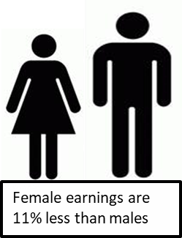
Gender pay gap
Key points
The gender pay gap is a persistent source of inequality. According to ONS, nationally the gender pay gap has been declining slowly over time. Over the last decade it has fallen by approximately a quarter among both full-time employees and all employees and in April 2023 it stood at 7.7%. There remains a large difference in the gap between employees aged 40 years and over and those aged under 40 years. Compared with lower-paid employees, the gap among higher earners is much larger, despite having decreased in recent years.
The gender pay gap decreased across all major occupational groups between 2022 and 2023. The gap in skilled trades occupations remains the largest of the major occupational groups, however, it has also decreased by the largest amount over the past years.
The gender pay gap is higher for all employees than it is for full-time employees or part-time employees. This is because women fill more part-time jobs, which in comparison with full-time jobs have lower hourly median pay.
In 2021, research by IFS found that over three-quarters of the reduction in the earnings gap over the past 25 years can be explained by the rapid increase in women’s educational attainment. It also found that the divergence in earnings occurs with parenthood, when the gendered roles that mothers and fathers take on appear to be largely unrelated to their relative earnings potential. IFS suggests that persistent social norms around parenting are reinforced by a policy environment that sustains and incentivises a traditionally gendered division of labour, even when policies are ostensibly gender-neutral.
Provisional data suggest that in Herefordshire in 2023, the median gender pay gap for all employees was 10.8% up from 4.8% in 2022, but still smaller than in both the West Midlands region (14.4%) and England (15.5%). For full-time employees only, the gap in Herefordshire was 6.3%, up from 0.1% in 2022, but again better than the West Midlands (9.8%) and England (9%).
In 2023*, the median gender pay gap (all employees) in Herefordshire was 10.8% but for full-time workers it was only 6.3%
*provisional data
Source: ONS – Annual Survey of Hours and Earnings (ASHE)
Frequency: Annually
Last updated: 30 November 2023
Next update: 30 November 2024
Need to know:
Source table = PROV - Work Geography Table 7.12 Gender pay gap 2023.xls
Herefordshire has a higher proportion of part-time employees than both England and the West Midlands region. Figures for part-time earnings only are not available for Herefordshire.
* ONS advise that over the coronavirus (COVID-19) pandemic period, earnings estimates were affected by changes in composition of the workforce and the impact of the Coronavirus Job Retention Scheme (furlough) making interpretation difficult; also data collection disruption and lower response rates mean that, for 2020 and 2021, data were subject to more uncertainty and should be treated with caution; so users are being encouraged to focus on long-term trends rather than year-on-year changes.

Slide 38
Income from self-employment
Key points
In the period October 2022 to September 2023, there were estimated to be around 18,400 people aged 16+ in Herefordshire who were self-employed (ONS - NOMIS)
The proportion of the working-age population (16-64) in Herefordshire who were self-employed (13.1%) was higher than in both Great Britain as a whole (9.2%) and the West Midlands region (8.7%) (ONS – NOMIS).
2021 Census data showed the rate of self-employment in Herefordshire to be 12% of adults aged 16+, which meant Herefordshire sat just outside the highest 10% of local authorities across England and Wales (the national rate was 10%). The rate remained relatively stable since 2011, both locally and nationally.
In the tax year 2020/21, median income from self-employment in Herefordshire was £16,100; lower than for the West Midlands region as a whole (£16,400) but not significantly so. Median income was 17th highest out of all 30 West Midlands local authority areas and 9th highest out of the 14 Unitary, County and Metropolitan Borough areas.
Data source: HM Revenue & Customs - Income and tax by borough and district or unitary authority
Frequency: Annually
Last updated: 8 March 2023
Next update: T.b.c.
Need to know: NOMIS estimates of the numbers and proportions of self-employed are taken from the Annual Population Survey (APS) and thus differ from the 2021 Census figures. Census data show the rate of self-employment in Herefordshire to be 12% of all 16+ year-olds – just outside the highest 10% of local authorities across England and Wales (the national rate was 10%). The number of self-employed (full and part-time including those who are also students) was 19,400 in 2021.
.

Slide 39
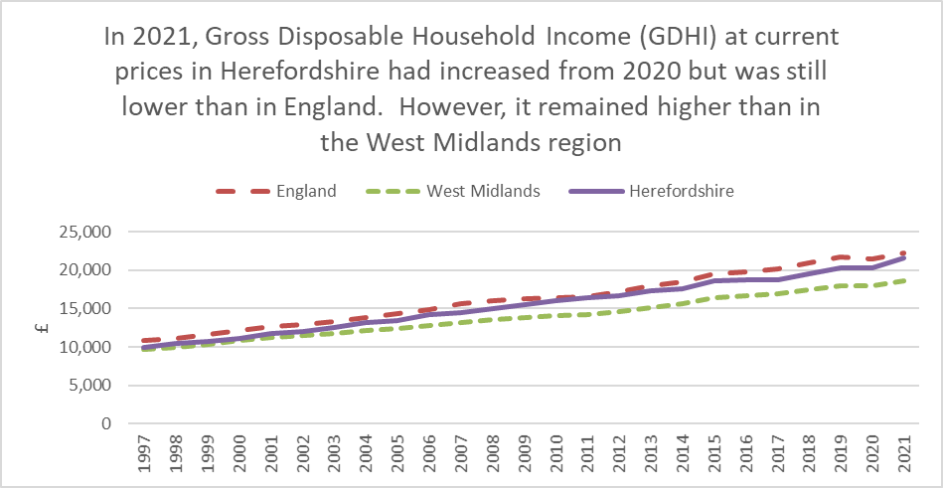
Gross disposable household income (GDHI)
Key points
In 2021, Herefordshire’s GDHI per head at current prices was £21,602 an increase from £20,249 in 2020 but lower than England’s (£22,213). It was however higher than that for the West Midlands (£18,566).
In 2021, GDHI in Herefordshire increased by 6.2% compared to 2020; better than nationally (3.6%) and regionally (3.4%).
The relatively high level of GDHI per head in Herefordshire compared to the West Midlands as a whole is in contrast to the low level of earnings for the county and the low Gross Value Added (GVA) per head. This difference may be partly explained by a relatively large proportion of people of retirement age in Herefordshire, who may derive a considerable income from pensions and other financial assets and investments.
Data source: ONS
Date last updated: 14 September 2023
Frequency: Annually
Next update: Summer 2024
Need to know: GDHI is the amount of money that individuals have available for spending or saving and is a concept that is seen to reflect the “material welfare” of the household sector, as such it is preferred to Gross Value Added (GVA) as the measure of economic welfare.
The household sector includes residents of traditional households, as well as those living in communal establishments. GDHI also includes the business income of self-employed people.
GDHI includes income from wages, salaries, self-employment, property and pensions and is money left after expenditure associated with this income i.e. taxes and social contributions. To make the measure comparable between areas, per head indices are used.

Slide 40
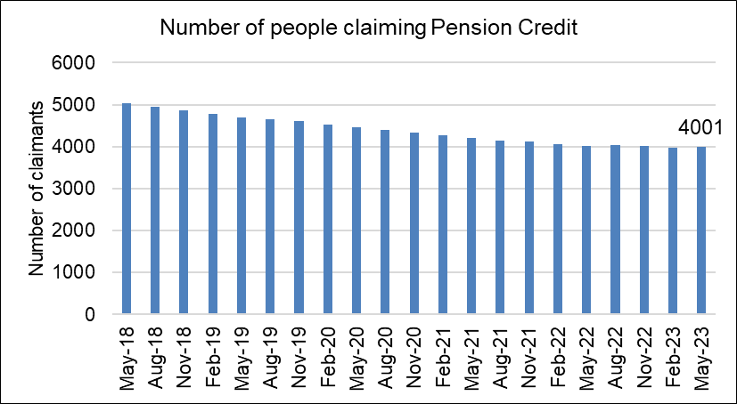
People claiming Pension Credit
Key points
Pension Credit provides help with living costs for people who are over State Pension age and on a low income. Pension Credit can also help with housing costs such as ground rent or service charges.
Pension Credit tops up:
  weekly income to £201.05 if you’re single
  joint weekly income to £306.85 if you have a partner.
Many of those eligible to claim Pension Credit do not do so – this may be partly due to lack of awareness and partly due to the perception older generations have of benefits and associated stigma.
The number of people claiming Pension Credit (UC) in Herefordshire has fallen fairly consistently since May 2018 from 5,025 to 4.001 in May 2023.
Need to know: The age in which you qualify for pension credit has gradually increased from 60 to State Pension Age between April 2010 and November 2018 in line with the female State Pension age.
To be entitled to Pension Credit, you must be of qualifying age and living in Great Britain. In the case of a couple, either may claim if both are of qualifying age but only one partner can get Pension Credit at any one time. The second element is the savings credit whereby pensioners aged 65 and over receive a cash reward for their second pension or savings income above the level of the savings credit threshold.
Data source: Department for Work & Pensions (Stat-Xplore)
Frequency: Quarterly in arrears
Last updated: 28 November 2023
Next update: February 2024

Slide 41
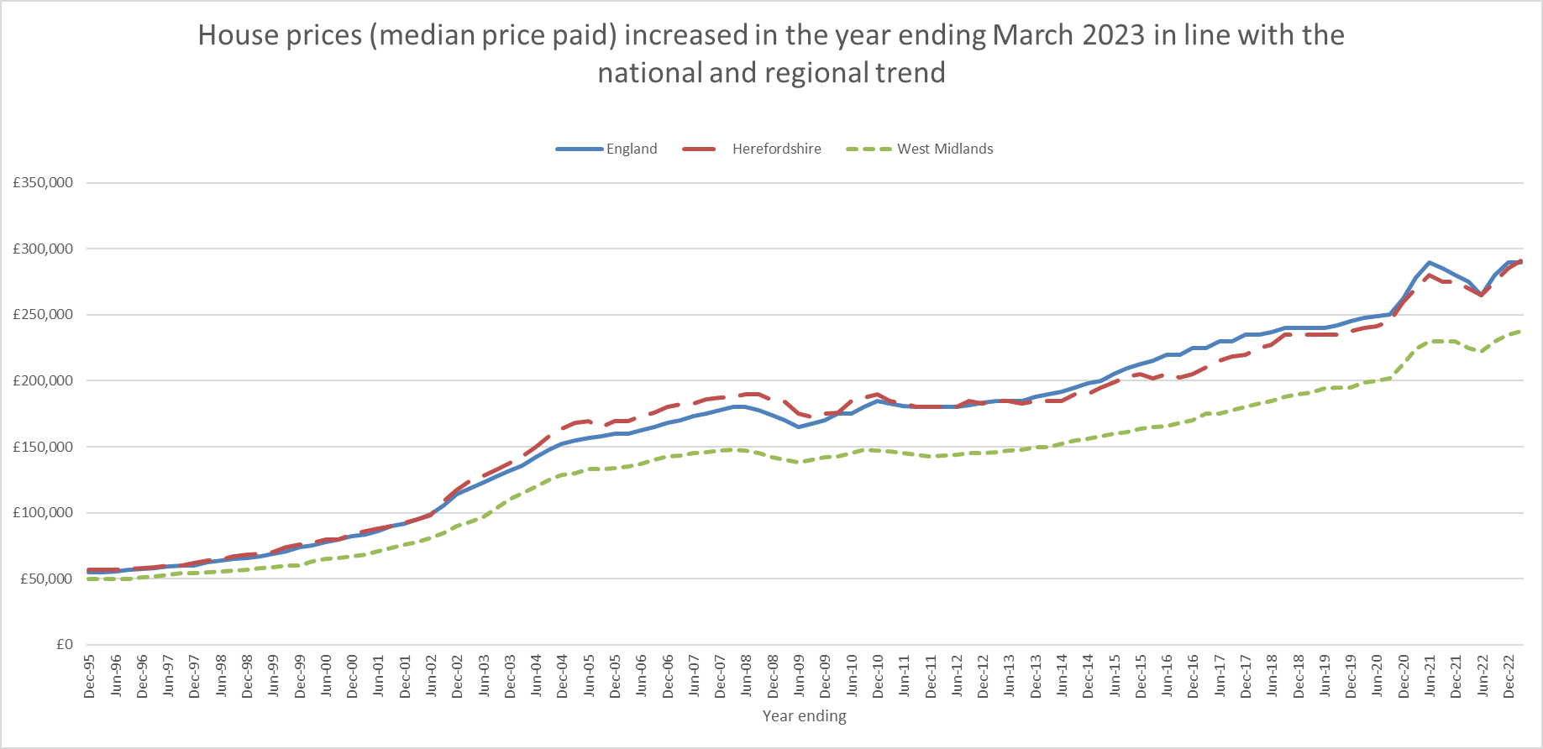
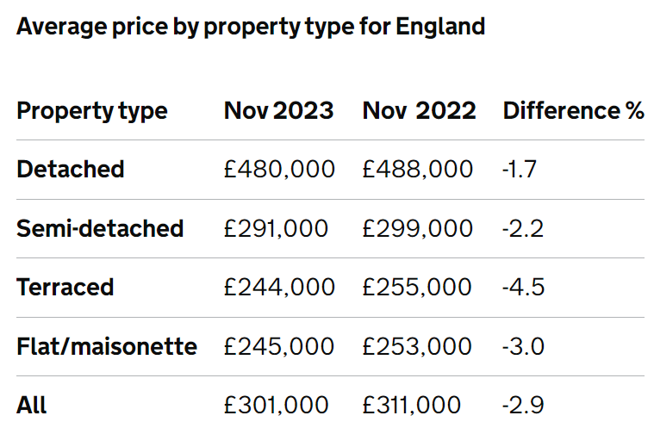
House prices
Key points
ONS reports that over the 12 months to November 2023 the average house price in England decreased to £302,000 (negative 2.9%), This is down from a decrease of 1.7% (revised estimate) in the 12 months to October 2023 and is the largest annual fall since 2009. The average house price in England was £9,000 lower than 12 months ago.
In the year ending March 2023, the median price paid in Herefordshire (all housing types) was £291,000 up from £285,000 for y/e December 2022. Nationally, the median price paid remained at £290,000 in y/e March 2023. In the West Midlands region prices increased from £235,000 to £237,500 in the same period.
ONS data show typical payments on a 5-year fixed mortgage for an average terraced property in Herefordshire is £1,050 with a deposit of £30,000 and a 25-year mortgage. The average price for a terraced property in Herefordshire was £206k in November 2023, up 24% since November 2018.
Data source: ONS
Frequency: 6-monthly
Last update: 20 September 2023
Next update: T.b.c.
Source: HM Land Registry
Frequency: Monthly
Last updated: 17 January 2024
Next update: 14 February 2024

Slide 42
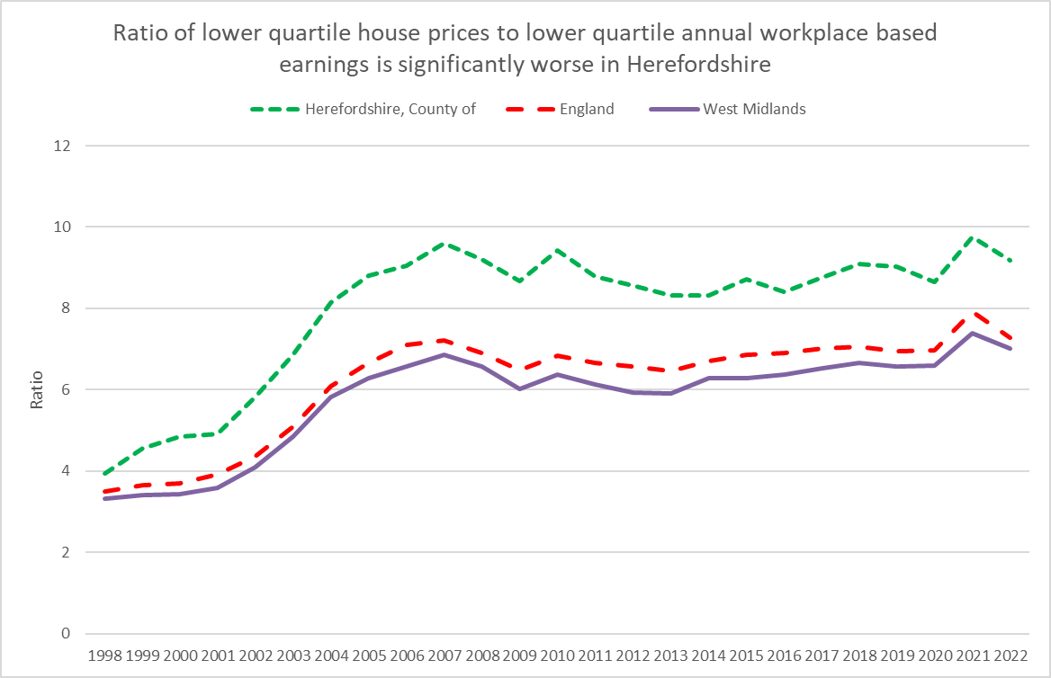
Housing affordability
Housing affordability is linked to house prices and to wages. ONS reports that over the last 25 years, housing affordability has worsened in every local authority area but especially in London or surrounding areas. In England in 2022, full-time employees could expect to spend 8.3 times their earnings on purchasing a home in the local authority area they work in. This was a statistically significant decrease compared with 2021*, when it was 9.1 times their workplace-based annual earnings.
It’s rurality means that Herefordshire has an over-representation of desirable, larger detached houses combined with a relatively low wage economy, which creates barriers to home ownership for young and single people and for those with low to average earnings.
Key points
In 2022, the ratio of lower quartile house price to lower quartile annual workplace-based earnings in Herefordshire was 9.17: significantly higher than in England (7.29) and the West Midlands region as a whole (7.01). Herefordshire had the 6th worst housing affordability out of the West Midlands region’s 30 local authority areas (all tiers).
In line with a fall observed nationally and regionally, the Herefordshire ratio fell slightly from 9.76 in 2021.
Need to know: Housing affordability can be measured based on either residence-based earnings or workplace-based earnings. The latter is, on balance, a more accurate reflection of the county’s economic status and as such is more influential in planning. The data above are for the lower quartile (rather than median ratio) as this gives a better representation of conditions at the lower end of the market where most first-time buyers are concentrated.
*The sharp price increases in 2021 corresponded with increases in the volume of sales and changes in Stamp Duty Land Tax and Land Transaction Tax. The ratios in 2022 are therefore a return to the long-term trend, following a sharp increase in 2021.
Data source: ONS
Last updated: 22 March 2023
Frequency: Annually
Next update: March 2024

Slide 43
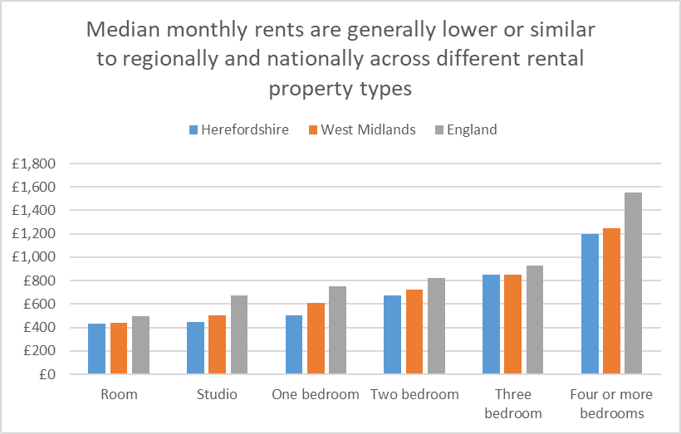
Private rental costs
Key points
Nationally, a chronic undersupply of private rental accommodation is being exacerbated by rising mortgage costs on buy-to-let properties, tax and regulatory changes that are causing many small landlords to quit the market. In addition, while the cost of rental homes has increased, the amount a household can receive in housing benefit has remained the same and according to NIESR, the growing disparity between the two has resulted in a strong fall in the number of affordable rental properties.
ONS reports that in England, private rental prices increased by 6.1% in the 12 months to November 2023, up from 6.0% in the 12 months to October 2023. When London is excluded from England, private rental prices increased by 5.7% in the 12 months to November 2023. The figures are the highest annual percentage changes since these data series began in January 2006.
According to ONS, between 12 July to 1 October 2023, those renting were more likely to report an increase in their rental payments than mortgage holders in their mortgage payments (55% and 34%, respectively). This proportion appears to have increased among renters compared with earlier this year, but not among mortgage holders (42% and 32%, respectively). Latest ONS data reveal that a third (33%) of adults in Great Britain who were paying rent, or a mortgage, said they were finding payments very or somewhat difficult to afford. This is a slight rise from 28% in a similar period last year.
ONS reports that in September 2023 that prices had risen by 10% or more since last visited for 21% of privately rented properties in England, up from the proportion of properties revisited in September 2022 (14%).
Census data show that 18.8% of Herefordshire households rented privately in 2021, up from 15.5% in 2011 but still a lower proportion than regionally (17.9%) and nationally (20.5%).
Median monthly rents (all property types) are lower in Herefordshire than regionally or nationally but are rising in line with the national and regional trend. Also, earnings are significantly lower here than regionally and nationally.
ONS data* indicate that in the period 1 October 2022 to 30 September 2023 the median monthly rent (all property types) in Herefordshire was £678; this compares to £850 for England and £750 for the West Midlands. As the second chart shows, rents are generally lower or similar in Herefordshire across the different rental types.
Data source: ONS
Last updated: 20 December 2023
Frequency: 6-monthly
Next update: T.b.c.
Need to know: *ONS advise that the sample used to produce these statistics is not statistical and may not be consistent over time; as such, these data should not be compared across time periods or between areas. Housing Benefit claimants are not included in the sample.

Slide 44
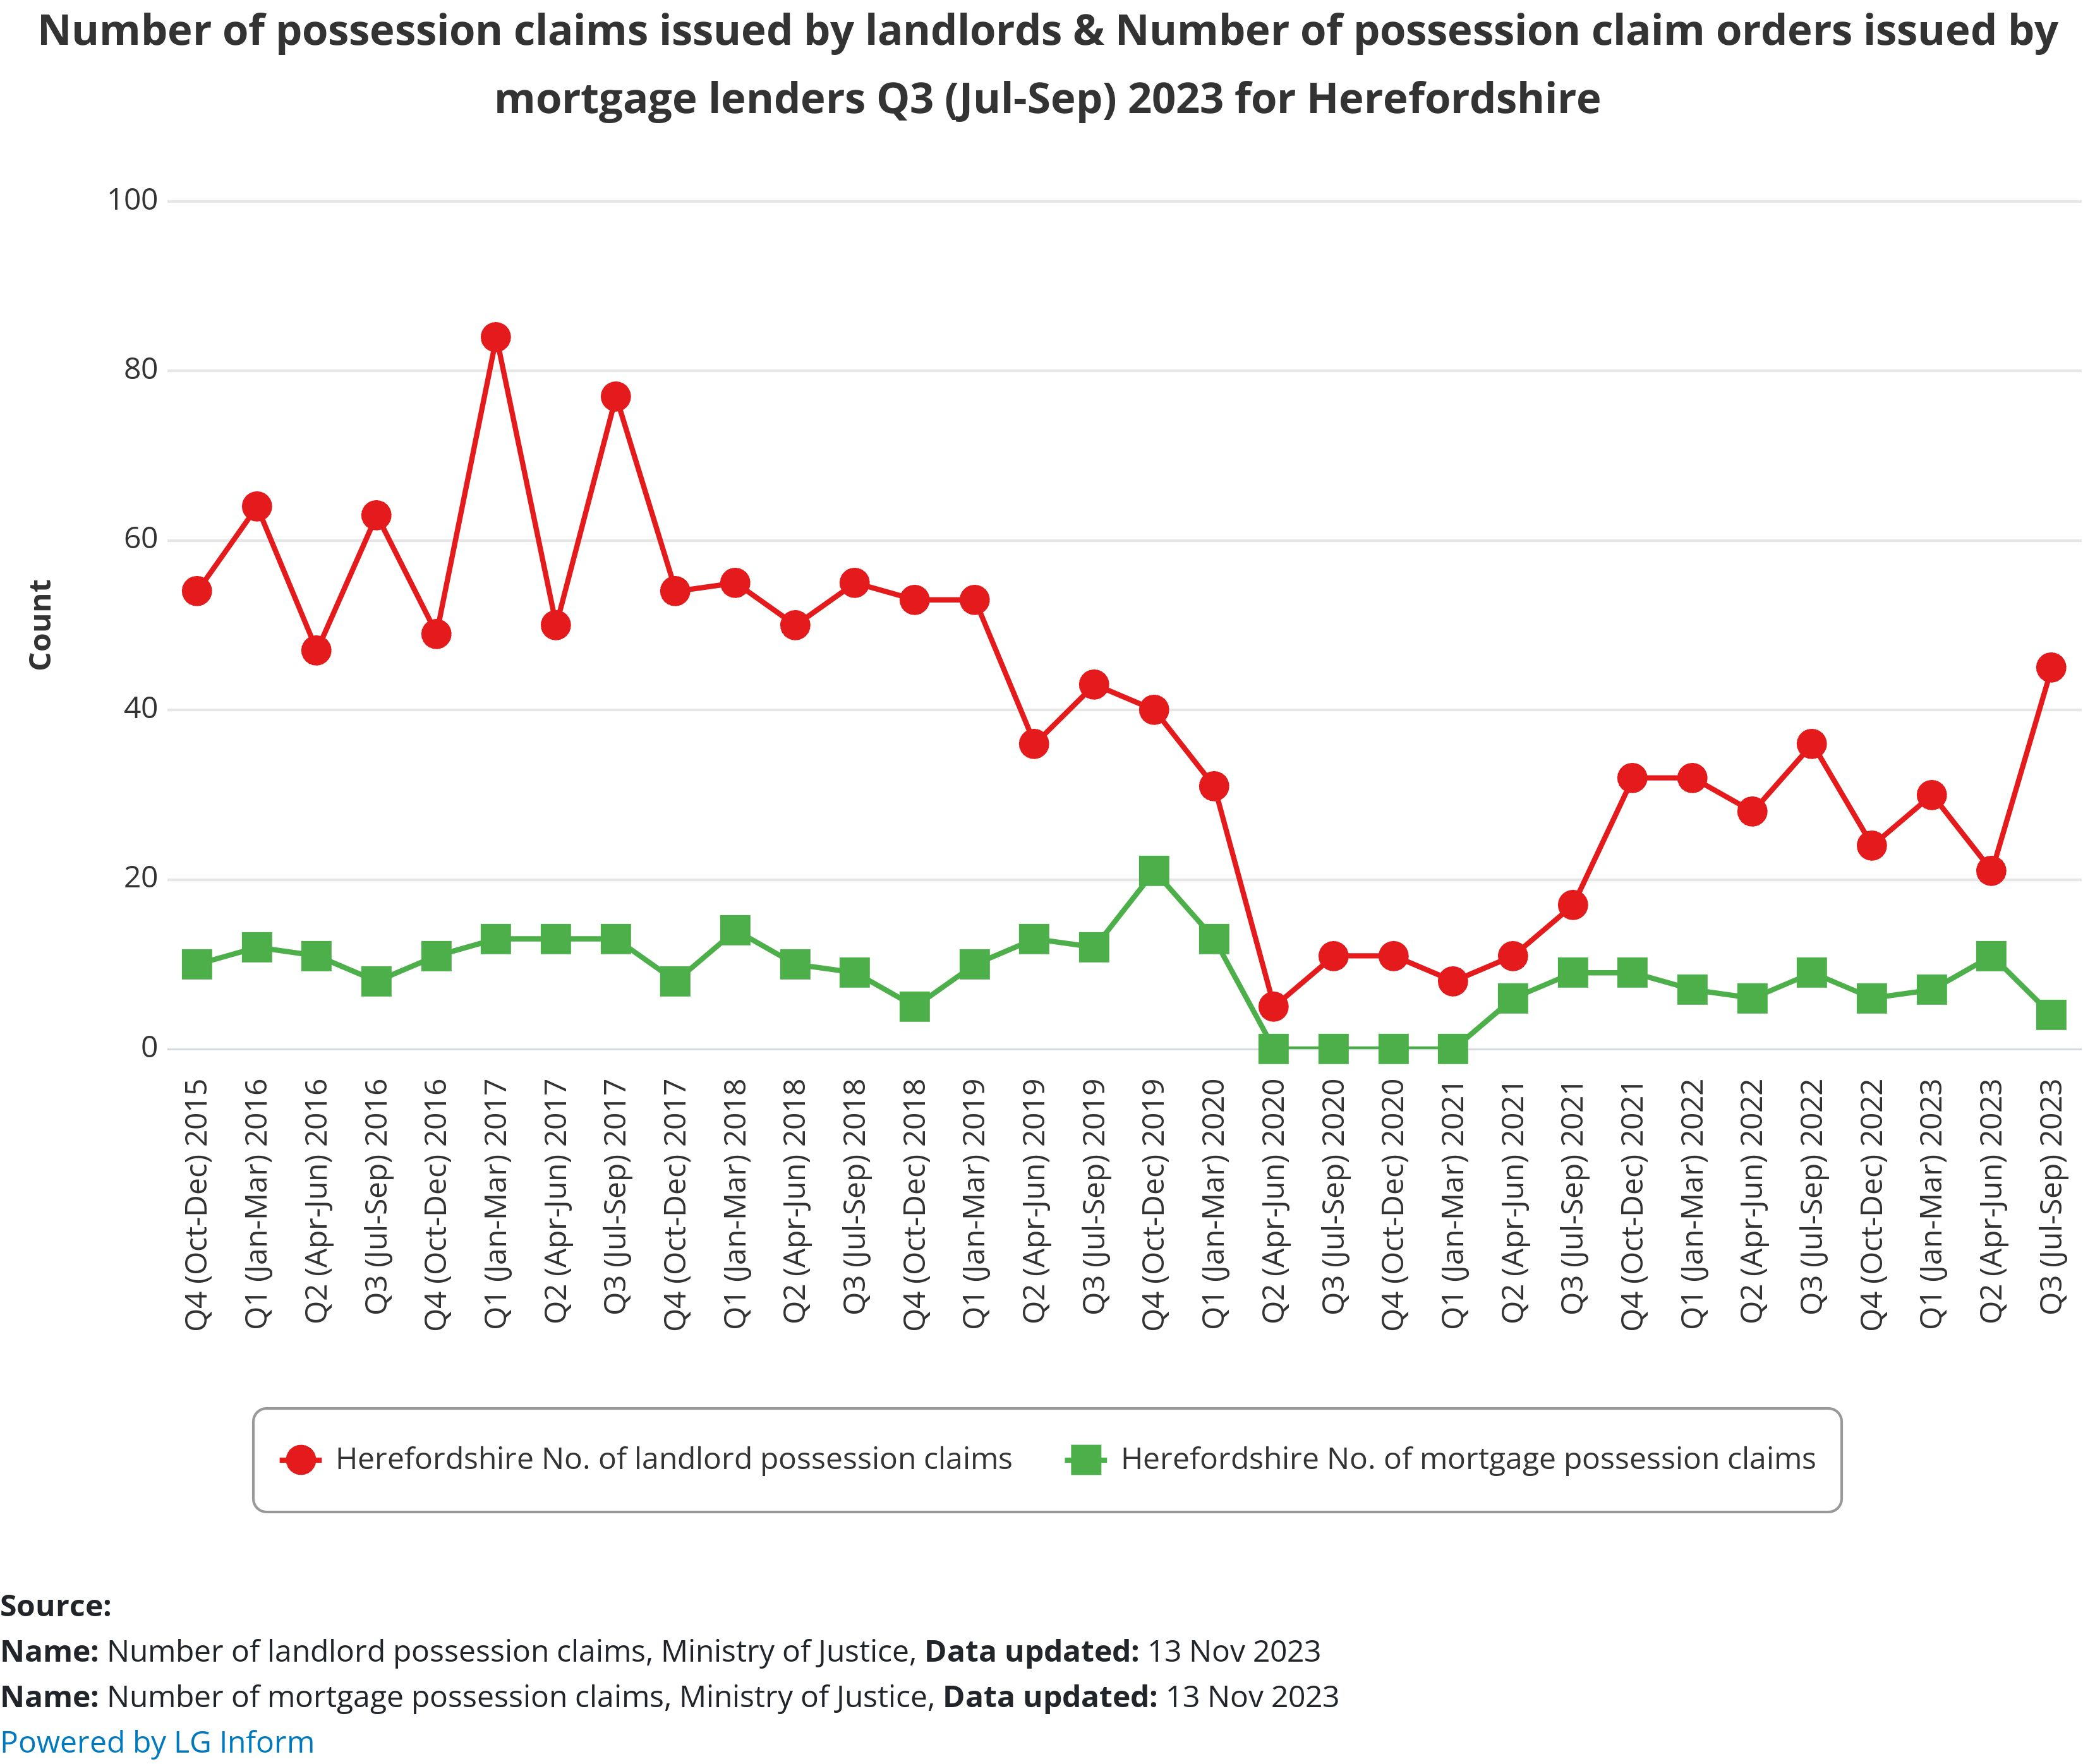
Mortgage and landlord possessions
Key points
Interest rates have risen substantially in the past 12 months as the Bank of England tried to control inflation. Consequently, mortgages became much more expensive at the same time as other cost were also increasing significantly. Borrowers coming off of fixed-term deals faced really significant payment increases and first-time buyers found it harder to get on the property ladder. Higher costs for landlords translated into higher rental prices.
ONS reports that in December 2023, more than a third (37%) of adults in Great Britain who were paying rent, or a mortgage, said they were finding payments very or somewhat difficult to afford.. This is a slight rise from 31% in a similar period last year. ONS also found that some groups were more likely to report difficulty with rent and mortgage payments, including lone parents, Asian and Asian British adults and Black, African, Caribbean or Black British adults.
In summer 2023, IFS research suggested that 60% of mortgage holders (8.5 million; 19% of adults) were likely to spend more than a fifth of their incomes on mortgage payments - a substantial increase.
Chronic undersupply has kept prices from tumbling, preventing negative equity becoming an issue, and tighter regulation of mortgage lending introduced after the Financial Crisis seems to have prevented repossessions on the sort of scale seen in past market upheavals.
Q3 2023 data from UK Finance show that nationally 87,930 homeowner mortgages were in arrears of 2.5% or more of the outstanding balance in the third quarter of 2023, 7% greater than in the previous quarter.
Nationally, there were 11,540 buy-to-let mortgages in arrears of 2.5% or more of the outstanding balance in the third quarter of 2023, 29% greater than in the previous quarter.
630 homeowner mortgaged properties were taken into possession in the third quarter of 2023, 9% fewer than in the previous quarter. 450 buy-to-let mortgaged properties were taken into possession in the third quarter of 2023, unchanged from the previous quarter.
Latest Ministry of Justice data (July – September 2023) showed mortgage claims, orders and warrants increased and repossessions decreased, while landlord possession actions had all increased, with possession claims rates rising across all regions.
As at Q3 2023/24, mortgage possessions in Herefordshire were lower than the previous quarter (4 compared to 11). However, landlord possessions more than doubled from 21 to 45. Historically these levels still remain low.
Source: LG Inform
Date last updated: 13 November 2023
Frequency: Quarterly
Next update: February 2024

Slide 45
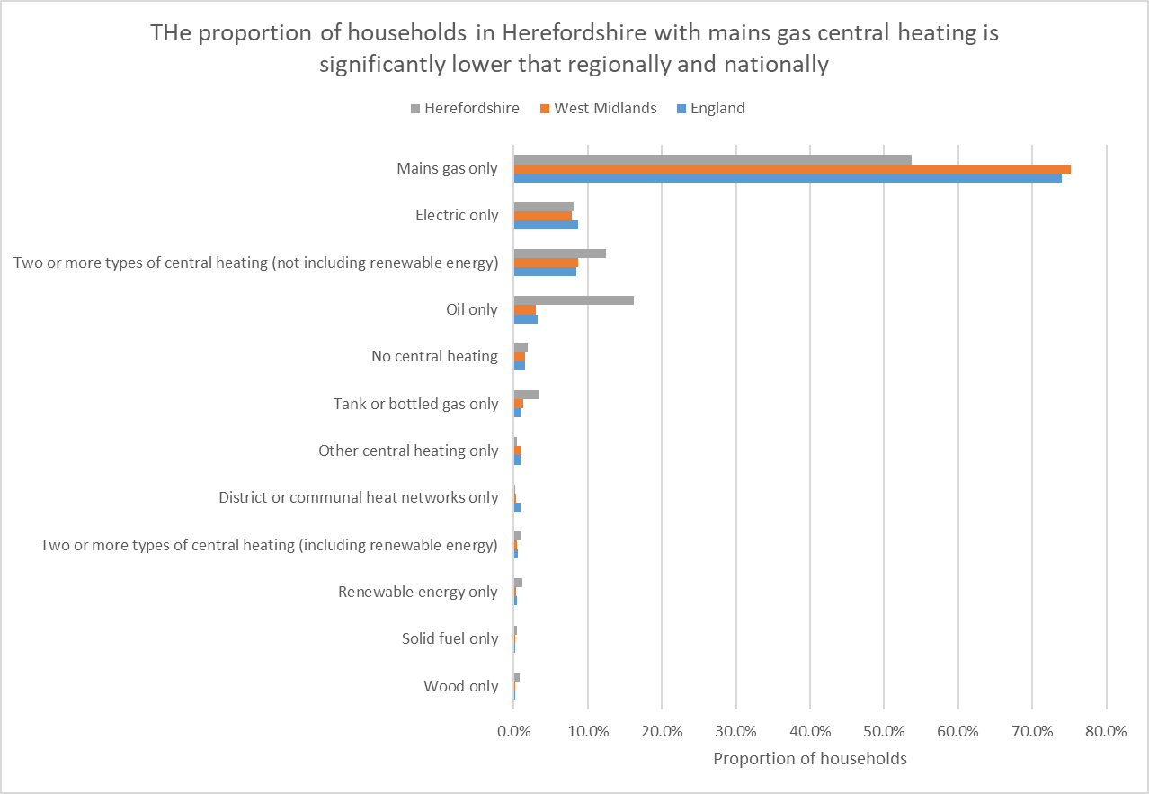
Household heating
Key points
ONS reports that in the year to December 2023 gas prices fell by 31.0% and electricity prices fell by 15.4%, according to the latest Consumer Prices Index including owner occupiers’ housing costs (CPIH) data.. Inflation rates for gas and electricity have remained similar since October 2023, when the annual rate fell its lowest level since records began in January 1989.
According to latest ONS survey data (13 December 2023 and 1 January 2024), 38% of adults who pay energy bills said it was very or somewhat difficult to afford them. This was compared with 46% during a similar period one year ago. 49% of adults in Great Britain are using less fuel, such as gas or electricity, in their homes because of the rising cost of living.
Cold homes are a risk factor across a range of serious health conditions and ultimately contribute to excess winter deaths.
Households with expensive oil-fired or bottled gas central heating are particularly vulnerable to cost-of-living increases. Department for Business, Energy & Industrial Strategy data show that in 2021, an estimated 37% of Herefordshire properties were not connected to the gas grid, compared to 13% in the West Midlands region and 14% in England as a whole.
2021 Census data show the proportion of households in Herefordshire with oil only central heating is significantly higher than regionally and nationally: 16.2% compared to 3.0% and 3.2% respectively. The proportion with tank or bottled gas only, although relatively small, is also significantly higher than regionally and nationally (3.5% compared to 1.2% and 1.0% respectively). Conversely, the proportion of households with mains gas central heating is significantly lower: 53.7% compared to 75.2% in the West Midlands and 74.0% in England.
1.9% of households in Herefordshire (over 1,500 homes) have no central heating compared to 1.5% regionally and nationally.
Data source: ONS
Frequency: Decennially
Last updated: 5 January 2023
Next update: 2031

Slide 46
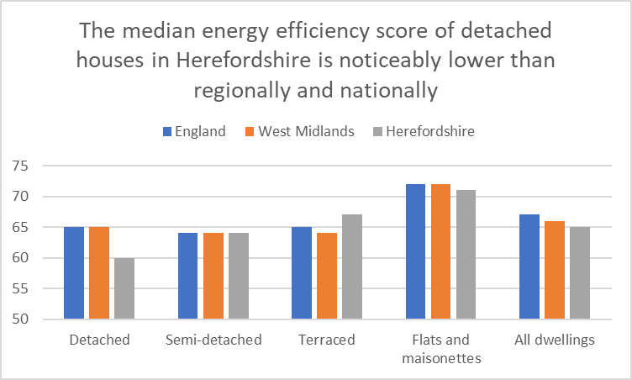
Energy efficiency of homes
Key points
Less energy efficient homes are more difficult and expensive to heat. National research by ONS has found that older adults 65+ and those with multiple generations living in them are disproportionately likely to be living in such homes.
Herefordshire has a median energy efficiency rating in band D, with an overall score of 65 across all property types, similar to the West Midlands region (66) and England as a whole (67), where the most energy-efficient homes have an energy efficiency rating in band A and the least energy-efficient homes are in band G.
Several factors affect the energy efficiency of housing, including property type, tenure and when it was constructed.
Less energy efficient properties are more expensive to keep warm.
Herefordshire has a disproportionately high number of relatively energy inefficient older detached houses compared to regionally and nationally (see fuel poverty slide).
The median energy efficiency score of detached houses in Herefordshire (60) is significantly lower than regionally and nationally (both 65) although still within Band D.
Conversely, the median energy efficiency score of terraced properties in higher than regionally and nationally (67 compared to 64 and 65 respectively).
Need to know: Energy Performance Certificates (EPCs) indicate the energy efficiency of dwellings. They are based on data about a building's energy features, for example, the building materials used, the heating systems and insulation. These are collected by an accredited energy assessor and entered into government-approved software to generate an EPC score, typically ranging from 0 to 100. Domestic EPCs are banded from A to G, where A is the most energy efficient.
Around 40% of all properties across England and Wales still did not have an EPC by 2021,
Data source: ONS
Frequency: Annually
Last updated: 22 October 2022
Next update: T.b.c.

Slide 47
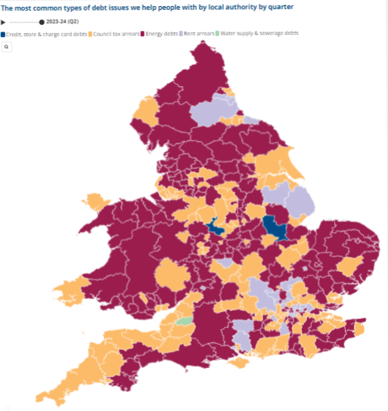
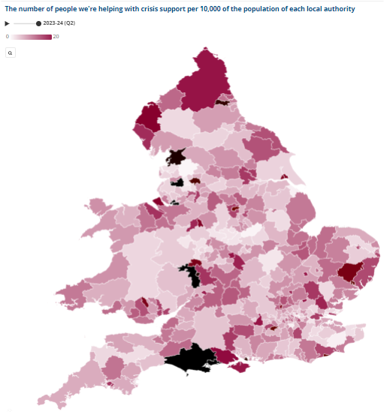
Debt issues and crisis support
Key points
Citizens Advice (CA) has developed an interactive dashboard that provides indicators around financial insecurity at local authority level. This shows that in Herefordshire, as in much of the rest of the country, the top debt issue faced by people before the pandemic was Council Tax arrears, followed by credit, store and charge card debts – but in Herefordshire this became energy debts between Q2 2021-22 and Q1 2023-24. However, in Q2 2023-24 it had again become Council Tax arrears.
In Q2 2023-24 in Herefordshire 5.58 people per 10,000 were being helped with crisis support: up from 1.34 in Q1 2019-2020 but down from 6.66 in Q4 2022-23 and relatively low compared to some other areas of the country.
Nationally, CA report that they have never seen a higher proportion of people in a negative budget and that more than 60% of the people helped with crisis support are disabled or have a long-term health condition.
Single people and single people with children, social housing tenants, people with disabilities, people whose ethnicity is mixed or black, and women are all more likely to be referred to food banks.
Source: CA cost-of-living dashboard
Frequency: Quarterly
Last updated: 11 October 2023
Next update: t.b.c.

Slide 48



What people have told us
The second Herefordshire Community Wellbeing Survey ran between January and March 2023 (the first was in early 2021) and asked a representative sample of Herefordshire adults about a range of topics to do with community and wellbeing.
Asked in the last 12 months, how often, if at all, they or their household had cut back on the use of heating 21% always or often had, rising to 36% amongst those of an ethnic minority background, 29% amongst those from the most deprived areas, and 29% amongst private renters. 3% of all adults said they always or often skipped meals or ate less.
Asked about measures they might take to reduce outgoings, 75% said they had started, were already, or were thinking about not turning their heating on when they usually would have and 51% said they have either started, are already, or are thinking about socialising less. 16% said they had started, were already, or were thinking about skipping meals.
Asked to think about their household’s total monthly or weekly income, 38% of those who expressed a view said it wasn’t easy to pay usual expenses (e.g. rent/mortgage, food, bills): up from 14% in 2021. For those living in the most deprived areas it was 65%, for social renters 69%, and private renters 62%.
Source: Herefordshire Council, Community Wellbeing Survey, 2023.
Frequency: Biennially
Last update: April 2023
Net update: None scheduled

Slide 49
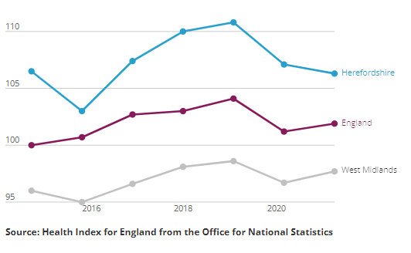
Impact on wellbeing
Unsurprisingly, the cost-of-living crisis is having a detrimental impact on both mental and physical wellbeing and is widening existing health inequalities. According to research by mental health charity MIND, three in every 50 people in England and Wales say they have considered ending their lives because of cost-of-living pressures, one in five report worsening depression, and one in ten say they’ve developed disordered eating as a result.
ONS has devised a Health Index for England comprising an overall score for each local authority area and a number of sub-domains. A score of 100 in the Health Index and its components represents health in England in 2015. A higher number always means better health and a lower number means worse health. The overall Health Index for England was improved in 2021 (the latest year available) compared with 2020, though it remained below 2019 levels.
Key points
In 2021, before the current cost-of-living crisis took hold, Herefordshire had an overall Health Index score of 99.9 in 2021: down 1.6 points compared with the previous year. Herefordshire ranked around average among local authority areas in England for health in 2021.
Herefordshire's Health Index value for "economic and working conditions" worsened by 0.8 points between 2020 and 2021, falling from 107.1 in 2020 to 106.3 in 2021. Consequently, Herefordshire went from being in the top 40% of local authority areas to being close to average across England for this subdomain. ONS reports that the change was largely because of an increase in unemployment (the index worsened by 1.7 points) and a worsening in job-related training (a decrease of 1.5).
The 2023 Community Wellbeing Survey of Herefordshire adults found that using the Warwick & Edinburgh Mental Wellbeing Score scale, 8% had poor wellbeing, The average (mean) score (25.9) was roughly in line with the 2021 survey (25.7) and the 2021 score for England as a whole (26.0), but was significantly lower among those living in the most deprived communities (24.3), those renting from a Housing Association/Trust (23.9) and people living with a disability (24.5).
Source: ONS
Last updated: 16 June 2023
Frequency: Annually
Next update: t.b.c.
ONS also publishes a personal wellbeing interactive map, which shows how wellbeing has changed at a local authority since 2011/12 and covers four domains: life satisfaction, feeling things are worthwhile, happiness and anxiety. In Herefordshire, scores for life satisfaction, worthwhile and happiness fell markedly during the pandemic, while anxiety increased, and are yet to recover to pre-pandemic levels.
Need to know: "Economic and working conditions" addresses child poverty, job-related training, unemployment, and workplace safety.

Slide 50
Section 4: Income deprivation, poverty and homelessness

Slide 51
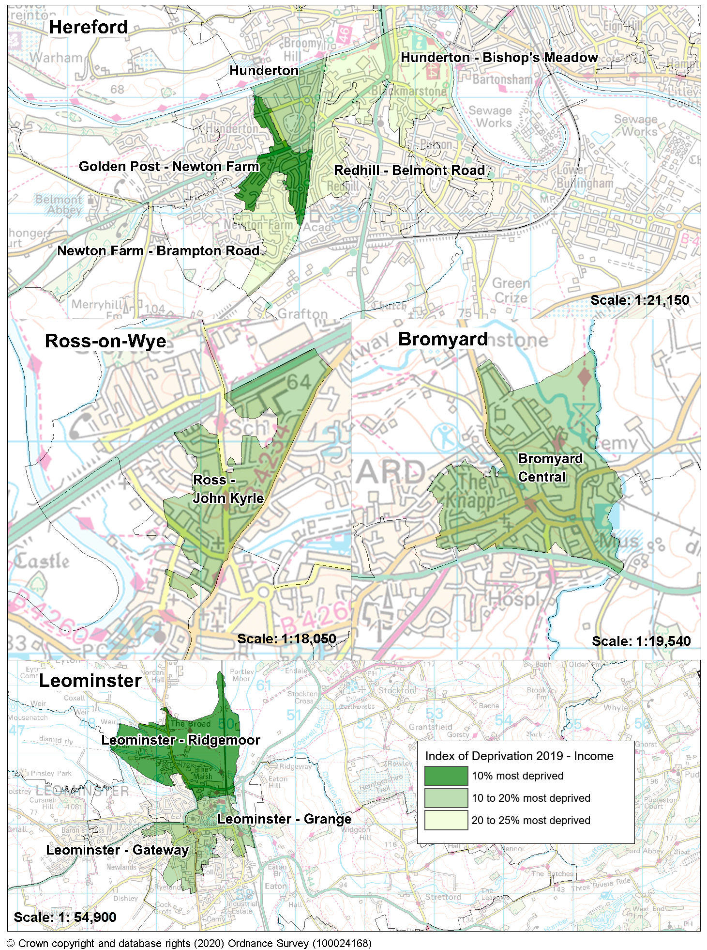
Income deprivation
The income domain of the Indices of Multiple Deprivation (IMD) 2019 measures the proportion of the population in a Lower Super Output Area (LSOA)* that live in income deprivation. The definition of low income used includes both people who are out-of-work and those who are in work but have low earnings (and who satisfy the respective means tests).
Key points
There are 10 LSOAs in Herefordshire that are amongst the 25% most deprived nationally in this domain, all having at least one in five people who live in income deprived households. Half of these areas are located in south Hereford, with a further three in Leominster and one each in Bromyard and Ross-on-Wye.
In nine out of ten of these areas the proportion of the population estimated as living in income deprived households has fallen since 2015, the exception being ‘John Kyrle’ where the proportion remains unchanged.
‘Golden Post – Newton Farm’ in Hereford and ‘Leominster Ridgemoor’ with respectively 29% and 28% of the population living in deprived households are within the 10% most deprived LSOAs in England.
There are 22 LSOAs across Herefordshire that are amongst the 25% least deprived nationally, with between 4% and 6% of their population living in income deprived households. These LSOAs are spread across the county with some in Hereford city and the market towns of Ledbury and Ross-on-Wye as well as a number in rural areas, although two thirds are within urban areas.
The income domain is divided into two supplementary indices - one for income deprivation affecting children and one for income deprivation affecting older people.
Need to know:
LSOAs are fixed statistical geographies of about 1,500 people designed by the Office for National Statistics (ONS).
Further information, including about Herefordshire’s overall IMD score and the other domains of the IMD can be found on the Understanding Herefordshire website.
Data source: Department for Levelling Up, Housing and Communities and Ministry of Housing, Communities & Local Government
Frequency: 5-yearly. Last updated: 2019. Next update: T.b.c.

Slide 52

Income deprivation by ward
Source: Office for Health Improvement & Disparities – Local Inequalities Explorer Tool Crown Copyright [date accessed 4 October 2023]
Data source: Department for Levelling Up, Housing and Communities and Ministry of Housing, Communities & Local Government
Frequency: 5-yearly. Last updated: 2019. Next update: T.b.c.

Slide 53

Children living in low-income families
Key points
Low income is often used as a proxy for poverty but they are not quite the same thing. Whether someone is in poverty or not is also determined by their fixed costs (see Full Fact - Poverty in the UK: a guide to the facts and figures.) Department for Work and Pensions (DWP) data show that around one in six people in the UK were in relative low income (relative poverty) before housing costs in 2021/22. This rises to just over one in five people once housing costs are accounted for.
In 2021/22, 18.6% of children under 16 in Herefordshire (5,554 children) were living in relative low-income families and 14.2% of children (4,230 children) in absolute low-income families: an increase from 16.4% and 13.0% respectively in 2020/21.
The proportion of children living in both relative and absolute low-income families was significantly lower than in England (19.9% and 15.3% respectively) and the West Midlands region (27.0% and 21.4% respectively).
Need to know
Relative low income refers to children living in households with income below 60% of the median in that year. A family must have claimed one or more of Universal Credit, Tax Credits or Housing Benefit at any point in the year to be classed as low income in these statistics.
Absolute low income is defined as a family in low income Before Housing Costs (BHC) in the reference year in comparison with incomes in 2010 to 2011. A family must have claimed one or more of Universal Credit, Tax Credits or Housing Benefit at any point in the year to be classed as low income in these statistics. Absolute low income takes the 60% of median income threshold from 2010 to 2011 and then fixes this in real terms (i.e. the line moves with inflation). This is designed to assess how low incomes are faring with reference to inflation. Source: OHID.
More information about measures of poverty in the UK can be found in Poverty in the UK: Statistics
Data source: Office for Health Improvements & Disparities Fingertips
Frequency: Annually
Last updated: 3 May 2023
Next update: May 2024

Slide 54

Children living in relative low-income families by ward
Key points
The number of children in each ward living in relative low-income families is obviously influenced by the number of children living in that ward. However, these data are not available as a rate at ward level.
Provisional Department for Work and Pensions (DWP) data for 2021/22 show that the wards with the highest numbers of children living in relative low-income households were Newton Farm (412), Hinton & Hunderton (330), Red Hill (258) and Leominster North & Rural (219).
The wards with the lowest numbers were Tupsley (54), Ledbury North (55), Eign Hill (59) and Old Gore (62).
The median number of children per ward living in relative low-income families for the county as a whole in 2021/22 was 115.
Need to know
Relative low-income is defined as a family whose equivalised income is below 60 per cent of contemporary median income, however only families that have claimed Child Benefit and at least one other household benefit (Universal Credit, Tax Credit or Housing Benefit) are be included in the statistics.
Data source: Department for Work & Pensions – Stat-Xplore
Frequency: Annually
Last updated: 23 March 2023
Next update: March 2024

Slide 55

Child poverty rates after housing costs
Key points
When housing costs are factored in, poverty rates in the UK are actually much higher than suggested by income measures alone: the charity Child Poverty Action Group cites 4.2 million children living in poverty in the UK in 2021-22.
Analysis by the Joseph Rowntree Foundation (JRF) suggests that child poverty rates fell during the pandemic as a result of government support measures such as the £20 Universal Credit uplift but are likely to have increased dramatically since as a result of the cost-of-living crisis – a situation JRF describes as “deeply worrying”.
JRF report that those families disproportionately likely to experience child poverty. Poverty rates are highest for people in the social rented and private rented sectors, and much higher for households including a disabled person or an informal carer. In addition, larger families (3 or more children) and certain minority ethnic families (e.g. Bangladeshi, Pakistani & Black ethnicities) are more likely to experience child poverty.
Data published by the charity End Child Poverty suggest that after taking account of housing costs, in 2021-22 30.7% of children in Herefordshire were living in poverty; a higher proportion than nationally (29.2%) but less than the West Midlands region (38%). This equates to around 10,900 children in Herefordshire living in poverty.
Source: End Child Poverty – Child poverty in your area
Frequency: Annually
Last updated: June 2023
Next update: June 2024

Slide 56

Fuel poverty and excess cold
Key points
Recent research by the University of York’s Cost of Living Research Group has found that nationally ‘fuel poverty has risen alarmingly since 2021. Households with a low-income are being hit hard, and the Westminster government’s Energy Price Guarantee has done little to alleviate hardship.’
Herefordshire is exposed to a number of risk factors for fuel poverty and excess cold, which are linked to its rurality, including below average earnings; a higher proportion of detached houses (40%) compared to England (23%); a higher proportion (37%) of households not on mains gas grid compared to nationally (15%); and a higher proportion (39%) of houses built pre-1900 than nationally (8%) (such homes can be more expensive and inefficient to heat).
In 2019, a BRE report found that 14,300 Herefordshire homes (17%) were deemed to have an excess cold hazard compared to 3% for England. Excess cold was more likely to affect owner occupied dwellings (20%) than private rented (16%) or social rented (4%) dwellings.
In 2021, the West Midlands had the highest rate of fuel poverty of any English region. There were 23 local authorities in England with an estimated fuel poverty rate above 18% in 2021, of these, 11 were in the West Midlands (including Herefordshire). This was before the surge in energy prices following the Russian invasion of Ukraine.
Applying the Government’s ‘low income, low energy efficiency' measure, around 19.2% (c.16,300) of households in Herefordshire were in fuel poverty in 2021: a higher proportion than in England (13.1%) and the West Midlands (18.5%) and an increase from 17% (c.14,000 households) in 2020.
Within Herefordshire, there is a wide variation in the proportions of households in fuel poverty, ranging from 5.6% of households in Belmont-Abbotsmead and Ledbury – New Mills LSOAs to 35.7% in Aymestrey Horseshoe LSOA.
Data source: Department for Business, Energy & Industrial Strategy
Frequency: Annually
Last updated: 27 April 2023
Next update: April 2024.
Need to know: The ‘Low Income Low Energy Efficiency’ (LILEE) indicator counts a household as fuel-poor if they are living in a property with an energy efficiency rating in band D, E, F or G and their disposable income (income after housing costs and energy needs) is below the relative poverty line (relative poverty being defined as having an income 60 per cent below the median national household income).

Slide 57

Homelessness
Key points
Significant rent and mortgage increases have driven up costs for many tenants and home-owners across the country and are a contributory factor in some landlords nationally quitting the rental sector. Changes in legislation that have placed an increased regulatory burden on landlords, as well as fiscal changes, have also made the rental sector less attractive, especially to smaller landlords. These developments are aggravating the long-standing national issue of under-supply of social and affordable housing and coupled with other cost-of-living pressures are likely to result in increased incidence of homelessness
According to a report commissioned by Crisis, forecasts show core homelessness rising significantly across the country in the immediate future
In Herefordshire between 2021-22 and 2022-23 the number of households that were either homeless (with a relief duty owed) or threatened with homeless (preventing duty owed) increased from 1,158 to 1,328
Within the total of those threatened with homelessness, the number of households threatened with homelessness due to a valid Section 21 Notice dropped from 115 to 88.
Data source: Department for Levelling Up, Housing and Communities
Data last updated: 13 October 2023
Frequency: Annually
Next update: October 2024

Slide 58
Appendix 1: Useful resources

Slide 59
Appendix: Useful resources (1)
Barnardo’s – ‘At What Cost?’ The impact of the cost-of-living crisis on children and young people (report)
CACI – Understanding the impact of the cost of living crisis (YouTube podcast series)
Cambridge Centre for Housing and Planning Research – Digital exclusion and the cost of living crisis (report)
Carers UK - State of Caring Survey 2023 - The impact of caring on: finances (report)
Centre for Cities – Cost-of-Living tracker
Centre for Economic Performance - From Covid-19 to collapse? The self-employed and the cost of living crisis (report)
Centre for Thriving Places – Thriving Places Index: Herefordshire
The Chartered Institute of Personnel and Development (CIPD) – Labour Market Outlook Autumn 2023 (report)
Citizens Advice – Cost-of-Living data dashboard
Citizens Advice - Living on Empty: a policy report from Citizens Advice (report)
Consumer Data Research Centre (CDRC) - Priority Places for Food Index
End Child Poverty – Child Poverty in your area (interactive map and report)

Slide 60
Appendix 1: Useful resources (2)
End Furniture Poverty - The Extent of Furniture Poverty in the UK (report)
End Furniture Poverty – On the cliff edge: the state of crisis support 2022/23 (report)
Financial Conduct Authority – Financial Lives Survey 2022 (report)
The Food Foundation - Children's Right2Food Dashboard
The Food Foundation - Food insecurity and inequalities experienced by disabled people (report)
The Health Foundation – Map of child poverty
The Health Foundation - What we know about the UK’s working-age health challenge
House of Commons Library – Rising cost of living in the UK (research briefing)
House of Commons Library - Poverty in the UK: Statistics (research briefing)
Institute for Fiscal Studies (IFS) - Housing quality and affordability for lower-income households (report)
IFS – Green Budget (October 2023) (report)
IFS - Living standards and inequality (report)
IFS - Living standards, poverty and inequality in the UK: 2023 (webinar)
Institute of Health Equity – Fuel poverty, cold homes and health inequalities in the UK (report)

Slide 61
Appendix 1: Useful resources (3)
Hargreaves Lansdown – Savings and resilience comparison tool
Joseph Rowntree Foundation (JRF) - UK Poverty 2023 (report)
JRF - Cost of living tracker, summer 2023 (research briefing)
JRF – Destitution in the UK 2023 (report)
Living Wage Foundation - Precarious pay and uncertain hours: insecure work in the UK Labour Market (report)
Local Government Association - LG Inform
Mental Health Foundation - Mental Health and the Cost-of-Living Crisis: Another pandemic in the making? (briefing paper)
Midlands Engine – Midlands Engine Observatory Intelligence Hub
National Centre for Social Research (NatCen) - Society Watch 2023: The Price We Pay - the social impact of the cost of living crisis (report)
National Institute for Economic and Social Research (NIESR) – UK Economic Outlook Autumn 2023 (report)
Office for Health Improvement and Disparities (OHID) – Health inequalities dashboard
OHID – Local Inequalities Explorer Tool
Office for National Statistics (ONS) - Build a custom area profile tool (Census 2021 data)

Slide 62
Appendix 1: Useful resources (4)
ONS - Business insights and impact on the UK economy
ONS - Census
ONS – Census 2021: How homes are heated in your area
ONS – Census 2021: How workforce qualification levels differ across England and Wales
ONS – Cost-of-Living: Latest insights
ONS - The cost of living, current and upcoming work
ONS - Digital Exclusion Risk Factors Mapped Across Herefordshire (interactive map)
ONS - Economic activity and social change in the UK, real-time indicators
ONS – Facts and figures about people living in Herefordshire
ONS – Health Index - Health in England: 2015 to 2021
ONS – Household Costs Indices for UK household groups
ONS - How are monthly mortgage repayments changing in Great Britain?
ONS – Impact of increased cost of living on adults across Great Britain: July to October 2023
ONS - Income estimates for small areas, England and Wales: financial year ending 2020

Slide 63
Appendix 1: Useful resources (5)
ONS – Inflation and price indices
ONS – NOMIS Herefordshire Labour Market Profile
ONS - Personal well-being in the UK: April 2022 to March 2023 (includes personal well-being explorer tools showing change in key indicators of wellbeing at local authority area level)
ONS - Regional consumer card spending, UK: 2019 to 2023
ONS - Subnational indicators explorer
ONS – UK Economy latest
ONS – UK Labour market overview
ONS - UK Measures of National Well-being Dashboard
ONS - Understanding towns: industry analysis
ONS - Understanding unemployment: what role does ethnicity and disability play?
ONS – Visualising people flows
ONS – ‘Young people from disadvantaged backgrounds feel less in control of their futures’ (article)
The Productivity Institute - The Midlands’ Productivity Challenge: Exploring the issues (insight paper)

Slide 64
Appendix 1: Useful resources (6)
The Productivity Institute - Regional Productivity Scorecard: ITL3 West Midlands
The Resolution Foundation - Shared prosperity: What would it take to see a return to rising living standards for all? (webinar)
The Resolution Foundation - A pre-election Statement: Putting the Autumn Statement 2023 in context (briefing note)
The Resolution Foundation – The 2030 Enquiry: The final report (report)
The Resolution Foundation – Turning a corner? The political and economic outlook for a critical election year (webinar)
Royal London – Cost of living report (report)
Royal Society for Public Health - Our health: the price we will pay for the cost-of-living crisis (report)
Rural Services Network - Rural Cost of Living Survey 2023: Final Report (report)
Rural Services Network: Autumn Statement 2023: What does it mean for rural? (opinion piece)
The Policy Institute - Experiencing the cost-of-living crisis: the impact on mental health (report)
University of Birmingham – Productivity in the West Midlands (report)
University of Birmingham / City REDI – West Midlands Economic Impact Monitor (bulletin)
University of Sheffield – UK adult food insecurity interactive map (2021)
ONS - UK Measures of National Well-being Dashboard

Slide 65
Appendix 1: Useful resources (7)
University of York – ‘Sticking Plasters and Systemic Solutions – cost of living responses in the UK’ (report)
Youth Futures Foundation - Unlocking youth employment: Opportunities for employers and marginalised groups (report)

Slide 66
Appendix 2: Composition of Herefordshire’s economy
Source: Lightcast (EMSI): economicmodelling.co.uk
Date last updated: 13 December 2023
Frequency of update: Annual
Next update: T.b.c.

Slide 67


Appendix 2 – Largest and highest paying industries
Need to know: The charts show occupations at Standard Industry Classification (SIC) 1 level but data are available down to SIC 4 level if more granularity is required.
Source: Lightcast (EMSI): economicmodelling.co.uk
Date last updated: December 2023
Frequency of update: Annual
Next update: December 2024

Slide 68


Appendix 2 – Fastest growing and most competitive industries
Need to know:
Competitive effect indicates how much of the job change within a given region is the result of some unique competitive advantage of the region. This is because the competitive effect, by definition, measures the job change that occurs within a regional industry that cannot be explained by broader trends.
The charts show occupations at Standard Industry Classification (SIC) 1 level but data are available down to SIC 4 level if more granularity is required.
Source: Lightcast (EMSI): economicmodelling.co.uk
Date last updated: December 2023
Frequency of update: Annual
Next update: December 2024

Slide 69

Appendix 2 – Highest industry employment concentrations
Need to know: The charts show occupations at Standard Industry Classification (SIC) 1 level but data are available down to SIC 4 level if more granularity is required.
Source: Lightcast (EMSI): economicmodelling.co.uk
Date last updated: December 2023
Frequency of update: Annual
Next update: December 2024

Slide 70


Appendix 2 – Largest and highest paying occupations
Need to know: The charts show occupations at Standard Occupation Classification (SOC) 1 level but data are available down to SOC 4 level if more granularity is required.
Source: Lightcast (EMSI): economicmodelling.co.uk
Date last updated: December 2023
Frequency of update: Annual
Next update: December 2024

Slide 71


Appendix 2 – Fastest growing and most competitive occupations
Need to know:
Competitive effect indicates how much of the job change within a given region is the result of some unique competitive advantage of the region. This is because the competitive effect, by definition, measures the job change that occurs within a regional industry that cannot be explained by broader trends.
The charts show occupations at Standard Occupation Classification (SOC) 1 level but data are available down to SOC 4 level if more granularity is required.
Source: Lightcast (EMSI): economicmodelling.co.uk
Date last updated: December 2023
Frequency of update: Annual
Next update: December 2024

