Slide 1
Herefordshire cost-of-living monthly monitoring report February 2023 Herefordshire Council Intelligence Unit

Slide 2
About the monthly monitoring report
The monthly monitoring report is a supplementary report to the quarterly Cost-of-Living Bulletin and provides the latest data from the limited number of datasets that are updated on a monthly basis.
If you need help to understand this document, or would like it in another format or language, please contact us on 01432 261944 or e-mail researchteam@herefordshire.gov.uk

Slide 3
Key points
The number of people claiming the Universal Credit (UC) doubled between March 2020 and May 2020 and is currently rising again. Numbers of claimants remained at a high level compared to pre-pandemic.
The number of people claiming Pension Credit (UC) in Herefordshire has fallen significantly and fairly consistently since May 2018.
From early 2021 onwards the numbers of people claiming out-of-work related benefits decreased gradually and fairly consistently from the peaks seen in May and August 2020 but this fall has now faltered and numbers increased in January. Numbers of claimants remain elevated when compared to the pre-pandemic level. Generally, those wards with the highest numbers of claimants before the pandemic still have the highest numbers now.

Slide 4
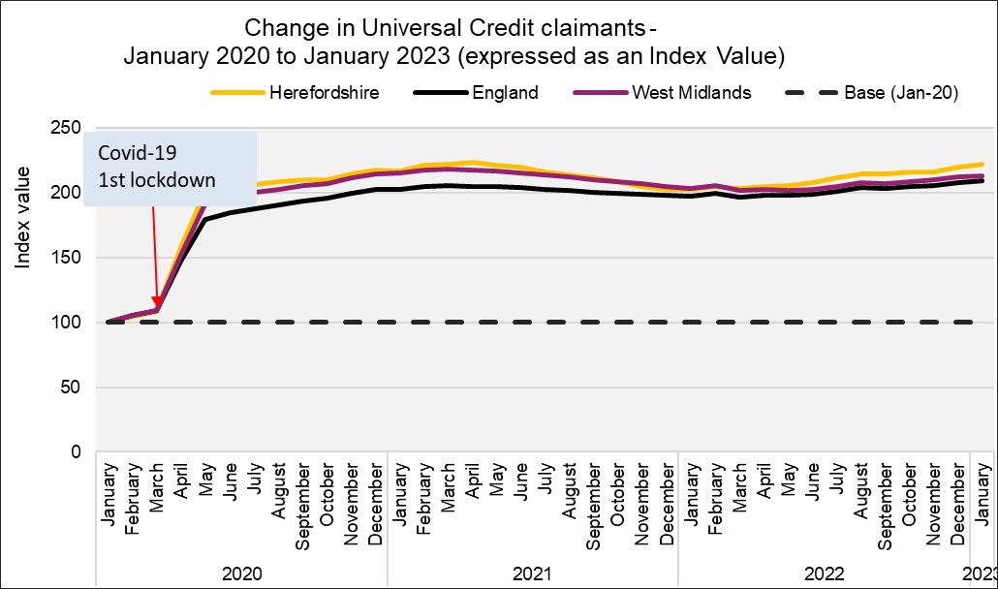
People claiming Universal Credit (UC)
Key points
The number of people claiming the Universal Credit (UC) doubled between March 2020 and May 2020. Since then the claimant numbers remained at a high level. Provisional data suggest there were 12,300 Universal Credit in claimants in Herefordshire in January 2023, slightly below the peak of 12,390 seen in April 2021 but well above the 5,980 seen in March 2020.
In Herefordshire, UC claimants currently comprise 11% of the working age population; lower than the West Midlands Region (16%) and England (14%) but still double the 5% seen in March 2020.
The wards with the highest number of UC claimants were Hinton & Hunderton (690) and Newton Farm (640) followed by Leominster East (460), Red Hill (460) and Widemarsh (450).
In November 2022, there were 10,030 households in Herefordshire claiming Universal Credit, of these households just over a half (5,200) had at least one child.
Need to know:
The monthly number of people on Universal Credit includes all individuals who have an open claim on the count date for the month.
Some people will have their claim terminated either at the request of the individual or if their entitlement to Universal Credit ends. If a termination is recorded, but the person is still receiving a payment, then the claim will still be classed as live at the end of each reporting month.
The latest month's figures are provisional and are subject to change in the next publication where they will be revised and finalised. Monthly figures are currently not subject to retrospection beyond the first revision.
Source: DWP
Date last updated: Feb. 2023
Frequency of update: Monthly
Next update: March 2023

Slide 5
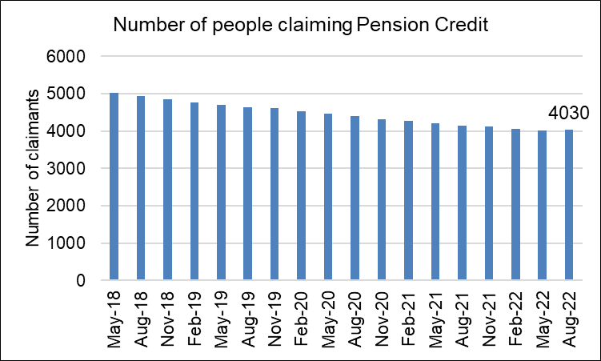
People claiming Pension Credit
Key points
Pension Credit provides help with living costs for people who are over State Pension age and on a low income. Pension Credit can also help with housing costs such as ground rent or service charges.
Pension Credit tops up:
weekly income to £182.60 if you’re single
joint weekly income to £278.70 if you have a partner
The number of people claiming Pension Credit (UC) in Herefordshire has fallen significantly and fairly consistently since May 2018 from 5,025 to 4,030 in August 2022.
Need to know: The age in which you qualify for pension credit has gradually increased from 60 to State Pension Age between April 2010 and November 2018 in line with the female State Pension age.
To be entitled to Pension Credit, you must be of qualifying age and living in Great Britain. In the case of a couple, either may claim if both are of qualifying age but only one partner can get Pension Credit at any one time. The second element is the savings credit whereby pensioners aged 65 and over receive a cash reward for their second pension or savings income above the level of the savings credit threshold.
Data source: Department for Work & Pensions (Stat-Xplore)
Frequency: quarterly in arrears
Last updated: 14 February 2023
Next update: May 2023

Slide 6
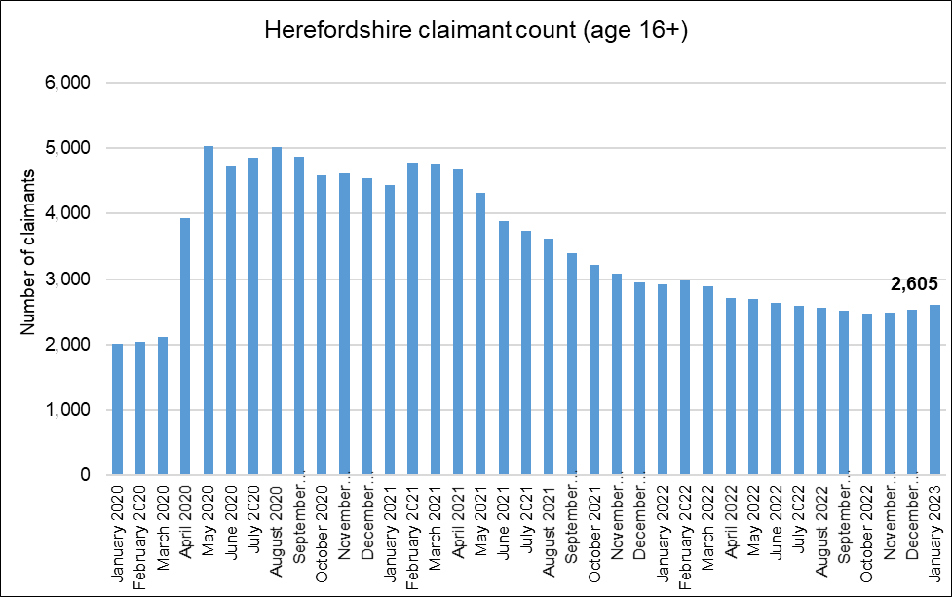
Out-of-work related claimant count: all ages
Key points
2,605 people aged 16+ claiming unemployment related benefits* in January 2022: an increase of 70 on the previous month.
The fairly steady decline in claimants since the Spring of 2021 now appears to have stalled and numbers remain elevated when compared to pre-pandemic levels, being 23% higher than in March 2020 (this compared to 24% higher across England as a whole).
There are currently around 520 more claimants than in the aftermath of the Great Recession (February 2012).
The claimant count rate a proportion of residents aged 16-64 for the county in January 2022 was 2.4% compared to 3.7% for England and 4.8% for the West Midlands region.
What this doesn’t tell us:
Claimant count is NOT a full measure of unemployment, but it is the most timely indicator.
From these data, we do not know which industry sector(s) any increases or decreases are being driven by.
Need to know
*Includes people claiming Jobseeker's Allowance plus those claiming Universal Credit who are required to seek and be available for work.
Month-by-month comparisons are difficult as previous data is often revised
Data source: ONS/NOMIS Date last updated: 14 Feb. 2023
Frequency of update: monthly
Next update: 14 March 2023

Slide 7
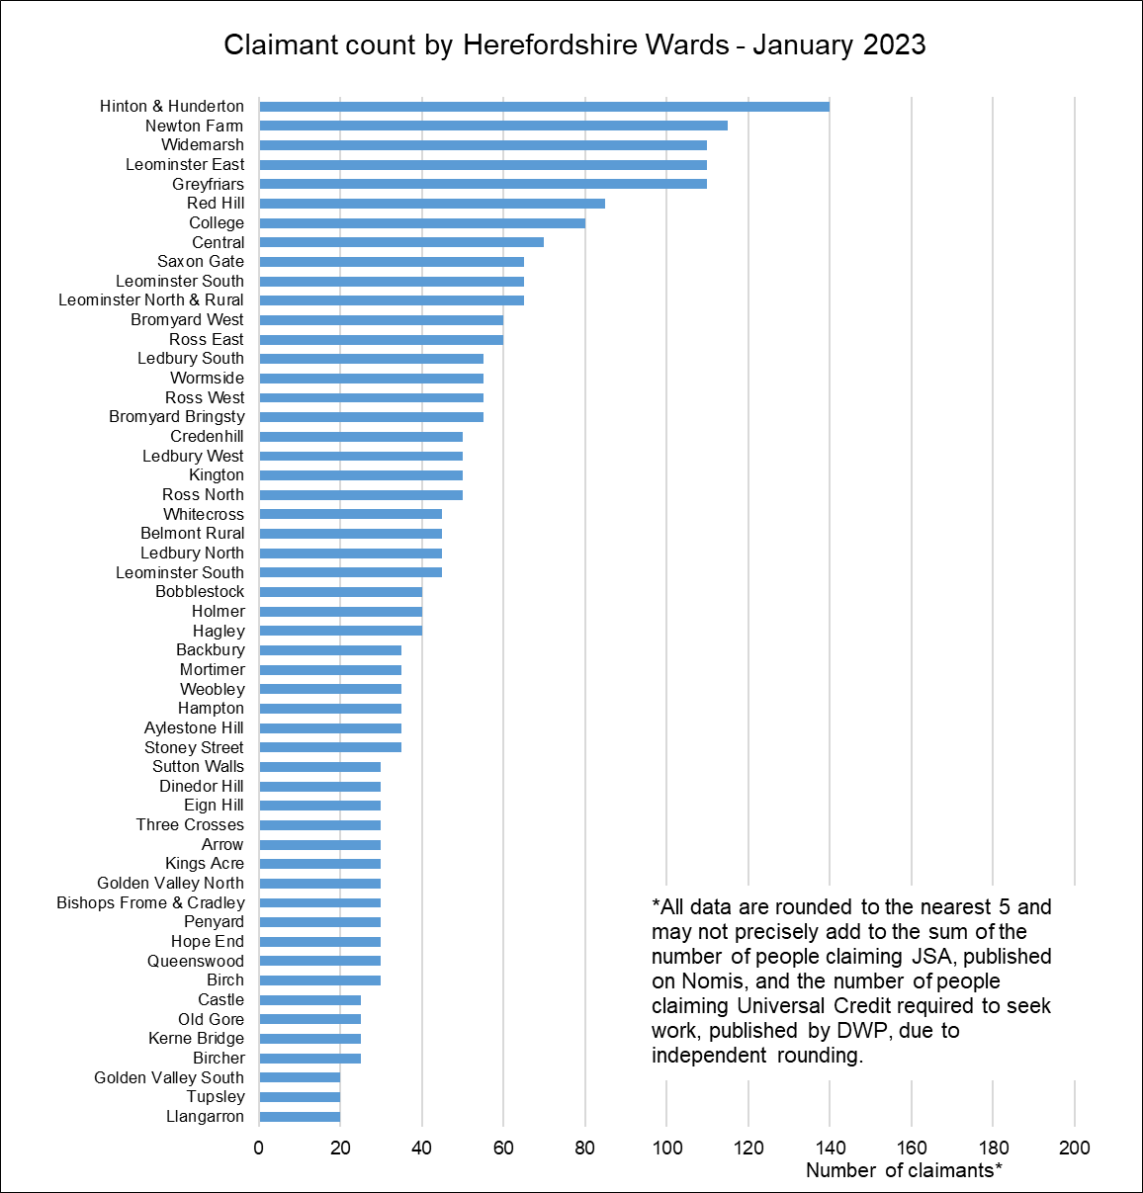
Claimant count by ward
Key points
Generally, those wards with the highest numbers of claimants before the pandemic still have the highest numbers now.
Currently, the Wards with the highest numbers of claimants are Hinton & Hunderton (140), Newton Farm (115), Widemarsh, Leominster East, and Greyfriars (110 each).
The largest proportional increases in the claimant count since March 2020 have occurred in Kerne Bridge (by 150%), Birch and Credenhill (each by 120%). In terms of numerical increases, the largest have been by 45 claimants in Widemarsh and by 30 in Widemarsh.
Data source: ONS/NOMIS Date last updated: 14 Feb. 2023
Frequency of update: monthly
Next updated: 14 March 2023

