Slide 1
Herefordshire cost-of-living bulletin January 2023 Herefordshire Council Intelligence Unit

Slide 2
About this bulletin
The purpose of this bulletin is to provide an overview of the local impact of the cost-of-living crisis and the groups likely to be most affected. It contains data and intelligence covering a range of relevant socio-economic indicators, acting as an evidence base to inform policy interventions. There are a limited number of datasets that are updated on a monthly basis and the benefits monitor will be updated monthly to reflect this. The rest of the slides are updated periodically to coincide with other data releases.
The bulletin comprises three sections:
Section 1: Monthly monitor - people in receipt of means-tested and out-of-work benefits
Section 2: Other cost-of-living related indicators
Section 3: Income deprivation and poverty
If you need help to understand this document, or would like it in another format or language, please contact us on 01432 261944 or e-mail researchteam@herefordshire.gov.uk

Slide 3
Key points
Continuing and significantly elevated numbers of people claiming Universal Credit compared to pre-pandemic levels. The number of people claiming out-of-work related benefits increased again in December and numbers remain significantly higher than pre-pandemic.
In 2021 the proportion of workless households in Herefordshire fell slightly and was lower than in England and the West Midlands region but not significantly so. Latest data suggest there are around 5,800 people in Herefordshire aged 16-64 absent from work due to long-term sickness.
The value of the local economy shrank to pre-2014 levels during the pandemic. Herefordshire has very low labour productivity compared to other ITL3 areas and an associated low-wage economy.
Herefordshire’s gross weekly earnings are significantly lower than the average for England as a whole and are growing at a lower rate. In 2021, Herefordshire had the lowest median earnings of all 14 comparator West Midlands authorities. In 2020 Herefordshire’s Gross Disposable Household Income fell and was lower than the average for England. Higher than average proportion of self-employed, whose median earnings are below the West Midlands average.
A higher proportion of young people not in education, employment or training (NEET) than nationally, with young people from areas of highest deprivation significantly more likely to be NEET.
Median house prices significantly higher than the West Midlands region average and housing affordability significantly worse than for the West Midlands region and England as a whole. Median monthly rents (all property types) are lower in Herefordshire than regionally or nationally but are rising in line with the national and regional trend. As at Q2 2022/23, mortgage and landlord possessions in Herefordshire both increased slightly from the previous quarter but historically these levels both remain low.
The numbers of children living in both relative and absolute poverty (low-income households measure) fell slightly in 2020/21 (the latest data available) but will likely have increased significantly since then.
Significantly higher pre-existing rates of fuel poverty and of homes deemed to have an excess cold hazard than nationally.
In Herefordshire between 2020-21 and 2021-22 the number of households that were either homeless (with a relief duty owed) or threatened with homeless (preventing duty owed) increased.
Among people supported by Citizens Advice, as in much of the rest of the country, the top debt issue faced by people currently is energy debts. The number of people being helped with crisis support has increased significantly but is still relatively low compared to some other areas of the country.

Slide 4
Section 1: Monthly monitor - people in receipt of means-tested and out-of-work benefits
The data in this section are those that are updated monthly (in arrears)

Slide 5
People claiming Universal Credit (UC)
Key points
The number of people claiming the Universal Credit (UC) doubled between March 2020 and May 2020. Since then the claimant numbers remained at a high level. Provisional data suggest there were 12,200 Universal Credit in claimants in Herefordshire in December 2022, slightly below the peak of 12,390 seen in April 2021 but well above the 5,980 seen in March 2020.
In Herefordshire, UC claimants currently comprise 11% of the working age population; lower than the West Midlands Region (16%) and England (14%) but still double the 5% seen in March 2020.
The wards with the highest number of UC claimants were Hinton & Hunderton (680) and Newton Farm (630) followed by Leominster East (470), Widemarsh (450) and Red Hill (440).
In August 2022, there were 9,828 households in Herefordshire claiming Universal Credit, of these households just over a half (5,000) had at least one child.
Need to know:
The monthly number of people on Universal Credit includes all individuals who have an open claim on the count date for the month.
Some people will have their claim terminated either at the request of the individual or if their entitlement to Universal Credit ends. If a termination is recorded, but the person is still receiving a payment, then the claim will still be classed as live at the end of each reporting month.
The latest month's figures are provisional and are subject to change in the next publication where they will be revised and finalised. Monthly figures are currently not subject to retrospection beyond the first revision.
Source: DWP
Date last updated: Jan. 2023
Frequency of update: Monthly

Slide 6
People claiming Pension Credit
Key points
Pension Credit provides help with living costs for people who are over State Pension age and on a low income. Pension Credit can also help with housing costs such as ground rent or service charges.
Pension Credit tops up:
weekly income to £182.60 if you’re single
joint weekly income to £278.70 if you have a partner
The number of people claiming Pension Credit (UC) in Herefordshire has fallen significantly and fairly consistently since May 2018 from 5,025 to 4,010 in May 2022.
Need to know: The age in which you qualify for pension credit has gradually increased from 60 to State Pension Age between April 2010 and November 2018 in line with the female State Pension age.
To be entitled to Pension Credit, you must be of qualifying age and living in Great Britain. In the case of a couple, either may claim if both are of qualifying age but only one partner can get Pension Credit at any one time. The second element is the savings credit whereby pensioners aged 65 and over receive a cash reward for their second pension or savings income above the level of the savings credit threshold.
Data source: Department for Work & Pensions (Stat-Xplore)
Frequency: quarterly in arrears
Last updated: 15 November 2022
Next update: 14 February 2023

Slide 7
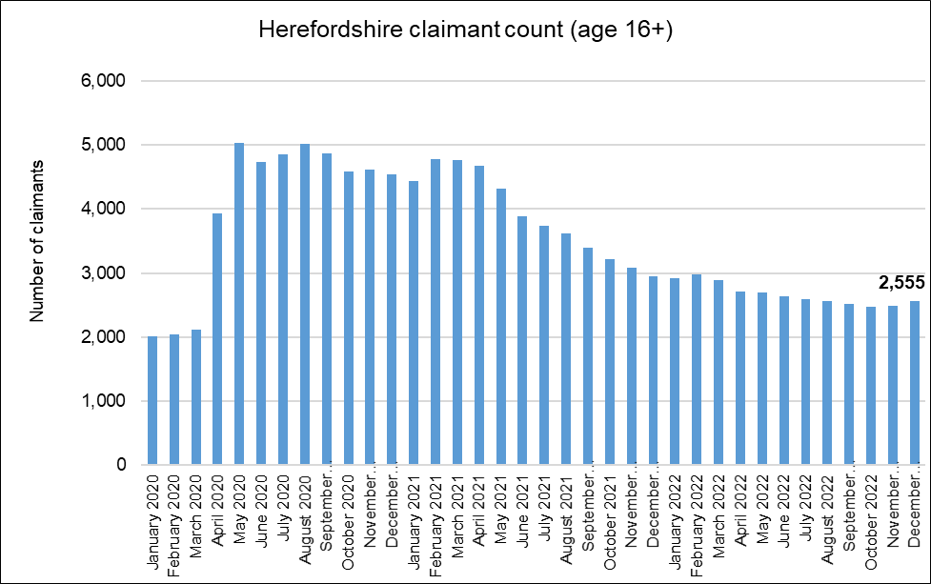
Out-of-work related claimant count: all ages
Key points:
2,555 people aged 16+ claiming unemployment related benefits* in December 2022: an increase of 70 on the previous month.
The fairly steady decline in claimants since the Spring of 2021 now appears to have stalled and numbers remain elevated when compared to pre-pandemic levels, being 21% higher than in March 2020 (this compared to 24% higher across England as a whole).
There are currently around 570 more claimants than in the aftermath of the Great Recession (February 2012).
The claimant count rate a proportion of residents aged 16-64 for the county in December 2022 was 2.3% compared to 3.8% for England and 4.8% for the West Midlands region.
What this doesn’t tell us:
Claimant count is NOT a full measure of unemployment, but it is the most timely indicator.
From these data, we do not know which industry sector(s) any increases or decreases are being driven by.
Need to know
*Includes people claiming Jobseeker's Allowance plus those claiming Universal Credit who are required to seek and be available for work.
Month-by-month comparisons are difficult as previous data is often revised
Data source: ONS/NOMIS Date last updated: 18 Jan. 2023
Frequency of update: monthly

Slide 8
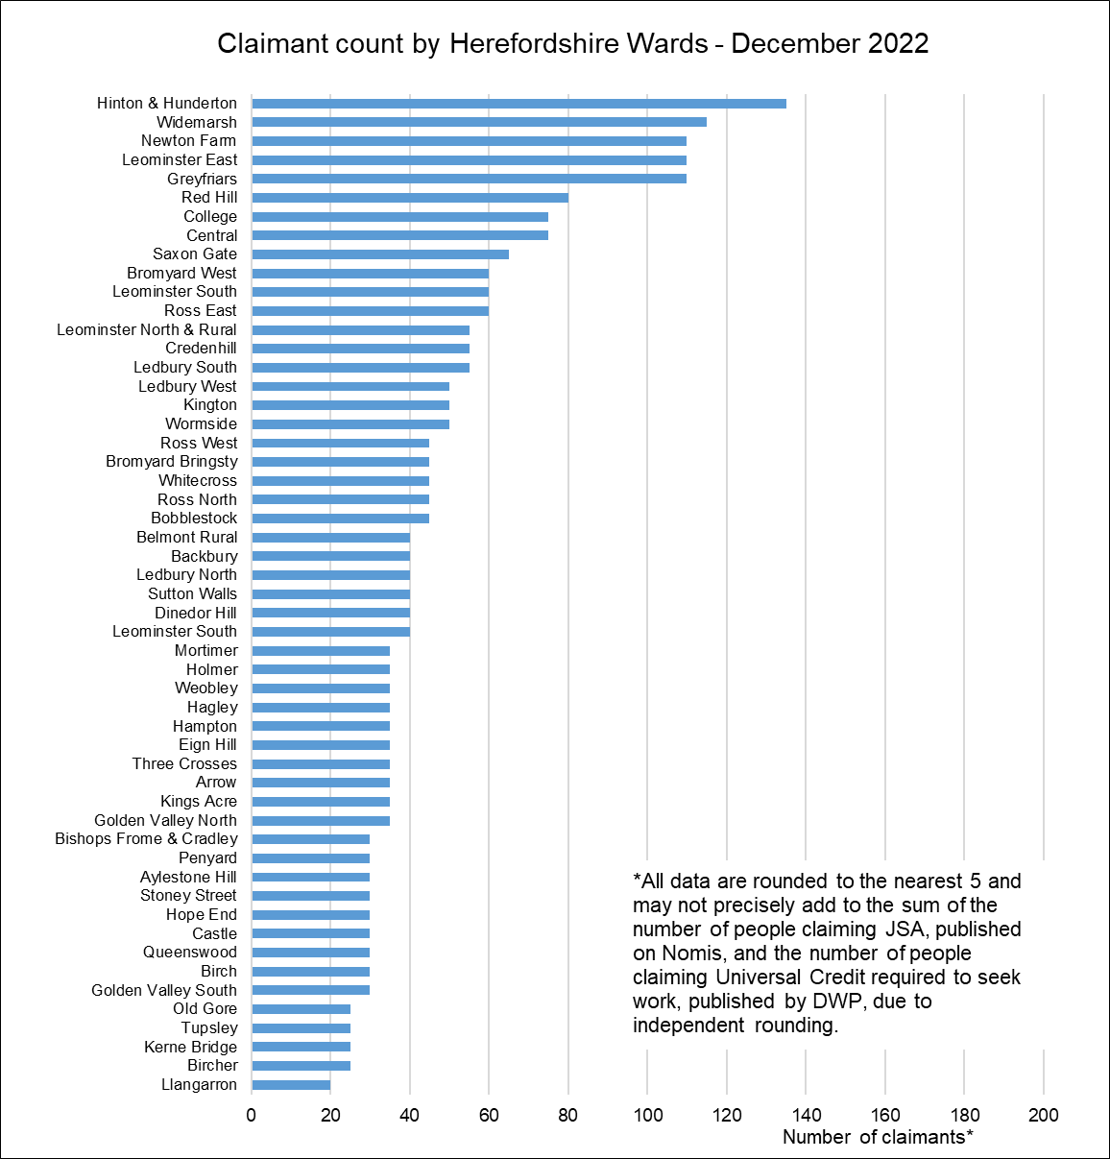
Claimant count by ward
Key points:
Generally, those wards with the highest numbers of claimants before the pandemic still have the highest numbers now.
Currently, the Wards with the highest numbers of claimants are Hinton & Hunderton (135), Widemarsh (115), Newton Farm, Leominster East, and Greyfriars (110 each).
The largest proportional increases in the claimant count since March 2020 have occurred in Kerne Bridge (by 150%) and Credenhill (by 120%). In terms of numerical increases, the largest have been by 35 claimants in Greyfriars and 30 in Credenhill.
Data source: ONS/NOMIS Date last updated: 18 Jan. 2023
Frequency of update: monthly

Slide 9
Section 2: Other cost-of-living related indicators

Slide 10
Model-based estimates of unemployment
Key points:
In the period October 2021 to September 2022 the unemployment rate in Herefordshire was 3.2% (CI+-0.9), compared to 3.7% (CI+-0.1) in England as a whole and 4.9% (CI+-0.5) across the West Midlands region.
Herefordshire’s unemployment rate was significantly lower than England as a whole but not significantly so and significantly lower than the West Midlands region but remains elevated compared to pre-pandemic levels, although not significantly so.
Compared to the previous period (July 2021 – June 2022), the Herefordshire rate was very slightly higher (3.2% vs 3.1%) but the increase was not statistically significant. In fact, due to the wide confidence intervals on these data, there has been no statistically significant change in the Herefordshire rate observed since January 2013- December 2013.
This shows the official annual unemployment rate which IS NOT the same as the claimant count rate.
What this doesn’t tell us:
No further breakdown is available below all-age county rate.
Need to know
Model-based estimates are produced for local authority areas. Estimates of unemployment for nations and regions are not model-based and have been taken directly from the Annual Population Survey dataset. For more information on the difference between the unemployment and claimant count rates see this article.
Data source: ONS/NOMIS
Date last updated: 17 January 2023
Frequency: quarterly
Next update: 11 April 2023

Slide 11
Workless households
Some families face numerous barriers to work and experience long-term worklessness, which is associated with a range of negative social outcomes and can prove difficult to reverse.
Key points
Problem debt is around twice as prevalent in workless households.
Around 60% of housing benefit claimants in temporary accommodation are workless or on out-of-work benefits.
In couple-parent families, relationship distress is around three times as prevalent if both parents are workless, as when both parents are working. The vast majority of parents reporting treatment for drug/alcohol use/dependency had been out of work for at least a month.
Around half of children in workless families are living with parents who have at least three potential barriers to work, such as ill health, low qualifications or lone parenthood. Children in workless families are almost twice as likely to live with at least one parent with poor mental health.
Children growing up in workless families are almost twice as likely as children in working families to fail to reach the expected levels at all stages of their education.
Up to 2021 (the latest data available) the proportion of workless households in Herefordshire (12.4%) had fallen slightly from 13.0% in 2020 and was lower than in England both as a whole (13.4%) and in the West Midlands region (14.2%) but not significantly so.
Data source: ONS
Last updated: 20 October 2022
Frequency: annual
Next update: October 2023
Need to know: Workless households are households where no one aged 16 years or over is in employment. These members may be unemployed or economically inactive. Economically inactive members may be unavailable to work because of family commitments, retirement or study, or sickness or disability. Percentages are of working age households i.e. where at least one household member is aged 16-64.

Slide 12
Absence from work due to long-term sickness
Sickness absence is a key indicator of labour productivity. In addition, long-term absence from the workplace can have a serious detrimental impact on individuals’ long-term health, financial security and social inclusion (NICE, 2019).
Furthermore, people with disabilities, in insecure employment, and in lower socio-economic groups, who are already at higher risk of financial insecurity and poverty, are also more likely to experience long-term sickness absence (IPPR, 2017; De Souza et al, 2006).
Mental ill-health is one of the major causes of long-term sickness absence and is being adversely impacted by the cost-of-living crisis (ONS, 2022).
ONS report that across the UK the number of working-age adults who are out of the labour market (known as "economically inactive") because of long-term sickness has been rising since 2019, from around 2.0 million people in spring 2019, to about 2.5 million in summer 2022.
Long-term sickness rates as a proportion of those economically inactive in Herefordshire have fluctuated very significantly in the past two decades and are currently (October 2021 – September 2022) higher than for Great Britain and the West Midlands: 26.7% compared to 24.3% and 25.4% respectively.
Currently (October 2021-September 2022), around 5,800 people aged 16-64 in Herefordshire are absent from work due to long-term sickness.
Source: ONS/NOMIS
Frequency: quarterly
Last updated: 17 January 2023
Next update: April 2023
Need to know: Percentages are proportion of those economically inactive aged 16-64.

Slide 13
The value of Herefordshire’s economy
There is a widely accepted association between economic growth and living standards. Herefordshire's GVA declined relative to England and the West Midlands region in the mid 2000s. Thereafter it increased fairly consistently in line with the national trend until 2016 when it dipped again. Although it increased again subsequently, increases were lower than nationally and regionally. In 2020 the economy was seriously impacted by the pandemic and in real terms contracted to less than the size it had been in 2014.
In 2020 (the latest year available) the value of Herefordshire’s economy at current prices was £3,857 million.
Adjusting to remove the effects of inflation (i.e. using the chained volume measure), as a result of the pandemic Herefordshire’s economy shrank by 11% in 2020 compared to the previous year. This followed an 8% increase in real terms between 2015 and 2019. This closely followed the trend nationally (8% increase in real terms 2015-2019 then a 10% fall 2019-2020).
COVID-19 pandemic
Financial Crisis – start of the Great Recession
Need to know: Gross value added (GVA) is the value of goods and services produced in an area, industry, or sector of an economy and is used to measure the value of the economy due to the production of goods and services over time. The data above provide estimates of GVA derived by balancing the income and production approaches to measuring GVA. The dataset includes both current price (nominal or value) and 'real' (chained volume) measures. Using an index value allows us to compare relative growth between different areas.
Data source: ONS
Frequency: annual
Last updated: 30 May 2022
Next update: Spring 2023

Slide 14
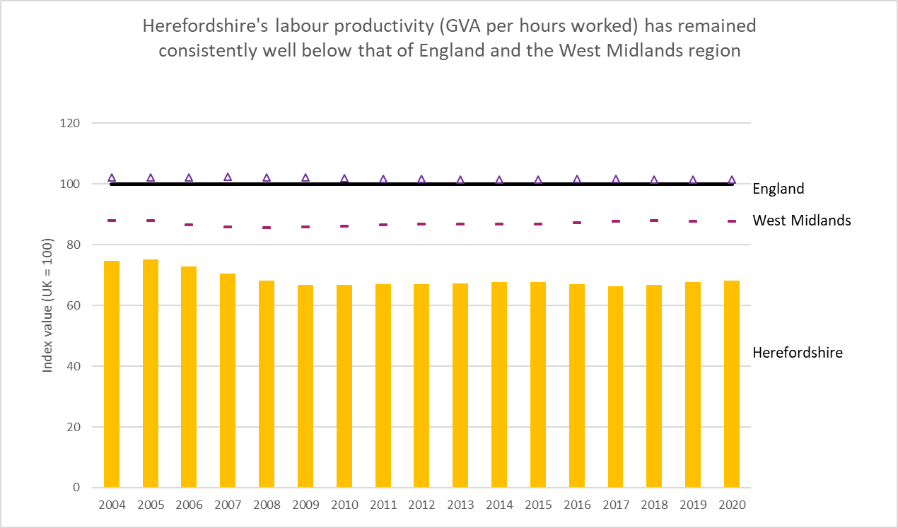
Labour productivity
The level of labour productivity is determined by how efficiently and effectively labour is utilized in an economy.
Comparing labour productivity (measured as Gross Value Added (GVA) per hour worked) provides an indication of the relative competitiveness of a local economy.
The level of labour productivity is one of the key determinants of wages and poor labour productivity can act as a barrier to social mobility.
Herefordshire has the second lowest labour productivity on any ITL3 region of Great Britain (ONS). Furthermore, this is a long-standing issue with Herefordshire’s productivity consistently below that of both England and the West Midlands since 2004 when current data begin.
The reasons for this are complex but are related to the composition of Herefordshire’s economy and the over-representation of low skilled occupations.
Source: ONS - What are the regional differences in income and productivity? (May 2021)
Data source: ONS Subregional Productivity (July 2022)
Frequency: annual
Last updated: 6 July 2022
Next update: TBC
Need to know: Gross value added (GVA) measures the contribution made to an economy by one individual producer, industry, sector or region. The figure is used in the calculation of gross domestic product (GDP) – University of Birmingham

Slide 15
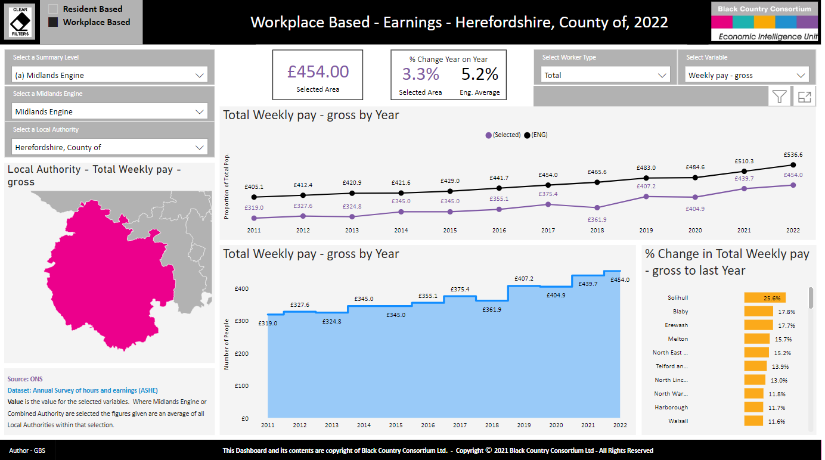
Earnings
Key points
Workplace-based median weekly earnings for all employees (full and part-time) who work in Herefordshire is now (2022) £454.00: a 3.3% increase from the amount recorded for 2021 (£439.70).
Herefordshire’s gross weekly earnings are significantly lower than the average for England as a whole (£536.60). Average earnings in England also grew at a faster rate in the past year (5.2%)
In 2021, Herefordshire had the lowest median earnings of all 14 comparator West Midlands authorities, however looking at England as a whole it was not among the local authorities that have the lowest median earnings in 2021.
Need to know: workplace-based earnings includes all people who work in Herefordshire regardless of which county they live in.. This gives a better sense of earnings from local employment than the residence-based measure.
Earnings figures are for full and part-time employees – Herefordshire has a higher proportion of part-time employees than both England and the West Midlands region.
Data source: : Midlands Engine Observatory Intelligence Hub
(Annual Survey of Hours and Earnings (ASHE))
Frequency: annual
Last updated: 26 October 2022
Next update: October 2023 Image Source: Midlands Engine Observatory Intelligence Hub

Slide 16
Income from self employment
There are currently around 21,000 people in Herefordshire who are self-employed (ONS - NOMIS)
The proportion of the working-age population in Herefordshire who are self-employed (15.2%) is significantly higher than in both England (9.3%) and the West Midlands region (8.2%) (ONS – NOMIS).
In the tax year 2019/20, median income from self-employment in Herefordshire was £14,400 – significantly lower than for the West Midlands region as a whole (£15,100) and toward the lower end of West Midlands local authority areas.
Source: HM Revenue & Customs - Income and tax by borough and district or unitary authority
Frequency: annual
Last updated: 13 April 2022
Next update: not known

Slide 17
Gross disposable household income (GDHI)
Gross disposable household income is the amount of money that individuals (the household sector) have available for spending or saving. GDHI, which forms part of the regional accounts data set, includes income from wages, salaries, self-employment, property and pensions and is money left after expenditure associated with this income i.e. taxes and social contributions. To make the measure comparable between areas, per head indices are used.
In 2020 Herefordshire’s GDHI per head at current prices was £20,690 a reduction from £20,824 in 2019 and lower than England’s (£21,962), but higher than that for the West Midlands (£18,363).
In 2020, the annual growth rate of per head GDHI in Herefordshire (-0.6%) was slightly worse than nationally (-0.2%) and regionally (+0.2%).
The relatively high level of GDHI per head in Herefordshire compared to the West Midlands as a whole is in contrast to the low level of earnings for the county and the low Gross Value Added per head. This difference may be partly explained by a relatively large proportion of people of retirement age in Herefordshire, who may derive a considerable income from pensions and other financial assets and investments. The deduction of costs associated with property ownership from GDHI data may also play a part as Herefordshire has a greater proportion of owner occupancy compared to the West Midlands.
Data source: ONS
Date last updated: 13 October 2022
Frequency: Annually
Next update: Summer 2023
Need to know: GDHI is preferred to Gross Value Added (GVA) as the measure of economic welfare

Slide 18
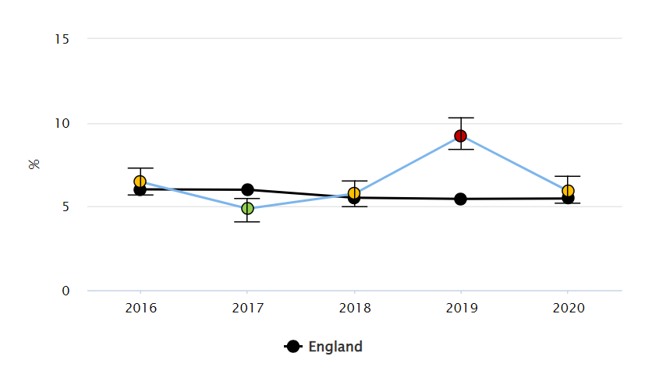
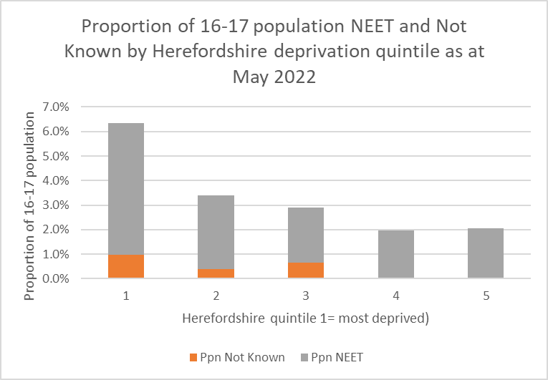
Young people not in Education, Employment or Training (NEET)
Why it matters?
The Scottish Longitudinal NEET Study (2015) showed that young people who are NEET, suffer long-lasting and cumulative detrimental effects. It found that:
NEETs remained disadvantaged in their level of educational attainment 10 and 20 years later. More than one in five of NEET young people in 2001 had no qualifications in 2011, compared with only one in twenty five of non-NEETS.
There is a 'scarring effect' on economic activity. In comparison with their non-NEET peers, NEET young people in 2001 were 2.8 times as likely to be unemployed or economically inactive 10 years later. The scarring effect is also evident in the occupational positions that NEET young people take up, if they entered employment. For example, NEET young people in 2001 were 2.5 times as likely as their non-NEET peers to work in a low status occupation in 2011, if they found work.
NEET experiences are associated with a higher risk of poor physical health after 10 and 20 years. The risk for the NEET group was 1.6-2.5 times that for the non-NEET group, varying with different health outcomes. NEET experiences are also associated with a higher risk of poor mental health after 10 and 20 years. The risk of depression and anxiety prescription for the NEET group is over 50% higher than that for the non-NEET group.
The local picture
In 2020 Herefordshire’s NEET/Not known rate was 5.9%, higher than the West Midlands (5.7%) and England (5.5%) but not significantly so.* The number of NEETS and Not Knowns varies significantly month-on-month, the annual rate data are an average of the figures submitted by to the DfE for the months of December, January, February each year.
Herefordshire’s NEET cohort has been above the national average since 2011. In part this is due to the lack of any support services for those furthest away from positive destinations. The impact of recent closures of local support services is likely to be significant.
“Not knowns” have been relatively stable since 2013/14 and generally lower than the national average.
Young people living in the most deprived areas of the county are much more likely to be NEET than those in the least deprived.
*Office for Health Improvement & Disparities Fingertips
Proportion of 16-17 year olds not in education, employment or training (NEET) or whose activity is not known
Source: .Office for Health Improvement & Disparities Fingertips
Frequency: annual.
Next update: TBC
Data source: Herefordshire Council, CYP Directorate

Slide 19
House prices
Key points
House prices (median price paid measure) rose to record levels during the pandemic adding further to housing affordability pressures, especially in destination areas for the so-called “race for space” however more recently the cost-of-living crisis and the increase in mortgage interest rates has started to reverse this trend.
ONS report that:
Average UK house prices increased by 12.6% over the year to October 2022, up from 9.9% in September 2022. The increase in the annual percentage change was partly caused by a sharp fall in UK average house prices in October 2021, following changes to Stamp Duty Land Tax.
The average UK house price was £296,000 in October 2022, which is £33,000 higher than this time last year and little changed from last month. Average house prices increased over the year to £316,000 (13.2%) in England, to £224,000
According to the latest HM Land Registry data, in England, the September 2022 data shows on average, house prices have not changed since August 2022. The annual price rise of 9.6% takes the average property value to £314,278. The average house price in the West Midlands region was £253,864: a 10.1% increase from September 2021.
Data source: ONS
Frequency: Quarterly in arrears
Last updated: 16 December 2022
Next update: March 2023

Slide 20
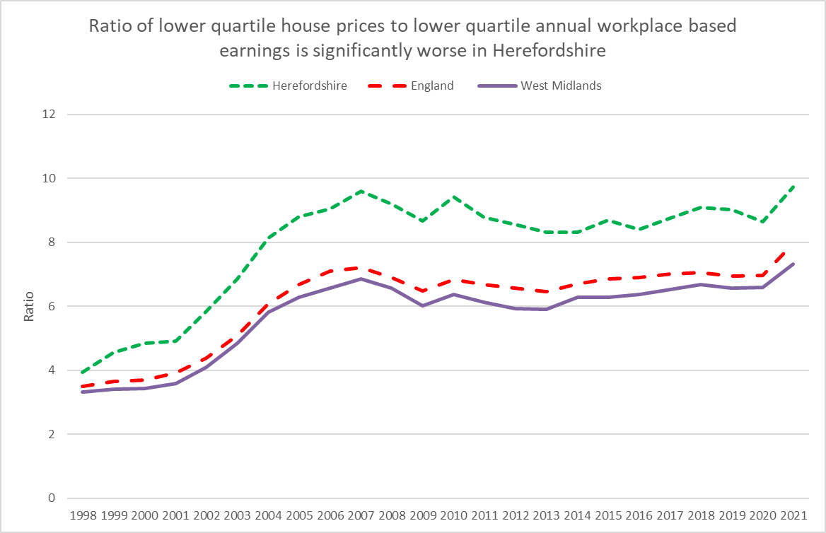
Housing affordability
The West Midlands Economic Impact Monitor (8 July 2022) reported that “the housing crisis has been growing for a number of years, with house prices hitting a record high in 2021, driven by undersupply of affordable housing. Shelter estimates that 17.5 million people (22 million including children) do not have access to a safe decent home, that suits their needs and is affordable.”
Key points
In 2021, the ratio of lower quartile house price to lower quartile annual workplace-based earnings in Herefordshire was 9.73: significantly higher than in England (7.96) and the West Midlands region as a whole (7.33).
Need to know: Housing affordability can be measured based on either residence-based earnings or workplace-based earnings. The latter is, on balance, a more accurate reflection of the county’s economic status and as such is more influential in planning
Data source: ONS
Last updated: 23 March 2022
Frequency: annual
Next update: March 2023

Slide 21
Private rental costs
Nationally, a chronic undersupply of private rental accommodation is being exacerbated by rising mortgage costs on buy-to-let properties and regulatory changes that have caused many small landlords to withdraw from the market.
Analysis by Sky News has found that the number of advertised rental properties in the UK has fallen markedly in the past three years, pushing up prices.
ONS reports that the median monthly rent recorded for England between October 2021 and September 2022 was £800: the highest ever recorded. The difference in monthly rental price between the most and least expensive local authorities was £
Private rental prices paid by tenants in the UK rose by 4.0% in the 12 months to November 2022, up from 3.8% in the 12 months to October 2022. Annual private rental prices increased by 3.9% in England
Median monthly rents (all property types) are lower in Herefordshire than regionally or nationally but until the latest period had been rising in line with the national and regional trend. Also, earnings are significantly lower here than regionally and nationally.
In the period 1 October 2021 – 30 September 2022 median rent was unchanged from the previous period at £650 in Herefordshire compared to an £695 (also unchanged) in the West Midlands and £800 (a slight increase) in England as a whole.
Data source: ONS
Last updated: 14 December 2022
Frequency: 6-monthly
Next update: June 2023

Slide 22
Mortgage and landlord possessions
Key points
As at Q2 2022/23 mortgage possessions in Herefordshire increased slightly to 9 from 6 the previous quarter. Landlord possessions also increased slightly from 28 claims issued to 36. However, historically these levels remain low.
Going forward, nationally, there has been concern that the cost-of-living crisis could instigate a significant increase in possessions in the coming months.
For an overview of mortgage arrears and possessions nationally see Q3 2022 data from UK Finance. UK Finance reports that nationally there were over 74,000 homeowner mortgages in arrears of 2.5% or more of the outstanding balance in the third quarter of 2022, 1% fewer than in the previous quarter.
There were c. 5,800 buy-to-let mortgages in arrears of 2.5% or more of the outstanding balance in the third quarter of 2022, 2% more than in the previous quarter.
700 homeowner mortgaged properties were taken into possession in the third quarter of 2022, 15% more than in the previous quarter, while 390 buy-to-let mortgaged properties were taken into possession: 11% more than in the previous quarter.
Source: LG Inform
Date last updated: 13 November 2022 (Q2 2022/23)
Frequency: quarterly
Next update: February 2023

Slide 23
Homelessness
Very significant rent and mortgage increases in recent months have driven up costs for many tenants and home-owners across the country and are a contributory factor in some landlords nationally quitting the rental sector. Changes in legislation that have placed an increased regulatory burden on landlords have also made the rental sector less attractive, especially to smaller landlords.
As a result, nationally, ‘no fault’ evictions are increasing and this is contributing to rising numbers of households becoming homeless.
Yearly data are not yet available for the current financial year but in Herefordshire between 2020-21 and 2021-22 the number of households that were either homeless (with a relief duty owed) or threatened with homeless (preventing duty owed) increased from 1,189 to 1,273.
Within the total of those threatened with homelessness, the number of households threatened with homelessness due to a valid Section 21 Notice increased significantly from 69 to 115.
Source: Department for Levelling Up, Housing and Communities
Data last updated: 22 September 2022
Frequency: Annual
Next update: September 2023

Slide 24
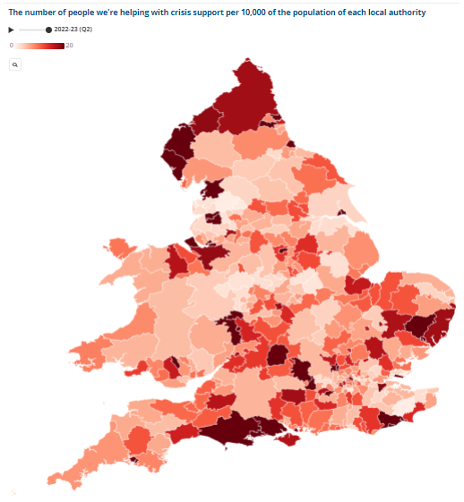
Debt issues
Citizens Advice (CA) has developed an interactive dashboard that provides indicators around financial insecurity at local authority level. This shows that in Herefordshire, as in much of the rest of the country, the top debt issue faced by people before the pandemic was council tax arrears, followed by credit, store and charge card debts – but (in the case of Herefordshire since Q4 2020-2021) this has become energy debts as energy costs rise.
Across England and Wales as a whole CA reports that it is helping more people with crisis support this year than at any other year on record. In Q2 2022-23 in Herefordshire 5.89 people per 10,000 were being helped with crisis support: up from 1.91 in Q4 2019-2020 but still relatively low compared to some other areas of the country.
Nationally, CA report that they have never seen a higher proportion of people in a negative budget and that they are seeing more disabled people facing cost of living issues than other issues.
Single people and single people with children, social housing tenants, people with disabilities, people whose ethnicity is mixed or black, and women are all more likely to be referred to food banks.
Source: CA cost-of-living dashboard

Slide 25
Section 3: Income deprivation and poverty

Slide 26
Income deprivation
The income domain of the Indices of Multiple Deprivation (IMD) measures the proportion of the population in a Lower Super Output Area (LSOA)* that live in income deprivation. The definition of low income used includes both people who are out-of-work and those who are in work but have low earnings (and who satisfy the respective means tests).
Key points
There are 10 LSOAs in Herefordshire that are amongst the 25% most deprived nationally in this domain, all having at least one in five people who live in income deprived households. Half of these areas are located in south Hereford, with a further three in Leominster and one each in Bromyard and Ross-on-Wye.
In nine out of ten of these areas the proportion of the population estimated as living in income deprived households has fallen since 2015, the exception being ‘John Kyrle’ where the proportion remains unchanged.
‘Golden Post – Newton Farm’ in Hereford and ‘Leominster Ridgemoor’ with respectively 29% and 28% of the population living in deprived households are within the 10% most deprived LSOAs in England.
There are 22 LSOAs across Herefordshire that are amongst the 25% least deprived nationally, with between 4% and 6% of their population living in income deprived households. These LSOAs are spread across the county with some in Hereford city and the market towns of Ledbury and Ross-on-Wye as well as a number in rural areas, although two thirds are within urban areas.
The income domain is divided into two supplementary indices - one for income deprivation affecting children and one for income deprivation affecting older people.
Need to know:
LSOAs are fixed statistical geographies of about 1,500 people designed by the Office for National Statistics (ONS).
Data Source: Department for Levelling Up, Housing and Communities and Ministry of Housing, Communities & Local Government
Frequency: 5-yearly. Last updated: 2019

Slide 27
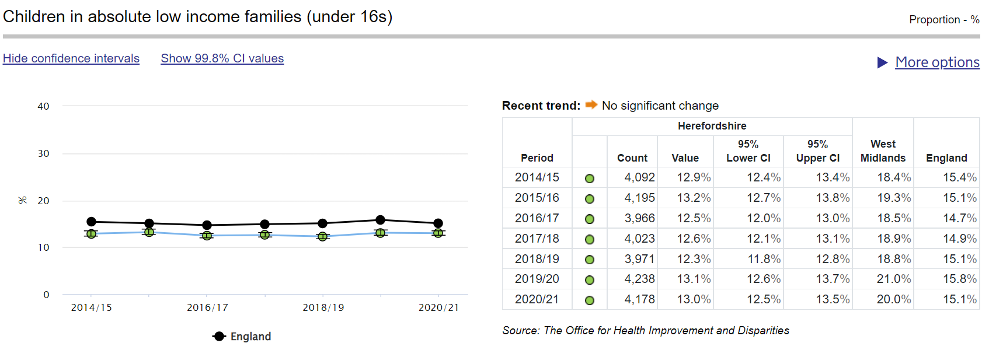
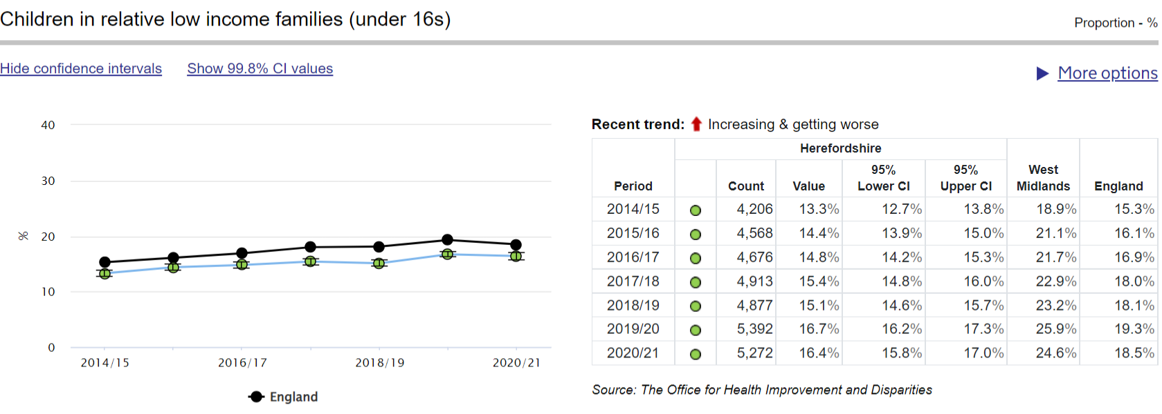
Trends in children living in low-income families
Key points
Low income is often used as a proxy for poverty but they are not quite the same thing. Whether someone is in poverty or not is also determined by their fixed costs. See Poverty in the UK: a guide to the facts and figures
Measured as under 16s in low income families
Rates in Herefordshire are below national
Trends following national patterns
Absolute low-income: fixed in real terms, i.e. to assess how low incomes are faring with reference to inflation
Relative low-income: threshold moves each year as overall average income changes - so rates are relative to changes in the average income
Need to know:
Low income = claiming UC, Tax Credits of Housing Benefit and with equivalised household income of less than 60% of UK median. This measure does not take account of housing costs.
Source: Office for Health Improvements & Disparities Fingertips
Frequency: annual
Last updated: January 2023

Slide 28
Child poverty rates after housing costs
Key points
When housing costs are factored in, poverty rates in the UK are actually much higher than suggested by income measures alone.
Recent research by the Joseph Rowntree Foundation shows that nationally, children have had higher poverty rates than both working-age adults and pensioners throughout the last 25 years. Twenty five years ago, a third of children lived in poverty. This fell to 28% by 2004/05 and reached its lowest level of 27% in 2010/11 to 2013/14. Since then, child poverty has been rising, reaching 31% in 2019/20.
In the 3-year period 2017-20 25% of children in the West Midlands region were living in poverty.
Families with children are more likely to be receiving benefits than families without children, so this pattern reflects changes in employment levels, earnings and benefits.” (JRF, 2022)
Statistics are not available below the regional level, but research carried out by Loughborough University and published by EndChildPoverty.org estimated the proportion of children who are in poverty after housing costs by local authority. This research estimated that 29% of children in Herefordshire were in poverty in 2019-20 (see map opposite).
The cost-of-living crisis is likely to push many more children in to poverty, even accounting for government interventions, and according to JRF “it seems clear that out-of-work families will fare worse than low-income families in work.” (JRF, 2022).
Herefordshire = 29%
Source: Joseph Rowntree Foundation

Slide 29
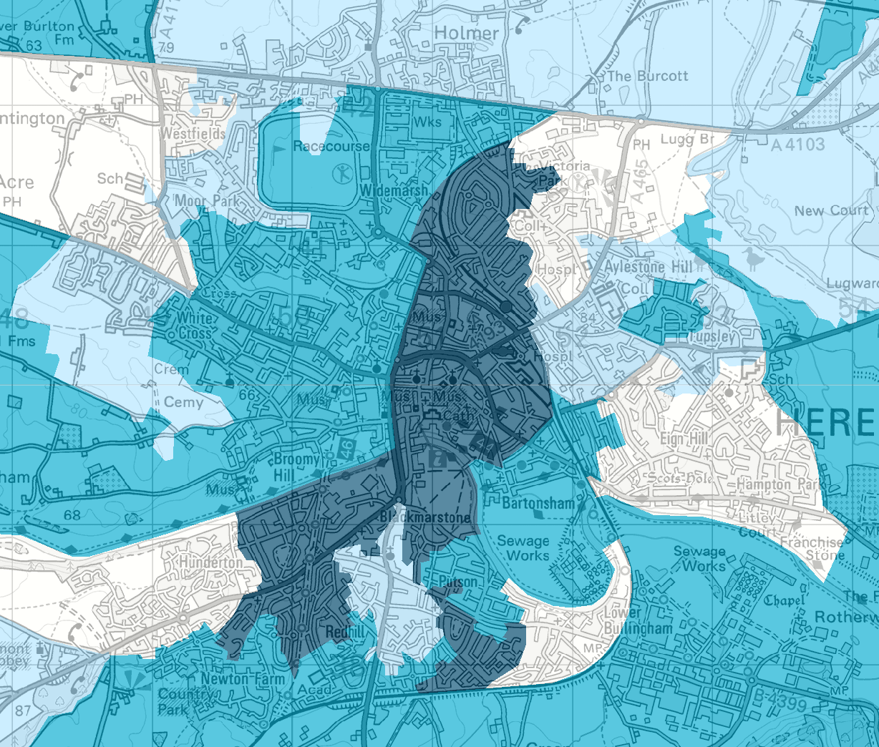
Fuel poverty
According to the End Fuel Poverty Coalition, as at October 2022, around 7m households were in fuel poverty in the UK (24.5% of all households). Accounting for government support measures it predicts that this will rise to 8.6m households (30.0%) from 1 April 2023.
Due to its rurality and housing stock, Herefordshire is particularly exposed to a number of risk factors for fuel poverty and excess cold:
High proportion of detached houses (40%) compared to England (23%)
Many houses (39% vs 8% nationally) were built pre-1900 – such homes can be expensive and inefficient to heat. 14,300 Herefordshire homes (17%) are deemed to have an excess cold hazard compared to 3% for England, which was more likely to affect owner occupied dwellings (20%) than private rented (16%) or social rented (4%). 20,600 county dwellings had at least one serious hazard; 14,300 of which had an excess cold hazard.
Only 69% of properties are on the mains gas grid compared to 87% nationally – heating using fuel oil and LPG is particularly expensive.
Applying the Government’s new 'low income, low energy efficiency' measure*, around 17% (c.14,000) of households in Herefordshire were in fuel poverty in 2020 (higher than England's 13%). However, this was of course before the surge in energy prices following the Russian invasion of Ukraine. On 9 December the Chief Executive’s staff update reported an estimate that put current fuel poverty numbers in Herefordshire at 23,876 households: 28% of all households in the county. Note: the map opposite is based on 2020 data.
Data source: Department for Business, Energy & Industrial Strategy
Frequency: annual
Last updated: 28 April 2022
Next update: TBC
Need to know: The ‘Low Income Low Energy Efficiency’ (LILEE) indicator counts a household as fuel-poor if they are living in a property with an energy efficiency rating in band D, E, F or G and their disposable income (income after housing costs and energy needs) is below the relative poverty line (relative poverty being defined as having an income 60 per cent below the median national household income).

Slide 30
Useful resources
Centre for Cities – Cost-of-Living tracker
Centre for Progressive Policy - Cost of Living Vulnerability Index and report
Centre for Thriving Places – Thriving Places Index: Herefordshire
Citizens Advice – Cost-of-Living data dashboard
Data Orchard – Food poverty mapping project (2019)
Health Foundation – Map of child poverty
LG Inform
Midlands Engine – Midlands Engine Intelligence Hub
OHID – Health inequalities dashboard
ONS - Build a custom area profile tool (Census 2021 data)
ONS – Census 2021: How homes are heated in your area
ONS – Cost-of-Living: Latest insights
ONS - The cost of living, current and upcoming work
ONS – UK Economy latest
ONS – UK Labour market overview
ONS – NOMIS Herefordshire Labour Market Profile
ONS - Personal well-being in the UK: April 2021 to March 2022 (includes personal well-being explorer tools showing change in key indicators of wellbeing at local authority area level)
Resolution Foundation - The Living Standards Outlook 2023
University of Sheffield – UK adult food insecurity interactive map (2021)

