Slide 1
Herefordshire Economic Update January 2022 Herefordshire Council Intelligence Unit

Slide 2
About this briefing
This monthly publication brings together the latest understanding about the economic impacts of coronavirus In Herefordshire. Previous editions are still available for reference on the Understanding Herefordshire website.
Contents
Key messages What’s new in Herefordshire this month, including links to the relevant detail within the document, followed by a summary of significant new data and intelligence relating to the wider economy which is likely to have a bearing on the county.
Section 1: Economic activity and socio-economic indicators A range of socio-economic indicators that are updated either annually or quarterly and provide insights into the health of the local economy and the economic and financial wellbeing of residents.
Section 2: The labour market. Information on workforce jobs, employment by industry, job postings, in demand skills, hard to fill vacancies and skills shortages and workforce educational attainment.
Section 3: Unemployment Including the latest claimant count data and model-based estimates of unemployment.
Section 4: Support for Herefordshire businesses Data on local authority administered support schemes for Herefordshire businesses.
Section 4: Intelligence roundup Links to recently published research, reports and webinars relevant to understanding the current state of Herefordshire’s economy and socio-economic trends likely to impact upon the county.
Section 5: Useful resources Links to organisations that provide data and intelligence resources relevant to understanding the current state of Herefordshire’s economy and socio-economic trends likely to impact upon the county.
If you need help to understand this document, or would like it in another format or language, please contact us on 01432 261944 or e-mail researchteam@herefordshire.gov.uk

Slide 3
Key messages: what’s new in Herefordshire this month? (1)
Welcome back to the Herefordshire Economic Update (formerly the Economic Impacts of COVID-19 Summary).
Given everything that’s happened since, the last (October) edition feels a long time ago. Back then, before Omicron reared it’s head, the path to economic recovery was looking somewhat smoother. In the interim, uncertainty has returned for many businesses and workers, especially those in the hospitality, entertainment and tourism sectors, while nationally the pace of economic growth appears to be slowing and according to the Resolution Foundation (Guardian 29/12/21), soaring energy prices, stalling wages and tax increases mean that low-income families are facing a “cost of living catastrophe” if more isn’t done to help them. Meanwhile, COP26 fell well short of the kind of action needed to stave off climate and ecosystem meltdown but did at least keep the dream of limiting global temperature rises to 1.5C just about alive. More positively, fears that labour shortages (HGV drivers particularly) and supply chain issues were going to wreck Christmas proved largely unfounded and Omicron seems to be disappearing as quickly as it arrived. Locally a lot’s happened too:
In December 2021 there were 3,015 people in Herefordshire (aged 16+) claiming out-of-work benefits, 65 fewer than the previous month’s revised figure. The claimant count is still 43% higher than in March 2020. In England as a whole it is 49% higher. The claimant count has decreased gradually (apart from the bump seen in February-April 2021) from the peaks seen in May and August in 2020. The number of claimants aged 18-24 is now only 10% higher than in January 2020, whereas for the 24-49 age group it is 61% higher and for the 50+ age groups it is 56% higher. Currently, the Wards with the highest numbers of claimants are Hinton & Hunderton (155), Newton Farm (145), and Widemarsh (130), by Red Hill (120) and Leominster East (110).
New model-based estimates of unemployment suggest that in the period October 2020 to September 2021 the unemployment rate in Herefordshire was 3.2% (CI+-0.7), compared to 4.9% (CI+-0.2) in England as a whole and 5.1% (CI+-0.5) across the West Midlands region.
Final Coronavirus Job Retention Scheme data show that 29,500 employments in Herefordshire were, at some point, furloughed during the course of the scheme. When the scheme ended at the end of September there were still 2,200 employments furloughed, equating to 3% of eligible employments. Fortunately, the end of the scheme did not translate into a corresponding rise in unemployment, with the claimant count continuing to fall month-on-month since.
Final data from the Self-Employment Income Support Scheme (SEISS) show that in total 10,400 people were furloughed at some point under the scheme, with 33,400 claims made totaling £89,600,000. The average claim value was £2,700.

Slide 4
Key messages: what’s new in Herefordshire this month? (2)
The Marches LEP has recently published its annual report detailing the support its provided to business over the past year and decade and celebrating some welcome local economic achievements and success stories.
As at 7 January, 56,215 Shop Local pre-paid cards had been issued and had been used with 1,160 different local merchants. 62,000 free bus trips have been made since that scheme started in September 2021. (https://www.herefordshire.gov.uk/businessbriefings)
Provisional data suggest there were 11,516 Universal Credit in claimants in Herefordshire in November 2021, slightly below the peak of 12,382 seen in April 2021 but well above the 5,983 seen in March 2020. In Herefordshire, UC claimants currently comprise 10% of the working age population; lower than the West Midlands Region (16%) and England (14%) but still double the 5% seen in March 2020.
Not new data, but with soaring wholesale energy prices meaning that nationally, energy bills could rise as much as 50% in the spring and with the End Fuel Poverty Coalition warning that an estimated 150,000 older households are likely to be plunged into fuel poverty, it is a timely moment to reflect on fuel poverty in Herefordshire. Applying the Government’s new 'low income, low energy efficiency' measure, around 17% (14,000) of households in Herefordshire were in fuel poverty in 2019 (higher than England's 13%). Under the old 'low income, high cost' measure the last estimate was 13% (10,700) in 2018, compared to England's 10%, which was lower than the 17% in 2015, although estimates have fluctuated since 2011. Businesses too will be feeling the pain with a new study from the payments service NatWest Tyl suggesting that nationally nearly 70% of small and medium-sized businesses (SMEs) believe that energy costs impact their growth. Nationally it is claimed that almost 65% of SMEs are spending up to one-fifth of their total business costs on energy consumption, while 8% of SMEs are spending 35-50% of their total business costs.
Analysis using EMSI’s measure of “competitive effect” suggests Herefordshire’s most competitive industries during the period 2020-2021 were accommodation and food service activities, manufacturing and arts, entertainment and recreation. The least competitive industries over the same period were construction, education, and human health and social work activities.

Slide 5
Key messages: what’s new in Herefordshire this month? (3)
The issue of low wages is likely to be a big deal in the weeks and months to come as the cost-of-living “crisis” unfolds and, historically, Herefordshire has not been in a good place in this respect. The latest Annual Survey of Hours and Earnings (ASHE) reveals that the workplace-based median weekly earnings for people who work in Herefordshire is now £536.60 (± £42.07); a 12% increase from the amount recorded for 2020, but still significantly lower than that in England £613.30 (± £2.40). However, for the first time since 2009, Herefordshire’s weekly earnings are not recorded as significantly different to the West Midland region’s although the amount is lower.
In 2021, women’s earnings in Herefordshire were 4% lower than men’s: a smaller gap compared the West Midlands region (10%) and England (9%).
Provisional data suggest there were 11,516 Universal Credit claimants in Herefordshire in November 2021, slightly below the peak of 12,382 seen in April 2021 but well above the 5,983 seen in March 2020. In Herefordshire, UC claimants currently comprise 10% of the working age population; lower than the West Midlands Region (16%) and England (14%) but still double the 5% seen in March 2020. The wards with the highest number of UC claimants are Hinton & Hunderton, Newton Farm, Leominster East, and Red Hill.
Herefordshire was allocated £1,329,601.78 by the DWP under the Household Support Fund Grant for the period 6 October 2021 to 31 March 2022. The Fund is providing free school meal households with support during school holidays and the council currently has applications open for universal credit recipients to apply for a grant towards essential household bills with around £380k spent to date
As at Q2 2021/22 (April-June) mortgage and landlord possessions in Herefordshire had risen slightly from the previous quarter but remained at historically very low levels (9 and 17 claims issued respectively in the whole of Q2).
According to EMSI, in Herefordshire there were a total of 10,375 unique job postings in November 2021. This compares to 9,176 in the previous month. Locally, job postings are now significantly higher than in the same period a year ago.
In 2021 as a whole the top ten in-demand skills in Herefordshire (with number of citations) were nursing (1,109), auditing (1,103), finance (958), personal care (902), mental health (869), warehousing (846), accounting (769), Key Performance Indicators (KPIs) (656), learning disabilities (644) and machinery (553).

Slide 6
The wider picture (1)
The Resolution Foundation has highlighted stagnant wages as one of the key labour market issues for this year, pointing to how in October, earnings growth fell to 3.8%, just as CPIH inflation rose to the same level, meaning that real wages were flat over the previous year. Pay growth over the last few months has been even weaker, and with the cost of living continuing to rise, it looks almost certain that real earnings will have fallen in the year to November. The medium-term outlook for wages is “uncertain but far from rosy” and RF predicts that “we’re set to be going into next Christmas with real earnings basically no higher than during this festive season, with growth of just 0.1% cent in the year to Q4 2022.” (Top of the Charts - The Year of the Squeeze, Torsten Bell, Resolution Foundation, 31 December 2021).
The IFS meanwhile notes that the planned April benefits increase of 3.1% is based on last September's inflation rate. But with inflation rising, it will fall well short of the 6% needed to maintain living standards for the poorest. According to the IFS, rising inflation would mean a 3% real cut in benefits year on year even before accounting for the removal of the £20 per week Universal Credit uplift.
A major new report from the IFS looks at the impact of the pandemic on inequality in education, the labour market, household living standards, mental health, and wealth in the UK shows the ways in which COVID has increased inequality on several dimensions and warns that “the effects are complex, pointing in different directions and resisting easy simplifications.”
ONS reports that in November 2021, UK public sector borrowing was £17.4 billion, a reduction from last year but still the second highest November borrowing on record. Borrowing in the financial year ending March 2021 is now estimated at 15.0% of gross domestic product (GDP), the highest borrowing to GDP ratio since the end of World War Two when it was at 15.2% in the financial year ending March 1946.
The age composition of those in employment has changed in the five years up to September 2021. Employment fell 466,000 (1.4%) in the year ending September 2021, largely driven by younger workers (employment of those aged 16 to 24 years fell 201,000). Inactivity for workers aged 55 years and above also increased in the early stages of the pandemic (Quarter 2 2020) and while movements to inactivity were lower in the same quarter in 2021, inactivity remained higher than in 2019 before the coronavirus pandemic.
ONS reports that in December 2021 there were 29.5 million employees in the UK: up 184,000 on the revised November 2021 level and up 409,000 on the pre-coronavirus (COVID-19) February 2020 level. All regions are now above pre-coronavirus levels, The UK employment rate increased by 0.2 percentage points on the quarter to 75.5%. The number of part-time workers decreased strongly during the pandemic, but has been increasing since April to June 2021, driving the increase in employment during the latest three-month period. The unemployment rate decreased by 0.4 percentage points on the quarter to 4.1%, while the economic inactivity rate increased by 0.2 percentage points to 21.3%. The redundancy rate decreased to a record low following the end of the Coronavirus Job Retention Scheme.

Slide 7
The wider picture (2)
According to latest data from Springboard reported by ONS, in the UK in the week to 8 January 2022, the volume of overall retail footfall in high streets; decreased by 11% from the previous week and was 69% of the level seen in the equivalent week of 2019.
As at 13 January 2022, ONS reported that just over one-fifth (21%) of businesses reported increased cancellations from customers in the last month, with 64% of businesses in the other service activities industry and nearly half (44%) of businesses in the accommodation and food service activities industry reporting an increase. More than half (55%) of businesses reported that implementing safety measures resulted in an increase in their operating costs, with 8% reporting costs increased substantially and 47% reporting costs had increased a little.
The West Midlands Weekly Economic Impact Monitor (Issue 69) reports that “the latest quarterly manufacturing Outlook Survey from Make UK and BDO show manufacturers within the West Midlands have seen a strong performance at the end of the year. According to the survey, output within the region recovered from the last quarter to +35% which was among the best performance of any UK region and a strong figure by historical standards. The figure was maintained by strong domestic and overseas orders (+41% and +43%), which were both significantly above the national average and a reflection of world markets, which have rebounded strongly throughout the course of the year.” It adds that “As a result of this strong performance, the outlook for jobs across the West Midlands has significantly improved as companies hire to meet demand. The employment balance in the region was +35% while investment intentions also increased to a balance of +50%, the best performing of any UK region. The big challenges for businesses, both regionally and nationally, lie in attracting and retaining talent, remains the escalating inflationary pressures, which are forcing businesses to raise prices.”
Nationally, ONS reports that growth in average total pay (including bonuses) was 4.2% and growth in regular pay (excluding bonuses) was 3.8% among employees in September to November 2021. However, inflation has pretty much cancelled out wage growth and in real terms (adjusted for inflation), total and regular pay have shown minimal growth in September to November 2021, at 0.4% for total pay and 0.0% for regular pay. Single-month growth in real average weekly earnings for November 2021 fell on the year for the first time since July 2020, at negative 0.9% for total pay and negative 1.0% for regular pay.
Looking at a longer-term trend, according to ONS, wealth inequality between the regions of Great Britain widened over the decade to 2020. Between April 2018 and March 2020, average (median) wealth among individuals in the South East of England (£236,000) was £157,000 higher than in the North East (£79,000). This gap was almost twice as high as in July 2010 to June 2012 (£80,000 in nominal terms or £92,000 after adjusting for inflation). For the average respondent in the South East of England, 33% of their wealth came from property compared with just 20% in the North East. A similar picture is seen in average household wealth.

Slide 8
The wider picture (3)
The last quarterly UK Economic Outlook Report from PWC (December 2021) suggests headline GDP growth in 2022 could be between 4.5% and 5.1% but this is largely driven by base effects. The annual growth figures in the first half of 2022 are expected to be skewed as the economy comes off its low base due to the national lockdown in early 2021. Core underlying growth will continue to be relatively modest, continuing the low-growth trend we have seen this year driven by the normalisation of economic activity.
Thereafter PWC anticipate GDP growth to slow down in 2023 as the economy returns to its pre-pandemic trend. By the end of 2022, the UK economy is likely to be roughly 1% to 2% above the pre-COVID levels. From 2023 onwards, the pace of growth is projected to slow down further as base effects fall out of the annual figures. PWC expects that growth could range between 1.3% and 1.8% in 2023.
PWC expects the uneven impact of the pandemic to continue as the recovery is increasingly polarised across sectors, regions and households. Lower income households are squeezed, especially those struggling to retrain and reenter the workforce post furlough, while higher income households have the potential to spend. Growth in the hospitality sector is projected to continue accelerating in a fully opened economy while output from other sectors, like construction and manufacturing, is expected to be moderated by workforce shortages, supply bottlenecks, and weakening demand and business confidence. At the regional level, the pandemic has resulted in the most severe regional disparity in output in the past 50 years, with the West Midlands, and the South East underperforming due to their heavy reliance on manufacturing, retail and wholesale, while Northern Ireland is the only region where economic growth has exceeded both expectations and the pre-crisis levels. PWC expects this polarisation to be one of the key drivers behind the UK’s low-growth prospects, and may be one of the core factors affecting growth over the medium-to-long term.
Inflation is likely to reach its highest level for three decades in Q2 2022, before returning gradually back to target, with energy and fuel prices expected to drive most of the rapid rise.
Emerging evidence suggests the end of the furlough scheme has not set back the labour market recovery however, it will take some months to understand the full impact of the end of furlough.
EMSI has produced an interactive table ranking local authorities in terms of the percentage increase seen in job postings between January and September 2021. Herefordshire is ranked 138 out of 388 with a 43% increase.

Slide 9
The wider picture (4)
A recent Guardian article highlighted “exorbitant” credit card interest rates and warned that some of the poorest households have resorted to credit cards to help pay for their living costs. The article cites research published in October by the Joseph Rowntree Foundation which found 4.4 million low-income households have had to take on new or increased borrowing through the pandemic, with the annual percentage rate (APR) on cards for customers with a low credit score being as high as 59.9%.
New research by the Centre for Ageing Better has found that financial inequality in later life is increasing dramatically. The richest people in their 50s and 60s today are twice as wealthy as the richest in this age group were 16 years before; the poorest are almost a third poorer. One in five in this age group say they will be unable to meet future financial needs in old age. A rise in private renting means fewer people will be able to rely on housing assets to fund old age, The gender employment gap among people approaching retirement means that women face greater financial precarity in later life. In addition, the quality of work has worsened for people in their 50s and 60s and poor health will limit many people’s ability to work up to state pension age. At the same time, large numbers in this age group are juggling working lives with caring for loved ones.
According to recent research by BRE into the economic impacts of poor quality housing in Britain, it is costing the NHS around £1.4bn per year to treat those people who are affected by poor housing. More than half (£857 million) of this annual NHS treatment bill can be attributed to defects in poor homes which expose residents to excess cold, while the second biggest cost to the NHS comes from hazards which cause people to fall and injure themselves, predominantly on staircases. The report also highlights the wider ‘societal costs’, such as those relating to care, which in some cases may continue for a lifetime and a mental health cost caused by suffering and trauma. The report argues that poor housing leads to a loss of economic potential (poorer educational achievement, loss of productivity, career prospects) for victims of hazards, family carers and employers.. When these societal costs are included, it is estimated that the full cost to society of leaving people living in poor housing is some £18.5bn per annum.
Some enlightening new research by the Resolution Foundation debunks the myth that young people today prefer to live in rented accommodation as a lifestyle choice and instead finds that the vast majority do want to buy but can’t afford it until much later in life than was the case a few decades ago. The report paints a bleak picture of the scale of the financial challenge they face. Currently, only a small minority (8 per cent) of those aged 25-to-34 who are not home owners have sufficient savings to afford a 10% deposit on the average first-time buyer home in their region; indeed, half (48%) of non-home owning young family units have less than £1,000 in the bank. Looking at whether they have sufficient earnings to get the required mortgage with a loan-to-income ratio of 4.5, 12% of young non-home owners have sufficient earnings but insufficient savings, and only 4% are sufficient in both (the fact this group is small indicates that when people can, they become homeowners).

Slide 10
The wider picture (5)
New research by the IFS into the gender pay gap finds that the average working-age woman in the UK earned 40% less than her male counterpart in 2019. That gap is about 13 percentage points, or 25%, lower than it was 25 years ago. The vast majority of the modest convergence in earnings of the past 25 years can be explained by the closing of the gender gap in education levels. Inequalities in all three components of labour market earnings – employment, working hours and hourly wages – remained large. In 2019, working women still earned 19% less per hour than men. This gap was 5 percentage points smaller than the gap in the mid 1990s, though again women’s relative advances in education can account for the majority of the gain. Gaps in all three components are linked. The fact that women have more career breaks and years working part-time contributes to them having lower hourly earnings further down the line. In a big break from the past, the hourly wage gap between men and women is now bigger for those with degrees or A-level-equivalent qualifications than for those with lower education. Gender gaps in hourly wage rates are especially large at the top, with women failing to reach the same levels of high pay as men. In terms of why this matters, as well being an issue of social justice, gender gaps in pay, paid work and unpaid work have substantial consequences for inequalities in material living standards. Women in single-adult families, especially single mothers, are especially vulnerable to poverty. The report finds that inequalities in earnings and its three components increase vastly after parenthood. The opening of gaps around childbirth suggests that unpaid care work is central in shaping inequalities in the labour market. Importantly, the gendered roles that mothers and fathers take on appear to be largely unrelated to their relative earnings potential: even mothers who earn more than their male partners before childbirth are more likely than their partners to reduce hours of work in the years after childbirth. The existing policy environment (including parental leave, childcare, and the tax and benefit system) often sustains and incentivises a traditionally gendered division of labour, even when policies are ostensibly gender-neutral.
Research on behalf of The Health Foundation reminds us that young people have been among the hardest hit groups in the Covid-19 crisis, losing out on education and work, with strong negative impacts on their mental health, aspirations and prospects. The report gathers the views of young people around a range of employment-related issues and among its many findings are that young people do not believe the work available to them is of good quality. Place, and particularly deprivation level, lack of experience and employer attitudes (often perceived as not valuing younger employees), compound to make young people feel that opportunities available to them are poor quality. For those still in education, a common issue is the low quality of work experience, often not related to their interests or not teaching them new skills.
According to the latest figures from ONS, Gross Domestic Product (GDP) is estimated to have grown by 0.9% in November 2021 and at that point was above its pre-coronavirus (COVID-19) pandemic level (February 2020) for the first time, by 0.7%. Services (0.7%), production (1.0%) and construction (3.5%) output all increased between October and November 2021; this means that services and construction output were both 1.3% above their pre-coronavirus pandemic levels while production remained 2.6% below.

Slide 11
The wider picture (6)
The Resolution Foundation has produced some timely research looking at the cost of living squeeze that raises real concerns for the poorest members of society over the months to come as a result of wages not keeping pace with sharply rising inflation, National Insurance increases, and the end of the UC uplift, which could result in 3 million households being unable to cover essential expenses by the spring. Already, Citizen’s Advice saw 280,000 people with debt issues in 2021, with a 49% increase in people seeking advice for fuel debt and a 65% increase in referrals for charitable support in November 2021 compared to the same month last year. Nationally, rent arrears currently total around £360 million.
Nationally, house prices rose by an average of 0.9% in November, putting annual growth back to double digits at 10.0%. According to Savills, strengthening buyer demand coupled with limited supply on the market will keep price growth in positive territory. The end of the stamp duty holiday brought an expected dip in UK mortgage approvals in October - 4% lower than the 2017-19 average for the month but new sales agreed are still running at elevated levels. The Bank Of England has suggested that just under half of the house price growth seen since January 2020 is down to the ‘race for space’, as buyers look to larger living spaces outside of city centres.
Savills reports that numbers of new Buy to Let (BTL) mortgages have doubled over the last year, with latest data showing 13,000 BTL loans in September. Mortgaged landlords have increased their share of the market since September 2020, as have home-movers, while first-time buyers (FTBs) now account for a lower share of the market. These new landlords are likely to benefit from increasing demand in the rental market. Tenant demand has been positive across all regions and London has experienced the most dramatic turnaround. The RICS survey reported the highest quarterly reading for London since the series began in 1999. As a result, the average UK rent increased 4.6% over the year to September. The top three local authorities for annual house price growth in August were all in Wales.
Midlands Engine recently undertook a Digital Deep Dive, which finds that across the Midlands over 280,000 people are employed directly in the Digital sector across the Midlands Engine (6% of total employment) across 20,000 enterprises (5.3% of total) generating £10.6bn of GVA (4.3% of total). Since the start of 2021 there have been 769,656 total job postings for digital roles of which 120,319 were unique. Job postings have increased by 82% since January. The report shows too that the standard of digital access still very much depends on where you live, with a broad rural / urban divide widening the difference. There are large rural areas where the 4G coverage is poor; 12.7% of the area, accounting for approximately 280k people. Poor mobile phone coverage is issue for some rural areas such as the Marches and Greater Lincolnshire. Midlands Engine concludes that a comprehensive full fibre broadband network in the Midlands could enable 155,000 new people to enter the region’s workforce and that 5G alone is worth £5 billion to the economy in the next 5 years.

Slide 12
The wider picture (7)
LARIA (newsletter 21/12/2021) has reported recent national survey findings from M.E.L. research shows that COVID continues to have a significant impact on people’s mental and physical wellbeing – something that will also impact employers through “burnout,” employee sickness and loss of skilled staff. The survey found that:
More than a third of respondents across England, Wales and Scotland think that their mental health had been negatively impacted and more than one in 10 (13%) said they ‘often’ felt lonely – with females (16%) significantly more likely than males (9%) to feel this way.
A fifth (21%) of employees said that their belief their employer cares about them had fallen while 32% felt this had improved.
Half (53%) of employees agree that their employer actively promotes mental wellbeing, one fifth (19%) disagree that this is the case. The same proportion saying that the pandemic had not improved their employers focus on mental health outcomes for staff – despite many organisations making claims to the contrary
Almost half of employees (48%) cited high workloads as a cause of stress or anxiety, more than twice as many as the next highest (Management style of manager – 22%; Pressure to meet targets – 22%).
Almost a third (30%) of those who are working from home at least some of the time are finding it more difficult to switch off from work. As we enter a new period of mandated home working in England this is a particularly important finding.
Three in ten (29%) rarely or never feel fulfilled at the end of the working day.
A quarter (24%) UK employees say they are currently looking for a new job.
Those employees who were homeworking (either exclusively or via a hybrid approach) were more likely to see a positive impact than a negative one across several metrics, including;
• Motivation and morale (34% positive vs. 19% negative impact of homeworking)
• Productivity (47% vs. 14%)
• Confidence with technology (37% vs. 9%)
• Ease of doing their job (40% vs 12%)

Slide 13
The wider picture (8)
However, a higher proportion (30%) of employees said working from home had negatively impacted how connected they felt to their team or colleagues compared to those who noticed a positive impact (25%). Females, and those aged over 35 were particularly likely to have been impacted negatively.
Finally (and bearing in mind this was in October since when the situation has if anything deteriorated):
A quarter (26%) were ‘very concerned’ about the cost of heating their home as winter approached
More than two fifths (41%) were concerned about the costs of feeding their family, with a similar number (38%) concerned about shortages of food in general.
Those aged over-65 were significantly less likely to be concerned than other age groups
According to the West Midlands Weekly Economic Impact Monitor (issue 69) graduates with a qualification in Arts, Humanities, and Education are far more likely than STEM and LEM (Law, Economics and Management) graduates to stay in the same region of study for work, while there is a converse picture among STEM graduates. The West Midlands displays one of the lowest retention rates of STEM graduates (42%) after the East Midlands (33.8%). The development of sectors with considerable potential for economic growth (such as the life sciences, low carbon, and digital industries) provides opportunities to improve graduate retention through creating high-quality jobs.
ONS data for the period 13 December 2021 to 9 January 2022 show that nationally:
In late December 2021, approximately 3% of the workforce were estimated to be on sick leave or not working because of coronavirus (COVID-19) symptoms, self-isolation or quarantine, this is the highest the figure has been since comparable estimates began in June 2020; the other service activities industry, which includes hairdressing and other beauty treatments, reported the highest absence levels (7%).
Just over one-fifth (21%) of businesses reported increased cancellations from customers in the last month, with 64% of businesses in the other service activities industry and nearly half (44%) of businesses in the accommodation and food service activities industry reporting an increase.
More than half (55%) of businesses reported that implementing safety measures resulted in an increase in their operating costs, with 8% reporting costs increased substantially and 47% reporting costs had increased a little.
Businesses within the accommodation and food service activities industry reported the highest percentage of businesses having less than three months of cash reserves (including no cash reserves), at 54% in early January 2022, up from 44% in early December 2021.

Slide 14
The wider picture (9)
Savills reports that a deficit in the supply of rental property is fueling rental price growth. According to their analysis, the Buy-to-Let sector is likely responsible for falling rental supply, with a growing number of mortgaged landlords selling up and exiting the market. New rental supply is not plugging the current supply gap. At a national level, the number of properties available to rent during Q4 2021 was -39% lower than the 2017 to 2019 average. Stock shortages were most acute in the North East with the number of listings on Rightmove running at just under half the 2017-19 average. This lack of stock has fueled strong rental growth in nearly all locations, with national annual rental growth of 7.4% per annum in the year to November 2021 far outpacing the annualised rate of growth seen between 2011 and 2019 of 2.1% per annum. In the year to October 2021 there were approximately 58,000 mortgaged Buy-to-Let redemptions, up from 28,000 a year ago, suggesting a growing number of mortgaged landlords are selling up and exiting the market. This is supported by the District Councils Network who recently warned that 76% of local councils have seen a rise in landlords either selling or converting to Airbnb lets. This has intensified pressure on council housing services.
ONS reports that in late December 2021, approximately 3% of the workforce were estimated to be on sick leave or not working because of coronavirus (COVID-19) symptoms, self-isolation or quarantine: the highest the figure has been since comparable estimates began in June 2020. The “other service activities” industry, which includes hairdressing and other beauty treatments, reported the highest absence levels (7%).
Consumer prices rose by 4.8% in the 12 months to December 2021, according to the lead measure of the Consumer Prices Index including owner occupiers’ housing costs (CPIH). This is up from 4.6% in the year to November 2021. The Consumer Prices Index (CPI) also rose to 5.4% in December 2021 from 5.1% in November 2021. A wide range of prices contributed to the rise in the 12-month inflation rate, with the largest upward contribution to the change in the 12-month rate coming from food and non-alcoholic beverages, with eight of the nine food groups providing an upwards contribution.

Slide 15
Herefordshire’s economy: key facts
In employment | 93,400
Self-employed | 20,600
Student | 4,500
Looking after family/home | 3,200
Long-term sick | 5,900
Retired | 4,600
These numbers relate to the working age population (aged 16-64)
Claimant count | 3,015
Workless households | 7,000
Total enterprises | 10,385
Micro (0-9) | 9,345
Small (10-49) | 870
Medium (50-249) | 135
Large (250+) | 30
Data Source: ONS/NOMIS Herefordshire Labour Market Profile
Date last updated: 18 January 2022
Frequency of update: monthly

Slide 16
Section 1. Economic activity and socio-economic indicators
Herefordshire’s most and least competitive industries (2020-2021)
Vehicle and cycle flows
Effects of lockdown on population movement
People claiming Universal Credit (UC)
Council Tax reductions
Fuel Poverty
Housing affordability
Mortgage and landlord possessions in Herefordshire

Slide 17
Herefordshire’s most and least competitive industries (2020-2021)
Source: Emsi- economicmodelling.co.uk
Date last updated: 11 January 2022
Frequency of update: annual
HC data lead: Intelligence Unit
Need to know: Competitive effect explains how much of the change in a given industry is due to some unique competitive advantage that the region possesses. This effect is calculated by taking the total regional growth and subtracting the national growth for the same industry. The regional growth that remains cannot be explained by national trends in that industry or the economy as a whole.

Slide 18
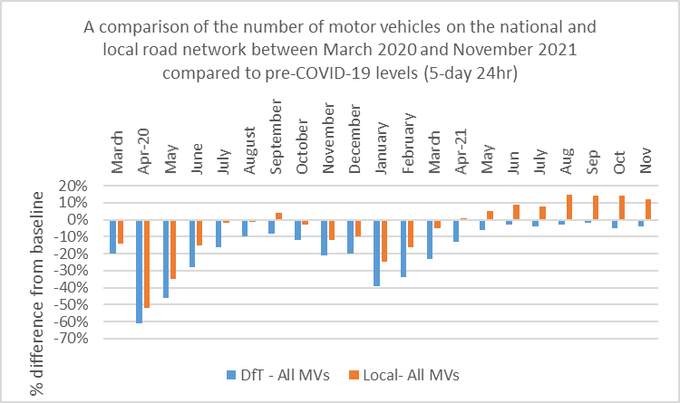
Vehicle and cycle flows
Key points:
The COVID-19 pandemic and subsequent lockdown restrictions has had a significant impact on vehicle flows and public transport both at national and local level.
Since May 2021, all motor vehicles (including cars, LGVs, and HGVs) at local level have remained above levels recorded pre-COVID. Nationally, vehicle flows are recovering at a slower rate and as of November 2021 are still below those recorded pre-COVID. At the peak of the first lockdown, motor vehicle flows decreased by 51% and 62% at local and national level compared to a pre-COVID baseline.
Bus patronage still remains low compared to pre-COVID levels both at local and national level but is starting to show signs of recovery, with local bus patronage back to 31% below pre-COVID levels compared to 92% at the peak of the first lockdown.
Car flows at local level recovered briefly to above those recorded pre-COVID in September 2020, but have consistently remained above pre-COVID levels since May 2021.
HGV flows despite declining rapidly at national and local level during the first lockdown, recovered quickly from June 2020 onwards. Locally, between February and September 2021 flows were at or above pre-COVID levels.
LGV flows recorded the greatest decline in flows during the first lockdown with local LGV flows increasing to above those recorded pre-COVID briefly in September and October 2020 before declining again. From March 2021, LGV flows at national and local level started to recover and have remained above the pre-COVID baseline since.
Source: Herefordshire Council Transport team
Need to know: The national data is for Great Britain, and is provided by the Department for Transport (DfT). Local traffic data including all motor vehicles, cars, LGVs and HGVs and cycling data has been analysed from Automatic Traffic Counter locations in Hereford. Local bus patronage data is provided by bus operators.

Slide 19
Effects of lockdown on population movement
This chart shows average visits to different categories of places, using location data of Google users, compared to the beginning of 2020.
Data showing up to 31st Dec, so reflect the influence of Christmas period.
There were increases in retail outlets immediately prior to Christmas while in recent days falls in access to retail and recreational outlet, stations and workplaces have fallen due to the holiday season.
As the data does not cover the post-Christmas return to work, compliance with work from home guidance (Plan B) cannot be as yet determined.
Implementation of Plan B restrictions (10 Dec)
Where can I find out more? This chart is updated daily on the Data Orchard website, using data published by Google. The baseline is the median value, for the corresponding day of the week, during the five weeks 3 Jan–6 Feb 2020. Note that the data is based on movements of those who have opted to turn on location history in their Google accounts on their mobile devices.

Slide 20
People claiming Universal Credit (UC)
The number of people claiming Universal Credit (UC) doubled between March 2020 and May 2020. Since then the claimant numbers remained at a high level. Provisional data suggest there were 11,516 Universal Credit claimants in Herefordshire in November 2021, slightly below the peak of 12,382 seen in April 2021 but well above the 5,983 seen in March 2020.
In Herefordshire, UC claimants currently comprise 10% of the working age population; lower than the West Midlands Region (16%) and England (14%) but still double the 5% seen in March 2020.
The wards with the highest number of UC claimants are Hinton & Hunderton, Newton Farm, Leominster East, and Red Hill.
Need to know:
The monthly number of people on Universal Credit includes all individuals who have an open claim on the count date for the month.
Some people will have their claim terminated either at the request of the individual or if their entitlement to Universal Credit ends. If a termination is recorded, but the person is still receiving a payment, then the claim will still be classed as live at the end of each reporting month.
The latest month's figures are provisional and are subject to change in the next publication where they will be revised and finalised. Monthly figures are currently not subject to retrospection beyond the first revision.
Source: DWP
Date last updated: Jan. 2022
Frequency of update: Monthly
HC data lead: IU

Slide 21
Council Tax reductions
Looking at the number of households claiming under the Council Tax Reduction Scheme is an important proxy-indicator of financial hardship, as households qualify for the discount by virtue of having a low income whether from benefits, low-paid work or self-employed work, and limited capital savings.
Currently, in Herefordshire there are 6,384 working age households receiving £7.6m in Council Tax discount under the Council Tax Reduction Scheme, pre-pandemic there were around 5,375 working age households receiving £4.9m.
Source: Herefordshire Council
Date last updated: 16 January 2022
Frequency of update: monthly but will be reported here quarterly
Need to know:
Households may be eligible for the scheme if they are on a low income or claim benefits. Bills can be discounted by up to 100% and claimants can apply if they own their own home, rent, are unemployed or working. The amount of discount depends on:
Where you live - each council runs its own scheme (more information about Herefordshire Council’s scheme can be found at Herefordshire Council - Council Tax Reduction
Circumstances (e.g. income, number of children, benefits, residency status)
Household income - this includes savings, pensions and partner’s income
If your children live with you
If other adults live with you
Source: Gov.uk - apply for council tax reduction
Note: There are other Council Tax discount schemes available with different eligibility criteria.

Slide 22
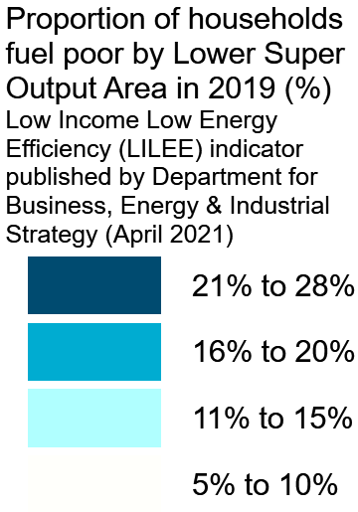
Fuel Poverty
Soaring wholesale energy prices mean that nationally, energy bills could rise as much as 50% in the spring and with the End Fuel Poverty Coalition warning that an estimated 150,000 older households are likely to be plunged into fuel poverty.
Applying the Government’s new 'low income, low energy efficiency' measure, around 17% (14,000) of households in Herefordshire were in fuel poverty in 2019 (higher than England's 13%). Under the old 'low income, high cost' measure the last estimate was 13% (10,700) in 2018, compared to England's 10%, which was lower than the 17% in 2015, although estimates have fluctuated since 2011.

Slide 23
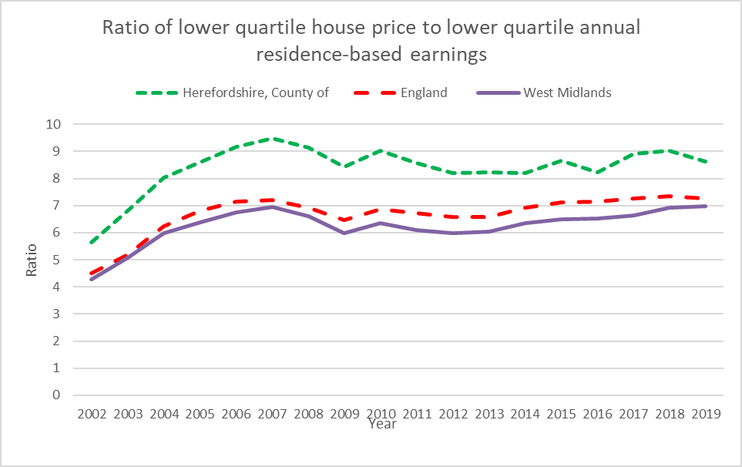
Housing affordability in Herefordshire
The housing market continues to remain buoyant and in many ways this is grounds for optimism. According to ONS the UK’s average house price increased by 10.2% over the year to October, down from 12.3% in the year to September 2021.
Private rental prices paid by tenants in the UK rose by 1.7% in the 12 months to November 2021, up from 1.6% in the 12 months to October 2021.
The Guardian reports that nationally, 2021 was the strongest calendar year for house price growth since 2006. According to Nationwide, prices jumped by 1% in December and the price of a typical UK home is now £254,822: an increase of nearly £24,000 over the year; the largest rise seen in a single year, in cash terms. Prices are now 16% higher than before the pandemic.
This has significant implications for Herefordshire, seen as an attractive destination in the “race for space” and where housing affordability has long been an issue. In 2019, before these latest developments, the ratio of lower quartile house price to residence-based lower quartile earnings in Herefordshire (8.62) was already the second highest of any local authority* in the West Midlands (after Solihull) and was significantly higher than the average for the West Midlands and England as a whole (6.97 and 7.27 respectively).
*Unitaries, counties and metropolitan boroughs
Data source: ONS
Last updated: 25 March 2021
Frequency: annual

Slide 24
Mortgage and landlord possessions in Herefordshire
As at Q2 2021/22 (April-June) mortgage and landlord possessions in Herefordshire had risen slightly from the previous quarter but remained at historically very low levels (9 and 17 claims issued respectively in the whole of Q2).
This is likely due to the various Government support packages available and action to encourage lenders to grant a mortgage holiday period and to protect social and private renters and landlords including the possessions moratorium.
Nationally, UK Finance reports that possessions have slightly risen in absolute terms, off a low base, as the courts work through the backlog of cases that built up during the possessions moratorium. The possession cases currently going through the courts are predominantly those that had built up significant levels of arrears prior to the start of the UK's response to the pandemic..
Mortgage arrears: Q3 2021 data from UK Finance shows that nationally mortgage arrears continued to fall to near historic lows in the third quarter. Overall, there was a reduction of 2,400 mortgages in arrears compared with the previous quarter, with a total of 74,210 homeowner mortgages in arrears of 2.5 per cent or more of the outstanding balance. Within the total, there were 25,110 homeowner mortgages in early arrears (those between 2.5 and 5 per cent of balance in arrears), a decrease of 5 per cent on the previous quarter and 10 per cent fewer than the same period in 2020. Barring an initial uptick at the end of March 2020, these early arrears figures have remained lower than the number seen before the pandemic began. Looking ahead, with the end of Covid-specific support schemes, it is expected that lenders' provision of tailored forbearance to customers in difficulty will moderate, but not prevent, increases in early arrears.
Source: LG Inform
Date last updated: December 2021 (Q2 2021/22)
Frequency of update: quarterly
HC data lead: Intelligence Unit

Slide 25
Section 2. The labour market
Demographics
Earnings
Gender pay gap
2020 labour force breakdown
Change in workforce jobs in the West Midlands region from March 2020 to June 2021
Herefordshire’s largest industries (by jobs)
Herefordshire’s largest occupations
Job postings in Herefordshire
Context: UK job adverts
In-demand skills in Herefordshire
Hot and cold hard skills in Herefordshire
Hard to fill vacancies
Workforce educational attainment

Slide 26
Demographics (2020)
Source: Emsi- economicmodelling.co.uk.
Frequency: Annual
Last updated: December 2021

Slide 27
Earnings
The latest Annual Survey of Hours and Earnings (ASHE) reveals that the workplace-based median weekly earnings for people who work in Herefordshire is now £536.60 (± £42.07); a 12% increase from the amount recorded for 2020 (£480.50).
Herefordshire’s weekly earnings are significantly lower than that in England £613.30 (± £2.40). For the first time since 2009, Herefordshire’s weekly earnings are not recorded as significantly different to the West Midland region’s although the amount is lower £585.0 (± £11.47) - Figure 3.
The county has the lowest median earnings of all 14 West Midlands authorities, however looking at England as a whole it is not among the local authorities that have the lowest median earnings in 2021.
Annualised earnings are £27,980 (± £2,194) also significantly lower England £30,979 (± £125) but similar to the West Midlands region, £30,504 (± £598) and.
If we look at residents based weekly earnings as opposed to work place based weekly earnings, these are £535.50 (±67.17) and it is lower compared to England and the West Midlands region although the differences are not significant.
Source: Annual Survey of Hours and Earnings (ASHE) available from NOMIS
Frequency: annual
Last updated: November 2021
Need to know: workplace-based earnings includes all people who work in Herefordshire regardless of which county they live in. Residents-based weekly earnings includes all people who live in Herefordshire i.e. includes those who work outside the county

Slide 28
Gender pay gap
The gender pay gap (GPG ) is the difference between average hourly earnings (excluding overtime) of men and women as a proportion of average hourly earnings (excluding overtime) of men.
Although the gap is now 25% lower than it was a quarter of a century ago, it is still around 13 percentage points and in 2019 the average working-age woman in the UK earned 40% less than her male counterpart.
Recent research by the IFS as part of the Deaton Review found that the vast majority of the modest convergence in earnings of the past 25 years can be explained by the closing of the gender gap in education levels.
The divergence occurs with parenthood, when the gendered roles that mothers and fathers take on appear to be largely unrelated to their relative earnings potential.
The IFS found that persistent social norms around parenting are reinforced by a policy environment that sustains and incentivises a traditionally gendered division of labour, even when policies are ostensibly gender-neutral.
In 2021, women’s earnings in Herefordshire are 4% lower than men’s; a smaller gap compared the West Midlands region (10%) and England (9%).
Source: Annual Survey of Hours and Earnings (ASHE) available from NOMIS
Frequency: annual
Last updated: November 2021

Slide 29
2020 Labour Force Breakdown
Source: Emsi-economicmodelling.co.uk
Frequency: annual
Last updated: December 2021

Slide 30
Change in workforce jobs* in the West Midlands region from March 2020 to September 2021
Industry sector | Mar-20 | Sep-21 | Change | % change
Agriculture, forestry and fishing | 32,296 | 46,004 | 13,708 | 42.44%
Mining and quarrying | 3,664 | 1,443 | -2,221 | -60.62%
Manufacturing | 308,686 | 286,341 | -22,345 | -7.24%
Electricity, gas, steam and air conditioning supply | 11,667 | 15,437 | 3,770 | 32.31%
Water supply; sewerage, waste management and remediation activities | 16,916 | 16,362 | -554 | -3.28%
Construction | 192,715 | 183,584 | -9,131 | -4.74%
Wholesale and retail trade; repair of motor vehicles and motorcycles | 433,528 | 458,023 | 24,495 | 5.65%
Transportation and storage | 176,825 | 181,007 | 4,182 | 2.37%
Accommodation and food service activities | 190,123 | 155,920 | -34,203 | -17.99%
Information and communication | 91,498 | 85,583 | -5,915 | -6.46%
Financial and insurance activities | 71,796 | 67,224 | -4,572 | -6.37%
Real estate activities | 49,158 | 40,733 | -8,425 | -17.14%
Professional, scientific and technical activities | 210,319 | 236,870 | 26,551 | 12.62%
Administrative and support service activities | 282,771 | 295,840 | 13,069 | 4.62%
Public administration and defence; compulsory social security | 104,037 | 105,931 | 1,894 | 1.82%
Education | 247,590 | 254,186 | 6,596 | 2.66%
Human health and social work activities | 375,317 | 381,211 | 5,894 | 1.57%
Arts, entertainment and recreation | 80,951 | 71,870 | -9,081 | -11.22%
Other service activities | 83,929 | 79,765 | -4,164 | -4.96%
Activities of households as employers;undifferentiated goods-and services-producing activities of households for own use | 1,883 | 4,450 | 2,567 | 136.33%
TOTAL | 2,965,669 | 2,967,784 | 2,115
*Workforce Jobs (WFJ) is a quarterly measure of the number of jobs in the UK and is the preferred measure of the change in jobs by industry. Estimates are only available at national and regional level.
Source: ONS/NOMIS
Date last updated: 16 December 2021; Frequency: quarterly

Slide 31
Herefordshire’s largest industries (by jobs)
Source: Emsi- economicmodelling.co.uk
Date last updated: 16 December 2021
Frequency of update: daily
HC data lead: Intelligence Unit

Slide 32
Herefordshire’s largest occupations
Source: Emsi- economicmodelling.co.uk
Date last updated: 16 December 2021
Frequency of update: daily
HC data lead: Intelligence Unit

Slide 33
Job postings in Herefordshire
According to EMSI, in Herefordshire there were a total of 10,375 unique job postings in November 2021. This compares to 9,176 in the previous month.
Locally, job postings are now significantly higher than in the same period a year ago. This, in combination with the claimant count data appears to suggest that Herefordshire’s economy was pre-Omicron recovering well from the economic turbulence of the past twelve months.
As at 15 December 2021 there were 6,693 unique job postings; 54.9% higher than on the same day last year.
Top posted occupations in November 2021 were nurses, care workers and home carers, book-keepers, payroll managers and wages clerks, van drivers, sales and retail assistants, and sales accounts and business development managers.
Source: Emsi- economicmodelling.co.uk
Date last updated: 16 December 2021
Frequency of update: daily
HC data lead: Intelligence Unit
Need to know: A unique job posting is one that has been de-duplicated as postings can appear on multiple websites, multiple times. Data include voluntary, internships, side jobs and freelance.

Slide 34
Context: Job adverts nationally
According to ONS:
The total volume of online job adverts on 7 January 2022 decreased by 3% to 117% of its February 2020 pre-coronavirus average level
Of the 28 categories, 17 saw a decrease in the number of online job adverts, while 10 increased and one remained unchanged when compared with the previous week. The largest weekly decreases were in “travel and tourism”, “admin, clerical and secretarial” and “facilities and maintenance”, which fell by 20%, 19% and 18%, respectively. Meanwhile, the largest weekly increase was in “IT, computing and software”, which rose by 17%.
Despite seeing a decrease of 12% from the previous week, “transport, logistics and warehouse” continues to be the category with the highest level of online job adverts when compared with its February 2020 pre-coronavirus average level at 230%.
The only weekly increase on 7 January 2022 was in London, where the volume of online job adverts increased by 6%. Meanwhile, the largest weekly decreases were in Wales, Scotland and the East Midlands, which fell by 12%, 11% and 10%, respectively. The volumes of online job adverts in all UK countries and English regions (12 in total) were above their February 2020 levels.
A detailed online discussion of pre-Omicron labour market trends is available from EMSI.
Source: ONS
Frequency: weekly
Last updated: 14 January 2021

Slide 35
Top 10 in-demand skills in Herefordshire
In 2021 as a whole the top ten in-demand skills in Herefordshire (with number of citations) were:
Nursing 1,109
Auditing 1,103
Finance 958
Personal Care 902
Mental Health 869
Warehousing 846
Accounting 769
Key Performance Indicators (KPIs) 656
Learning disabilities 644
Machinery 553
Need to know: Hard skills are abilities that have been taught to or learnt by a person.
Source: Emsi- economicmodelling.co.uk
Date last updated: 16 December 2021
Frequency of update: monthly
HC data lead: Intelligence Unit

Slide 36
Hot and cold hard skills in Herefordshire
Hot and cold hard skills compared to 1 year ago (November 2020)
Hot and cold hard skills compared to 1 month ago (October 2021)
Need to know: Hard skills are abilities that have been taught to or learnt by a person.
Source: Emsi- economicmodelling.co.uk
Date last updated: 16 December 2021
Frequency of update: monthly
HC data lead: Intelligence Unit

Slide 37
Hard-to-fill vacancies
There is no standard definition of a “hard-to-fill” vacancy but the chart shows occupations where there have been 10 or more unique Herefordshire job postings in October/November 2021 by median posting duration and job posting intensity.
This is the most timely proxy for “hard-to-fill” vacancies and although there are some issues associated with this methodology has been shown to be a robust approximation.
Those roles that appear highest on the chart for both measures can be regarded as most “hard-to-fill”.
Nationally, ONS reports that the number of job vacancies in October to December 2021 rose to a new record of 1,247,000, an increase of 462,000 from its pre-coronavirus January to March 2020 level, with most industries displaying record numbers of vacancies. However, the rate of growth in vacancies continued to slow down. The ratio of vacancies to every 100 employee jobs reached a record high 4.1 in October to December 2021.
Need to know: Posting Intensity is a ratio of total job postings to unique, or de-duplicated, job postings. A higher than average posting intensity can mean that employers are putting more effort than normal into hiring that position. Posting intensity is available by occupation, by job title, by company, and by region. The median posting duration (how long a posting was live before it was taken down) can be compared to the regional average for all postings in the region, giving an indication of whether these positions are harder or easier to fill than the typical job posting.
Source: Emsi- economicmodelling.co.uk
Date last updated: 16 December 2021
Frequency of update: quarterly
HC data lead: Intelligence Unit

Slide 38
Workforce educational attainment
Source: Emsi- economicmodelling.co.uk
Frequency: Annual
Last updated: December 2021

Slide 39
Section 3: Unemployment
Claimant count (unemployment-related benefits)
Claimant count: all ages
Claimant count as a proportion of all residents aged 16 to 64
Claimant count by age
Claimant count: 18-24s
Claimant count rate by ward
Analysis of national claimant count trends
Model-based unemployment rate: trend

Slide 40
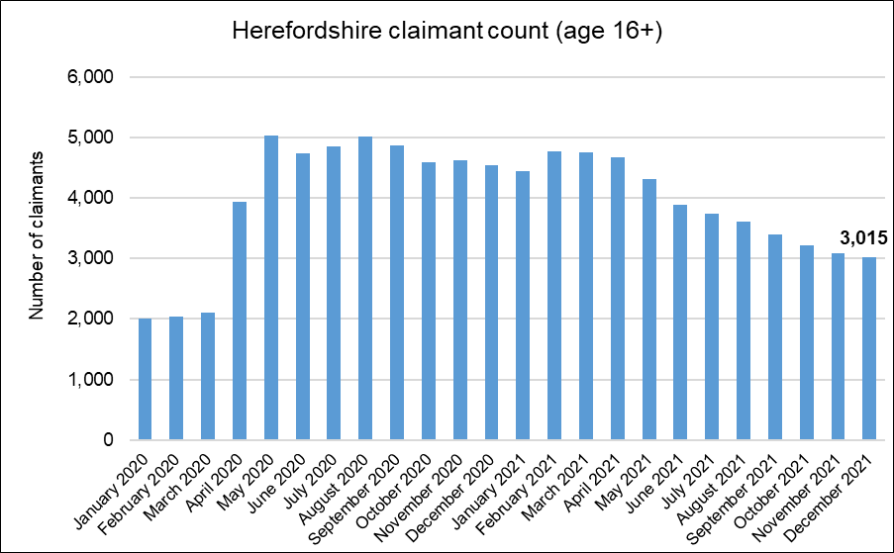
Claimant count: all ages
Key points:
3,015 people aged 16+ claiming unemployment related benefits* in December 2021.
Apart from the bump in early 2021, numbers have decreased gradually from the peaks seen in May and August 2020.
The lowest level seen since April 2020
About 2,000 fewer than the peaks of 5,000 last May and August
, but have generally remained at record highs since April 2021.
43% higher than the number in March 2020, compared to England as a whole it is +49%.
Around 50 more claimants than peak due to 2008-09 recession
The claimant count rate for the county as a whole in December was 2.7% compared to 4.5% for England as a whole.
What this doesn’t tell us:
Claimant count is NOT a full measure of unemployment, but it is the most timely indicator
We don’t know which sectors jobs have been lost from
Some jobs will have been protected by government support schemes
! Need to know !
* Includes people claiming Jobseeker's Allowance plus those claiming Universal Credit who are required to seek and be available for work.
Month-by-month comparisons are difficult as previous data is often revised
Source: ONS/NOMIS Date last updated: 18 January 2022
Frequency of update: monthly
HC data lead: Intelligence Unit

Slide 41
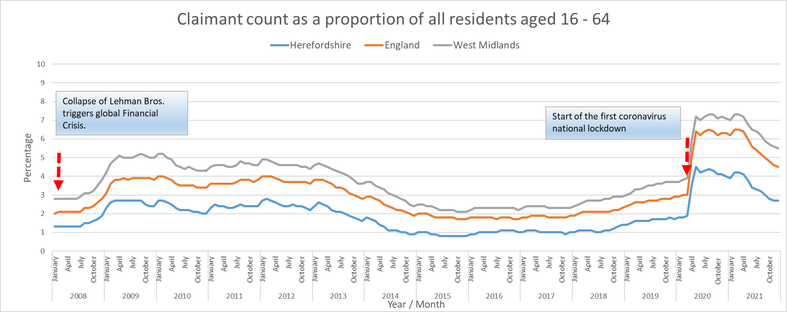
Claimant count as a proportion of all residents aged 16 to 64
Key points:
The Herefordshire claimant count as a proportion of the working age population has increased but started from a lower base and remains significantly lower than in the West Midlands and England as a whole.
What this doesn’t tell us:
Claimant count is NOT a full measure of unemployment, but it is the most timely indicator
We don’t know which sectors jobs have been lost from
Some jobs will have been protected by government support schemes
Need to know:
The residence-based proportion shown in this chart is the official measure below national/regional level. It is available for local authorities, constituencies, travel to work areas, regions and countries and expresses the number of claimants as a percentage of the population aged 16-64, sourced from the mid-year population estimates. At national/regional level the official measure is the workplace-based rate, but this measure can be used to compare national/regional areas with smaller areas (e.g. local authorities) to ensure comparison of like with like. Although the claimant count rate is one official measure of unemployment, a more accurate measure of the unemployment rate is derived from the Labour Force Survey. For more information see ONS/NOMIS or the Economics Help website.
Data source: ONS/NOMIS.
Last updated: 18 January 2022
Frequency of update: monthly
HC data lead: Intelligence Unit

Slide 42
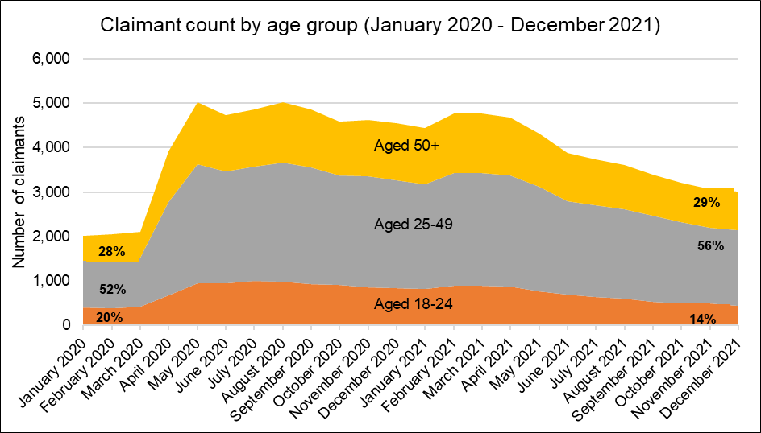
Claimant count by age
Key points:
The distribution of claimants between age-groups in Herefordshire has changed significantly since the start of 2020.
The number of claimants aged 18-24 is now only 10% higher than in January 2020, whereas for the 25-49 age group it is 61% higher and for the 50+ age groups it is 56% higher.
In January 2020 18-24 year-olds comprised 20% of all claimants – this has now fallen to 14%. 25-49 year-olds comprised 52% of all claimants in January 2020 and this has now increased to 56%. For the 50+ age group the proportion is similar: 29% now compared to 28% in January 2020.
What this doesn’t tell us:
Claimant count is NOT a full measure of unemployment, but it is the most timely indicator
We don’t know which sectors jobs have been lost from
Some jobs will have been protected by government support schemes
Data source: ONS/NOMIS
Date last updated: 18 January 2022
Frequency of update: monthly
HC data lead: Intelligence Unit

Slide 43
Claimant count: 18-24s
Key points:
435 people aged 18-24 were claiming unemployment related benefits* in December 2021.
Month-on-month comparisons are difficult as previous data is often revised, but numbers have fallen since peaking at 1,000 in July 2020.
5% higher than the number in March 2020, but appears to have recovered more than in England (28%) – although note it started from a much lower base.
What this doesn’t tell us:
Claimant count is NOT a full measure of unemployment, but is the most timely indicator
We don’t know which sectors jobs have been lost from Some jobs will have been protected by government support schemes.
! Need to know !
* Includes people claiming Jobseeker's Allowance plus those claiming Universal Credit who are required to seek and be available for work.
Data source: ONS/NOMIS
Date last updated: 18 January 2022
Frequency of update: monthly
HC data lead: Intelligence Unit

Slide 44
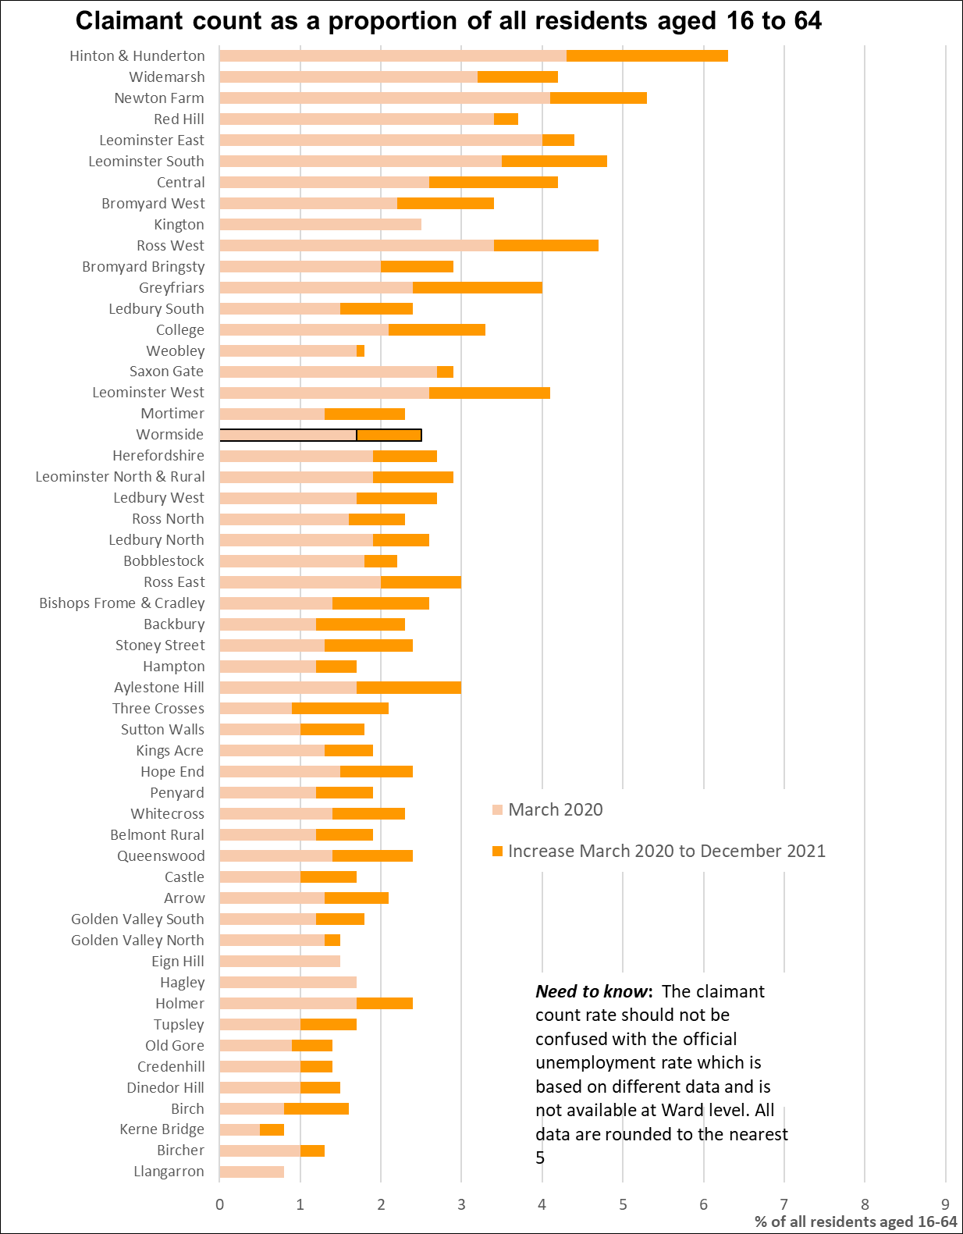
Claimant count rate by ward (proportion of residents aged 16-64)
Key points:
Generally, those wards with the highest claimant count rates before the pandemic still have the highest rates in December 2021
Currently, the Wards with the highest numbers of claimants are Hinton & Hunderton (155), Newton Farm (145), and Widemarsh (130), by Red Hill (120) and Leominster East (110).
The largest proportional increases in the claimant count since March 2020 have occurred in Kerne Bridge (150%), Sutton Walls (150%), Backbury (125%) and Three Crosses (125%). In terms of numerical increases, the largest have been in Widemarsh (50 claimants), Ledbury South and Bromyard West (both 35 claimants).
Note that due to the small population sizes a relatively small change in the number of claimants can have a significant impact on the rate.
Data source: ONS/NOMIS
Date last updated: 18 January 2022
Frequency of update: monthly
HC data lead: Intelligence Unit

Slide 45
Model-based unemployment rate: trend
Key points:
In the period October 2020 to September 2021 the unemployment rate in Herefordshire was 3.2% (CI+-0.7), compared to 4.9% (CI+-0.2) in England as a whole and 5.1% (CI+-0.5) across the West Midlands region.
Herefordshire’s unemployment rate was significantly lower than England as a whole and the West Midlands region.
This shows the official annual unemployment rate which IS NOT the same as the claimant count rate.
What this doesn’t tell us:
No further breakdown is available below all-age county rate.
! Need to know !
Model-based estimates are produced for local authority areas. Estimates of unemployment for nations and regions are not model-based and have been taken directly from the Annual Population Survey dataset. For more information on the difference between the unemployment and claimant count rates see this article.
Data source: ONS/NOMIS
Date last updated: 18 January 2022
Frequency of update: quarterly
HC data lead: Intelligence Unit

Slide 46
Section 4: Support for Herefordshire businesses
Local authority administered grants paid to Herefordshire businesses

Slide 47
Local authority administered grants paid to Herefordshire businesses
Description | Period | Number of grants paid | Total paid out
Local Restrictions Support Grant
Open scheme | Payments made up to closure on 30 April 2021 | 2,993 | £1,026,281
Closed scheme | Payments made up to closure 30 April 2021 | 2,682 | £3,598,903
Closed scheme: addendum post 5 January | Payments made up to closure 30 June 2021 | 4,634 | £10,575,272
Closed Business Lockdown payment | Closed 31 May 2021 | 2,342 | £10,447,730
April restart grants | Payments made up to closure 31 July 2021 | 2,299 | £16,385,508
Christmas support payment | Payments made until scheme closed 31 March 2021 | 121 | £121,000
Additional Restrictions Support Grant | Payments made up to 16 January 2022 | 2,617 | £7,056,070.97
Local Authority Discretionary Grant Fund | Payments made 14 June 2020 - 31 August 2020 | 772 | £3,220,466
Small Businesses Grant Fund and Retail, Hospitality and Leisure Businesses Grant Fund | Payments made up to closure on 31 August 2020 | 5,021 | £58,615,000
Current support for businesses delivered via local authorities comprises ongoing business rates relief together with the following grant schemes. Some additional support is also available directly from central government departments. Open local authority administered schemes currently comprise:
Additional Restrictions Grant is provided to local areas by agreement and became an allocation. Funding can be used to fund business support activities.
Omicron Hospitality and Leisure Grant provides local councils with one-off grant funding to support to hospitality, leisure and accommodation businesses, in recognition that the rise of the Omicron variant – no data are yet available for this scheme.
In addition to these schemes, the government has provided eligible retail, hospitality and leisure properties in England with an Expanded Retail Discount on business rates – initially 100% relief from 1 April 2021 to 30 June 2021 and then 66% relief for the period from 1 July 2021 to 31 March 2022, capped at £2 million per business for properties that were required to be closed on 5 January 2021, or £105,000 per business for other eligible properties. Currently, the Expanded Retail Discount” is awarded to 1,239 Herefordshire businesses and totals £7,441,000 in 2021/22 business rates discount.
Data sources: Herefordshire Council and Department for Business, Energy and Industrial Strategy
Frequency: monthly, Last updated: 16 January 2022.

Slide 48
Section 5. Intelligence roundup
Below are links to recently published research, media reports and webinars relevant to understanding the current state of Herefordshire’s economy and wider socio-economic trends likely to impact upon the county:
Bank of England
Monetary Policy Report (November 2021)
Centre for Cities
If people can work anywhere, will they want to stay living in cities?
EMSI/Burning Glass
Exploring Skills Gaps in your Local Economy
Defining the Labour Market Puzzle: What effects are emerging from the disruption?
Which Regions and Localities Have Seen the Biggest Growth in Employer Demand in 2021?
Goldman Sachs
How Rising Natural Gas Prices Could Crimp Growth
What’s Ahead for Global Economies and Markets in 2022?
Health Foundation
Not just any job, good jobs!

Slide 49
Section 5. Intelligence roundup (2)
House of Commons Public Accounts Committee
Delivering gigabitcapable broadband. Thirty-Second Report of Session 2021–22
IFS
Early years inequalities in the wake of the pandemic
Health and social care: what are the challenges after COVID?
What's the impact of trade on inequality?
The curse of graduating during a recession
Inequality: what do we know, and why do we care?
The price we pay for carbon: can taxes take us to net zero?
Autumn Budget and Spending Review 2021
Men and women at work: the more things change the more they stay the same?
The cost of living crunch

Slide 50
Section 5. Intelligence roundup (3)
Joseph Rowntree Foundation
UK poverty report 2022
Midlands Engine
Midlands Engine Regional Economic Impact Monitor 20
State of the Region Report 2021
Digital Deep Dive
ONS
Vacancies and jobs in the UK: December 2021
PWC
UK economic outlook (December 2021)

Slide 51
Section 5. Intelligence roundup (4)
The Resolution Foundation
Pastures new: Is lower migration the route to a new, higher wage, British economy?
Hope to buy? Assessing trends in home ownership
What comes next for the UK’s post-pandemic labour market?
Open for business? Assessing the performance of British firms
Gaining from growth: When the economy grows, do wages?
Covid cohorts: How have different generations fared in the second phase of the pandemic?
Budgeting for Britain: What the Budget and Spending Review tell us about the Government’s economic strategy
Gaining from growth: When the economy grows, do wages?
Cogs and Monsters: How economics needs to adapt to solve the world’s crises
Crunch time: The causes and consequences of Britain’s cost of living squeeze
Changing jobs? How economic change affects the world of work
New year, old pandemic: Assessing the politics, economics and epidemiology of 2022
Beyond Beveridge: Have social security shifts prepared us for economic change?

Slide 52
Section 6. Useful resources
Below are links to organisations that provide data and intelligence resources relevant to understanding the current state of Herefordshire’s economy and socio-economic trends likely to impact upon the county:
99% - Herefordshire 2030
British Business Bank – Coronavirus loan schemes statistics
British Retail Consortium Insight Dashboard (key performance measures for UK retail)
Cabinet Office - Statistics on coronavirus support for business and individuals
Centre for Cities – UK unemployment tracker
Centre for Rural Economy
Data Orchard – COVID Recovery Dashboard for Herefordshire
DEFRA Rural Economic Bulletin for England
Department for Industry, Energy & Industrial Strategy - Coronavirus grant funding: local authority payments to small and medium businesses
Department for Work & Pensions - Family Resources Survey: financial year 2019 to 2020
HESA – Higher Education Student Data
HMRC - coronavirus (COVID-19) statistics (CJRS & SEISS)
HM Treasury - Coronavirus (COVID-19) business loan scheme statistics
LG Inform - LGA Research Summary Report - Mortgage and Landlord Possession Statistics Quarterly
London Stock Exchange

Slide 53
Section 5. Useful resources (continued)
Below are links to data, reports and resources that provide relevant context to understanding the current state of Herefordshire’s economy and socio-economic trends like to impact upon the county:
Midlands Engine Intelligence Hub (a single, interactive portal for up-to-the-minute pan regional data, research and expert insights)
Office for National Statistics (ONS) - UK economy latest
ONS - Coronavirus (COVID-19) latest insights
ONS - High streets in Great Britain: March, 2020
ONS - Inflation and price indices
ONS - Internet users, UK: 2020
ONS - Labour market overview, UK
ONS – NOMIS Herefordshire Labour Market Profile
ONS - Understanding spatial labour productivity in the UK
ONS - What are the regional differences in income and productivity?
Our World in Data
University of Birmingham - The Economic and Social Impacts of Coronavirus (Covid-19) on the West Midlands (including link to the West Midlands Weekly Economic Monitor)
Universities UK – Higher education in numbers
UK COVID-19 Firm Creation (An ESRC funded project based at the University of Kent exploring the impact of COVID-19 on business creation in the UK)
UK Finance – Mortgage arrears and possessions

