Slide 1

COVID-19 in Herefordshire
Intelligence summary
Public Health & Intelligence Unit
20th October 2021

Slide 2
Contents
Key messages (slide 3)
COVID-19 testing (slides 4-5)
COVID-19 cases (slides 6-8), including demographics (slide 9) and local areas (slides 10-11)
Variants of concern (slide 12)
Vaccinations: uptake (slide 13-16)
Patients admitted to hospital (slide 17)
Profile of deaths: published data (slide 18)
Effects of lockdown on population movement (slide 19)
Compliance with COVID-19 guidance – social distancing and mask wearing (slide 20)
Other resources (slide 21)
If you need help to understand this document, or would like it in another format or language, please contact us on 01432 261944 or e-mail researchteam@herefordshire.gov.uk

Slide 3
Covid-19 in Herefordshire: key messages, 20 October
  The Government has published the COVID-19 Response: Autumn and Winter Plan 2021, which outlines how “[vaccination] boosters, testing and refreshed public health advice will help keep the virus under control in the coming months”. It also describes a range of ‘Plan B’ measures which could be (re)introduced to protect the NHS if necessary, e.g. mandatory face coverings.
  The number of new cases in Herefordshire has fallen in the last week with 813 recorded in the last week compared to 936 the previous week, although rates remain relatively high across the county with widespread community transmission evident. The Herefordshire seven day case rate has fallen sharply while national and regional rates have increased so that the latest local figure (420 per 100,000) is ow close to both the national and regional rates after having being appreciably higher than both figures only two weeks ago.
  While confirmed cases in secondary school age children are falling they continue to drive the overall rate: one third of new cases in the last week were aged 11 to 17. The rate amongst over 80s have fallen in the last week.
  Within recent weeks there has been an increase in the number of cases linked to adult social care settings. A similar patterns is seen across the country. This is not unexpected, as case rates are high, with widespread community transmission. ​
  The number of hospital admissions remain high with 38 admitted in the first ten days of October – consequently, the pressure on Wye Valley Trust is high. Overall total deaths remain close to average for the time of year, although Covid-related deaths continue to rise with four registered in the last two weeks.
  There has been a recent gradual decline in the number of LFD tests. People should be reminded of the importance of LFD testing in giving early identification of cases, a fact especially when younger people will be spending time with more vulnerable family members over half-term
  ‘Plan A’ outlined in the COVID-19 Response: Autumn and Winter Plan 2021 relies on effective vaccination coverage, and all eligible individuals are encouraged to take up both doses of their vaccine. The second dose more than doubles the resistance against developing symptoms, and considerably reduces the risk of death. Overall vaccination rates are in line with regional and national averages: 88% of all Herefordshire residents who are registered with an English GP (aged 18+) have received a first dose, and 84% a second dose. However there are some exceptions:
    Booster vaccinations are underway across the county with those eligible being invited to book an appointment
    Vaccination uptake amongst under 50s remains below 85%, particularly of the second dose amongst people aged 40 to 49
    Uptake is noticeably lower in some of the more deprived areas of the county

Slide 4
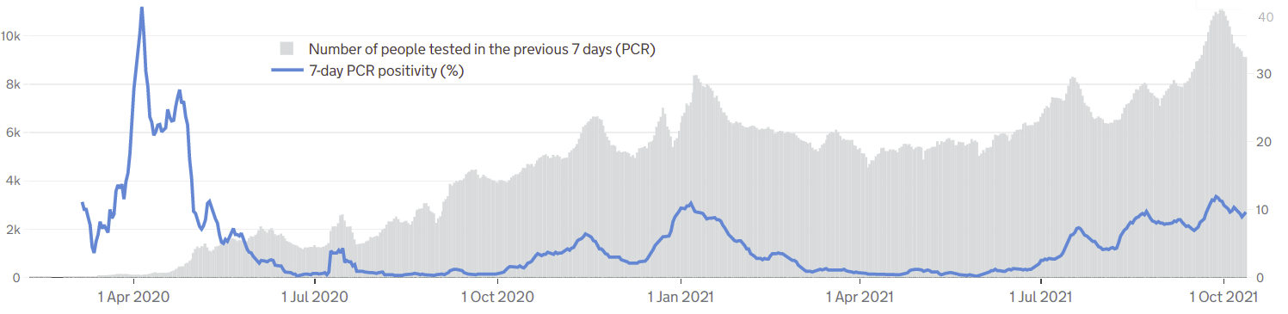

Symptomatic COVID-19 testing: PCR tests and positivity
The graph gives a complete picture of local PCR testing for Herefordshire residents, regardless of where the test was carried out.
The average number of people tested daily has fallen throughout October and as of 12 October was 9,120.
The line shows the positivity rate from PCR tests (i.e. the % of people whose test is positive). The rate has fallen since the peak in late September and as of 12 October was 9.6%. This local figure remains higher than that seen across England (8.5%) but lower than that for the West Midlands (10.0%).
Declining positivity combined with the fall in the number of tests is likely to be due to lower prevalence of the virus.
! Need to know !
PCR data is for rolling 7 day periods, not daily / weekly counts
Counts individuals tested in each 7-day period, not the number of tests carried out. A person is only counted once.
Wholly residence based, whereas previous data included a mixture of Herefordshire residents & also people working in the county.
Where can I find out more? Local level testing data is now updated daily on the government’s Covid-19 dashboard. Details of the roll-out of lateral flow tests to local authorities was published by the government on 9 November, and a guide for local delivery of community testing was published on 11 January.

Slide 5
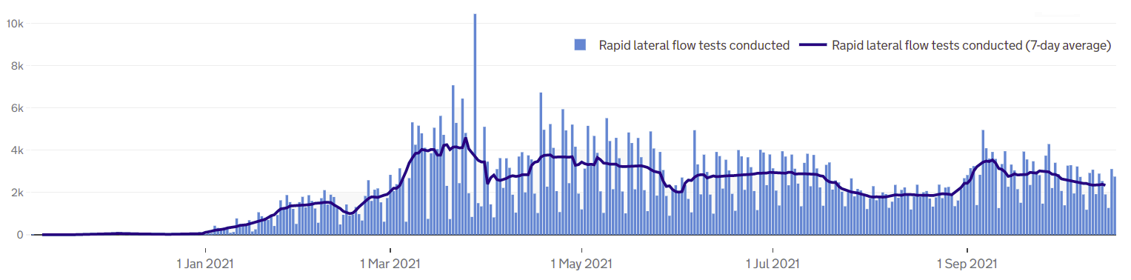
COVID-19 testing: Lateral Flow Device (LFD) tests
! Be aware !
The requirement for a confirmatory PCR test following a positive LFD result was re-introduced on 29 March. It had been suspended for LFD testing on 27 Jan due to the prevalence of the virus.
Unlike the published PCR test data, LFD tests are counted by the number of tests which returned either a positive, negative or void result – which can mean that a person is counted more than once. Data is published as a daily count and 7-day average.
Lateral flow device (LFD) tests are swab tests that give results in less than an hour, without needing to go to a lab. They have become one of the main approaches nationally to controlling the spread, and since 9 April, everyone in England has been eligible for twice-weekly testing.
Almost 723,000 LFD tests had been recorded in Herefordshire by 18 October with a daily average of 2,340 undertaken in the seven days to 18 October.
Generally, the number of tests fell after the increase seen in early September associated with mass testing in educational settings as the autumn term commenced – however, the figure subsequently stabilised during the second half of the month, although a gradual decline has been seen in the last two weeks.
The Covid Symptom Study reported that the most common symptoms are now headache, runny nose and fever – only one of which would is included in the classic COVID symptoms for a PCR test.
Notes
LFD tests for NHS staff using a self-reporting tool have been included from 17 December 2020. Some negative care home tests may not be included for the first 2 weeks of January
All LFD tests are counted under Pillar 2 (Gov’t testing programme)
Where can I find out more? Local level testing data is updated daily on the government’s Covid-19 dashboard. Details of the roll-out of lateral flow tests to local authorities was published by the government on 9 November.

Slide 6
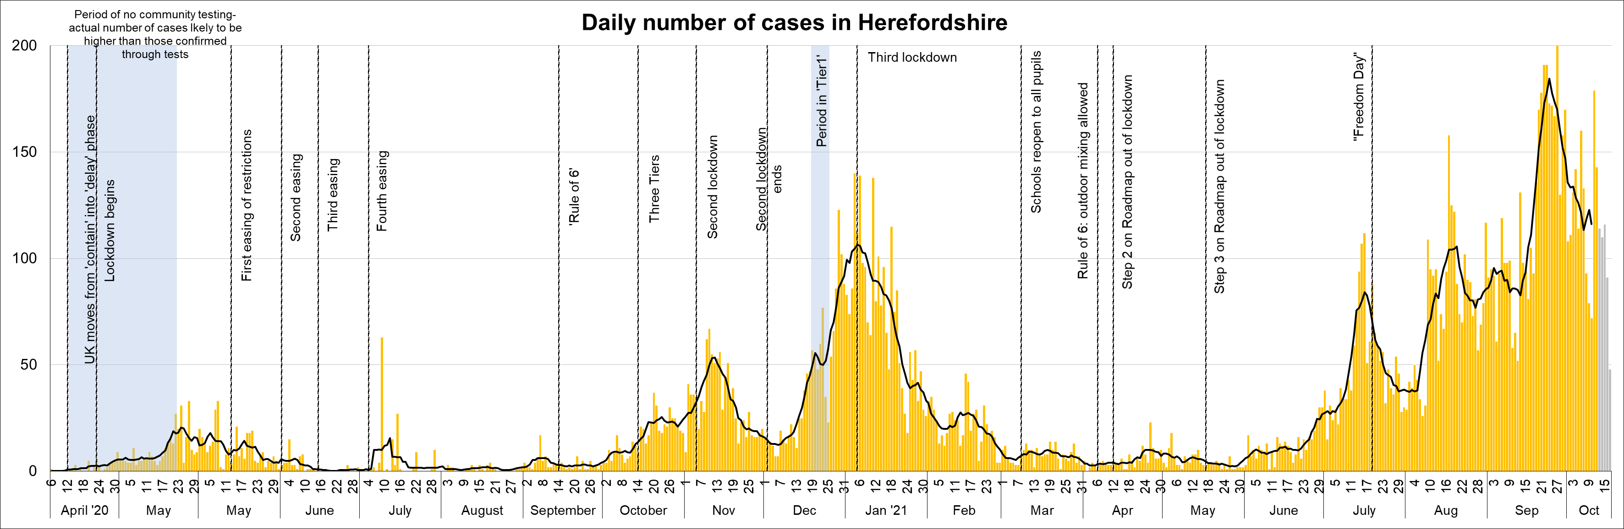
Lab-confirmed COVID-19 cases in Herefordshire
Lab-confirmed cases are the official count of people who live in Herefordshire and have tested positive for COVID-19. In the first few months of the pandemic, numbers of confirmed cases were dependent on testing policy so are not comparable with later waves.
There were 813 new cases confirmed in the 7 days to 13 October– an 13% decrease on the seven days to 6 October (936). (Note that reporting lags mean daily numbers can change, and the grey bars for the last 5 days may increase)
The line on the chart shows the average daily number of new cases. This figure has fallen sharply since the peak in late September and as of 11 October the figure was 113, a figure almost a third lower than the September peak.
Where can I find out more? Confirmed cases are updated daily by PHE

Slide 7
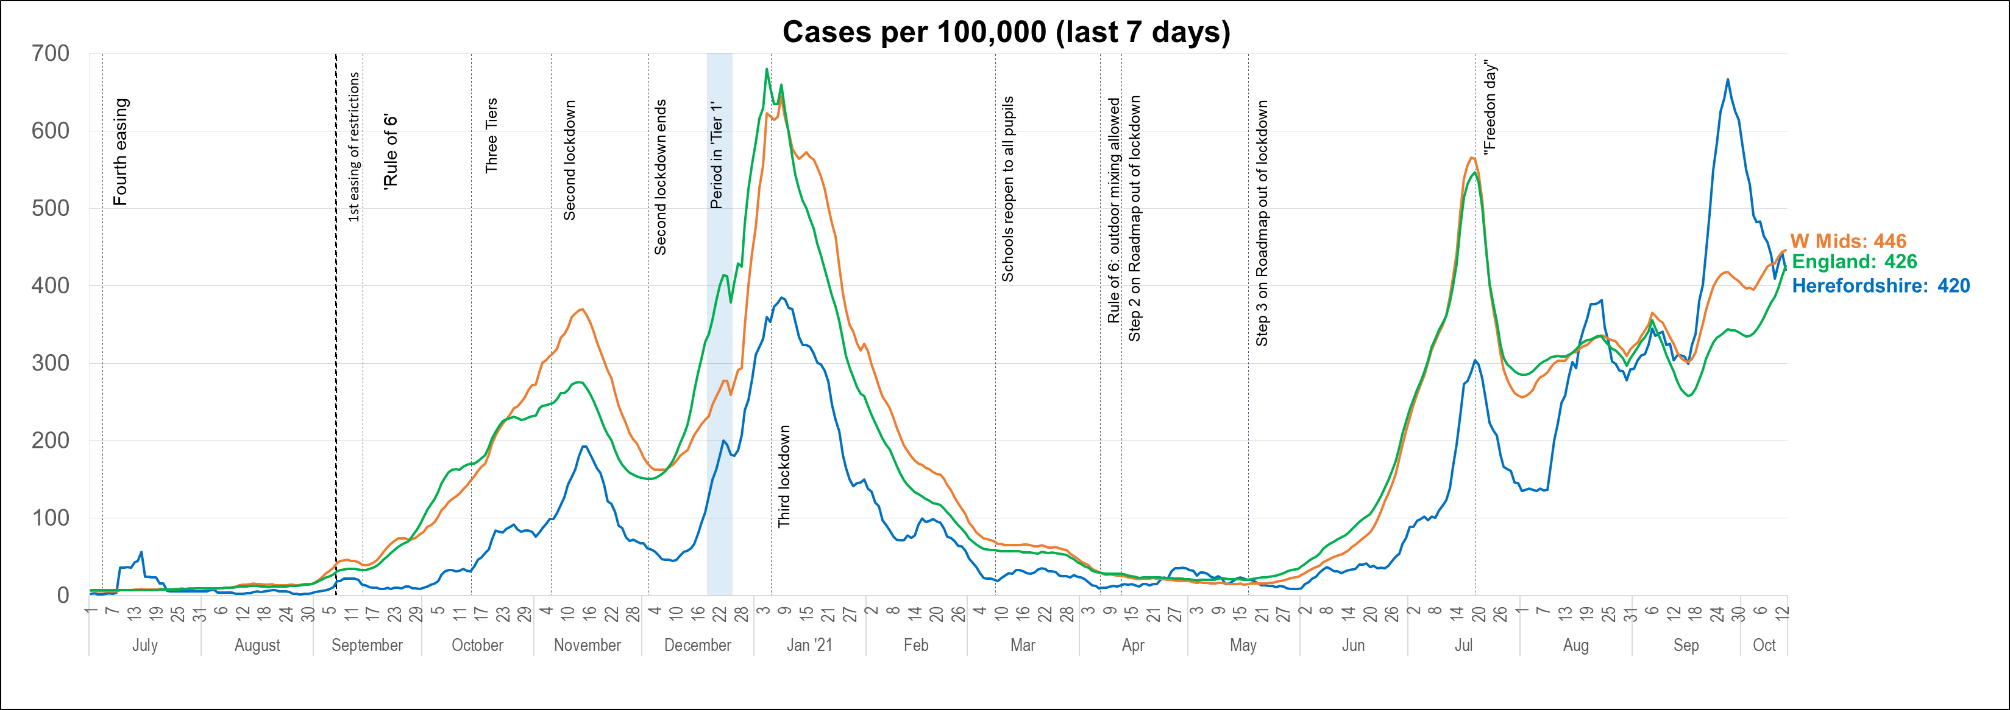
Lab-confirmed cases: comparisons
! Be aware !
Rates per 100,000 resident population give a fairer comparison of the number of cases in each area but they do not take account of the different rates of testing or differences in the age and sex of the local populations.
With one of the smallest ‘upper tier’ local authority populations (193,200), Herefordshire’s rate can be dramatically affected by relatively small changes in numbers of cases. An average of 28 cases a day in a week would result in a rate of 100 per 100,000.
These are not rates of infection amongst the population: they can only reflect those who have been tested, so numbers are highly dependent on the availability of tests.
The chart shows the recent trend in cases per 100,000 resident population for 7-day periods (the latest one ending 5 days ago to allow for lags in the results of tests). This rate is commonly quoted in national reporting.
The Herefordshire rate has fallen sharply over the last two weeks, although it remains higher than at any time before mid September. While the local rate is falling those across the country are rising, so that the Herefordshire figure is now similar to the national figure and marginally below that reported for the West Midlands, having been considerably higher than both only two weeks ago.
Where can I find out more? The graph is based on daily updated PHE data on lab-confirmed cases. Further comparisons are included in the LG Inform dashboard. You can also view the local 7-day case rates and numbers on the Herefordshire Council website.

Slide 8
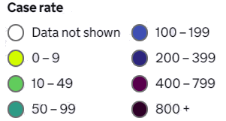
Lab-confirmed cases: comparison with neighbouring authorities
Latest published comparisons, for the week ending 14 October*, show:
The Herefordshire decreased by 12% in the last week
At 409 per 100,000 the local figure is lower than that for England as a whole (436 per 100,000).
While the local rate has fallen in th elast seven days those in neighbouring English and Welsh authorities have increased and are all now higher than that reported for Herefordshire.
* Note that he slight lag in this data reflects the latest date for which complete data is available from test results
Time period: (08/10/21 to 14/10/21)
Where can I find out more? Maps comparing 7 day numbers of cases and rates per 100,000 people are updated daily by PHE

Slide 9
Demographics of COVID-19: rates per 100,000 by age over time
This “heat map” shows how the 7-day rates per 100,000 for specific age groups have changed each week from March to the beginning of September. Each row represents an age group. As rates increase, the chart colours become darker.
  It is important to note that rates per 100,000 can be significantly affected by relatively small numbers of cases in a population as small as Herefordshire, even more so when broken down into age-groups. The absolute number of cases are shown as context. This is especially true when there are single-figure case numbers within groups.
The highest rate remains in secondary school age children who accounted for one third of new cases this week, although the number of new cases in this cohort has fallen by almost a half over the last three weeks.
Although the rate in 5-10 year olds continues to fall it remains high compared to other age bands. Similarly, the 40-49 year old rate is also falling. Both these figures can be explained by within household transmission among young families.
The lowest rate is evident in the 80+ cohort.

Slide 10
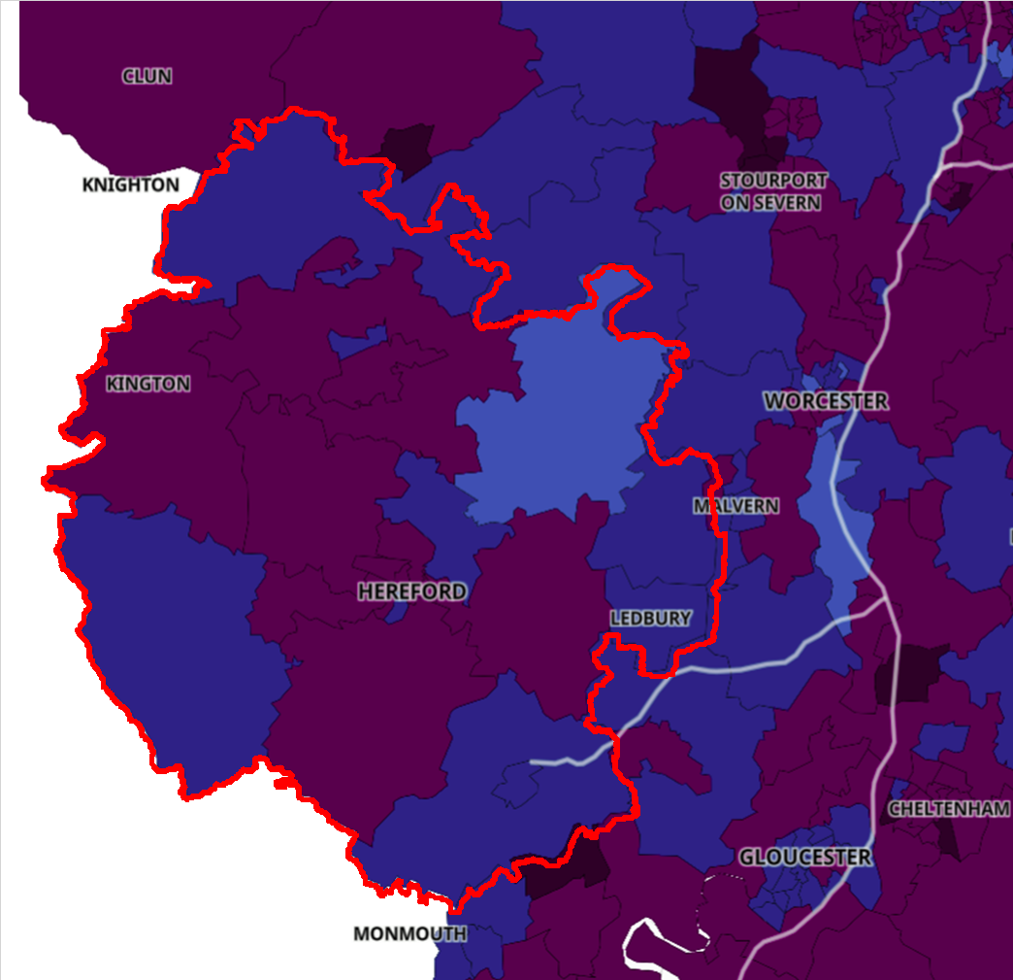

Lab-confirmed cases around the county: this week
The map shows the latest 7-day rates of new cases per 100,000 population, as published by Public Health England: the darker the shading, the higher the rate (unshaded areas have had fewer than 3 cases in the last 7 days).
In the week to 14 October the rates increased in seven of Herefordshire’s 23 MSOAs with decreases seen in 16. Ten MSOAs have rates higher than that for England (436 per 100,000).
Two MSOAs had rates in excess of 550 cases per 100,000:
  ‘Hereford Central’ – 621 per 100,000 (63 cases)
  ‘Shobden, Luston and Bodenham’ 589 per 100,000 (53 cases)
! Need to know !
It’s important to note that these rates are very sensitive to small changes for small areas like MSOAs. For instance, an increase of 1 case from 9 to 10 cases in an area of 10,000 people (about the size of Ledbury), would increase the rate from 90 to 100 per 100,000.
Note that the slight time-lag in this data reflects that test results are incomplete for the most recent few days
^ Middle super output areas: geographies designed by the Office for National Statistics in 2004 to have broadly similar population sizes – which means that they tend to be geographically bigger in rural Herefordshire.
Time period: (24/9/21 to 30/9/21)
Where can I find out more? This map of weekly confirmed cases by middle super output area (MSOA) in England are included in the PHE dashboard, which is updated daily.

Slide 11
Lab-confirmed cases around the county: trends in rates over time
Whilst the previous slide shows cases in the last 7 days, this “heat map” shows how the 7-day rates per 100,000 have changed in each area of Herefordshire from late March. The areas (MSOAs*) are ranked by the rate seen in the week ending 03 September.
  It’s important to note that rates per 100,000 can be significantly affected by relatively small numbers of cases in areas as small as MSOAs, especially when there are single-figure case numbers. The absolute number of cases are shown as context.
Two Herefordshire MSOAs have had 50 or more cases in the last week (compared to 5 the previous week).
The highest rates are evident in ‘South Leominster’ and ‘Shobdon, Luston and Bodenham’, while rates remain high in parts of Hereford - however, compared to the last month fewer “hotspots” are evident this week.
* Middle super output areas: geographies designed by ONS to have broadly similar population sizes

Slide 12
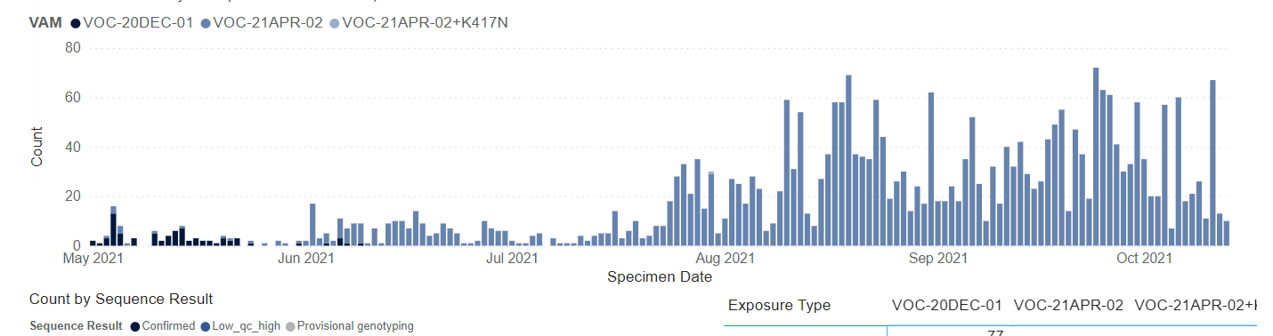
Variants of concern: confirmed cases of the Delta variant in Herefordshire
A Covid-19 variant is classed as a variant of concern (VOC) if it is associated with one or more of the following:
  An increase in transmissibility or other detrimental change in epidemiology
  An increase in the severity of the infection
  Escape from immunity derived from natural infection
  A decrease in effectiveness of vaccinations or clinical treatment
The presence of an ‘S’ gene positive result is indicative of a variant of concern, currently most likely to be VOC-21APR-02 (the Delta variant).
Since the 10th of June, almost all genotyping/sequencing results have indicated the Delta variant.
A single provisional genotyping result indicated a potential Delta variant with the K417N mutation in a Herefordshire resident who was tested on the 30th of June 2021. Enhanced contact tracing has been undertaken, with testing of close contacts arranged as advised by PHE.
! Need to know !
The most accurate way to identify a Covid-19 variant of concern is via the full sequencing of test specimens, but this process can take longer than other methods of identification, so the presence of an ‘S’ gene positive result is used as an indication.
*Not all samples are processed in laboratories which have the capability to run assays which are able to detect the the S gene (TaqPath lab) – results from labs which do perform the assay may be used as a proxy for the frequency of VOC overall.
Where can I find out more? PHE provide regularly updated information concerning the Delta variant and other new variants under investigation in Variants of Concern Briefing notes

Slide 13
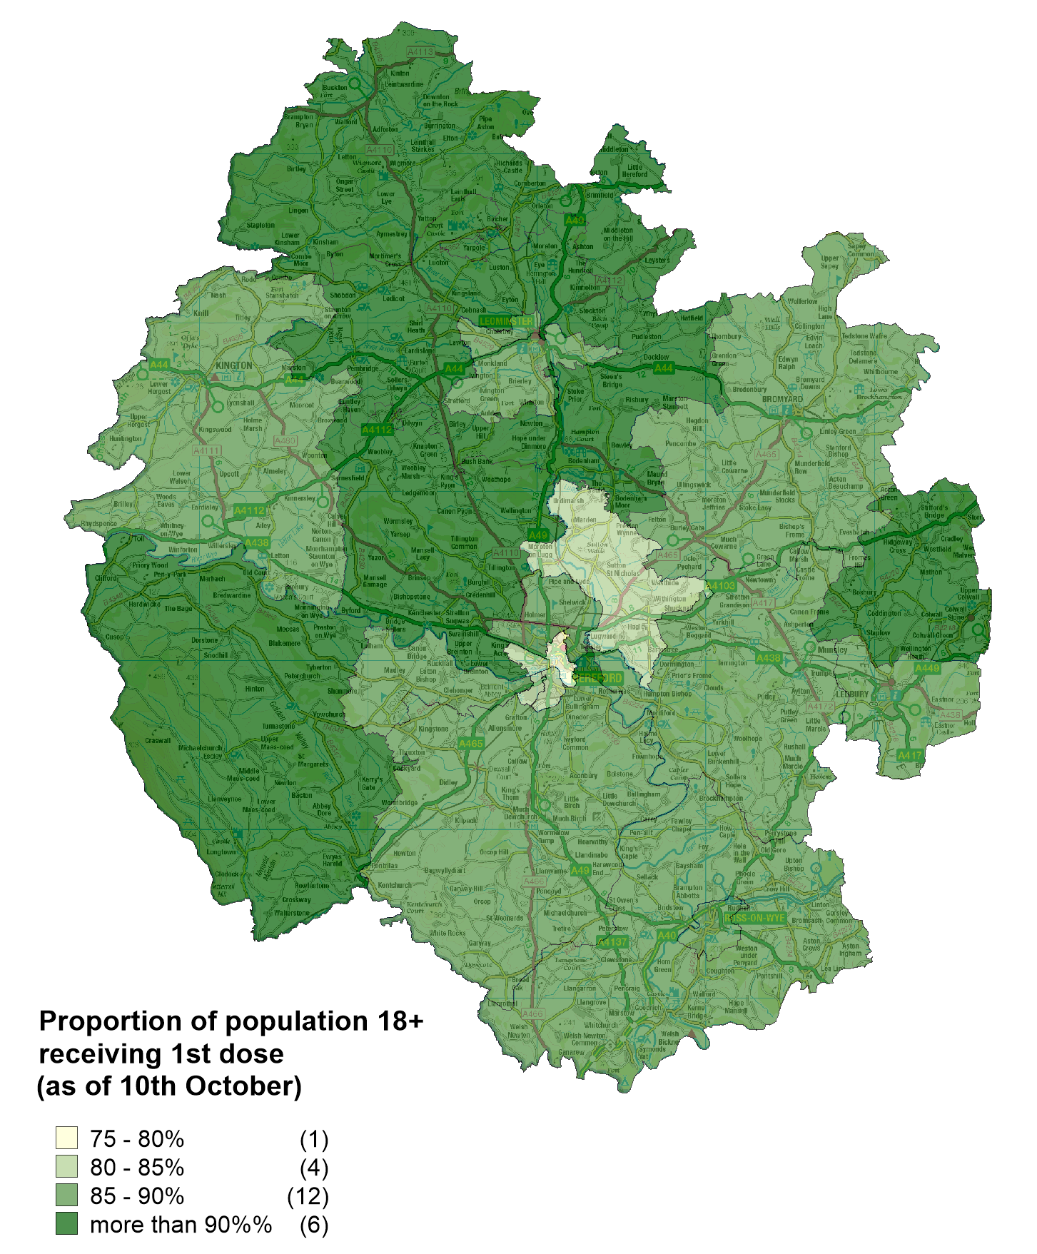
Vaccinations in Herefordshire: 1st dose
  NHS data indicates that as of 10 October 143,172 Herefordshire GP patients (aged 18+) had received their first dose: 88% of eligible residents. A further 3,635 under 18s had received their first dose
  The proportion of the community dwelling population vaccinated by MSOA ranges from 79% (‘Hereford Central’) to 93% (‘Wigmore, Orleton and Brimfield’).
  The four lowest figures (all under 84%) were recorded in Hereford
  Six (same as last week) MSOAs reported figures of over 90%
Note: Differences in the proportion of the population vaccinated by MSOA will, in part, reflect the differing age profiles between areas because of the way the vaccine programme has been prioritised. The complexities of the data mean that it currently isn’t possible to account for this in reporting.
Vaccination rates for MSOAs bordering Wales are likely to be underreported as Herefordshire residents who receive vaccines in Wales and are not included in the Herefordshire data. This may partly explain the geographical patterns seen here.
! Be aware !
Some readers may have access to other sources of data on vaccinations. Numbers and percentages may vary due to:
  Date: the published NHS data lags behind unpublished data intended for other intelligence purposes
  Population base: the figure here is the percentage of Herefordshire residents registered with an English GP practice, whilst others will be a proportion of the resident population
  Age/eligibility group: reporting groups can change
Where can I find out more? The numbers of COVID-19 vaccinations are published weekly (Thursdays) by the NHS: www.england.nhs.uk/statistics/statistical-work-areas/covid-19-vaccinations/

Slide 14
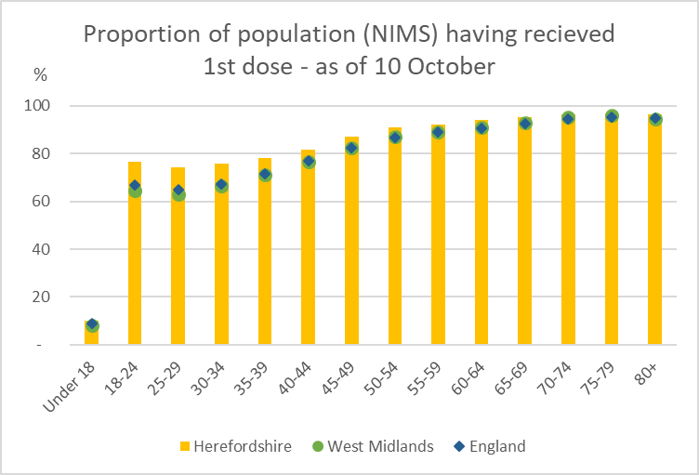
Vaccination: Uptake by age group – 1st dose
Uptake in those age between 18 and 54 is higher in Herefordshire compared to England and the West Midlands (particularly in the younger cohorts) - in older age groups the local figures are generally in line with those seen nationally and regionally.
As numbers are still low it is not possible to discern any differences between local uptake in those aged under 18 and rates seen across the country as a whole.
Where can I find out more? The numbers of COVID-19 vaccinations are published weekly (Thursdays) by the NHS: www.england.nhs.uk/statistics/statistical-work-areas/covid-19-vaccinations/

Slide 15
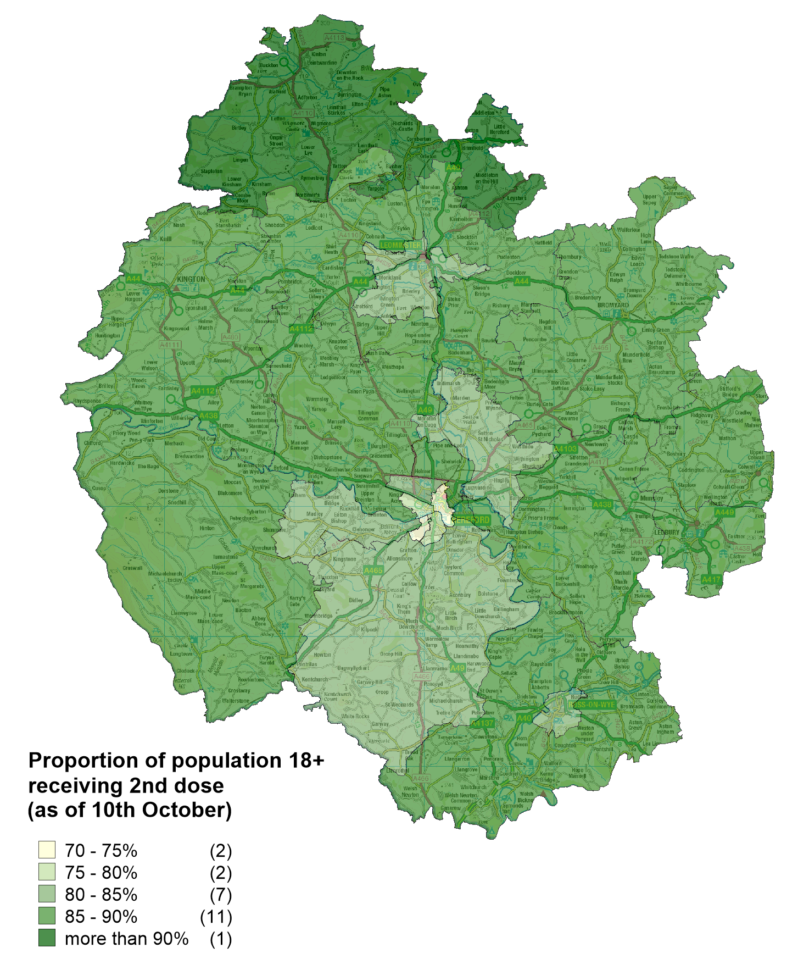
Vaccinations in Herefordshire: 2nd dose
  NHS data indicates that as of 10 October 137,055 Herefordshire GP patients (aged 18+) had received their second dose: 84% of eligible patients.
  The proportion of the community dwelling population vaccinated by MSOA ranges from 74% (‘Hereford Central’) to 90% (‘Wigmore, Orleton and Brimfield’).
  Two (same as last week) MSOAs report second dose uptake of under 75% - these correspond to two of the four Hereford MSOAs which report the lowest figure for uptake of the first dose.
Note: Differences in the proportion of the population vaccinated by MSOA will, in part, reflect the differing age profiles between areas because of the way the vaccine programme has been prioritised. The complexities of the data mean that it currently isn’t possible to account for this in reporting.
Vaccination rates for MSOAs bordering Wales are likely to be underreported as Herefordshire residents who receive vaccines in Wales and are not included in the Herefordshire data. This may partly explain the geographical patterns seen here.
! Be aware !
Some readers may have access to other sources of data on vaccinations. Numbers and percentages may vary due to:
  Date: the published NHS data lags behind unpublished data intended for other intelligence purposes
  Population base: the figure here is the percentage of Herefordshire residents registered with an English GP practice, whilst others will be a proportion of the resident population
  Age/eligibility group: reporting groups can change
Where can I find out more? The numbers of COVID-19 vaccinations are published weekly (Thursdays) by the NHS: www.england.nhs.uk/statistics/statistical-work-areas/covid-19-vaccinations/

Slide 16
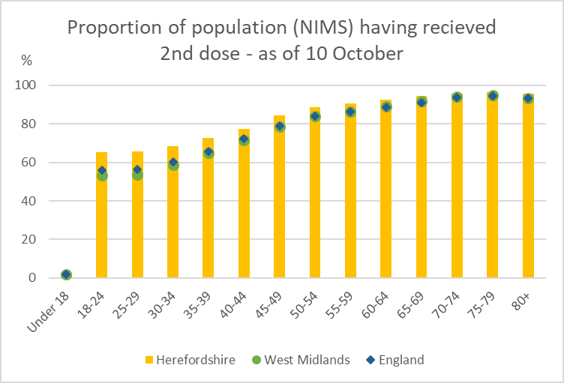
Vaccination: Uptake by age group – 2nd dose
Uptake of the second dose in those age groups under 65 is marginally higher than levels seen across England and the West Midlands.
In older age groups local uptake is the same as seen nationally and regionally
Where can I find out more? The numbers of COVID-19 vaccinations are published weekly (Thursdays) by the NHS: www.england.nhs.uk/statistics/statistical-work-areas/covid-19-vaccinations/

Slide 17
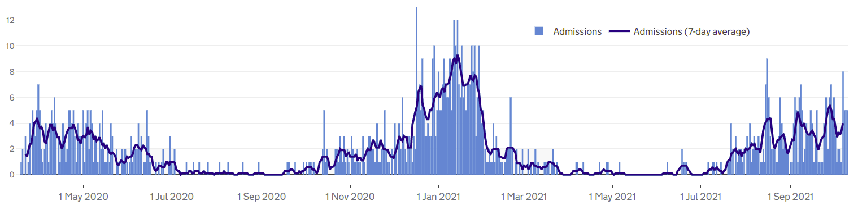
Patients with Covid-19 in Herefordshire hospitals
The number of Covid-19 patients admitted to Wye Valley Trust hospitals has increased since mid-summer - in July 26 were admitted while during August there were 82 and in September 107; as of 10th October there have been 38 admitted during the month.
As of 11 October there was one patient on mechanical ventilation.
Local data indicates that during the pandemic those aged 65+ have accounted for 79% Covid-19 inpatients, although the proportions have changed over the pandemic.
  April and July 2020 (when there were a total of 129 inpatients) all inpatients were aged 65+
  October 2020 and March 2021 (664 inpatients) 80% were 65+, 19% were 18-64 and less than 1% were under 18
  Between April and July (22 inpatients) 16% were 65+ and 72% aged 18-64
  Since the beginning of August (137 inpatients) 62% were 65+, 33% were 18-64 5% were under 18
Where can I find out more? The numbers of COVID-19 patients in hospital by acute trust are updated daily by PHE at https://coronavirus.data.gov.uk/, with an 11 day lag.

Slide 18
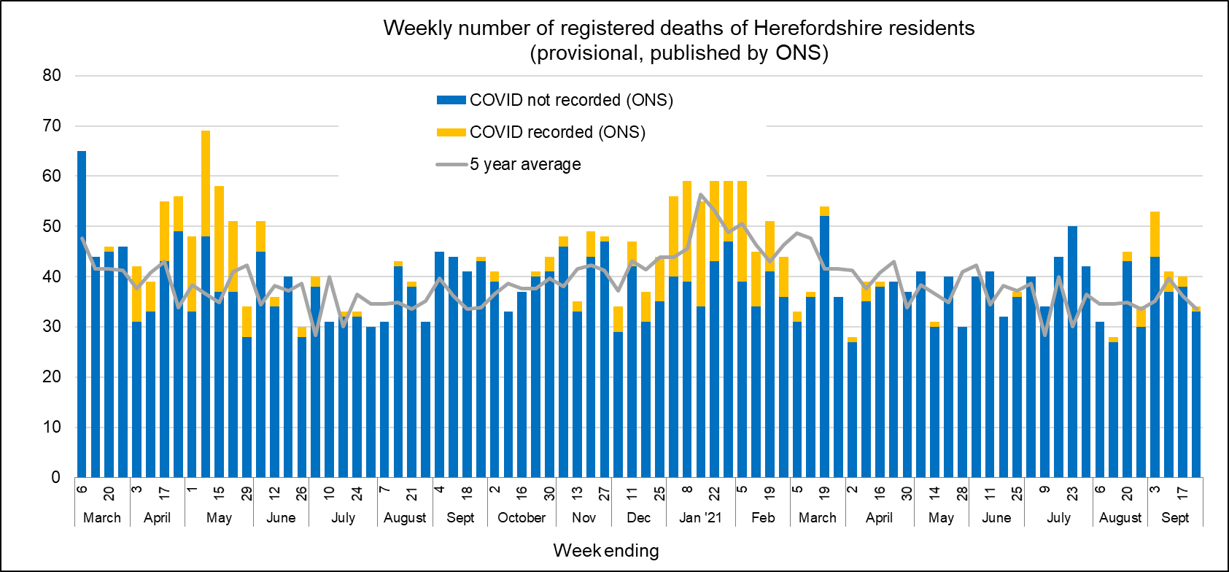
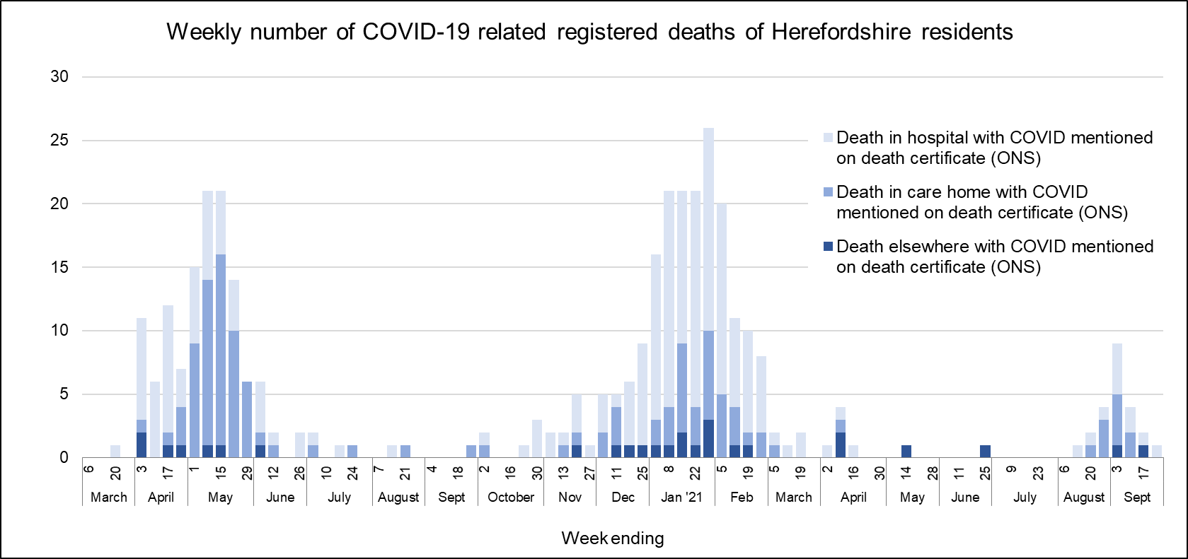
Profile of deaths: published data
Five deaths related to Covid-19 have been reported in ONS’ published data since the last update – occurring during the week ending 8 October September
  The official total amongst Herefordshire residents to 366 throughout the whole pandemic
  17 were recorded in September compared to 13 in August and two between May and July.
Covid related deaths in Herefordshire remain lower than nationally: crude death rate is currently 190 per 100,000 compared to England’s 250.
Public Health England also publish numbers of people who have died within 28 days of a first positive test:
  307 in total (registered by 19 October), a figure lower than that published by ONS as the latter does not require a positive test for COVID-19 to be mentioned on a death certificate.
Research shows that the risk of death involving COVID-19 is lower for people who have received two vaccinations compared to one or no vaccination
  between 2 January and 2 July 2021 of 51,300 deaths involving Covid 1.25% were in people who were fully vaccinated, which includes people who had been infected before they were vaccinated¹.
Where can I find out more? ONS publish provisional data on weekly numbers of registered deaths by usual residence for local authorities every Tuesday, with an 11 day lag. Deaths recorded as COVID-19 by ONS include deaths where possible or confirmed COVID-19 is mentioned as any cause of death. They are therefore higher than the PHE figures, which only include those who have died following a positive test.
1 Deaths involving COVID-19 by vaccination status in England: deaths occurring between 2 January and 2 July 2021

Slide 19
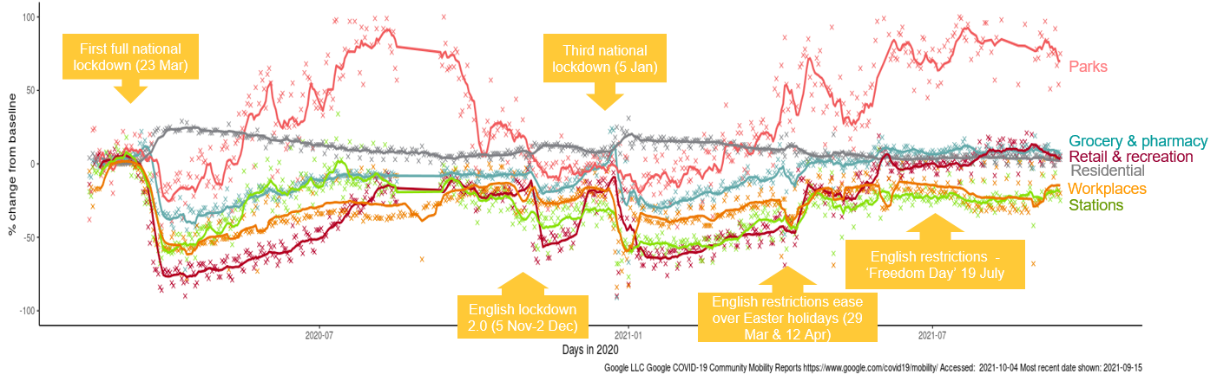
Effects of lockdown on population movement
This chart shows average visits to different categories of places, using location data of Google users, compared to the beginning of 2020.
The pattern is similar for all three lockdowns with and initial drop in visits to most categories (except residential) followed by a gradual increase (except parks, which has a seasonal pattern). Following the easing of restrictions over the Easter holiday increases were again been observed in most categories.
Changes in mobility since the beginning of September have resulted in a slight increase in mobility to ‘workplaces’ due to people returning to work after the summer holidays – conversely, the opposite is true for ‘retail and recreation’, although for the same reason.
Mobility to transit stations and workplaces remain below pre-pandemic levels; -23% and -20% respectively.
Where can I find out more? This chart is updated daily on the Data Orchard website, using data published by Google. The baseline is the median value, for the corresponding day of the week, during the five weeks 3 Jan–6 Feb 2020. Note that the data is based on movements of those who have opted to turn on location history in their Google accounts on their mobile devices.

Slide 20
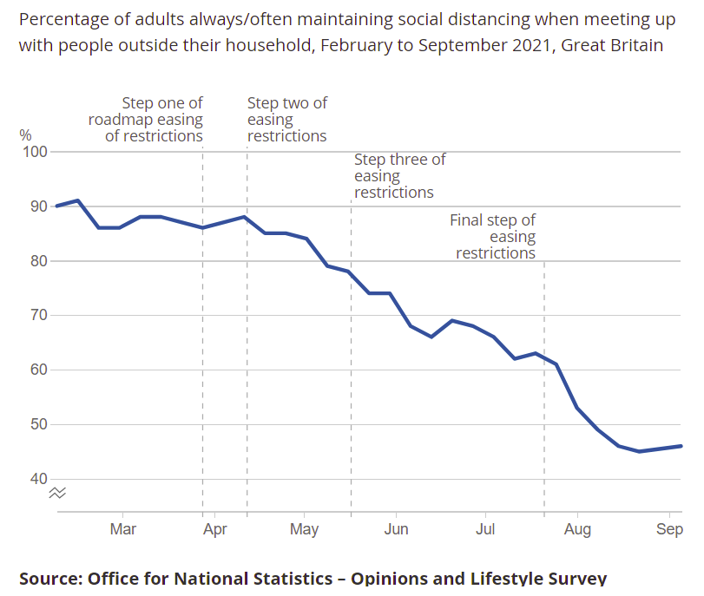
Compliance with COVID-19 guidance – social distancing and mask wearing
Since 19 July, there has been no legal requirement to either socially distance or wear a face covering in England – although many places still encourage both.
Latest data from ONS (25 August to 5 September) indicates that the perceived benefits of wearing face masks and social distancing have remained high, with 87% stating they felt these measures were important, or very important for slowing the spread of the virus.
The graph shows the percentage of adults across England reporting always or often maintaining social distancing when meeting people outside their household:
  Prior to the initial easing of restrictions in March over 85% said they always or often maintained social distancing, a figure which did not begin to fall until after step two of the easing in April.
  However, since April it has dropped consistently – levelling off at around 45% by late August.
The percentage of people who reported having worn a mask in the week to 5 September remained high at 89%.
  Most people reported that they had worn their masks whilst shopping (89%). People were less likely to wear masks when travelling on public transport (34%), or at work (26%).
  Reported mask wearing was lower among those aged 16-29 (85%). This is supported by the YouGov data from July which suggested that whilst other age groups reported continued mask use, it “slumped” amongst 18-24s.
Find out more: Information on the impacts of Covid on various aspects of lifestyle can be found on the ONS website: Coronavirus (COVID-19) latest insights: Lifestyle

Slide 21
Other resources
Wider vulnerabilities
  The draft 2020 Director of Public Health report: Impacts of COVID-19 is available on the Council’s website (final version due for publication early May)
  April’s monthly bulletin of the economic impacts of coronavirus is available on the Understanding Herefordshire website
New research and open access analytical tools are continually emerging. As well as the sources linked to throughout these slides, you may be interested in:
  The Office for National Statistics' daily coronavirus roundup: the latest research into the effects on the economy and society
  The Health Foundation - COVID-19 policy tracker: an interactive timeline of key events and government policy announcements related to coronavirus
  An LG Inform dashboard tailored to Herefordshire & Worcestershire, showing daily updates in cases and comparisons with other areas.
  A Herefordshire Council dashboard provides up to date information on cases in the county and provides links to other useful information.
  A summary of Google mobility data for Herefordshire provided by Data Orchard shows average visits to different categories of places over the pandemic.

