Slide 1

COVID-19 in Herefordshire
Intelligence summary
Public Health & Intelligence Unit
8th September 2021

Slide 2
Contents
Key messages (slide 3)
COVID-19 testing (slides 4-5)
COVID-19 cases (slides 6-8), including demographics (slide 9) and local areas (slides 10-11)
Variants of concern (slide 12)
Vaccinations: uptake (slide 13-16)
Patients admitted to hospital (slide 17)
Profile of deaths: published data (slide 18)
Effects of lockdown on population movement (slide 19)
Other resources (slide 21)
If you need help to understand this document, or would like it in another format or language, please contact us on 01432 261944 or e-mail researchteam@herefordshire.gov.uk

Slide 3
Covid-19 in Herefordshire: key messages, 8 September
  As of 16 August, close contacts are no longer required to self-isolate if they are under 18, or adults who have been double jabbed for two weeks or more. However, close contacts are being advised to limit contact with the clinically extremely vulnerable, take part in regular asymptomatic testing, wear a face covering in enclosed spaces, and practice social distancing for the period of time they would previously have been required to self-isolate. There are additional return to work requirements for close contacts working in health and social care settings. All confirmed cases are still legally required to self-isolate.
  Herefordshire’s cases have remained steady over the last fortnight (around 580 per week) having fallen from a peak (730) seen in mid August. The local seven day case rate is high (303 per 100,000) with rates at levels seen in January. Rates are marginally lower than those for England and the West Midlands.
  Rates of infection are highest in younger age groups where the majority are not fully vaccinated – this is particularly evident in those aged 11 to 21. Rates have increased in those aged 60+, the majority of cases are associated with community transmission rather than care home situations. Generally, cases are spread throughout the county rather than being centered on a few ‘hotspots’.
  Currently, the majority of situations are in workplace settings where small numbers of cases are being reported. However, in recent weeks there has been an increase in the number of cases linked to adult social care settings. A similar patterns is seen across the country. Restaurants, pubs, clubs, bars, and festivals are commonly being cited by cases as settings of suspected exposure. ​
  The number of hospital admissions is rising, during August there have been 80 Covid-19 related hospital admissions which represents almost 60% of those admitted since February. Overall total deaths remain close to average for the time of year, although Covid-related deaths are increasing with six registered during August compared to two between May and July.
  87% of all Herefordshire GP registered patients (aged 18+) have received a first dose of the COVID-19 vaccine, and 80% a second dose. Rates for most age groups are in line with regional and national averages. All eligible individuals are encouraged to take up their vaccine, including their second dose as this doubles the resistance against developing symptomatic Covid-19 from an average of 35% effectiveness after the first dose to 80% after the second.

Slide 4
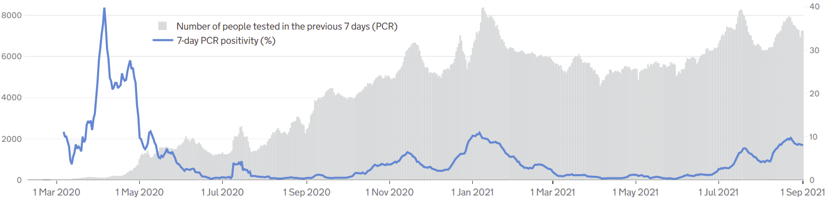

Symptomatic COVID-19 testing: PCR tests and positivity
The graph gives a complete picture of local PCR testing for Herefordshire residents, regardless of where the test was carried out.
On average 7,260 people were tested daily in the seven days to 01 September, although testing activity has fallen since a peak of almost 8,000 seen in mid August. The local test rate is above the average for England, but below that for the West Midlands.
Pillar 2 test positivity has decreased slightly, but remains moderate/high at 10.4%.
The line shows the positivity rate from PCR tests (i.e. the % of people whose test is positive). The rate has fallen in the last 10 days and as of 1 September was 8.0%. This latest figure is the same as that seen across England but lower than that for the West Midlands (9.8%).
! Need to know !
PCR data is for rolling 7 day periods, not daily / weekly counts
Counts individuals tested in each 7-day period, not the number of tests carried out. A person is only counted once.
Wholly residence based, whereas previous data included a mixture of Herefordshire residents & also people working in the county.
Where can I find out more? Local level testing data is now updated daily on the government’s Covid-19 dashboard. Details of the roll-out of lateral flow tests to local authorities was published by the government on 9 November, and a guide for local delivery of community testing was published on 11 January.

Slide 5
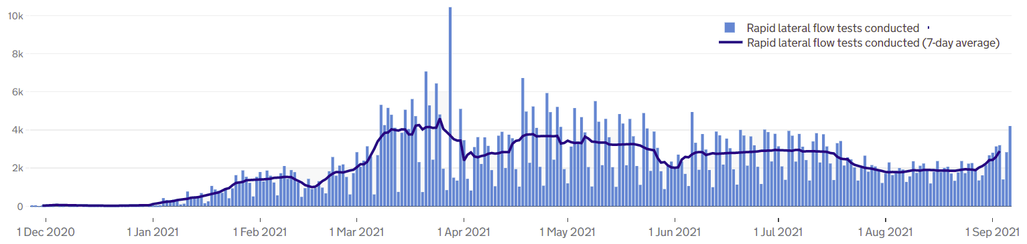
COVID-19 testing: Lateral Flow Device (LFD) tests
! Be aware !
The requirement for a confirmatory PCR test following a positive LFD result was re-introduced on 29 March. It had been suspended for LFD testing on 27 Jan due to the prevalence of the virus.
Unlike the published PCR test data, LFD tests are counted by the number of tests which returned either a positive, negative or void result – which can mean that a person is counted more than once. Data is published as a daily count and 7-day average.
Lateral flow device (LFD) tests are swab tests that give results in less than an hour, without needing to go to a lab. They have become one of the main approaches nationally to controlling the spread, and since 9 April, everyone in England has been eligible for twice-weekly testing.
Over 605,000 LFD tests had been recorded in Herefordshire by 06 September with a daily average of 2,890 undertaken in the seven days to 03 September.
Generally, the number of tests undertaken has increased since late August as ta result of mass testing in educational settings as the autumn term commences.
The Covid Symptom Study reported that the most common symptoms are now headache, runny nose and fever – only one of which would is included in the classic COVID symptoms for a PCR test.
Notes
LFD tests for NHS staff using a self-reporting tool have been included from 17 December 2020. Some negative care home tests may not be included for the first 2 weeks of January
All LFD tests are counted under Pillar 2 (Gov’t testing programme)
Where can I find out more? Local level testing data is updated daily on the government’s Covid-19 dashboard. Details of the roll-out of lateral flow tests to local authorities was published by the government on 9 November.

Slide 6
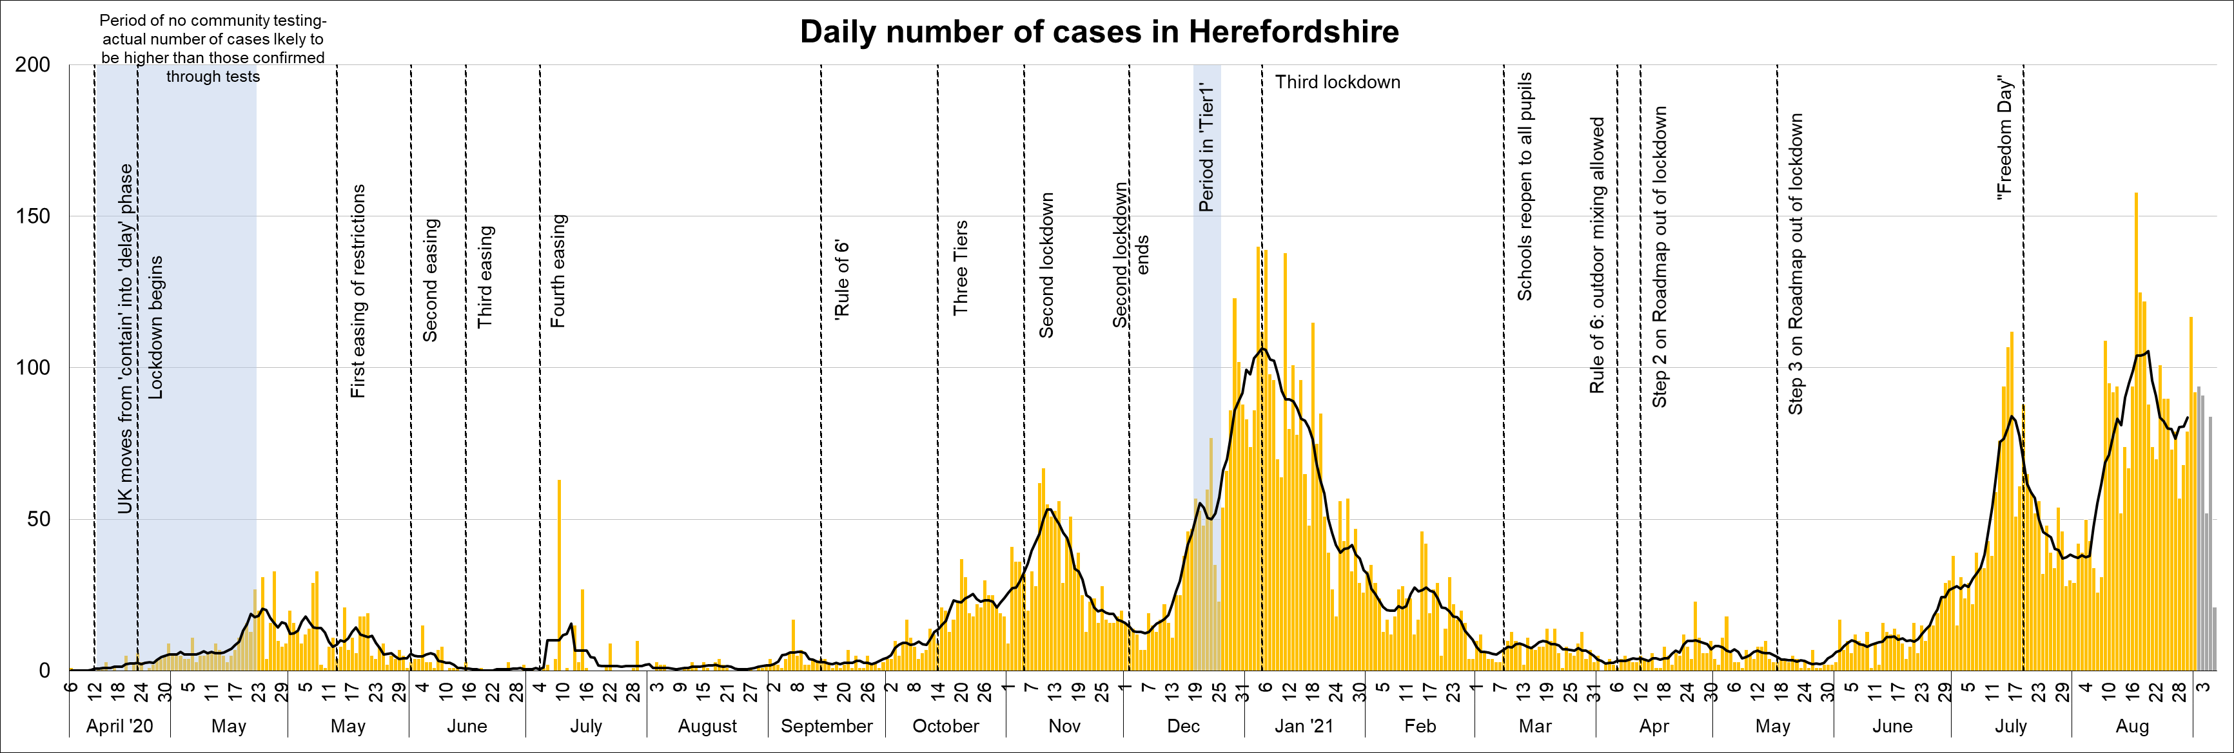
Lab-confirmed COVID-19 cases in Herefordshire
Lab-confirmed cases are the official count of people who live in Herefordshire and have tested positive for COVID-19. In the first few months of the pandemic, numbers of confirmed cases were dependent on testing policy so are not comparable with later waves.
There were 586 new cases confirmed in the 7 days to 02 September – a similar number to that seen in the previous 7 days (583). The latest weekly number of cases is the highest figure since mid January. (Note that reporting lags mean daily numbers can change, and the grey bars for the last 5 days may increase)
The line on the chart shows the average daily number of new cases. This figure has fallen since mid August, although an increasing trend is evident for the last few days which is likely to be related to increased testing associated with schools and colleges returning for the Autumn term.
Where can I find out more? Confirmed cases are updated daily by PHE at https://coronavirus.data.gov.uk/

Slide 7
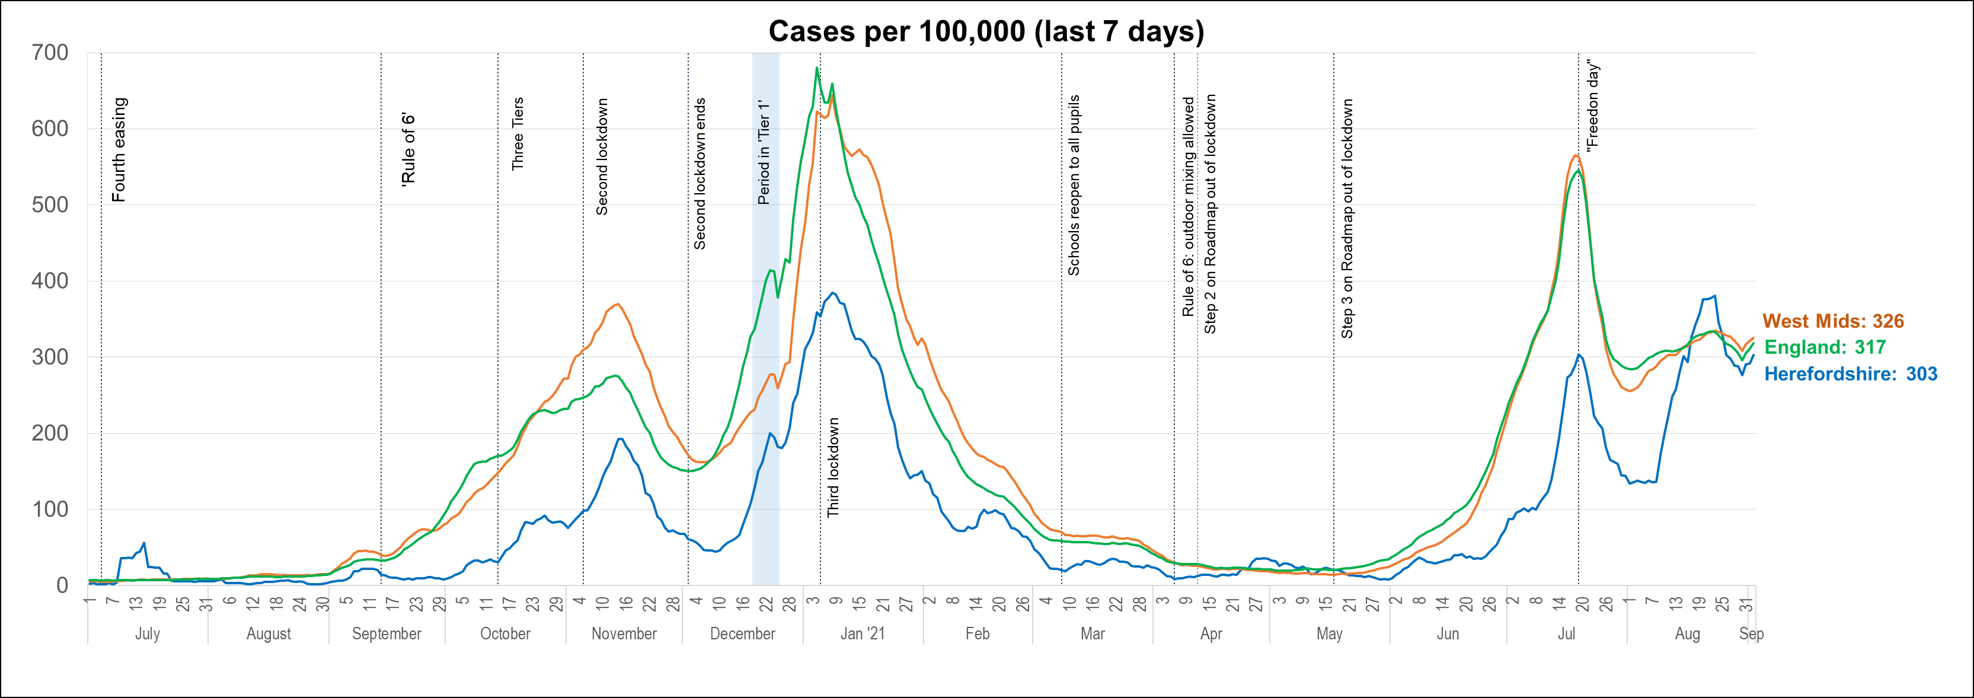
Lab-confirmed cases: comparisons
! Be aware !
Rates per 100,000 resident population give a fairer comparison of the number of cases in each area but they do not take account of the different rates of testing or differences in the age and sex of the local populations.
With one of the smallest ‘upper tier’ local authority populations (193,200), Herefordshire’s rate can be dramatically affected by relatively small changes in numbers of cases. An average of 28 cases a day in a week would result in a rate of 100 per 100,000.
These are not rates of infection amongst the population: they can only reflect those who have been tested, so numbers are highly dependent on the availability of tests.
The chart shows the recent trend in cases per 100,000 resident population for 7-day periods (the latest one ending 5 days ago to allow for lags in the results of tests). This rate is commonly quoted in national reporting.
As of 02 September the Herefordshire rate was 303 per 100,000 – while this figure is lower than that reported in mid August it remains more than twice the figure seen at the beginning of that month.
The latest Herefordshire figure is marginally lower than those recorded both nationally and regionally having been higher than both rates for several days in late August.
Where can I find out more? The graph is based on daily updated PHE data on lab-confirmed cases. Further comparisons are included in the LG Inform dashboard. You can also view the local 7-day case rates and numbers on the Herefordshire Council website.

Slide 8
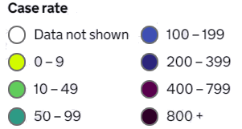
Lab-confirmed cases: comparison with neighbouring authorities
Latest published comparisons, for the week ending 2 September*, show:
Herefordshire’s has remained the same
At 303 per 100,000 the local figure is slightly lower than one third of that for England as a whole (317 per 100,000).
Rates in most neighbouring authorities have risen in the last week and remain broadly similar to that seen locally.
* Note that he slight lag in this data reflects the latest date for which complete data is available from test results
Time period: (27/8/21 to 2/9/21)
Where can I find out more? Maps comparing 7 day numbers of cases and rates per 100,000 people are updated daily by PHE at https://coronavirus.data.gov.uk/

Slide 9
Demographics of COVID-19: rates per 100,000 by age over time
This “heat map” shows how the 7-day rates per 100,000 for specific age groups have changed each week from March to the beginning of September. Each row represents an age group. As rates increase, the chart colours become darker.
  It is important to note that rates per 100,000 can be significantly affected by relatively small numbers of cases in a population as small as Herefordshire, even more so when broken down into age-groups. The absolute number of cases are shown as context. This is especially true when there are single-figure case numbers within groups.
The highest rates persist in younger age groups, although due to the time period covered, only a small proportion are related to increasing levels of LFD testing in educational settings.
Rates have increased in those aged 60+, a pattern driven primarily by the 70-79 cohort, although the majority of these cases have been in the community, rather than in care homes.

Slide 10

Lab-confirmed cases around the county: this week
The map shows the latest 7-day rates of new cases per 100,000 population, as published by Public Health England: the darker the shading, the higher the rate (unshaded areas have had fewer than 3 cases in the last 7 days).
In the week to 02 September the rates decreased in 12 of Herefordshire’s 23 MSOAs with increases seen in 10 (no change in one). Ten MSOAs have rates higher than that for England (377 per 100,000).
Three MSOAs had rates above 400 per 100,000:
  ‘Hereford East’ – 467 per 100,000 (28 cases)
  ‘Hereford Central’ – 457 per 100,000 (46 cases)
  ‘Ross-on-Wye’ – 424 per 100,000 (48 cases)
! Need to know !
It’s important to note that these rates are very sensitive to small changes for small areas like MSOAs. For instance, an increase of 1 case from 9 to 10 cases in an area of 10,000 people (about the size of Ledbury), would increase the rate from 90 to 100 per 100,000.
Note that the slight time-lag in this data reflects that test results are incomplete for the most recent few days
^ Middle super output areas: geographies designed by the Office for National Statistics in 2004 to have broadly similar population sizes – which means that they tend to be geographically bigger in rural Herefordshire.
Time period: (278/21 to 2/9/21)
Where can I find out more? This map of weekly confirmed cases by middle super output area (MSOA) in England are included in the PHE dashboard, which is updated daily.

Slide 11
Lab-confirmed cases around the county: trends in rates over time
Whilst the previous slide shows cases in the last 7 days, this “heat map” shows how the 7-day rates per 100,000 have changed in each area of Herefordshire from late March. The areas (MSOAs*) are ranked by the rate seen in the week ending 03 September.
  It’s important to note that rates per 100,000 can be significantly affected by relatively small numbers of cases in areas as small as MSOAs, especially when there are single-figure case numbers. The absolute number of cases are shown as context.
All but four 23 Herefordshire MSOAs have had 20 or more cases in the last week.
The high rates in ‘Hereford East’ and ‘Hereford Central’ are associated with community transmission and household clusters, while the high rate in ‘Ross-on-Wye’ is driven by a situation in a care home setting.
* Middle super output areas: geographies designed by ONS to have broadly similar population sizes

Slide 12
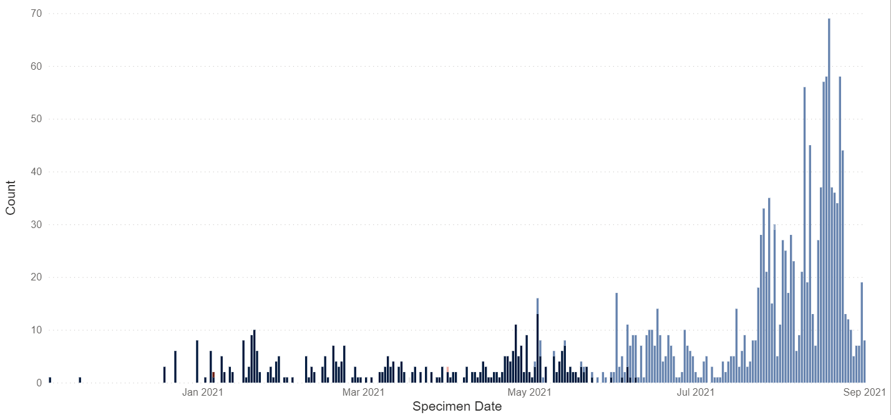
Variants of concern: confirmed cases of the Delta variant in Herefordshire
A Covid-19 variant is classed as a variant of concern (VOC) if it is associated with one or more of the following:
  An increase in transmissibility or other detrimental change in epidemiology
  An increase in the severity of the infection
  Escape from immunity derived from natural infection
  A decrease in effectiveness of vaccinations or clinical treatment
The presence of an ‘S’ gene positive result is indicative of a variant of concern, currently most likely to be VOC-21APR-02 (the Delta variant).
Since the 10th of June, almost all genotyping/sequencing results have indicated the Delta variant.
A single provisional genotyping result indicated a potential Delta variant with the K417N mutation in a Herefordshire resident who was tested on the 30th of June 2021. Enhanced contact tracing has been undertaken, with testing of close contacts arranged as advised by PHE.
! Need to know !
The most accurate way to identify a Covid-19 variant of concern is via the full sequencing of test specimens, but this process can take longer than other methods of identification, so the presence of an ‘S’ gene positive result is used as an indication.
*Not all samples are processed in laboratories which have the capability to run assays which are able to detect the the S gene (TaqPath lab) – results from labs which do perform the assay may be used as a proxy for the frequency of VOC overall.
Where can I find out more? PHE provide regularly updated information concerning the Delta variant and other new variants under investigation in Variants of Concern Briefing notes

Slide 13
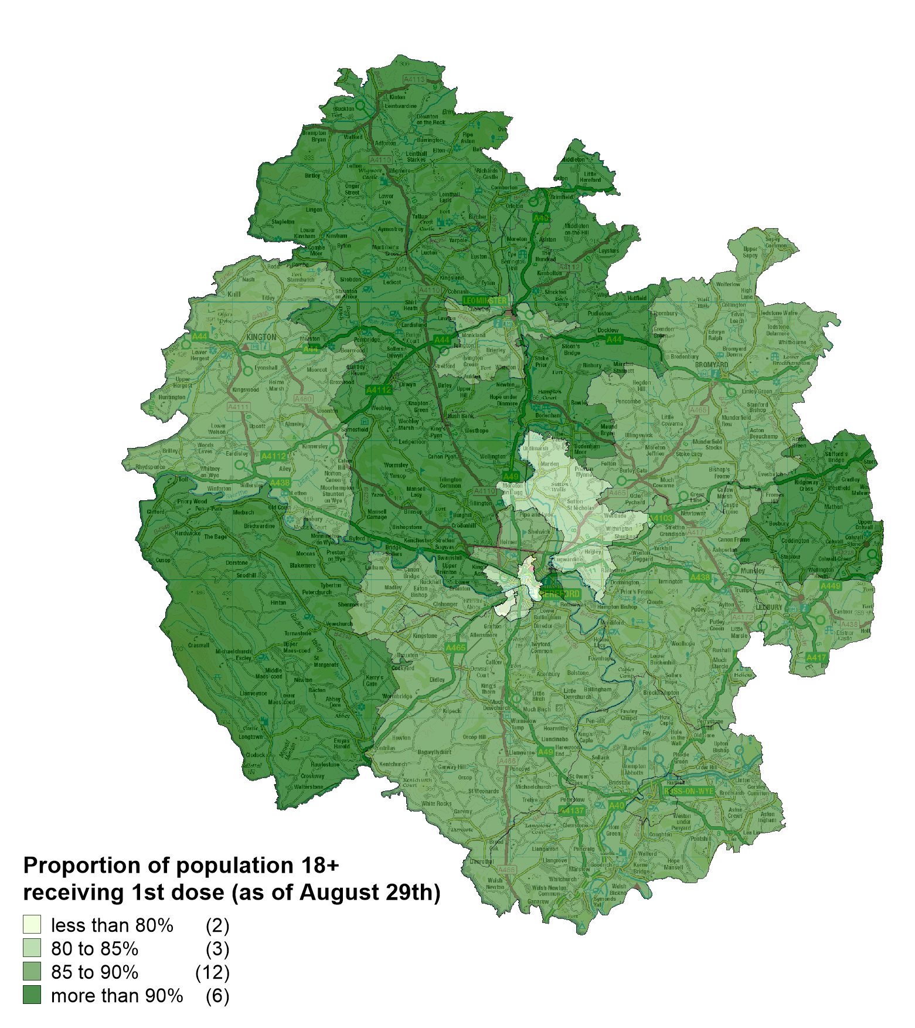
Vaccinations in Herefordshire: 1st dose
  NHS data indicates that as of 29 August 142,413 Herefordshire GP patients (aged 18+) had received their first dose: 87% of eligible residents. A further 2,702 under 18s had received their first dose
  The proportion of the community dwelling population vaccinated by MSOA ranges from 78% (‘Hereford Central’) to 93% (‘Wigmore, Orleton and Brimfield’).
  The four lowest figures (all under 84%) were recorded in Hereford
  Six MSOAs reported figures of over 90%
Note: Differences in the proportion of the population vaccinated by MSOA will, in part, reflect the differing age profiles between areas because of the way the vaccine programme has been prioritised. The complexities of the data mean that it currently isn’t possible to account for this in reporting.
Vaccination rates for MSOAs bordering Wales are likely to be underreported as Herefordshire residents who receive vaccines in Wales and are not included in the Herefordshire data. This may partly explain the geographical patterns seen here.
! Be aware !
Some readers may have access to other sources of data on vaccinations. Numbers and percentages may vary due to:
  Date: the published NHS data lags behind unpublished data intended for other intelligence purposes
  Population base: the figure here is the percentage of Herefordshire residents registered with an English GP practice, whilst others will be a proportion of the resident population
  Age/eligibility group: reporting groups can change
Where can I find out more? The numbers of COVID-19 vaccinations are published weekly (Thursdays) by the NHS: www.england.nhs.uk/statistics/statistical-work-areas/covid-19-vaccinations/

Slide 14
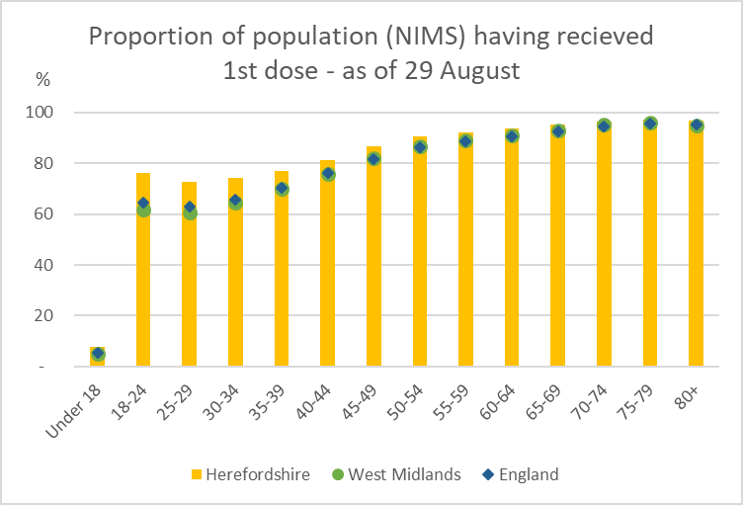
Vaccination: Uptake by age group – 1st dose
Uptake in those age between 18 and 54 is higher in Herefordshire compared to England and the West Midlands (particularly in the younger cohorts) - in older age groups the local figures are generally in line with those seen nationally and regionally.
As numbers are still low it is not possible to discern any differences between local uptake in those aged under 18 and rates seen across the country as a whole.
Where can I find out more? The numbers of COVID-19 vaccinations are published weekly (Thursdays) by the NHS: www.england.nhs.uk/statistics/statistical-work-areas/covid-19-vaccinations/

Slide 15
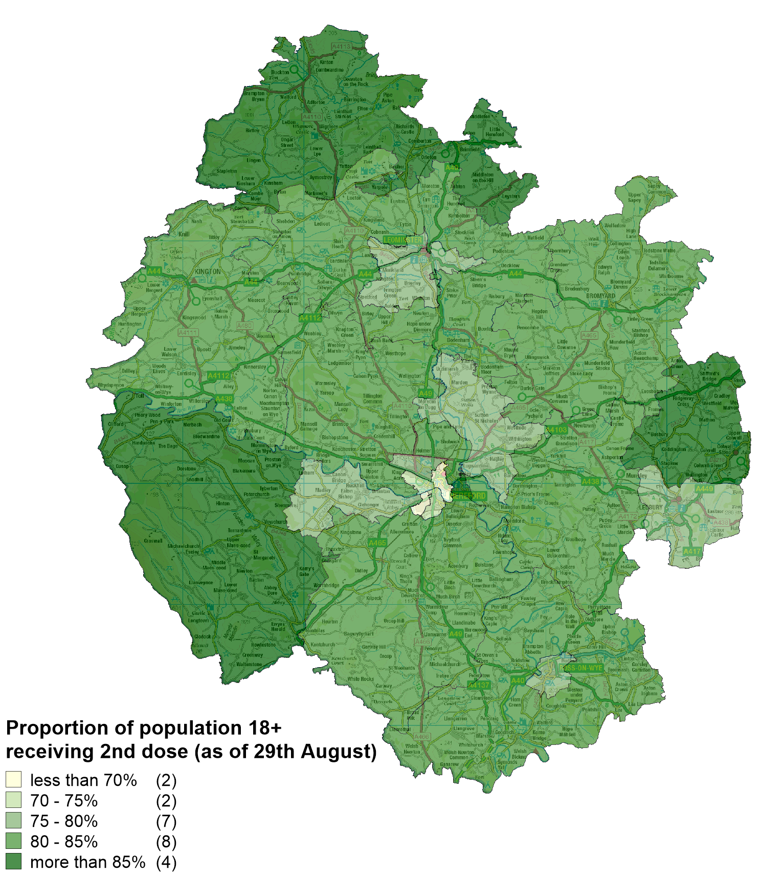
Vaccinations in Herefordshire: 2nd dose
  NHS data indicates that as of 29 August 130,114 Herefordshire GP patients (aged 18+) had received their second dose: 80% of eligible patients.
  The proportion of the community dwelling population vaccinated by MSOA ranges from 68% (‘Hereford Central’) to 87% (‘Wigmore, Orleton and Brimfield’).
  Four MSOAs report second dose uptake of under 75% - these correspond to the same four Hereford MSOAs which report the lowest figure for uptake of the first dose
Note: Differences in the proportion of the population vaccinated by MSOA will, in part, reflect the differing age profiles between areas because of the way the vaccine programme has been prioritised. The complexities of the data mean that it currently isn’t possible to account for this in reporting.
Vaccination rates for MSOAs bordering Wales are likely to be underreported as Herefordshire residents who receive vaccines in Wales and are not included in the Herefordshire data. This may partly explain the geographical patterns seen here.
! Be aware !
Some readers may have access to other sources of data on vaccinations. Numbers and percentages may vary due to:
  Date: the published NHS data lags behind unpublished data intended for other intelligence purposes
  Population base: the figure here is the percentage of Herefordshire residents registered with an English GP practice, whilst others will be a proportion of the resident population
  Age/eligibility group: reporting groups can change
Where can I find out more? The numbers of COVID-19 vaccinations are published weekly (Thursdays) by the NHS: www.england.nhs.uk/statistics/statistical-work-areas/covid-19-vaccinations/

Slide 16
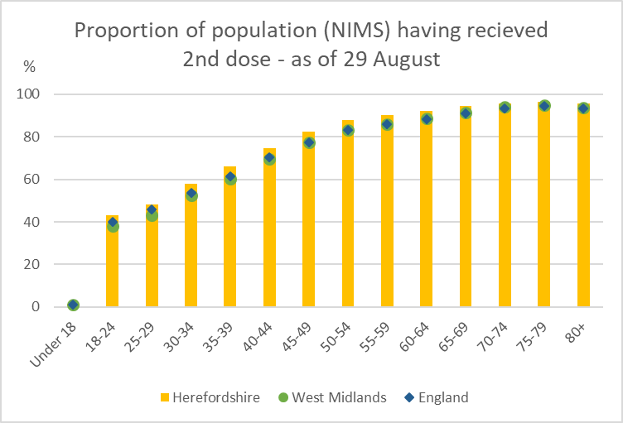
Vaccination: Uptake by age group – 2nd dose
Uptake of the second dose in all age groups in Herefordshire is generally in line with levels seen across England and the West Midlands.
Where can I find out more? The numbers of COVID-19 vaccinations are published weekly (Thursdays) by the NHS: www.england.nhs.uk/statistics/statistical-work-areas/covid-19-vaccinations/

Slide 17
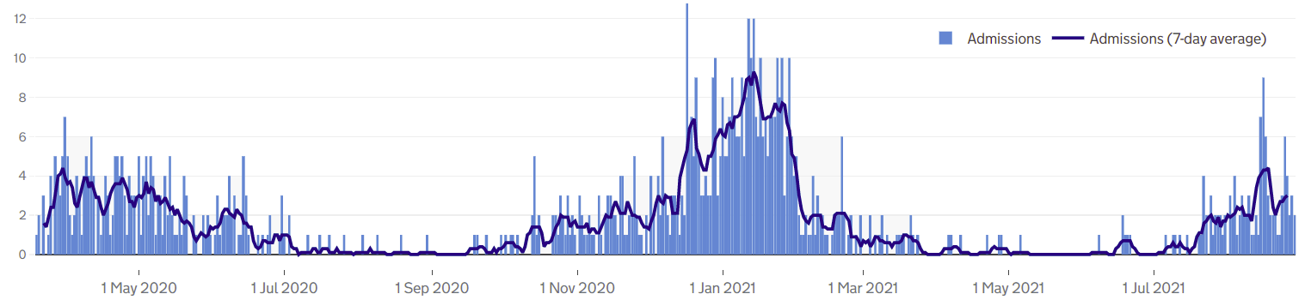
Patients with Covid-19 in Herefordshire hospitals
A single Covid-19 patient was admitted to Wye Valley Trust hospitals in May while a further six were admitted in June. In July 26 were admitted while so far during August (as of 29 August) 80 have been admitted which represents 60% of all patients admitted since the end of February.
As of 31 August there were two patients on mechanical ventilation.
Local data indicates that during the pandemic those aged 65+ have accounted for 79% Covid-19 inpatients, although the proportions have changed over the pandemic.
  April and July 2020 (when there were a total of 129 inpatients) all inpatients were aged 65+
  October 2020 and March 2021 (664 inpatients) 80% were 65+, 19% were 18-64 and less than 1% were under 18
  Between April and July (22 inpatients) 16% were 65+ and 72% aged 18-64
  In the last five weeks (132 inpatients) 68% were 65+, 28% were 18-64 and 4% under 18.
Where can I find out more? The numbers of COVID-19 patients in hospital by acute trust are updated daily by PHE at
https://coronavirus.data.gov.uk/

Slide 18
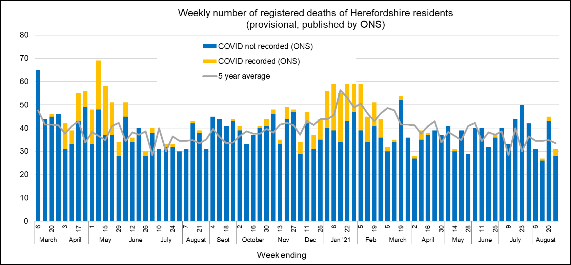
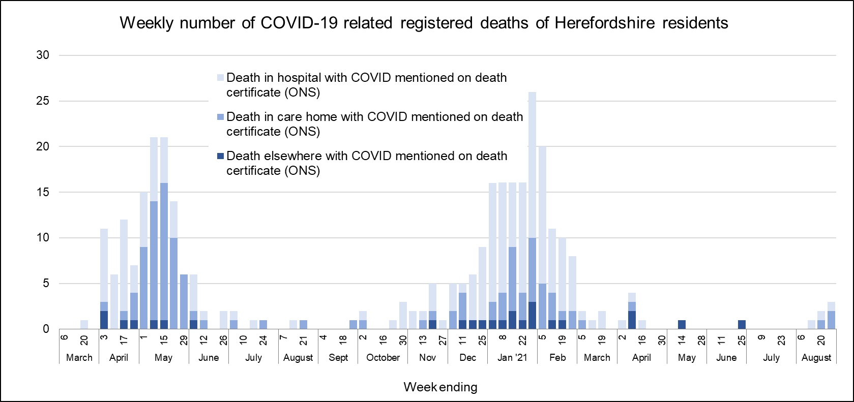
Profile of deaths: published data
Five deaths related to Covid-19 has been reported in ONS’ published data since the last update – occurring during the two weeks ending 27 August
  The official total amongst Herefordshire residents to 345 throughout the whole pandemic
  6 recorded during August compared to two between May and July. (last death recorded 26 August)
Covid related deaths in Herefordshire remain lower than nationally: crude death rate is currently 179 per 100,000 compared to England’s 242.
Public Health England also publish numbers of people who have died within 28 days of a first positive test:
  295 in total (registered by 8 September), a figure lower than that published by ONS as the latter does not require a positive test for COVID-19 to be mentioned on a death certificate.
Where can I find out more? ONS publish provisional data on weekly numbers of registered deaths by usual residence for local authorities every Tuesday, with an 11 day lag. Deaths recorded as COVID-19 by ONS include deaths where possible or confirmed COVID-19 is mentioned as any cause of death. They are therefore higher than the PHE figures, which only include those who have died following a positive test.

Slide 19
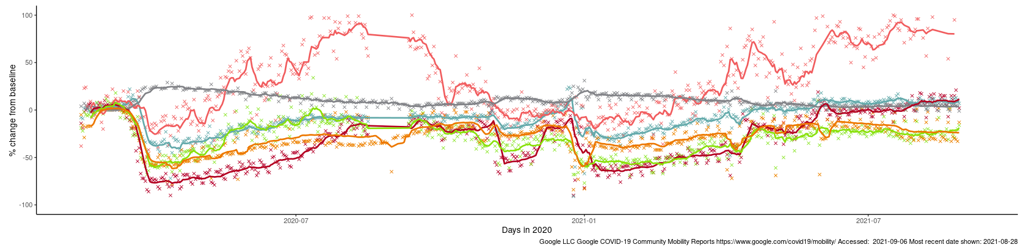
Effects of lockdown on population movement
This chart shows average visits to different categories of places, using location data of Google users, compared to the beginning of 2020.
The pattern is similar for all three lockdowns with and initial drop in visits to most categories (except residential) followed by a gradual increase (except parks, which has a seasonal pattern). Following the easing of restrictions over the Easter holiday increases were again been observed in most categories.
Changes in mobility post Step 4 (19th July) have resulted in a slight decline in mobility to ‘workplaces’ and ‘transit stations’, although this is likely to be related to effects of the holiday season and an increase in mobility to retail and recreation locations. Both sectors are currently 28% below the pre-pandemic level.
However, access to ‘retail and recreation’ has shown a moderate increase since July 19 and is now 11% above the pre-pandemic level.
Changing visits in Herefordshire to…
Third national lockdown (5 Jan)
Parks
First full national lockdown (23 Mar)
Retail & recreation
Residential
Grocery & pharmacy
Stations
Workplaces
English restrictions - ‘Freedom Day’ 19 July
English lockdown 2.0 (5 Nov-2 Dec)
English restrictions ease over Easter holidays (29 Mar & 12 Apr)
Where can I find out more? This chart is updated daily on the Data Orchard website, using data published by Google. The baseline is the median value, for the corresponding day of the week, during the five weeks 3 Jan–6 Feb 2020. Note that the data is based on movements of those who have opted to turn on location history in their Google accounts on their mobile devices.

Slide 20
Other resources
Wider vulnerabilities
  The draft 2020 Director of Public Health report: Impacts of COVID-19 is available on the Council’s website (final version due for publication early May)
  April’s monthly bulletin of the economic impacts of coronavirus is available on the Understanding Herefordshire website
New research and open access analytical tools are continually emerging. As well as the sources linked to throughout these slides, you may be interested in:
  The Office for National Statistics' daily coronavirus roundup: the latest research into the effects on the economy and society
  The Health Foundation - COVID-19 policy tracker: an interactive timeline of key events and government policy announcements related to coronavirus
  An LG Inform dashboard tailored to Herefordshire & Worcestershire, showing daily updates in cases and comparisons with other areas.
  A Herefordshire Council dashboard provides up to date information on cases in the county and provides links to other useful information.
  A summary of Google mobility data for Herefordshire provided by Data Orchard shows average visits to different categories of places over the pandemic.

