Slide 1
COVID-19 in Herefordshire
Intelligence summary
Public Health & Intelligence Unit
19th May 2021

Slide 2
Contents
Key messages (slide 3)
COVID-19 testing (slides 4-5)
COVID-19 cases (slides 6-8), including demographics (slide 9) and local areas (slides 10-11)
Vaccinations in Herefordshire (slide 12)
Vaccinations: uptake by age group hospital (slide 13)
Patients admitted to hospital (slide 14)
Profile of deaths: published data (slide 15)
Other resources (slide 16)
If you need help to understand this document, or would like it in another format or language, please contact us on 01432 261944 or e-mail researchteam@herefordshire.gov.uk

Slide 3
Covid-19 in Herefordshire: key messages, 19 May
  Step 2 of the UK Government’s roadmap out of lockdown allowed for the re-opening of most retail, hospitality and leisure facilities with restrictions from 12 April, while from 17 May Step 3 now allows for indoor hospitality and limited housing mixing.
  A small number of individuals within the county have been confirmed with the variant B.1.617.2 (Indian variant). Strict control measures are in place, and there is currently no concern for transmission into the wider community. Currently, there are no plans to introduce surge testing locally. However, close monitoring of the situation is continuing.
  National evidence had suggested that seasonal workers may be less willing or able to travel this year due to the pandemic. A new survey of farms in Herefordshire has found that, although there continue to be some concerns about future recruitment, 4,500 temporary overseas workers are still expected this summer (peak arrivals in May/June). Most will be accommodated on the farms, with the highest numbers in the Ledbury, Ross and Hereford localities. The majority are still likely to come from Bulgaria and Romania, will be aged 25 to 44, and more men are expected than women.
  The number of new cases in Herefordshire has fallen in the last week and the localised outbreak which drove the increases seen in late April is now under control having been successfully managed.
    36 new cases confirmed so far in the last 7 days, compared to 56 the previous week and the seven day case rate is again less than that for England as a whole.
    More than one third of new cases have been in the west of Hereford and are primarily linked to a school outbreak.
  The number of PCR tests remain relatively steady while positivity has fallen as outbreaks come under control.

Slide 4
Covid-19 in Herefordshire: key messages, 19 May
  Although average daily number of asymptomatic (LFD) tests recorded in the seven days to 14 May dropped compared to the previous week the local rate remains the highest in the West Midlands and 10th highest in England. Access to LFD tests, either through community test sites or home testing kits, continues to expand.
  Despite the recent rise in cases, the number of COVID-19 in-patients remain at their lowest levels since late September and total deaths are below average for the time of year. Situations remain low. Reflecting this, Herefordshire’s local system alert level remains at Level 2.
    Over one third of this week’s cases were in the 5 to 10 age bracket – there were two confirmed cases in people aged 60+.
    Six patients admitted during April and one in May (to 9th), and no-one has been on mechanical ventilation since mid-March
    Two deaths involving COVID-19 included in latest ONS mortality update – both occurred in the week ending 2nd April.
  70% of all Herefordshire GP registered patients have received a first dose COVID-19 vaccine. Following the invitation for all those in the Phase 1 priority groups (i.e groups 1-9) identified by the Joint Committee on Vaccination and Immunisation people aged 40+ are currently being invited.
  While the proportion of the Herefordshdire population aged 50+ having received the 1st dose is in line with those reported for England and the West Midlands, the figures for those aged 40 to 49 are lower than those seen nationally and regionally.

Slide 5
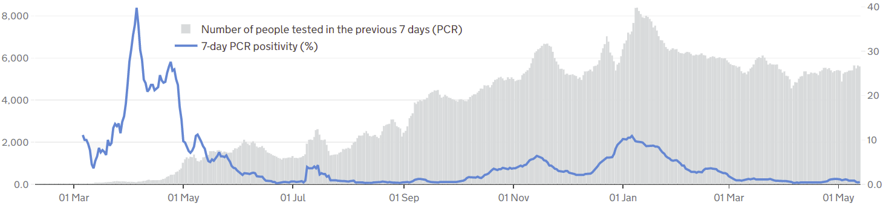

Symptomatic COVID-19 testing: PCR tests and positivity
The graph gives a complete picture of local PCR testing for Herefordshire residents, regardless of where the test was carried out.
On average 5,500 people were tested daily in the seven days to 13 May – marginally more than the April average (5,200) and higher than the national and regionals figures.
The line shows the positivity rate from PCR tests (i.e. the % of people whose test is positive). After the slight rise in the rate seen in late April when it reached 1.2% the figure has subsequently fallen as associated outbreaks have come under control. As of 13 April the rate was 0.5%.
  high positivity to May 2020 shows the impact of testing policy at that time, when only suspected cases amongst those most vulnerable to the disease were being tested. Availability of testing increased throughout the summer.
  Since May 2020, increases in positivity rate have matched the peaks in cases: generally around 1-2%, rising to 6% during November peak and 11% on 6 January
! Need to know !
PCR data is for rolling 7 day periods, not daily / weekly counts
Counts individuals tested in each 7-day period, not the number of tests carried out. A person is only counted once.
Wholly residence based, whereas previous data included a mixture of Herefordshire residents & also people working in the county.
Where can I find out more? Local level testing data is now updated daily on the government’s Covid-19 dashboard. Details of the roll-out of lateral flow tests to local authorities was published by the government on 9 November, and a guide for local delivery of community testing was published on 11 January.

Slide 6
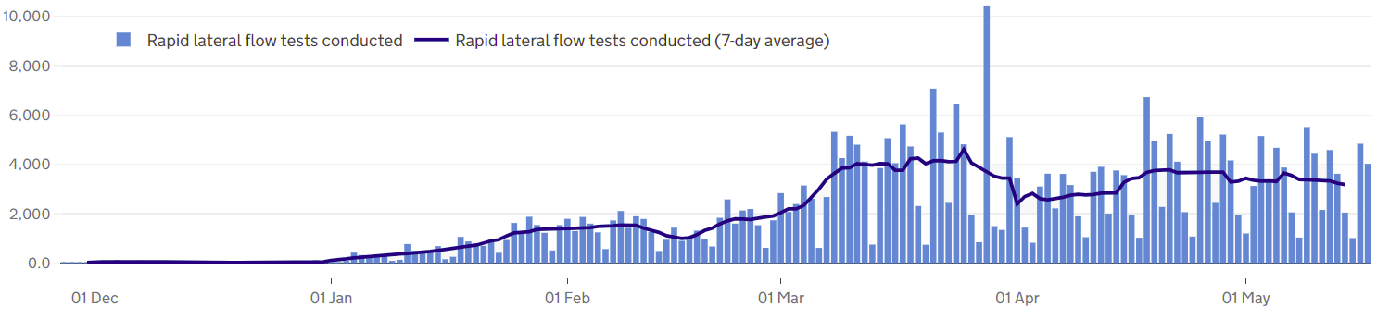
COVID-19 testing: Lateral Flow Device (LFD) tests
! Be aware !
The requirement for a confirmatory PCR test following a positive LFD result was re-introduced on 29 March. It had been suspended for LFD testing on 27 Jan due to the prevalence of the virus.
Unlike the published PCR test data, LFD tests are counted by the number of tests which returned either a positive, negative or void result – which can mean that a person is counted more than once. Data is published as a daily count and 7-day average.
Lateral flow device (LFD) tests are swab tests that give results in less than an hour, without needing to go to a lab. They have become one of the main approaches nationally to controlling the spread, with eligibility gradually widened. Since 9 April, everyone in England has been eligible for twice-weekly testing.
Almost one third of a million LFD tests had been recorded in Herefordshire by 17 May. Although the daily average number of tests recorded in the seven days to 14 May (3,180) dropped compared to the previous week the local rate remains the highest in the West Midlands and 10th highest in England with around 11 tests taken for every 100 residents over a 7-day period.
  The step change at the beginning of March reflects schools reopening to all pupils with twice-weekly testing of staff and secondary school pupils, and families of all school-age children also eligible.
  Community LFD testing is now available at 12 sites across the county, including 8 pharmacies. Plans are in place to further increase availability, e.g. more places to collect home test kits, mobile testing facilities, and pilots in specific locations.
Notes
LFD tests for NHS staff using a self-reporting tool have been included from 17 December 2020. Some negative care home tests may not be included for the first 2 weeks of January
All LFD tests are counted under Pillar 2 (Gov’t testing programme)
Where can I find out more? Local level testing data is updated daily on the government’s Covid-19 dashboard. Details of the roll-out of lateral flow tests to local authorities was published by the government on 9 November.

Slide 7
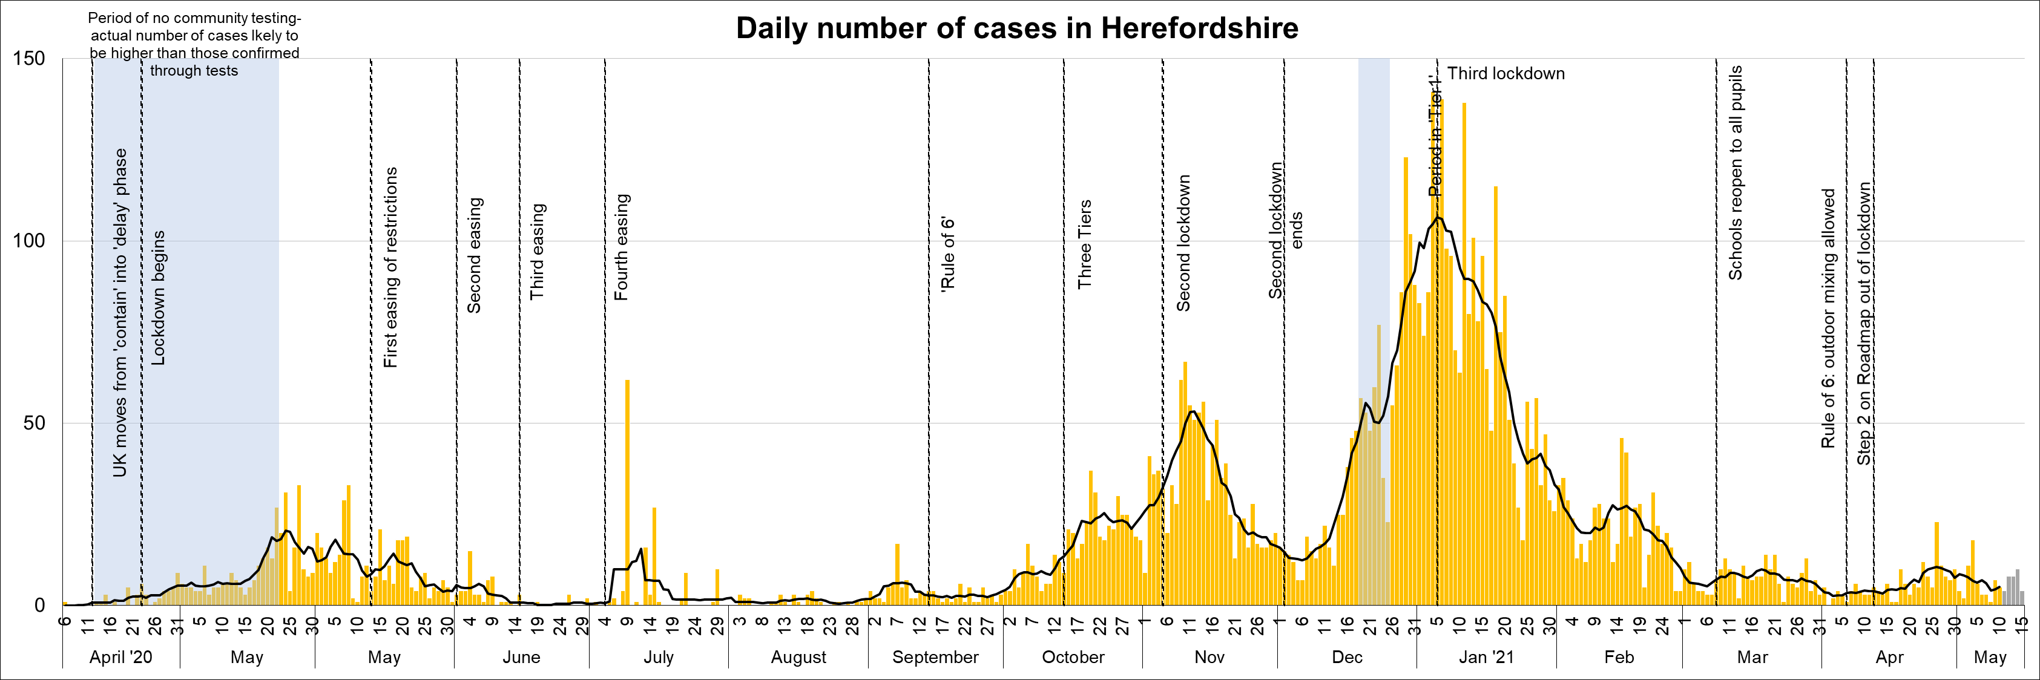
Lab-confirmed COVID-19 cases in Herefordshire
Lab-confirmed cases are the official count of people who live in Herefordshire and have tested positive for COVID-19. In the first few months of the pandemic, numbers of confirmed cases were dependent on testing policy so are not comparable with later waves.
There were 36 new cases confirmed in the 7 days to 13 May, compared to 56 in the previous 7 days - the average for the last week of April and the first week of May was 57. (Note that reporting lags mean daily numbers can change, and the grey bars for the last 5 days may increase)
The line on the chart shows the average daily number of new cases. In the first three weeks of April an average of 4 new cases were recorded daily, while the more than doubled the following week; the latest figure is 5 for the seven days ending 10 May - half the figure rate recorded two weeks previously – indicating that localised outbreaks associated with the rise in cases at the end of April are now under control.
Where can I find out more? Confirmed cases are updated daily by PHE at https://coronavirus.data.gov.uk/.

Slide 8
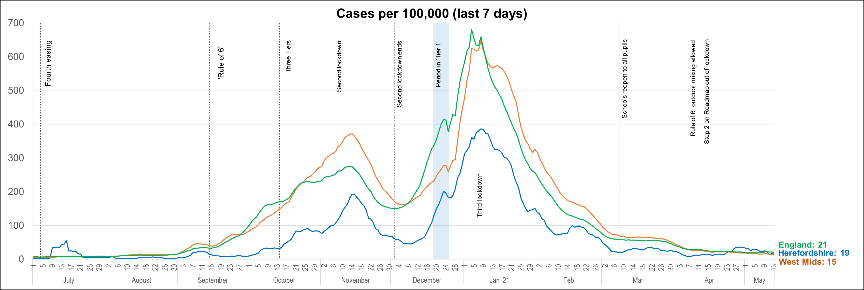
Lab-confirmed cases: comparisons
! Be aware !
Rates per 100,000 resident population give a fairer comparison of the number of cases in each area but they do not take account of the different rates of testing or differences in the age and sex of the local populations.
With one of the smallest ‘upper tier’ local authority populations (193,200), Herefordshire’s rate can be dramatically affected by relatively small changes in numbers of cases. An average of 28 cases a day in a week would result in a rate of 100 per 100,000.
These are not rates of infection amongst the population: they can only reflect those who have been tested, so numbers are highly dependent on the availability of tests.
The chart shows the recent trend in cases per 100,000 resident population for 7-day periods (the latest one ending 5 days ago to allow for lags in the results of tests). This rate is commonly quoted in national reporting.
Due to localized outbreaks the Herefordshire 7-day rate rose to 36 per 100,000 in the week to 29 April - the highest figure since the beginning of March. However, the rate subsequently fell and as of 13 May had fallen to 19 per 100,000, a figure lower than that currently seen nationally.
Where can I find out more? The graph is based on daily updated PHE data on lab-confirmed cases. Further comparisons are included in the LG Inform dashboard. You can also view the local 7-day case rates and numbers on the Herefordshire Council website.

Slide 9
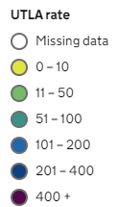
Lab-confirmed cases: comparison with neighbouring authorities
Latest published comparisons, for the week ending 13 April*, show:
Herefordshire’s rate fell by one third over the seven days
At 19 per 100,000 the local figure is again lower than that for England as a whole (21 per 100,000), although it remains higher than those in surrounding authorities.
All neighbouring areas have rates below the national average ranging between 3 and 18 per 100,000 population; Welsh neighbours have particularly low rates.
* Note that he slight lag in this data reflects the latest date for which complete data is available from test results
Time period: (7/5/21 to 13/5/21)
Where can I find out more? Maps comparing 7 day numbers of cases and rates per 100,000 people are updated daily by PHE at https://coronavirus.data.gov.uk/.

Slide 10
Demographics of COVID-19: rates per 100,000 by age over time
This “heat map” shows how the 7-day rates per 100,000 for specific age groups have changed each week from September. Each row represents an age group. As rates increase, the chart colours become darker.
  It is important to note that rates per 100,000 can be significantly affected by relatively small numbers of cases in a population as small as Herefordshire, even more so when broken down into age-groups. The absolute number of cases are shown as context. This is especially true in the current situation of single-figure case numbers in some groups.
The overall rate increased in the last two of weeks April driven by cases amongst 22 to 59 year-olds primarily linked to a localised outbreak. However, rates in this age range have subsequently fallen as the outbreak has come under control.
In the last week the rate in the 5 to 10 year old age bracket has risen owing to an outbreak in an educational setting.
Rates remain low among those aged 60 and over with only two new cases in the seven days to 14 May.

Slide 11

Lab-confirmed cases around the county: this week
The map shows the latest 7-day rates of new cases per 100,000 population, as published by Public Health England: the darker the shading, the higher the rate (unshaded areas have had fewer than 3 cases in the last 7 days).
In the week to 13 May four of Herefordshire’s 23 MSOAs had three or more cases all of which had rates above that for England (21 per 100,000).
The highest rates were in;
‘Hereford South West’ – 97 per 100,000 (8 cases)
‘Lugwardine, Withington & Moreton on Lugg’ - 52 per 100,000 (4 cases)
! Need to know !
It’s important to note that these rates are very sensitive to small changes for small areas like MSOAs. For instance, an increase of 1 case from 9 to 10 cases in an area of 10,000 people (about the size of Ledbury), would increase the rate from 90 to 100 per 100,000.
Note that the slight time-lag in this data reflects that test results are incomplete for the most recent few days
^ Middle super output areas: geographies designed by the Office for National Statistics in 2004 to have broadly similar population sizes – which means that they tend to be geographically bigger in rural Herefordshire.
Time period: (7/5/21 to 13/5/21)
Where can I find out more? This map of weekly confirmed cases by middle super output area (MSOA) in England are included in the PHE dashboard, which is updated daily.

Slide 12
Lab-confirmed cases around the county: trends in rates over time
Whilst the previous slide shows cases in the last 7 days, this “heat map” shows how the 7-day rates per 100,000 have changed in each area of Herefordshire from December. The areas (MSOAs*) are ranked by the rate in the last week.
  It’s important to note that rates per 100,000 can be significantly affected by relatively small numbers of cases in areas as small as MSOAs, especially in the current situation of single-figure case numbers. The absolute number of cases are shown as context.
As numbers of cases remain relatively low the heat map tends to highlight geographical ‘hot spots’. This is particularly evident in ‘Lugwardine, Withington & Moreton on Lugg’ where the number of new cases increased in the three weeks to 7 May, although the rate fell last week as the associated local outbreak has come under control.
The increasing rate in Hereford South West and Hereford West are linked to an outbreak in an educational setting.
* Middle super output areas: geographies designed by ONS to have broadly similar population sizes

Slide 13
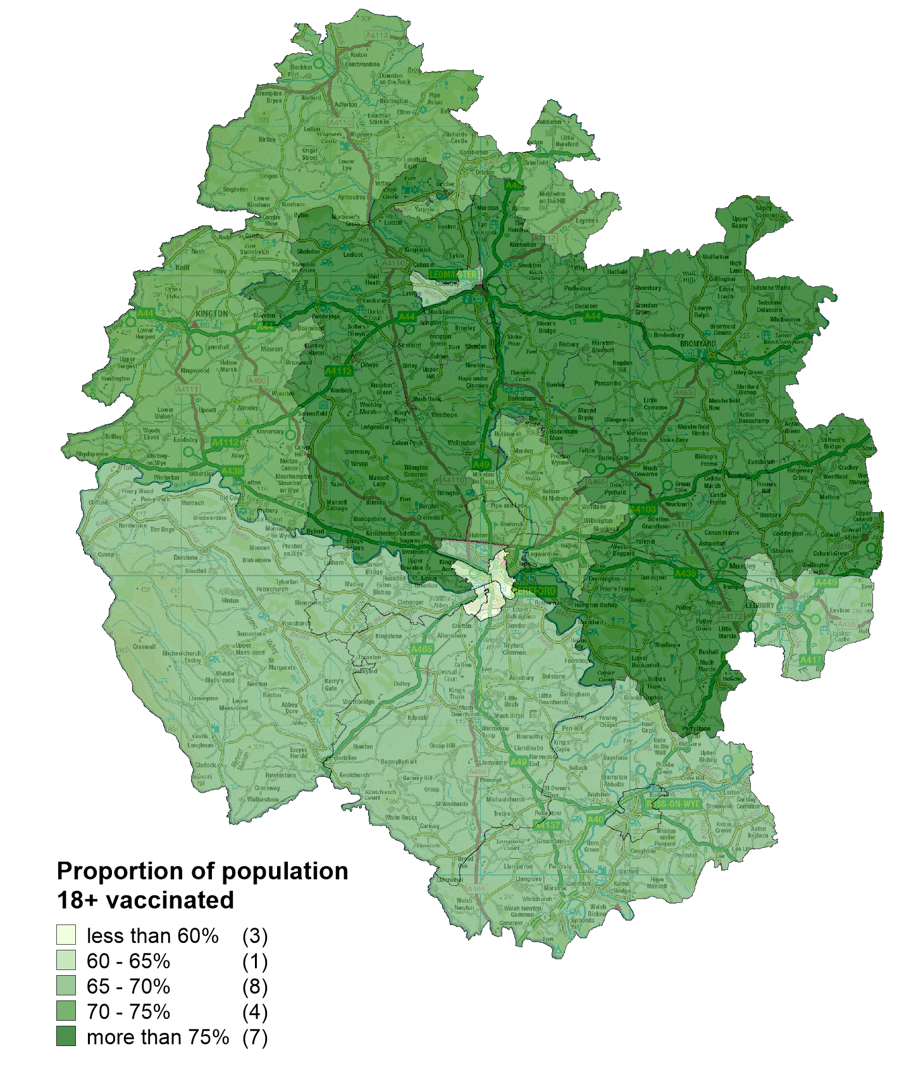
Vaccinations in Herefordshire: 1st dose
  NHS data indicates that as of 11 April 109,869 Herefordshire residents had received their first dose: 70% of eligible residents (aged 18+).
  The proportion of the community dwelling population vaccinated by MSOA ranges from 59% (Hereford Central) to 81% (Colwall, Cradley & Wellington).
  The proportion vaccinated is currently lower in Hereford (64%) than the rest of the county (73%).
Note: Differences in the proportion of the population vaccinated by MSOA will, in part, reflect the differing age profiles between areas because of the way the vaccine programme has been prioritised. The complexities of the data mean that it currently isn’t possible to account for this in reporting.
! Be aware !
Some readers may have access to other sources of data on vaccinations. Numbers and percentages may vary due to:
  Date: the published NHS data lags behind unpublished data intended for other intelligence purposes
  Population base: the figure here is the percentage of the resident population, whilst others will be a proportion of those registered with a GP
  Age/eligibility group: reporting groups can change
Where can I find out more? The numbers of COVID-19 vaccinations are published weekly (Thursdays) by the NHS: www.england.nhs.uk/statistics/statistical-work-areas/covid-19-vaccinations/

Slide 14
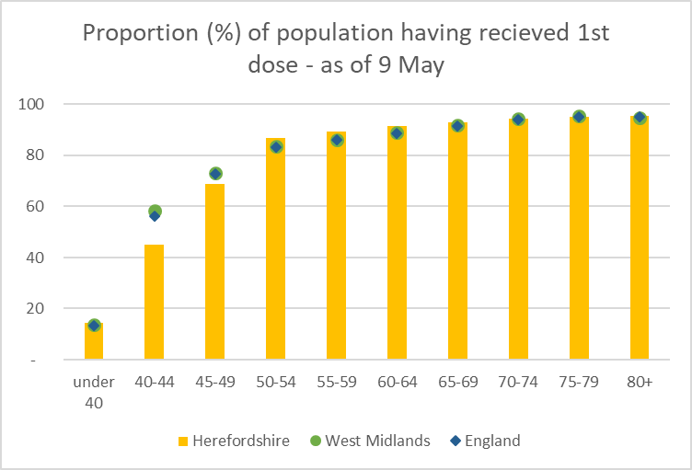
Vaccination: Uptake by age group
At 45%, 1st dose uptake among 40-44 year olds in the county is behind the W Mids (59%) and England (56%) averages.
Also behind is uptake among 45-59 year olds, 69% in the county, compared to the 73% average for both the W Mids and England.
Uptake in all other age groups is in line with/ above regional and national averages.
Where can I find out more? The numbers of COVID-19 vaccinations are published weekly (Thursdays) by the NHS: www.england.nhs.uk/statistics/statistical-work-areas/covid-19-vaccinations/

Slide 15
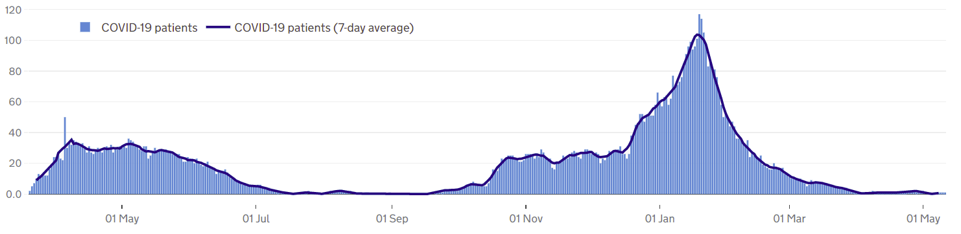
Patients with Covid-19 in Herefordshire hospitals
Published data shows that by 8 May there was one COVID-19 patient in Wye Valley Trust hospitals - for five days over the Easter weekend (3 to 7 April) there were none – for the first time since 20 September
Over the course of the pandemic a total of 758 patients have been admitted, almost a third of whom were admitted during January. Sixteen patients were admitted during March and six in April, while only one have been admitted in May (as of 9 May); no patients have been on mechanical ventilation since mid-March.
Where can I find out more? The numbers of COVID-19 patients in hospital by acute trust are updated daily by PHE at https://coronavirus.data.gov.uk/, with an 11 day lag.

Slide 16
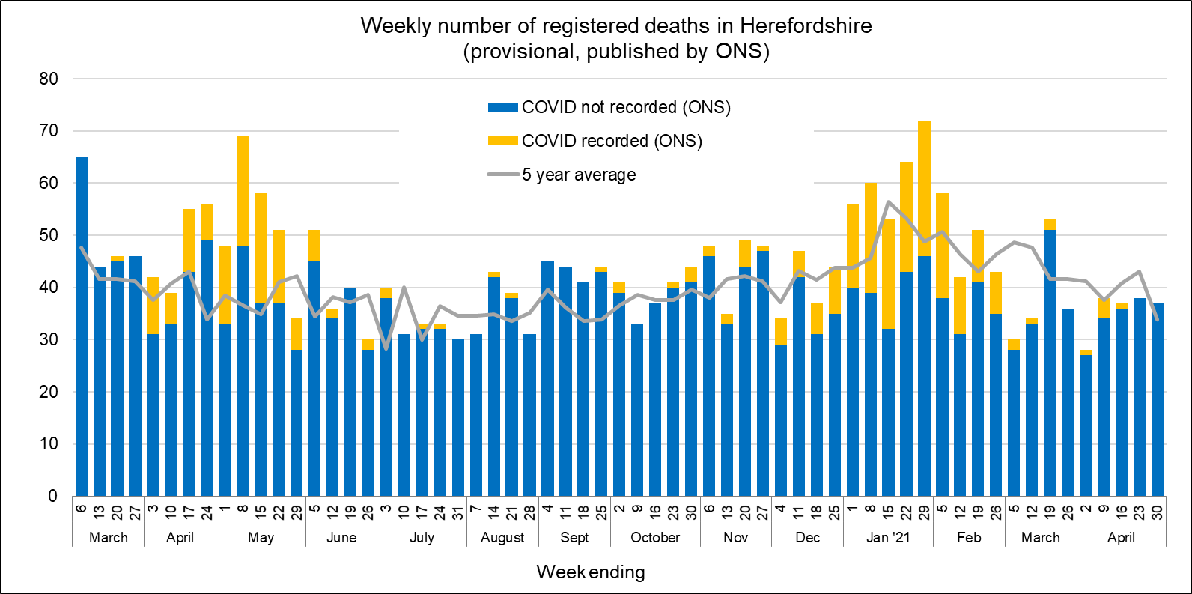
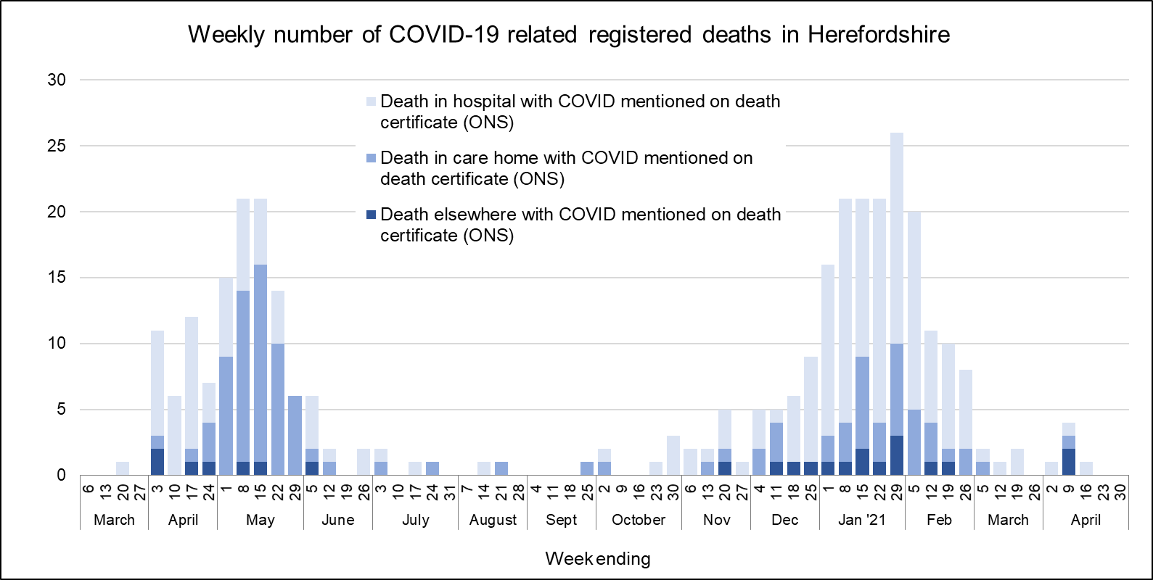
Profile of deaths: published data
Two deaths related to Covid-19 has been reported in ONS’ published data since the last update (occurring by 30 April and registered by 7 May) – both deaths occurred during the week ending 2 April
  Taking the official total amongst Herefordshire residents to 337 throughout the whole pandemic
  Eleven recorded since the end of February
Covid-related deaths in Herefordshire remain lower than nationally: crude death rate is currently 175 per 100,000 compared to England’s 234.
Public Health England also publish numbers of people who have died within 28 days of a first positive test:
  282 in total (registered by 17 May), a figure lower than that published by ONS as the latter does not require a positive test for COVID-19 to be mentioned on a death certificate.
Where can I find out more? ONS publish provisional data on weekly numbers of registered deaths by usual residence for local authorities every Tuesday, with an 11 day lag. Deaths recorded as COVID-19 by ONS include deaths where possible or confirmed COVID-19 is mentioned as any cause of death. They are therefore higher than the PHE figures, which only include those who have died following a positive test.

Slide 17
Other resources
Wider vulnerabilities
  The draft 2020 Director of Public Health report: Impacts of COVID-19 is available on the Council’s website (final version due for publication early May)
  April’s monthly bulletin of the economic impacts of coronavirus is available on the Understanding Herefordshire website
New research and open access analytical tools are continually emerging. As well as the sources linked to throughout these slides, you may be interested in:
  The Office for National Statistics' daily coronavirus roundup: the latest research into the effects on the economy and society
  The Health Foundation - COVID-19 policy tracker: an interactive timeline of key events and government policy announcements related to coronavirus
  An LG Inform dashboard tailored to Herefordshire & Worcestershire, showing daily updates in cases and comparisons with other areas.
  A Herefordshire Council dashboard provides up to date information on cases in the county and provides links to other useful information.
  A summary of Google mobility data for Herefordshire provided by Data Orchard shows average visits to different categories of places over the pandemic.

