Slide 1
COVID-19 in Herefordshire
Intelligence summary
Public Health & Intelligence Unit
21st April 2021

Slide 2
Contents
Key messages (slide 3)
COVID-19 testing (slides 4-5)
COVID-19 cases (slides 6-8), including demographics (slide 9) and local areas (slides 10-11)
Vaccinations in Herefordshire (slide 12)
Patients admitted to hospital (slide 13)
Profile of deaths: published data (slide 14)
Other resources (slide 15)
If you need help to understand this document, or would like it in another format or language, please contact us on 01432 261944 or e-mail researchteam@herefordshire.gov.uk

Slide 3
Covid-19 in Herefordshire: key messages, 21 April
  We are now in Step 2 of the UK Government’s roadmap out of lockdown: ‘stay at home’ ended and the ‘rule of six’ was reintroduced on 29 March, and last week (12 April) most retail, hospitality and leisure facilities were able to re-open with restrictions. The recommendation to ‘shield’ for the 11,400 clinically extremely vulnerable people in Herefordshire ended on 1 April, and care home residents are now allowed two visitors.
  These changes haven’t had any effect on case numbers so far, but some increases are to be expected as society reopens and more asymptomatic cases are identified through regular LFD testing – eligibility for which was widened to everyone on the 9th of April.
  The average number of asymptomatic (LFD) tests have been down from the 4,000 per day that they had been since early March over the school holidays, but are already showing signs of returning to similar levels. This Monday saw the third highest daily number recorded to date (6,700). Access to LFD tests, either through community test sites or home testing kits, continues to expand.
  COVID-19 cases and in-patients are now at their lowest levels since late September and total deaths are below average for the time of year. Situations remain low. Reflecting this, Herefordshire’s local system alert level has been downgraded to Level 2.
    The proportion of symptomatic (PCR) people testing positive has been at or below 0.5% since 5 April.
    29 new cases across the whole county in the week to 15 April: no more than 5 cases in any MSOA. Only three confirmed cases in people aged 60+.
    One death involving COVID-19 occurred in the fortnight to 9 April (registered by 16 April).
  Two thirds of all Herefordshire GP registered patients have received a first dose COVID-19 vaccine. Those aged 45 and over are currently being invited, following the invitation for all those in the Phase 1 priority groups (i.e groups 1-9) identified by the Joint Committee on Vaccination and Immunisation. Data has not yet been published for second doses.
  April’s economic impacts of coronavirus is now available. Indications are that the latest lockdown has not had as big an impact as the first, either nationally or locally. The number of people claiming unemployment related benefits remained stable in March at 4,800 – still more than double the pre-pandemic number.

Slide 4
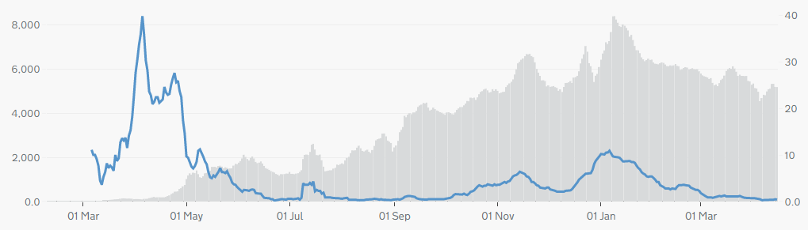

Symptomatic COVID-19 testing: PCR tests and positivity
The graph gives a complete picture of local PCR testing for Herefordshire residents, regardless of where the test was carried out.
5,200 people were tested in the seven days to 15 April – 100 fewer than a fortnight ago and about 900 fewer than in late February. The recent trend is difficult to see because of the Easter weekend, but generally reflects fewer symptomatic people requiring a test.
The line shows the positivity rate from PCR tests (i.e. the % of people whose test is positive). Having fluctuated around 1% in early March, it has been at or below 0.5% since 5 April (latest: 0.4% on 15 April), its lowest level since the end of September.
  high positivity to May shows the impact of testing policy at that time, when only suspected cases amongst those most vulnerable to the disease were being tested. Availability of testing increased throughout the summer.
  Since May, increases in positivity rate have matched the peaks in cases: generally around 1-2%, rising to 6% during November peak and 11% on 6 January
! Need to know !
PCR data is for rolling 7 day periods, not daily / weekly counts
Counts individuals tested in each 7-day period, not the number of tests carried out. A person is only counted once.
Wholly residence based, whereas previous data included a mixture of Herefordshire residents & also people working in the county.
Where can I find out more? Local level testing data is now updated daily on the government’s Covid-19 dashboard. Details of the roll-out of lateral flow tests to local authorities was published by the government on 9 November, and a guide for local delivery of community testing was published on 11 January.

Slide 5
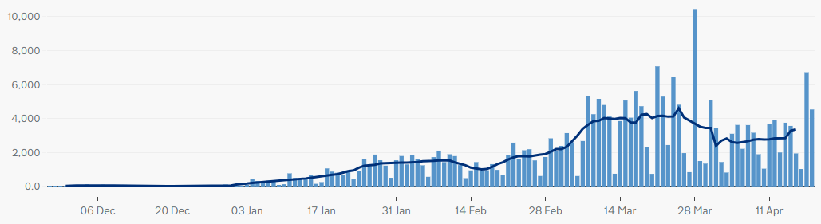
COVID-19 testing: Lateral Flow Device (LFD) tests
! Be aware !
The requirement for a confirmatory PCR test following a positive LFD result was re-introduced on 29 March. It had been suspended for LFD testing on 27 Jan due to the prevalence of the virus.
Unlike the published PCR test data, LFD tests are counted by the number of tests which returned either a positive, negative or void result – which can mean that a person is counted more than once. Data is published as a daily count and 7-day average.
Lateral flow device (LFD) tests are swab tests that give results in less than an hour, without needing to go to a lab. They have become one of the main approaches nationally to controlling the spread, with eligibility gradually widened. Since 9 April, everyone in England has been eligible for twice-weekly testing.
A total of 232,000 LFD tests had been recorded in Herefordshire by 19 April. The recent drop in the average daily number coincided with school Easter holidays, but early indications following the start of term this week (the last two bars on the chart) are that they will return quickly: 6,700 tests recorded on Monday, the third highest daily figure
  The step change at the beginning of March reflects schools reopening to all pupils with twice-weekly testing of staff and secondary school pupils, and families of all school-age children also eligible.
  Community LFD testing is now available at 12 sites across the county, including 8 pharmacies. Plans are in place to further increase availability, e.g. more places to collect home test kits, mobile testing facilities, and pilots in specific locations.
Notes
LFD tests for NHS staff using a self-reporting tool have been included from 17 December 2020. Some negative care home tests may not be included for the first 2 weeks of January
All LFD tests are counted under Pillar 2 (Gov’t testing programme)
Where can I find out more? Local level testing data is updated daily on the government’s Covid-19 dashboard. Details of the roll-out of lateral flow tests to local authorities was published by the government on 9 November.

Slide 6
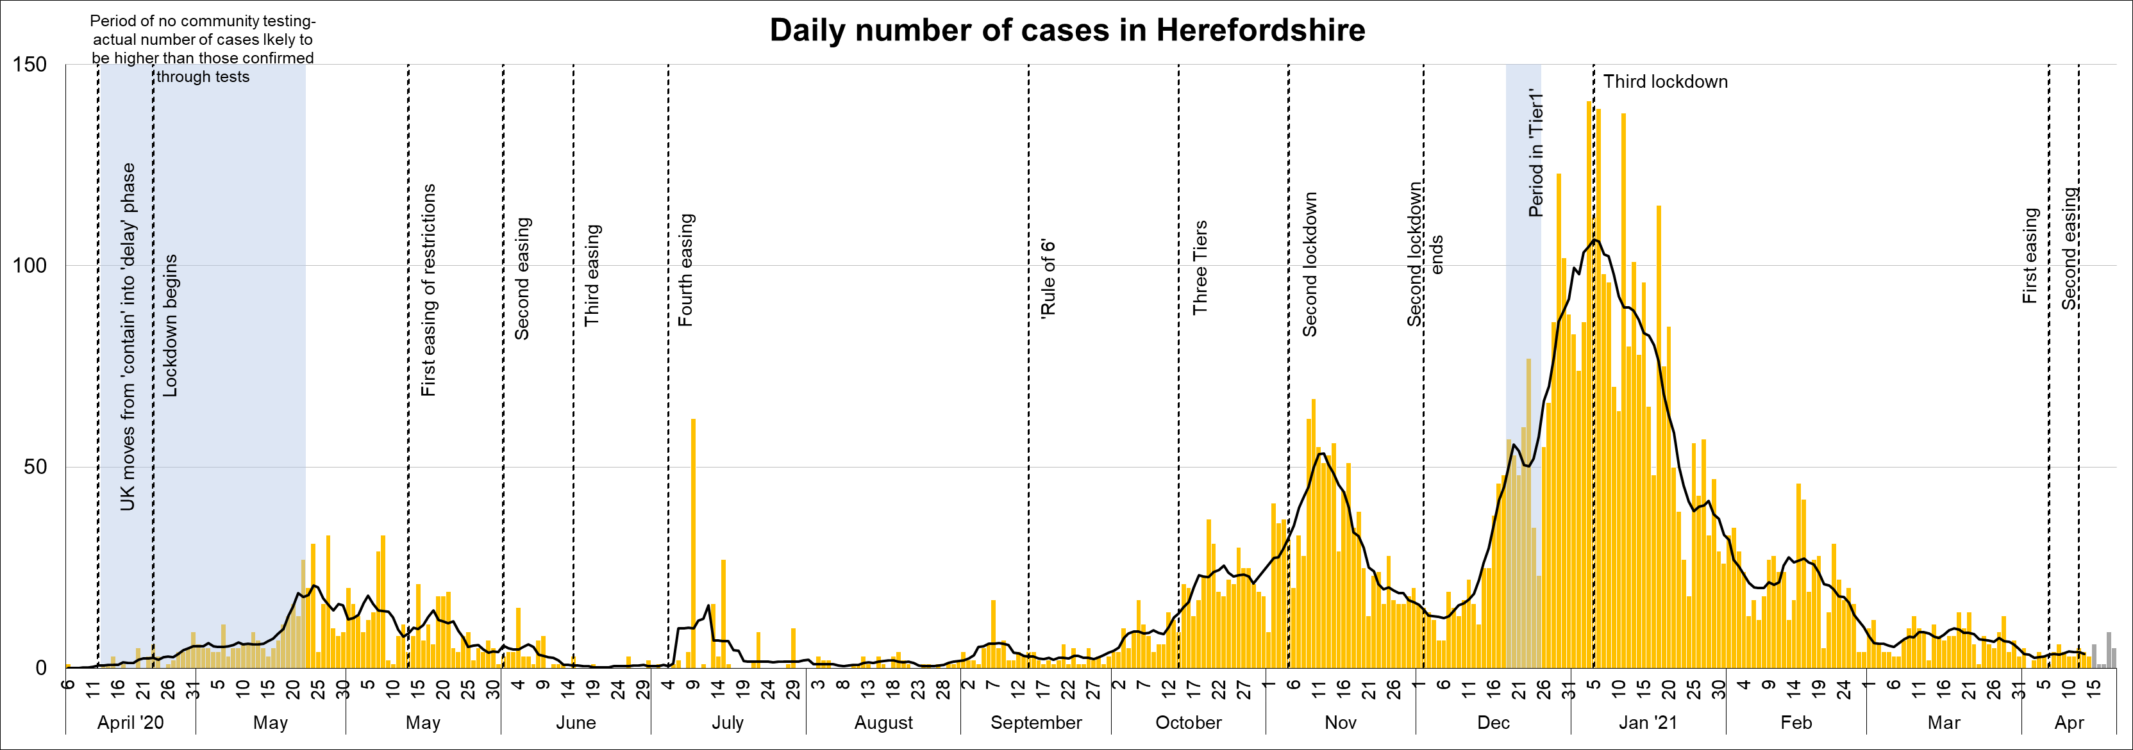
Lab-confirmed COVID-19 cases in Herefordshire
Lab-confirmed cases are the official count of people who live in Herefordshire and have tested positive for COVID-19. In the first few months of the pandemic, numbers of confirmed cases were dependent on testing policy so are not comparable with later waves.
The total lab-confirmed cases is now 6,937 (19 April). 29 new cases have been confirmed so far in the last 7 days, similar to the last three weekly periods (note that reporting lags mean daily numbers can change, and the grey bars for the last 5 days may increase).
The line on the chart shows the average daily number of new cases: between 3 and 4 since the beginning of April (latest complete data is 4 for the 7 days ending 12 April) – but this is likely to increase as society continues to reopen.
Where can I find out more? Confirmed cases are updated daily by PHE at https://coronavirus.data.gov.uk/.

Slide 7
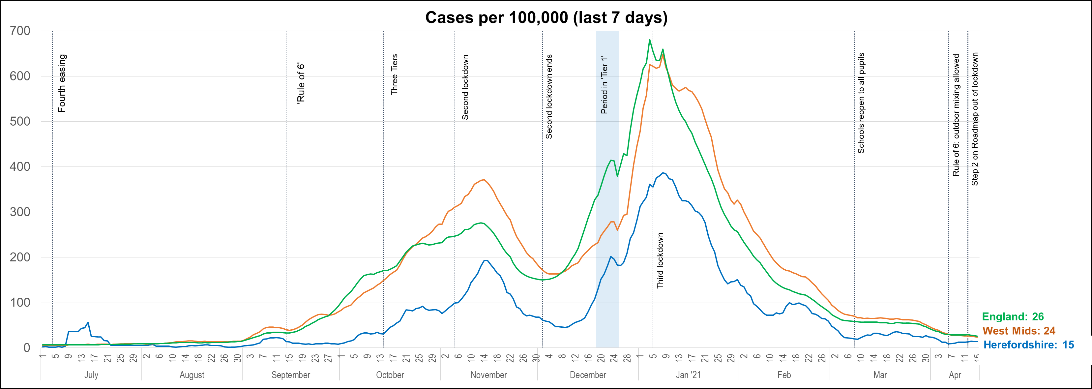
Lab-confirmed cases: comparisons
! Be aware !
Rates per 100,000 resident population give a fairer comparison of the number of cases in each area but they do not take account of the different rates of testing or differences in the age and sex of the local populations.
With one of the smallest ‘upper tier’ local authority populations (193,200), Herefordshire’s rate can be dramatically affected by relatively small changes in numbers of cases. An average of 28 cases a day in a week would result in a rate of 100 per 100,000.
These are not rates of infection amongst the population: they can only reflect those who have been tested, so numbers are highly dependent on the availability of tests.
The chart shows the recent trend in cases per 100,000 resident population for 7-day periods (the latest one ending 5 days ago to allow for lags in the results of tests). This rate is commonly quoted in national reporting.
The Herefordshire rate has fallen again so far during April; having fluctuated between 25 and 35 for much of March, it now stands at 15 per 100,000 (7 days ending 15 April).
The local rate remains lower than both the national and regional figures.
Where can I find out more? The graph is based on daily updated PHE data on lab-confirmed cases. Further comparisons are included in the LG Inform dashboard. You can also view the local 7-day case rates and numbers on the Herefordshire Council website.

Slide 8
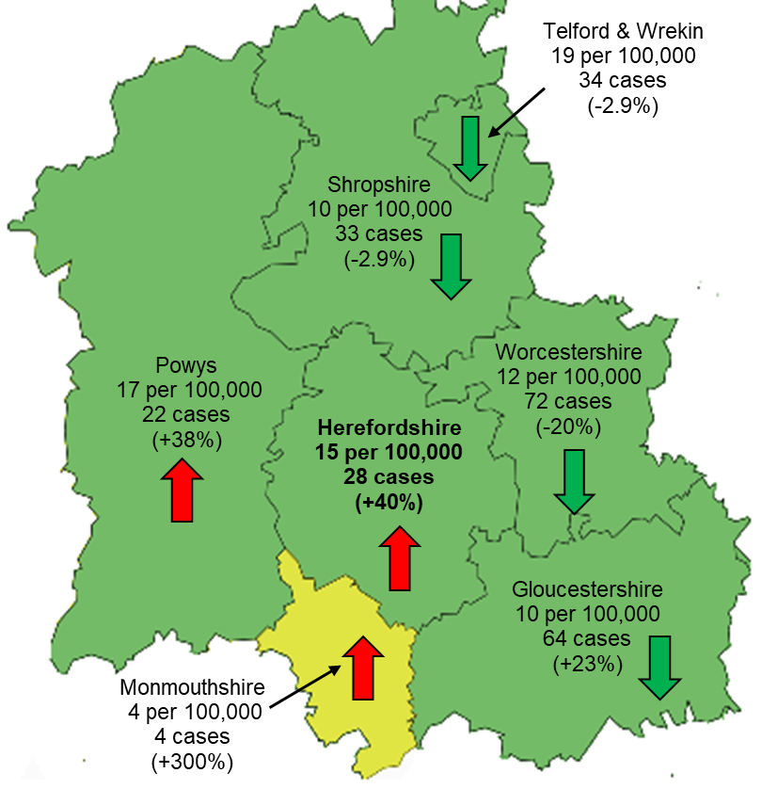
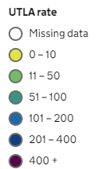
Lab-confirmed cases: comparison with neighbouring authorities
Latest published comparisons, for the week ending 15 April*, show:
Herefordshire’s rate increased by 40% over the seven days – but this reflects an increase of just 8 cases
Fluctuations in rates are to be expected when absolute numbers of cases are so low so comparisons of increases/decreases aren’t particularly useful.
All neighbouring areas have rates below the national average: between 10 and 19 per 100,000 population, with the exception of Monmouthshire (4)
* Note that he slight lag in this data reflects the latest date for which complete data is available from test results
Time period: (9/4/21 to 15/4/21)
Where can I find out more? Maps comparing 7 day numbers of cases and rates per 100,000 people are updated daily by PHE at https://coronavirus.data.gov.uk/.

Slide 9
Demographics of COVID-19: rates per 100,000 by age over time
This “heat map” shows how the 7-day rates per 100,000 for specific age groups have changed each week from September. Each row represents an age group. As rates increase, the chart colours become darker.
  It is important to note that rates per 100,000 can be significantly affected by relatively small numbers of cases in a population as small as Herefordshire, even more so when broken down into age-groups. The absolute number of cases are shown as context. This is especially true in the current situation of single-figure case numbers in some groups.
Overall rates have fallen in the last couple of weeks and are now at levels last seen in late September, and in the last week there were no more than five cases in any age group.
Rates remain low among those aged 60 and over with only three new cases in the seven days to 16 April.

Slide 10
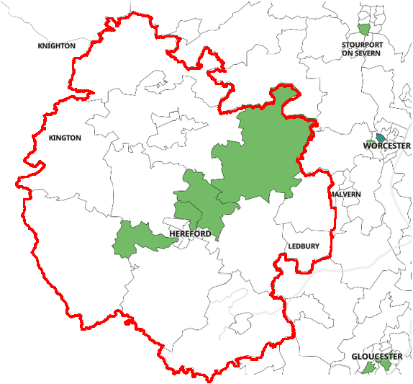
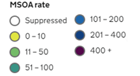
Lab-confirmed cases around the county: this week
Positive cases from samples taken in the 7 day period ending 15/4/21*
The map shows the latest 7-day rates of new cases per 100,000 population, as published by Public Health England: the darker the shading, the higher the rate (unshaded areas have had fewer than 3 cases in the last 7 days).
In the week to 15 April all but 4 of Herefordshire’s 23 MSOAs^ had fewer than three cases*
Three of the four had just 3 new cases, whilst the other had 5:
  ‘Belmont, Madley & Clehonger’ (44 per 100,000): 3 cases
  ‘Hereford North East’ (39 per 100,000): 3 cases
  ‘Lugwardine, Withington & Moreton on Lugg’ (39 per 100,000): 3 cases
  ‘Bromyard & Bishop's Frome’ (46 per 100,000): 5 cases
Note that data for Wales is not included
! Need to know !
It’s important to note that these rates are very sensitive to small changes for small areas like MSOAs. For instance, an increase of 1 case from 9 to 10 cases in an area of 10,000 people (about the size of Ledbury), would increase the rate from 90 to 100 per 100,000.
Note that the slight time-lag in this data reflects that test results are incomplete for the most recent few days
^ Middle super output areas: geographies designed by the Office for National Statistics in 2004 to have broadly similar population sizes – which means that they tend to be geographically bigger in rural Herefordshire.
Data supressed where numbers are low to avoid possible identification of individuals
Where can I find out more? This map of weekly confirmed cases by middle super output area (MSOA) in England are included in the PHE dashboard, which is updated daily.

Slide 11
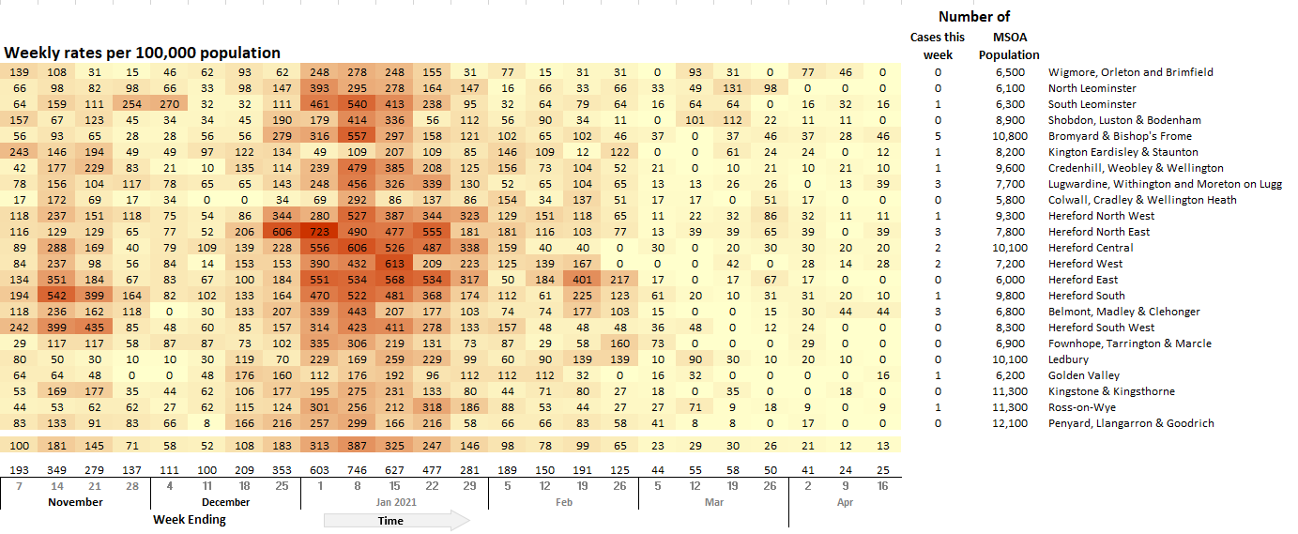
Lab-confirmed cases around the county: trends in rates over time
Whilst the previous slide shows cases in the last 7 days, this “heat map” shows how the 7-day rates per 100,000 have changed in each area of Herefordshire from November. The areas (MSOAs*) are ranked by the rate in the last week.
  It’s important to note that rates per 100,000 can be significantly affected by relatively small numbers of cases in areas as small as MSOAs, especially in the current situation of single-figure case numbers. The absolute number of cases are shown as context.
At these relatively low levels, the heat map tends to highlight geographical ‘hot spots’ with clusters of new cases linked to settings where there is mixing of households and support bubbles. There have been none of note in recent weeks.
* Middle super output areas: geographies designed by ONS to have broadly similar population sizes

Slide 12
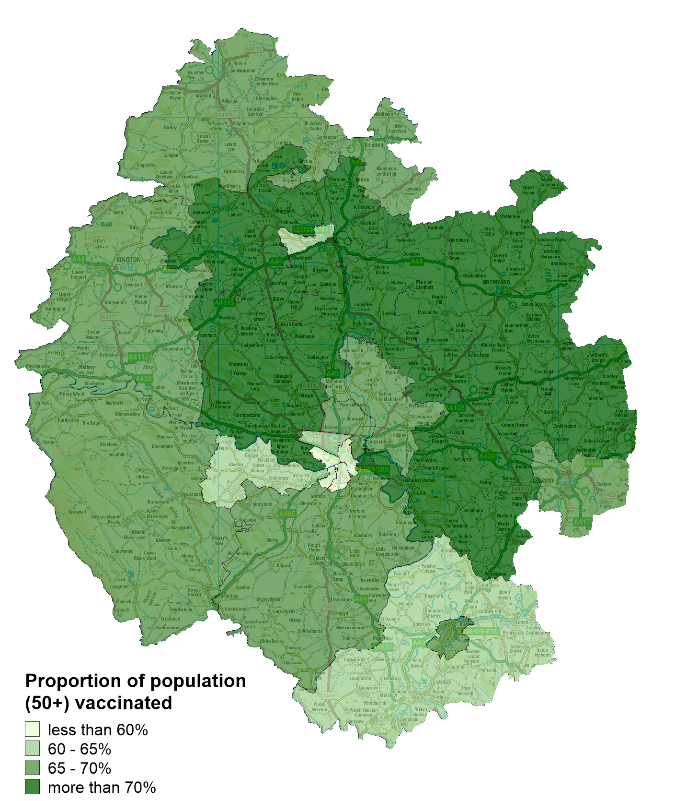
Vaccinations in Herefordshire
  NHS data indicates that as of 11 April 103,518 Herefordshire residents had received their first dose: 66% of eligible residents (aged 18+).
  The proportion of the community dwelling population vaccinated by MSOA ranges from 56% (Hereford Central and Hereford South West) to 76% (Colwall, Cradley & Wellington).
  The proportions vaccinated are currently lower in Hereford city than the rest of the county.
Note: Differences in the proportion of the population vaccinated by MSOA will, in part, reflect the differing age profiles between areas because of the way the vaccine programme has been prioritised. The complexities of the data mean that it currently isn’t possible to account for this in reporting.
! Be aware !
Some readers may have access to other sources of data on vaccinations. Numbers and percentages may vary due to:
  Date: the published NHS data lags behind unpublished data intended for other intelligence purposes
  Population base: the figure here is the percentage of the resident population, whilst others will be a proportion of those registered with a GP
  Age/eligibility group: reporting groups can change
Where can I find out more? The numbers of COVID-19 vaccinations are published weekly (Thursdays) by the NHS: www.england.nhs.uk/statistics/statistical-work-areas/covid-19-vaccinations/

Slide 13
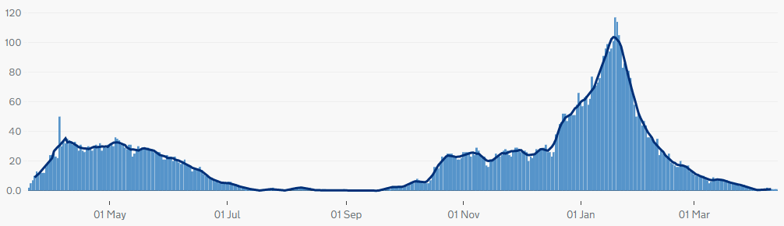
Patients with Covid-19 in Herefordshire hospitals
Published data shows that by 11 April there was only one COVID-19 patient in Wye Valley Trust hospitals. For five days over the Easter weekend (3 to 7 April) there were none – for the first time since 20 September
Over the course of the pandemic a total of 754 patients have been admitted, almost a third of whom were admitted during January. Only 16 were admitted during March, and non-one has been on mechanical ventilation since mid-March.
Where can I find out more? The numbers of COVID-19 patients in hospital by acute trust are updated daily by PHE at https://coronavirus.data.gov.uk/, with an 11 day lag.

Slide 14
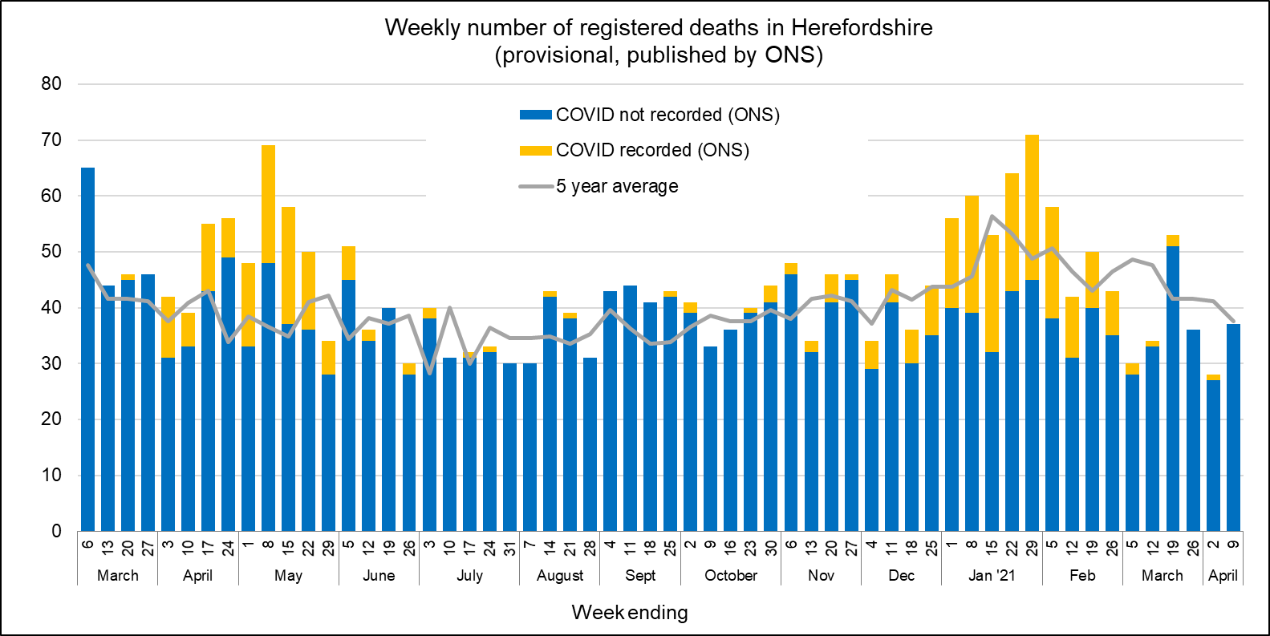
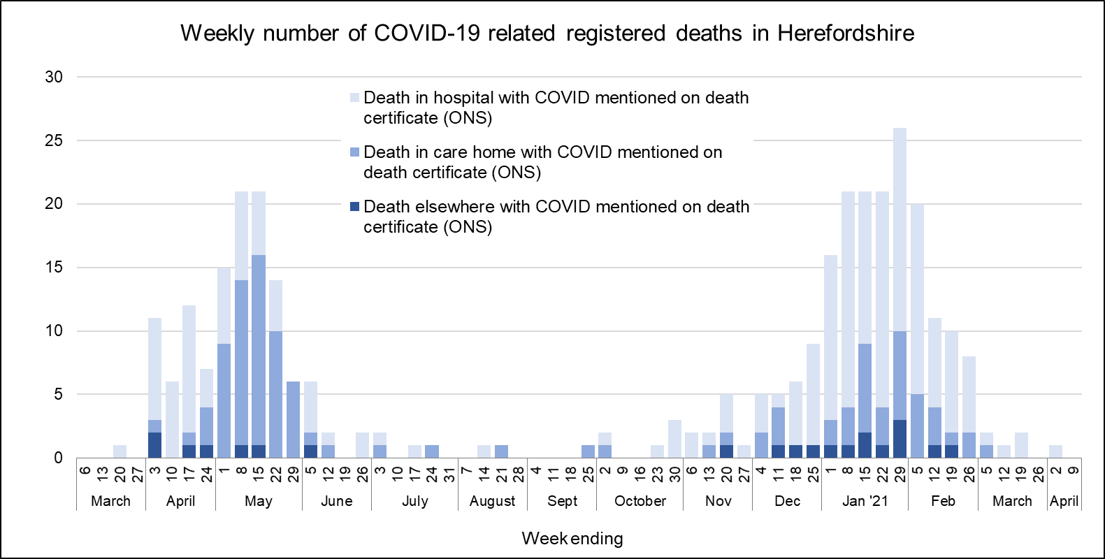
Profile of deaths: published data
One death related to Covid-19 has been reported in ONS’ published data since the last update (occurring by 9 April and registered by 16 April)
  Taking the official total amongst Herefordshire residents to 332 throughout the whole pandemic
  Only six recorded since the end of February
Covid-related deaths in Herefordshire remain lower than nationally: crude death rate is currently 170 per 100,000 compared to England’s 229.
Public Health England also publish numbers of people who have died within 28 days of a first positive test:
  283 in total (registered by 21 April), a figure lower than that published by ONS as the latter does not require a positive test for COVID-19 to be mentioned on a death certificate.
Where can I find out more? ONS publish provisional data on weekly numbers of registered deaths by usual residence for local authorities every Tuesday, with an 11 day lag. Deaths recorded as COVID-19 by ONS include deaths where possible or confirmed COVID-19 is mentioned as any cause of death. They are therefore higher than the PHE figures, which only include those who have died following a positive test.

Slide 15
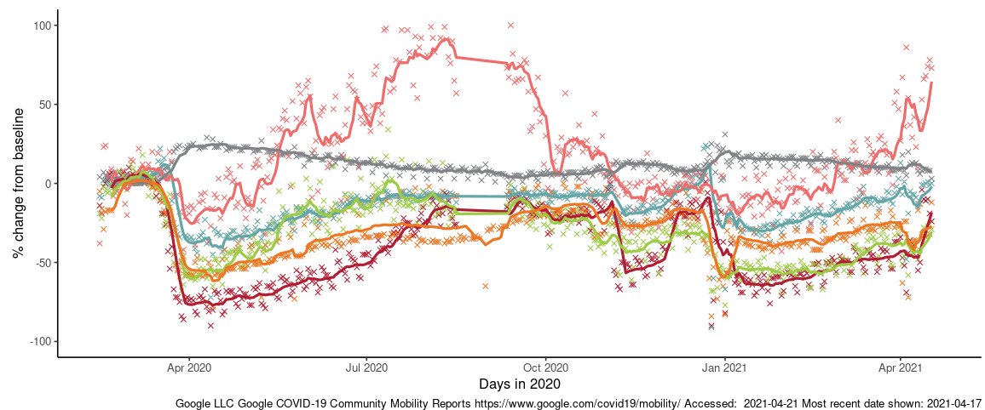
Effects of lockdown on population movement
This chart shows average visits to different categories of places, using location data of Google users, compared to the beginning of 2020.
After an initial drop following the 4 Jan lockdown, visits to most categories (except residential) increased slowly during the latest lockdown – although still remain below the pre-pandemic baseline (except parks, which has a seasonal pattern).
There has been a clear upturn in movement since the end of March, particularly to ‘retail and recreation’ and ‘parks’. Neither are unsurprising, given the ending of the ‘stay at home’ rule and reintroduction of ‘rule of 6’ on 29 March in time for the Easter holiday weekend, and lifting of restrictions on non-essential retail and outdoor eating/drinking on 12 April.
Changing visits in Herefordshire to…
Third national lockdown (5 Jan)
Parks
First full national lockdown (23 Mar)
Residential
Grocery & pharmacy
Retail & recreation
Workplaces
Stations
English lockdown 2.0 (5 Nov-2 Dec)
English social restrictions ease on 29 Mar & 12 Apr
Where can I find out more? This chart is updated daily on the Data Orchard website, using data published by Google. The baseline is the median value, for the corresponding day of the week, during the five weeks 3 Jan–6 Feb 2020. Note that the data is based on movements of those who have opted to turn on location history in their Google accounts on their mobile devices.

Slide 16
Other resources
Wider vulnerabilities
  The draft 2020 Director of Public Health report: Impacts of COVID-19 is available on the Council’s website (final version due for publication early May)
  April’s monthly bulletin of the economic impacts of coronavirus is available on the Understanding Herefordshire website
New research and open access analytical tools are continually emerging. As well as the sources linked to throughout these slides, you may be interested in:
  The Office for National Statistics' daily coronavirus roundup: the latest research into the effects on the economy and society
  The Health Foundation - COVID-19 policy tracker: an interactive timeline of key events and government policy announcements related to coronavirus
  An LG Inform dashboard tailored to Herefordshire & Worcestershire, showing daily updates in cases and comparisons with other areas.
  A Herefordshire Council dashboard provides up to date information on cases in the county and provides links to other useful information.
  A summary of Google mobility data for Herefordshire provided by Data Orchard shows average visits to different categories of places over the pandemic.

