Slide 1
COVID-19 in Herefordshire
Weekly intelligence summary
Public Health & Intelligence Unit
24th March 2021

Slide 2
Contents
Key messages (slide 3)
COVID-19 testing (slides 4-5),
COVID-19 cases (slides 6-8), including demographics (slide 9) and local areas (slides 10-11)
Vaccinations in Herefordshire (slide 12)
Patients admitted to hospital (slide 13)
Profile of deaths: published data (slide 14-15)
Other resources (slide 16)
If you need help to understand this document, or would like it in another format or language, please contact us on 01432 261944 or e-mail researchteam@herefordshire.gov.uk

Slide 3
Covid-19 in Herefordshire: key messages, 24 March
  There has been a slight increase in the number of new cases in Herefordshire this week, but numbers remain low (average of 8 per day). Some increases are to be expected as society reopens and more asymptomatic cases are identified through regular LFD testing. It’s important to note that even in areas with higher rates due to outbreaks, numbers have been in the low tens and have been quickly brought under control.
  The average number of asymptomatic (LFD) tests remains around 4,000 a day. As well as the families of school-children, all businesses are now eligible for testing of staff. There are now 8 sites for community LFD testing across the county.
  COVID-19 cases and in-patients remain at their lowest levels since early October and total deaths are lower than average for the time of year. There have been just three new outbreaks/situations this week.
    demand for symptomatic (PCR) testing is a quarter of what it was at the January peak, and the proportion testing positive (0.9%) is at its lowest since early October.
    57 new cases across the whole county in the week to 18 March: fewer than 3 new cases in half of all MSOAs, and no more than 10 in any. Slight increase in cases amongst school-age children, but no cases aged 80+ for the first time since September.
    1 death involving COVID-19 occurred in the week to 12 March (registered by 19 March) – the lowest since the end of November. After a sustained period of ‘excess deaths’ driven by COVID-19, total deaths during the last month have been lower than average for the time of year.
  Over half of all Herefordshire GP registered patients have received a first dose of COVID-19 vaccine. All those aged over 50 and those at higher risk (e.g. clinically, as carer, health/social care worker, care home resident) should now have been invited. This includes all those in the Phase 1 priority groups (i.e groups 1-9) identified by the Joint Committee on Vaccination and Immunisation.
  Next week sees the second stage in Step 1 of the UK Government’s roadmap out of lockdown: outdoor gatherings following the Rule of 6 or 2 households will be permitted and the ‘stay at home’ rule will end on 29 March. The recommendation to ‘shield’ for the 11,400 clinically extremely vulnerable people in Herefordshire will also end on 1 April.

Slide 4
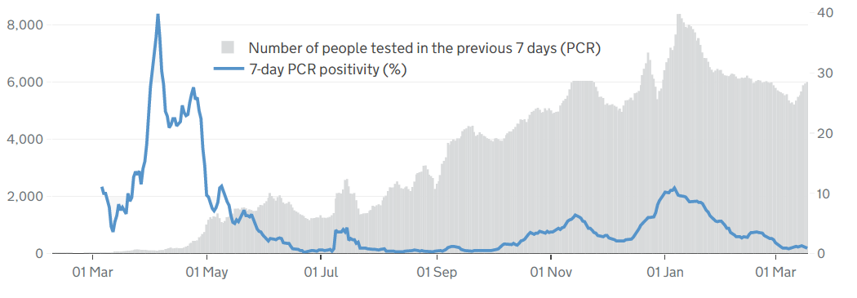

Symptomatic COVID-19 testing: PCR tests and positivity
The graph gives a complete picture of local PCR testing for Herefordshire residents, regardless of where the test was carried out.
The number of tests was higher this week (6,000) compared to last (5,200): although the level remains 25% lower than the January peak, reflecting lower numbers of symptomatic people currently requiring a test.
The line shows that the positivity rate from PCR tests (i.e. the % of people whose test is positive). It is currently (18 March) 0.9% - a similar rate to this time last week and remaining at its lowest level since early October.
  high positivity to May shows the impact of testing policy at that time, when only suspected cases amongst those most vulnerable to the disease were being tested. Availability of testing increased throughout the summer.
  Since May, increases in positivity rate have matched the peaks in cases: generally around 1-2%, rising to 6% during November peak and 11% on 6 January
! Need to know !
PCR data is for rolling 7 day periods, not daily / weekly counts
Counts individuals tested in each 7-day period, not the number of tests carried out. A person is only counted once.
Wholly residence based, whereas previous data included a mixture of Herefordshire residents & also people working in the county.
Where can I find out more? Local level testing data is now updated daily on the government’s Covid-19 dashboard. Details of the roll-out of lateral flow tests to local authorities was published by the government on 9 November, and a guide for local delivery of community testing was published on 11 January.

Slide 5
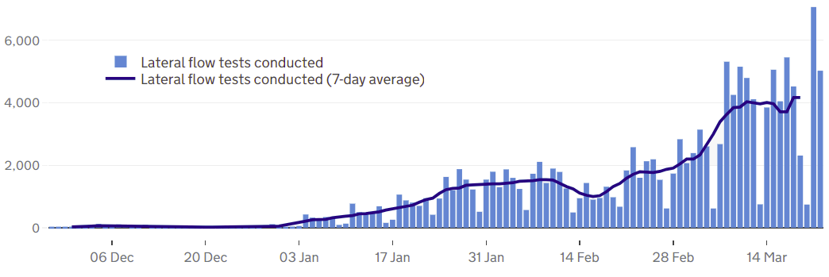
COVID-19 testing: Lateral Flow Device (LFD) tests
Lateral flow device (LFD) tests are swab tests that give results in less than an hour, without needing to go to a lab. They are the national approach to rapid, frequent, community testing and eligibility continues to be widened.
A total of 141,000 LFD tests had been recorded in Herefordshire by 22 March. The current average is 4,000 a day, which has been fairly consistent since 10 March.
  The step change at the beginning of March reflects schools reopening to all pupils with twice-weekly testing of staff and secondary school pupils, and families of all school-age children also eligible.
  Health and care home staff were the first to be regularly tested, and the initial offer of community LFD testing was to critical workers unable to work from home. All businesses are now able to apply for LFD testing for their staff.
  Community LFD testing is now available at 8 sites across the county, including 4 pharmacies.
! Be aware !
From 27 Jan the requirement for confirmatory PCR testing following a positive LFD result was removed for most LFD testing.
This means that a positive LFD test is now considered a confirmed case and requires the person to self-isolate.
Self-conducted tests will still require confirmation.
Unlike the published PCR test data, LFD tests are counted by the number of tests which returned either a positive, negative or void result – which can mean that a person is counted more than once. Data is published as a daily count and 7-day average.
Notes
LFD tests for NHS staff using a self-reporting tool have been included from 17 December 2020. Some negative care home tests may not be included for the first 2 weeks of January
All LFD tests are counted under Pillar 2 (Gov’t testing programme)
Where can I find out more? Local level testing data is updated daily on the government’s Covid-19 dashboard. Details of the roll-out of lateral flow tests to local authorities was published by the government on 9 November.

Slide 6
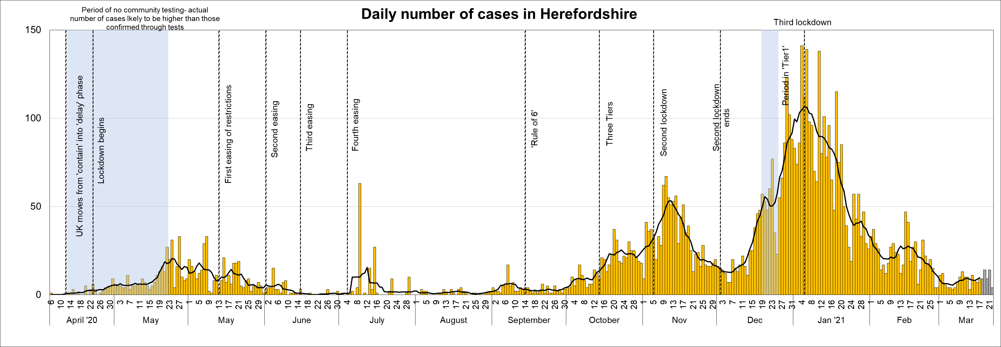
Lab-confirmed COVID-19 cases in Herefordshire
Lab-confirmed cases are the official count of people who live in Herefordshire and have tested positive for COVID-19. In the first few months of the pandemic, numbers of confirmed cases were dependent on testing policy so are not comparable with later waves.
The total lab-confirmed cases over the course of the epidemic is now 6,784 (18 March). This week’s increase of 57 cases is similar to the week before (note that reporting lags mean daily numbers can change, and the grey bars for the last 5 days will increase).
The line on the chart shows the average daily number of new cases: currently 8.1 (8 Mar) - similar to levels seen in early October.
Where can I find out more? Confirmed cases are updated daily by PHE at https://coronavirus.data.gov.uk/.

Slide 7
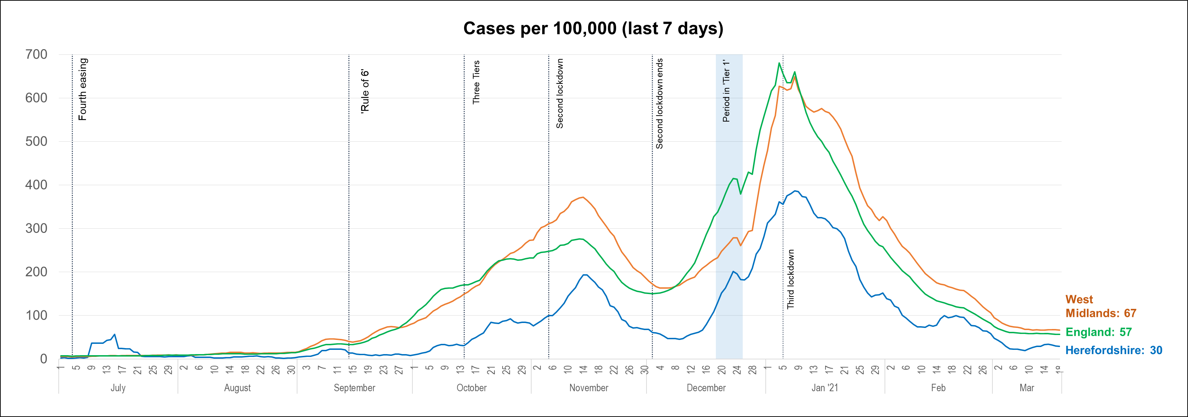
Lab-confirmed cases: comparisons
! Be aware !
Rates per 100,000 resident population give a fairer comparison of the number of cases in each area but they do not take account of the different rates of testing or differences in the age and sex of the local populations.
With one of the smallest ‘upper tier’ local authority populations (193,200), Herefordshire’s rate can be dramatically affected by relatively small changes in numbers of cases. An average of 28 cases a day in a week would result in a rate of 100 per 100,000.
These are not rates of infection amongst the population: they can only reflect those who have been tested, so numbers are highly dependent on the availability of tests.
The chart shows the recent trend in cases per 100,000 resident population for 7-day periods (the latest one ending 5 days ago to allow for lags in the results of tests). This rate is commonly quoted in national reporting.
The latest rate of 30 per 100,000 is slightly higher than this time last week but remains less than a tenth of the peak seen in January.
Following a plateau in mid-February when the gap narrowed, the Herefordshire rate is close to half of the national rate and less than half the regional figure.
Where can I find out more? The graph is based on daily updated PHE data on lab-confirmed cases. Further comparisons are included in the LG Inform dashboard. You can also view the local 7-day case rates and numbers on the Herefordshire Council website.

Slide 8
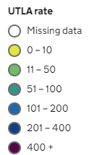
Lab-confirmed cases: comparison with neighbouring authorities
Latest published comparisons, for the week ending 18 March*, show:
Herefordshire’s rate increased by 11% over the seven days to 18 March, but note that because numbers are so low, this only represents six more cases than the previous week.
With the exception of Telford and Wrekin 7-day case rates fell in other bordering authorities (as indicated by the arrows).
The rate in Herefordshire is broadly similar to elsewhere, with the exception of Worcestershire where the rate is almost twice as high.
* Note that he slight lag in this data reflects the latest date for which complete data is available from test results
Time period: (12/3/21 to 18/3/21)
Where can I find out more? Maps comparing 7 day numbers of cases and rates per 100,000 people are updated daily by PHE at https://coronavirus.data.gov.uk/.

Slide 9
Demographics of COVID-19: rates per 100,000 by age over time
This “heat map” shows how the 7-day rates per 100,000 for specific age groups have changed each week from September. Each row represents an age group. As rates increase, the chart colours become darker.
  It is important to note that rates per 100,000 can be significantly affected by relatively small numbers of cases in a population as small as Herefordshire, even more so when broken down into age-groups. The absolute number of cases are shown as context. This is especially true in the current situation of single-figure case numbers in some groups.
Overall rates remain at levels last seen in early October.
In the last week there were no new cases in those aged 80+ (the first time since mid-September), while new cases amongst 30-39 year-olds halved. Case rates amongst school-age children rose, but are still very low numbers.

Slide 10
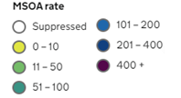
Lab-confirmed cases around the county: this week
Positive cases from samples taken in the 7 day period ending 18/3/21*
The map shows the latest 7-day rates of new cases per 100,000 population, as published by Public Health England: the darker the shading, the higher the rate (unshaded areas have had fewer than 3 cases in the last 7 days).
As for the last two weeks, 15 of Herefordshire’s 23 MSOAs^ had fewer than three cases in the week to 18 March*
Four areas had higher rates than England overall (57 per 100,000), but the absolute number of cases is low. These MSOAs include the school communities of Shobdon and Luston, which were closed last week due to a number of cases.
  ‘Leominster North’ (115 per 100,000): 7 cases
  ‘Shobdon, Luston and Bodenham’ (112 per 100,000): 10 cases
  ‘Wigmore, Orleton and Brimfield’ (93 per 100,000): 6 cases
  ‘Kington, Eardisley and Shobdon’ (73 per 100,000): 6 cases
Note that data for Wales is not included
! Need to know !
It’s important to note that these rates are very sensitive to small changes for small areas like MSOAs. For instance, an increase of 1 case from 9 to 10 cases in an area of 10,000 people (about the size of Ledbury), would increase the rate from 90 to 100 per 100,000.
Note that the slight time-lag in this data reflects that test results are incomplete for the most recent few days
^ Middle super output areas: geographies designed by the Office for National Statistics in 2004 to have broadly similar population sizes – which means that they tend to be geographically bigger in rural Herefordshire.
Data supressed where numbers are low to avoid possible identification of individuals
Where can I find out more? This map of weekly confirmed cases by middle super output area (MSOA) in England are included in the PHE dashboard, which is updated daily.

Slide 11
Lab-confirmed cases around the county: trends in rates over time
Whilst the previous slide shows cases in the last 7 days, this “heat map” shows how the 7-day rates per 100,000 have changed in each area of Herefordshire from September. The areas (MSOAs*) are ranked by the rate in the last week.
  It’s important to note that rates per 100,000 can be significantly affected by relatively small numbers of cases in areas as small as MSOAs, especially in the current situation of single-figure case numbers. The absolute number of cases are shown as context.
Rates in most areas remain at the relatively low levels similar to those last seen in early October, and half of MSOAs had fewer than 3 new cases last week.
At these relatively low levels, the heat map illustrates geographical hot spots with clusters of new cases linked to settings where there is mixing of households and support bubbles. Note that in recent weeks even these hot spots have far fewer cases than were seen in all areas during the widespread community transmission of the winter.
* Middle super output areas: geographies designed by the Office for National Statistics in 2004 to have broadly similar population sizes

Slide 12
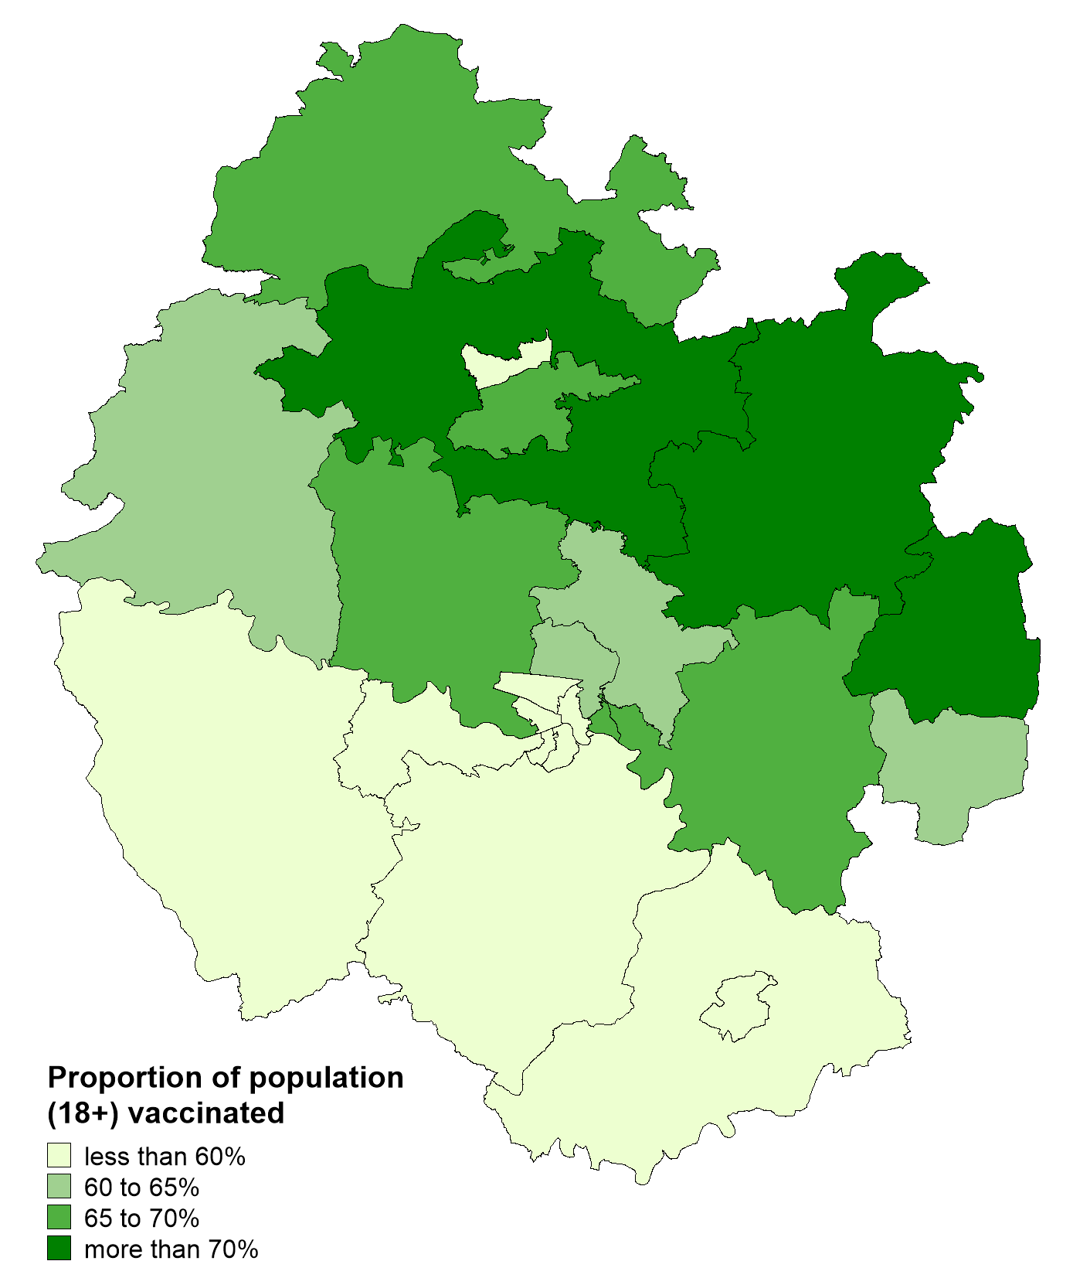
Vaccinations in Herefordshire
  NHS data indicates that as of 21 March 96,700 Herefordshire residents had received their first dose: 62% of eligible residents (aged 18+).
  The proportion of the community dwelling population* vaccinated by MSOA ranges from 51% (Hereford South West) to 73% (Colwall, Cradley & Wellington).
  The proportions vaccinated are currently lower in Hereford city, Ross and the rest of south Herefordshire than the rest of the county.
Note: Differences in the proportion of the population vaccinated by MSOA will, in part, reflect the differing age profiles between areas because of the way the vaccine programme has been prioritised. The complexities of the data mean that it currently isn’t possible to account for this in reporting.
! Be aware !
* i.e. excluding residents of care homes as these would skew the distribution
Some readers may have access to other sources of data on vaccinations. Numbers and percentages may vary due to:
  Date: the published NHS data lags behind unpublished data intended for other intelligence purposes
  Population base: the figure here is the percentage of the resident population, whilst others will be a proportion of those registered with a GP
  Age/eligibility group: reporting groups can change
Where can I find out more? The numbers of COVID-19 vaccinations are published weekly (Thursdays) by the NHS: www.england.nhs.uk/statistics/statistical-work-areas/covid-19-vaccinations/

Slide 13
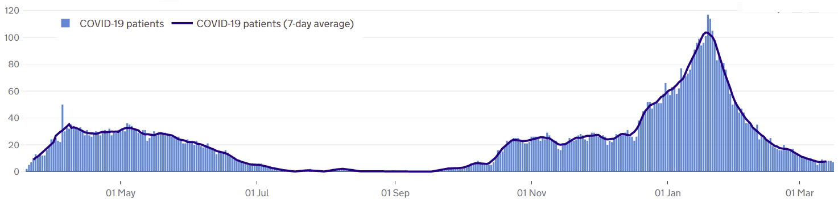
Patients with Covid-19 in Herefordshire hospitals
Published data shows that by 13 March there were 8 COVID-19 patients in Wye Valley Trust hospitals compared to the peak of 117 seen on 19 January. The 7-day average (7.6) is now lower than at any point since mid October.
Over the course of the pandemic a total of 742 patients have been admitted, almost a third of whom were admitted during January. In the first two weeks of March, 7 patients were admitted.
Where can I find out more? The numbers of COVID-19 patients in hospital by acute trust are updated daily by PHE at https://coronavirus.data.gov.uk/, with an 11 day lag.

Slide 14
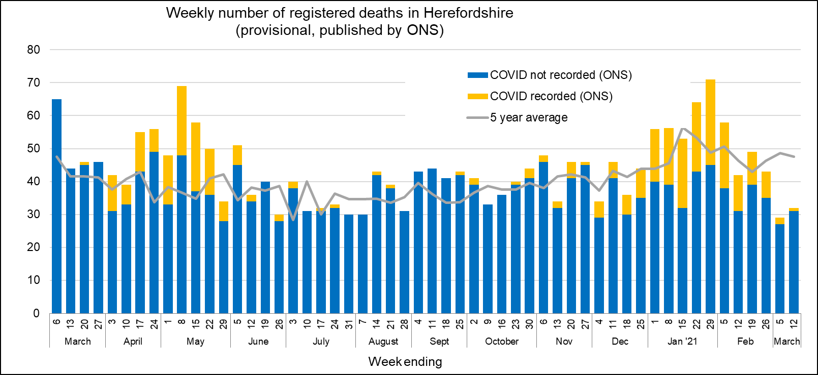
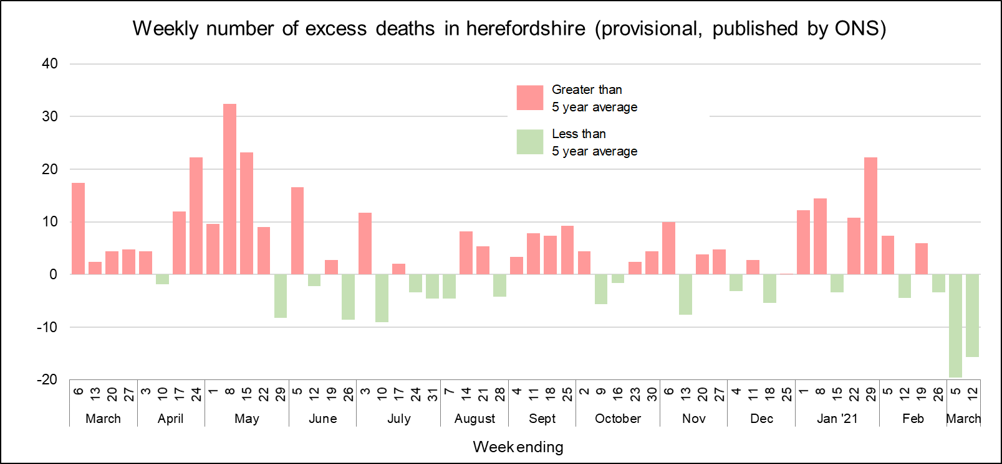
Profile of deaths: published data
One death related to Covid-19 was reported in this week’s published ONS data (occurring by 12 Mar and registered by 19 Mar) – this takes the official total amongst Herefordshire residents to 329 throughout the whole pandemic.
Almost one third (105) of deaths occurred in January.
  Following a sustained period of ‘excess deaths’ linked to Covid-19 during January and February, overall numbers of deaths have been below average levels for the time of year in four of the last five weeks.
  As in May, one in every three deaths in January were related to Covid-19, although fewer of them were ‘excess deaths’ compared to May.
  There have been 206 ‘excess deaths’ in Herefordshire since the beginning of March 2020.
There are signs that the latest wave of Covid-related deaths has peaked with only three Covid-19 related deaths so far recorded in March.
Deaths in Herefordshire remain lower than nationally: the crude death rate is currently 171 per 100,000 compared to the England figure of 228.
Public Health England also publish numbers of people who have died within 28 days of a first positive test:
  280 in total (registered by 24 March), a figure lower than that published by ONS as the latter does not require a positive test for COVID-19 to be mentioned on a death certificate.
Where can I find out more? ONS publish provisional data on weekly numbers of registered deaths by usual residence for local authorities every Tuesday, with an 11 day lag. Deaths recorded as COVID-19 by ONS include deaths where possible or confirmed COVID-19 is mentioned as any cause of death. They are therefore higher than the PHE figures, which only include those who have died following a positive test.

Slide 15
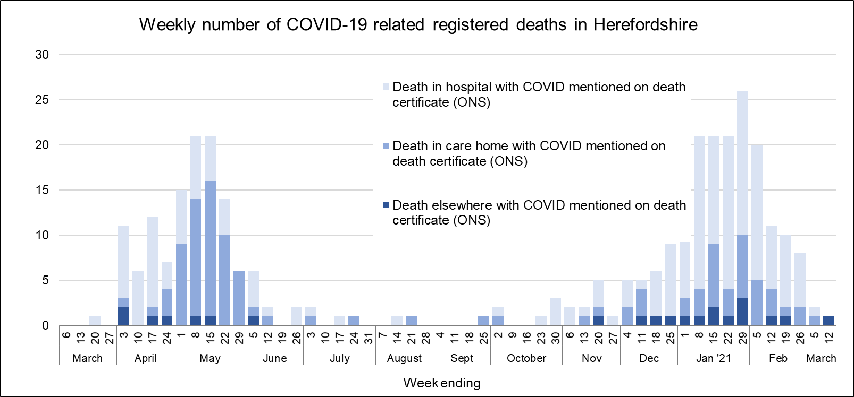
Deaths associated with Covid-19: location
During the first wave in April around two thirds of deaths were in hospital and a quarter in care homes, whereas in May the proportions were reversed. Since mid December hospital deaths have again dominated with almost three quarters (117) occurring in this setting while one fifth (33) have been in care homes.
Over the course of the pandemic 106 Covid-related deaths have occurred in care homes, 200 in hospital (some of whom will have been care home residents), 18 at home and 4 in a hospice.
The highest numbers of deaths in small areas are linked to deaths of care home residents, mainly during April and May. Otherwise, there has been no geographic pattern of COVID-related deaths in Herefordshire.
Where can I find out more? ONS publish provisional data on weekly numbers of registered deaths by usual residence for local authorities every Tuesday, with an 11 day lag. Deaths recorded as COVID-19 include deaths where possible or confirmed COVID-19 is mentioned as any cause of death. Their interactive map is updated less regularly, and currently includes deaths occurring up to the end of December.

Slide 16
Other resources
Wider vulnerabilities
  The draft 2020 Director of Public Health report: Impacts of COVID-19 is available on the Council’s website (final version due for publication mid-April)
  A monthly bulletin of the economic impacts of coronavirus is published on the Understanding Herefordshire website
New research and open access analytical tools are continually emerging. As well as the sources linked to throughout these slides, you may be interested in:
  The Office for National Statistics' daily coronavirus roundup: the latest research into the effects on the economy and society
  The Health Foundation - COVID-19 policy tracker: an interactive timeline of key events and government policy announcements related to coronavirus
  An LG Inform dashboard tailored to Herefordshire & Worcestershire, showing daily updates in cases and comparisons with other areas.
  A Herefordshire Council dashboard provides up to date information on cases in the county and provides links to other useful information.
  A summary of Google mobility data for Herefordshire provided by Data Orchard shows average visits to different categories of places over the pandemic.

