Slide 1
COVID-19 in Herefordshire
Weekly intelligence summary
Public Health & Intelligence Unit
10th February 2021

Slide 2
Contents
Key messages (slide 3)
COVID-19 testing (slides 4-5),
COVID-19 cases (slides 6-8), including demographics (slide 9-10) and local areas (slides 11-12)
Patients admitted to hospital (slide 13)
Profile of deaths: published data (slide 14-15)
Wider impacts – national restrictions (slide 16)
Effects of lockdown on population movement (slide 17)
Other resources (slide 18)
If you need help to understand this document, or would like it in another format or language, please contact us on 01432 261944 or e-mail researchteam@herefordshire.gov.uk

Slide 3
Key messages
Although case rates have fallen considerably and we are starting to see a fall in number of patients with COVID-19 in hospital in the county, Herefordshire remains on level 5 (red) on the local system rating, to reflect the continued pressure on health and care capacity.
New cases continue to fall and average daily numbers are now one third of the peak in early January; and lower than the November peak. This mirrors the national picture, suggesting that the current lockdown is taking effect.
    The total number of lab-confirmed cases in the county throughout the course of the pandemic is now 6,210 (9 Feb). This is 159 more than for the same time last week – almost a half less less than the previous week (283).
    The 7-day case rate per 100,000 population reached 386 on 8 January, and is currently 101 (5 Jan) – similar to mid December and lower than the November peak.
    Rates have generally fallen in all age-groups in recent weeks (including the young adults which had been driving the increases) and across all areas of the county. Despite halving in the last week, the rate amongst people aged 80+ remains relatively high.
  Demand for testing from symptomatic residents continues to fall, although 6,200 people had a lab-based PCR test in the week to 5 Feb. It’s encouraging that the number that were positive has fallen to 3.5%. Rapid lateral flow device (LFD) testing continues to increase, and capacity will increase further with three new community testing sites in Hereford, Ross and Ledbury for people who need to leave home to work.
  Published data on people in Herefordshire hospitals with Covid-19 shows that there were 50 inpatients on 30 Jan, less than half of the peak seen on 19 Jan. More recent local intelligence indicates that numbers are continuing to fall.
  Numbers of deaths involving Covid-19 continue to increase, resulting in a higher than average number of deaths for the time of year. 26 were included in the latest week’s ONS data (occurring by 29 Jan and registered by 5 Feb). PHE data indicates that six more have occurred since, which will appear in future weeks’ official counts.
  Outbreaks and situations continue to be identified and supported, and the number of outbreaks/situations continues to reduce. Transmission is becoming increasingly linked to key workers at social care and other workplaces, and within households, rather than the widespread community transmission seen during December and early January.

Slide 4
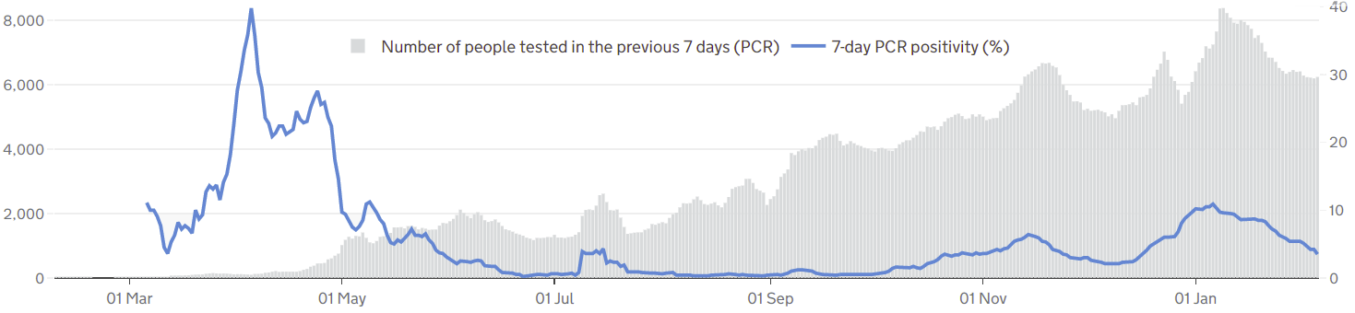

COVID-19 testing: PCR tests and positivity
The graph gives a complete picture of local PCR testing for Herefordshire residents, regardless of where or under which Pillar the test was carried out.
Demand for testing continues to fall slightly, with 6,200 people tested in the week to 5 Feb. This is lower than last week and continues a falling trend in numbers of tests – a pattern likely due to falling numbers of people needing tests because they have symptoms.
The line shows that the positivity rate from PCR tests (i.e. the % of people whose test is positive) continues to fall: currently 3.5% (5 Feb)
  the high positivity to May shows the impact of testing policy at that time, when only suspected cases amongst those most vulnerable to the disease were being tested
  reflecting the low levels of cases in the summer and early autumn, positivity remained low despite increasing numbers of tests as national policy changed
  it rose from October, particularly during December – from 2% of tests being positive to a peak of 11% on 6 January
! Need to know !
PCR data is for rolling 7 day periods, not daily / weekly counts
Counts individuals tested in each 7-day period, not the number of tests carried out. A person is only counted once.
Wholly residence based, whereas previous data included a mixture of Herefordshire residents & also people working in the county.
Where can I find out more? Local level testing data is now updated daily on the government’s Covid-19 dashboard. Details of the roll-out of lateral flow tests to local authorities was published by the government on 9 November, and a guide for local delivery of community testing was published on 11 January.

Slide 5
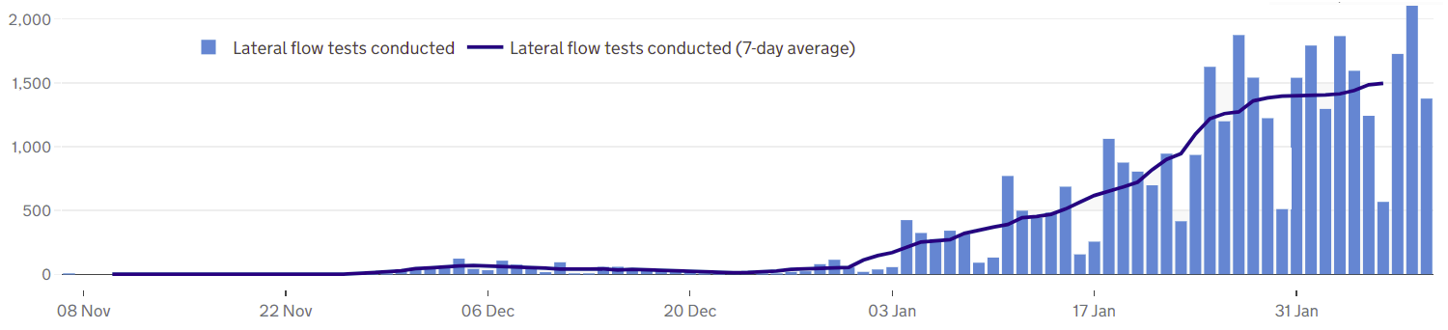
COVID-19 testing: Lateral Flow Device (LFD) tests
! Be aware !
From 27 Jan the requirement for confirmatory PCR testing following a positive LFD result was removed for most LFD testing.
This means that a positive LFD test is now considered a confirmed case and requires the person to self-isolate.
This change is due to the current prevalence of COVID. Self-conducted tests will still require confirmation.
Unlike the published PCR test data on the previous slide, LFD tests are counted by the number of tests which returned either a positive, negative or void result – which can mean that a person is counted more than once. Data is published as a daily count and 7-day average.
Lateral flow device (LFD) tests are swab tests that give results in less than an hour, without needing to go to a lab. They are the national approach to rapid, frequent, community testing and have been rolled out at different times amongst a range of key groups in different areas (for example care homes, schools and colleges).
LFD testing in Herefordshire has increased substantially since the new year
  Initial focus on health staff, before being rolled out to care home staff (see note that not all tests may be included for the whole period), and a pilot at the college in early Jan
  A total of 35,500 LFD tests had been carried out in Herefordshire by 9 Feb
  By 30 Jan there were almost 1,400 tests a day on average – 50% up on the week before, continuing the rapid expansion of the programme, although the rate of increase has slowed over the last week.
  Further roll-out continues; including in schools and with the national policy change that all areas are now eligible for community LFD testing – to focus on key workers unable to work from home in the first instance
  Community LFD test centres are now open in Hereford and Ross for key workers who are required to leave their house to work during lockdown with twice weekly testing recommended. A similar service is due to be rolled out in Ledbury.
Notes
LFD tests for NHS staff using a self-reporting tool have been included from 17 December 2020. Some negative care home tests may not be included for the first 2 weeks of January
All LFD tests are counted under Pillar 2 flows (Gov’t testing programme)
Where can I find out more? Local level testing data is now updated daily on the government’s Covid-19 dashboard. Details of the roll-out of lateral flow tests to local authorities was published by the government on 9 November.

Slide 6
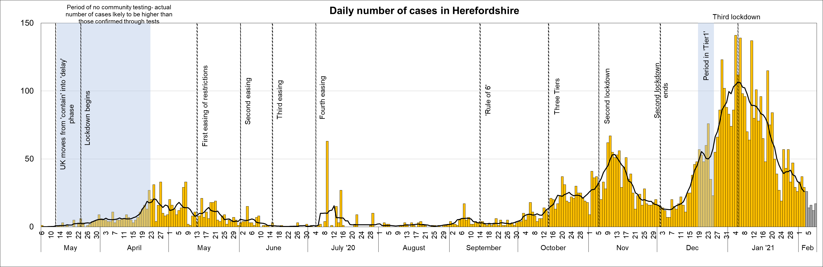
Lab-confirmed COVID-19 cases in Herefordshire
Lab-confirmed cases are the official count of people who live in Herefordshire and have tested positive for COVID-19. In the first few months of the pandemic, numbers of confirmed cases were dependent on testing policy so are not comparable with later waves.
The total lab-confirmed cases over the course of the epidemic is now 6,210 (9 Feb). This is 159 more than this time last week, all from swabs taken between 3 and 9 Feb (note that reporting lags mean daily numbers can change, and the grey bars for the last 5 days will increase). Although still high, this increase is almost 50% lower than the previous week (283) and is one fifth of the increase recorded in the week ending 12 Jan.
The line on the chart shows the average daily number of new cases. These have fallen from the peak of over 100 early in the new year, and as of 3 Feb was 26 – a third lower than seven days previously, and equal to the level in mid-December.
Where can I find out more? Confirmed cases are updated daily by PHE at https://coronavirus.data.gov.uk/.

Slide 7
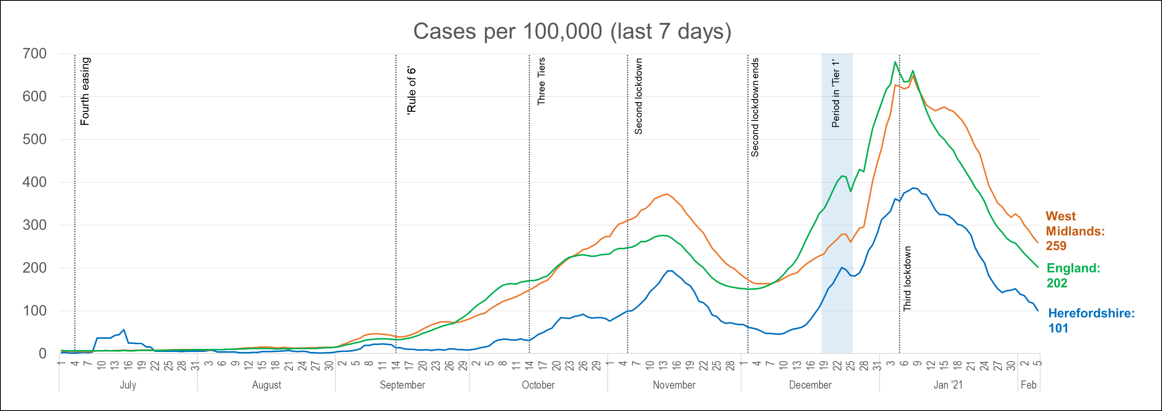
Lab-confirmed cases: comparisons
! Be aware !
Rates per 100,000 resident population give a fairer comparison of the number of cases in each area but they do not take account of the different rates of testing or differences in the age and sex of the local populations.
With one of the smallest ‘upper tier’ local authority populations (193,200), Herefordshire’s rate can be dramatically affected by relatively small changes in numbers of cases. An average of 28 cases a day in a week would result in a rate of 100 per 100,000.
These are not rates of infection amongst the population: they can only reflect those who have been tested, so numbers are highly dependent on the availability of tests.
The chart shows the recent trend in cases per 100,000 resident population for 7-day periods (the latest one ending 5 days ago to allow for lags in the results of tests). This rate is commonly quoted in national reporting.
The local rate has continued to fall from the peak of 386 per 100,000 on 8 January, and was 101 per 100,000 by 5 Feb. This figure is the same as that seen in mid December and lower than the November peak. This falling trend indicates the continuing positive effect of the latest lockdown.
The Herefordshire pattern follows that seen across both England and the West Midlands. Although the fall has not been as rapid as nationally, the local rate is still half the national. The regional rate remains higher.
Where can I find out more? The graph is based on daily updated PHE data on lab-confirmed cases. Further comparisons are included in the LG Inform dashboard. You can also view the local 7-day case rates and numbers on the Herefordshire Council website.

Slide 8
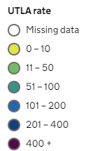
Lab-confirmed cases: comparison with neighbouring authorities
Latest published comparisons, for the week ending 5 Feb*, show:
Herefordshire’s rate fell by a third over the seven days to 5 Feb
Over this week, 7-day case rates continued to fall in all bordering authorities (as indicated by the arrows).
The Herefordshire rate is higher than both Welsh neighbours and similar to Gloucestershire’s, but remains lower than in authorities to the north and east of the county.
* Note that he slight lag in this data reflects the latest date for which complete data is available from test results
Time period: (30/1/21 to 5/2/21)
Where can I find out more? Maps comparing 7 day numbers of cases and rates per 100,000 people are updated daily by PHE at https://coronavirus.data.gov.uk/.

Slide 9
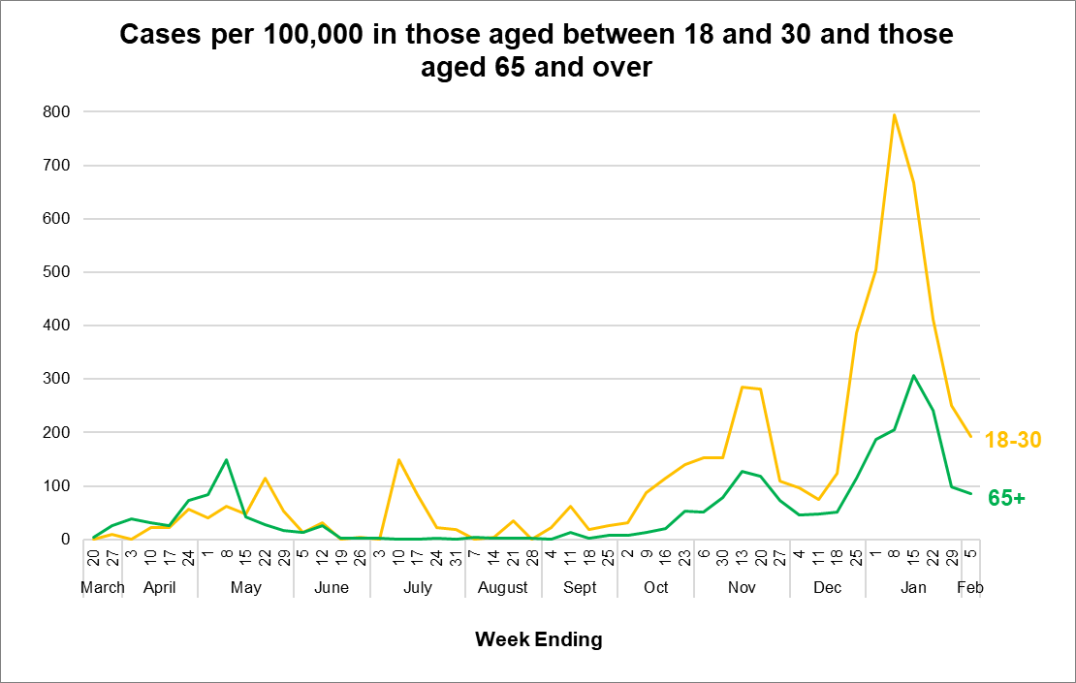
Demographics of COVID-19 cases in Herefordshire: age profile
The chart shows the weekly case rate for these two age groups: during the second half of December and the first week of January the rate amongst 18-30 year-olds grew rapidly - indicating that this group was driving the overall increase in cases. However, in the last four weeks the rate for the 18-30 cohort has fallen sharply. While the rate for those aged 65+ have also fallen, this has only been apparent in the last three weeks. For both cohorts the rate of decrease has reduced in the last week.
The table highlights how the age profile of cases has changed through the course of the pandemic:
  In the first wave those aged 65 and over accounted for more than a third of all confirmed cases (due to testing policy).
  September and October saw a much younger profile, with the proportion of all cases in those aged 18 to 30 reaching 28% while the proportion in the older age group was less than half that reported in April and May.
  Since November 18-30 year olds and over 65s have each accounted for about one fifth of all cases.

Slide 10
Demographics of COVID-19: rates per 100,000 by age over time
This “heat map” shows how the 7-day rates per 100,000 for specific age groups have changed each week from July. Each row represents an age group. As rates increase, the chart colours become darker.
  It is important to note that rates per 100,000 can be significantly affected by relatively small numbers of cases in a population as small as Herefordshire, even more so when broken down into age-groups. The absolute number of cases are shown as context.
  The farm outbreak stands out in July, when rates were otherwise low for all ages for most of the summer. October shows the higher rates in 18-21 year-olds associated with students returning to university, followed by the rises in all age-groups prior to the November lockdown taking effect.
Reflecting the general decline in cases since the new year, rates for all ages are now either at or below the levels they were at the end of December.
The sharpest fall continues to be seen amongst 18-30 year-olds, for whom rates are now a fifth of what was seen at the turn of the year.
The rate amongst people aged 80+ has again halved in the last week and is at its lowest since mid-December. However, the figure of 131 per 100,000 is the third highest in the population this week. The link to care homes continues.

Slide 11
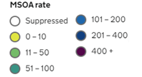
Lab-confirmed cases around the county: this week
Positive cases from samples taken in the 7 day period ending 5/2/21*
The map shows the latest 7-day rates of new cases per 100,000 population, as published by Public Health England: the darker the shading, the higher the rate (unshaded areas have had fewer than 3 cases in the last 7 days).
Two of Herefordshire’s 23 MSOAs reported less than 3 cases in the week to 5 Feb* compared to one last week. Both Leominster areas.
Highest rates remain in Hereford, although all rates were lower than that for England overall (203 per 100,000). The highest rates were in:
  ‘Hereford North East’ (14 cases, 181 per 100,000)
  ‘Hereford Central’ (17 cases, 169 per 100,000),
  ‘Hereford South West’ (14 cases, 169 per 100,000)
Rates in all other areas were less than 160 per 100,000.
Note that data for Wales is not included
! Be aware !
- It’s important to note that these rates are very sensitive to small changes for small areas like MSOAs^. For instance, an increase of 1 case from 9 to 10 cases in an area of 10,000 people (about the size of Ledbury), would increase the rate from 90 to 100 per 100,000.
* Note that the slight time-lag in this data reflects that test results are incomplete for the most recent few days
^ Middle super output areas: geographies designed by the Office for National Statistics in 2004 to have broadly similar population sizes – which means that they tend to be geographically bigger in rural Herefordshire.
Data supressed where numbers are low to avoid possible identification of individuals
Where can I find out more? This map of weekly confirmed cases by middle super output area (MSOA) in England are included in the PHE dashboard, which is updated daily.

Slide 12
Lab-confirmed cases around the county: trends in rates over time
Whilst the previous slide shows cases in the last 7 days, this “heat map” shows how the 7-day rates per 100,000 have changed in each area of Herefordshire from August. The areas (MSOAs*) are ranked by the rate in the last week with the highest at the top.
It illustrates how cases had generally been scattered across the county and were relatively low in all areas until mid-October. Most areas saw increases during the November peak, but this was particularly driven by high case rates in the city – especially the south.
The latest wave saw rises across the county through December, peaking in most areas by 8 Jan. This reflected widespread community transmission.
Rates have fallen in all areas since early January, although most still remain relatively high compared to pre-December levels - note however that as cases numbers fall, one or two cases can have a dramatic impact on an area’s rate.
Hereford still has the highest rates, although on average rates in the city have fallen by a third in the last week.
The higher rates are linked to care provider and other workplaces - with onward transmission within households driving up numbers
* Middle super output areas: geographies designed by the Office for National Statistics in 2004 to have broadly similar population sizes

Slide 13
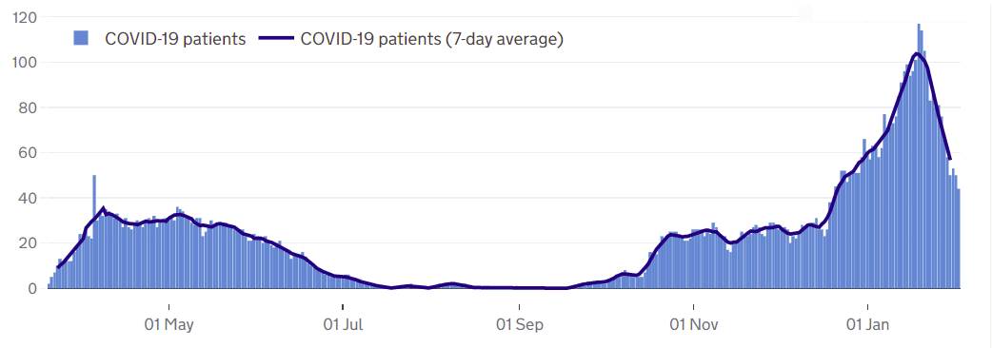
Patients in Herefordshire hospitals with Covid-19
Information on the number of COVID-19 inpatients in NHS trusts is now included in the government’s public Coronavirus in the UK dashboard, with an 11 day lag.
Published data shows that by 30 Jan there were 50 COVID-19 patients in Wye Valley Trust hospitals compared to the peak of 117 seen on 19 Jan which continues a steeply downward trend. The most recent 7-day average of 57 is still almost twice the peak of 32 seen in the first wave. The highest number on a single day previously was 50 (5 April).
Over the course of the pandemic a total of 687 patients have been admitted, a third of whom have been admitted since the beginning of January.
Patients in Wye Valley Trust hospitals
Where can I find out more? The numbers of COVID-19 patients in hospital by acute trust are updated daily by PHE at https://coronavirus.data.gov.uk/, with an 11 day lag.

Slide 14
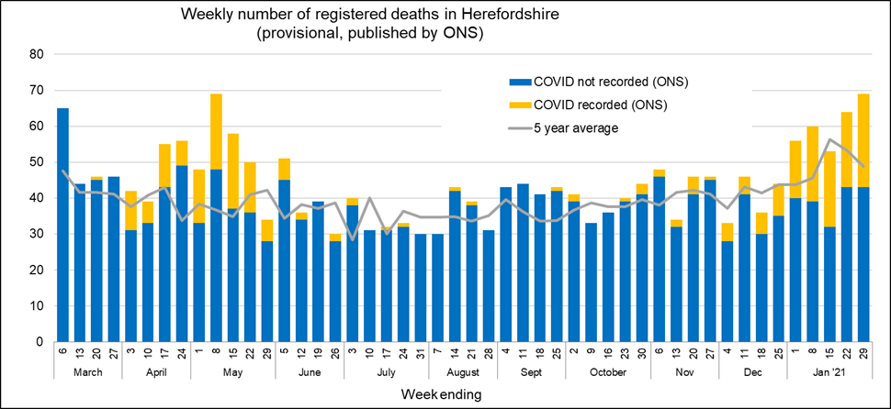
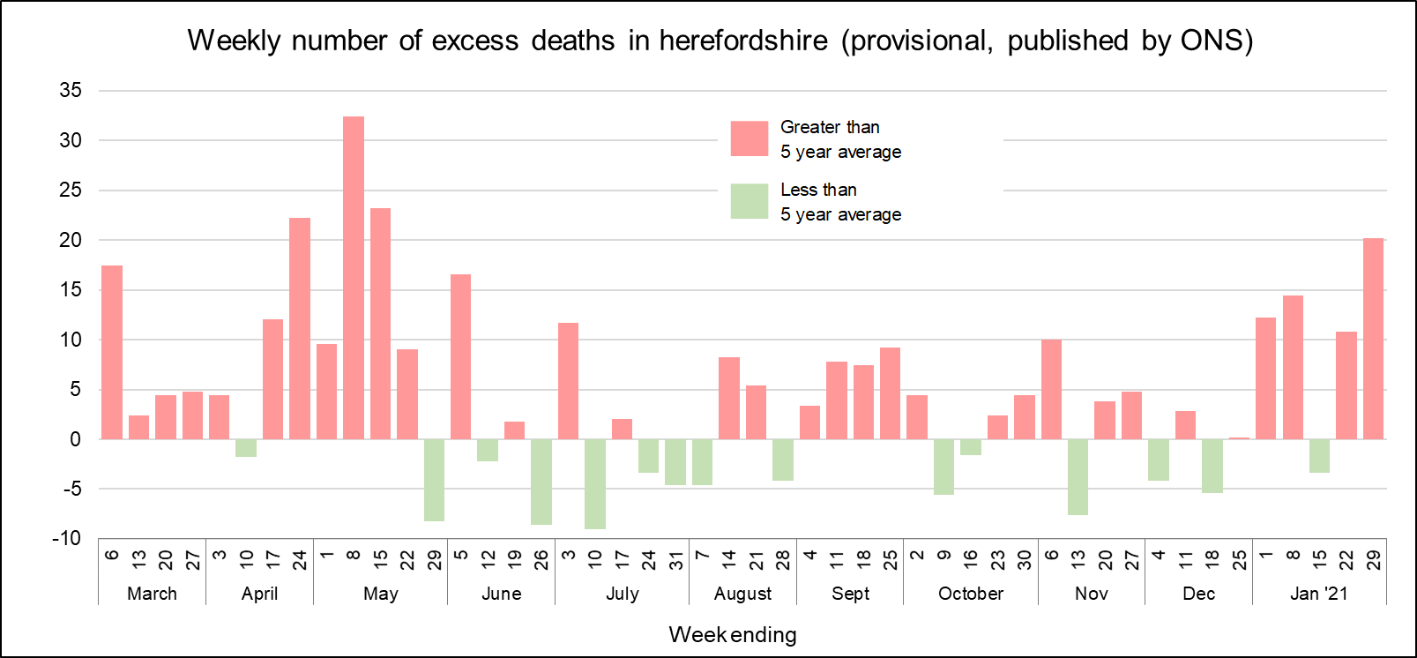
Profile of deaths: published data
Numbers of deaths related to Covid-19 remain relatively high: mentioned on 26 death certificates in this week’s published ONS data (occurring by 29 Jan and registered by 5 Feb) – 16 in hospital and 7 in care homes.
This takes the official total amongst Herefordshire residents to 277 throughout the whole pandemic, one third (89) of which have been in the last four weeks.
Proportion due to Covid-19 has also increased recently: recorded in 36% of deaths in the last 4 weeks, higher than the 30% in first 3 weeks of May
The number of deaths have been higher than average for 4 of the last 5 weeks. This is the first time that we have seen so called ‘excess deaths’ linked to Covid-19 since May.
  In England and Wales, deaths have been consistently above average since early October
  Deaths in Herefordshire remain lower than nationally with the crude death rate currently being 144 per 100,000 compared to the England figure of 193.
Public Health England also publish numbers of people who have died within 28 days of a first positive test:
  256 in total, a figure lower than that published by ONS as the latter does not require a positive test for COVID to be mentioned on a death certificate
  Six of these have been registered since 5 Feb– so are likely to be counted in the next couple of weeks’ ONS death registration data.
Where can I find out more? ONS publish provisional data on weekly numbers of registered deaths by usual residence for local authorities every Tuesday, with an 11 day lag. Deaths recorded as COVID-19 by ONS include deaths where possible or confirmed COVID-19 is mentioned as any cause of death. They are therefore higher than the PHE figures, which only include those who have died following a positive test.

Slide 15
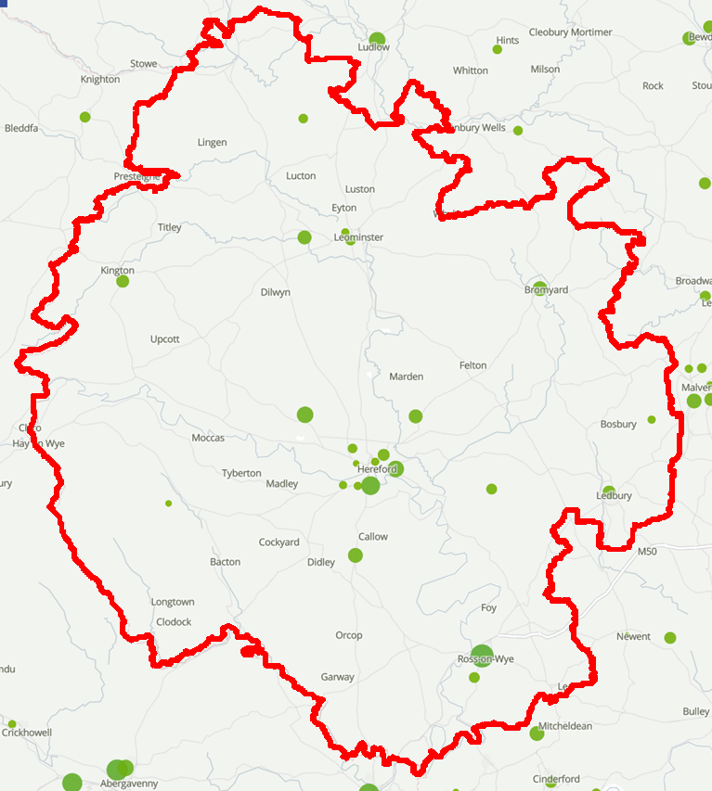
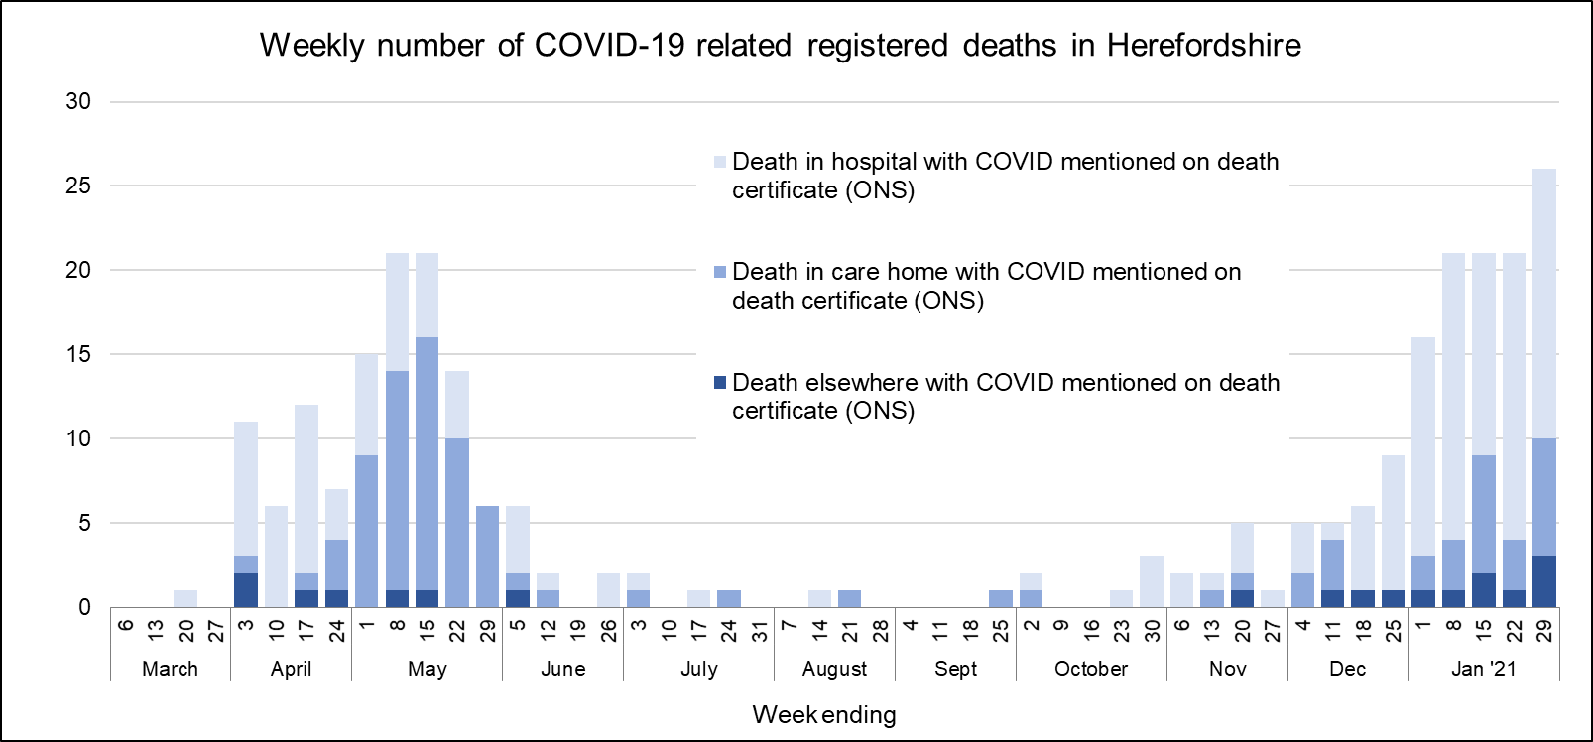
Deaths associated with COVID-19: location
Deaths involving COVID-19 in and around Herefordshire
During the first wave, whereas in April around two thirds of deaths were in hospital and a quarter in care homes in May the proportions were reversed. During the second wave hospital deaths have again dominated with almost three quarters (75) occurring in this setting while one fifth (22) have been in care homes.
Over the course of the pandemic 94 have occurred in care homes, 164 in hospital (some of whom will have been care home residents), 14 at home and 4 in a hospice.
Some areas of Herefordshire have seen more COVID related deaths than others: in 4 MSOAs the total has been more than 10 as of the end of December. These high totals are due to deaths which occurred in April or May, and are linked to location of care homes.
No areas saw more than 3 deaths in any month from July to December, suggesting that there has been no particular pattern of deaths in the community in general.
Source: Office for National Statistics
Note that points are placed at the centre of the middle super output area (MSOA) they represent and do not show the actual location of deaths. The size of the circle is proportional to the number of deaths.
Where can I find out more? ONS publish provisional data on weekly numbers of registered deaths by usual residence for local authorities every Tuesday, with an 11 day lag. Deaths recorded as COVID-19 include deaths where possible or confirmed COVID-19 is mentioned as any cause of death. Their interactive map is updated less regularly, and currently includes deaths occurring up to the end of December.

Slide 16
Wider impacts: clinically vulnerable people
The UK government announced a third national lockdown with immediate effect from 5 January. More stringent than the English lockdown in November; schools are likely to be closed for the majority of pupils until March, and shielding has been reintroduced for the most vulnerable.
The official guidance says that clinically extremely vulnerable (CEV) people should “follow resumed shielding guidance and should:
  not attend work, school, college or university.
  limit the time you spend outside the home
  only go out for medical appointments, exercise or if it is essential.”
Local and national support systems have been
re-introduced, and CEV people needing support
are encouraged to register with the government’s
National Shielding Support Service (NSSS):
  Just over 200 people have registered since the NSSS was
  switched back on for Herefordshire on Sunday 31 December,
  compared with 364 during the previous lockdown
  Three-quarters want priority online delivery slots
  One-quarter requested contact from the council, and of
  those who were able to be contacted, fewer than 10 needed
  support for either food or other reasons
People who have been identified as CEV since November,
and those who were in receipt of Talk Community support in
previous lockdowns are being contacted
Clinically Extremely Vulnerable: Shield
7,300 (4%)
Specific serious health conditions
Everyone:
Stay at home unless necessary. Stay 2 metres apart from anyone not in your household or bubble.
192,300
Herefordshire
residents
Clinically Vulnerable:
be especially careful & minimise contact with others
56,000 residents (1 in 3)
70+; eligible for annual flu jab
on medical grounds; pregnant
* People aged 60+ have also been identified as potentially being at higher risk. 26,100 residents are aged 60-69

Slide 17
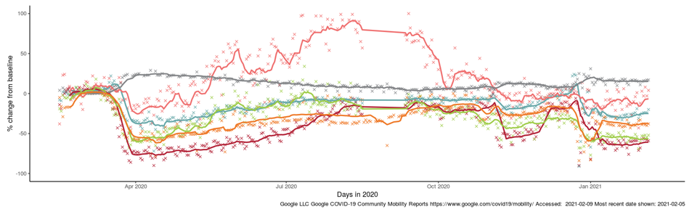
Effects of lockdown on population movement
This chart shows average visits to different categories of places, using location data of Google users, compared to the beginning of 2020.
Visits to all categories except residential seem to have fallen during the current English national restrictions (Lockdown 3), but not to the levels seen at the end of March. This is probably to be expected, since more activity is permitted than in the spring. The BBC analysed the differences.
Unsurprisingly, ‘retail and recreation’ – places like restaurants, cafés, shopping centres, museums, libraries and cinemas which have had to close again in the latest lockdown – have seen the sharpest drop and are currently 65% lower than baseline. Visits to stations are 55% lower.
After a post-Christmas increase, visits to workplaces do seem to have levelled off around 40% lower than the baseline. This isn’t as low as in the spring (-60%), but will be affected by more places of work remaining open this time, e.g. early years childcare and health services.
Changing visits in Herefordshire to…
First full national lockdown (23 Mar)
New national lockdown (5 Jan)
Residential
Parks
Grocery & pharmacy
Workplaces
Stations
Retail & recreation
English lockdown 2.0 (5 Nov-2 Dec)
Where can I find out more? This chart is updated daily on the Data Orchard website, using data published by Google at www.google.com/covid19/mobility/. The baseline is the median value, for the corresponding day of the week, during the five weeks 3 Jan–6 Feb 2020. Note that the data is based on movements of those who have opted to turn on location history in their Google accounts on their mobile devices.
Where can I find out more? This chart is updated daily on the Data Orchard website, using data published by Google at www.google.com/covid19/mobility/. The baseline is the median value, for the corresponding day of the week, during the five weeks 3 Jan–6 Feb 2020. Note that the data is based on movements of those who have opted to turn on location history in their Google accounts on their mobile devices.

Slide 18
Other resources
Wider vulnerabilities
  A factsheet of the numbers of people in Herefordshire likely to be affected by different aspects of the virus and the measures taken to control its spread can be downloaded from the Understanding Herefordshire website (produced March 2020)
  A monthly monitor of key economic recovery indicators: contact the intelligence unit
New research and open access analytical tools are continually emerging. As well as the sources linked to throughout these slides, you may be interested in:
  The Office for National Statistics' daily coronavirus roundup: the latest research into the effects on the economy and society
  The Health Foundation - COVID-19 policy tracker: an interactive timeline of key events and government policy announcements related to coronavirus
  An LG Inform dashboard tailored to Herefordshire & Worcestershire, showing daily updates in cases and comparisons with other areas.
  A Herefordshire Council dashboard provides up to date information on cases in the county and provides links to other useful information.

